Slide 1
Question ?

Slide 2
Spring .... MVC Framework ... Model , View , Controller -- >DispatcherServlet
doGet()
doPost()
Required ?
Application apart form business requirements.. Non Functional Requirement.
Security
Euerka .... (service discovery )
Connection pooling ( Thread pool , Database , )
Load Balancing
Scalability (VIRTACL , Horizonatal , )
Sticky Session ( BOOKING WINDOW )..
Adaptability
Connection

Slide 3
Dispatcher - bean , Application Context .. ,SessionContext. requestConext,
Database connection - property
View
Servlet

Slide 4
Spring IOC - Memory Management - Garbadge Collector (GC)
Stack - Local Variable
Heap - Dyanmic Variable , new = operator ( Heap) ..
int x; stack
C - > calloc , malloc ( Function to get memory space , allocate memory space )
We cannot control the GC -- he can request to release the memory (mark & sweep)
push, pop - > stack
Exe - > Stack Segment , Code seg , Data Segment , Extended Seg
Spring container - > take care the life cycle of an object. ,
Dependency Injection

Slide 5
Type application
1. Desktop .. ( NotePad, Calculator etc) Execute on user machine
some appliation are using for communincation (putty,telnet)
2. Web application ( Execute on remote server and we get HTML response broswer parse it and display the response )
Browser - Client ( it can be invoke from command line , putty , telnet )
Server ( This mahine and application is runining on it continuously)
Database ( Database can be on same server or it can be on different machine . or database server can be different )

Slide 6
Protocal HTTP
1. HTTP
The Hypertext Transfer Protocol (HTTP) is a networking protocol for distributed, collaborative, hypermedia information systems. HTTP is the foundation of data communication for the World Wide Web. HTTP functions as a request-response protocol in the client-server computing model.
2. HTTPS
... is an abbreviation of Hypertext Transfer Protocol Secure. It is a secure extension or version of HTTP. This protocol is mainly used for providing security to the data sent between a website and the web browser. It is widely used on the internet and used for secure communications. This protocol uses the 443 port number for communicating the data.
1. public key 2. private key

Slide 7
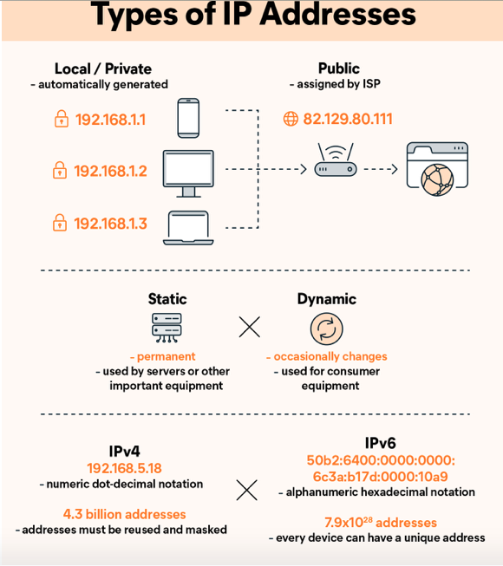
IP address ..
An IP address, or Internet Protocol address, is a series of numbers that identifies any device on a network. Computers use IP addresses to communicate with each other both over the internet as well as on other networks.
to identify the mahine

Slide 8
1. Framework
Spring / Struts
Hibernate
JSF
A. Spring
The Spring Framework is an application framework and inversion of control container for the Java platform. The framework's core features can be used by any Java application, but there are extensions for building web applications on top of the Java EE platform.
B. Hibernate
Hibernate ORM is an object–relational mapping tool for the Java programming language. It provides a framework for mapping an object-oriented domain model to a relational database.
C. JSF
Jakarta Server Faces is a Java specification for building component-based user interfaces for web applications and was formalized as a standard through the Java Community Process being part of the Java Platform, Enterprise Edition.

Slide 11
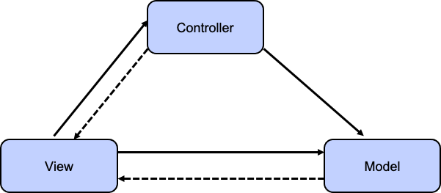

Slide 12
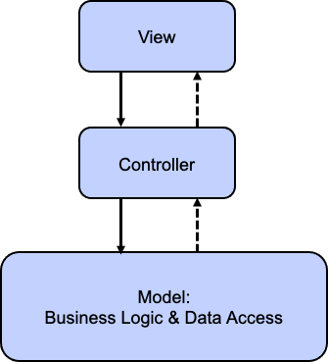

Slide 13
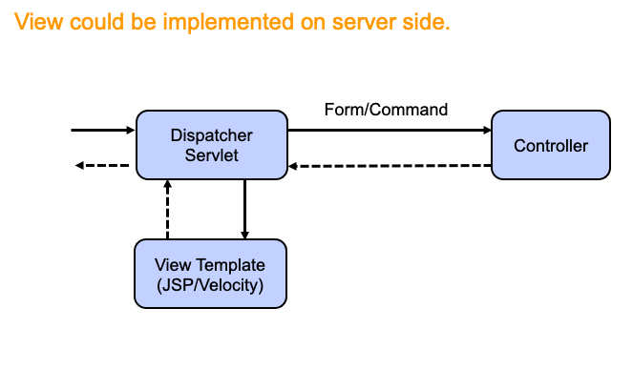

Slide 14
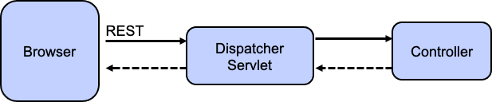

Slide 15
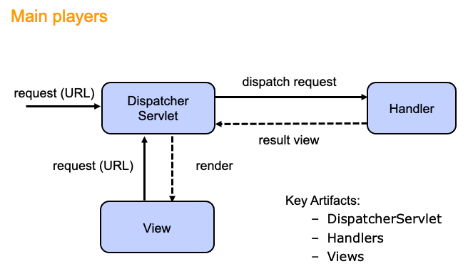

Slide 16
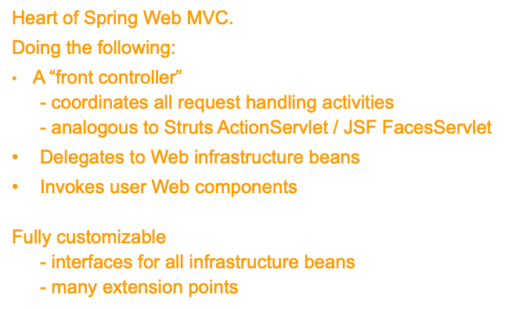

Slide 18
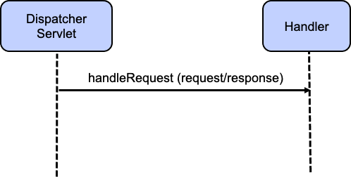

Slide 19
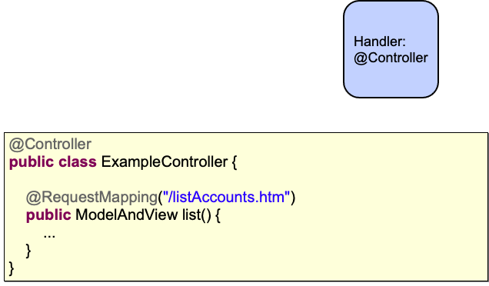

Slide 22
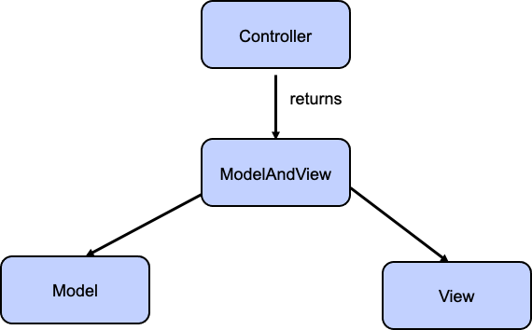

Slide 25
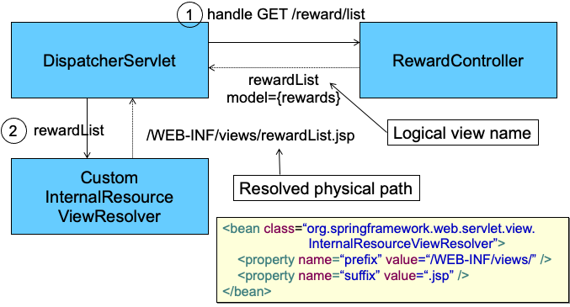

Slide 27
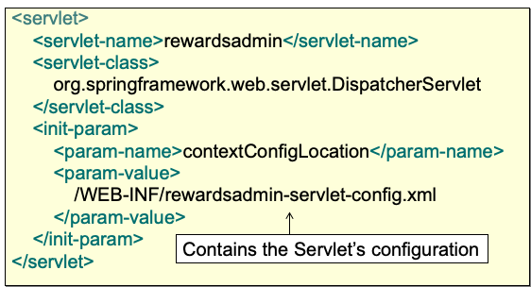

Slide 28
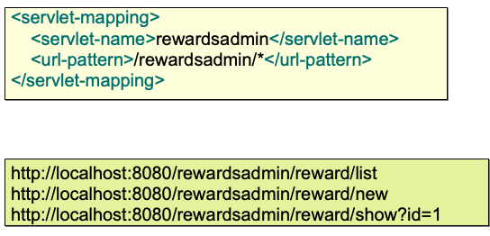

Slide 29
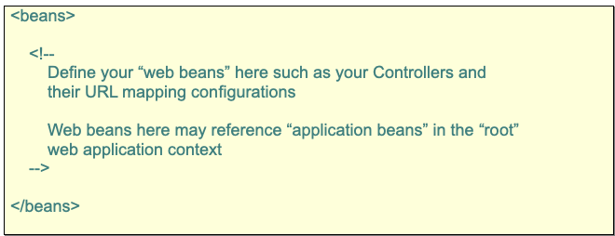

Slide 30
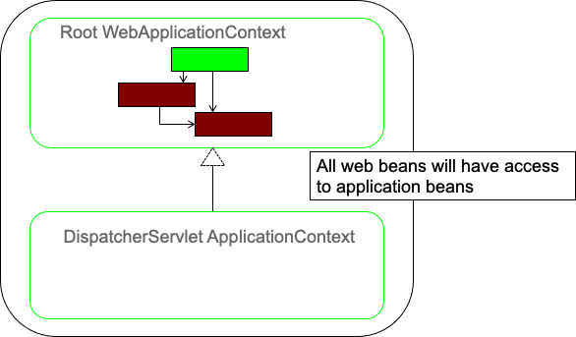

Slide 31
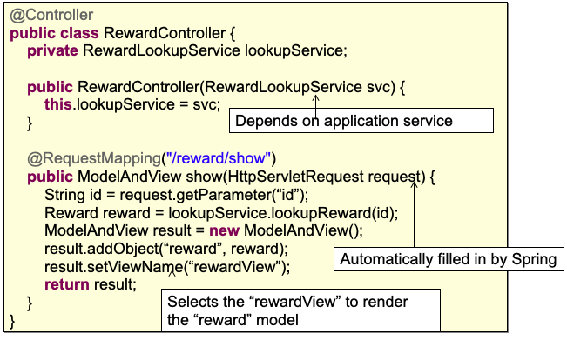

Slide 32

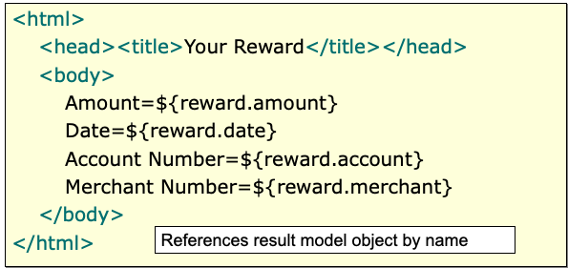

Slide 33
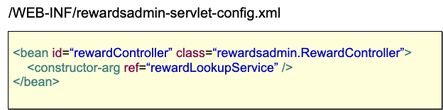

Slide 34
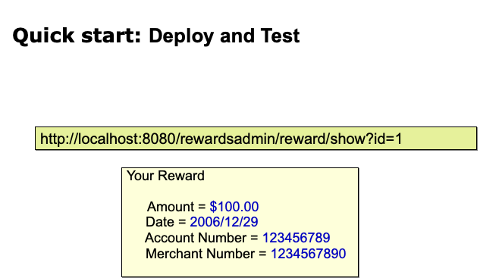

Slide 35
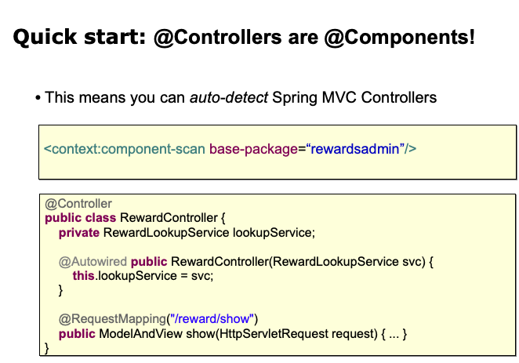

Slide 36
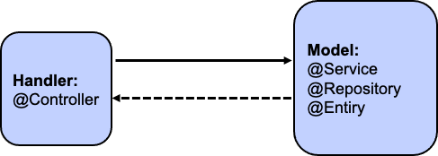

Slide 37
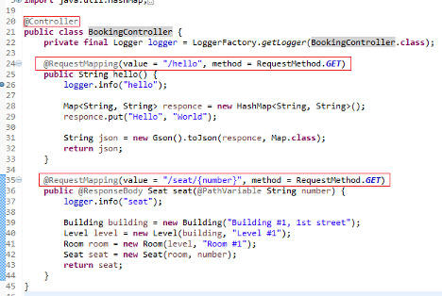

Slide 38



Slide 39
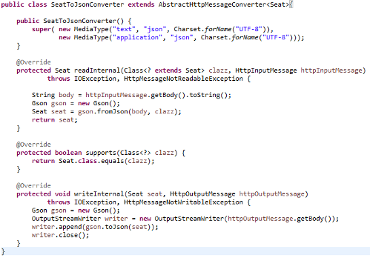

Slide 40
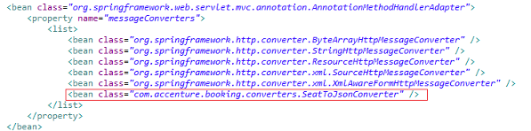

Slide 41
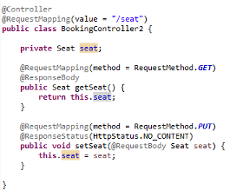

Slide 42
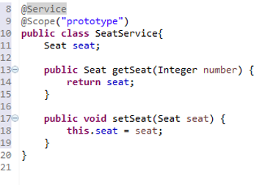

Slide 43
Thank You !!

