Slide 1
Reanalyzing user personas derived from survey data
Kevin Eliasen
Fred Lambuth
Sean Oslin
Dominic Pedrotti

Slide 2
Project
Analyze quantitative and free-text survey data from Rosenfeld Media
Goal
Develop insights for the creation and marketing of a new conference on research
Background
Notes:
Rosenfeld Media conducted a survey with quantitative, free-text, and mixed questions. They received more responses than were feasible to effectively analyze manually.
Enable client to automate the process of extracting information from surveys to create survey-respondent profiles.

Slide 3
Project description
Recreate existing personas using DS tools
Use DS tools to create new personas

Slide 4
Goals: to help RM to
Determine who to market the conference to
Determine the best format/content for the conference
Determine the survey questions which are most/least valuable
Provide key findings about survey respondents
Provide Python code that can be reused for similar analyses

Slide 5
Deliverables
New personas
Python code to replicate analysis
Recommendations for changes to the survey tool

Slide 6
Phase 1 goals
Proof of concept: using data science techniques to generate profiles similar to those generated
Use data science techniques to recreate the the division of survey respondents into 5 personas
Answer the same questions in the existing personas but with our analysis of the data - compare significant differences.

Slide 7
Original personas
Very Experienced Researchers
Somewhat Experienced Researchers
Less Experienced Researchers
Executive or Consultant
Specialist

Slide 8
Personas – Initial 5, Now 2
5 personas
Split people based on job title and experience
Statistical Analysis did not provide predictive indicators of attendance
2 personas
Based on likelihood to attend conferences
Profiles similar in a many ways
Analysis showed certain key areas stuck out
Takeaway
If you’re part of a conference, sell your book.
Notes:
My name is Kevin Eliasen. Dom Pedrotti and I worked on the quantitative side of the survey results. We found that we could re-create the personas created by Rosenfeld Media, but the quantitative data did produce specific drivers as to which people within each persona where more likely to attend conferences. We then split the data into two personas – people who have and wish to continue to attend conferences and people who are less likely to attend. That’s when we found some distinct differences. For example, people who attend conferences are more likely to consume other instructional materials. So if you’re part of a conference, sell your book.
Based on how survey respondent answered question ##.

Slide 9
Defredistration - dedaunting
726 rows of text
11 questions
726 X 11 = ~8,000 responses
1 man … and his trusty sidekick
Natural Language Processing = NLP
Word counts
Topic Models
Notes:
Methods:
The survey contained a wealth of written answers. Getting one human or a coordinating a team of them to read and analysze all of these entries was a dauting task.
We used NLP to perform statistical analysis of the word counts, the clustering of words into topics and finding the most representive written responses.
Finding the most “representative” responses proved to be a very useful insight into the large number of survey response.
Results:
Split by likely and not-likely attendees, there is similiarity in their written answers. Going strictly by written answers, it would be difficult to predict who would attend and who would not.
However, what we did find where they differed in their written response is their preference in invited conference speakers and certain words were found to be used in pairs.
Takeaway:
Next year, with a new survey, you’ll only need one person to read all the written results.

Slide 10
Dom, dom dom dom Dommmmm
Survey format
Target audiences
Intangible Factors
Repeatability
Notes:
Many questions get the same response from just about everyone (fuck you fred) , many sections of questions contain questions that are correlated with responses from other
questions
Of those who likely, and not likely to attend, both groups are very similar in background, positions, and concerns. Everyone cares about money, most are more likely to learn from a book or watch a video
, the most important target audience would be those who have previously attended a conference or do it often
We don’t know intangible factors, ie. Rosenfeld’s reputation, company budgets for employee training
Our approach is repeatable

Slide 11
Highest entropy questions

Slide 12
What 2 groups have in common

Slide 13
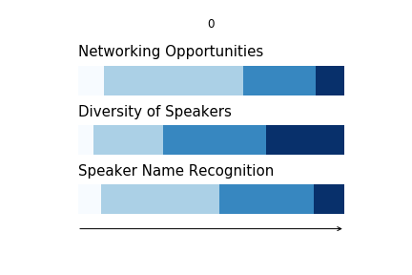
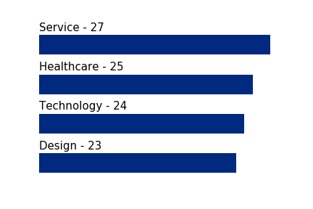
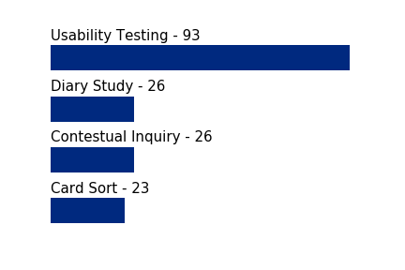
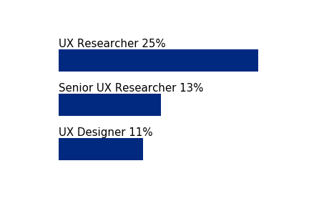
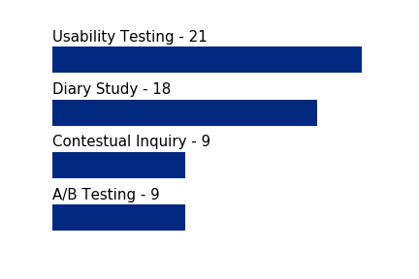
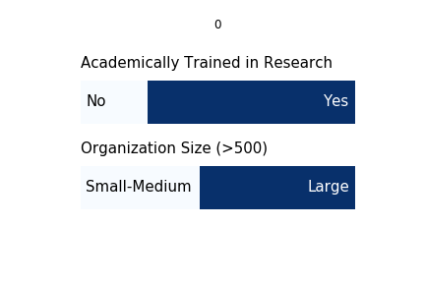
Least likely to attend a research conference
Respondents indicated Not to Somewhat Likely to Attend on the survey
Industry
Title
Academic training in research
Current research
Future research
Size
What they want to see
Respondent’s advice for a research conference
"Don't focus on practical workshops, they're usually too short to be useful. Focus on sharing experiences. (could be done online without an event)”
“not just theory - I need to… take what I learn back to my job and use it.”
“start by gaining credibility in the field. I don't know who you are, why you care and this survey doesn't seem to indicate you're an expert in the field”
“The next evolution of UXR has to be bigger than just "advocacy", and has to show our methods work”

Slide 14
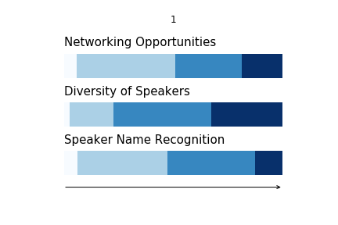
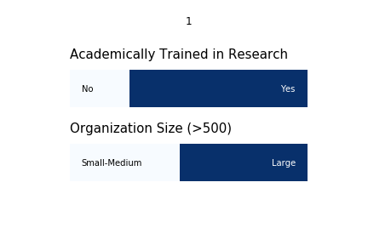
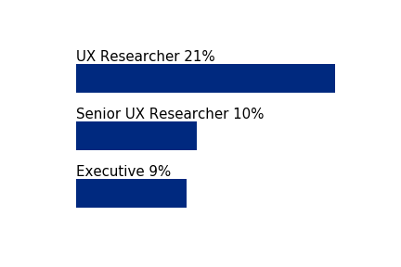
Most likely to attend a research conference
Respondents indicated Likely to Attend on the survey
Industry
Bar chart - top 4 or 5
Size
100% stacked bar chart
Title
Bar chart – top 4 or 5
Academic training in research
Current research
Bar chart 4 -5 top subjects or bullet points
Future research
Bar chart 4 -5 top subjects or bullet points
What care most in a conference
Respondent’s advice for a research conference
"workshops should target a specific level of expertise”
“Examples of application in practice of established methods”
“creative ways to build activities into the day.”
“more events for experienced practitioners”
“huge number of early-career folks who are struggling to get work in UX research roles, and we need to get them real-world experience”
“Slack for pre-conference introductions, a channel for each speaker, … handle Q&A through the Slack channels”
Notes:
Neil

Slide 15
Findings about most likely

Slide 16
Recommendations to RM

Slide 17
Conclusions

