Slide 1
Reanalyzing user personas derived from survey data
Kevin Eliasen
Fred Lambuth
Sean Oslin
Dominic Pedrotti

Slide 2
What 2 groups have in common

Slide 3
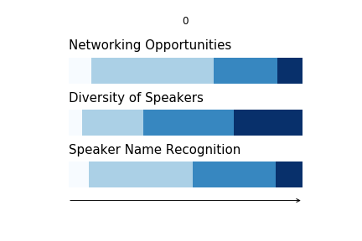
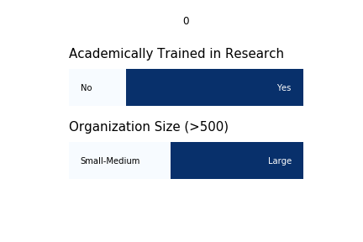
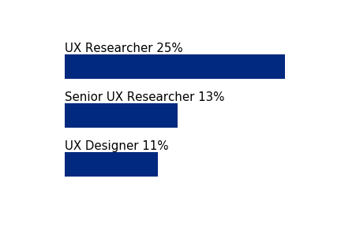
Least likely to attend a research conference
Respondents indicated Not to Somewhat Likely to Attend on the survey
Industry
Bar chart - top 4 or 5
Size
Title
Academic training in research
Current research
Bar chart 4 -5 top subjects or bullet points
Future research
Bar chart 4 -5 top subjects or bullet points
What care about most in a conference
Respondent’s advice for a research conference
"…keynote that doesn't have a flashy C-Suite title but is capable of actually talking about what's going on in the world”
“…current paths we have for gaining experience are fairly limited”
” …’techniques’ side is covered across a range of conferences. I feel like there are less conferences that really focus on the strategic (and possibly ops) side of research”
“…audience may be in different maturity levels of the research practice at least for some sessions so you may have different tracks based on that to cover a wider range of people.”
Notes:
Neil

Slide 4
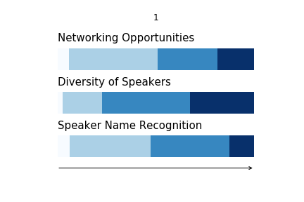
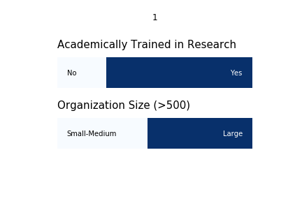
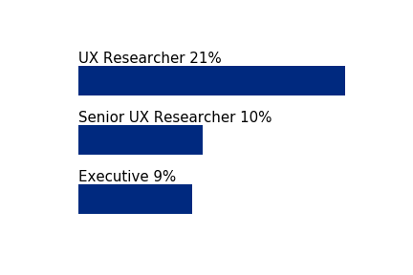
Most likely to attend a research conference
Respondents indicated Likely to Attend on the survey
Industry
Bar chart - top 4 or 5
Size
100% stacked bar chart
Title
Bar chart – top 4 or 5
Academic training in research
Current research
Bar chart 4 -5 top subjects or bullet points
Future research
Bar chart 4 -5 top subjects or bullet points
What care most in a conference
Respondent’s advice for a research conference
“…workshops should target a specific level of expertise.”
“Examples of application in practice of established methods.”
“…creative ways to build activities into the day.”
“…more events for experienced practitioners.”
“…huge number of early-career folks who are struggling to get work in UX research roles, and we need to get them real-world experience.”
“…Slack for pre-conference introductions, a channel for each speaker, … handle Q&A through the Slack channels…”
Notes:
Neil

Slide 5
Findings about most likely

