Slide 1
Reanalyzing user personas derived from survey data
Kevin Eliasen
Fred Lambuth
Sean Oslin
Dominic Pedrotti

Slide 2
Project background
Apply data science methods to quantitative and qualitative survey data for Rosenfeld Media, a New York conference-producing and publishing company.
RM wants to automate the process of extracting actionable information from surveys to create survey-respondent profiles and assist with marketing.

Slide 3
Project description
2 parts
Recreate personas using statistical natural language processing techniques

Slide 4
Original personas

Slide 5
Re-created personas

Slide 6
Differences

Slide 7
Re-imagined personas
Methods

Slide 8
Lowest entropy questions

Slide 9
What 2 groups have in common

Slide 10
What 2 groups have in common

Slide 11
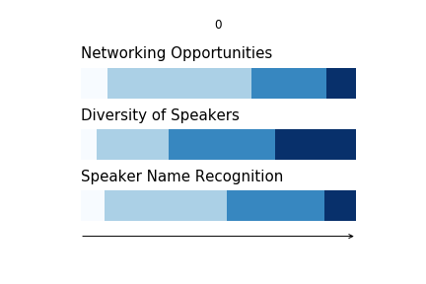
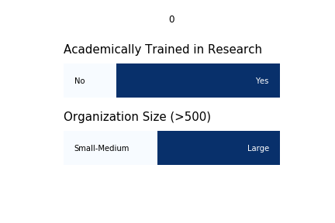
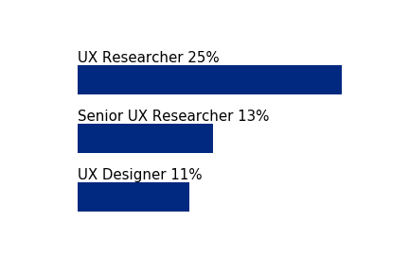
Least likely to attend a research conference
Respondents indicated Not to Somewhat Likely to Attend on the survey
Industry
Bar chart - top 4 or 5
Size
Title
Academic training in research
Current research
Bar chart 4 -5 top subjects or bullet points
Future research
Bar chart 4 -5 top subjects or bullet points
What care about most in a conference
Respondent’s advice for a research conference
"…Don't focus on practical workshops, they're usually too short to be useful. Focus on sharing experiences. (this type of sharing could be done online without and event....)”
“…not just theory - I need to be able to take what I learn back to my job and use it.”
” …’techniques’ side is covered across a range of conferences. I feel like there are less conferences that really focus on the strategic (and possibly ops) side of research”
“…audience may be in different maturity levels of the research practice at least for some sessions so you may have different tracks based on that to cover a wider range of people.”
Notes:
Neil

Slide 12
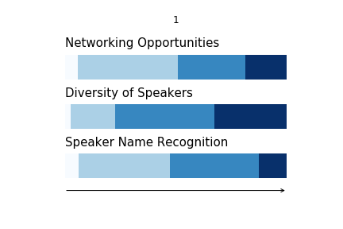
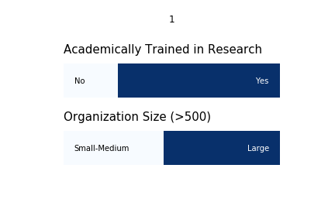
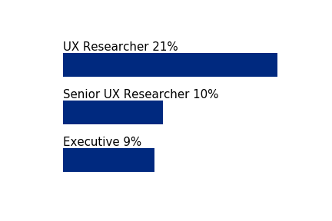
Most likely to attend a research conference
Respondents indicated Likely to Attend on the survey
Industry
Bar chart - top 4 or 5
Size
100% stacked bar chart
Title
Bar chart – top 4 or 5
Academic training in research
Current research
Bar chart 4 -5 top subjects or bullet points
Future research
Bar chart 4 -5 top subjects or bullet points
What care most in a conference
Respondent’s advice for a research conference
“…workshops should target a specific level of expertise.”
“Examples of application in practice of established methods.”
“…creative ways to build activities into the day.”
“…more events for experienced practitioners.”
“…huge number of early-career folks who are struggling to get work in UX research roles, and we need to get them real-world experience.”
“…Slack for pre-conference introductions, a channel for each speaker, … handle Q&A through the Slack channels…”
Notes:
Neil

Slide 13
Findings about most likely

Slide 14
Recommendations to RM

Slide 15
Findings about most likely

Slide 16
Conclusions

