Slide 1
Researching Researchers
Research Insights & Personas
Notes:
Lou

Slide 2
Our Team
Research Team
Abby Covert
Rocio Werner
Trisha Thommi
Neil Mejia
Johann Sarmiento
Sean Oslin
Stakeholders
Lou Rosenfeld
Natalie Hanson
Steve Portigal
Notes:
Lou

Slide 3
Agenda
Why did we research researchers?
What did we learn from our survey?
How did we derive personas from our data?
What personas emerged?
What’s next?
Notes:
Lou

Slide 4
Why did we research researchers?
There are more people doing research than ever before.
Research teams are getting larger.
Researchers are getting their seat at the table.
There are more non-professionals doing research than ever before.
Research is entering a post-tribal phase.
Notes:
Lou

Slide 5
Insights
Notes:
Abby

Slide 6
Insights Across Quant & Qual
We are designing this conference for a primarily UX audience.
They want to hear from researchers from outside UX
Organization size doesn’t impact content.
Methods aren’t all they are looking for.
There is whitespace in the UX world for a conference about research.
Our audience is boots on the ground doing research.
Our audience is fairly senior in research.
UX Designers & UX Researchers share research responsibility.
Our respondents attend events far less frequently then they read or watch videos.
Our respondents value their network.
When we looked at respondents by likelihood and frequency for conference attendance, some clear segments emerged.
There are five types of people we should be designing this conference for
Our audience vastly prefers small to medium-sized events.
We now know what’s most important, and to who.
They come for the content, not as much for the socialization.
Insights Expanded on in Presentation
Full Insights Report
Notes:
Abby

Slide 7
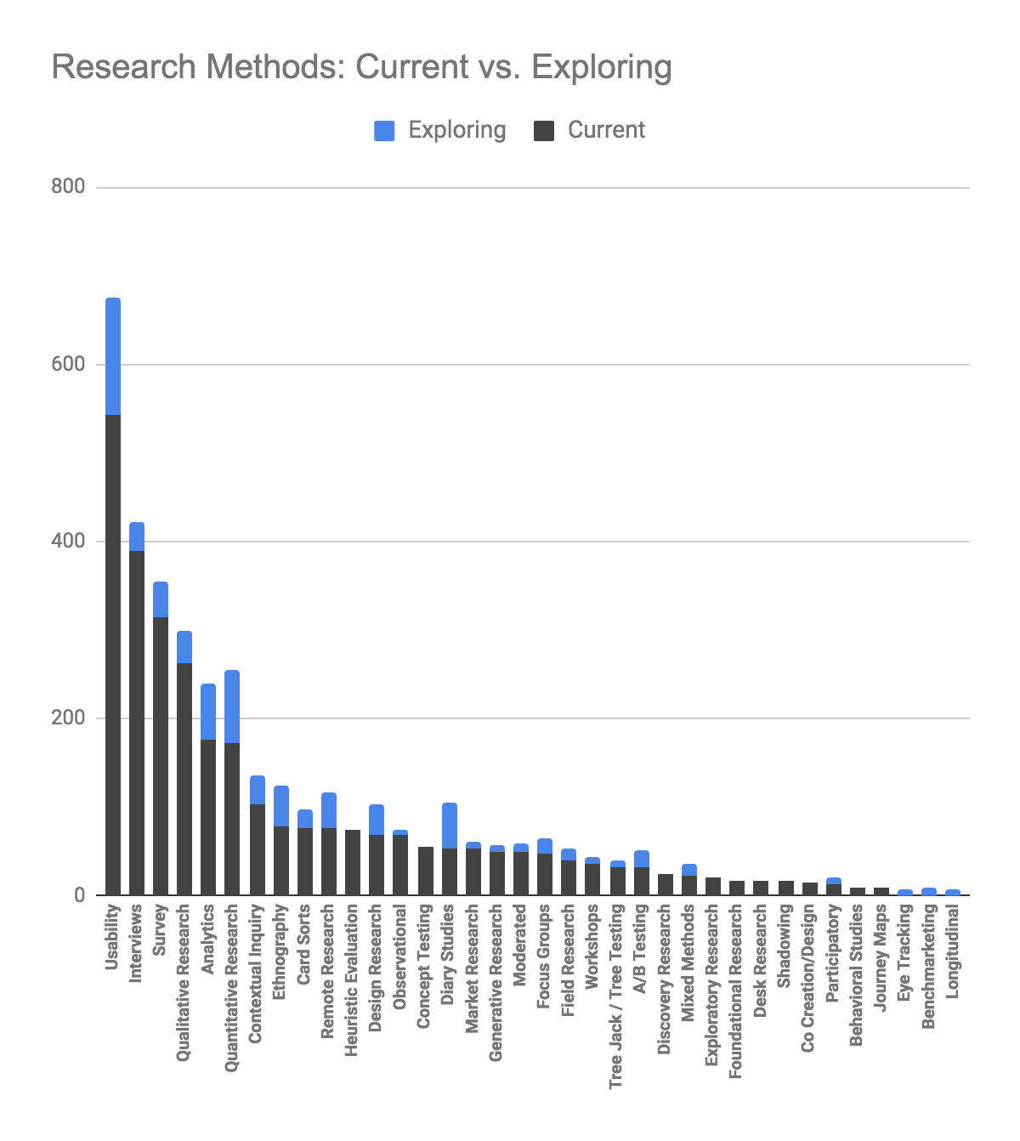
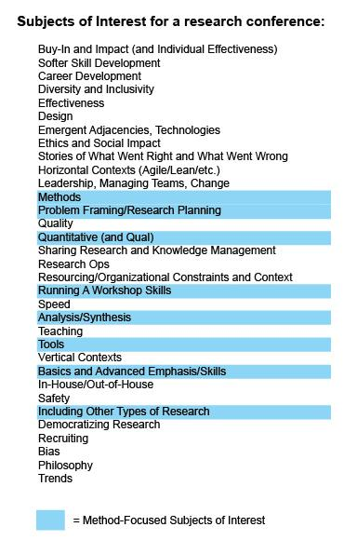
Methods are only a small part of what this audience wants out of a conference about research.
There isn’t a huge delta between what people are currently using in terms of methods and what they are looking to explore further
Of the types of subjects of interest they had for a research conference, only a small percentage were related to methods
Notes:
Abby

Slide 8
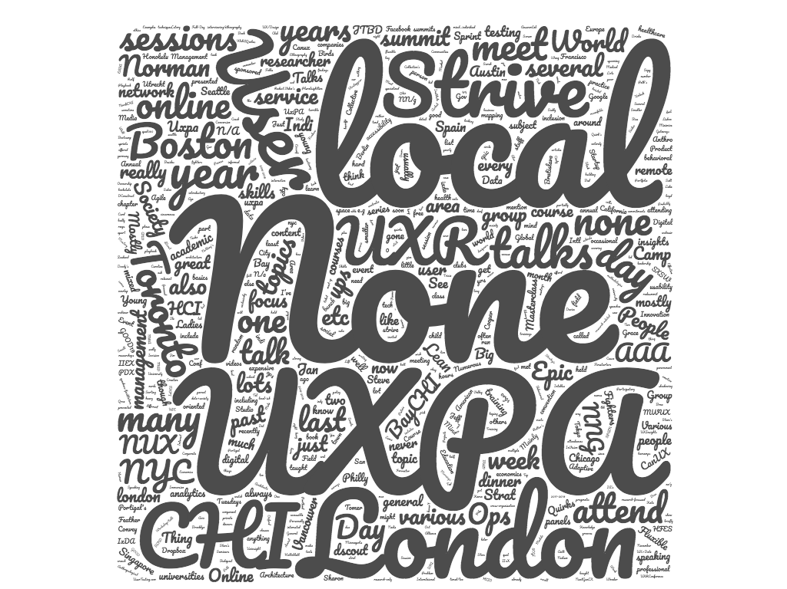
Many of our potential audience have never been to a conference dedicated to research
Local meetups like CHI and UXPA are some of the most common research focused events for our respondents
None was the most popular answer to the question “What (if any) events have you attended on the subject of research in the past few years?”
Strive and EPIC were the most common research conferences that were mentioned by name
UXPA was also mentioned a lot but in many cases it was referring to local UXPA events
Notes:
Abby

Slide 9
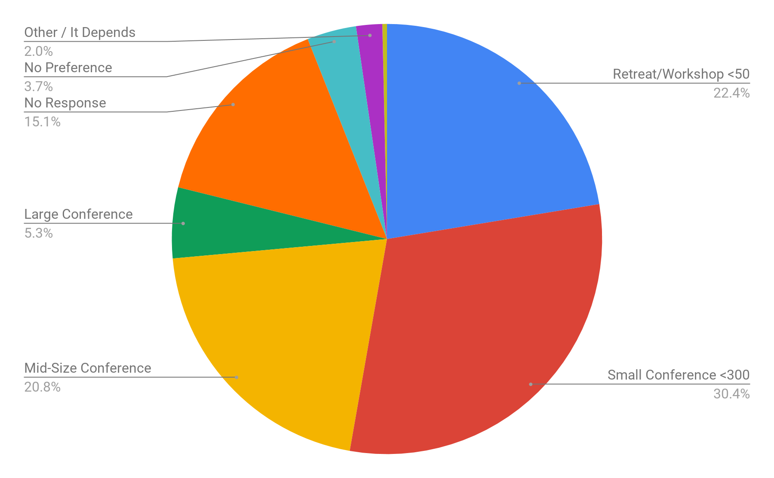
This audience is most comfortable at a range of small to medium events
Small Conferences (less than 300 people) took the top preference, trailed by retreats/workshops and Mid Size conferences
Large conferences of 500+ was the least preferable of the formats proposed
Notes:
Abby

Slide 10
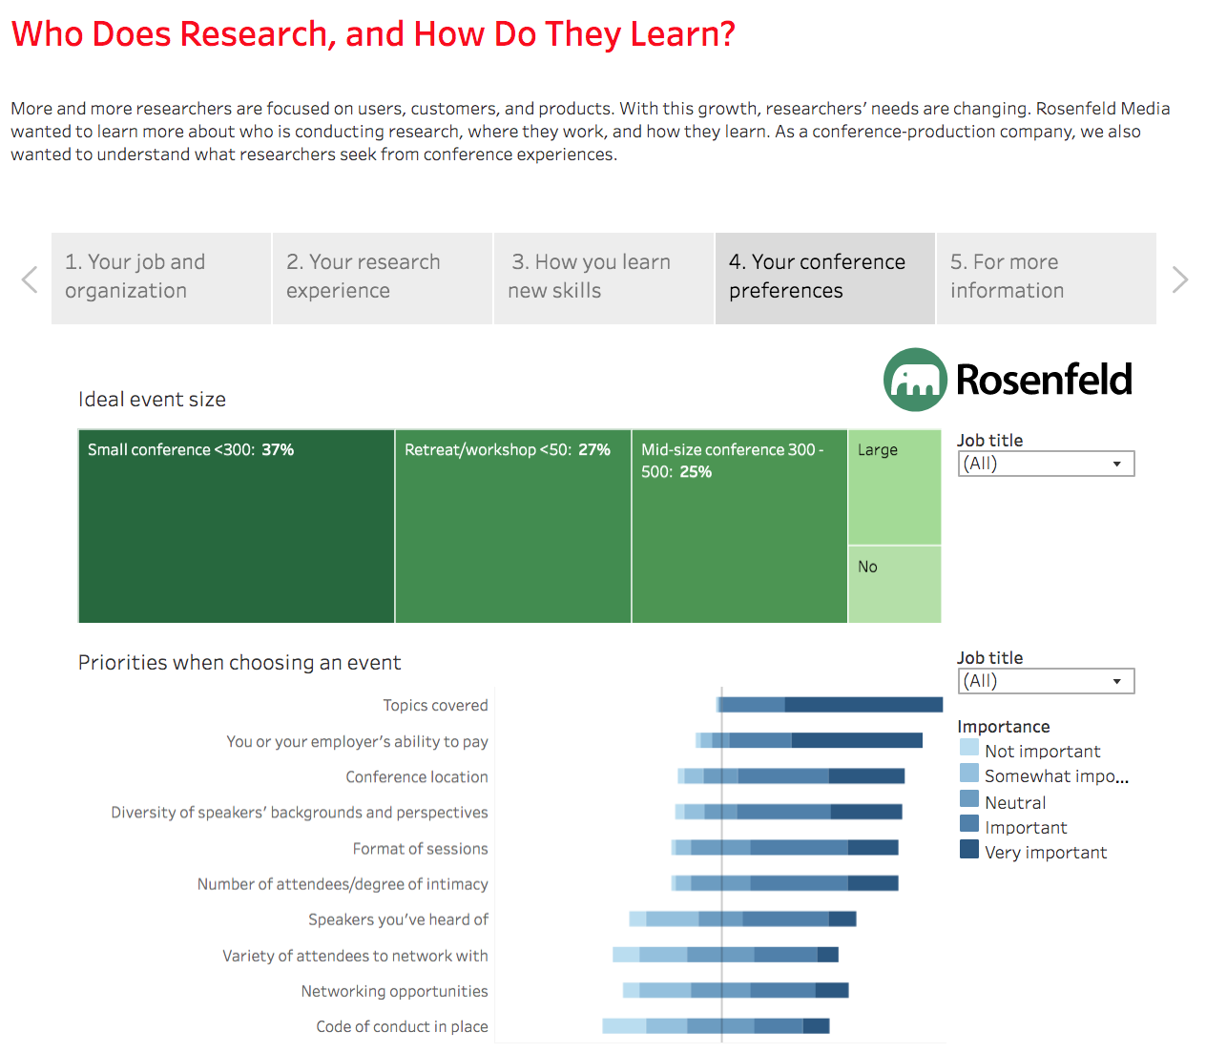
Find your own insights...
Our Tableau expert, Sean Oslin, has formatted all the quantitative data into an interactive, explorable data set that you can use to dig out insights of your own.
https://rfld.me/2LYkw2c
Notes:
Sean

Slide 11
Our journey from respondents, to segments, to personas
Notes:
Abby

Slide 12
Our Mission
Develop meaningful personas from the qualitative and quantitative data that was collected via our survey that represent the recommended target audience for the forthcoming research conference being worked on by Rosenfeld Media
Notes:
Abby

Slide 13
Approach
Use statistical analysis to determine which factors impact each other consistently AND exhibit preferences that would lead them to be in the potential audience for this conference (Johann)
Recommend data points to group responses together for analysis (Abby & Johann)
Review qualitative responses within each group to determine the useful personas that could emerge (Neil, Trisha, Rocio)
Document those personas and present them to the community (Full Team)
Notes:
Abby

Slide 14
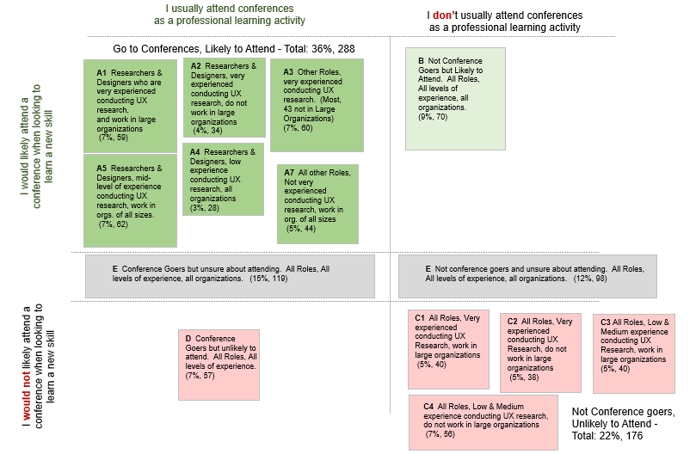
Segmentation
In order to dig into a meaningful subset of the responses, we identified two data points to focus on when dividing up our respondents into segments:
Past experience attending conferences How often do you attend a conference related to your role?
Likelihood to attend a conference If you are looking to learn a new skill or concept, how likely are you to attend a conference?
Notes:
Abby

Slide 15
Personas that emerged...
Very Experienced Researchers
Somewhat Experienced Researchers
Less Experienced Researchers
Executive or Consultant
Specialist
Notes:
Abby

Slide 16


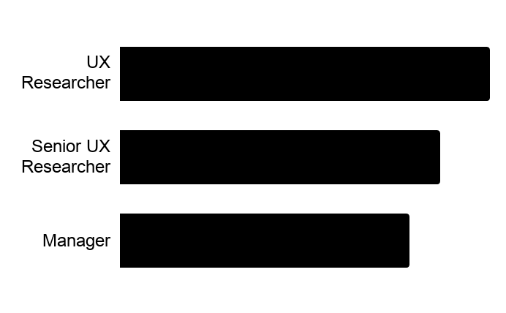
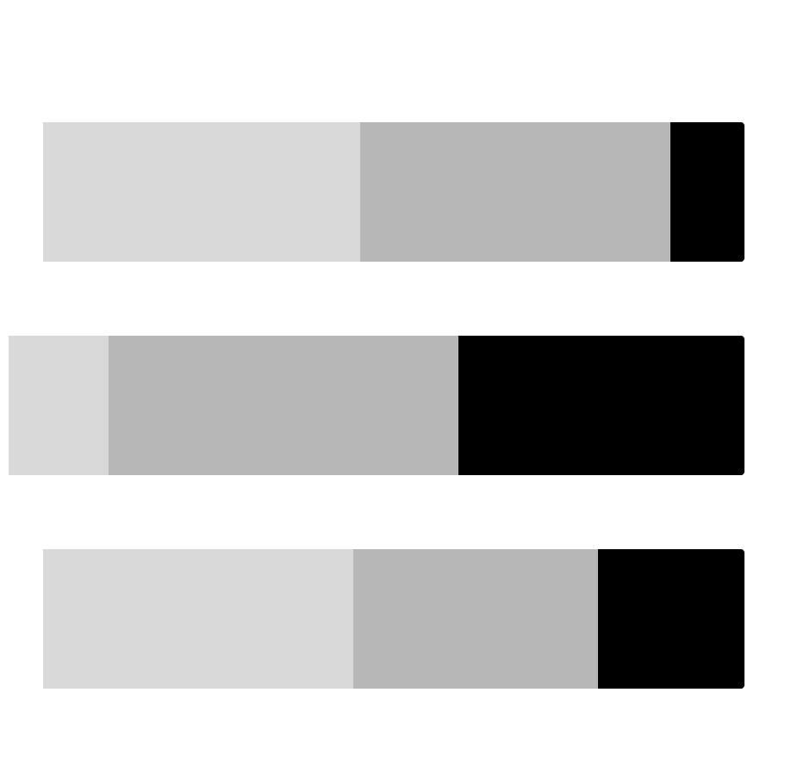
Very Experienced Researchers & Designers
Individual Contributors and Managers from a variety of organization sizes who are experienced in conducting research.
68%
academically trained in research
70%
currently work in large orgs
What factors are most important to this person when deciding whether to attend a conference about research?
Speakers
Topics
Content
What topics would they be most attracted to at a conference about research?
Current methods
Emerging methods
Turning research into action
What advice do they have for the Rosenfeld Media team in pursuing a conference about research?
“Don’t do what everyone else is doing. Don’t be just another conference. Give me a unique offering.”
Job Titles
UX Researcher 37%
Senior UX Researcher 32%
Manager 29%
Which types of sessions are most important for this person?
Workshops
Mid-size conference
Multi-track
Who would they expect to see at a conference about research?
New people
Regular people who are doing great research work
What types of learning activities does this person rely on outside of attending conferences?
Read blog/Medium articles
Read a book
Watch video of talk
Speaker Name Recognition
Diversity of Speakers
Networking Opportunities
Not
Important
Very
Important
Notes:
TRISH

Slide 17
Findings About
Very Experienced
Researchers & Designers
Education: Many of these individuals have post-graduate education whether it’s a Masters or PhD. With their training in research, they enjoy adapting their knowledge to their professional work.
Research Methods: They are experienced when conducting qualitative research (i.e., user interviews, usability tests, focus groups) in their current roles but would like to conduct more quantitative research (i.e., surveys, A/B testing, card sorting) in the future.
Conference Content: They prefer to see regular people speaking on the great research work they have done versus bigger names within the field. It’s important to them to stay on top of emerging methods while also hearing about others’ experiences on current methods.
Notes:
TRISH

Slide 18


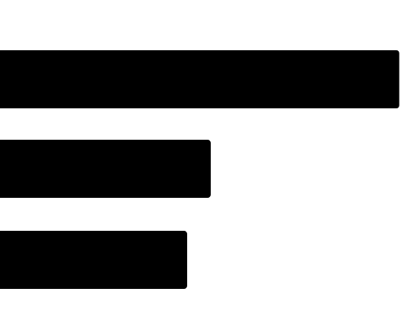
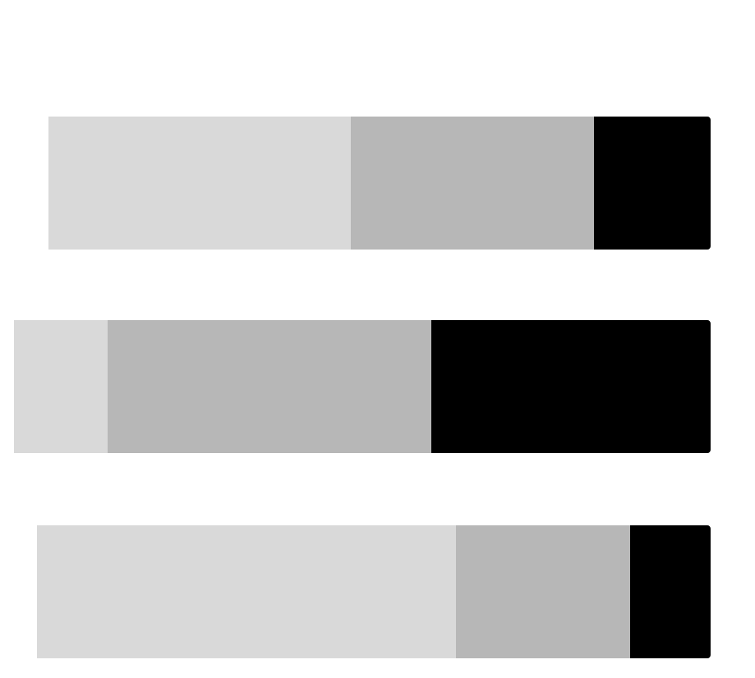
Somewhat Experienced Researchers
Individual contributors and managers with mid level experience conducting research in a variety of methods in organizations of all sizes.
63%
academically trained in research
58%
currently work in large orgs
What factors are most important to this person when deciding whether to attend a conference about research?
Topics
Ability to pay
Diversity of speakers
Which types of sessions are most important for this person?
Workshops
Full-length talks
Keynotes
What topics would they be most attracted to at a conference about research?
Methods & best practices
Research in organizations
Who would they expect to see at a conference about research?
Multidisciplinary
Specific names
What advice do they have for the Rosenfeld Media team in pursuing a conference about research?
“Mix of theory and heavy on practical, mixing talk lengths/formats could cover a lot of area and balance those nicely.”
What types of learning activities does this person rely on outside of attending conferences?
Read blogs and/or books
Watch videos of talks
Attend a local meetup or talk
Job Titles
UX Researcher 34%
UX Designer 18%
Senior UX Researcher 16%
Speaker Name Recognition
Diversity of Speakers
Networking Opportunities
Not
Important
Very
Important
Notes:
ROCIO
n = 62
For the important factors in the side bar, n = 61 (1 had no answer)

Slide 19
Findings About
Somewhat Experienced Researchers & Designers
Education: Primarily learned research through industry workshops and university classes. They rely on reading blogs/books and attending conferences and watching videos of talks to learn
Research Methods: Have a breadth of experience in qualitative and quantitative methods and mixed method research
Conference Content: They are seeking research conference offerings in an intimate setting across multiple disciplines (academic/non-academic, various industries, multiple role perspectives) that include best practices, methods, and research in organizations. It is important that they be able to apply learnings into their work immediately
Notes:
Rocio

Slide 20


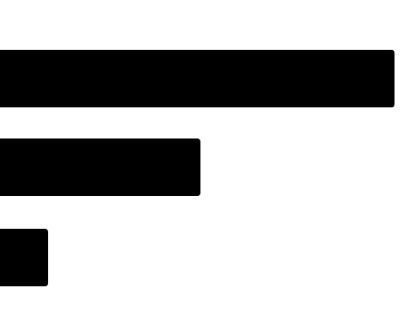
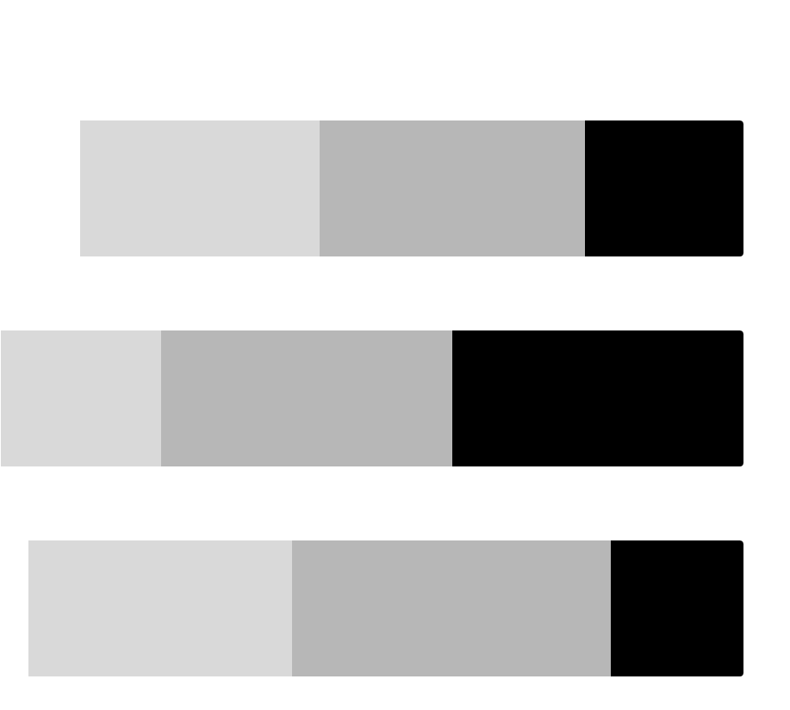
71%
academically trained in research
Less Experienced Researchers
Individual Contributors and Managers from a variety of organization sizes who are not as experienced in conducting research.
43%
currently work in large orgs
What factors are most important to this person when deciding whether to attend a conference about research?
Topics
Session format (tie)
Ability to pay (tie)
Diversity of speakers
Which types of sessions are most important for this person?
Workshops
Keynotes
Discussion circles/topic tables
What topics would they be most attracted to at a conference about research?
Methods & best practices
Analysis & synthesis
Who would they expect to see at a conference about research?
Large organizations
Multidisciplinary
What advice do they have for the Rosenfeld Media team in pursuing a conference about research?
“Have a wide variety of topics, for people of various levels of experience.”
What types of learning activities does this person rely on outside of attending conferences?
Read blogs and/or books
Attend a local meetup or talk
Watch videos of talks
Job Titles
UX Researcher 57%
UX Designer 29%
Senior UX Researcher 7%
Speaker Name Recognition
Diversity of Speakers
Networking Opportunities
Not
Important
Very
Important
Notes:
ROCIO
n = 28

Slide 21
Findings About
Less Experienced Researchers & Designers
Education: Background in research includes bootcamps, on the job, conference/workshops, and university classes. They rely on reading blogs/books and attending conferences and local meetup/talk events to learn
Research Methods: Most have experience with usability testing, interviews, and survey research methods
Conference Content: They are seeking a research conference to be an intimate setting offering guidance from large organizations across multiple disciplines on best practices and methods, especially analysis and synthesis
Notes:
Rocio

Slide 22

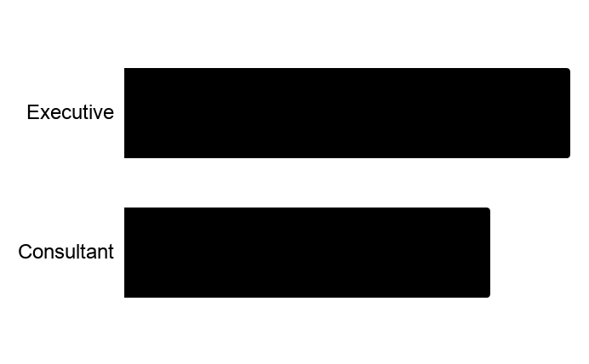
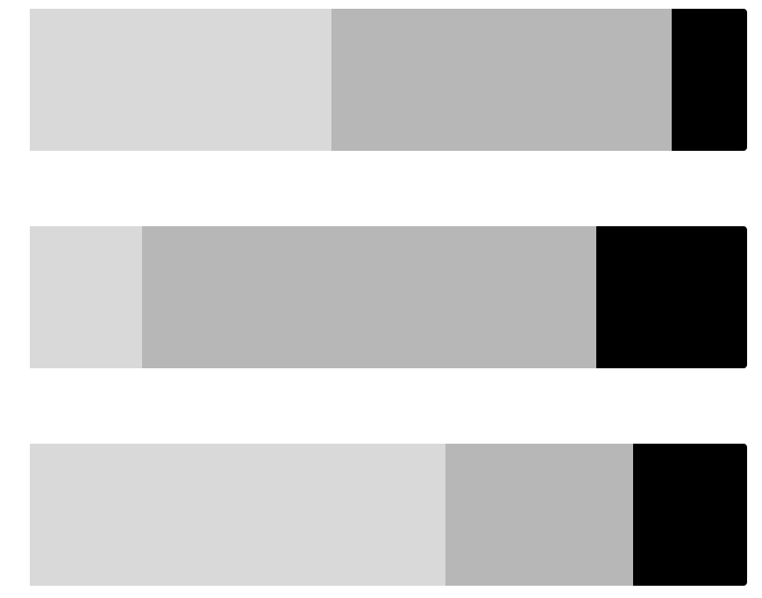
70%
academically trained in research
Design Executives and Consultants
Individuals in leadership positions or providing leadership through consulting who are very experienced conducting research and work in organizations of all sizes
60%
currently work in small orgs
What factors are most important to this person when deciding whether to attend a conference about research?
Conference topics
Location
Cost
Which types of sessions are most important for this person?
Workshops
Keynote speakers
Group discussions / opportunities to share ideas
What topics would they be most attracted to at a conference about research?
Application of research results
Measuring impact of research
New research methods
Who would they expect to see at a conference about research?
Researchers in corp. roles
Company executives
Not Facebook, Apple, Google, ect.
What advice do they have for the Rosenfeld Media team in pursuing a conference about research?
“I would love for it to include a conversation about how research can move from a supportive role to one that drives the direction that companies invest in.”
What types of learning activities does this person rely on outside of attending conferences?
Read blogs & books
Watch videos of talks
Attend a local meetup or talk
Job Titles
Executive 55%
Consultant 45%
Speaker Name Recognition
Diversity of Speakers
Networking Opportunities
Not
Important
Very
Important
Notes:
Neil

Slide 23
Findings About
Executives & Consultants
Education: Many of these individuals are highly educated and have completed Masters and PhDs in their field
Research Methods: Online interviews and field research are the two most common types of research this groups expects to focus on in the future
Conference Content: Generally this group has more experience attending conferences and in some cases even speaking at them. This group is most interested in topics relating to applying research results and measure the impact of the work
Notes:
Neil

Slide 24


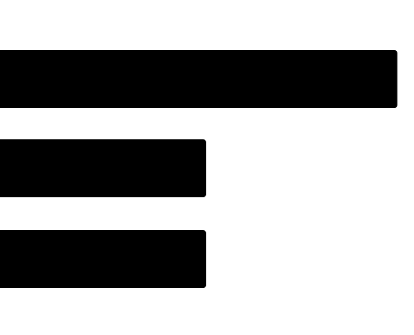
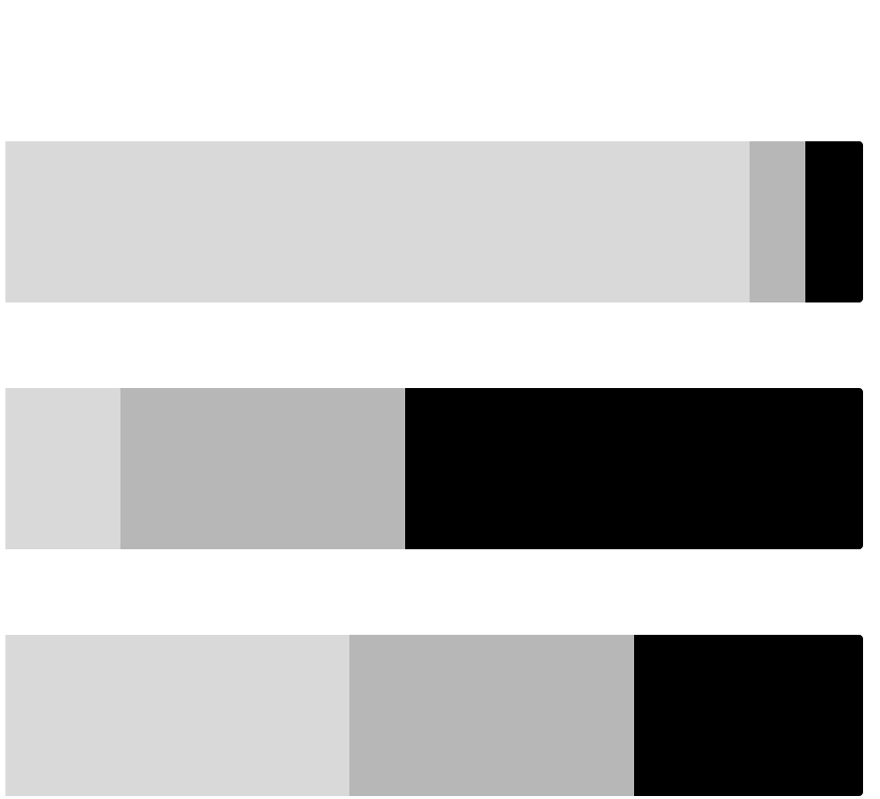
75%
academically trained in research
Specialist
Individuals pursuing a specialty within design who have a mid level experience conducting research in organizations of all sizes
50%
currently work in medium orgs
What factors are most important to this person when deciding whether to attend a conference about research?
Cost
Conference topics
Time commitment
Which types of sessions are most important for this person?
Workshops / hands on experience
Group discussions / opportunities to share ideas
Keynote speakers
What topics would they be most attracted to at a conference about research?
New research methods
Examples of real world research
Analysis techniques - using qual & quant data together
Who would they expect to see at a conference about research?
Researchers in industries other than tech
Academic researchers
Examples of research including details of the end-to-end process
What advice do they have for the Rosenfeld Media team in pursuing a conference about research?
“Provide opportunities for emerging researchers to network or get advice from experienced researchers.
It should not be the focus of the conference but something small on the side would be very helpful to newcomers.”
What types of learning activities does this person rely on outside of attending conferences?
Read blogs & books
Watch videos of talks
Attend a local meetup or talk
Job Titles
Academic 25%
Strategist 13%
IA 13%
Speaker Name Recognition
Diversity of Speakers
Networking Opportunities
Not
Important
Very
Important
Notes:
Neil

Slide 25
Findings About
Specialists
Education: Many of these individuals are highly educated. Most have received formal training on conducting research and several have completed masters and PhDs in their field.
Research Methods: Focus groups and field research are the two most common types of research this group expects to focus on in the future.
Conference Content: Generally this group is earlier in their research career which is likely why there is significant value in the opportunity to network at conferences. This group prefers smaller conferences that facilitate group discussions and the opportunity to share ideas.
Notes:
Neil

Slide 26
Comparing Personas
Notes:
Abby

Slide 27
Very Experienced
Somewhat Experienced
Less Experienced
Executives/Consultants
Specialists
68%
academically trained in research
63%
academically trained in research
71%
academically trained in research
70%
academically trained in research
75%
academically trained in research
70%
currently work in large orgs
58%
currently work in large orgs
43%
currently work in large orgs
60%
currently work in small orgs
50%
currently work in medium orgs
Job Titles
Job Titles
Job Titles
Job Titles
Job Titles
UX Researcher 37%
UX Researcher 34%
UX Researcher 57%
Executive 55%
Academic 25%
Senior UX Researcher 32%
UX Designer 18%
UX Designer 29%
Consultant 45%
Strategist 13%
Manager 29%
Senior UX Researcher 16%
Senior UX Researcher 7%
IA 13%
Speaker Name Recognition
Speaker Name Recognition
Speaker Name Recognition
Speaker Name Recognition
Speaker Name Recognition
Diversity of Speakers
Diversity of Speakers
Diversity of Speakers
Diversity of Speakers
Diversity of Speakers
Networking Opportunities
Networking Opportunities
Networking Opportunities
Networking Opportunities
Networking Opportunities
Not
Important
Not
Important
Very
Important
Very
Important
Not
Important
Not
Important
Very
Important
Very
Important
Not
Important
Very
Important
Notes:
Abby

Slide 28
KEY
5 Personas
4 Personas
3 Personas
2 Personas
Important Factors in Deciding to Attend a Conference
Types of Sessions Interested in
Topics of Interest at a Research Conference
Who would they want to see at a research conference
Very Experienced
Speakers
Topics
Content
Workshops
Mid-size conference
Multi-track
Current methods
Emerging methods
Turning research into action
New people
Regular people who are doing great research work
Topics
Ability to pay
Diversity of speakers
Workshops
Full-length talks
Keynotes
Methods & best practices
Research in organizations
Multidisciplinary
Specific names
Somewhat Experienced
Less Experienced
Topics
Session format
Ability to pay
Diversity of speakers
Workshops
Keynotes
Discussion circles/topic tables
Methods & best practices
Analysis & synthesis
Large organizations
Multidisciplinary
Executives/Consultants
Topics
Location
Cost
Workshops
Keynote speakers
Group discussions / opportunities to share ideas
Application of research results
Measuring impact of research
New research methods
Researchers in corp. roles
Company executives
Not Facebook, Apple, Google, ect.
Specialists
Cost
Topics
Time commitment
Workshops / hands on experience
Group discussions / opportunities to share ideas
Keynote speakers
New research methods
Examples of real world research
Analysis techniques - using qual & quant data together
Researchers in industries other than tech
Academic researchers
Examples of research including details of the end-to-end process
Notes:
Abby

Slide 29
What now?
Notes:
Lou

Slide 30
Next Steps
The first Advancing Research Conference will be held March 30-April 1 in NYC
We have a call for proposals open until 9/29
We want to hear ideas from speakers of all experience levels
We will be prioritizing voices from underrepresented communities
We will be paying our speakers and covering hotel and travel
We will be providing content and speaker coaching for each speaker
Keep up/participate: join the Advancing Research community
Notes:
Lou

