Slide 1
Reanalyzing user personas derived from survey data
Kevin Eliasen
Fred Lambuth
Sean Oslin
Dominic Pedrotti

Slide 2
What 2 groups have in common

Slide 3
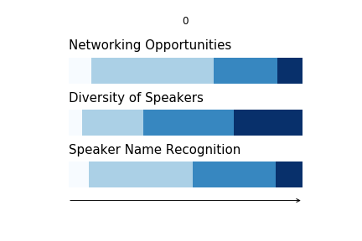
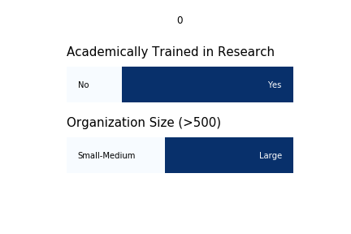
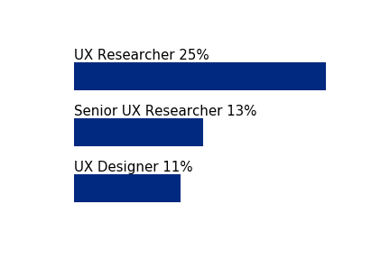
Least likely
***
Industry
Bar chart - top 4 or 5
Size
100% stacked bar chart
Title
Academic training in research
100% stacked bar chart
Current research
Bar chart 4 -5 top subjects or bullet points
Future research
Bar chart 4 -5 top subjects or bullet points
What care about most in a conference
Multiple 100% stacked bar chart
Your advice to RM in pursuing a research conference?
“Don't just give the usual motley crew another platform to perform. Go and find new things and people to excite the industry.”
“Get researchers out there in the field talking to people and making mistakes that they can share.”
Add more
Notes:
Neil

Slide 4
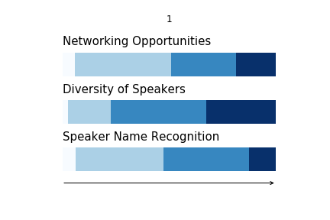
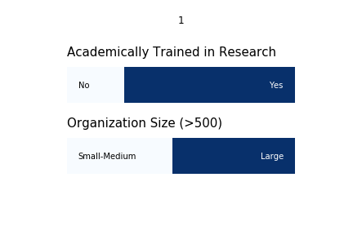
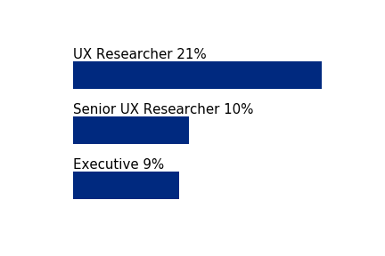
Most likely to attend
***
Industry
Bar chart - top 4 or 5
Size
100% stacked bar chart
Title
Bar chart – top 4 or 5
Academic training in research
100% stacked bar chart
Current research
Bar chart 4 -5 top subjects or bullet points
Future research
Bar chart 4 -5 top subjects or bullet points
What care about most in a conference
Multiple 100% stacked bar chart
Your advice to RM in pursuing a research conference?
“Don't just give the usual motley crew another platform to perform. Go and find new things and people to excite the industry.”
“Get researchers out there in the field talking to people and making mistakes that they can share.”
Add more
Notes:
Neil

Slide 5
Findings about most likely

