Slide 1
Creating user personas from survey data
Kevin Eliasen
Fred Lambuth
Sean Oslin
Dominic Pedrotti

Slide 2


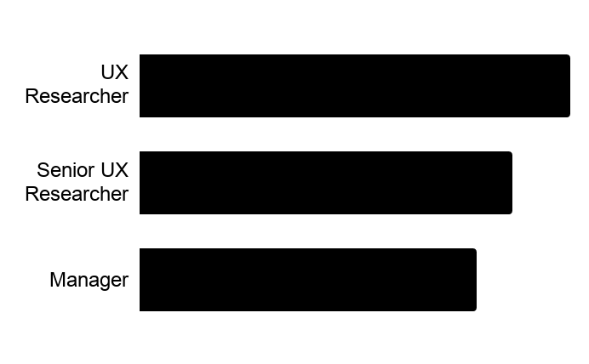
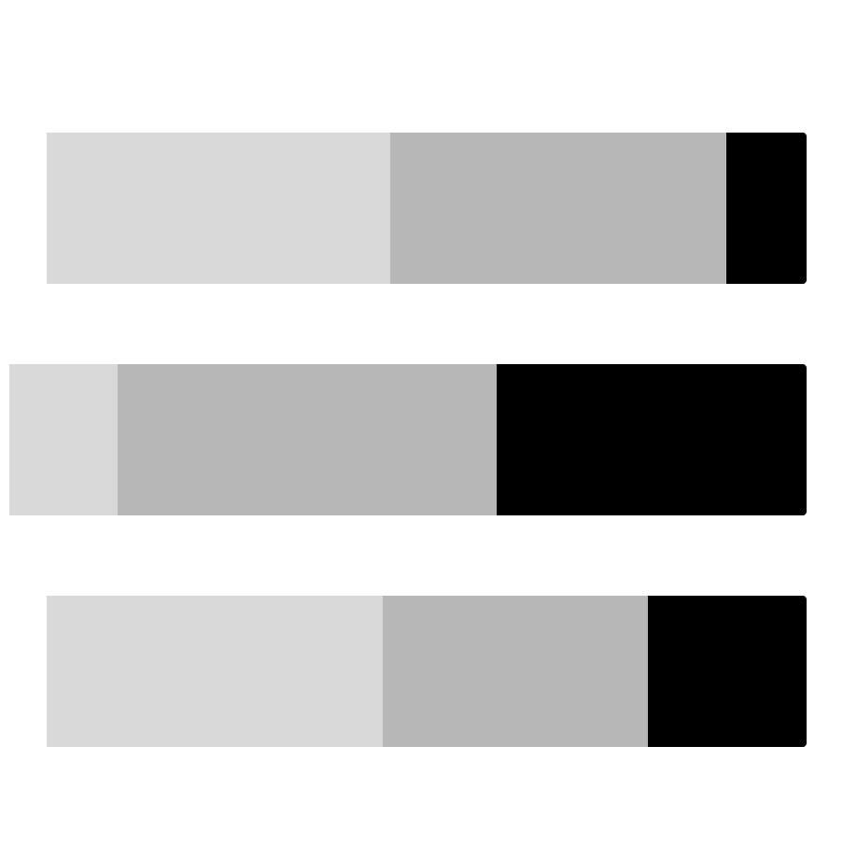
Very Experienced Researchers & Designers
Individual Contributors and Managers from a variety of organization sizes who are experienced in conducting research.
68%
academically trained in research
70%
currently work in large orgs
What factors are most important to this person when deciding whether to attend a conference about research?
Diverse speakers
Location
Format of sessions
What topics would they be most attracted to at a conference about research?
AI/data science
Case studies
New technology
What advice do they have for the Rosenfeld Media team in pursuing a conference about research?
"I feel that the "techniques" side is covered across a range of conferences. I feel like there are less conferences that focus on the strategic (and possibly ops) side of research.”
”More events for experienced practitioners.”
Job Titles
UX Researcher 37%
Senior UX Researcher 32%
Manager 29%
Which types of sessions are most important for this person?
Long-talk
Workshop
Keynote
Who would they expect to see at a conference about research?
New people
Regular people who are doing great research work
What types of learning activities does this person rely on outside of attending conferences?
Speaker Name Recognition
Diversity of Speakers
Networking Opportunities
Not
Important
Very
Important
Notes:
TRISH

Slide 3


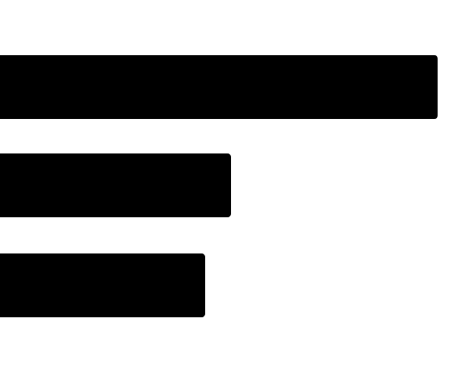
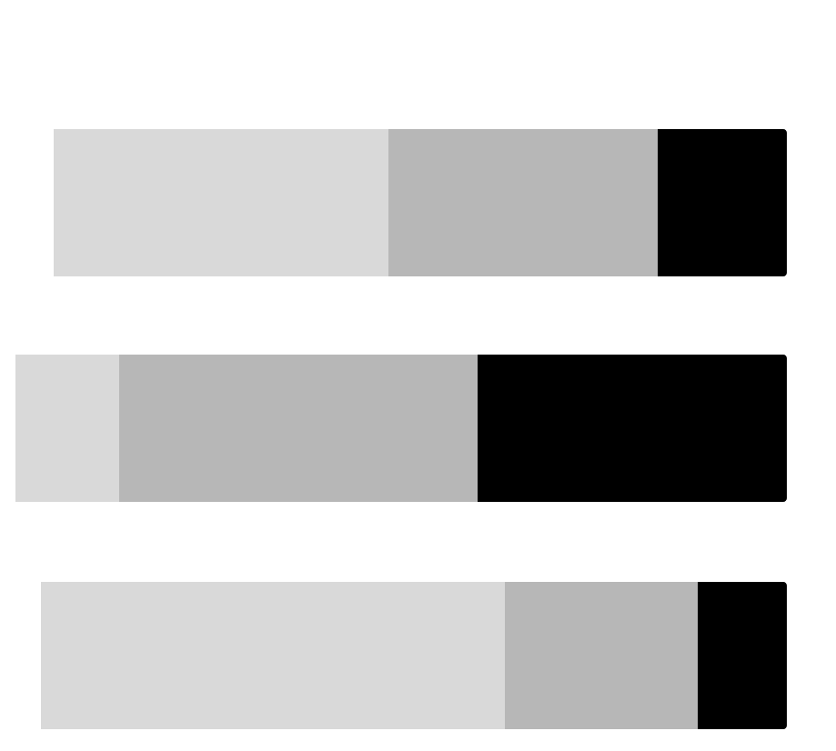
Somewhat Experienced Researchers
Individual contributors and managers with mid level experience conducting research in a variety of methods in organizations of all sizes.
63%
academically trained in research
58%
currently work in large orgs
What factors are most important to this person when deciding whether to attend a conference about research?
Diverse speakers
Location
Format of sessions
Which types of sessions are most important for this person?
Workshops
Long talk
Keynote
What topics would they be most attracted to at a conference about research?
Mixed methods approach
Leading team
Product development
Who would they expect to see at a conference about research?
Steve Portigal
Jared Spool
Google & Facebook
What advice do they have for the Rosenfeld Media team in pursuing a conference about research?
“I'm looking to learn from professionals, not people trying to break in.”
“[not] only focusing on companies with big dedicated research teams”
What types of learning activities does this person rely on outside of attending conferences?
Job Titles
UX Researcher 34%
UX Designer 18%
Senior UX Researcher 16%
Speaker Name Recognition
Diversity of Speakers
Networking Opportunities
Not
Important
Very
Important
Notes:
ROCIO
n = 62
For the important factors in the side bar, n = 61 (1 had no answer)

Slide 4


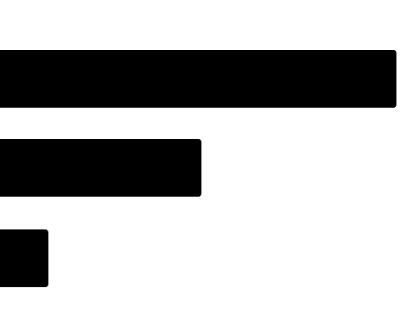
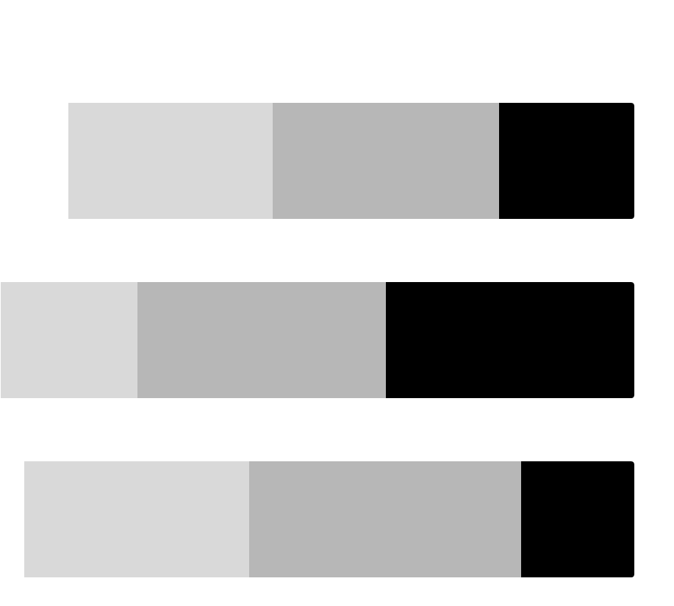
71%
academically trained in research
Less Experienced Researchers
Individual Contributors and Managers from a variety of organization sizes who are not as experienced in conducting research.
43%
currently work in large orgs
What factors are most important to this person when deciding whether to attend a conference about research?
Location
Diverse speakers
Format of sessions
Which types of sessions are most important for this person?
Workshops
Long talk
Keynote
What topics would they be most attracted to at a conference about research?
Mixed method
Practical application
Planning execution
Who would they expect to see at a conference about research?
Kate Towsey
Indi Young
Erika Hall
What advice do they have for the Rosenfeld Media team in pursuing a conference about research?
“Include marginalized people.”
What types of learning activities does this person rely on outside of attending conferences?
Job Titles
UX Researcher 57%
UX Designer 29%
Senior UX Researcher 7%
Speaker Name Recognition
Diversity of Speakers
Networking Opportunities
Not
Important
Very
Important
Notes:
ROCIO
n = 28

Slide 5

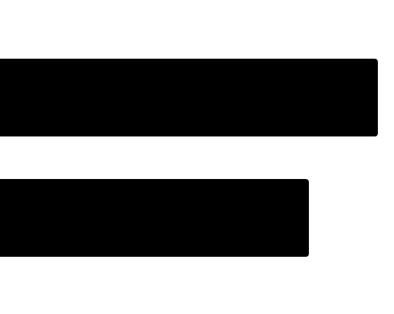
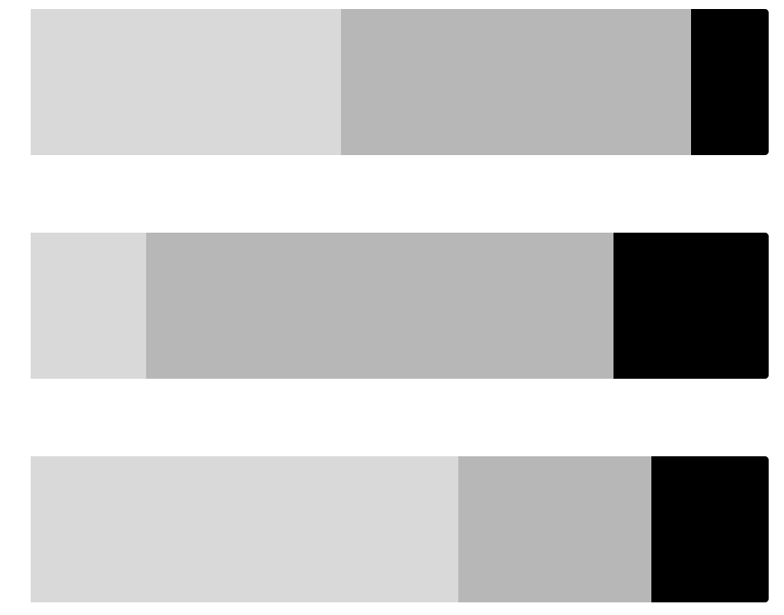
70%
academically trained in research
Design Executives and Consultants
Individuals in leadership positions or providing leadership through consulting who are very experienced conducting research and work in organizations of all sizes
60%
currently work in small orgs
What factors are most important to this person when deciding whether to attend a conference about research?
Location
Diverse speakers
Format Sessions
Which types of sessions are most important for this person?
Workshops
Long talk
Keynote
What topics would they be most attracted to at a conference about research?
New methods
Knowledge management
Technology/AI
Who would they expect to see at a conference about research?
Industry leaders
Working company
Indi Young
What advice do they have for the Rosenfeld Media team in pursuing a conference about research?
“I find it very frustrating to attend a research track at a conference in which only the very basics of research are discussed.”
“Include topics … related to research -- research and transformation, research and biz strategy etc.”
What types of learning activities does this person rely on outside of attending conferences?
Read blogs & books
Watch videos of talks
Attend a local meetup or talk
Job Titles
Executive 55%
Consultant 45%
Speaker Name Recognition
Diversity of Speakers
Networking Opportunities
Not
Important
Very
Important
Notes:
Neil

Slide 6


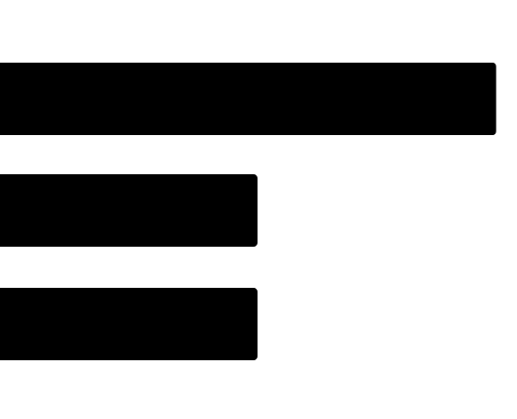
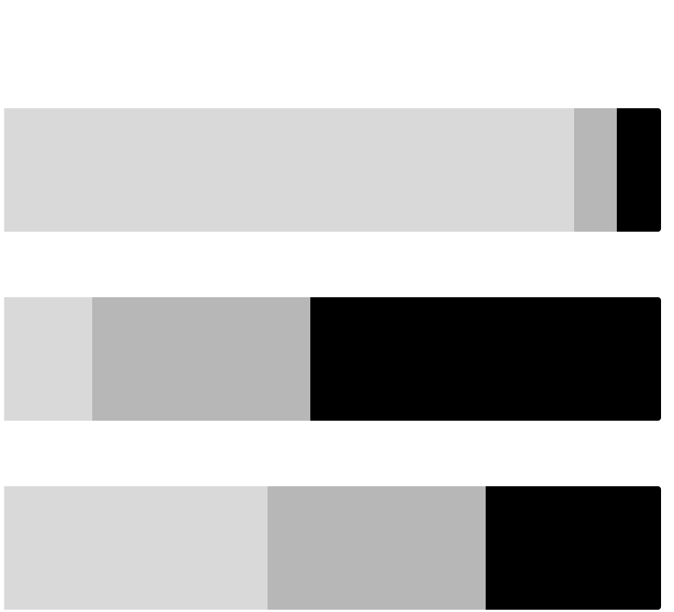
75%
academically trained in research
Specialist
Individuals pursuing a specialty within design who have a mid level experience conducting research in organizations of all sizes
50%
currently work in medium orgs
What factors are most important to this person when deciding whether to attend a conference about research?
Location
Diverse speakers
Format Sessions
Which types of sessions are most important for this person?
Workshops
Keynote
Long talk
What topics would they be most attracted to at a conference about research?
New research methods
Best practices
Analysis techniques - qual data
Who would they expect to see at a conference about research?
Sam Ladner
People from different fields, backgrounds
Steve Portigal
What advice do they have for the Rosenfeld Media team in pursuing a conference about research?
“Don't just give the usual motley crew another platform to perform. Go and find new things and people to excite the industry.”
“Get researchers out there in the field talking to people and making mistakes that they can share.”
What types of learning activities does this person rely on outside of attending conferences?
Read blogs & books
Watch videos of talks
Attend a local meetup or talk
Job Titles
Academic 25%
Strategist 13%
IA 13%
Speaker Name Recognition
Diversity of Speakers
Networking Opportunities
Not
Important
Very
Important
Notes:
Neil

