Slide 1
Reanalyzing user personas derived from survey data
Kevin Eliasen
Fred Lambuth
Sean Oslin
Dominic Pedrotti

Slide 2
Project background
Apply data science methods to quantitative and free-text survey data for Rosenfeld Media, a conference-producing and publishing company.
The survey will assist in the creation and marketing of a new conference on research.
RM wants to automate the process of extracting information from surveys to create survey-respondent profiles.

Slide 3
Project description
Recreate existing personas using DS tools
Use DS tools to create new personas

Slide 4
Goals: to help RM to
Determine who to market the conference to
Determine the best format/content for the conference
Determine the survey questions which are most/least valuable
Provide key findings about survey respondents
Provide Python code that can be reused for similar analyses

Slide 5
Deliverables
New personas
Python code to replicate analysis
Recommendations for changes to the survey tool

Slide 6
Phase 1 goals
Proof of concept: using data science techniques to generate profiles similar to those generated
Use data science techniques to recreate the the division of survey respondents into 5 personas
Answer the same questions in the existing personas but with our analysis of the data - compare significant differences.

Slide 7
Original personas
Very Experienced Researchers
Somewhat Experienced Researchers
Less Experienced Researchers
Executive or Consultant
Specialist

Slide 8
Re-imagined personas
Not/somewhat Likely to Attend
Most Likely to Attend
Notes:
Based on how survey respondent answered question ##.

Slide 9
Differences

Slide 10
Lowest entropy questions

Slide 11
Highest entropy questions

Slide 12
What 2 groups have in common

Slide 13
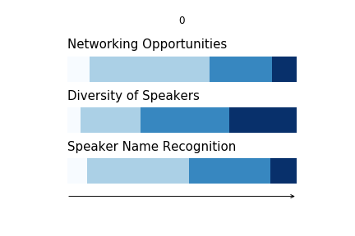
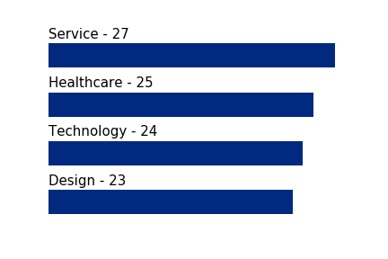
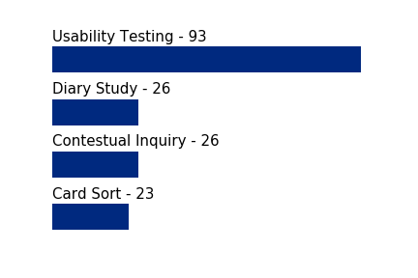
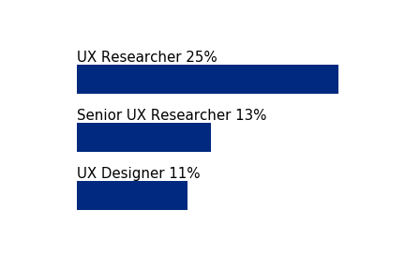
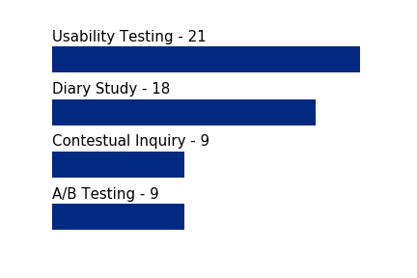
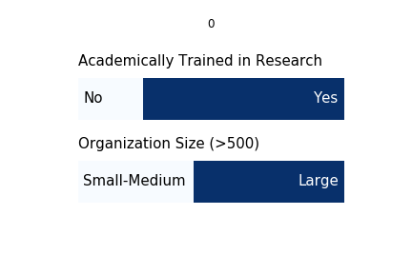
Least likely to attend a research conference
Respondents indicated Not to Somewhat Likely to Attend on the survey
Industry
Title
Academic training in research
Current research
Future research
Size
What they want to see
Respondent’s advice for a research conference
"Don't focus on practical workshops, they're usually too short to be useful. Focus on sharing experiences. (could be done online without an event)”
“not just theory - I need to… take what I learn back to my job and use it.”
“start by gaining credibility in the field. I don't know who you are, why you care and this survey doesn't seem to indicate you're an expert in the field”
“The next evolution of UXR has to be bigger than just "advocacy", and has to show our methods work”

Slide 14
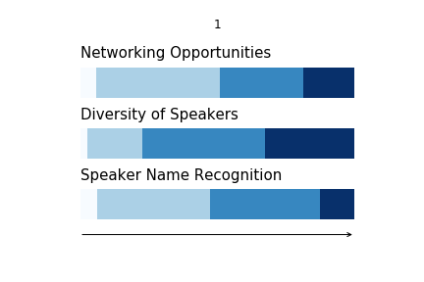
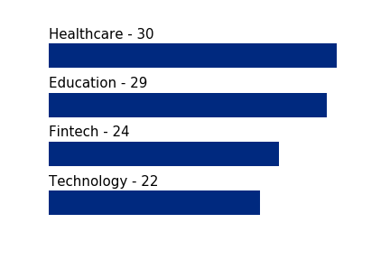
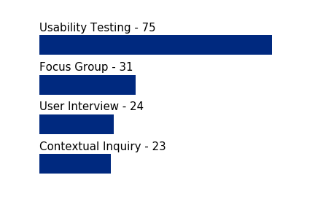
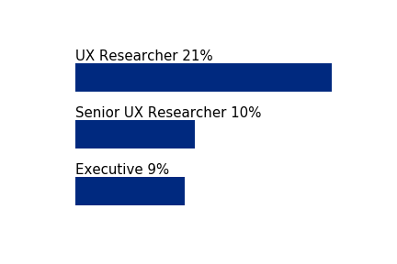
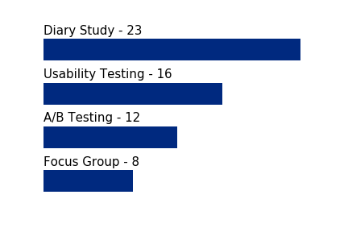
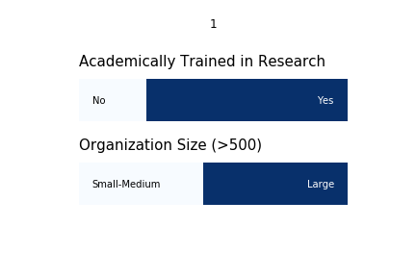
Most likely to attend a research conference
Respondents indicated Likely to Attend on the survey
Industry
Title
Academic training in research
Current research
Future research
Size
What care most in a conference
Respondent’s advice for a research conference
"workshops should target a specific level of expertise”
“Examples of application in practice of established methods”
“creative ways to build activities into the day.”
“more events for experienced practitioners”
“huge number of early-career folks who are struggling to get work in UX research roles, and we need to get them real-world experience”
“Slack for pre-conference introductions, a channel for each speaker, … handle Q&A through the Slack channels”
Notes:
Neil

Slide 15
Findings about most likely

Slide 16
Recommendations to RM

Slide 17
Conclusions

