Slide 1
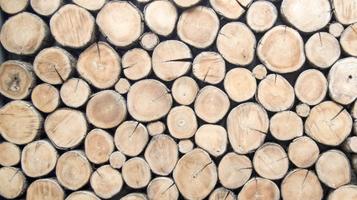



Log-Structured Non-Volatile Main Memory
Qingda Hu*, Jinglei Ren, Anirudh Badam, and Thomas Moscibroda Microsoft Research *Tsinghua University
Notes:
Today I’ll talk about our work on non-volatile memory. It is joint work with Qingda, Anirudh and Thomas.
Briefly, we designed log-structured memory management for non-volatile main memory, so you can see many logs in the picture.
Before introducing the logs, let's get to know non-volatile memory, or NVM.

Slide 2


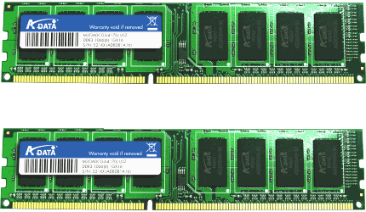
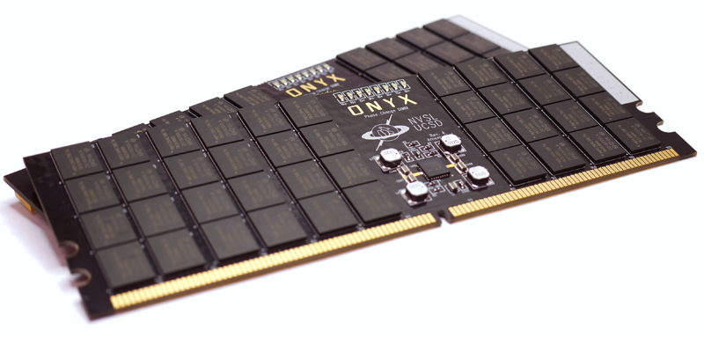
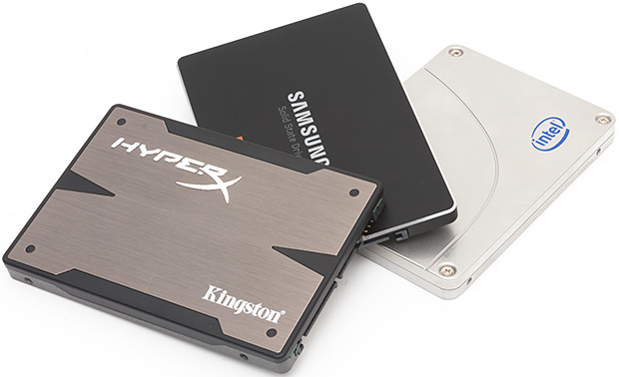
Non-volatile memory is coming…
Data storage
3D XPoint/Optane (2015 - )
Read: ~50ns
Write: ~10GB/s
PCM
Read: ~100ns
Write: ~1GB/s
Read: ~10µs
Write: ~100MB/s
Notes:
NVM is a new revolutionary storage media that can hold persistent data, just like disks. At the same time, it supports byte-addressable access at DRAM-level performance.
Take phase change memory (PCM) for example. Its read performance is similar to DRAM, and its write performance is one or two orders of magnitude better than SSDs.
More importantly, NVM is approaching our life. Intel and Micron have announced products 3D XPoint and Optane.

Slide 3
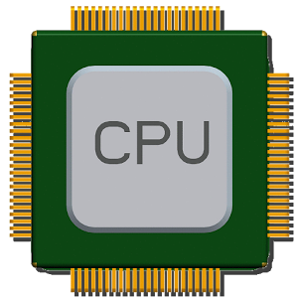


Background: Impact of NVM
Non-Volatile Main Memory (NVMM)
Architecture:
Data persistence as a bottleneck
➔ 10+x application performance improvement
DRAM
DRAM
NVM
SSD
Notes:
So, what is the impact of NVM to the current software systems? Traditionally, data persistence easily becomes a bottleneck because we have to constantly move data from DRAM to SSD and the other way around.
In the near future, we can set up NVM as part of the main memory, so that applications can directly access persistent data through CPU instructions. Therefore, the traditional bottleneck is avoided. We refer to this architecture as non-volatile main memory (NVMM).
It can boost application performance by more than 10 times, according to many prior experiments.

Slide 4
Executive Summary
Motivation
Solution: Log-structured memory management for NVMM.
Evaluation: 7x less memory waste; 90% higher write throughput.
Application
Inefficient use of memory space
Application
Library
Library
Inefficient support for crash consistency
DRAM
NVMM
SSD
Notes:
Now, let me give you a one-slide overview of our work.
To develop software systems on NVM, we find two major problems.
One is inefficient use of memory space. There is a lot of waste of memory space. The other is inefficient support for crash consistency, leading to low write throughput -- I will explain them latter.
To solve these problems, we designed a log-structured memory management library for non-volatile main memory.
Our evaluation shows that this log-structured way can reduce memory waste by almost 7 times and improve write throughput by almost 90%.

Slide 5
Outline
Motivation
Log-Structured NVMM
Tree-Based Address Mapping
Evaluation
Notes:
Next, I will detail our work in four parts. Let's start with motivation.

Slide 6
Motivation I
Inefficient use of memory space
Reason: Traditional DRAM allocators incur high memory fragmentation.
Explanation:
Internal fragmentation:
External fragmentation:
8B
16B
…
8B | 8B | 8B | 8B | 8B | … | 8B | 8B
……
16B | 16B | … | 16B
……
…
……
24B
Waste
32B
32B | Waste (32B) | 32B | 32B | Waste (32B)
64B request
Notes:
As aforementioned, we have two problems. The first is inefficient use of memory space. That is because traditional DRAM allocators bring about high memory fragmentation.
Here is an illustration of how a traditional DRAM allocator works. Typically, the allocator divides the main memory space into fixed-length large chunks. Each chunk serves memory allocations of a specific size. The sizes of allocation are predefined, static.
So, there is internal fragmentation if the requested size is smaller than the best-fit slot, as show in the figure.
There is external fragmentation when the workload changes. For example, initially a workload requests most allocations below 32B. After a while, it begins to request larger allocations. Then, it is possible most chunks have been used for small allocations, so not enough chunks are left for the large allocations, even though many free small segments exist. This is external fragmentation.

Slide 7
Motivation I
Inefficient use of memory space (cont.)
Fragmentation is a more severe issue for NVM!
process
process
process
process
process
process
DRAM
NVMM
Notes:
For NVM, fragmentation is a more severe issue. DRAM can accept a reasonable level of fragmentation because data occupation tends to be temporary.
It is OK to waste some space for a short while. But for NVM, data occupation is supposed to be permanent.
Therefore reducing fragmentation and waste is very critical. This is the first motivation.

Slide 8
Motivation II
Inefficient support for crash consistency
Reason: Write-twice in log and home.
Explanation: Redo logging for example.
transaction {
a += 1;
b -= 1;
}
NVMM
Home
a
b
Log
a’
b’
Notes:
The second motivation is inefficient support for crash consistency. The key reason is that a traditional crash consistency mechanism writes data twice to ensure crash consistency.
We take redo logging for example. Suppose variables A and B locate in NVM. We want to move 1 from B to A, and ensure that the sum of both variables remains the same. This can be expressed by this transaction.
If the transaction is interrupted by a crash, it must either roll back to the beginning state, or roll forward to the end state. To maintain such crash consistency, we cannot directly update A and B in-place.
Instead, we have to first log the new values in a special logging area.
Only after that, we update A and B in-place. Suppose the transaction is crashed. We can roll forward the transaction using the new values in the log. So, there is nothing wrong with crash consistency. But we can see that A and B are both written twice, once in the log, and once in the home. Such write-twice behavior largely reduces the write throughput of NVM and increases its wear-out. Wear-out is also critical for NVM because its endurance is limited.

Slide 9
Outline
Motivation
Log-Structured NVMM
Tree-Based Address Mapping
Evaluation
Notes:
To solve the two problems, we designed log-structured non-volatile main memory.

Slide 10
Log-Structured NVMM
Library and architecture
Process (user space)
Address mapping (DRAM)
Transaction
Home addr. | Log addr.
&a
&b | …
translate(&a)
a
a’
Allocated | Available
a
Memory management: An append-only log
mmap()
 | Application X
NVM device
Notes:
Let me first introduce the core design, and then explain why the design solves the problems. The log-structured NVMM is a user-space library by which applications can allocate or free NVM space and access NVM data through transactions.
This library manages part of the physical NVM that is assigned to a certain application. We assume OS decides which NVM part is assigned. Our library just maps whatever given NVM to the process memory space.
Then, the whole NVM space is organized as a large append-only log. There is no separate log and home areas.
When there is an allocation or write, the new data is always added to the end of the log.
Then, a question is: how can the application find the new location of a variable? That requires an address translation mechanism. It translates an address in application view to the real address in the log. So, every NVM access has to call an address translate function. Internally, our library maintains an address mapping structure to perform the translation. In our system, we put address mappings in DRAM for better performance. If the address mappings are lost due to a crash, they can be rebuilt from the log. So, access or update to address mappings does not involve NVM. That's favorable to performance.

Slide 11
Log-Structured NVMM
Low fragmentation
For internal fragmentation: Compact append
For external fragmentation: Log cleaning
Allocated | Available
a
No internal fragmentation
Allocated | Available
a
a’
Notes:
Next, let's see how this log-structured approach solves the two motivative problems.
For memory fragmentation, we completely avoid internal fragmentation because all data is compactly appended to the log. There is just no fragment between them.
Meanwhile, external fragmentation still exists. For example, suppose A is updated and the new value is appended to the log. Then the old value is free, making a fragment. We deal with such external fragmentation by log cleaning. Here is what we do.
The huge log physically consists of a linked list of chunks. Periodically, we scan some chunks and collect valid data to a new chunk.
Then, the original chunks can be reused. So, fragments are gone. After those data movements, we need to update the address mappings accordingly. Essentially, it is the address mapping facility that enables removal of external fragmentation. Overall, our library can effectively overcome the fragmentation issue and reduce memory waste.

Slide 12
Log-Structured NVMM
Efficient crash-consistent update
No separate areas. Write only once.
Header: size, checksum, etc.
transaction {
a += 1;
b -= 1;
}
Address mapping
Home addr. | Log addr.
&a
&b
a
b
a’
b’
Allocated | Available
Notes:
For the second problem, maintaining crash consistency, we no longer need to write data twice, because we don't have separate log and home areas. The whole NVM is just a log.
Take this transaction for example. Initially, A and B are mapped to some addresses in the log. To update them, we append their new values to the log along with some metadata. The metadata includes a checksum of the new values. Suppose a crash interrupts the transaction. We can verify the checksum on recovery. If it is invalid, we simply truncate the log and discard new values. In this way, we write A and B only once but still guarantees crash consistency. In most cases, we can save a significant amount of write traffic, leading to high throughput and low wear-out. In summary, the log-structured approach solves the two problems. But applying it to the main memory is not as easy as it sounds.

Slide 13
Outline
Motivation
Log-Structured NVMM
Tree-Based Address Mapping
Evaluation
Notes:
Next, I’ll introduce challenges and a key technical contribution of our work.

Slide 14
Tree-Based Address Mapping
Unique challenges to NVMM
Pervasive and highly frequent memory accesses.
Allocation granularity ≠ access granularity ➔ No O(1) lookup.
Filesystems: hash(block number) as the index.
Databases: hash(key or tuple ID) as the index.
Main memory: hash(address)? That maps every address!
Tree-based mapping made performant.
0xABB4, size=16
? 0xABC8
0xABC0, size=24
...
Notes:
Although the log-structured approach has been used in filesystems and databases. NVM brings two unique challenges.
First, every NVM access needs address translation, so the frequency is very high, orders of magnitude higher than disk I/Os. That requries very high performance of address translation.
Second, in main memory, the allocation granularity is not equivalent to the access granularity. That means we cannot directly use O(1) data structures like hash table to do the address mapping.
To understand this, let's first see filesystems and databases who have the same allocation and access granularity. In a filesystem, data is both allocated and accessed in blocks. So, we can use the block number to index the data. Particularly, we can use a hash table to map block number to disk address in O(1). Similarly in a database, either a key-value pair or a tuple is the allocation and access granularity. Data can be mapped by the key or tuple ID. It is also good.
But, in main memory, it is more complicated. An application can allocate an area at some address, but access any arbitrary address in that area. So, which address should we use to index that area? Definitely, we cannot map every memory address.
Therefore, the only viable way to map memory addresses is to use a tree data structure. In such a tree, each node holds the starting address and the size of an allocated area. We only need to index the staring address of an allocated area. Different from hash table, a tree maintains the order of indexed addresses. So we can find nearby addresses. For example, an application allocates a 24B area at the address 0xABC0. If the application queries the address 0xABC8, we can go down the tree and find the node 0xABC0 that contains the target address. So, a tree enables using the allocation granularity to serve arbitrary access. In summary, we need a tree structure for address mapping and the tree has to be very performant.

Slide 15


Tree-Based Address Mapping
Two-layer mapping
Partition index: $Ο(1)$
……
……
……
Tree for a small
partition (4KB)
$$Ο(\log{n})$$
Improves transaction throughput by 39.6% on average.
Notes:
We designed four techniques to achieve good enough performance. The first one is two-layer mapping.
The height of a tree determines the average tree operation overhead, so we cut the tree. Particularly, we divide the NVM space into fixed-length partitions, so just O(1) cycles are necessary to find the partition for an address. This is the first layer of mapping.
Then, for each partition, we use a small tree as the second-layer mapping. Since the partition size is very small, typically 4KB, such a partition-local tree has a largely reduced height.
According to our evaluation with various workloads, this optimization improves transaction throughput by almost 40% on average.

Slide 16
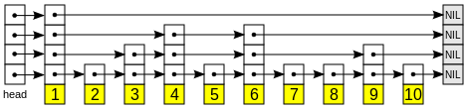
Tree-Based Address Mapping
Skip list
……
A probabilistically balanced tree. No complex balancing operations ➔ No locking for read-only operations.
Improves transaction throughput by 48.9% with four threads.
Notes:
The second optimization is using the skip list for the tree. A problem with a regular strictly balanced tree like a B-tree is that it requires complex tree balancing operations. As a result, every access to the tree has to hold a lock, which easily becomes the bottleneck.
In contrast, the skip list is a probabilistic tree structure without balancing operations. A skip list consists of several singly linked lists of nodes to form a tree structure. I don't go to details here but what we can achieve is lock-free lookup operations. Of course, you could choose other lock-free trees.
Anyway, our observation is that avoiding lock for very frequent lookup operations improves the transaction throughput by almost 50% with four threads.

Slide 17
Tree-Based Address Mapping
Group update
Within each transaction, all writes are first buffered in DRAM.
Writes with contiguous addresses are combined on transaction commit.
Improves transaction throughput by 42.3% on average.
Notes:
The third optimization is group update. When running a transaction, all writes are first buffered in DRAM, and sorted before transaction commit. Then contiguous writes are combined in order to reduce the number of tree node updates. This technique improves transaction throughput by over 42% on average.

Slide 18
Tree-Based Address Mapping
Hot tree node cache
A thread-local cache that references recently accessed nodes of the trees.
A special hash table design: Deliberately high collision.
Motivation: Addresses within a cached node are not hit due to random distribution of their hash values.
Solution: Use high-order bits of an address as its hash value.
Improves transaction throughput by 30.1% on average.
0xABB*
0xABC*
0xABD*
0xABC00 (size=24)
0xABCD0 (size=16)
? 0xABC08
Collison and found!
Notes:
Finally, the fourth optimization is hot tree node cache. It is a thread-local hash table that stores references to recently accessed tree nodes.
We make a special design for this hash table. Regularly, we don't want collision in a hash table. But in this case, we deliberately increase the collision. Recall the reason why we need a tree structure instead of a hash table for address mapping. It is the same problem here. Addresses nearby a cached address are not hit in a regular hash table.
So, we came up with a simple solution: use high-order bits of an address as its hash value. Nearby addresses of a cached address tend to be a collision and encounter the cached node.
Overall, the tree node cache improves transaction throughput by over 30% on average.

Slide 19
Outline
Motivation
Log-Structured NVMM
Tree-Based Address Mapping
Evaluation
Notes:
The last part of the talk is a quick view of the evaluation results.

Slide 20
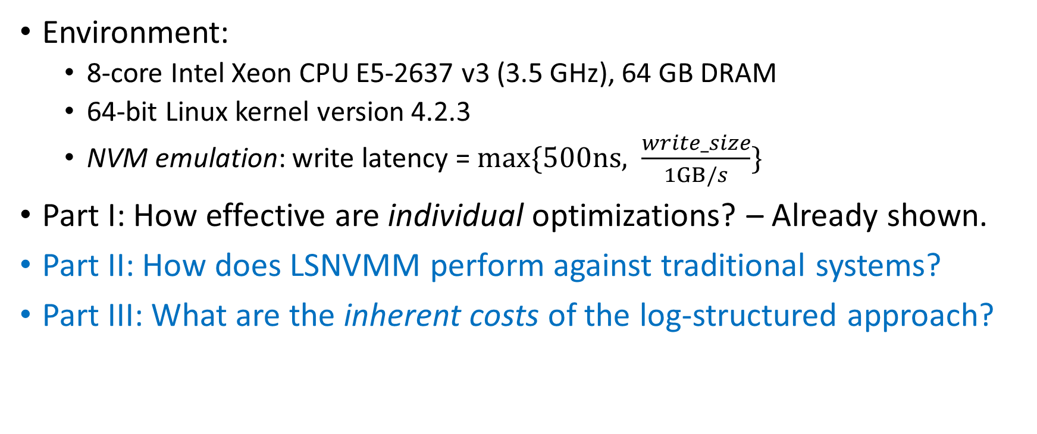
Evaluation
Environment:
8-core Intel Xeon CPU E5-2637 v3 (3.5 GHz), 64 GB DRAM
64-bit Linux kernel version 4.2.3
NVM emulation: write latency = $max⁡\{500ns, \frac{write_size}{1GB/s}\}$
Part I: How effective are individual optimizations? – Already shown.
Part II: How does LSNVMM perform against traditional systems?
Part III: What are the inherent costs of the log-structured approach?
Notes:
Our experiments are run on a regular server. The NVM is emulated by adding write latency to DRAM writes.
In previous slides, I already show how effective each optimization is. So, here we focus on how LSNVMM compare to other systems and what are inherent costs of the log-structured approach.

Slide 21
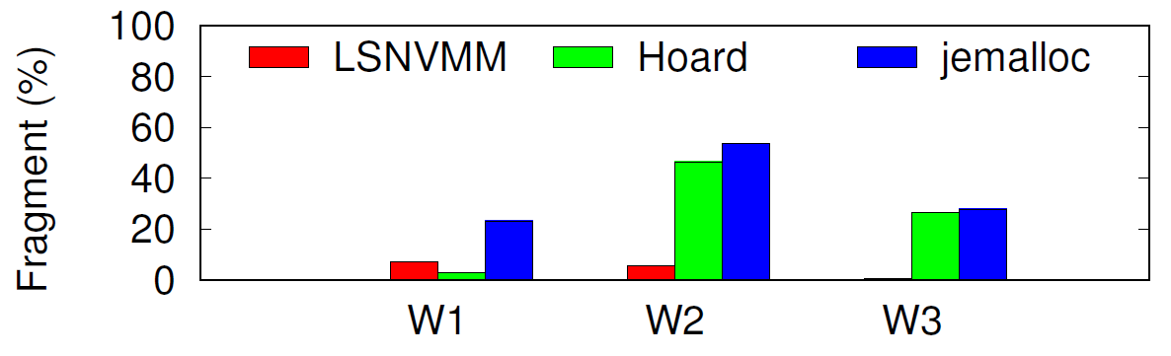
Evaluation
Fragmentation: Compared to Hoard and jemalloc
Workloads 1 ~ 3 collected from [S. Rumble, FAST ’14].
Hoard/jemalloc produces 25.3%/35.0% fragmentation on average.
Log-structured NVM (LSNVMM) produces 4.5% fragmentation on average.
Notes:
This slide shows fragment reduction. Hoard and jemalloc are two typical and widely used DRAM allocators. In various workloads collected from this RAMCloud paper, Hoard and jemalloc incurs 25% and 35% waste of memory on average, respectively. In contrast, NVM only produces 4.5% waste which is mainly due to the metadata we write in the log.

Slide 22
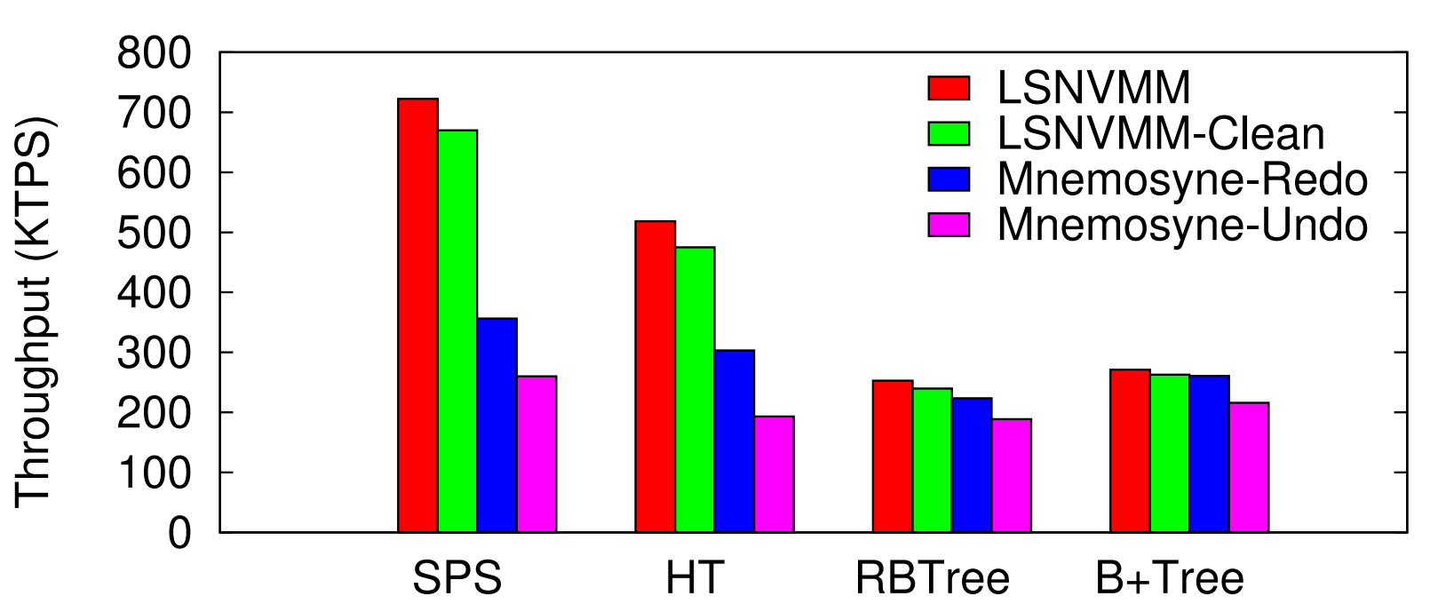
Evaluation
Transaction throughput compared to Mnemosyne
With 4 threads, log-structured NVMM performs 44.7% and 80.8% better than Mnemosyne and Mnemosyne-Undo, respectively, on average.
Notes:
In terms of transaction throughput, we compare LSNVMM to Mnemosyne and Mnemosyne-Undo. Mnemosyne is a state-of-the-art persistent memory system that uses redo logging. Mnemosyne-Undo is a variant of Mnemosyne using undo logging. We test them with various data structures. LSNVMM outperforms Mnemosyne and Mnemosyne-Undo by 45% and 80% on average, respectively.

Slide 23
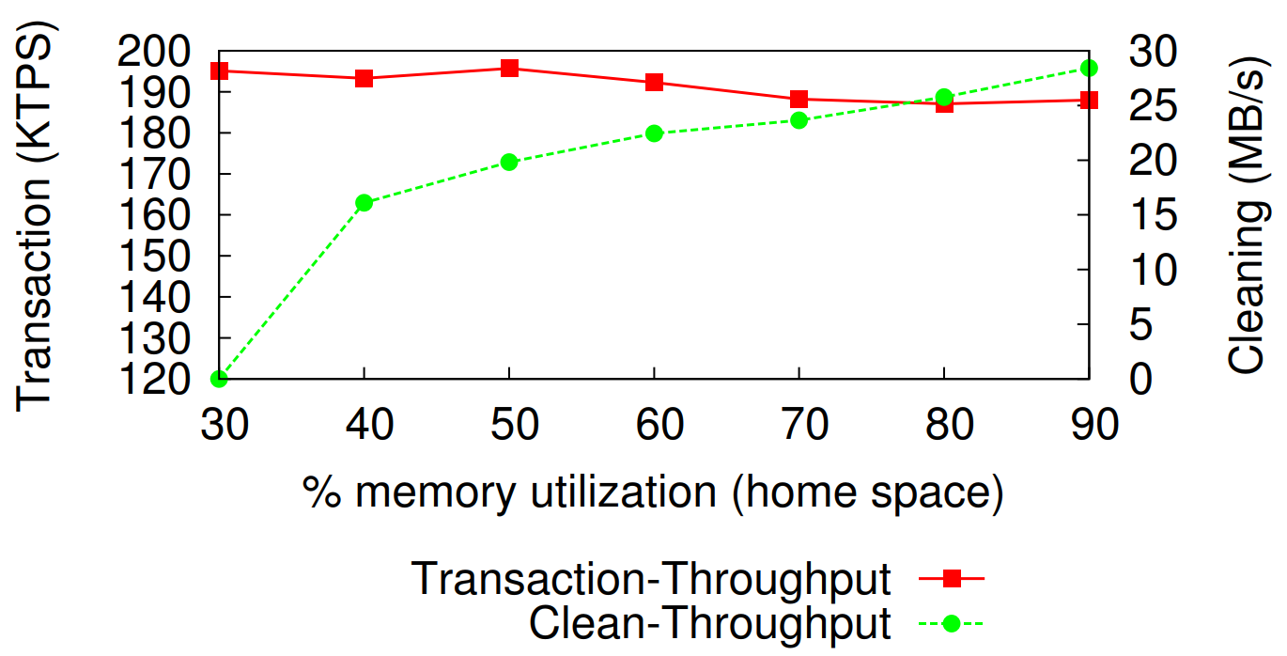
Evaluation
Cost of log cleaning
The performance degradation due to log cleaning is 8% at 90% memory utilization.
Notes:
Next we show the cost of log cleaning. In the figure, the x axis is the memory utilization. The left y axis is the transaction throughput, and the right y axis is the cleaning throughput. We run this experiment with a key-value store by inserting 128B values to the store. We can see that the performance degradation due to cleaning is only 8% even at 90% memory utilization.

Slide 24
Conclusion
Takeaway I: Applying the log-structured approach to NVMM can largely reduce memory fragmentation and improve system performance.
Takeaway II: A tree-based address mapping mechanism can be made efficient to serve log-structured NVMM.
Thank you!
Q & A
Notes:
In conclusion, I summarize two insights you may take away from this talk.

Slide 25
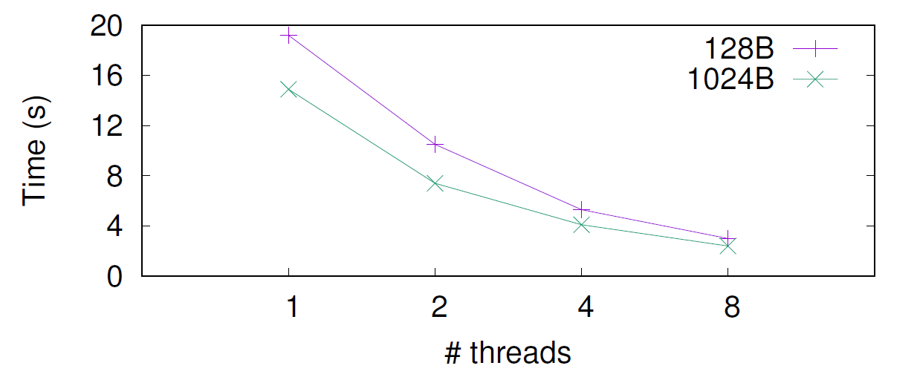
Backup
Recovery time (10GB logs)

Slide 26
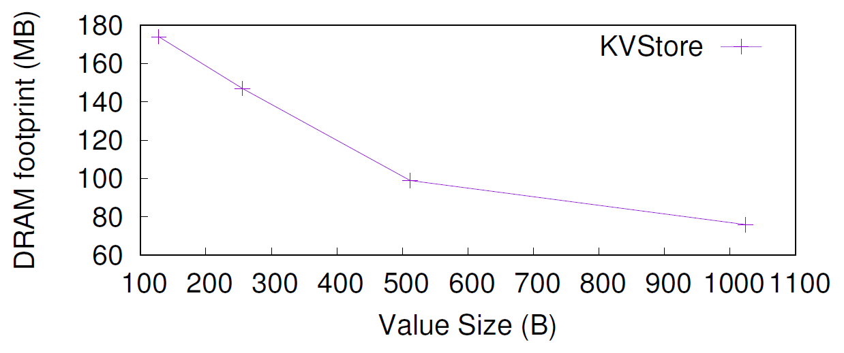
Backup
DRAM footprint (1GB data)

