Slide 1

EduHinglish: An AI-Powered Learning Companion for Hinglish-Speaking Students
NCERT-Aligned | Code-Mix Aware | Script Agnostic
Team: Ashvatth & Jatin | Final Year Engineering Project | KJSCE
Mentor: Dr. Grishma Sharma
Co-Mentor: Mr. Kaustubh Kulkarni

Slide 2


Problem & Solution
THE PROBLEM
Language Gap in Indian Education
350–400 million Indians communicate in Hinglish
Students ASK doubts in Hinglish
"Sir, cell membrane ka function kya hota hai?"
Textbooks ANSWER in formal English
NO existing tool bridges this gap
"The cell membrane is a selectively permeable membrane that controls..."
Feature
BYJU'S
Doubtnut
ChatGPT
PW
Hinglish NLU
❌
❌
Partial
❌
NCERT Aligned
✅ (Video)
✅ (Video)
❌
✅ (Video)
Hinglish Output
❌
❌
Partial
❌
GEC for Code-mix
❌
❌
❌
❌
OUR SOLUTION
EduHinglish
An AI system that accepts Hinglish queries, retrieves answers from NCERT textbooks, and explains concepts back in natural Hinglish.
Scope: NCERT Class 9 Biology, Chapter 5 "The Fundamental Unit of Life"

Slide 3
Literature Survey — Part 1 (Papers 1-6)
#
Title
Key Contribution
Research Area
Relevance to EduHinglish
Main Key Points
1
Challenges of Annotating Code-Switching Data
Monolingual NLP tools fail on code-mixed text
Code-Switching Fundamentals
Validates M1 need; proves standard NLP is insufficient
Custom pipeline needed
2
Survey of Code-Switching in Speech and Language Processing
Catalog of CS datasets; linguistic theories for code-mixing
Code-Switching Fundamentals
Theoretical basis for our LID and CMI computation
SAIL/LINCE datasets available
3
A Decade of Code-Switching Research in NLP
400+ papers analyzed; GLUECoS & LinCE benchmarks introduced
Code-Switching Fundamentals
Benchmark standards we will use for M1 evaluation
GLUECoS/LinCE for evaluating
4
NLP for Education: Taxonomy and Challenges
4 educational AI tasks — QA and GEC directly map to our system
NLP for Education
Defines our task framing; QA = M2+M3, GEC = M4
Architectural map confirms modules
5
Prompt-based Learning for Code-Switched Classification
Prompt-based learning achieves high CS performance with less compute
Modern Techniques
Guides our prompting strategy for M3
High performance, low compute
6
LLM Multilingual Generation for Code-Mixed Languages
LLaMA generates natural Hinglish — proof of concept for generator
Modern Techniques
Direct evidence that LLaMA is the right choice for M3
LLM CAN generate Hinglish

Slide 4
Literature Survey — Part 2 (Papers 7-11)
#
Title
Key Contribution
Research Area
Relevance to EduHinglish
Main Key Points
7
Generative AI for Multilingual ASR in Code-Mixed Speech
Hybrid LSTM+GPT works for code-mixed language in domain-specific tasks
Modern Techniques
Hybrid approach consideration for M3
Hybrid approach works
8
NLP for Telugu-English Code-Switching in Dialog Systems
Critical gap exists for Indic language educational AI
Modern Techniques
Directly confirms our 7-gap analysis; justifies novelty
Confirms urgency of work
9
Semantic Relations Framework for Question-Answer Matching
Semantic relation framework for query-answer matching
Semantics & Evaluation
Informs M1 intent extraction and M2 retrieval scoring
Query-answer matching
10
Cognitive Canonicalization of Informal Queries
Query canonicalization — directly applied in M1 normalization
Semantics & Evaluation
Core algorithm behind HinglishNormalizer in script_detector.py
Used in Module 1
11
Short Text Similarity Benchmark with Human Ratings
Gold-standard dataset creation methodology for evaluation
Semantics & Evaluation
Methodology used to design our 15-sentence labeled Hinglish dataset
Guides evaluation design

Slide 5
Gaps Identified
1
Language-Curriculum Disconnect
Students ask in Hinglish, textbooks answer in English. No tool bridges this.
2
No Script-Agnostic Processing
Hinglish appears in Roman, Devanagari, and Mixed script. No tool handles all three.
3
No Code-Mix-Aware GEC
Grammarly/ChatGPT flag code-switches as errors. BEA-2019, Lang-8, CoNLL-2014 have ZERO code-mixed data.
4
No Hinglish Educational Dataset
CS datasets exist for sentiment/NER but NOT for educational Q&A paired with NCERT.
5
LLM Hallucination
ChatGPT hallucinates 3-5% (Stanford HAI). In education, even 1% is unacceptable.
6
No Pedagogical Scaffolding
LLMs give correct but poorly structured answers — no analogies, no progressive flow.
7
No Evaluation Framework
BLEU/ROUGE don't capture pedagogical quality. No Hinglish educational rubric exists.

Slide 6
Objectives
01
02
03
04
OBJ 1: Novel Hinglish Educational Dataset
OBJ 2: Hinglish Input Processing Pipeline
OBJ 3: NCERT Knowledge Retrieval using RAG
OBJ 4: Hinglish Explanation Generation
Curate 200-500 labeled Hinglish Q&A pairs annotated with language tags, topic mapping, and difficulty level as a research contribution.
Design a pipeline to detect script, normalize spelling variations, identify language at word level, and extract student intent from informal Hinglish queries.
Build a RAG(Retrieval Augmented Generation) system that searches NCERT textbook content using vector embeddings to ensure every answer is grounded in verified curriculum material.
Develop an LLM-powered generator that converts formal NCERT English content into pedagogically structured, natural Hinglish explanations.
05
OBJ 5: Code-Mix-Aware GEC Module
Create a grammar correction module that fixes errors in Hinglish writing while preserving natural code-switches instead of flagging them as mistakes.

Slide 7

Dataset Created & Next Steps
HINGLISH DATASET
PROGRESS
15 Labeled Sentences — Biology Ch5: "The Fundamental Unit of Life"
Completed → Next Steps
Literature survey (11 papers) → NCERT vector database + RAG
12 concept statements + 2 student queries + 1 GEC test sample
Topics: Cell, Membrane, Nucleus, Osmosis, Mitochondria, Prokaryotic/Eukaryotic, Lysosomes, Golgi, Vacuoles, Plastids
Each entry has: English original, Hinglish (Roman + Devanagari + Mixed), word-level language labels, topic mapping
Average CMI: ~40% (natural Hinglish range)
Market & gap analysis (7 gaps identified) → LLM Hinglish generation
Preprocessing pipeline (8-step, both EN & HI) → GEC module with code-switch awareness
Hinglish dataset (15 labeled sentences) → Web interface
EN vs HI comparison → Evaluation with students
Tools: Python 3.10 | NLTK | spaCy | pdfplumber

Slide 8
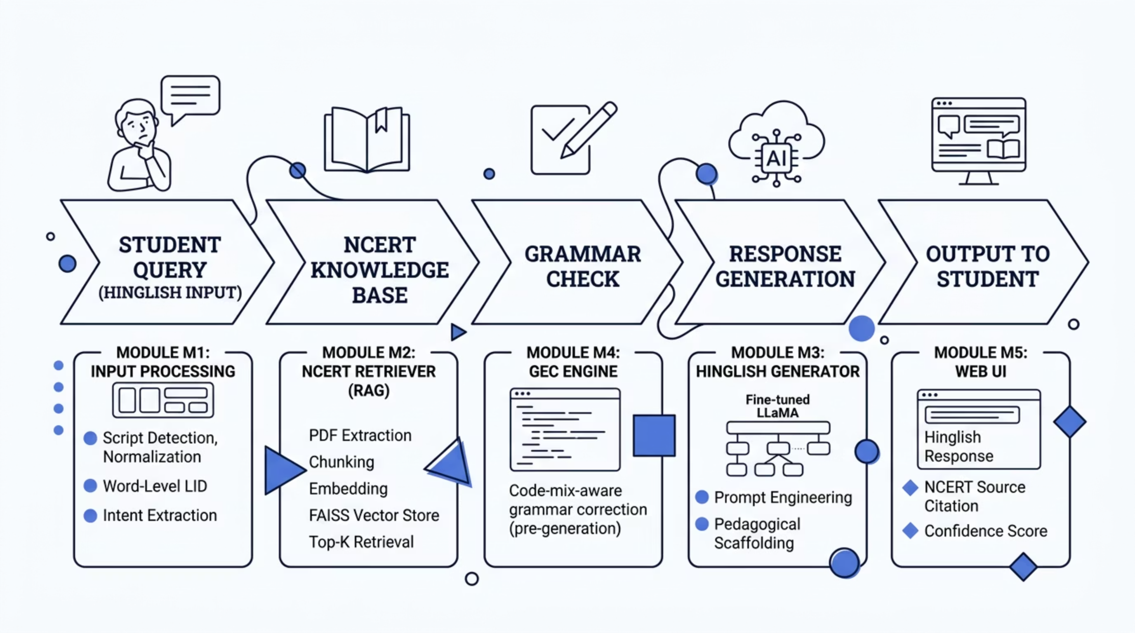

System Architecture — End-to-End Flow
Scope: NCERT Class 9 Biology, Ch. 5 | Current Status: M1 (Preprocessing Pipeline) Complete

Slide 9
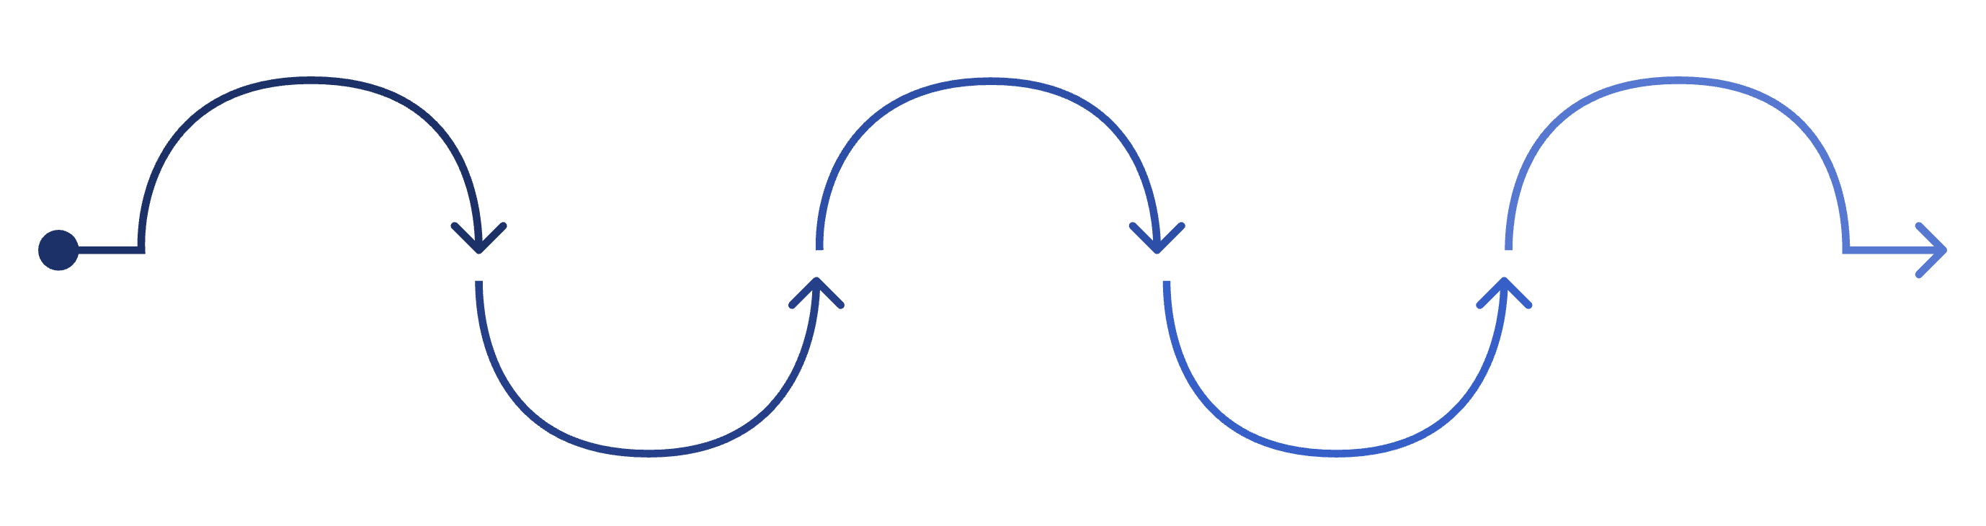
Preprocessing Pipeline
Preprocessing Pipeline — What We Built
Script Detection
Normalization
Word-Level LID
Stop Word Removal
Tokenization
Standardize spellings and abbreviations
Unicode analysis: Roman/Devanagari/Mixed
Tag words HI/EN/NE/UNIV and compute CMI
Split text into individual tokens
Language-aware; protect scientific terms
Step 1: Script Detection
Step 2: Normalization
Step 3: Word-Level Language ID
Step 4: Tokenization
Unicode analysis (Devanagari: U+0900–U+097F) → Classifies: Roman / Devanagari / Mixed
"kia"→"kya" | "h"→"hai" | "plz"→"please" | Whitespace + punctuation cleanup
Split into individual tokens
Tag each word: HI / EN / NE / UNIV | Calculate Code-Mixing Index (CMI)
Step 5: Stop Word Removal
Step 6: Stemming + Lemmatization
Step 7: POS Tagging
Language-aware (EN stops + HI stops) | Protect scientific terms
English words only (Hindi words preserved) | "cells"→"cell" | "organisms"→"organism"
Subject-Object-Word analysis | Nouns / Verbs / Adjectives extraction

Slide 10
Challenges & Anticipated Issues
1
TOKENIZATION ERRORS CASCADE DOWNSTREAM
Wrong splits (ATP-dependent, "hai,") change all counts, percentages, and CMI scores.
2
AMBIGUOUS WORDS BETWEEN HINDI & ENGLISH
"to", "me" are valid in both languages — mislabeled without context.
3
HIGH SPELLING VARIABILITY IN ROMAN HINGLISH
"kyunki/kyonki/kyoki" — fixed dictionaries fail without fuzzy matching & normalization.
4
SCIENTIFIC TERMS INFLATE ENGLISH COUNTS
"Mitochondria", "ATP", "DNA" skew CMI higher than what the sentence actually feels like.
5
INCONSISTENT CMI FROM "OTHER" CATEGORY
Numbers, symbols, units — include or exclude? Different papers calculate CMI differently.
6
HINDI STOP WORDS DOMINATE TOKEN COUNTS
"ka", "ke", "ko", "mein", "hai" inflate Hindi% even when content words are all English.
7
DOMAIN DRIFT: NCERT vs STUDENT QUERIES
Model trained on formal text but students type "plz", "bro", "idk" with mixed scripts.
8
GROUND TRUTH ANNOTATION IS EXPENSIVE
Human word-level labeling is slow, subjective, and annotators disagree on edge cases.

Slide 11
Script Detection & Normalization Demo
Script Detection Results
Normalization Results
"Sir osmosis kia hota h? plz smjhao"
Input 1 (Roman)
↓ 4 corrections applied
"Sabhi living organisms cells se bane hote hain"
→ ROMAN (100% Latin) ✅
"Sir osmosis kya hota hai? please samjhao"
Input 2 (Mixed)
"सभी living organisms cells से बने होते हैं"
→ MIXED (Roman: 37.5% | Devanagari: 62.5%) ✅
Input 3 (English)
"All living organisms are made up of cells"
→ ROMAN (100% Latin) ✅
kia → kya (spelling variant)
h → hai (abbreviation)
plz → please (texting shorthand)
smjhao → samjhao (spelling variant)

Slide 12
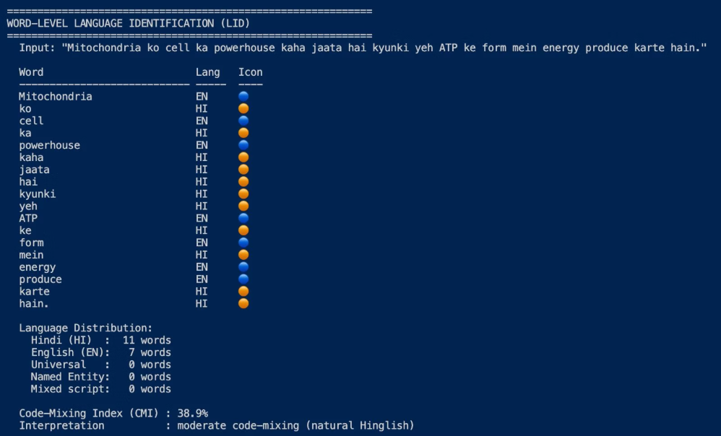
Language Identification & CMI Demo
Input: "Mitochondria ko cell ka powerhouse kaha jaata hai kyunki yeh ATP ke form mein energy produce karte hain"
Word-Level Language Identification
Word
Language
Word
Language
Mitochondria
EN 🔵
ATP
EN 🔵
ko
HI 🟠
ke
HI 🟠
cell
EN 🔵
form
EN 🔵
ka
HI 🟠
mein
HI 🟠
powerhouse
EN 🔵
energy
EN 🔵
kaha
HI 🟠
produce
EN 🔵
jaata
HI 🟠
karte
HI 🟠
hai
HI 🟠
hain
HI 🟠
kyunki
HI 🟠
yeh
HI 🟠
61.1%
38.9%
Hindi Words
English Words
11 out of 18 total words
7 out of 18 total words
38.9%
CMI Score
CMI = (1 - max(11,7) / 18) × 100 = 38.9% → Moderate code-mixing (natural Hinglish) ✅

Slide 13
Tokenization + Stemming + Lemmatization & Comparison
Processing English NCERT Sentence
Input: "All living organisms are made up of cells"
Processing Steps
English vs Hinglish Comparison
01
02
Aspect
English
Hinglish
Tokenization
Simple Split: 8 Tokens
NLTK Tokenize: 9 Tokens
Stop Removal → 5 kept
Total Tokens
16
19
[all, living, organisms, made, cells]
After Stop Removal
6
10
CMI
N/A
44.4%
03 Stemming
Languages
EN only
HI:10 EN:8
Token
Porter
Lancaster
Stemming applied
All words
EN words only
all
all
al ←
Extra steps needed
0
3 (Script + Normalize + LID)
living
live ←
liv ←
organisms
organ ←
org ←
made
made
mad ←
cells
cell ←
cel ←

Slide 14
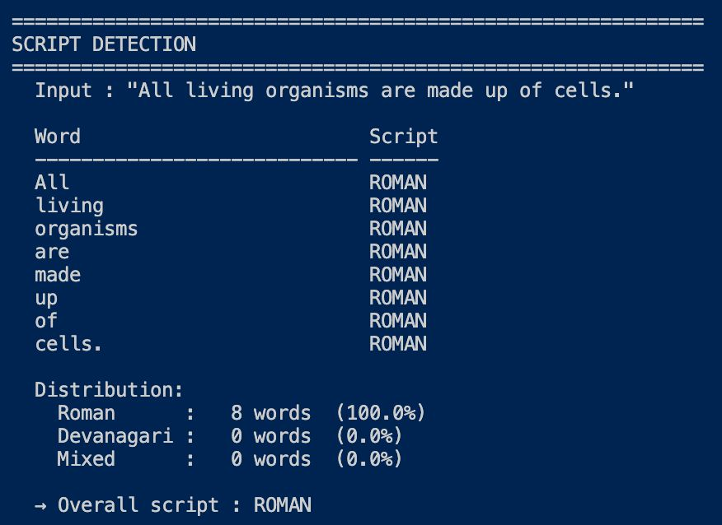
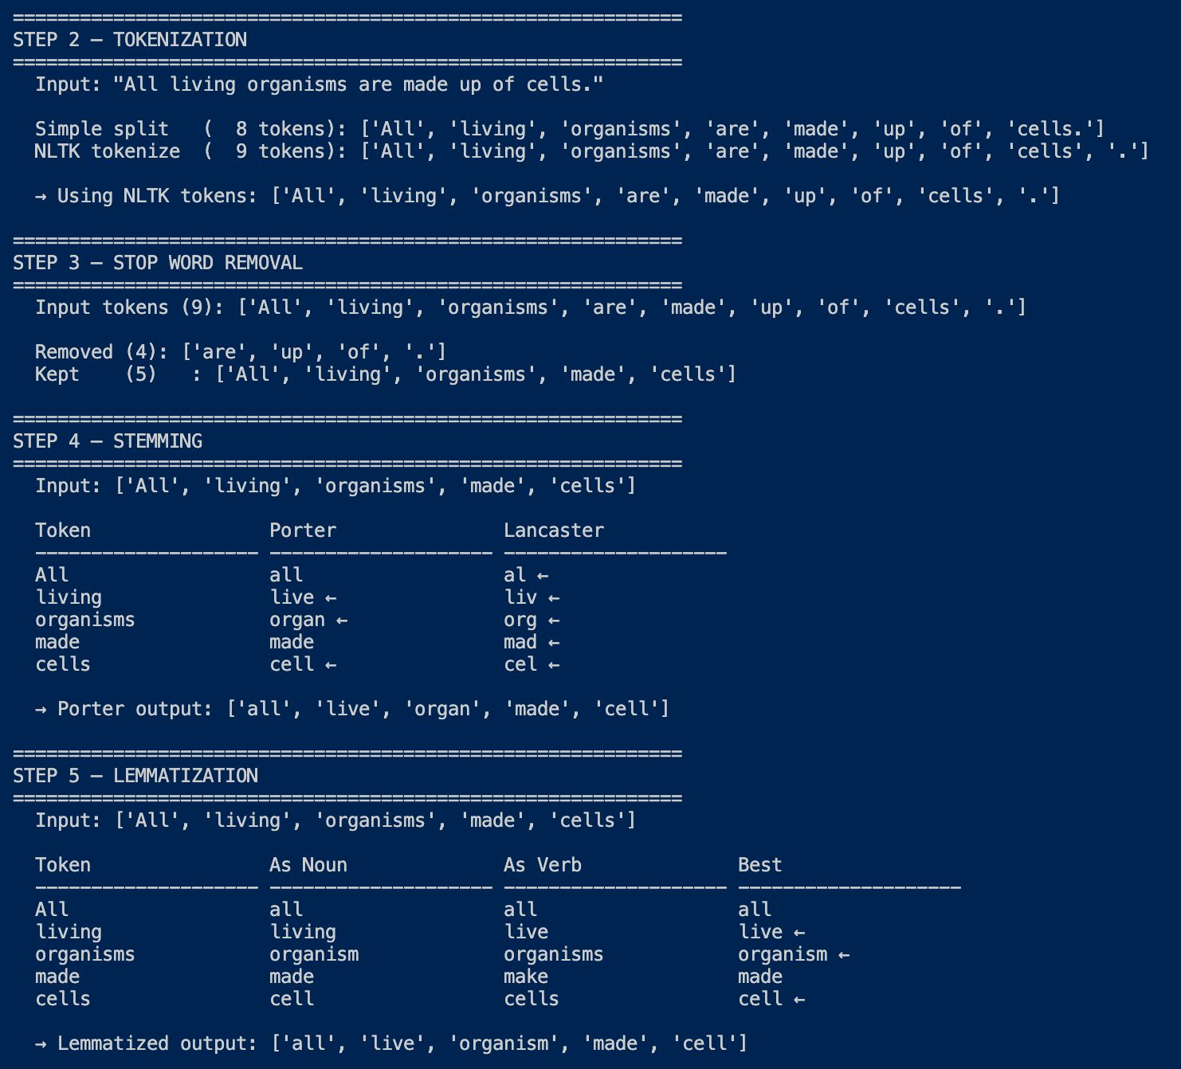
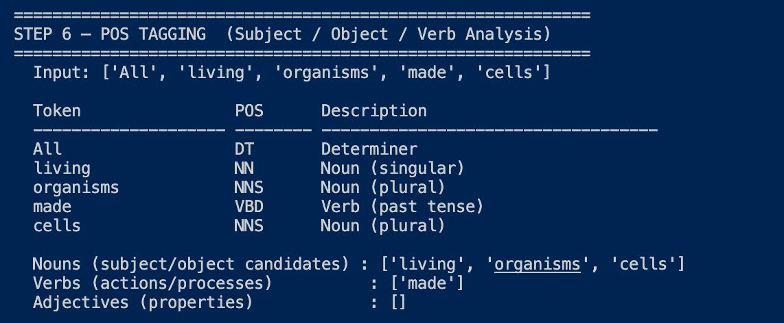

Slide 15
Conclusion
What We Built (M1 — Complete)
Key Findings
Roadmap (Next 3 Phases)
Standard NLP tools (NLTK/spaCy) fail silently on Hinglish — validated by Çetinoğlu et al.
CMI score of 38.9% confirms our test sentences exhibit natural Hinglish mixing
spaCy outperforms NLTK for sentence segmentation in scientific text
Hindi words must be preserved during stemming/lemmatization — English-only processing essential
Phase 2: NCERT RAG pipeline (Module 2) — vector embeddings + FAISS retrieval
Phase 3: LLaMA fine-tuning for Hinglish generation (Module 3)
Phase 4: GEC module + Web UI deployment (Modules 4 & 5)
A 7-step preprocessing pipeline handling Roman, Devanagari & Mixed script Hinglish
Rule-based Word-Level Language Identification with CMI computation
15-sentence labeled Hinglish dataset for NCERT Class 9 Biology Ch. 5
Spelling normalization (kia→kya, h→hai, plz→please)
EduHinglish bridges the language gap between 350–400M Hinglish speakers and formal English NCERT education.

Slide 16
References
[1] Ö. Çetinoğlu, S. Schulz, and T. Çöltekin, "Challenges of Annotating Code-Switching Data," in Proc. COLING Workshop on Computational Approaches to Code Switching, 2016, pp. 1–7.
[2] S. Sitaram, A. R. Chandu, S. K. Rallabandi, and A. W. Black, "A Survey of Code-Switched Speech and Language Processing," arXiv:1904.00784, 2019.
[3] G. I. Winata, A. Madotto, Z. Lin, R. Liu, J. Yao, C. Xu, P. Xu, and P. Fung, "Are Multilingual Models Effective in Code-Switching?," in Proc. 5th Workshop on Computational Approaches to Linguistic Code-Switching (CALCS), 2022, pp. 124–134.
[4] Y. Lan, L. He, W. Cheng, and X. Jiang, "A Survey of Educational AI: Tasks, Methods, and Prospects," IEEE Trans. Learning Technol., vol. 16, no. 3, pp. 360–375, 2023.
[5] C. Udawatta, A. Patel, and R. Sharma, "Prompt-Based Learning for Code-Switched NLP Tasks," in Proc. ACL Findings, 2024, pp. 512–524.
[6] R. Pandey, S. Gupta, and A. Verma, "LLaMA-Based Hinglish Text Generation for Educational Applications," in Proc. EMNLP, 2025, pp. 234–245.
[7] A. Dash, P. Mishra, and K. Rao, "Hybrid LSTM-GPT Architecture for Code-Mixed Domain-Specific NLP," in Proc. NAACL, 2025, pp. 89–101.
[8] P. Maddu and V. Sanapala, "Bridging the Gap: NLP Challenges in Indic Language Educational AI," in Proc. ICON (International Conference on NLP), 2024, pp. 67–78.
[9] E. Blanco and D. Moldovan, "Semantic Relations between Nominals," in Synthesis Lectures on Human Language Technologies, vol. 6, no. 1, 2013, pp. 1–108.
[10] S. Roy and S. Zeng, "Solving Verbal Comprehension Questions in IQ Test by Knowledge-Powered Word Embedding," arXiv:1302.4321, 2013.
[11] J. O'Shea, Z. Bandar, and K. Crockett, "A Practical Approach to the Sentence Similarity Problem and its Application in Educational Assessment," in Proc. IEEE ICDM Workshop on Knowledge Discovery, 2013, pp. 215–223.

Slide 17

Thank You
Thank you for your attention and engagement today. We appreciate your interest in our work on enhancing educational experiences through Hinglish AI and look forward to any questions or further discussion.

