Slide 1
Competition & Lecture Management System
System Prototype
SigmaGo
November 10, 2017

Slide 2
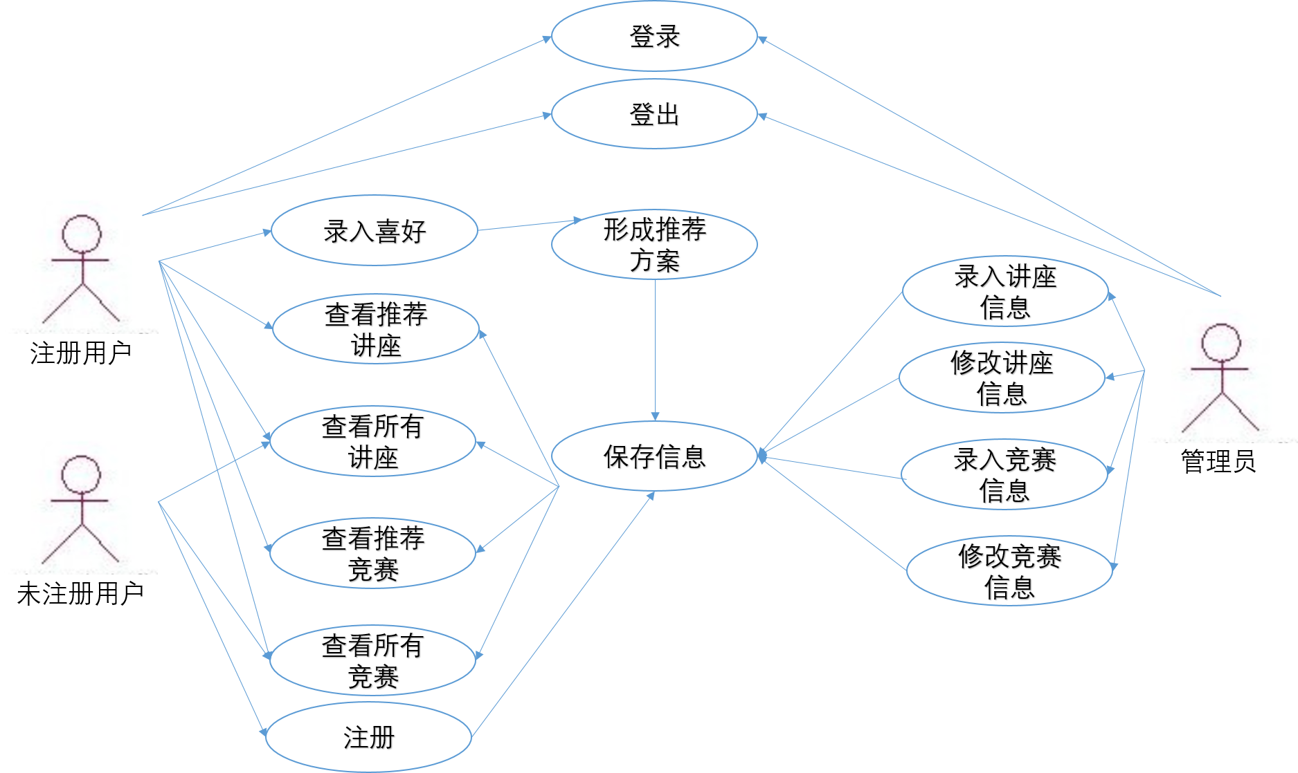
Use Case Diagram

Slide 3
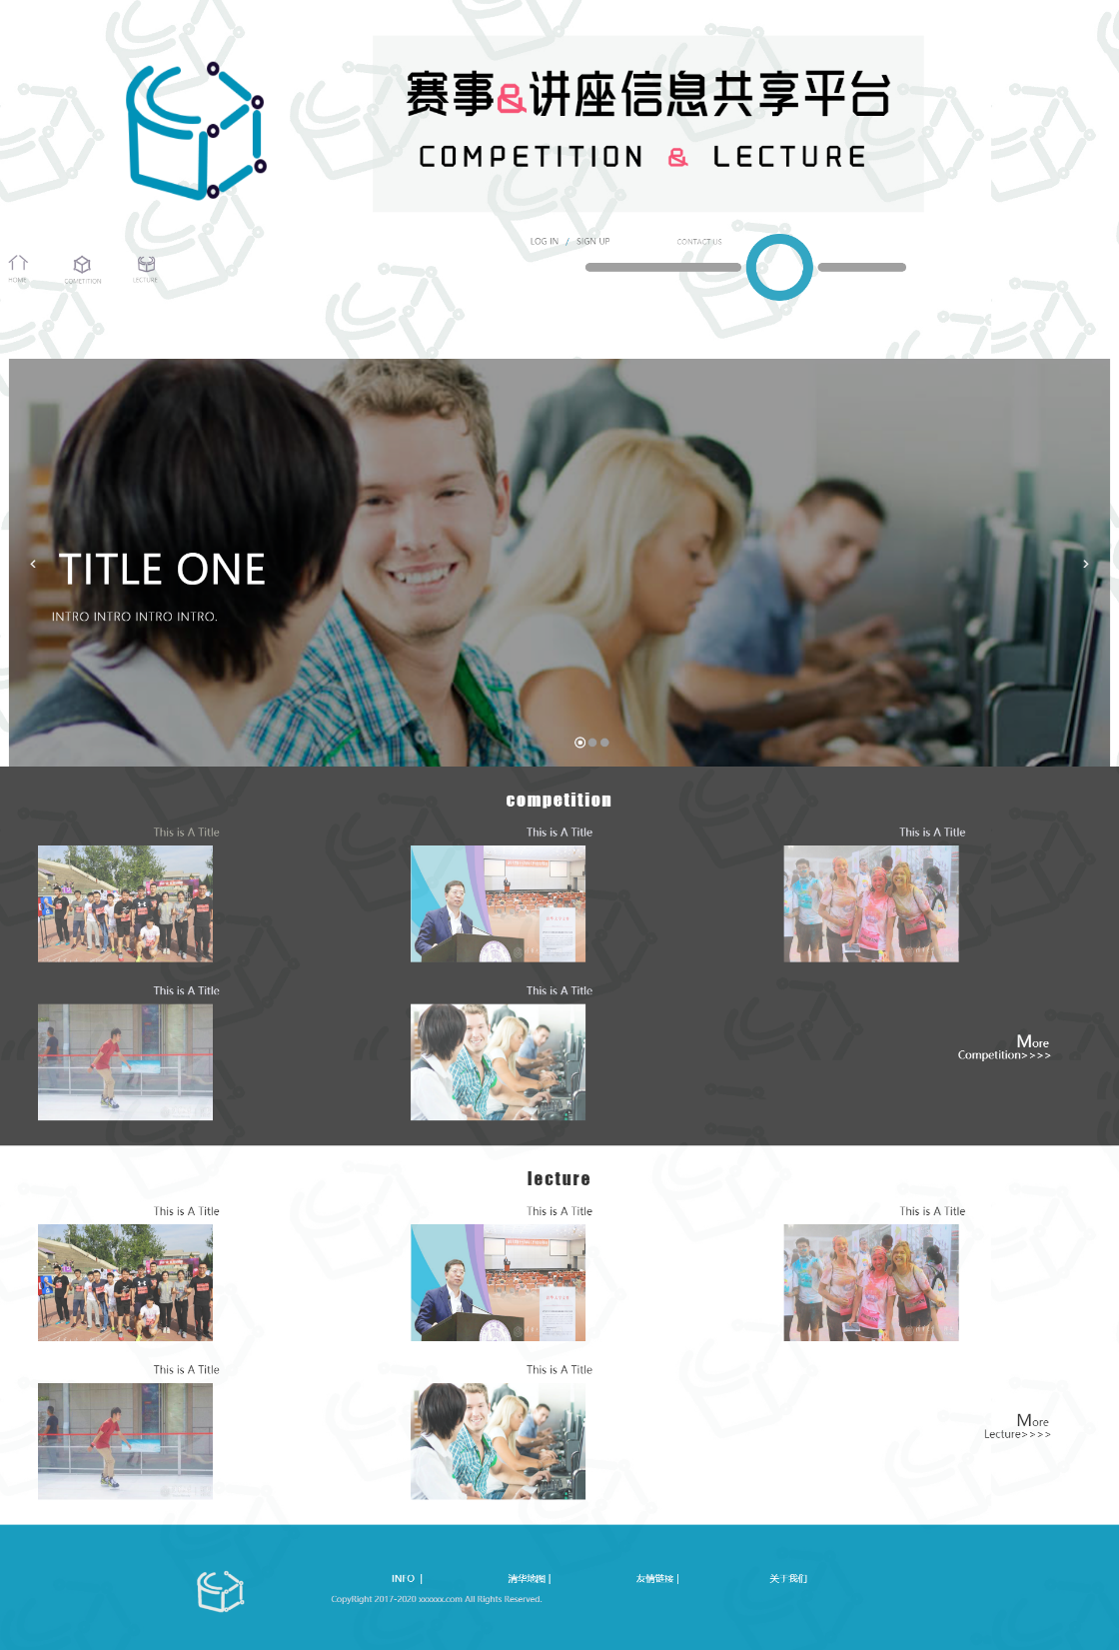
Home Page
Recent Activities
Competition Recommendations
Lecture Recommendations

Slide 4
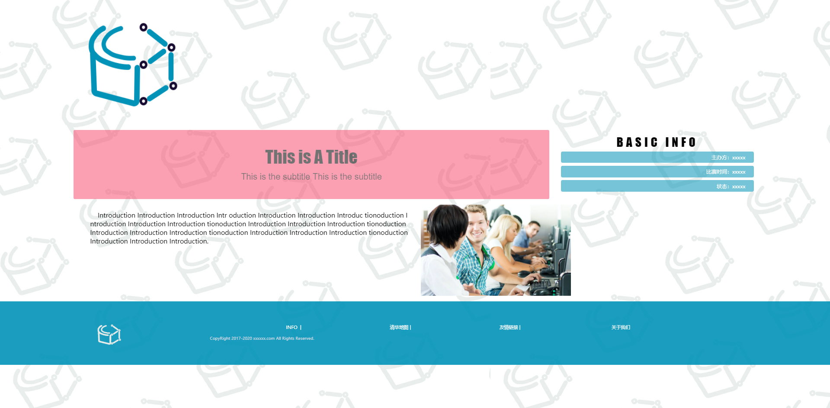
Single Page (Lecture or competition)

Slide 5
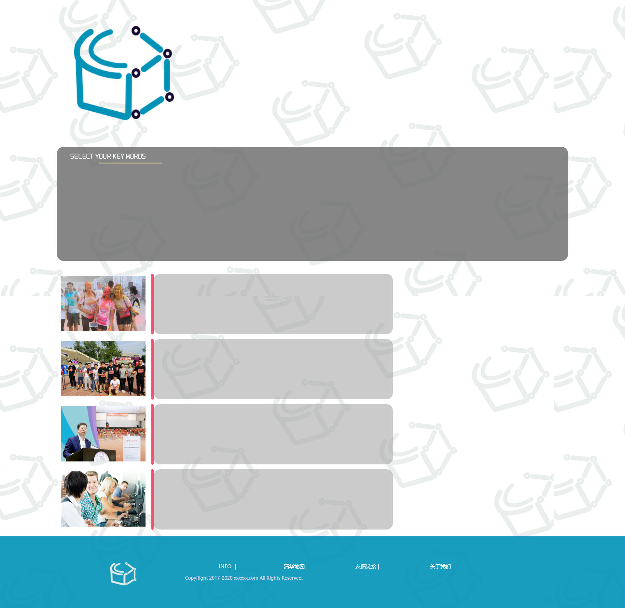
List Page
Title
Key Words
List

Slide 6
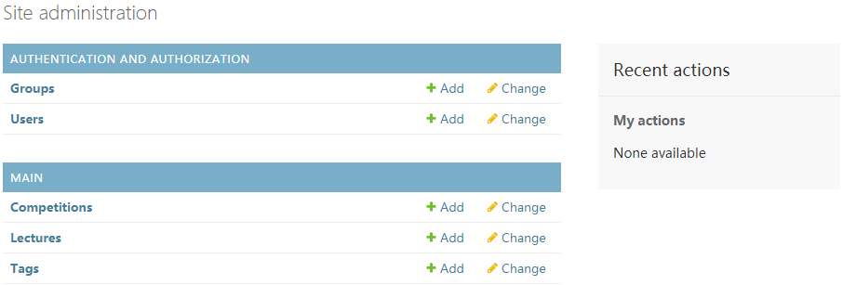
Back-end Management

Slide 7
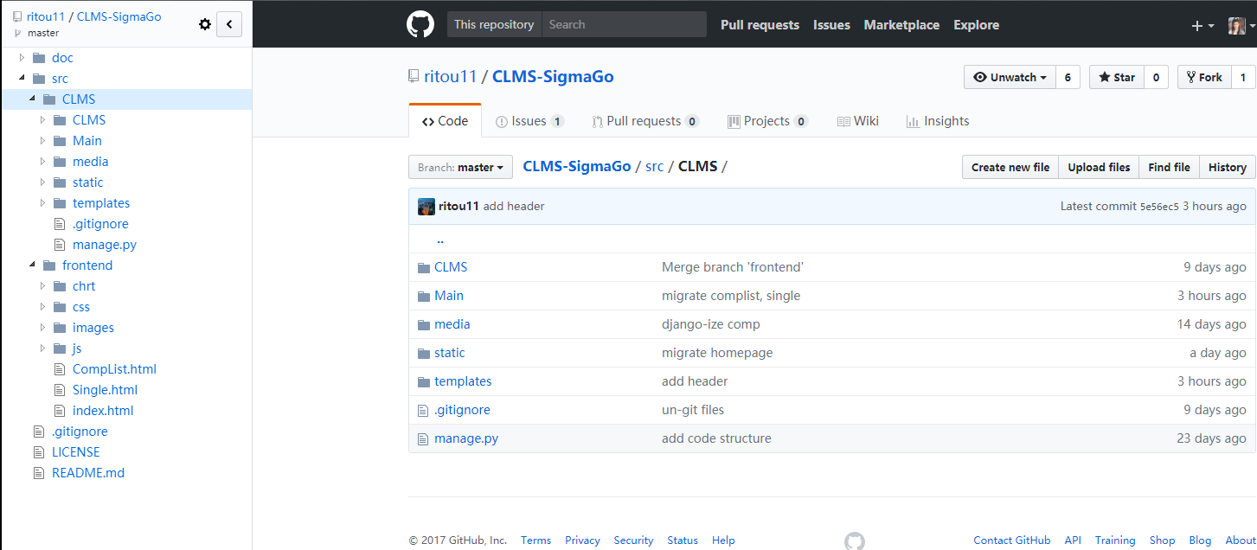
Version management

