Slide 1
Preprocessing and Layout Analysis for Offline Handwriting Recognition
東北大学大学院工学研究科
電子工学専攻川又研究室
Perttu Pitkänen

Slide 2
Overview
Handwriting recognition
Preprocessing
Stroke Width Analysis
Layout Analysis
Bounding Box Expansion
RLSA
Tests
Test Results
Conclusions
Remaining Problems
Future Work
Questions and Answers

Slide 3
Handwriting recognition 1
Offline handwriting recognition (HWR) is the process of extracting text in digital form from handwritten images.
Offline recognition process can be divided into three main phases:
Preprocessing
Feature extraction
Classification
Implementation done with MATLAB and its image processing toolbox

Slide 4
Handwriting recognition 2
Preprocessing
Image is enhanced for feature extraction phase and the detected characters are segmented from the original image.
Layout analysis can be considered to be a part of preprocessing.
Feature Extraction
Shape describing features are extracted from previously acquired objects (words).
Classification
Extracted features are used in machine learning algorithms to create the feature vector and to classify the inputs into word classes.

Slide 5
Preprocessing
Most of the preprocessing is same than previously
Image aquisition
Noise removal
Adaptive Wiener filter
Binarization
Sauvola algorithm
Object property analysis
Features such as holes in object, size, area or aspect ratio
Stroke width variation
All methods need pre-defined parameters!
Object property analysis now uses sroke width instead of other features.
Majority of methods proved to be useful in preprocessing.

Slide 6
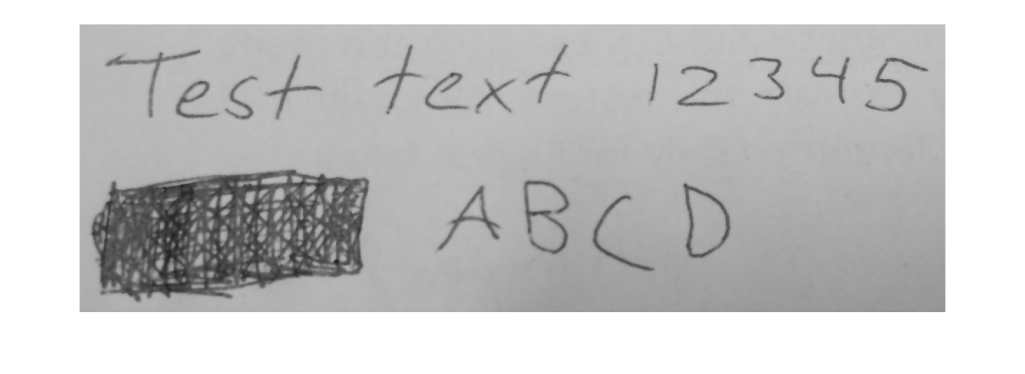
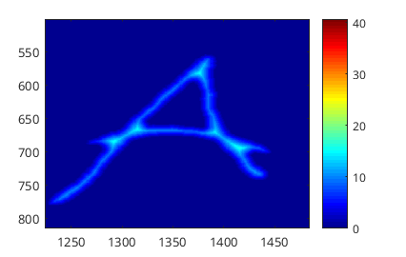
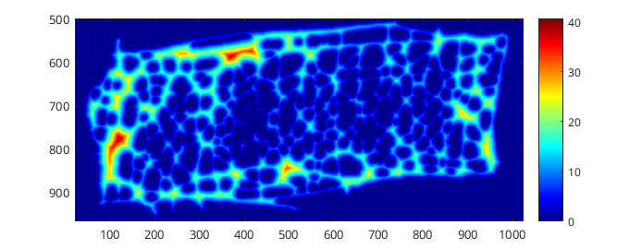
Stroke Width Analysis 1
One distinctive feature of text is that it consists of ”strokes”.
Strokes have only a little variation in thickness.
Other objects such as images can have lot of variation in thickness.
The amount of variation can be used to distinquish text from other objects.
Dark blue represents thin stroke width and dark red thick strokes.

Slide 7

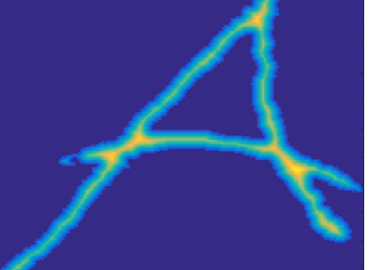
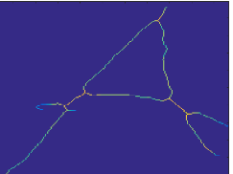
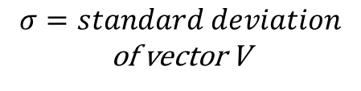
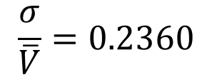

Stroke Width Analysis 2
Get image region
Distance transform
For each pixel find distance to nearest black pixel
Get image skeleton
Make one dimensional vector V which contains all distance transform values
V = [6.403, 8.5440, 6.4031, 8.0623, 5.6569, 7.2801,...]
Calculating stroke width metric to represent the width variation.
Standard deviation of V divided by the mean value of V.
$$\frac{σ}{\overline{V}}=0.2360$$
$σ=standard deviation$
of vector V
$$\overline{V}=mean of vector V$$
Remove areas which have stroke widith metric values larger than threshold.

Slide 8
Layout Analysis
Analysing the image regions to find where the text is located and what kind of bodies of text it contains.
Columns, rows, words.
Proposed method to find the areas of interest is to draw bounding boxes over the text objects, expand them in all directions and combine overlapping boxes.
Layout is saved hierarchically into areas of interest, rows and words.

Slide 9
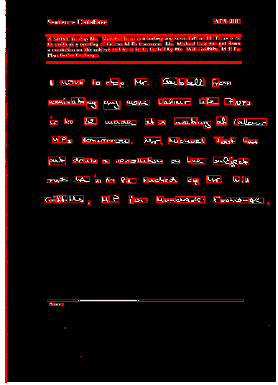
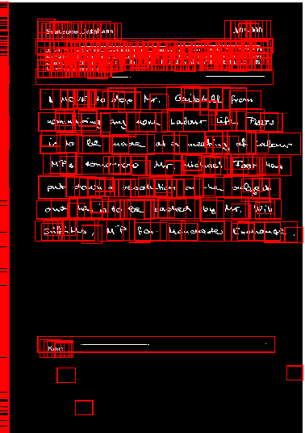
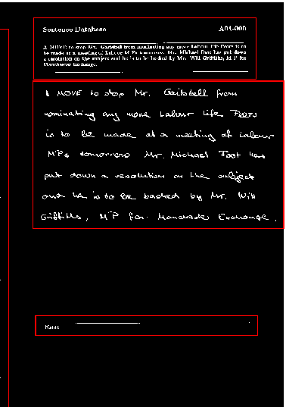
Bounding box expansion
In the last phase boxes that take only a small fraction of the total area are removed.
= Area of interest box

Slide 10
Layout Analysis 2
To find rows of text the run length smearing algorithm is used.
The RLSA finds rows of black pixels and changes them to white if their lengths are under given threshold.
The bounding box is aquired for each object generated by RLSA. These bounding boxes represent the rows.
The same method is used to find individual words within rows. For words the RLSA is executed also vertically. Smaller threshold values are used.

Slide 11
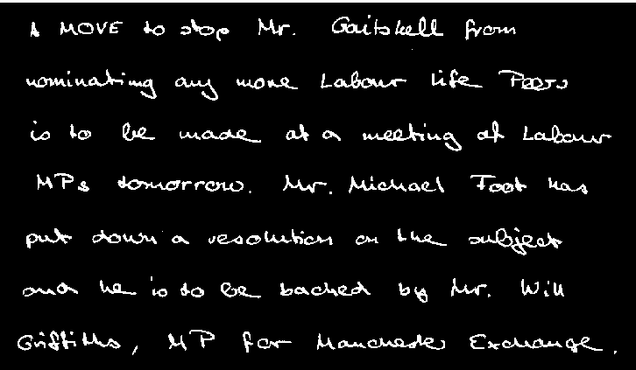
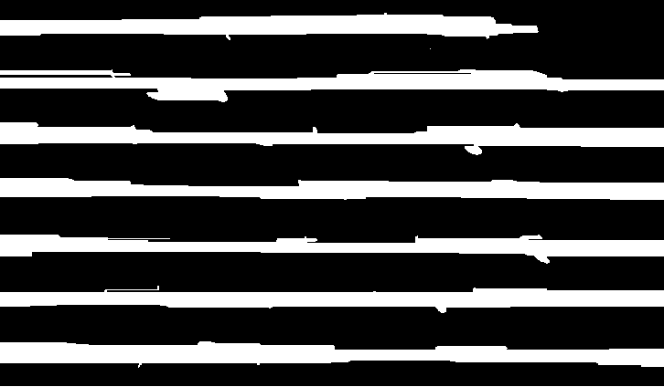
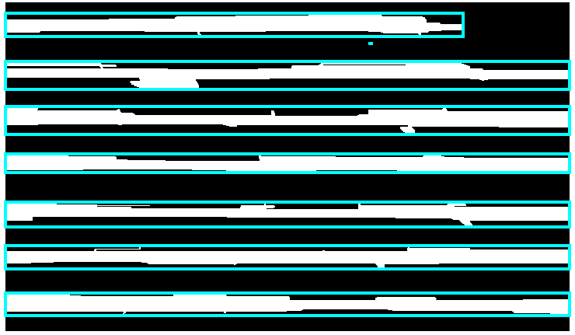
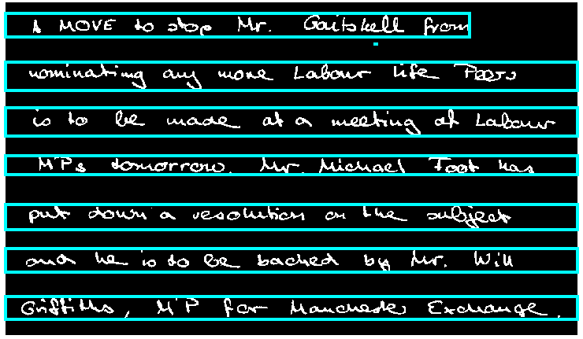
RLSA for rows
= Row box

Slide 12
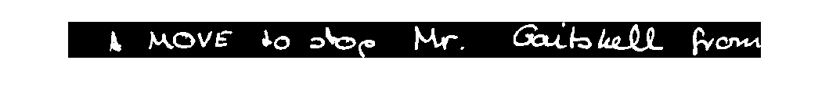
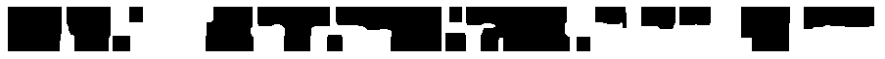
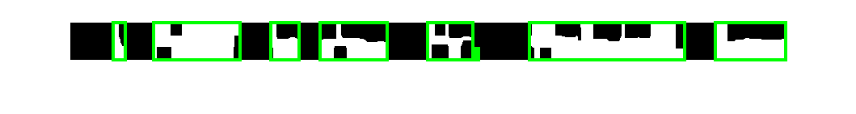
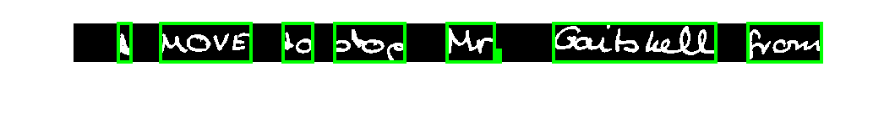
RLSA for words
= Word box
Same procedure but this time the algorithm is also run vertically to get dots or other broken characters into word.

Slide 13
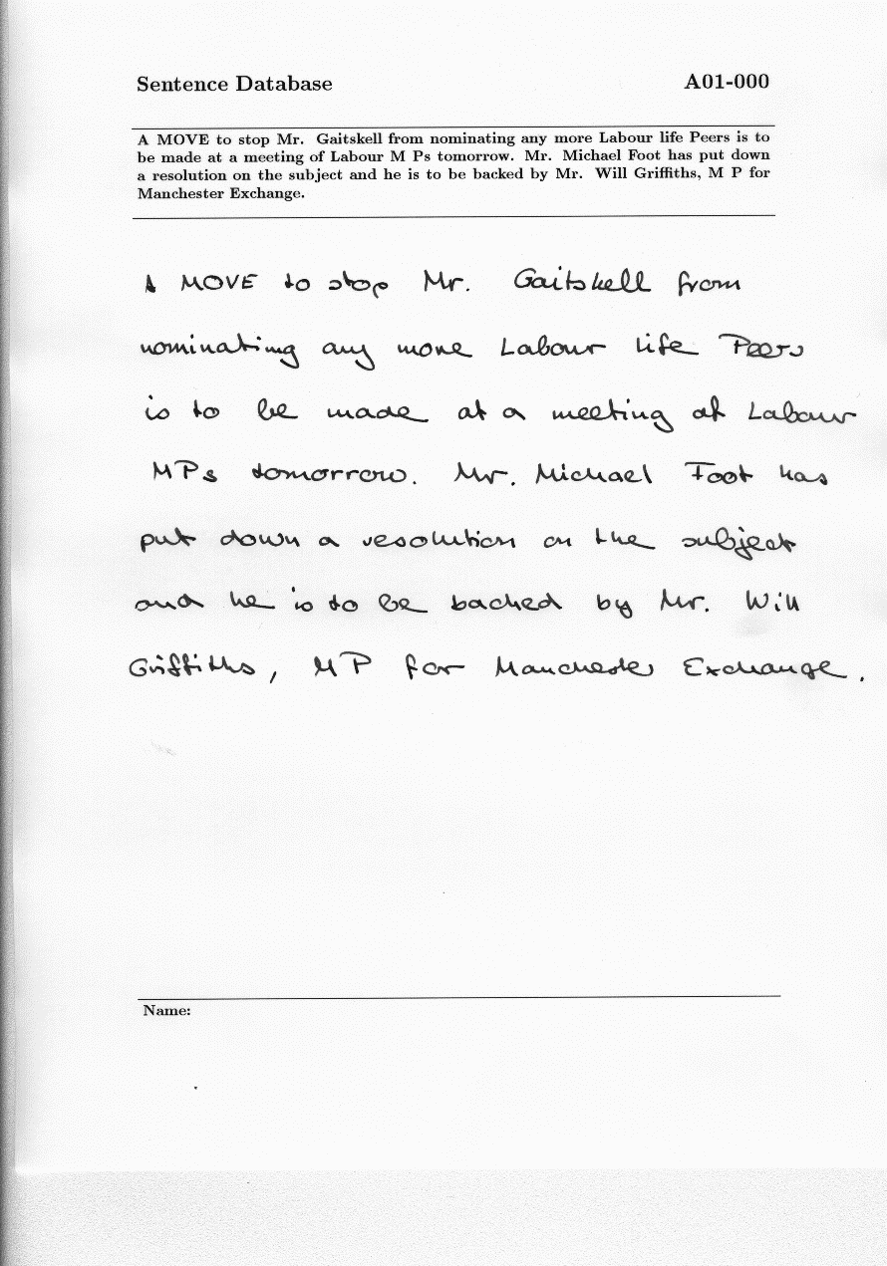
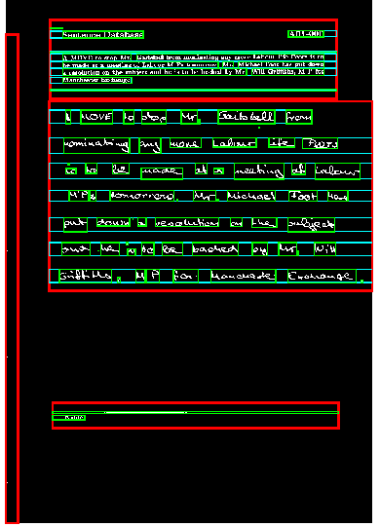
Full layout visualized
= Area of interest box
= Row box
= Word box

Slide 14
Tests
The system is still dependant on the parameter values.
The tests goal is to find the optimal threshold values for IAM database images.
First the optimal parameter values are found and then the accuracy is tested with these parameters.
How to evaluate the accuracy of the system mathematically?
IAM database contains metadata about the number of rows and words.
Compare the real values to those detected by the system.

Slide 15

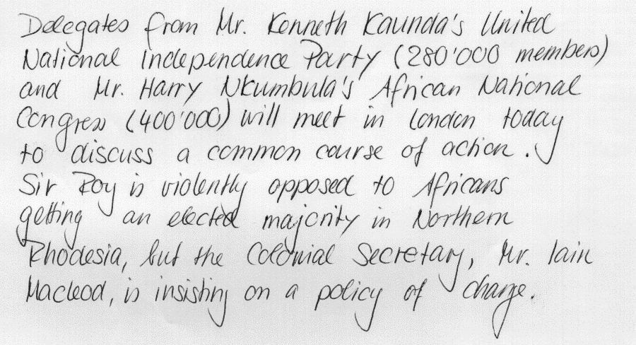
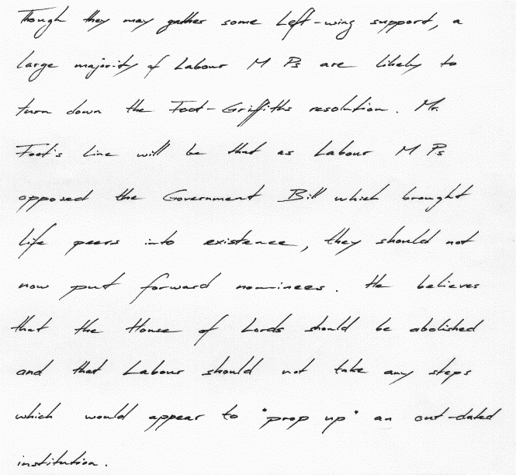
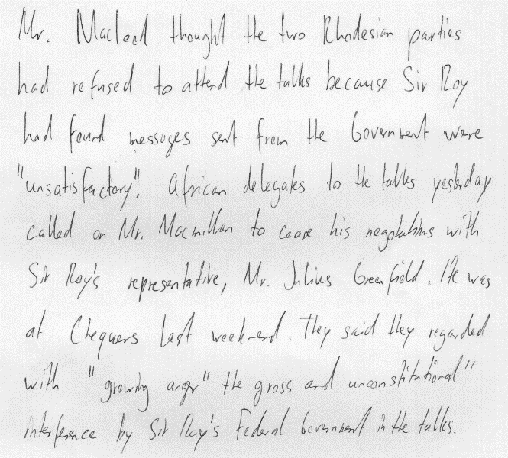
Example entries in IAM handwriting database.
Only the handwritten part was used during the tests.

Slide 16
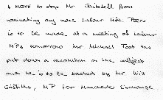
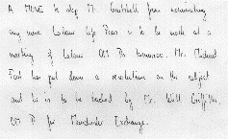
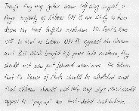
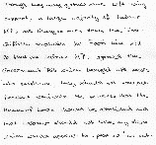
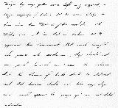
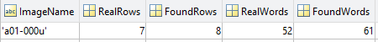
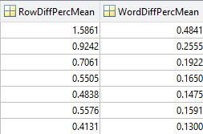
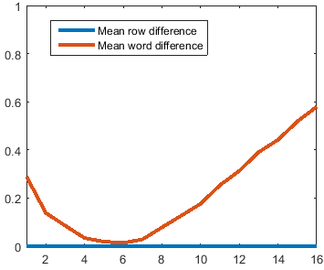
Test procedure to find optimal parameters
5 different handwriting samples and their metadata
numberOfRows = 7
numberOfWords = 52
Iterate through a list of tested values
testValues = [0,0.1,0.2,0.3,0.4,0.5,0.6,0.7,0.8,0.9,1];
With each iteration run the preprocessing and layout analysis for each image
for testedValue in testValues:
for image in images:
result = preprocess(image,testedValue);
end
end
Apply optimal value and choose next tested parameter
Get the number of detected rows and words
Get the percentage of difference compared to real values
Get the mean difference among the images for each tested parameter value
Visualize results and find the optimal value

Slide 17
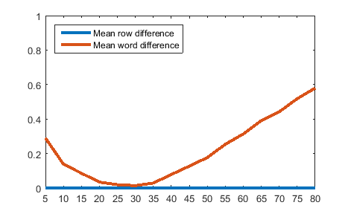
Example of test data
Result data for RLSA horizontal threshold test.
Lowest difference is aquired with threshold 30.

Slide 18
Test results
Preprocessing parameters:
wienerFilterSize = 15
sauvolaNeighbourhoodSize = 180
sauvolaThreshold = 0.3
strokeWidthThreshold = 0.6
Layout analysis parameters:
aoiXExpansionAmount = 40
aoiYExpansionAmount = 60
rlsaRowThreshold = 300
rlsaWordHorizontalThreshold = 30
rlsaWordVerticalThreshold = 30
With above parameters the system achieved following performance:
Number of images | Row detection accuracy | Word detection accuracy
5 | 100% | 98%
10 | 92% | 82%
15 | 92% | 85%
20 | 92% | 86%
25 | 92% | 85%

Slide 19
Conclusions
The chosen methods proved to be useful in preprocessing and layout analysis.
The tests proved that the chosen parameters work well for IAM database images.
Word detection is slightly more sensitive about parameter changes than the row detection.

Slide 20
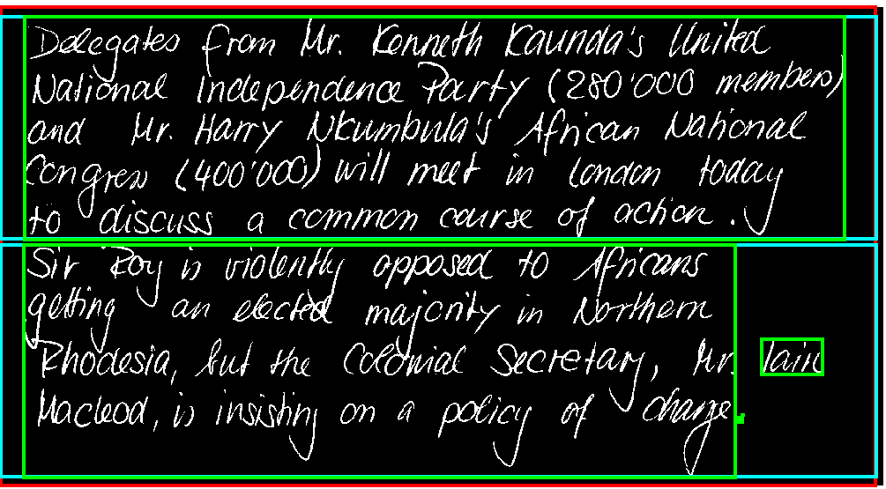
Remaining problems
The row and word detection isn’t perfect
If two rows contain overlapping characters those rows are combined as one.
For the same reason multiple words can also be combined as one.
= Area of interest box
= Row box
= Word box
Result: 2 rows and 5 words
Real values: 9 rows and 68 words

Slide 21
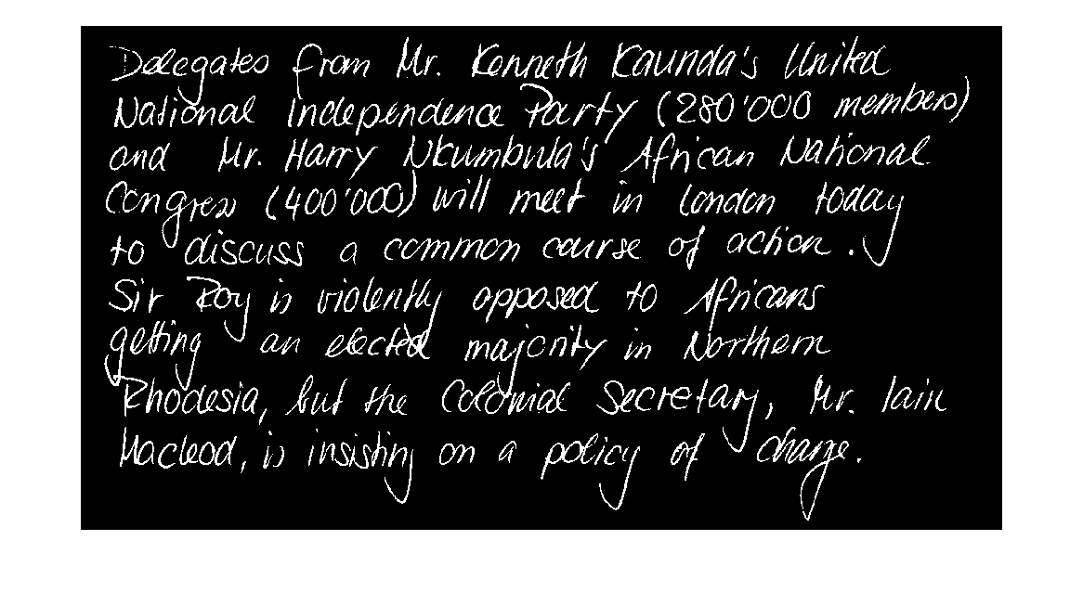
Remaining problems: Overlapping characters
= Real word box (unrealized)

Slide 22
Future work
Solve the overlapping rows/words problem.
Some papers have been published regarding this problem. More research is needed.
Automatic parameter choosing.
Use some mathematical properties such as object area or size to choose appropriate parameter value for some functions.
Average object area → RLSA threshold?
Continue to feature extraction phase.

Slide 23
Questions and Answers 1
Presentation time:
Presentation: 19:10
Questions: 19:40
Okubo: (p.19) The accuracy of your proposed method is 92%. Is the error occurring only for the picture like in p.19?
The error can occur for multiple reasons. One reason is overlapping characters such as in p.19 and p.20 which are then combined into fewer large objects. Other reason can be broken characters/words which can make the word/row count higher than the real values.
Okubo: (p.16) Please use vector image when you put a figure on the slide from MATLAB to avoid low resolution.
I will remember this for the next presentation.

Slide 24
Questions and Answers 2
Kenya: You used the thickness information for text detection. Is the method better than your previous method? What is better than previous method? Accuracy or processing time? Comparing between the methods may show us interesting result.
I chose the thickness method because the previous methods based on area, aspect ratio, number of holes etc. were highly dependent on various parameters and were sensitive to change. The new method, on the other hand, only needs one threshold value and is more robust with varying text size. Mainly the motivation was to reduce the amount constant parameters in the system. I didn’t compare the processing time at this point nor did I made any other accuracy tests between these two approaches. I concede that it would have been appropriate to compare these two approaches before choosing one or another.

Slide 25
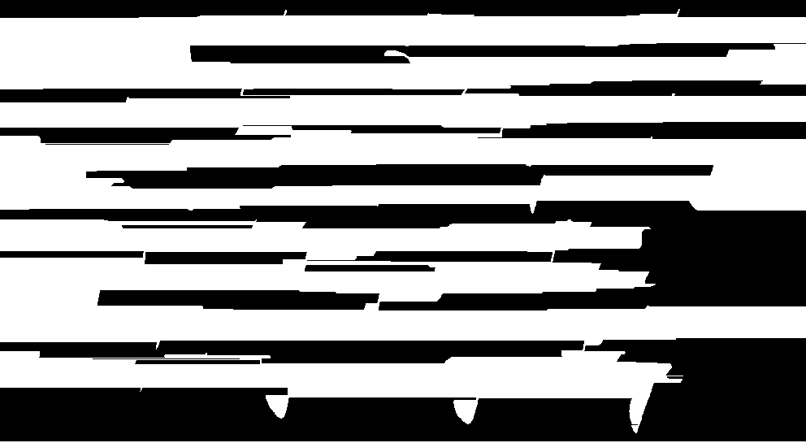
Questions and Answers 3
Konta: (p.19) Can you show the result of RSLA?
I did not have the image at the time of presentation. Here it is now.

Slide 26
Questions and Answers 4
Konta: How about detecting a long black line existing on the horizontal direction? This line could be the line that is dividing the row of the text and useful for avoiding the row box miss detection.
(Note: I must have misunderstood this question at the time of presentation) The suggestion would be one good method to detect rows. I need to put more research into the subject of overlapping characters and some papers have been published considering this subject.

Slide 27
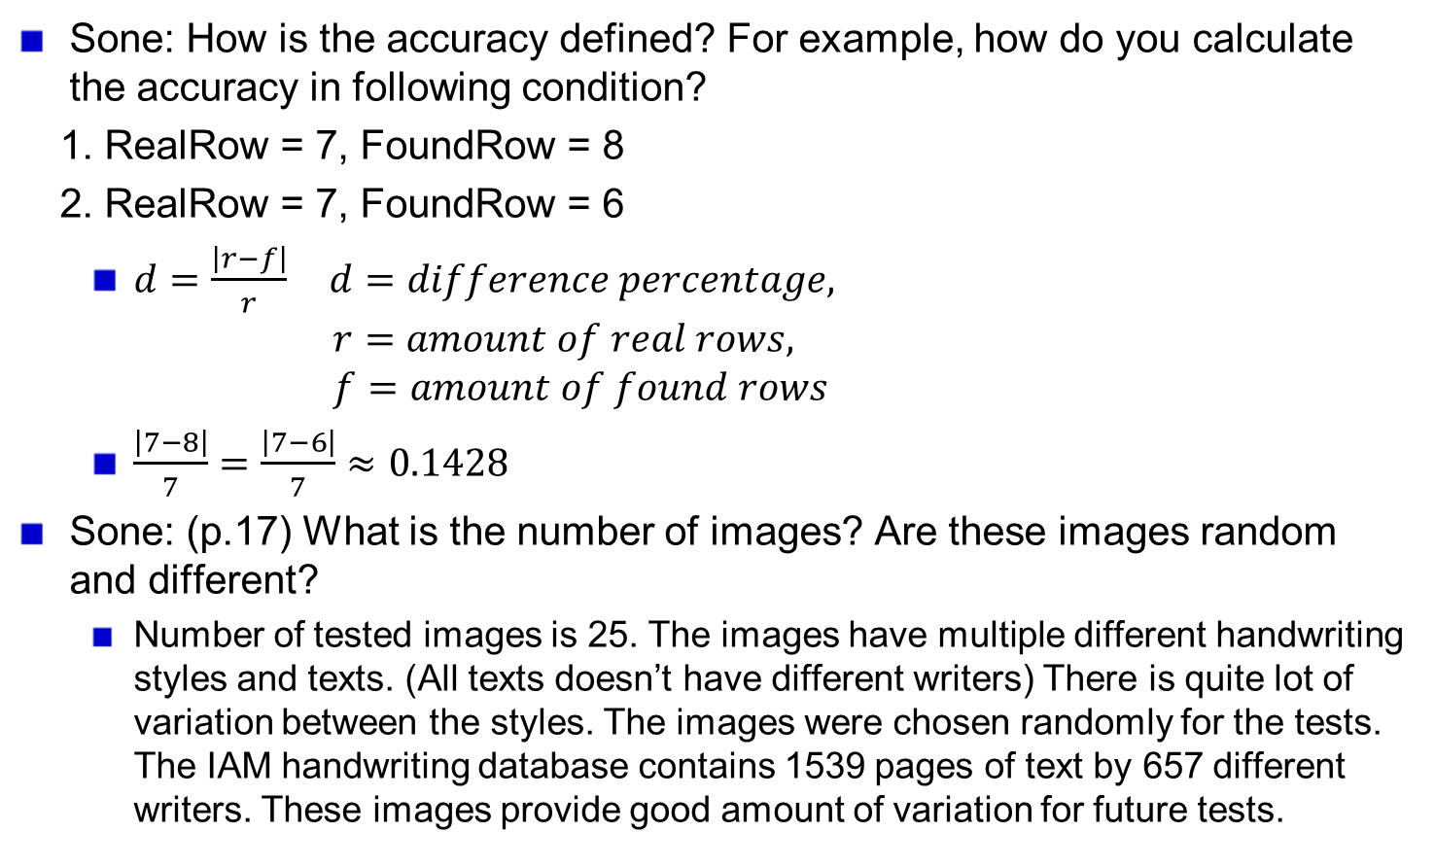
Questions and Answers 5
Sone: How is the accuracy defined? For example, how do you calculate the accuracy in following condition?
1. RealRow = 7, FoundRow = 8
2. RealRow = 7, FoundRow = 6
$d=\frac{\left|r−f\right|}{r} d=difference percentage,$ $r=amount of real rows,$ $f=amount of found rows$
$\frac{\left|7−8\right|}{7}=\frac{\left|7−6\right|}{7}≈0.1428$
Sone: (p.17) What is the number of images? Are these images random and different?
Number of tested images is 25. The images have multiple different handwriting styles and texts. (All texts doesn’t have different writers) There is quite lot of variation between the styles. The images were chosen randomly for the tests. The IAM handwriting database contains 1539 pages of text by 657 different writers. These images provide good amount of variation for future tests.

Slide 28
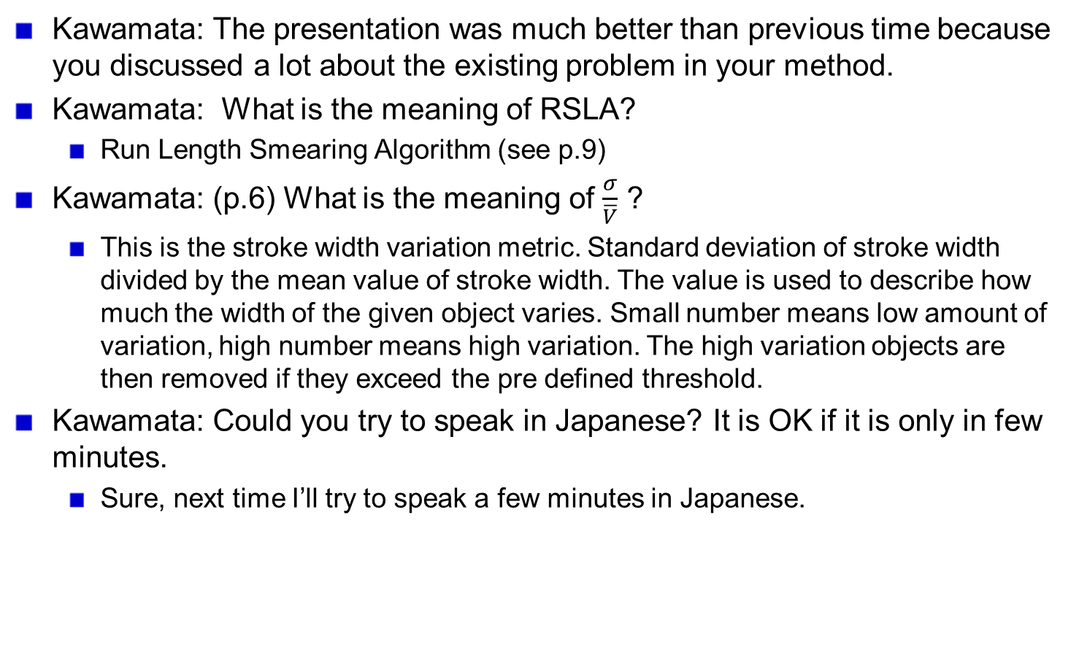
Questions and Answers 6
Kawamata: The presentation was much better than previous time because you discussed a lot about the existing problem in your method.
Kawamata: What is the meaning of RSLA?
Run Length Smearing Algorithm (see p.9)
Kawamata: (p.6) What is the meaning of $\frac{σ}{\overline{V}}$ ?
This is the stroke width variation metric. Standard deviation of stroke width divided by the mean value of stroke width. The value is used to describe how much the width of the given object varies. Small number means low amount of variation, high number means high variation. The high variation objects are then removed if they exceed the pre defined threshold.
Kawamata: Could you try to speak in Japanese? It is OK if it is only in few minutes.
Sure, next time I’ll try to speak a few minutes in Japanese.

