Slide 1
Block Based Hough Transform Mapping for Offline Handwriting Recognition 手書き文字認識に向けた ブロックベースハフ変換マッピング
東北大学大学院工学研究科
電子工学専攻川又研究室
Perttu Pitkänen

Slide 2
アウトライン
オフライン手書き文字認識について
ブロックベースハフ変換マッピング
部分集合
ハフ変換マッピング
部分集合 2 & 3
追加の制約と手法について
実験
実験の結果
まとめ

Slide 3
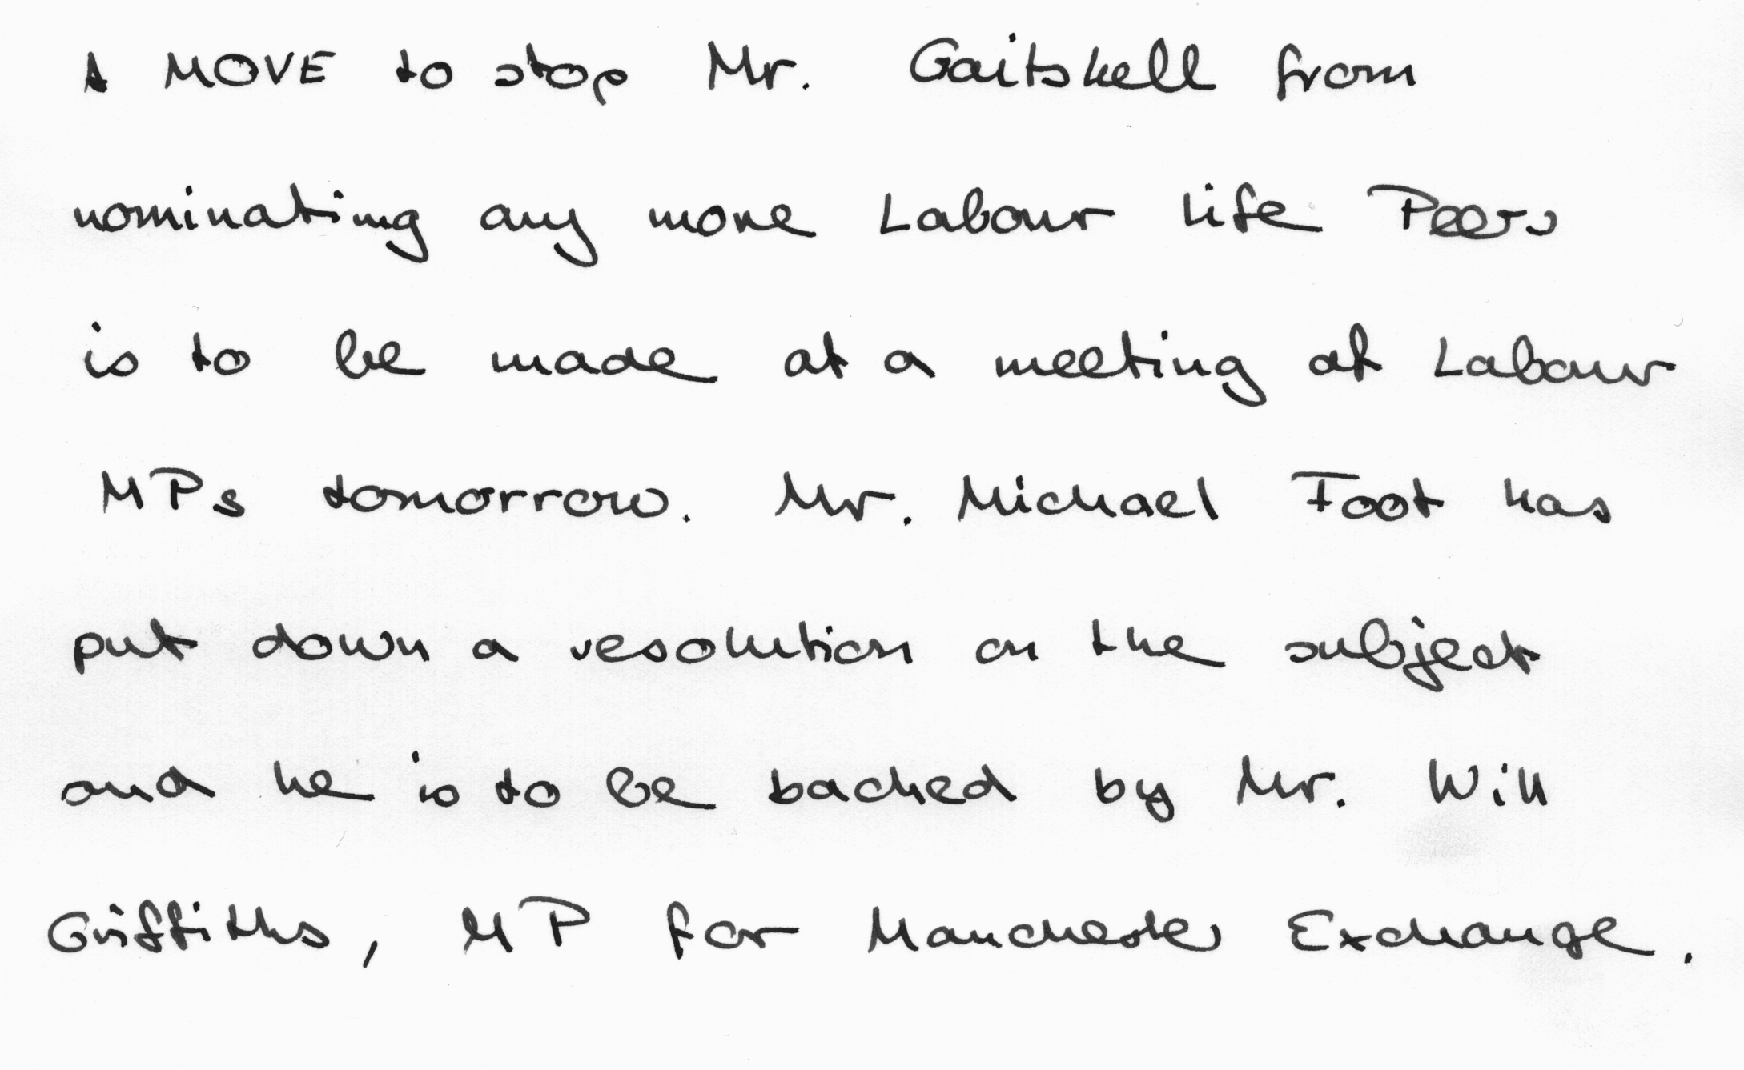

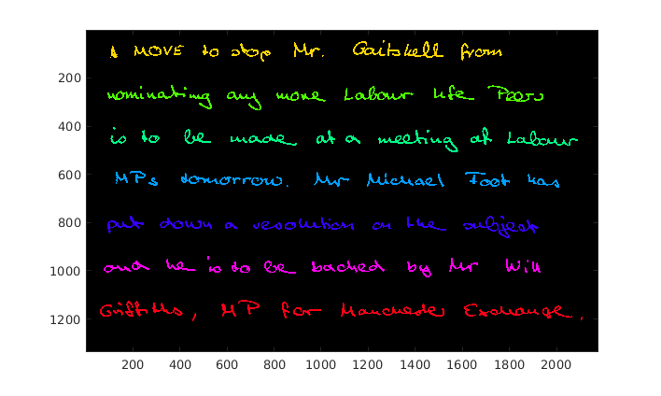
オフライン手書き文字認識
オフライン手書き文字認識とは，手書き文字の画像からコンピュータが識別可能なテキストデータを抽出する処理である．
入力画像
プリプロセッシング
研究対象
レイアウト解析
特徴抽出
分類
テキストデータ

Slide 4
Offline Handwriting Recognition
The goal of pre-processing is to provide high quality binarized image by applying filters and binarization to it.
Layout analysis aims to locate the text from image excluding images and figures.
Feature extraction gathers numerical data of the word or character shape.
Classification utilizes feature data and uses machine learning approaches to recognize which word or character current input is.

Slide 5
Review
Previously implemented features:
Pre-Processing:
Noise removal
Binarization
Layout analysis
Stroke width analysis
RLSA (Run Length Smearing Algorithm)
Current pre-processing methods and stroke width analysis works well.
Line detection needed better method than RLSA.
Most important problem was to implement a good way to detect handwritten lines even when text lines overlap.

Slide 6
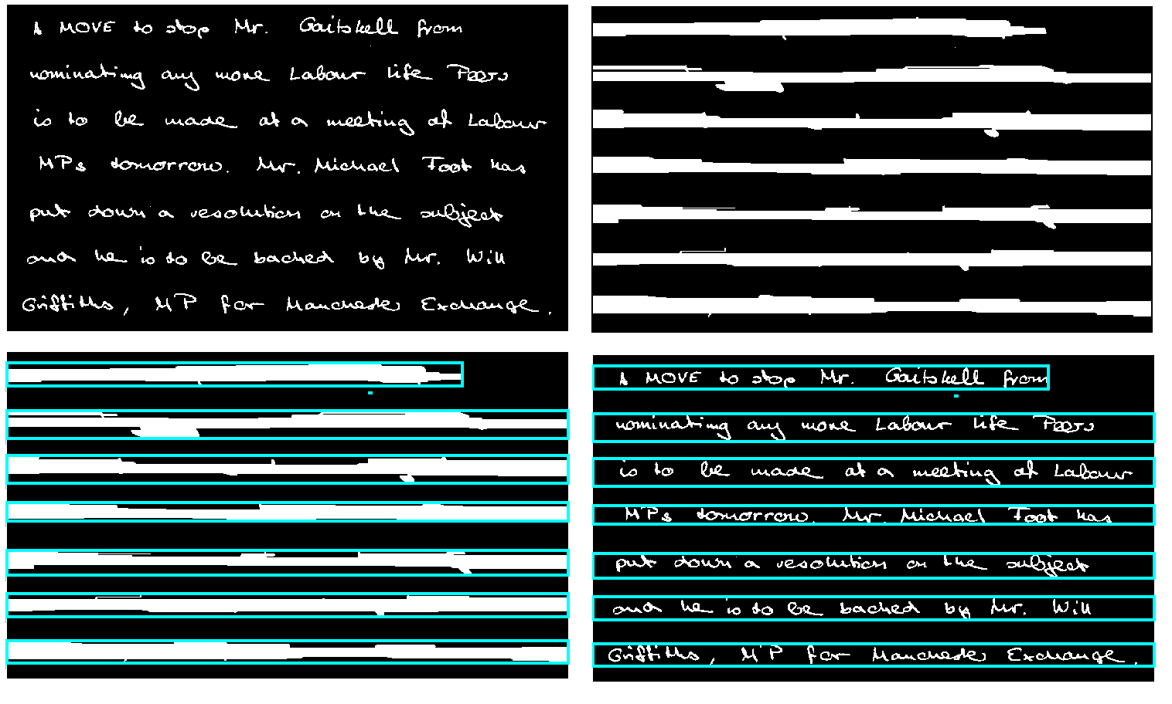
Run Length Smearing Algorithm
Zero pixels in between two one pixels are set to one if their distance smaller than chosen threshold

Slide 7
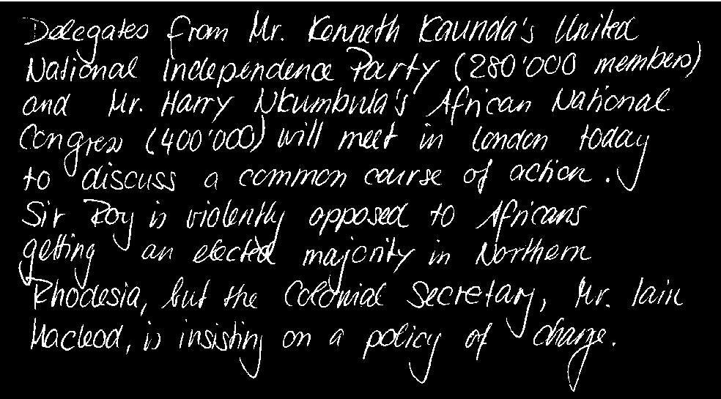

Problem with RLSA
Run Length Smearing Algorithm was wery fast and could detect lines and words if they were completely separated and the handwriting had very clear layout.
With overlapping lines or lines with skew the RLSA could not detect lines correctly
More sophisticated approach was needed.
Only 2 ”lines” detected

Slide 8
Block Based Hough Transform Mapping
Method proposed by Louloudis et.al. To detect handwritten text lines and words from images.
+ Especially designed for handwritten text.
+ Can detect lines with some variation in skew.
+ Can segment overlapping characters.
+ Outperforms other line detection methods.
- Can natively detect only single column data.
- No open source implementation available.
- Complex methods → Relatively slow execution time.
The method was implemented in MATLAB for this research.

Slide 9
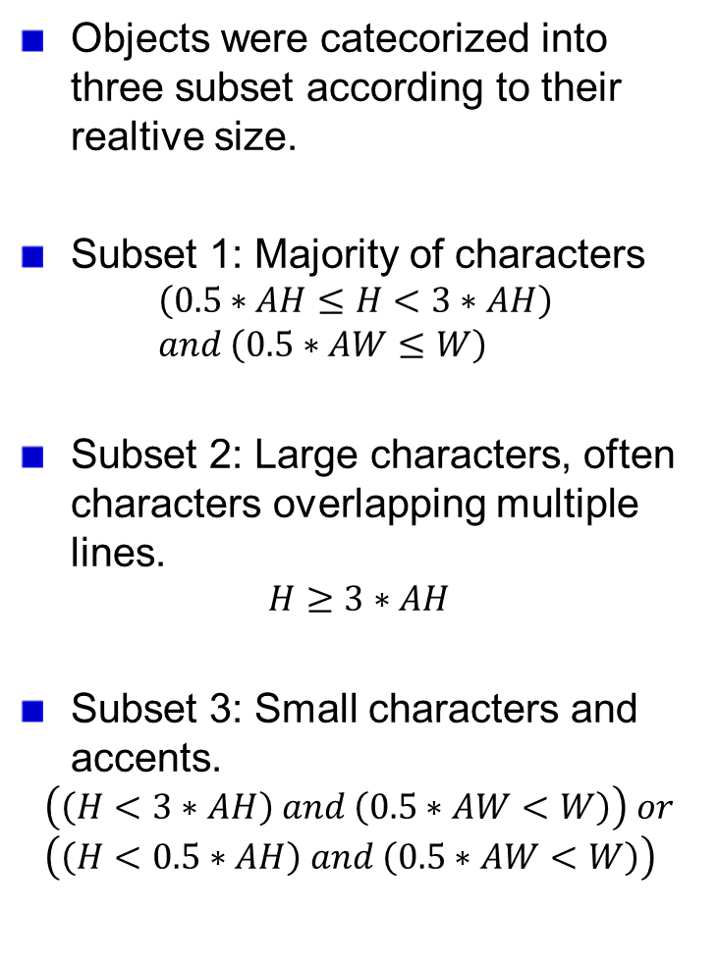
Subsets
Objects were catecorized into three subset according to their realtive size.
Subset 1: Majority of characters
$$\left(0.5∗AH≤H<3∗AH\right) \\ and \left(0.5∗AW≤W\right)$$
Subset 2: Large characters, often characters overlapping multiple lines.
$$H≥3∗AH$$
Subset 3: Small characters and accents.
$$\left(\left(H<3∗AH\right) and \left(0.5∗AW<W\right)\right) or \\ \left(\left(H<0.5∗AH\right) and \left(0.5∗AW<W\right)\right)$$
Height of Component
Subset 2
3*AH
Subset 1
0.5*AH
Subset 3
1.5*AW
Width of Component
H: Height of Component
W: Width of Component
AH: Average Height
AW: Average Width

Slide 10
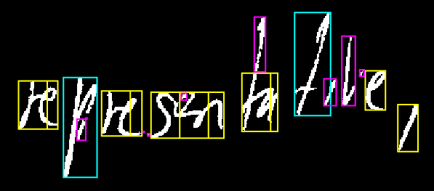
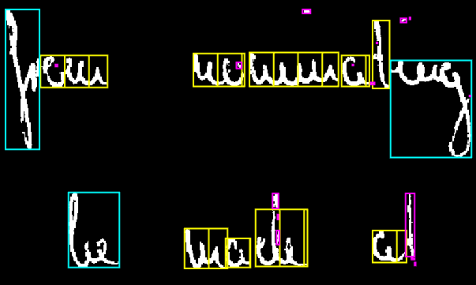
Examples of Subset Characters
Subset 1
Subset 2
Subset 3

Slide 11



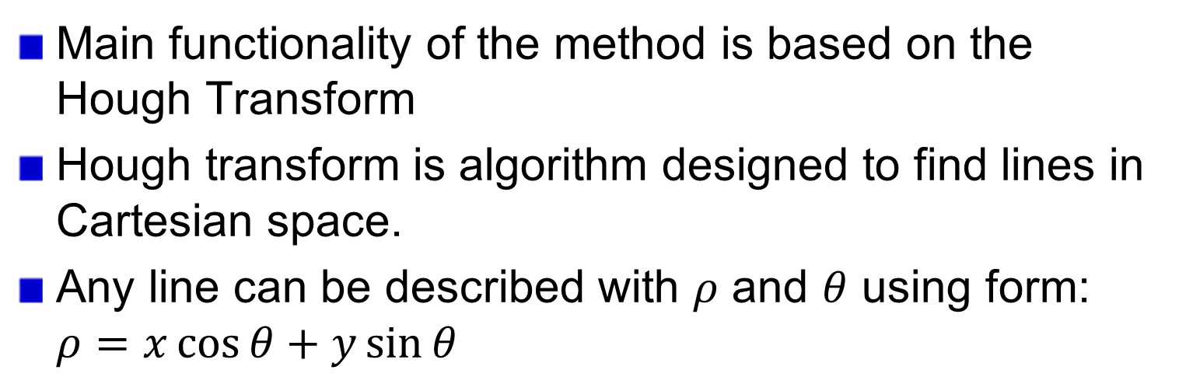





Hough transform
Main functionality of the method is based on the Hough Transform
Hough transform is algorithm designed to find lines in Cartesian space.
Any line can be described with $ρ$ and $θ$ using form: $ρ=x\cos{θ}+y\sin{θ}$
Cartesian Space
Hough Space
y
$$ρ$$
$$ρ_{1}$$
$$ρ_{1}$$
$$ρ_{1}$$
$$θ_{1}$$
$$θ_{1}$$
x
$$θ_{1}$$
$$θ$$

Slide 12
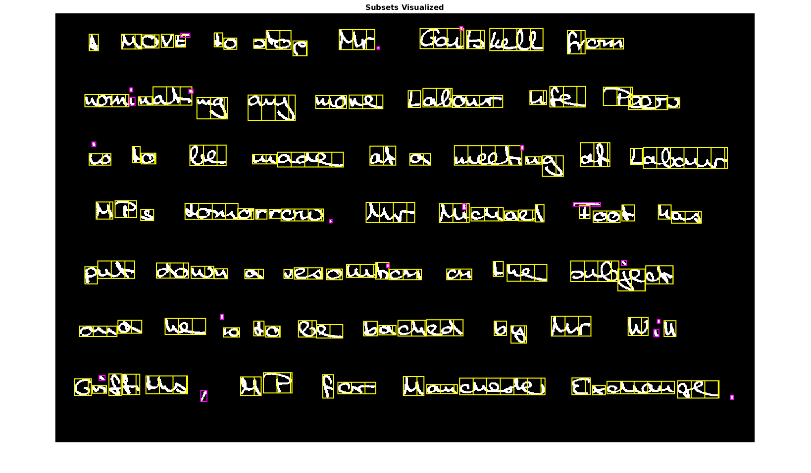
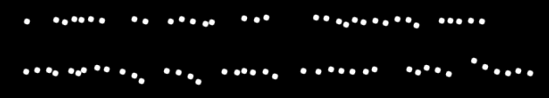
Hough Transform
Subset 1 characters are partitioned into average width sized blocks.
The centroid of each of these blocks is used as datapoints for Hough Transform.

Slide 13
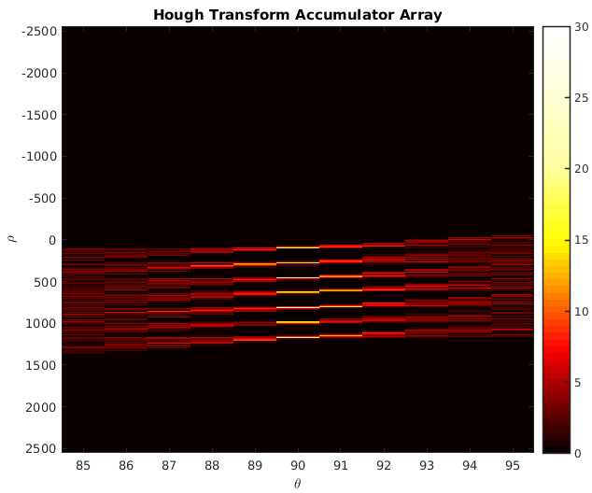
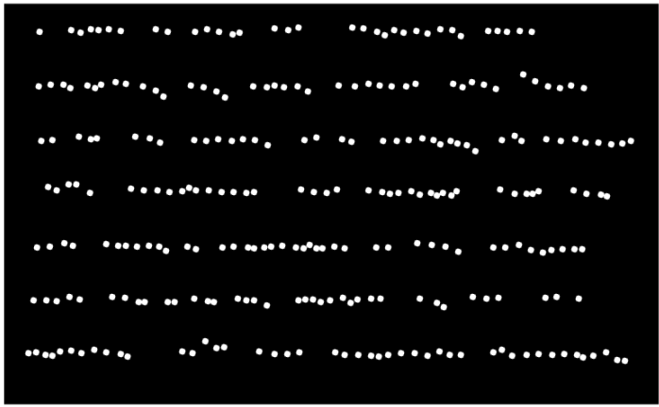
Data Points and Corresponding Accumulator Array
Hough Transform

Slide 14

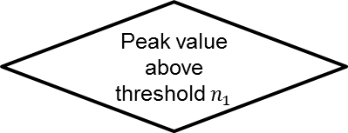



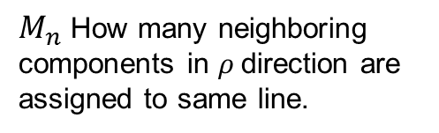
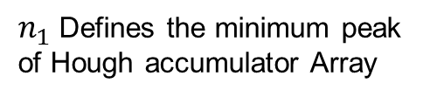
Line Extraction from Accumulator Array
Accumulator array
Find Peak
0 | 0 | 14
0 | 2 | 6
0 | 7 | 8
0 | 44 | 2
2 | 8 | 3
11 | 1 | 8
10 | 0 | 13
17 | 0 | 4
0 | 0 | 14
0 | 2 | 6
0 | 7 | 8
0 | 44 | 2
2 | 8 | 3
11 | 1 | 8
10 | 0 | 13
17 | 0 | 4
0 | 0 | 14
0 | 2 | 6
0 | 7 | 8
0 | 44 | 2
2 | 8 | 3
11 | 1 | 8
10 | 0 | 13
17 | 0 | 4
0 | 0 | 14
0 | 0 | 6
0 | 0 | 8
0 | 0 | 2
2 | 0 | 3
11 | 0 | 8
10 | 0 | 13
17 | 0 | 4
No
Peak value above threshold $n_{1}$
$ρ$bin
$$M_{n}=3$$
Done
Yes
Get $M_{n}$ neigbhors of the peak
Half of a components centroids are in area
No
Remove values from accumulator Array
$θ$bin
Yes
Assign corresponding components to a new line
$n_{1}$ Defines the minimum peak of Hough accumulator Array
$M_{n}$ How many neighboring components in $ρ$direction are assigned to same line.

Slide 15
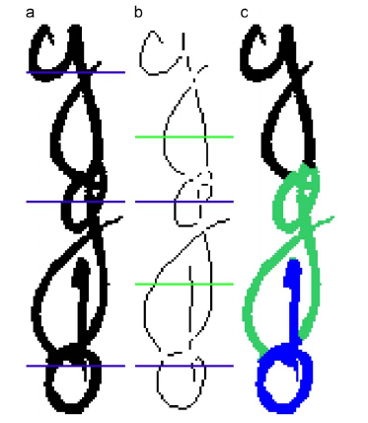
Subset 2 & 3
Subset 3 objects are assigned to closest line if they are less than average distance from it.
Splitting procedure is executed for Subset 2.
If two or more lines intersect Subset 2 component it can be splitted.
Splitting is done in the objects sekeletons intersection points above intersecting lines except the hightest line.
a: Subset 2 component
b: Skeleton image of the component
c: Succesfully splitted component

Slide 16
Additional Constraints and Techniques
Components that weren’t assined to any line must be assinged to the nearest line if they are close to it.
If a lines has only small amount of block centroids and its skew is larger than threshold, the line is discarded.
Word detection was proposed in the article by Louloudis et.al. but it was not implemented due to lack of time.

Slide 17

Output
Succesful line detection
Line detection which shows some remaining problems

Slide 18
Evaluation
Current method depends on multiple parameter values.
Their effect was studied and optimal values were chosen according to these test results.
Word detection was not implemented at this point.
Only the number of lines could be used as a metric to measure the current implementations accuracy.
The IAM Handwriting Database provided the image files and metadata suitable for these tests.

Slide 19
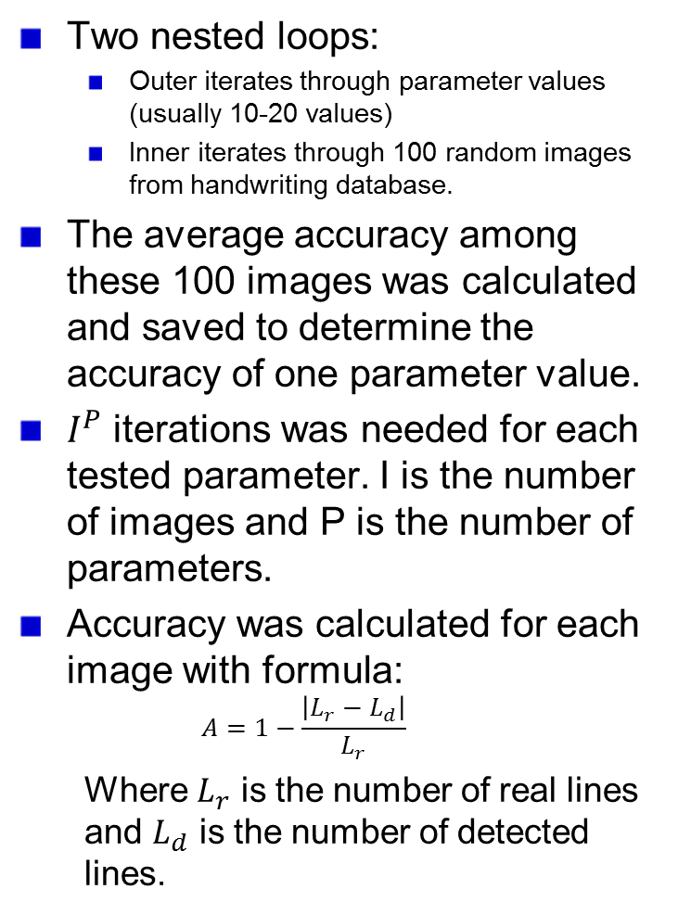
Evaluation Procedure
Two nested loops:
Outer iterates through parameter values (usually 10-20 values)
Inner iterates through 100 random images from handwriting database.
The average accuracy among these 100 images was calculated and saved to determine the accuracy of one parameter value.
$I^{P}$ iterations was needed for each tested parameter. I is the number of images and P is the number of parameters.
Accuracy was calculated for each image with formula:
$$A=1−\frac{\left|L_{r}−L_{d}\right|}{L_{r}}$$
Where $L_{r}$ is the number of real lines and $L_{d}$ is the number of detected lines.
Choose first parameter value
Change Parameter value
Choose first image
Yes
Run pre-processing and layout analysis
Change image
No
Param. left
Done
Save number of detected lines
Calculate average accuracy
Images left
No
Yes

Slide 20
Tests
All parameters were tested for IAM Handwriting database in mind.
Parameters from pre-processing and layout analysis methods were evaluated.
Best parameters were chosen according to tests.
If test didn’t show a noticeably better parameter value the parameter was chosen by visually inspecting the output or according to corresponding scientific article.

Slide 21
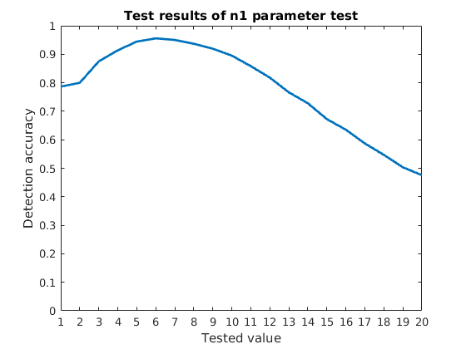
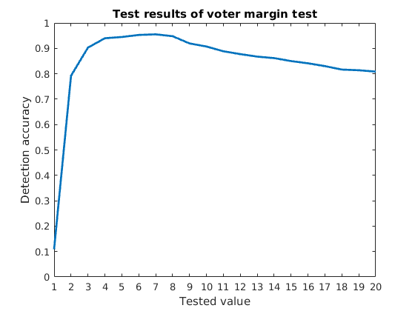
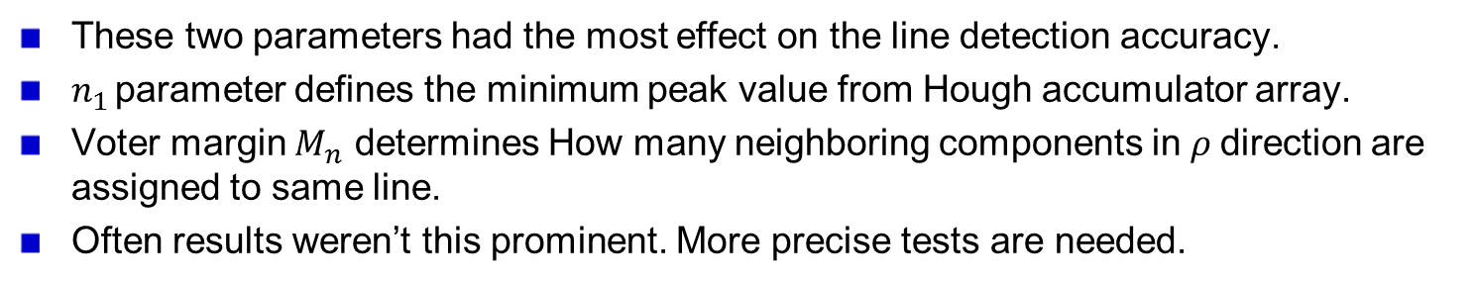
Result Samples
These two parameters had the most effect on the line detection accuracy.
$n_{1 }$parameter defines the minimum peak value from Hough accumulator array.
Voter margin $M_{n}$ determines How many neighboring components in $ρ$direction are assigned to same line.
Often results weren’t this prominent. More precise tests are needed.

Slide 22
Conclusions
The method gained around 97 % accuracy regarding number of lines.
Many parameter values didn’t have prominent effect on the amount of lines.
Remaining problems:
Line number can be right even if some components are assigned to wrong lines.
Given method can only detect single column text.
Word detection would provide more accurate tests and results.

Slide 23
Summary
Block based Hough transform mapping promised good performance when segmentating handwritten lines.
Implementation for the algorithm was completed to detect lines.
When tested, the method achieved 97% accuracy in regard of number of lines.
Implementation of the word detection feature and more accurate tests are needed.

Slide 24
Questions and Answers
Presentation time: 19.20 Question time: 18.58
Kenya Tanaka P9. Is the 1.5AW correct in the figure? It seems like that it is different from the formula.
The value in the figure is not correct even tough I tought that during the presentation. The formulas were copied from newer paper and the figure was done according to a similar figure in older paper by Louloudis et.al. Actually the values I used with processing were the values in formula not those in the figure.
P14. What is the meaning of “neighboring”? Is it vertical direction?
Neighboring is in this case selected in ρ direction which is vertical in accumulator array. However in Cartesian space the data points can have a constant angle which depends on the θ value, and they might not be exactly vertical.

Slide 25
Questions and Answers
Hayato Iwata P8. How is the time of the calculation of this algorithm if it is compared to RLSA?
Whole processing for current implementation with Hough transform mapping takes 10-14 seconds depending on the number of objects. RLSA takes around one second.
P19. How is the line detection accuracy calculated if the both of negative miss detection and positive miss detection happens in same image?
(At the time of the presenation I didn’t understand this question correctly) Only the total amount of lines counts. If at the same time both positive and negative misdetection happens the count of lines stays the same as if these misdetections did not happen. I agree that the number of lines is not a good metric to measure the accuracy, and I think that the number of words would be more reliable. However it was the number of lines only metric that could be used at this point.

Slide 26
Questions and Answers
Atsuhiro Okubo P9. According to your slide, subset 1 consists of major character, but the minimum width of the subset one is larger than the average (1.5 AW). Isn`t it strange?
These values were gotten from the articles by Louloudis et.al. And I didn’t change them (the used value was actually 0.5AW). I think the motivation with the width constraints is that handwritten words can be quite wide because of cursive handwriting consists usually of many connected characters. Additionally I think the splitting operation works better if there are wide components.

Slide 27
Questions and Answers
Abe sensei You said that you studied about preprocessing and layout analysis, but you talked only about layout analysis. Could you tell me about preprocessing?
The pre-processing was earlier phase of the research and I discussed it in earlier seminars, so I left pre-processing aspects out as I didn’t believe to have the time to discuss them. For pre-processing it is important to enhance image quality and aquire binarized image. The binarized image should only have the textual data with best possible quality. My earlier experiments showed that noise removal with adaptive Wiener filter and binarization with Sauvola algorithm works well for pre-processing purposes.

Slide 28
Questions and Answers
Kawamata sensei Are these methods your original?
All methods are from the articles describing the block based Hough transform mapping. Only the experiment procedure is original. How did you determine the parameters of the subsets? Parameters were not defined by me but they were introduced in the aforementioned articles.
Can you use this method to Kanji text?
This method can be applied for any kind of text. However Japanese text might have more separated characters compared to cursive handwriting. In some cases Japanese and Chinese can be written vertically, not horizontally as assumed in this research. I see these problems to be trivial regarding the pre-processing and layout analysis research.

