Slide 1
Preprocessing for Offline Handwriting Recognition
東北大学大学院工学研究科
電子工学専攻川又研究室
Perttu Pitkänen

Slide 2
Overview
Introduction
Handwriting recognition
Preprocessing
Binarization
Sauvola algorithm
Property analysis
Results
Conclusions
Future work

Slide 3
Introduction
Matlab was used for implementation with image processing toolbox.
This research concentractes on writing done with English alphabet.

Slide 4
Handwriting recognition 1
Handwriting recognition (HWR) is the process of extracting text in digital form from handwritten images or input devices.
Divided into offline and online handwriting recognition
Offline HWR recognition takes static image and runs the recognition process to it.
Online HWR analyzes characters on input. For example with tablet pc.
Used methods for handwriting recognition include Optical Character Recognition (OCR) or Intelligent Word Recognition (IWR).

Slide 5
Handwriting recognition 2
OCR is used to recognize individual characters while IWR recognizes whole words.
Offline recognition process can be divided into three main phases:
Preprocessing
Feature extraction
Classification
The preprocessing and feature extraction phases are similar in both OCR and IWR.
Each phase reduces the amount of data to be processed.

Slide 6
Handwriting recognition 3
Preprocessing
Includes noise removal, binarization and segmentation.
Image is enhanced for feature extraction phase and the detected characters are segmented from the original image.
Feature Extraction
Shape describing features are extracted from previously acquired objects.
Histogram of ordered gradients, horizontal and vertical histograms, topological features (loops, junctions), etc.

Slide 7
Handwriting recognition 4
Classification
Extracted features are used in machine learning algorithms to create the feature vector.
The inputs are classified according to this vector.
For example simple k-nearest neighbors algorithm can be applied to find the correct category for the input.
For now the research has concentrated on preprocessing.

Slide 8
Preprocessing 1
During this research following preprocessing methods were considered for offline HWR:
Image aquisition
Noise removal
Binarization
Object property analysis
Object extraction

Slide 9
Preprocessing 2
Image is converted to grayscale.
Noise is removed using 6x6 adaptive wiener filter
Adapts to the variation. More smoothing if variance is large.
6x6 neighbourhood optimal for most cases. Larger filter sizes resulted in exessive blur.
Histogram equalization is not applied because in most cases it increased the visibility of irrelevant objects such as paper texture and noise.

Slide 10
Binarization
Binarization is one of the most important parts of the preprocessing.
Image may have uneven lighting resulting in visible shadows or gloss.
Sauvola algorithm was designed for document binarization purpose.
Sauvola algorithm resulted in best results with quick comparison with other algorithms.

Slide 11
Sauvola algorithm
Uses adaptive thresholding to binarize document images with uneven lightning or texture.
Enhanced version of Nilback binarization algorithm.
Can apply different algorithms to textual and non-textual areas of the image. (Nilback can only detect varying lightning)

Slide 12
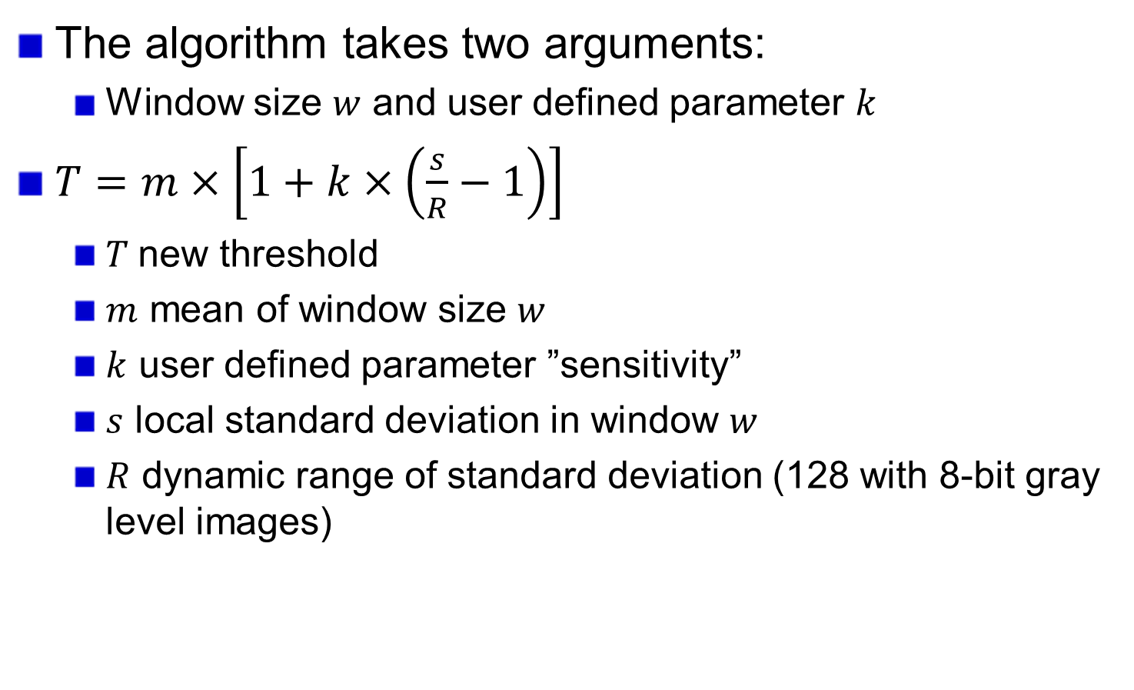
Sauvola algorithm
The algorithm takes two arguments:
Window size $w$ and user defined parameter $k$
$T=m×\left[1+k×\left(\frac{s}{R}−1\right)\right]$
$T$new threshold
$m$ mean of window size $w$
$k$ user defined parameter ”sensitivity”
$s$ local standard deviation in window $w$
$R$ dynamic range of standard deviation (128 with 8-bit gray level images)

Slide 13
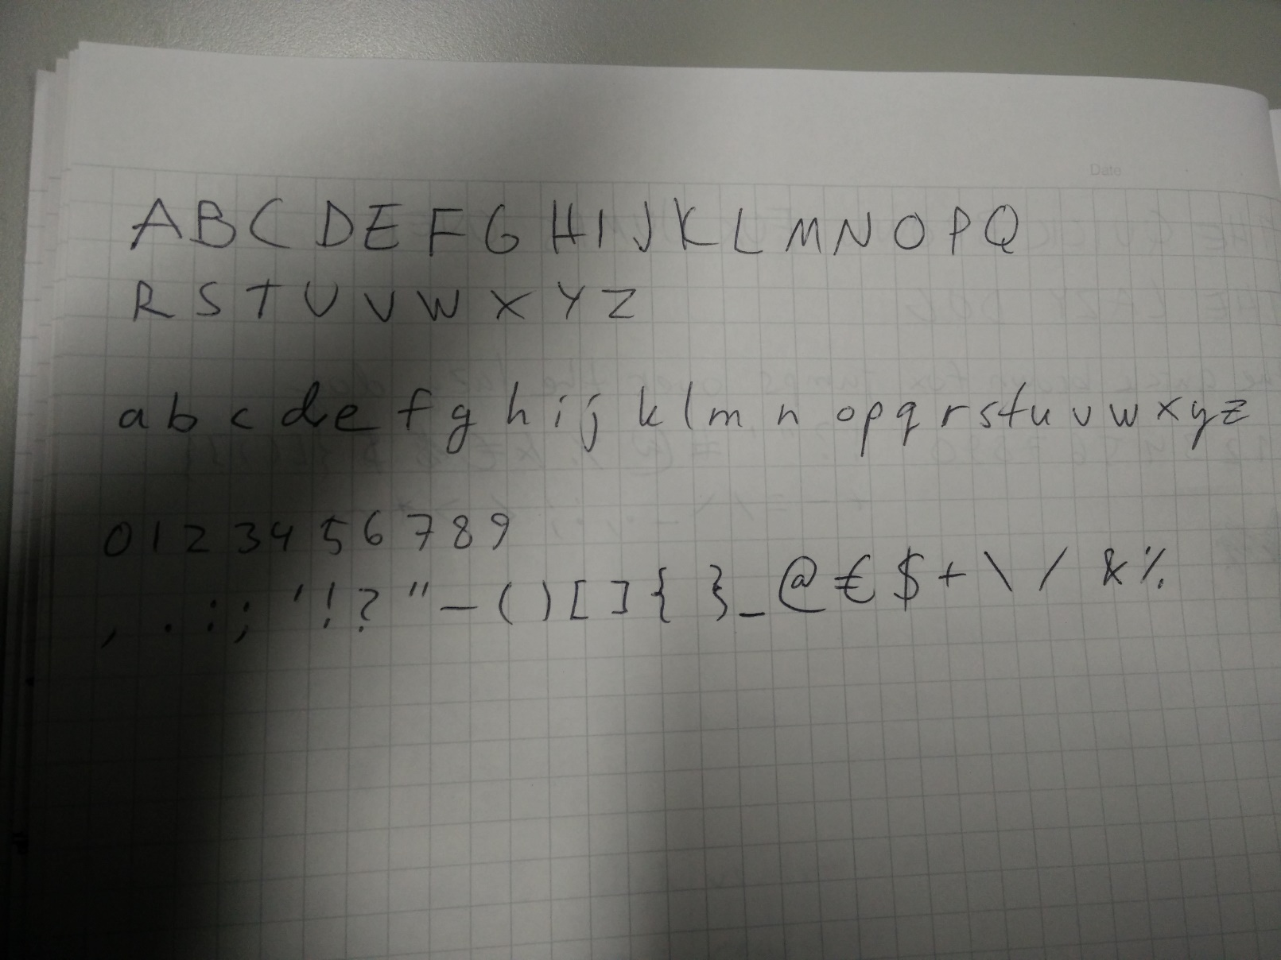
Original image with shadow. 95 individual objects.

Slide 14
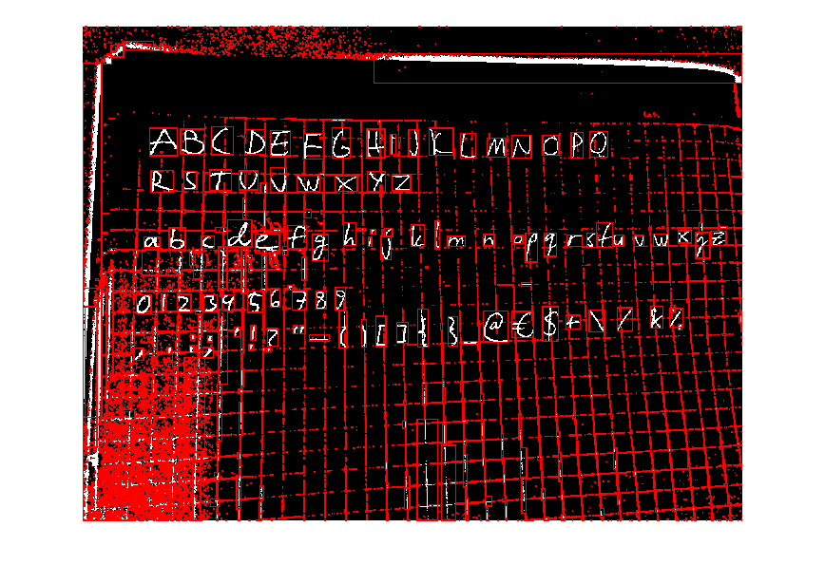
No noise removal. Sauvola with k=0.1 w=100x100
22741 objects

Slide 15
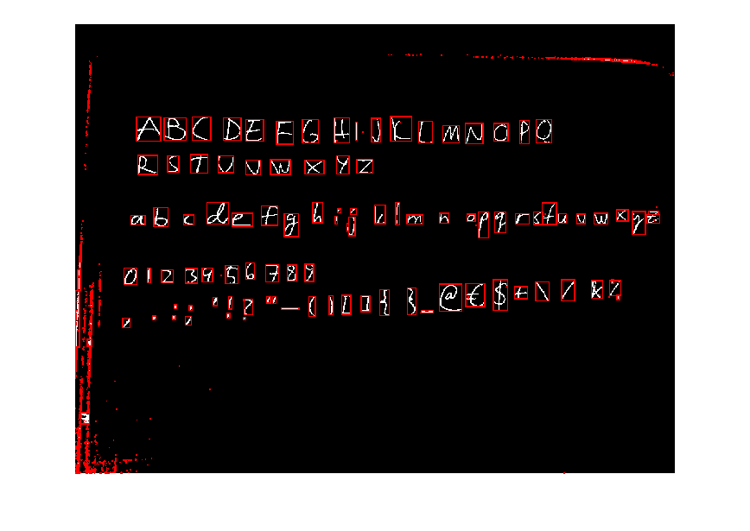
No noise removal. Sauvola with k=0.4
1590 objects

Slide 16
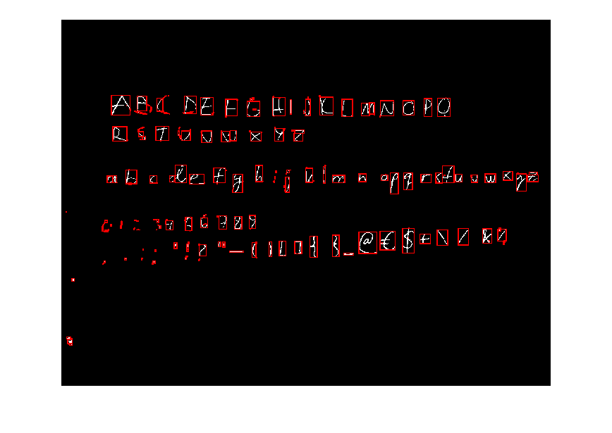
No noise removal. Sauvola with k=0.9
368 objects

Slide 17
Sauvola algorithm
For this case the threshold 0.4 works best.
Lower thresholds resulted in more noise. Higher thresholds result in more broken objects.
Window size 100x100 worked best for most cases.
With lower window sizes more broken objects and higher window sizes resulted in more noise.

Slide 18
Noise removal
Adaptive Wiener filter was used.
Filter window size affected results
Chosen window size 6. Size 3 had slightly more noise and larger window sizes broke the objects.

Slide 19
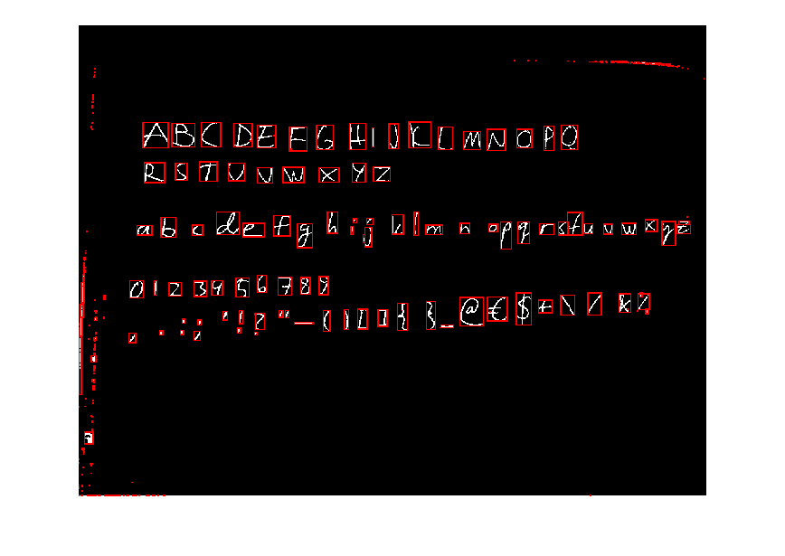
Wiener filter size 6 (k=0.4 w=100)
325 objects

Slide 20
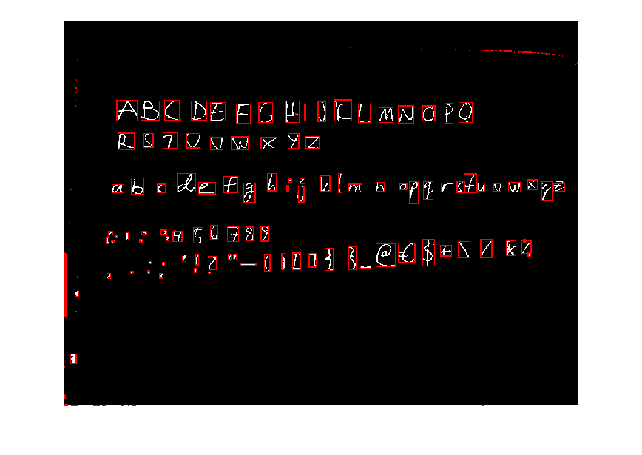
Wiener filter size 20
250 objects

Slide 21
Object property analysis
Usually some irrelevant objects still remain after binarization.
Some object properties are analyzed and the objects are removed which have feature values outside the preferred values.
Example object properties include area, major axis length and Euler number (Number of objects in the region minus the number of holes in those objects).
When only relevant objects remain they can be easily extracted to smaller sub-images for further processing.

Slide 22
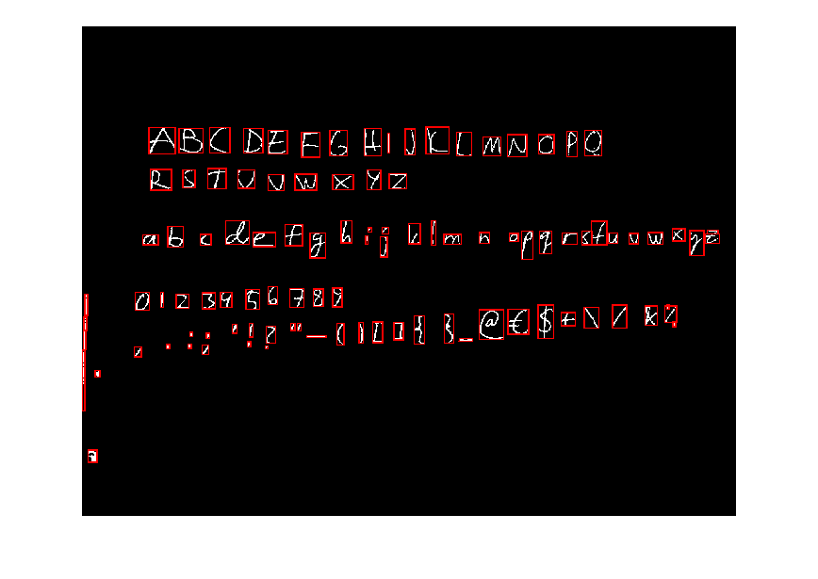
Objects smaller than 209 pixels removed.
102 objects

Slide 23

Objects with Euler number lower than -4 removed.
101 objects

Slide 24
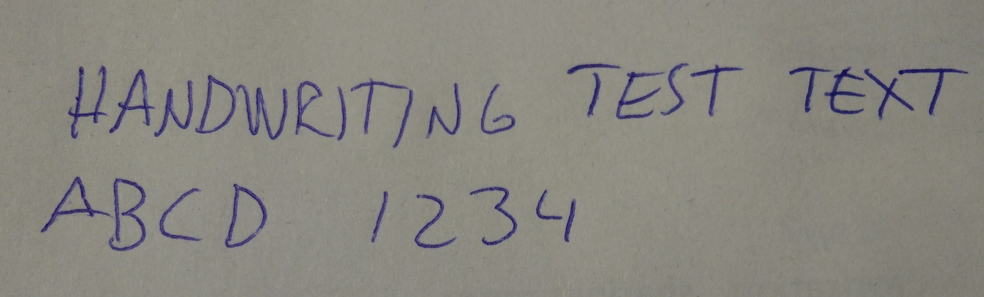

Errors with different image and same parameters
(Lighter pen caused more holes in objects during binarization
which then caused Euler number to be lower than expected.)

Slide 25
Conclusions
Chosen methods are useful in preprocessing.
Chosen arguments will work only for the specific case.
Problems:
Human handwriting can vary a lot even with same person.
Different size and thickness with characters.
Different color pens or pencils.
Differing image resolutions.
Solutions:
Keep resolution as constant.
Try to find optimal stroke width without prior information.
Apply morphological closing to remove small holes.

Slide 26
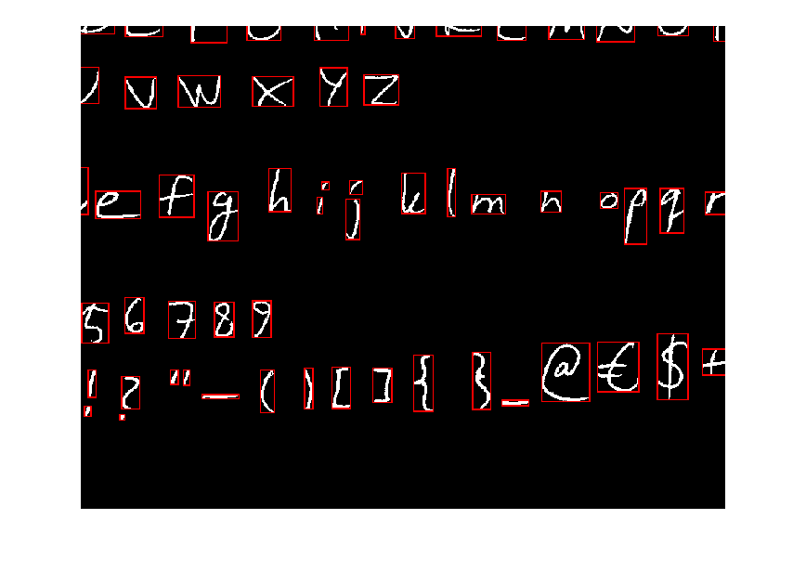
Future work 1
Enhance the preprocessing making it less dependant on arguments.
Extract and analyze more object properties to remove the irrelevant objects.
Combine letters and characters containing separate elements. (i j ! ? ” = ; : %)
Useful feature considering Hiragana and Katakana characters. (ひらがな)

Slide 27
Future work 2
Layout analysis. Detect words, rows and columns of text.
Feature extraction:
Vertical and horizontal histograms.
Histogram of ordered gradients.
Topological features such as endpoints, loops and junctions.
Etc.
Classification with k-nearest neighbors algorithm.
Use IAM database for large scale tests.

Slide 28
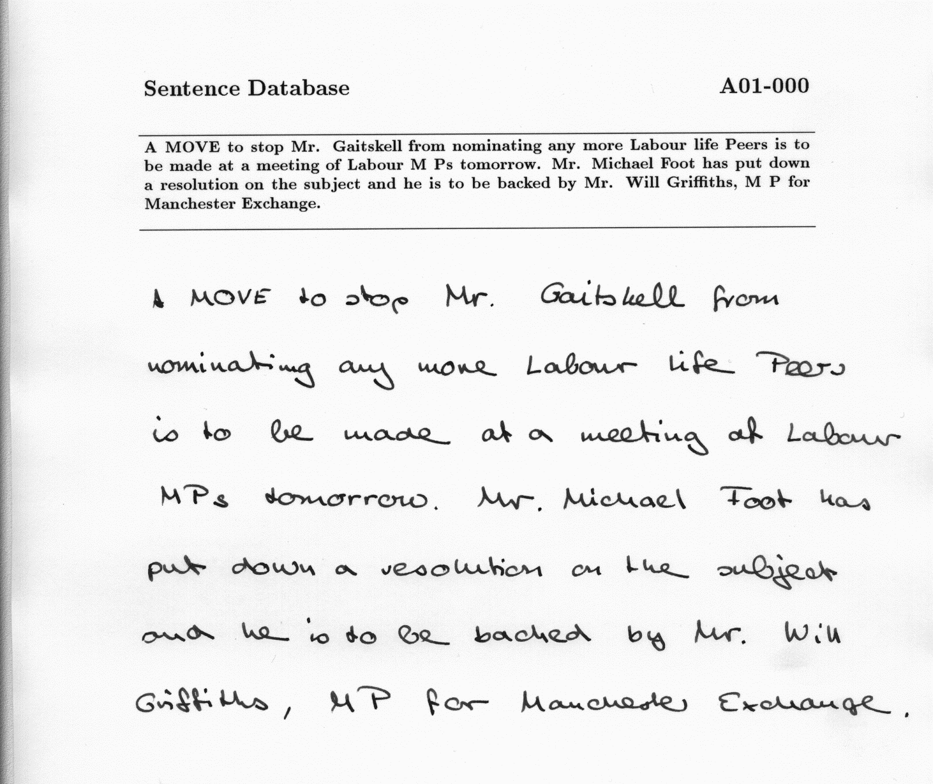
Example entry in IAM handwriting database.

Slide 29
Questions?

