Slide 1

FDI data call update 2025
J. Demmler
27/05/2025
Notes:
Note: If the image placeholder rotates when placing an image, do this:
1) Undo
2) Open the image in any image processing program (Paint etc.)
3) Save the image
3) Place the image again to your presentation
This problem occasionally happened when inserting a vertical image

Slide 2
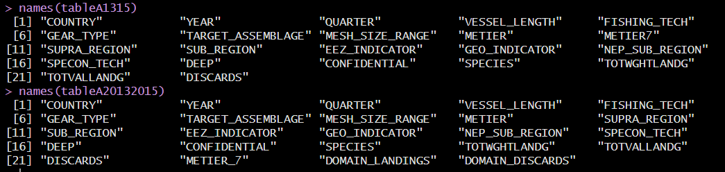
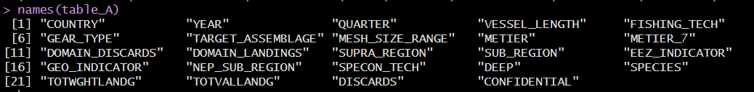
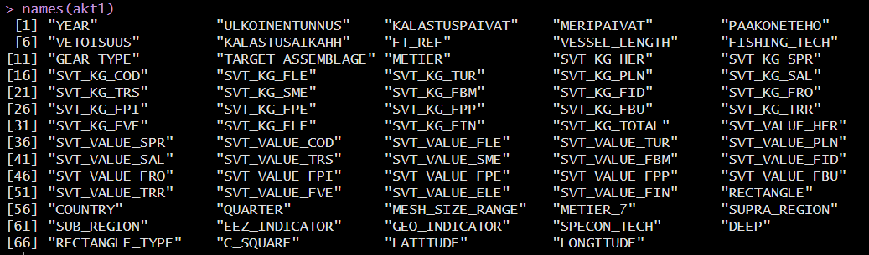
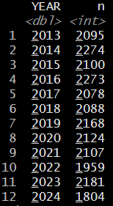
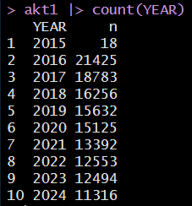
Issue 1
From SAS
TABLE A WORKFLOW:
Currently only table A has 2013-3015 data
TABLE G-J WORKFLOW:
Based on DCPROD data starting 2015

Slide 3
Issue 2

Slide 4
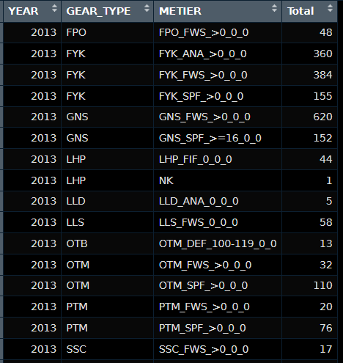
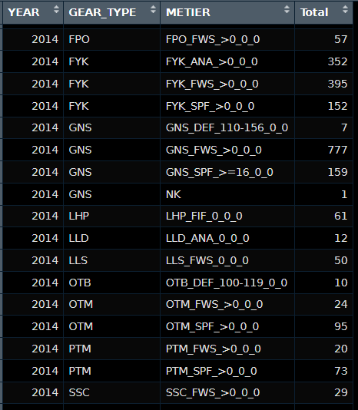
Issue 3

Slide 5
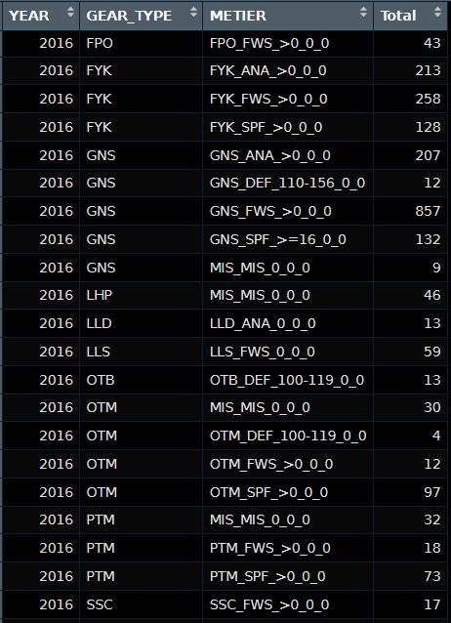
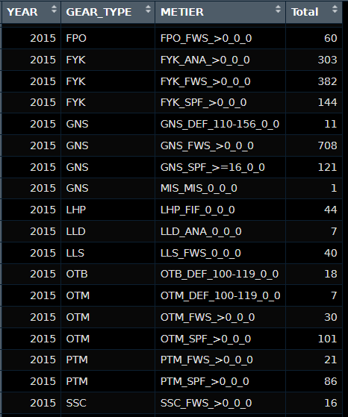
Issue 3

Slide 6
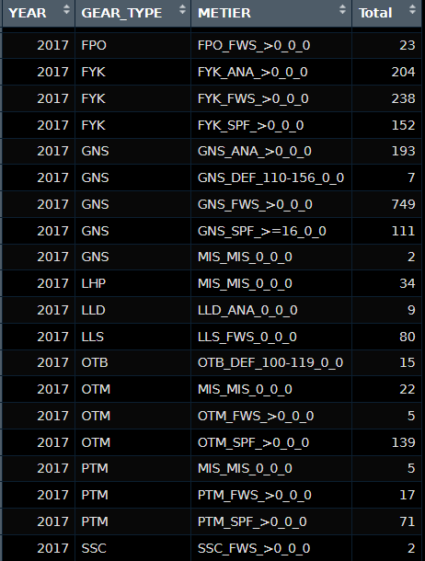
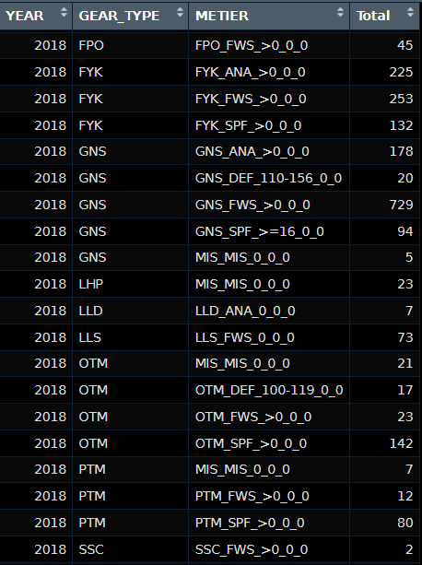
Issue 3

Slide 7
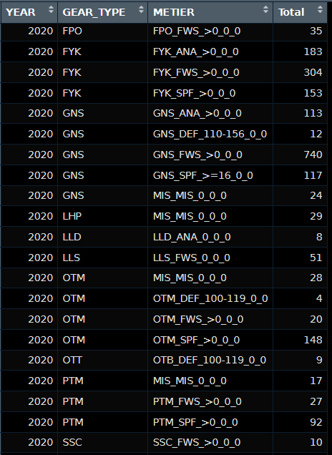
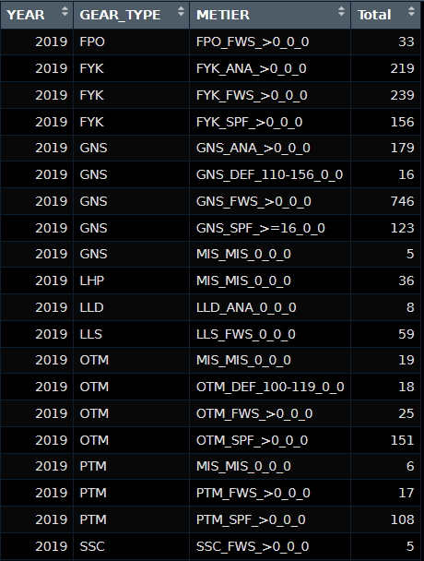
Issue 3

Slide 8
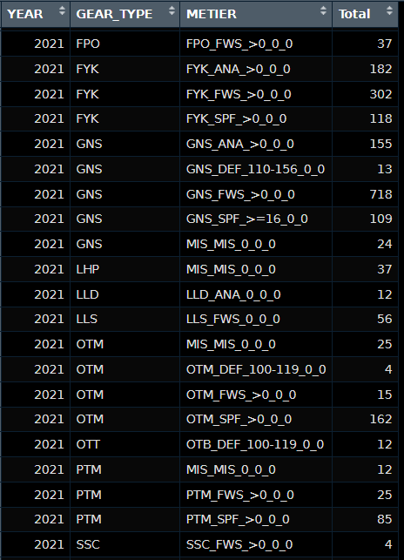
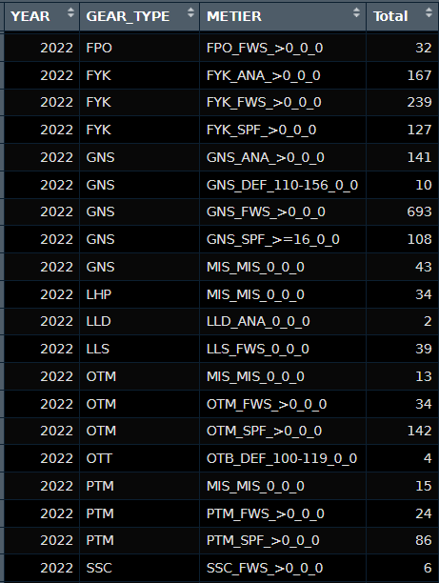
Issue 3

Slide 9
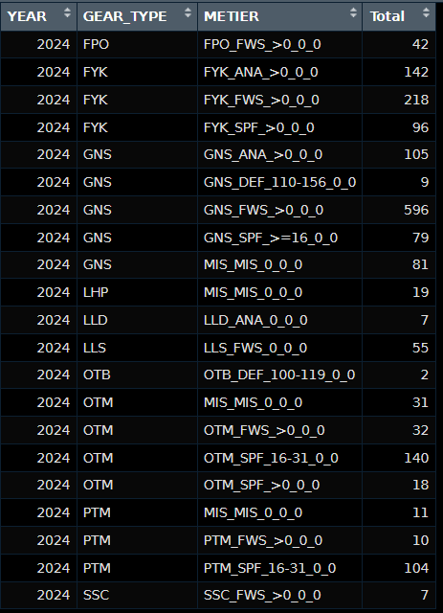
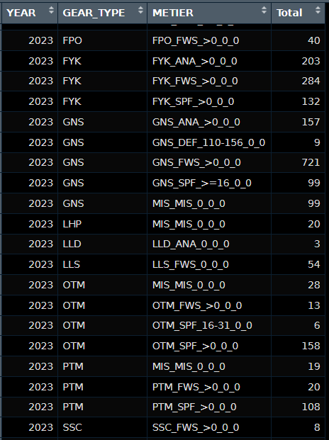
Issue 3

Slide 10
Issue 4

Slide 11
Issue 5

