Slide 1

FDI data call update 2025
J. Demmler
26/05/2025
Notes:
Note: If the image placeholder rotates when placing an image, do this:
1) Undo
2) Open the image in any image processing program (Paint etc.)
3) Save the image
3) Place the image again to your presentation
This problem occasionally happened when inserting a vertical image

Slide 2
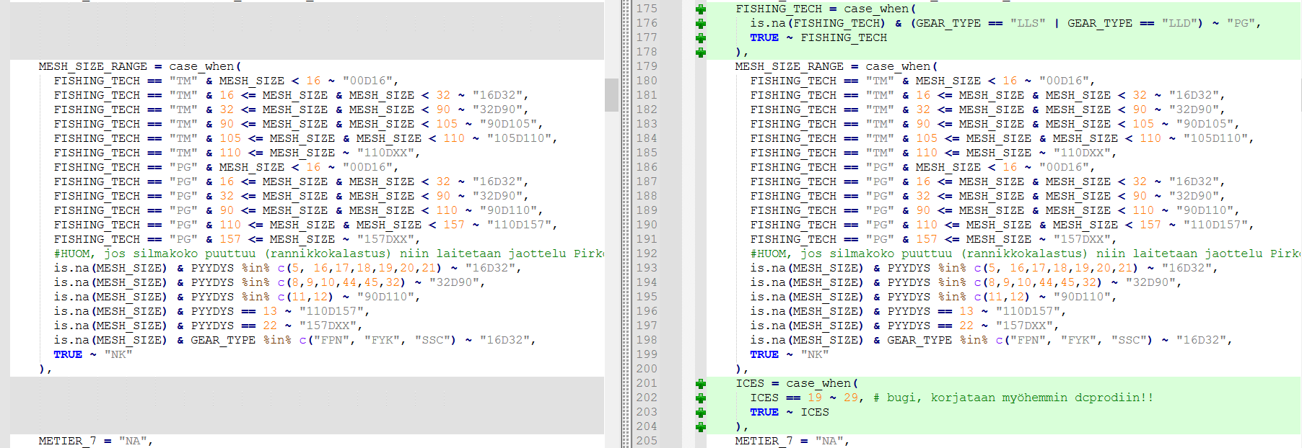
2016-2023 script
Issue 6
2013-2023 script

Slide 3
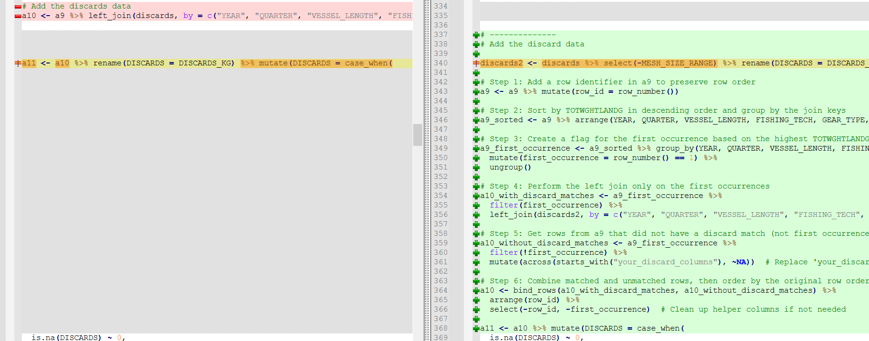
2016-2023 script
2013-2023 script

Slide 4
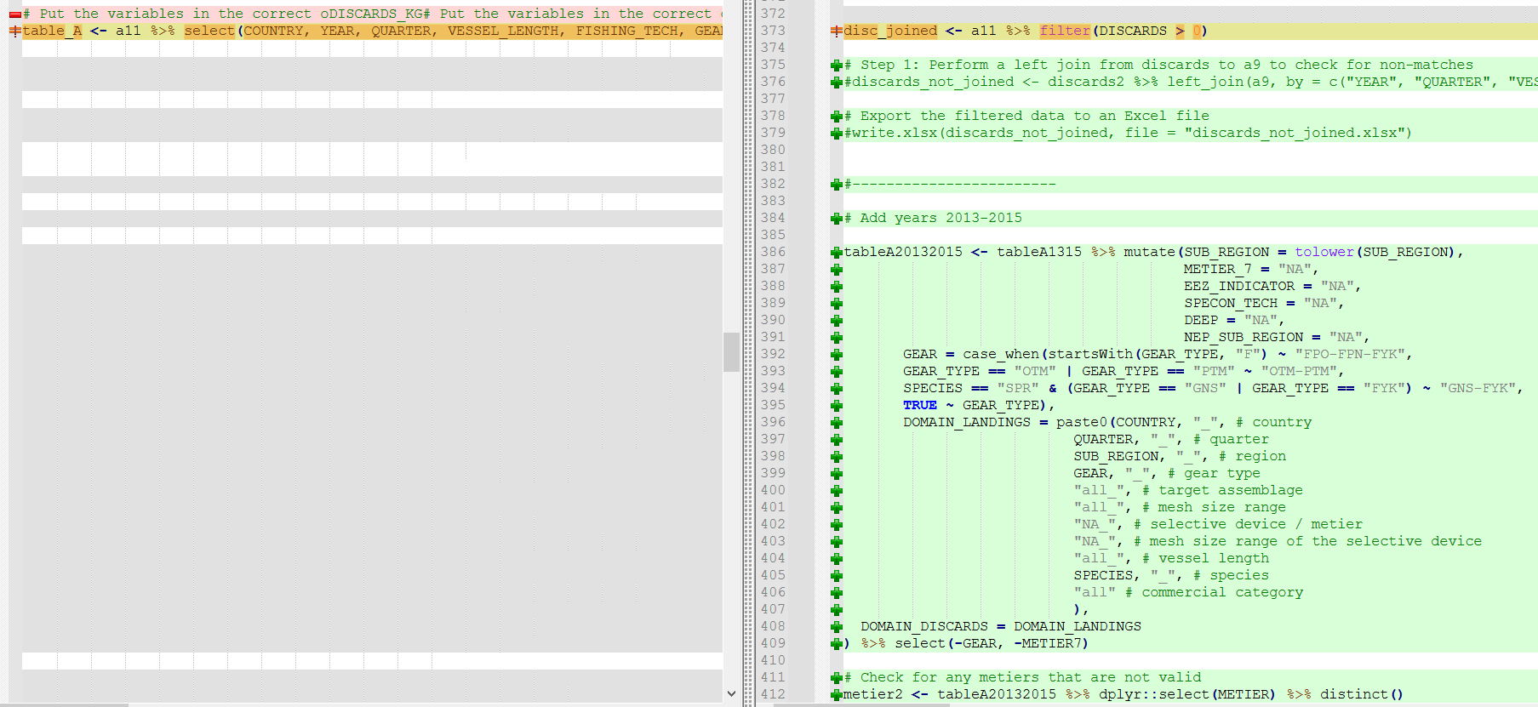
2016-2023 script
2013-2023 script

Slide 5
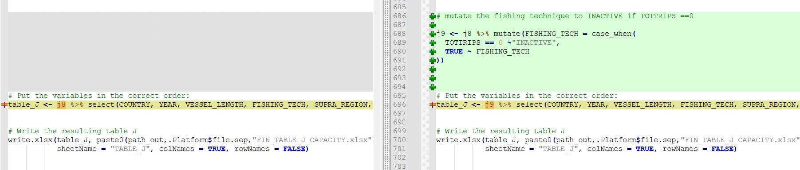
2016-2023 script
2013-2023 script

Slide 6
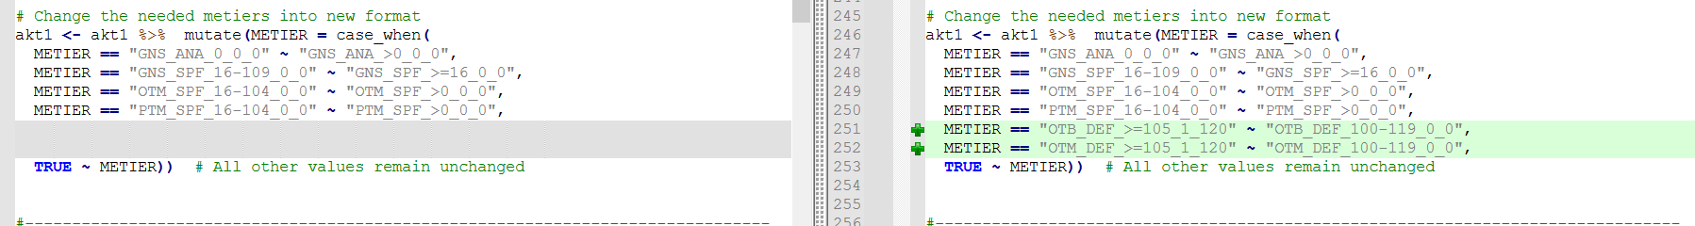
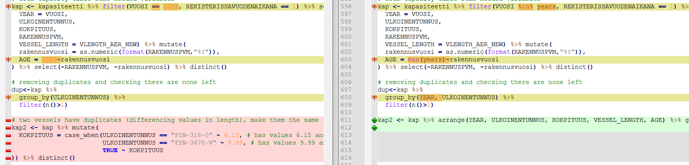
(no year) script
2013-2023 script

Slide 7
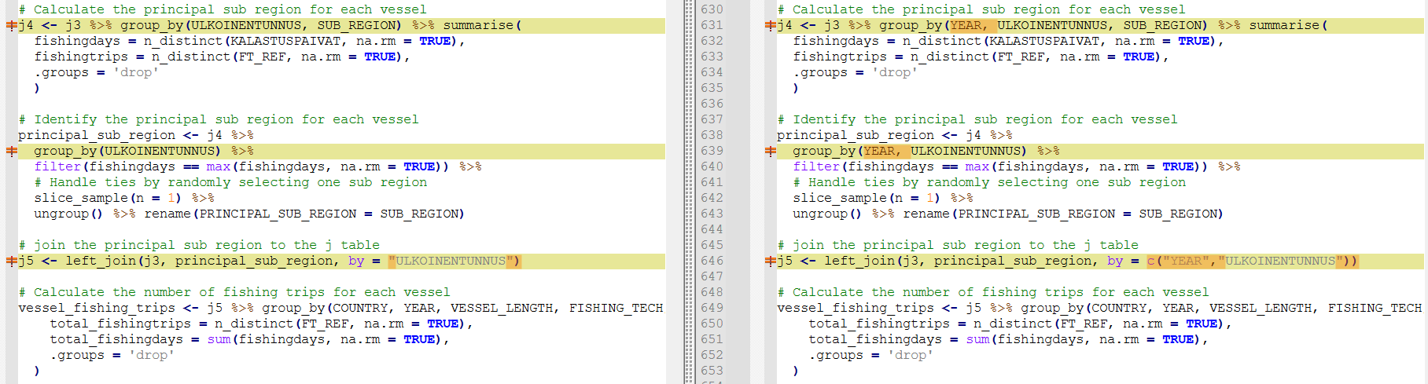
(no year) script
2013-2023 script

Slide 8
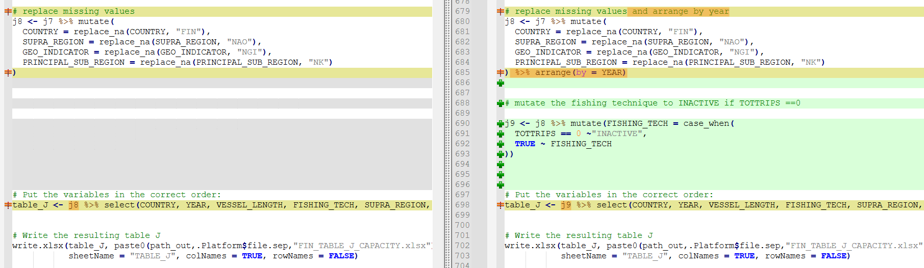
(no year) script
2013-2023 script

Slide 9
Issue 1

