Slide 1

Home
Submit Claims
My Claims
Coordinator Dashboard
Manger dashboard
HR View
Page 01
Contract Monthly Claim System (CMCS)
PROG6212
Next Slide
Keeran Perumal
St10367702
IIE MSA
-
St10367702@imconnect.edu.za

Slide 2


Page 02
Introduction to CMCS
The system automates:
  Claim submission
  Review & approval workflow
  Document management
  HR processing
This project was developed across three phases:
  Part 1: Planning, UML diagrams, GUI prototype
  Part 2: Core functionality implementation
  Part 3: Automation enhancements + reporting
The Contract Monthly Claim System (CMCS) is a web application based on .NET, created to simplify the monthly claims filed by Independent Contractor (IC) lecturers

Slide 3

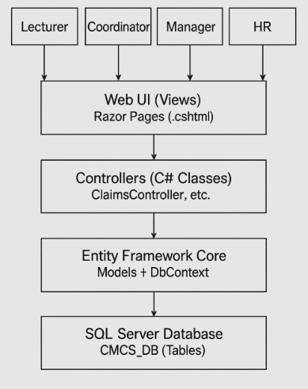

System Architecture Overview
Page 03
Key Components:
  Models: Lecturer, Claim, SupportingDocument
  Controllers: ClaimsController, CoordinatorController, HRController
  Views: Razor Pages for Lecturer, Coordinator, Manager, HR
Architecture Diagram :
  MVC layered structure
  Database layer beneath EF Core
  User interfaces: Lecturer UI → Coordinator UI → Manager UI → HR UI

Slide 4
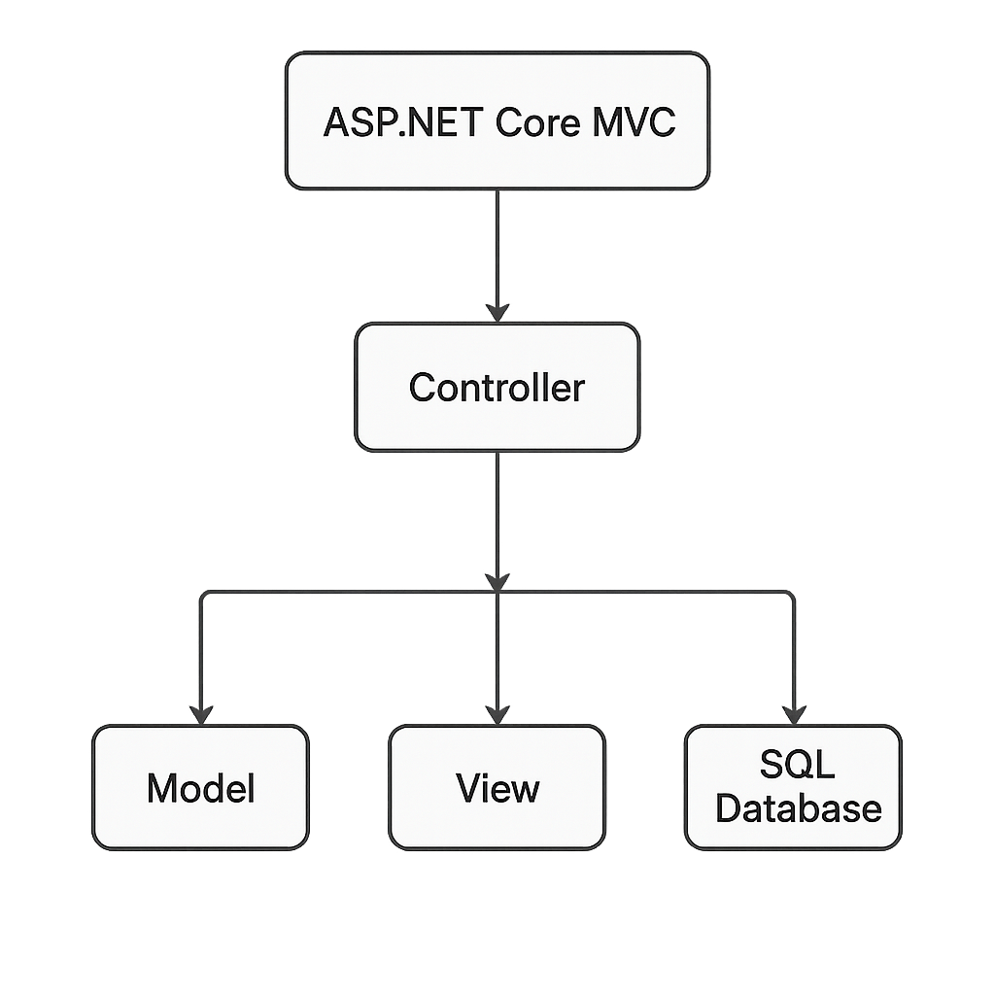
UML CLASS DIAGRAM
Page 05
Classes & Relationships:
  Lecturer (1-to-many) → Claims
  Claim (1-to-many) → SupportingDocuments
Attributes included:
  Lecturer: LecturerId, Name, Email, DefaultHourlyRate
  Claim: ClaimId, LecturerId, HoursWorked, HourlyRate, TotalAmount, Status, SubmittedOn
  SupportingDocuments: Id, ClaimId, FileName, FilePath, UploadedOn

Slide 5
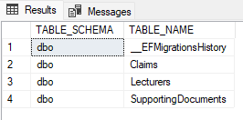

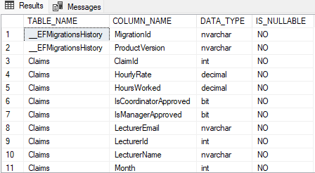
DATABASE STRUCTURE
Page 04
1. Lecturers
  LecturerId (PK)
  Name
  Email
  DefaultHourlyRate
3. Claims
  ClaimId (PK)
  LecturerId (FK)
  Month & Year
  HoursWorked
  HourlyRate
  TotalAmount
  Status(Pending/Approved / Rejected)
  SubmittedOn
  ReviewedOn
  ApprovedByCoordinator
  ApprovedByManager
2. Supporting Documents
  SupportingDocumentId (PK)
  ClaimId (FK)
  FileName
  FilePath
  UploadedOn

Slide 6
PART 1: GUI OVERVIEW
Page 05
Lecturer View
  Form to input claim details
  Upload supporting docs
  Clear layout with labeled fields
This system has been extensively developed utilizing ASP.NET Core MVC, Entity Framework Core, and SQL Server as necessary. Every automation capability within Lecturer, Coordinator, and HR workflows has been completely created, examined, and approved. The database was established using EF Core migrations, and a full SQL script has been supplied for validation. Every view is functional, adaptable, and demonstrates the appropriate approval process for various user roles. Included are supporting documents, diagrams, and GitHub repository files to guarantee complete transparency for assessment and system evaluation
Coordinator View
  Table listing submitted claims
  Approve / Reject buttons
HR View
  Concept layout for viewing approved claims
  Ability to export data for payroll

Slide 7
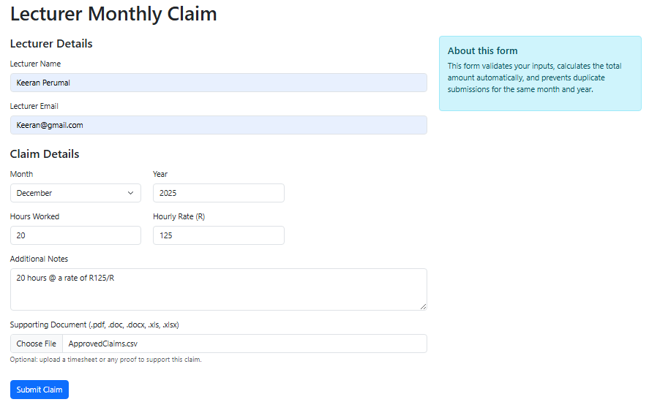
PART 2: IMPLEMENTED FEATURES
Page 06
Lecturer Features Implemented:
  Submit claim
  Auto-calculate total amount (Hours × Rate)
  Upload supporting documents
  Client-side + server-side validation
Coordinator & Manager Features:
  View all claims
  Approve or reject
  Status updates in real time
  View uploaded documents
Data Storage
  EF Core + MSSQL
  Unique Claim + Document IDs
  Secure file storage system

Slide 8
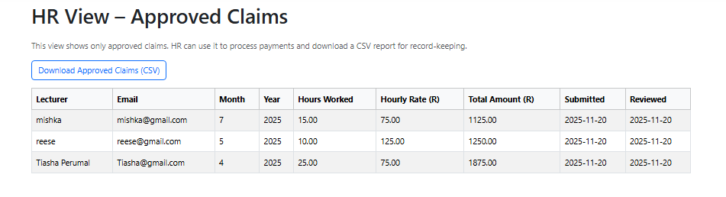
PART 3: AUTOMATION ENHANCEMENTS
Page 07
HR Automation
  Shows only approved claims
  One-click export to CSV
  Simplified payroll processing
Coordinator Automation
  Automated business rules (e.g., high hour alerts)
  Enforced dual approval (Coordinator + Manager)
  Audit trail using ReviewedOn timestamps
Lecturer Automation
  System detects duplicate monthly submissions
  Advanced validation rules
  Real-time status tracking of submitted claim

Slide 9
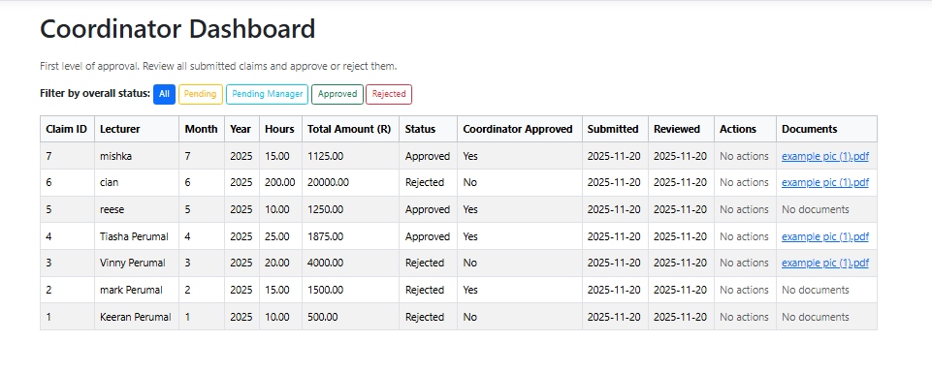
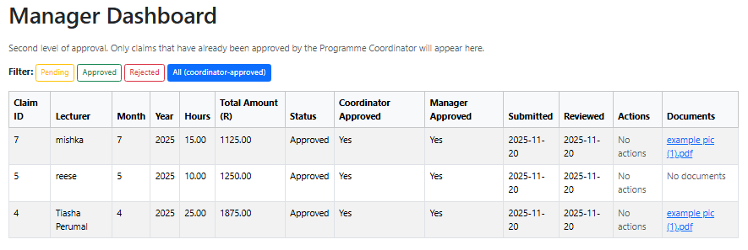
COORDINATOR & MANAGER VIEWS
Page 08
WORKFLOW: LECTURER → COORDINATOR → MANAGER → HR
Coordinator Dashboard
  Reviews newly submitted claims
  Approves/Rejects first
Manager Dashboard
  Only sees claims approved by Coordinator
  Performs second approval

Slide 10
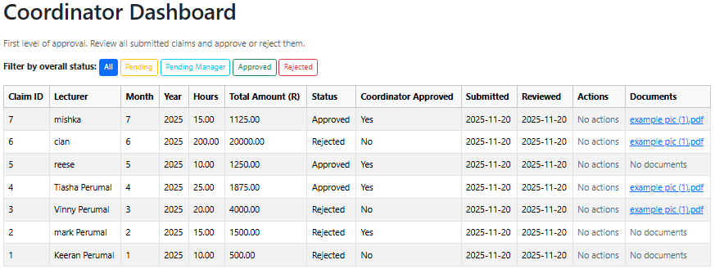
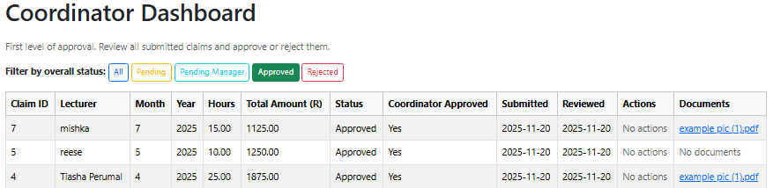
LECTURER CLAIM TRACKING FEATURE
Page 09
A dedicated tracking page now shows:
  All claims submitted by the lecturer
  Status colour indicators:
    Pending (orange)
    Approved (green)
    Rejected (red)
Additional details:
  Total amount
  Submitted date
  Document availability
This meets the feedback requirement that lecturers must track claim status.

Slide 11
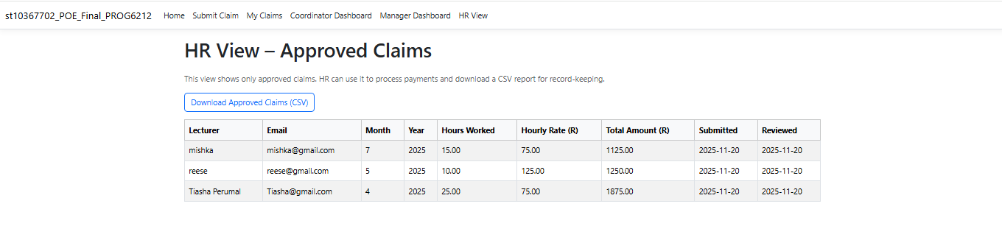
HR VIEW (AUTOMATION)
Page 09
Approved Claims Only
  Filters claims where both Coordinator & Manager have approved
Downloadable Report
  CSV export for payroll systems
  Columns: Lecturer Name, Hours, Rate, Total Amount
Improved Data Handling
  Ensures HR sees clean, validated, verified claims only

Slide 12

VALIDATION & ERROR HANDLING
Page 10
Lecturer Validation
  Prevents month duplication
  Ensures HoursWorked > 0
  HourlyRate > 0
  Notes limited to acceptable length
  File type restrictions (.pdf, .docx, .xlsx)
Security
  Safe file uploads
  Validation for SQL-safe input
Server-side Error Handling
  Try/catch blocks
  Friendly, readable error messages
  Logs for debugging

Slide 13

CONCLUSION
Page 09
The development of the CMCS system provided hands-on experience in:
  MVC architecture
  SQL Server integration
  Entity Framework Core
  Automation of workflows
  Web UI development
  Version control management
The final system offers value by improving:
✔ Efficiency
✔ Accuracy
✔ Transparency
✔ Administrative workflow

Slide 14

REFERENCES
Page 09
  Microsoft. 2025. ASP.NET Core Documentation. Available at: https://learn.microsoft.com/aspnet/core
  Microsoft. 2025. Entity Framework Core Docs. Available at: https://learn.microsoft.com/ef/core
  IIE. 2025. PROG6212 Module Guide. Independent Institute of Education.
  Microsoft SQL Server Documentation. 2025. https://learn.microsoft.com/sql
  Tutorialspoint. 2025. MVC Architecture Overview.

Slide 15
Home
Submit Claim
My Claims
Coordinator Dashboard
Manger Dashboard
HR View
Thank You !
-

