Slide 1


FILE TRANSFER PROTOCOL
Presented by
Gcs Rahul - AP21110010235
P. Dharan - AP21110010201
G. Dinesh - AP21110010240
V. Phalgun - AP21110010223
NVSSS. Pavan - AP21110010209
G. Rehan - AP21110010259

Slide 2

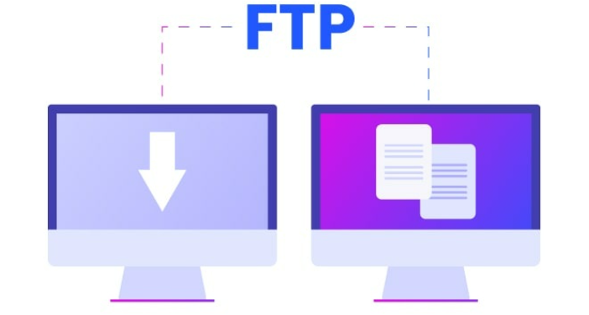
Introduction
File Transfer Protocol, or FTP, is a widely-used network protocol that has played a crucial role in facilitating file exchange over the internet since the 1970s.

Slide 3
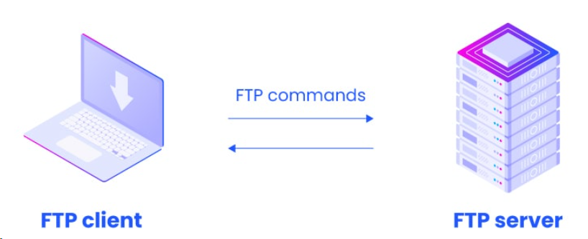
The Client-Server Model
FTP operates on a client-server model, wherein the client initiates requests, and the server responds. This simple yet effective architecture has been instrumental in making file transfer reliable and convenient.

Slide 4
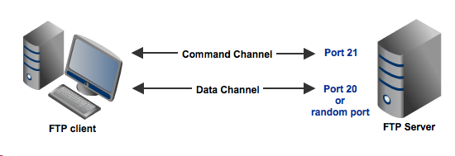
Ports in FTP
FTP uses two ports:
Command port
Data port

Slide 5
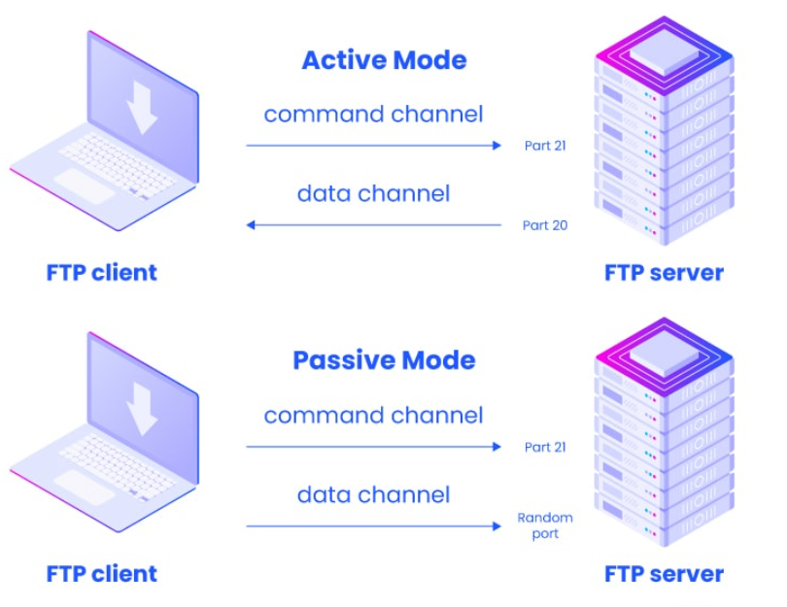
Modes of Operation
FTP has two modes of operation:
Active Mode
Passive Mode.

Slide 6
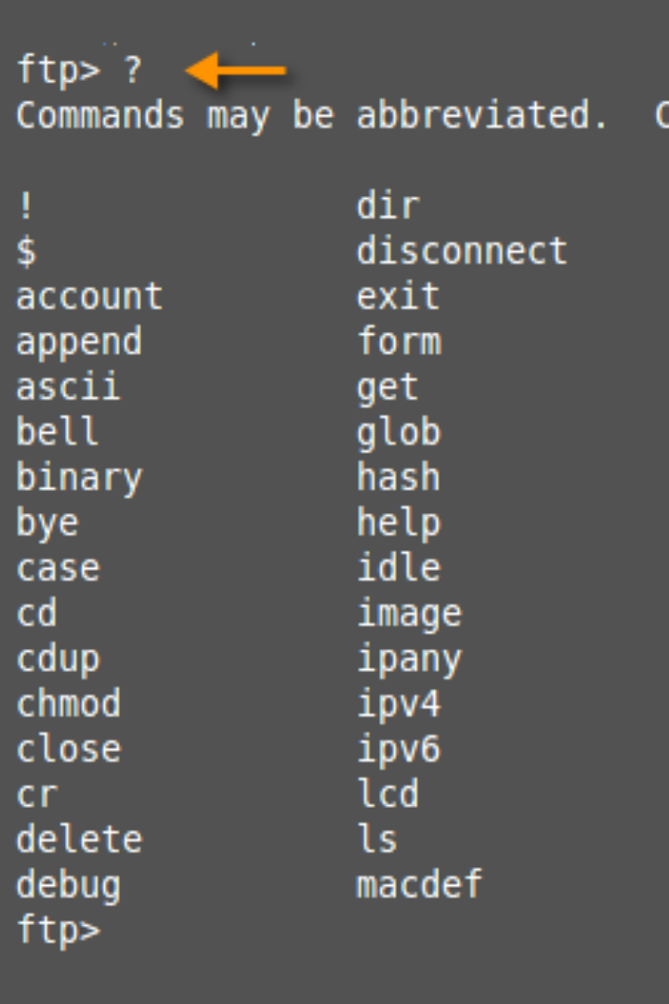
Common Commands
FTP has several commands that are used to facilitate file transfer. Some key commands include
CLOSE
DELETE
LS,HELP
EXIT
DEBUG.

Slide 7

Security Concerns
Traditional FTP is vulnerable to security breaches as it transmits data, including usernames and passwords, in plain text. This makes it susceptible to interception. However, there are secure alternatives like FTPS (FTP Secure) and SFTP (SSH File Transfer Protocol) which have been developed to address these concerns.

Slide 8
Applications
Uploading and downloading files
Sharing files across networks
Managing website content

Slide 9
Alternatives and Best Practices
While FTP is a popular choice for file transfers, there are other protocols like HTTP and SCP/SFTP that are also widely used.

Slide 10
THANK YOU

