Slide 1
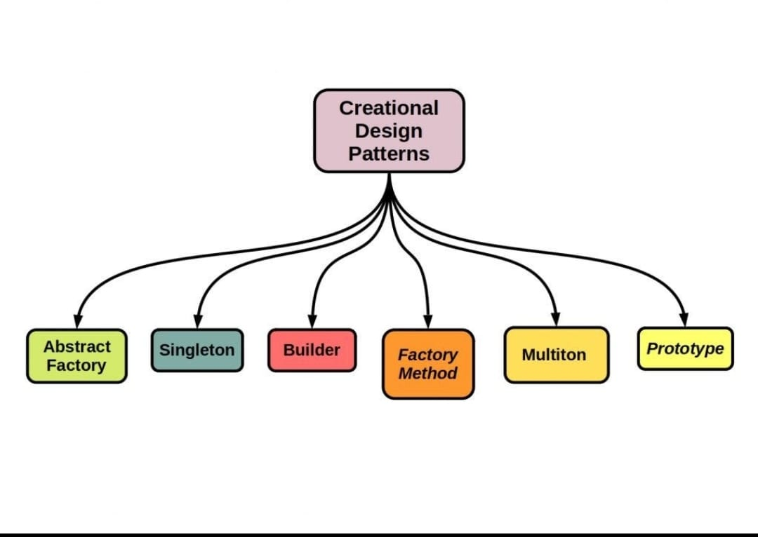
Gang of Four (GOF) Design Patterns
The Gang of Four (GoF) Design Patterns, introduced in the book “Design Patterns: Elements of Reusable Object-Oriented Software,” authored by Erich Gamma, Richard Helm, Ralph Johnson, and John Vlissides, provide a catalog of proven solutions to common design problems in software development.
By :
Fazal - AP20110010223
Teja Siva Kumar - AP21110010196
Akshaya - AP21110010197
Ajay - AP21110010198
Samaya - AP21110010199
Sarayu - AP21110010202
Dharan - AP21110010201

Slide 2
Creational Patterns
1
Factory Method
2
Singleton
Defines an interface for creating an object.
Ensures a class only has one instance and provides a global access point to it.
3
Builder
4
Prototype
Separates the construction of a complex object from its representation.
Specify the kinds of objects to create using a prototypical instance.

Slide 3
Structural Patterns
Adapter
Decorator
Facade
Allows the interface of an existing class to be used as another interface.
Attaches additional responsibilities to an object dynamically.
Provides a unified interface to a set of interfaces in a subsystem.

Slide 4
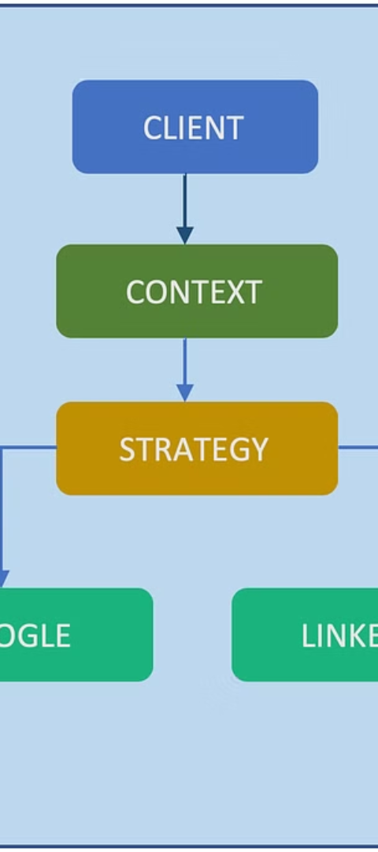
Behavioral Patterns
1
Strategy
Defines a family of algorithms, encapsulates each one, and makes them interchangeable.
2
Observer
Defines a one-to-many dependency between objects so that when one object changes state, all its dependents are notified and updated automatically.
3
Template Method
Defines the skeleton of an algorithm in a method, deferring some steps to subclasses.

Slide 5
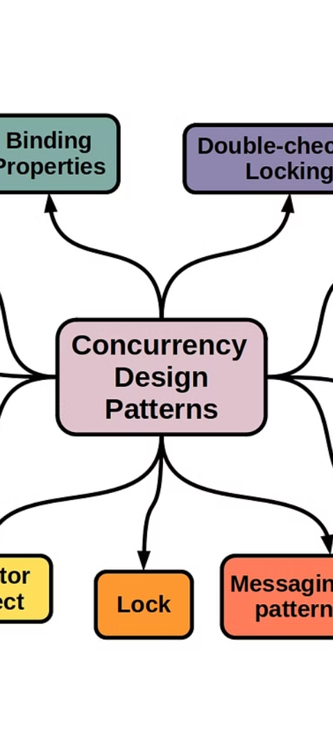
Concurrency Patterns
Active Object
Monitor Object
Decouples method execution from method invocation to enhance concurrency.
Synchronizes concurrent operations to control access to shared resources.

Slide 6



Architectural Patterns
Layered Architecture
Microservices
Event-Driven Architecture
Architects the system as a collection of small autonomous services.
Organizes the system into layers such as presentation layer, business layer, and data layer.
Produces, detects, consumes, and reacts to events.

Slide 7
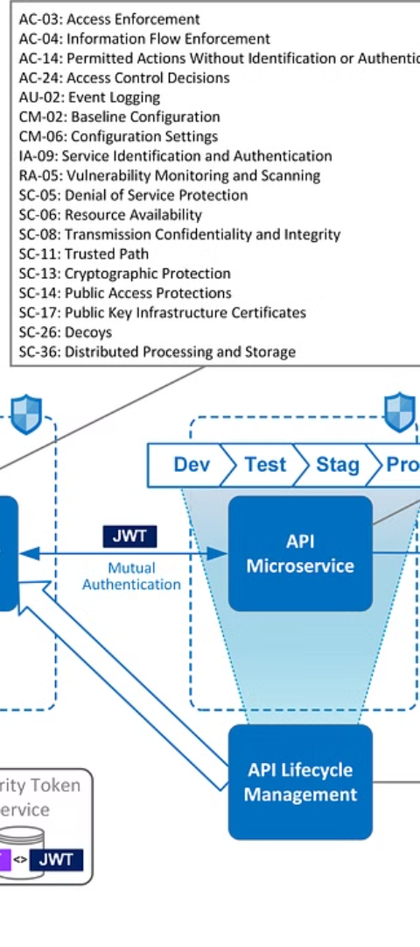



Security Patterns
Access Control
Restricts access to certain features or data to only authorized users.
Firewall
Protects the system from unauthorized access to or from a private network.
Token
Represents a claim of the user’s identity. Can be used for authentication purposes.

Slide 8
Offline Sync Patterns
Data Synchronization
Conflict Resolution
Ensures data across devices remains consistent and up to date.
Handles the scenario when multiple devices modify the same data simultaneously.

