Slide 1
TIC TAC TOE :
HEADER.py
PYTHON PROJECT :
Perumalla Dharan - AP21110010201
Tarun Teja Kudeti - AP21110010205
Vatala Phalgun - AP21110010223
Dinesh Grandhi - AP21110010240
Hands on using Python - CSE 106L

Slide 2
Table Of ‘Contents’ {
01
02
03
HEADER.py
Introduction
Modules used
Sample Outputs
}

Slide 3
01
Introduction:
HEADER.py
Tic-Tac-Toe is one of the paper-and-pencil games. This game requires two players in 3x3 grid with Player 1 acts as “O” and Player 2 acts as “X”, or vice versa. The objective of this game is to take place of three connecting grids in a horizontal, vertical, or diagonal way/fork.

Slide 4
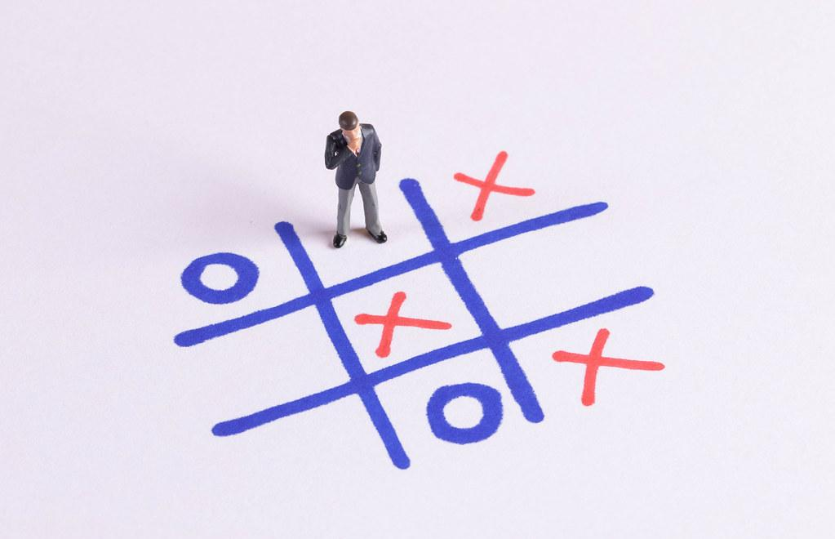
HEADER.py

Slide 5
02
Modules Used:
HEADER.py
Initializing Window
pg.init()
fps = 30
CLOCK = pg.time.Clock()
screen = pg.display.set_mode((width, height+100),0,32)
pg.display.set_caption("Tic Tac Toe")

Slide 6
HEADER.py
2. Loading Images
opening = pg.image.load('tic tac opening.png')
x_img = pg.image.load('x.png')
o_img = pg.image.load('o.png')

Slide 7
HEADER.py
3. Check Win Condition for Rows
for row in range (0,3):
if ((TTT [row][0] == TTT[row][1] == TTT[row][2]) and(TTT [row][0] is not None)):
# this row won
winner = TTT[row][0]
pg.draw.line(screen, (250,0,0), (0, (row + 1)*height/3 -height/6),\
(width, (row + 1)*height/3 - height/6 ), 4)
break

Slide 8
HEADER.py
4. Check Win Condition for Columns
for col in range (0, 3):
if (TTT[0][col] == TTT[1][col] == TTT[2][col]) and (TTT[0][col] is not None):
# this column won
winner = TTT[0][col]
#draw winning line
pg.draw.line (screen, (250,0,0),((col + 1)* width/3 - width/6, 0),\
((col + 1)* width/3 - width/6, height), 4)
break

Slide 9
HEADER.py
5. Check Win Condition for Diagonals
# check for diagonal winners
if (TTT[0][0] == TTT[1][1] == TTT[2][2]) and (TTT[0][0] is not None):
# game won diagonally left to right
winner = TTT[0][0]
pg.draw.line (screen, (250,70,70), (50, 50), (350, 350), 4)

Slide 10
HEADER.py
6. Reset Game
def reset_game():
global TTT, winner,XO, draw
time.sleep(3)
XO = 'x'
draw = False
game_opening()
winner=None
TTT = [[None]*3,[None]*3,[None]*3]

Slide 11

03
Sample Outputs:
HEADER.py

Slide 12
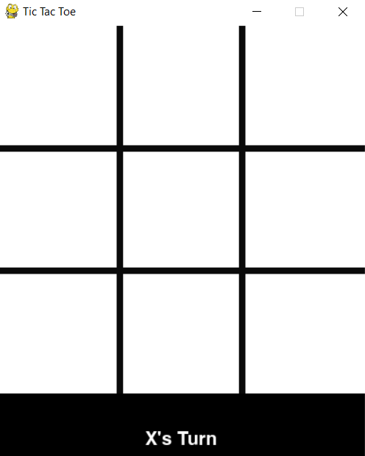
HEADER.py

Slide 13
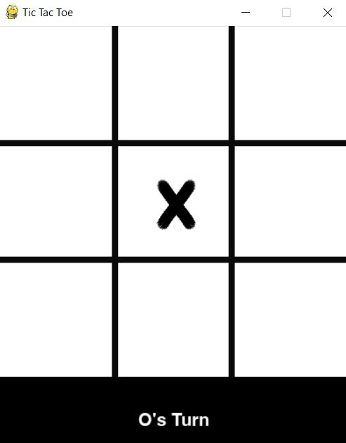
HEADER.py

Slide 14
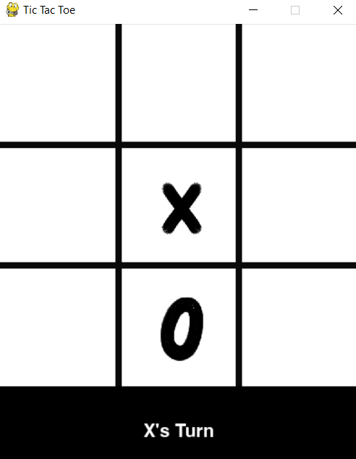
HEADER.py

Slide 15
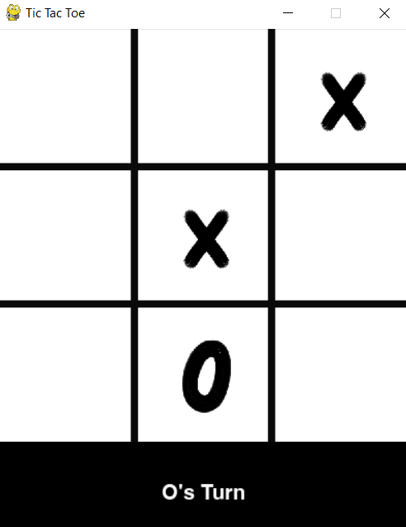
HEADER.py

Slide 16
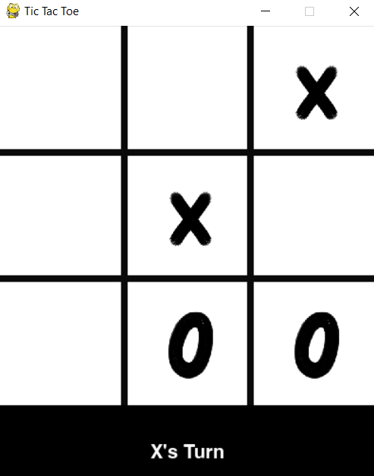
HEADER.py

Slide 17
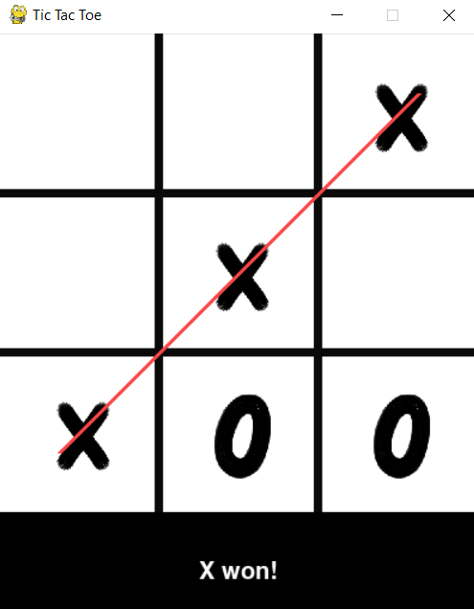
HEADER.py

Slide 18
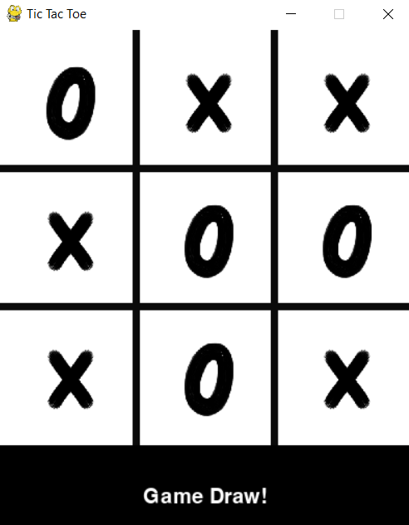
HEADER.py

Slide 19
HEADER.py
print(“THANKYOU”)

