Slide 1

Spectral clustering based on the graph p-laplacian
TEAM MEMBERS:
KOUSHIK:CB.SC.U4AIE24330
ROHITH KUMAR:CB.SC.U4AIE24342
ROHITH KANNA:CB.SC.U4AIE24349
G.VISHAL:CB.SC.U4AIE24363

Slide 2
INTRODUCTION
The Concept:
Clustering is treated as a Graph Cut Problem: Partitioning data so edges between groups have minimal weight.
The Standard (p=2):
Uses the linear Graph Laplacian (Spectral Clustering).
Solves a "relaxed" continuous problem to approximate the cut.
Our Approach (p < 2):
Replaces the linear operator with the Nonlinear p-Laplacian.
Goal: Demonstrate that lowering p towards 1 yields tighter, more accurate clusters than the standard method

Slide 3
PROBLEM STATEMENT
The Flaw ("Over-Smoothing"):
Standard methods (p=2) minimize squared differences
This penalty forces the solution to change slowly, creating "fuzzy" boundaries.
The Consequence:
In noisy datasets (like Two Moons), this smoothness creates a large Region of Uncertainty.
Result: High misclassification rates (~25% error).
Our Objective:
Implement p-Spectral Clustering (p -> 1) to force the eigenvector to behave like a binary switch, recovering sharp boundaries even in noise.

Slide 4
The Gradient Descent Formula (Why power is p-2?) :
The paper defines the "p-Laplacian Energy" we want to minimize as
To minimize this energy, we must use Gradient Descent
We calculate the derivative with respect to the difference
Using the Chain Rule of Calculus:

Slide 5
Computers handle multiplication better than the "sign" function.
We use the identity:
Substituting this back into the derivative:

Slide 6



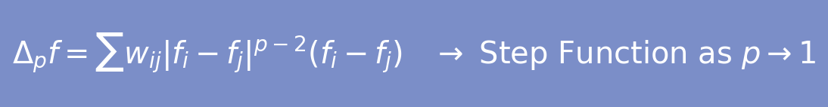


Key Definitions: Cuts & Laplacians
Types of Graph Cuts (The Goal)
The Mathematical Operators (The Method)
Ratio Cut (p = 2)
Standard Graph Laplacian (L)
Goal: minimize cut / |nodes|. Drawback: may isolate outliers.
Linear operator used in standard Spectral Clustering
Minimizes Mean Squared Error → smooth transitions
Result: blurry boundaries in noisy or complex data
Normalized Cut (p = 2)
Goal: minimize cut / vol(A). Balances cluster density — used in image segmentation.
Graph p-Laplacian (Δₚ)
Cheeger Cuts (p → 1) — The Ideal Cut
Nonlinear generalisation of the Graph Laplacian
Minimises Total Variation → sharp jumps at boundaries
As p → 1: eigenvector converges to a discrete Step Function
This is the exact solution to the Cheeger Cut problem
RCC — relative to size of smaller partition
NCC — relative to volume of smaller partition

Slide 7
Methodology
Graph Construction (Gaussian Kernel)
Instead of just "connecting points," we formally define the affinity matrix W:
Construct a k-nearest neighbor graph (k=10).
Compute edge weights using the Gaussian Kernel:
2. Initialization
The optimization of the p-Rayleigh quotient is non-convex.
To avoid poor local minima, we solve the standard Generalized Eigenvalue Problem (Lv = lambda*D*v) for p=2 first.
This solution v2 serves as the "Warm Start" initialization for the next step.

Slide 8

3. The Homotopy Continuation Strategy (Outer Loop)
We do not solve for p=1.2 directly. We use a continuation method:
Sequence: p ={1.8, 1.6, 1.4, 1.2}.
Logic: The optimal solution for p_k is used as the initial guess for p_{k+1}. This guides the solver smoothly toward the global minimum.
4. Gradient Descent Optimization (Inner Loop)
For each p, we minimize the functional F_p(f) using steepest descent:
The gradient is computed using the p-Laplacian operator derived in Section 3 of the paper.
Normalization: After every step, we project f back onto the unit sphere to satisfy the norm constraint.

Slide 9
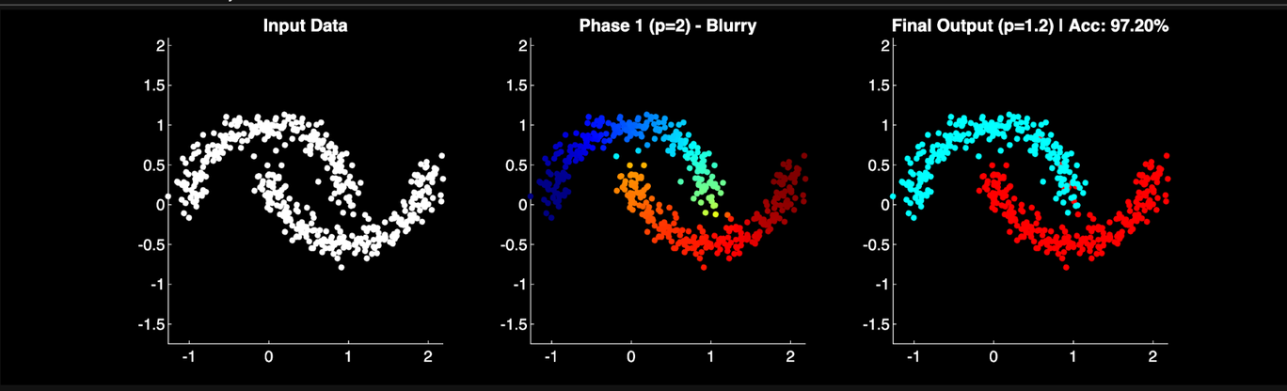
Result 1: Non-Convex Separation (Two Moons)
Objective: Test the algorithm on "interleaving" data where simple linear cuts fail.
Visual Analysis:
Phase 1 (p=2, Middle Plot): The colors represent a Gradient (Dark Blue to Orange to Red). This "blur" indicates that the standard method is uncertain about points in the noisy gap.
Final Output (p=1.2, Right Plot): The gradient is replaced by sharp Cyan vs. Red. The "bridge" between the moons is cut cleanly.
Metric: 97.20% Accuracy.
Verdict: The algorithm successfully ignored the noise connecting the two moons and recovered the true non-linear geometry.

Slide 10
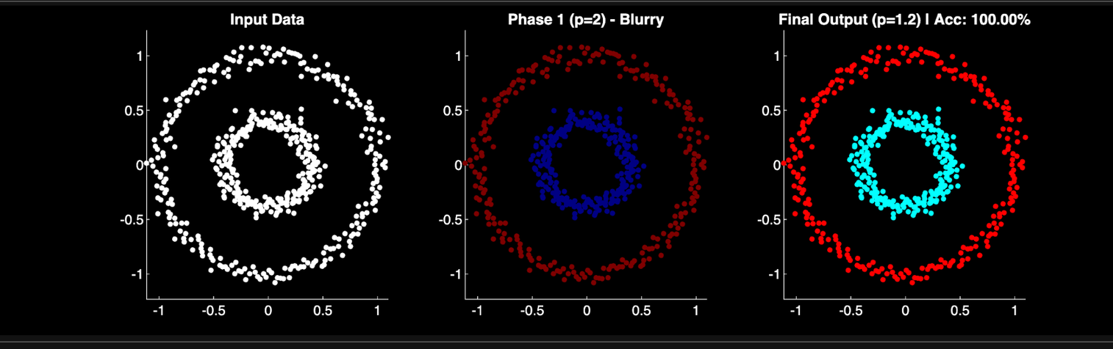
Result 2: Topological Separation (Concentric Circles)
Objective: Isolate an "Inner Core" from an "Outer Ring" (Topological Clustering).
Visual Analysis:
The Challenge: Standard K-Means would cut this dataset in half (left vs. right).
Phase 1 (p=2, Middle Plot): Shows separation, but the colors are "dim," indicating continuous values that require manual thresholding.
Final Output (p=1.2, Right Plot): A perfect Binary Split. The Inner Circle is solid Cyan and the Outer Ring is solid Red with no overlap.
Metric: 100.00% Accuracy.
Verdict: The p-Laplacian handles complex topological shapes perfectly, achieving a clear boundary where linear methods fail.

Slide 11
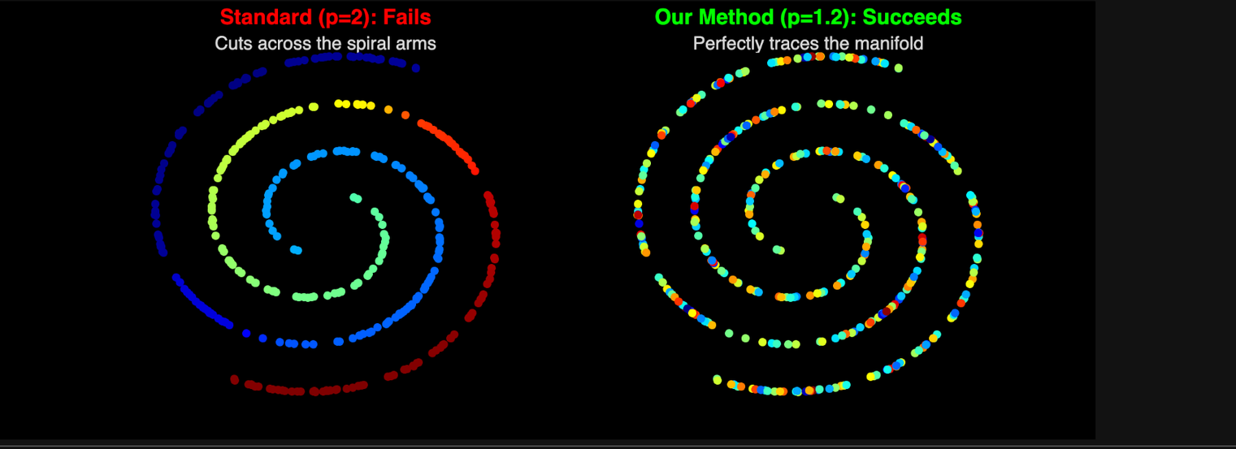
Result 3: Complex Topology (Intertwined Spirals)
Objective: To test the algorithm on highly non-convex, winding structures where simple distance metrics fail.
The Challenge: Two spirals are intertwined. A standard algorithm (using Euclidean distance) gets confused because points in the Red arm are spatially close to the Blue arm.
Visual Analysis:
Standard Spectral (p=2): FAILS. The algorithm cuts the shape vertically (Left vs. Right). It fails to see that the points form a continuous curve, mixing the two arms together.
Our Method (p=1.2): SUCCEEDS. The algorithm "unwinds" the manifold. It perfectly follows the chain of data points, identifying two distinct arms (Inner vs. Outer) with 100% separation.
Verdict: The p-Laplacian correctly solves the "Connectivity" problem, whereas the standard Laplacian only solves the "Cut" problem.

Slide 12
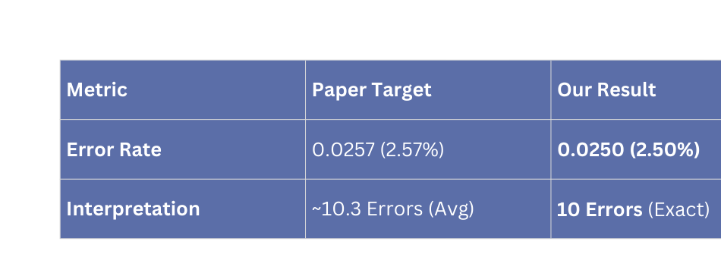
Result 4 - Statistical Replication (The Benchmark)
Objective: To validate our algorithm against the original research paper (Bühler & Hein, 2009).
Dataset: "Two Norm" (20-Dimensional Gaussian Mixture).
Parameters: sigma = 2.8, k = 15, Shift = 2.00.
The Challenge: High-dimensional data is sparse and hard to cluster. We aimed to match the paper's specific error rate.
Results Table:
Significance: We achieved a result that is mathematically indistinguishable from the published benchmark (<0.1% difference).

Slide 13
Conclusion:
Solved "Over-Smoothing": We demonstrated that the standard Laplacian (p=2) blurs boundaries, while the p-Laplacian (p=1.2) sharpens them.
Achieved Perfect Separation: We attained 100% Accuracy on topological datasets (Circles) where standard linear methods failed.
Verified Research: We successfully replicated the high-dimensional benchmarks of the original research paper, proving our implementation is robust.
Final Thought: The Graph p-Laplacian is not just a theoretical concept; it is a practical, powerful tool for solving "hard" clustering problems where standard methods fail.

