Slide 1


Welcome to TensorFlow!
Introduction to TensorFlow
18/05/2017

Slide 2

Syllabus
TensorFlow Overview
Why TensorFlow?
Tensors, Graphs and Sessions
Constants, variables, basic operations and types
Control dependencies
Placeholders and feeding inputs
Linear regression
Optimizers
Loss functions
Logistic regression

Slide 3
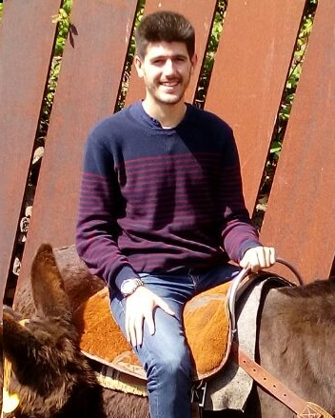
Instructor
Albert Climent Bigas
B.S. in Physics and M.S. in Automatic Control and Robotics
Data Scientist at Pervasive Technologies
albert.climent@pervasive-tech.com

Slide 4
Goals
Understand TF’s computation graph approach
Explore TF’s built-in functions
Learn how to build and structure ML models.

Slide 5
Books
TensorFlow for Machine Intelligence (TFFMI)
Hands-On Machine Learning with Scikit-Learn and TensorFlow. Chapter 9: Up and running with TensorFlow
Fundamentals of Deep Learning. Chapter 3: Implementing Neural Networks in TensorFlow (FODL)
TensorFlow is being constantly updated so books might become outdated fast
Check tensorflow.org directly

Slide 6
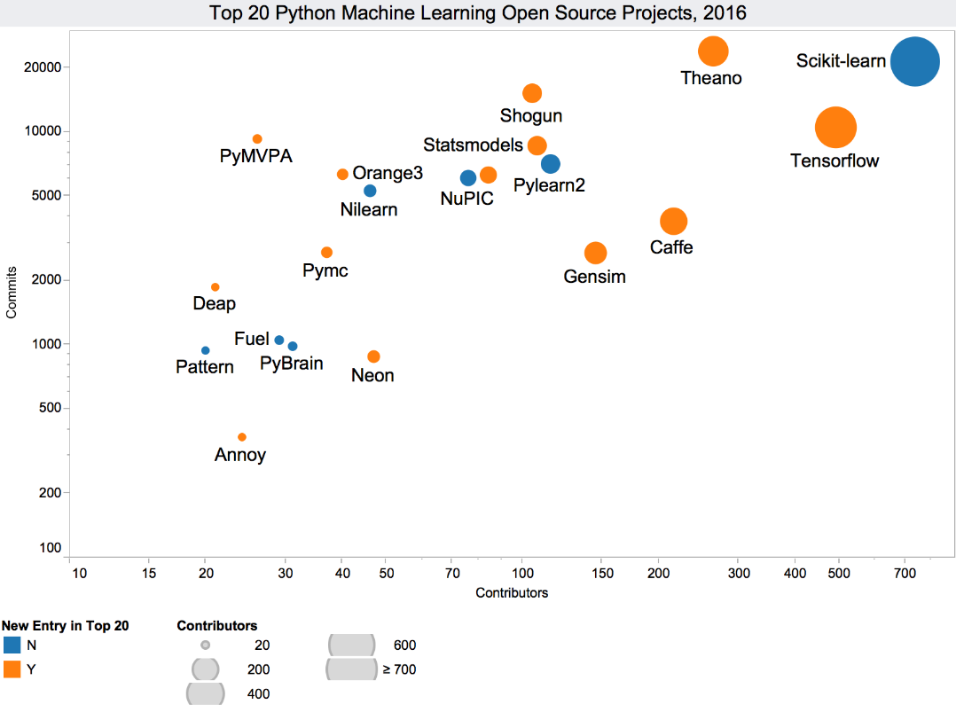
TF is not the only Machine learning library
Open source ML projects:
TensorFlow
Scikit learn
Theano
Pylearn2
Caffe
Source: Kdnuggets News

Slide 7
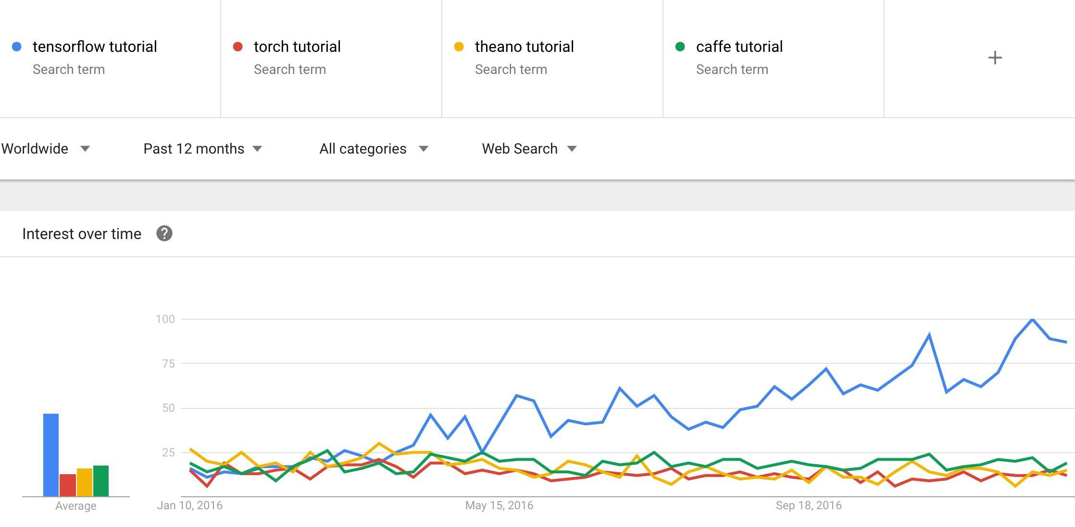
Why TensorFlow?

Slide 8
Why TensorFlow?
Python API
Portability: deploy computation to one or more CPUs or GPUs in a desktop, server, or mobile device with a single API
Flexibility: from Raspberry Pi, Android, Windows, iOS, Linux to server farms
Visualization (TensorBoard is da bomb)
Checkpoints (for managing experiments)
Auto-differentiation autodiff (no more taking derivatives by hand. Yay)
Large community (> 10,000 commits and > 3000 TF-related repos in 1 year)
Awesome projects already using TensorFlow

Slide 9
Companies using Tensorflow
Google
OpenAI
DeepMind
Snapchat
Uber
Airbus
eBay
Dropbox
A bunch of startups

Slide 10
Some cool projects using
TensorFlow

Slide 11
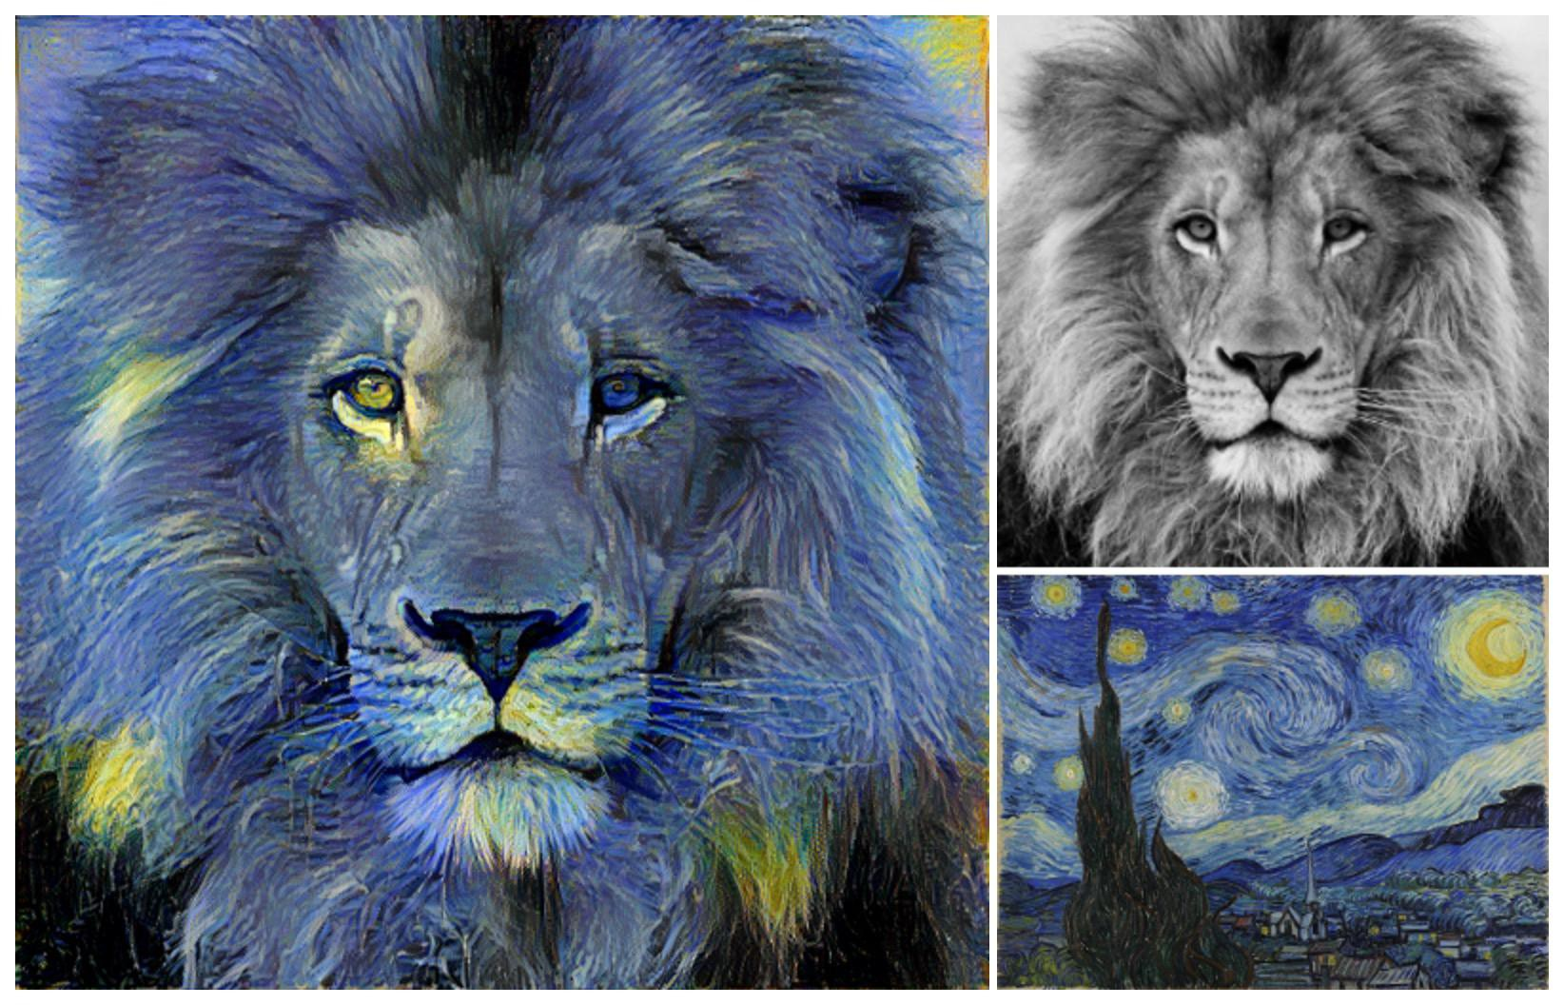
Neural Style Translation
“Image Style Transfer Using Convolutional Neural Networks” by Leon A. Gatys et al. (2016)

Slide 12
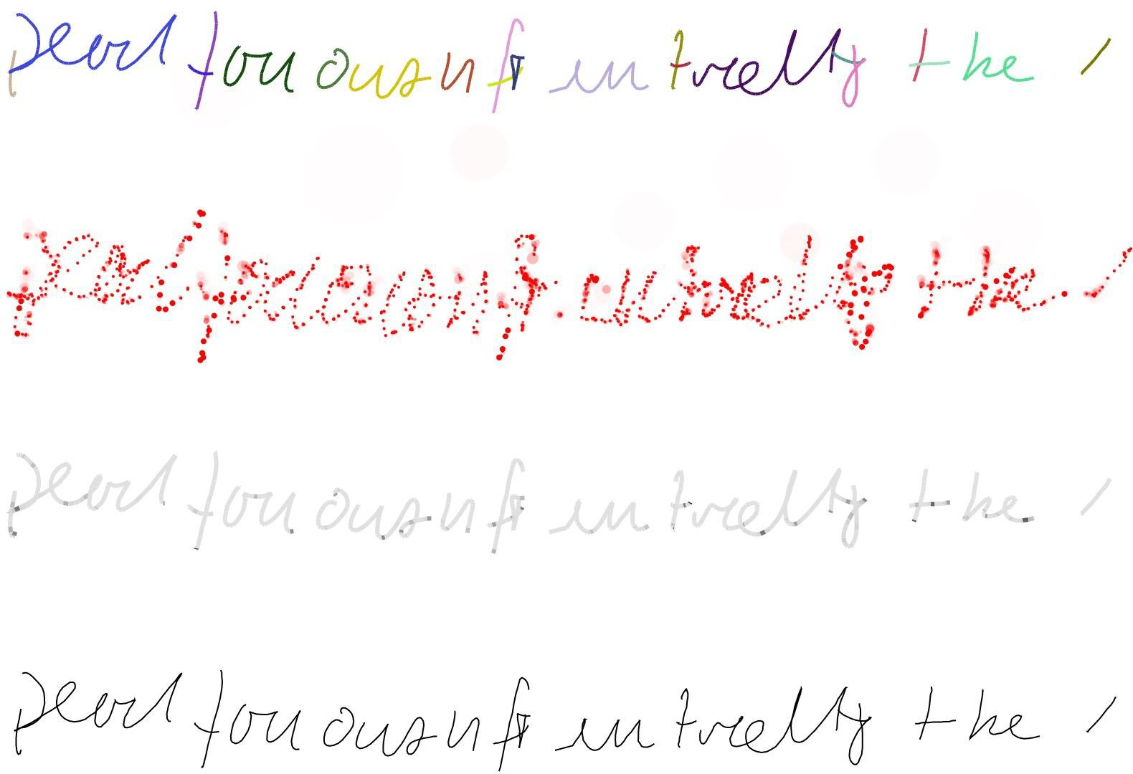
Generative Handwriting
“Generative Handwriting using LSTM Mixture Density Network with TensorFlow” by hardmaru@GitHub (2016)

Slide 13
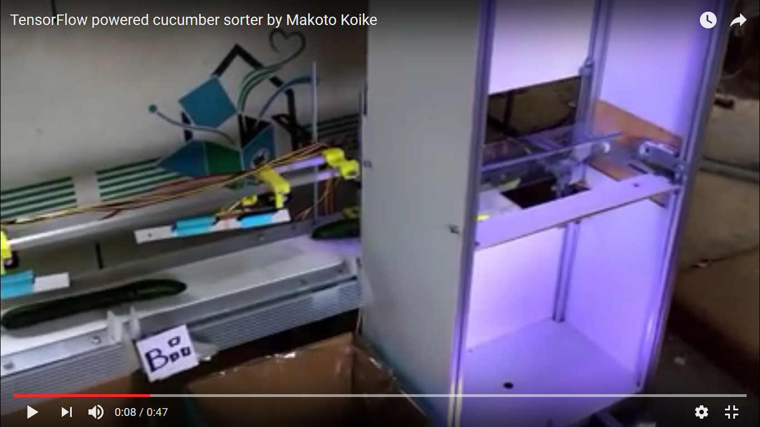
Cucumber Sorter
https://www.youtube.com/watch?v=4HCE1P-m1l8
Cucumber sorter by Makoto Koike

Slide 14
Tensors, Graphs and Sessions

Slide 15

What’s a tensor?

Slide 16
What’s a tensor?
It is a n-dimensional matrix.
0-d tensor: scalar
1-d tensor: vector
2-d tensor: matrix
and so on...

Slide 17
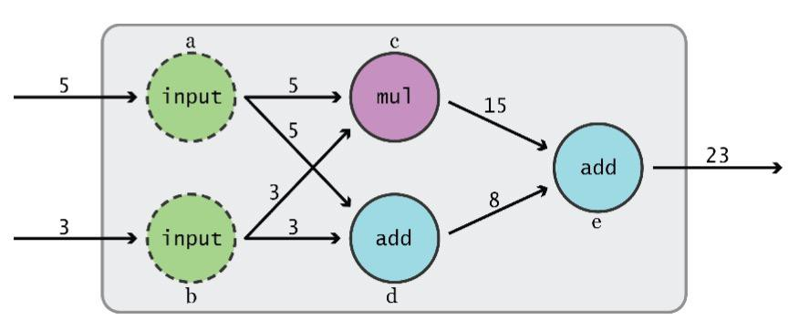
Data Flow Graphs
TensorFlow separates definition of computations from their execution
Graph by TFFMI

Slide 18
Data Flow Graphs
Phase 1: assemble a graph
Phase 2: use a session to execute operations in the graph.
Graph by TFFMI

Slide 19

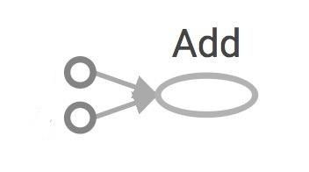
Data Flow Graphs
3
a
5
Nodes: operators, variables, and constants
Edges: tensors

Slide 20
Data Flow Graphs
3
3
5
a
a
5
>> Tensor("Add:0", shape=(), dtype=int32)
(Not 8)

Slide 21
Sessions
A Session object encapsulates the environment in which Operation objects are executed, and Tensor objects are evaluated.

Slide 22
How to get the value of 'a' using a session?
Create a session, assign it to variable 'sess' so we can call it later.
Within the session, evaluate the graph to fetch the value of 'a'

Slide 23
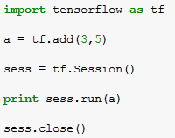
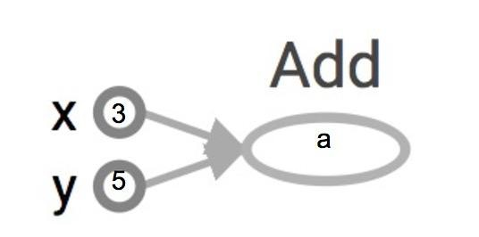
How to get the value of 'a' using a session?
Create a session, assign it to variable 'sess' so we can call it later.
Within the session, evaluate the graph to fetch the value of 'a'
8
The session will look at the graph, trying to think: hmm, how can I get the value of 'a', then it computes all the nodes that leads to 'a'.

Slide 24
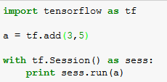
How to get the value of 'a' using a session?
Create a session, assign it to variable 'sess' so we can call it later.
Within the session, evaluate the graph to fetch the value of 'a'
8
The session will look at the graph, trying to think: hmm, how can I get the value of 'a', then it computes all the nodes that leads to 'a'.

Slide 25
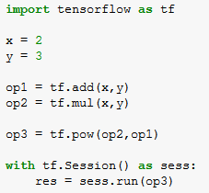
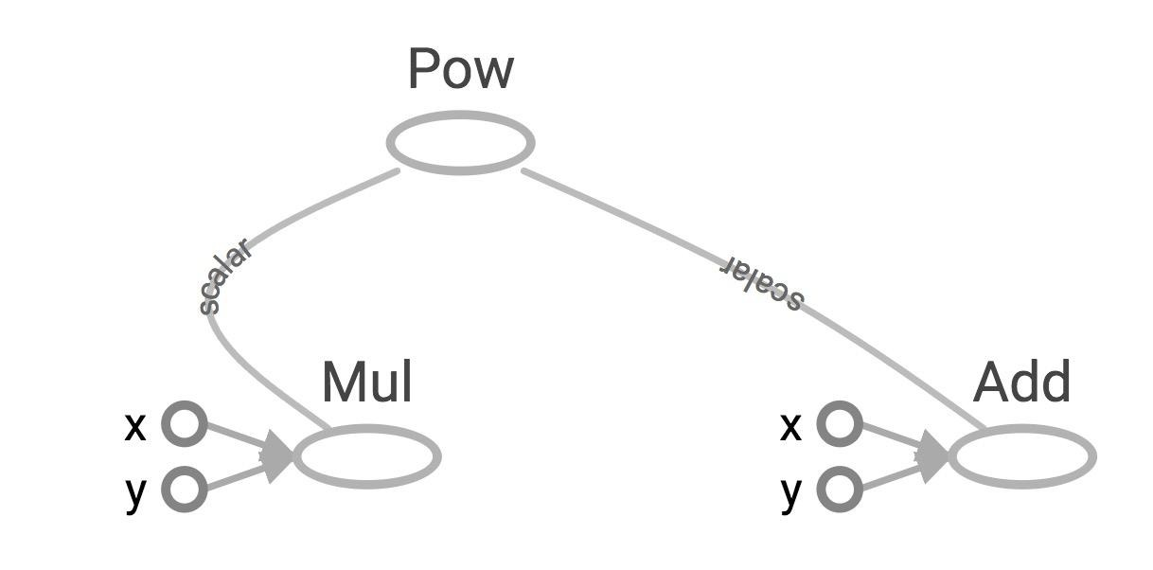
More graphs
Visualized by TensorBoard

Slide 26
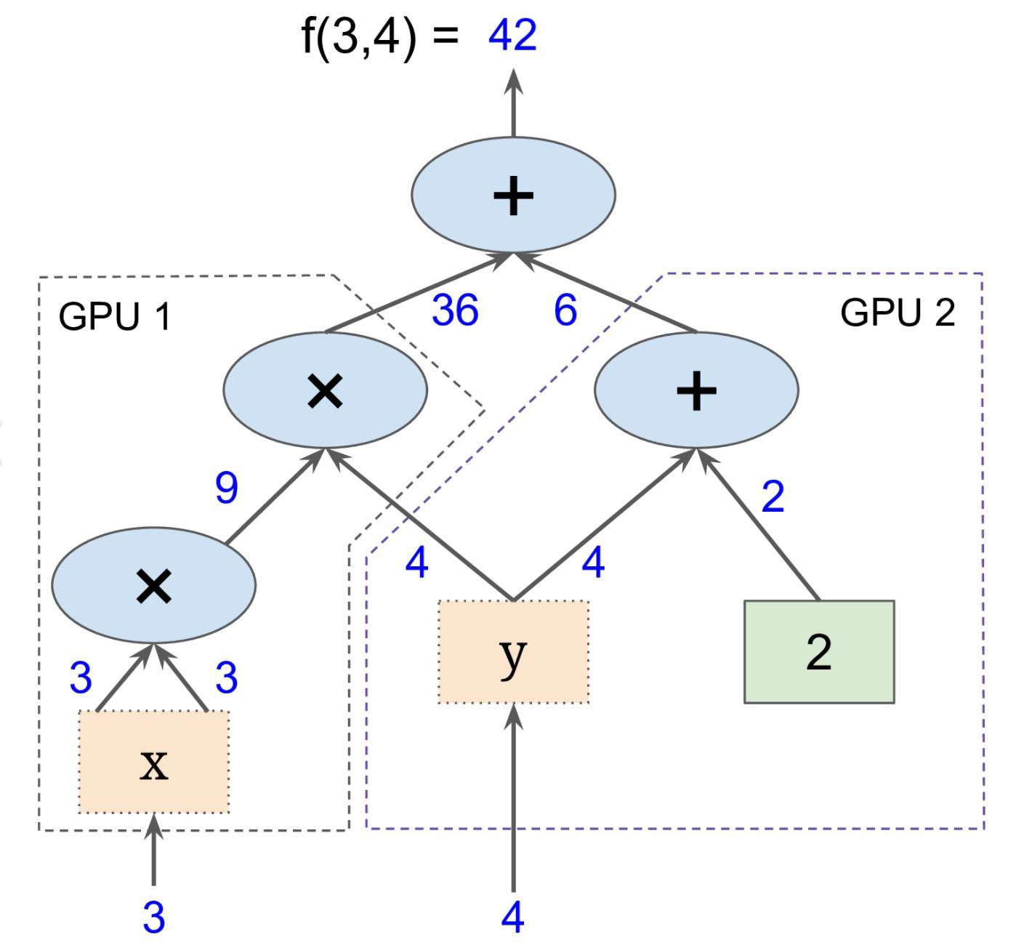
More graphs
It is possible to break graphs into several chunks and run them parallelly across multiple CPUs, GPUs, or devices.
Graph from the book “Hands-On Machine Learning with Scikit-Learn and TensorFlow”

Slide 27
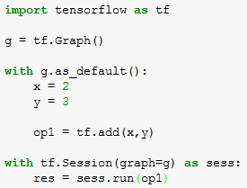
Graphs
You can work with the default graph or you can define different graphs.

Slide 28
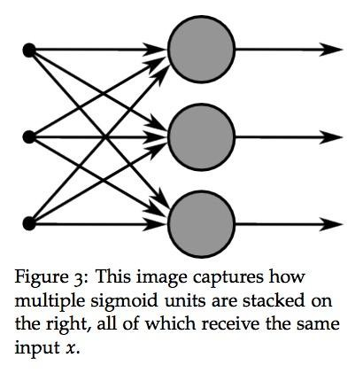
Why graphs
Save computation (only run subgraphs that lead to the values you want to fetch)
Break computation into small, differential pieces to facilitates auto-differentiation
Facilitate distributed computation, spread the work across multiple CPUs, GPUs, or devices
Many common machine learning models are commonly taught and visualized as directed graphs already
A neural net graph by Richard Socher (CS224D)

Slide 29
BREAK!!!

