Slide 1


Basic Models in TensorFlow
Introduction to TensorFlow
31/05/2017

Slide 2
Agenda
Review
Linear regression in TensorFlow Optimizers
Loss functions
Logistic regression on MNIST

Slide 3

Review

Slide 4
Computation graph
TensorFlow separates definition of computations from their execution
Phase 1: assemble a graph
Phase 2: use a session to execute operations in the graph.

Slide 5
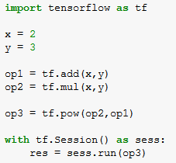
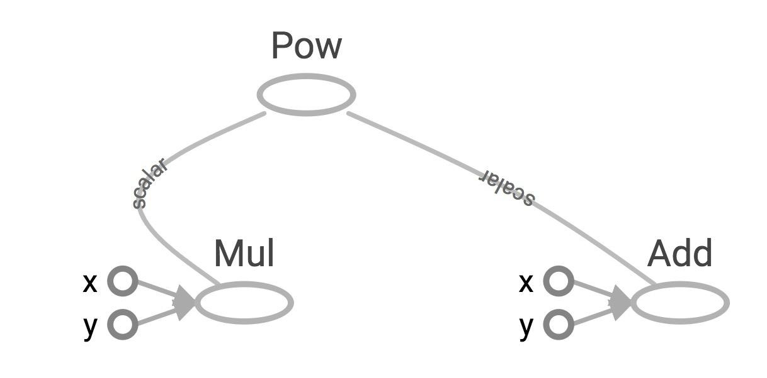
TensorBoard
Visualized by TensorBoard
Create a FileWriter object to write your graph to event files

Slide 6
tf.constant and tf.Variable
Constant values are stored in the graph definition
Sessions allocate memory to store variable values

Slide 7
tf.placeholder and feed_dict
Feed values into placeholders by dictionary (feed_dict)
You can feed values in variables too

Slide 8
Exercise
03_linear_regression_starter

Slide 9
Linear Regression

Slide 10
Model relationship between a scalar dependent variable y and independent variables X

Slide 11
The City of Chicago
X: number of incidents of fire Y: number of incidents of theft

Slide 12
Want
X: number of incidents of fire Y: number of incidents of theft Predict Y from X

Slide 13
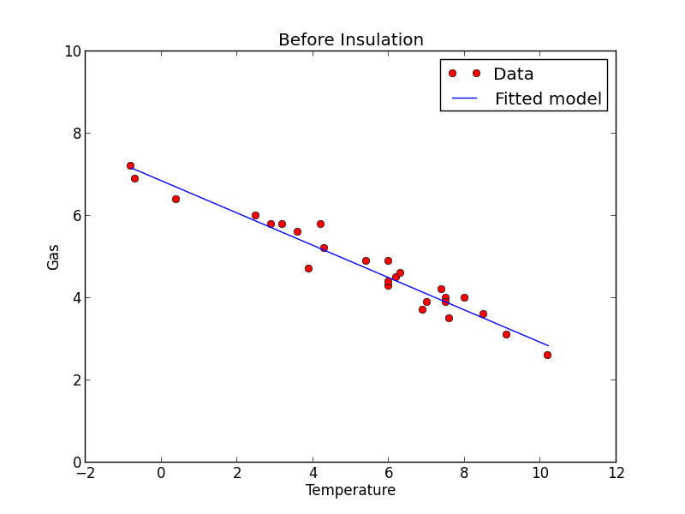
Model
Linear model:
y = W·x+b
Error:
e = (y-y_pred)²

Slide 14
Phase 1: Assemble our graph

Slide 15
Step 1: Read in data
Ialready did that for you

Slide 16
Step 2: Create placeholders for inputs and labels
tf.placeholder(dtype, shape=None, name=None)

Slide 17
Step 3: Create weight and bias
tf.Variable(initial_value=None, trainable=True, collections=None, name=None, dtype=None, ...)

Slide 18
Step 4: Build model to predict Y
y_pred= X * w + b

Slide 19
Step 5: Specify loss function
tf.square(y - y_pred, name="loss")

Slide 20
Step 6: Create optimizer
tf.train.GradientDescentOptimizer(learning_rate=0.001).minimize(loss)

Slide 21
Phase 2: Train our model
Initialize variables
Run optimizer op
(with data fed into placeholders for inputs and labels)

Slide 22
See your model in TensorBoard
Step 1: writer = tf.summary.FileWriter('./my_graph/03/linear_reg', sess.graph)
Step 2: $ tensorboard --logdir='./my_graph'

Slide 23
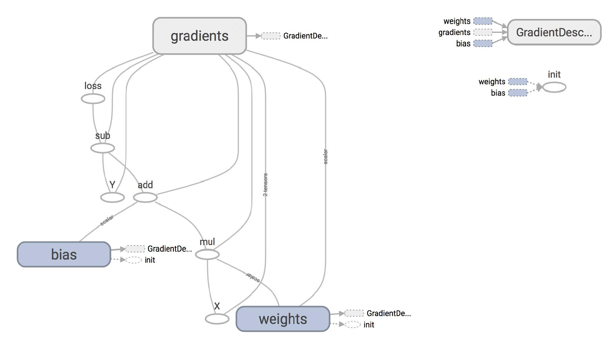

Slide 24
Plot the results with matplotlib
Step 1: Uncomment the plotting code at the end of your program
Step 2: Run it again

Slide 25
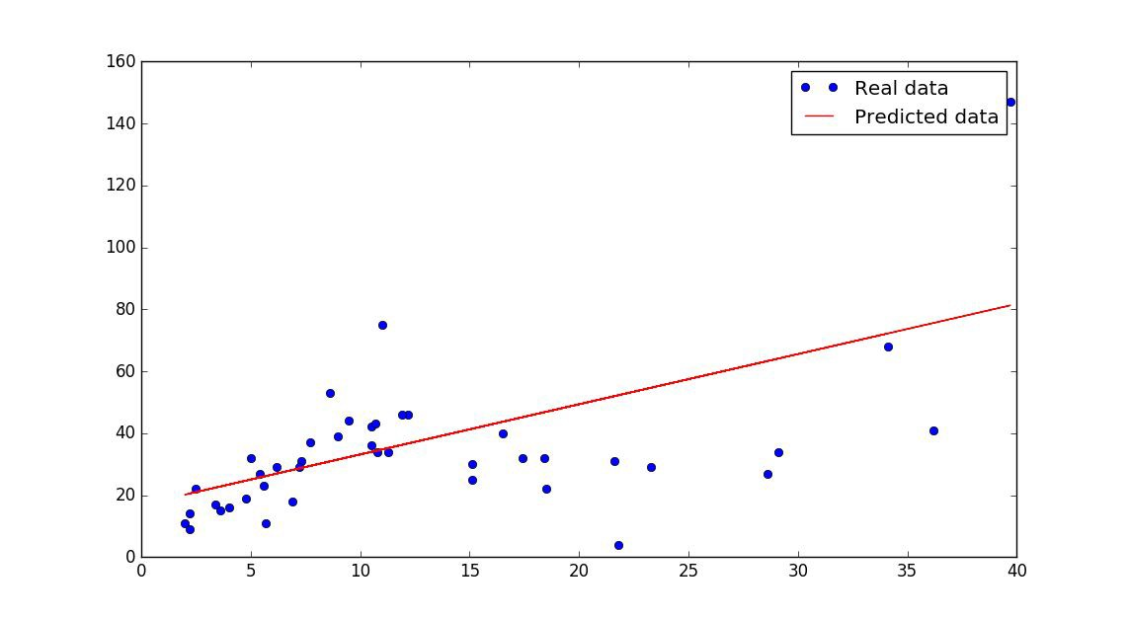

Slide 26
How does TensorFlow know what variables to update?

Slide 27
Optimizer
optimizer = tf.train.GradientDescentOptimizer(learning_rate=0.001).minimize(loss)
_, l = sess.run([optimizer, loss], feed_dict={X: x, Y:y})

Slide 28
Optimizer
optimizer = tf.train.GradientDescentOptimizer(learning_rate=0.001).minimize(loss)
_, l = sess.run([optimizer, loss], feed_dict={X: x, Y:y})
Session looks at all trainable variables that loss depends on and update them

Slide 29
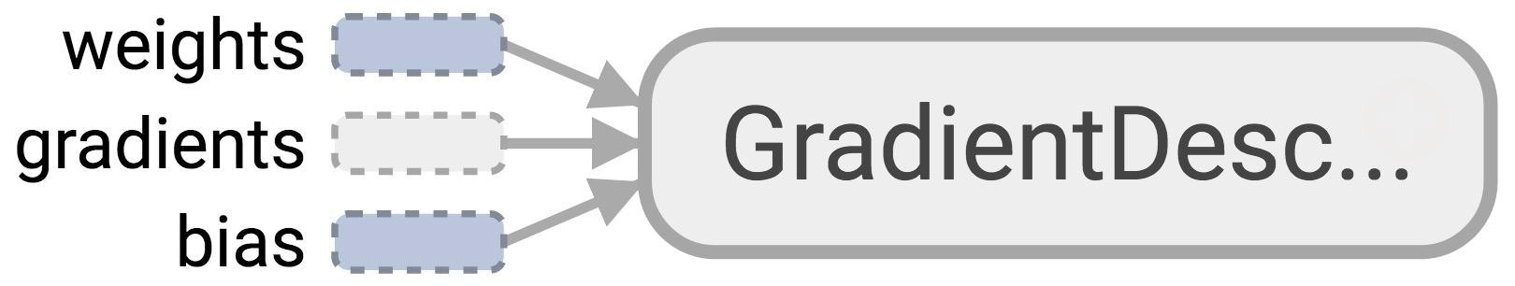
Optimizer
Session looks at all trainable variables that loss depends on and update them

Slide 30
Trainable variables
tf.Variable(initial_value=None, trainable=True, collections=None, validate_shape=True, caching_device=None, name=None, variable_def=None, dtype=None, expected_shape=None, import_scope=None)

Slide 31
List of optimizers in TF
tf.train.GradientDescentOptimizer
tf.train.AdagradOptimizer tf.train.MomentumOptimizer tf.train.AdamOptimizer tf.train.ProximalGradientDescentOptimizer tf.train.ProximalAdagradOptimizer tf.train.RMSPropOptimizer
And more

Slide 32
Discussion question
How to know that our model is correct?
How to improve our model?

Slide 33
How to improve our model

Slide 34
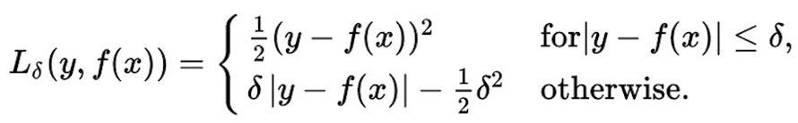
Huber loss
Robust to outliers
Intuition: if the difference between the predicted value and the real value is small, square it
If it’s large, take its absolute value

Slide 35
Implementing Huber loss
Can’t write:
if y-y_pred < delta

Slide 36
Huber loss
def huber_loss(labels, predictions, delta=1.0):
residual = tf.abs(predictions - labels)
condition = tf.less(residual, delta)
small_res = 0.5 * tf.square(residual)
large_res = delta * residual - 0.5 * tf.square(delta)
return tf.select(condition, small_res, large_res)

Slide 37
Exercise
03_logistic_regression_mnist_starter

Slide 38
Logistic Regression

Slide 39
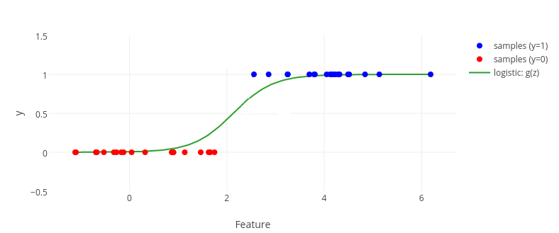
Logistic regression model

Slide 40
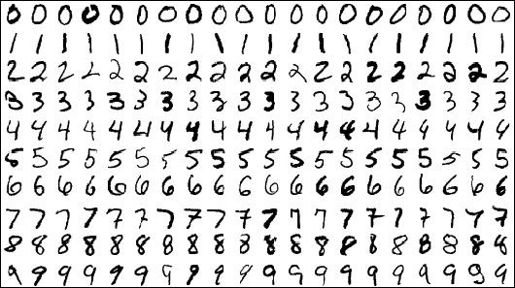
MNIST Database
Each image is a 28x28 array, flattened out to be a 1-d tensor of size 784

Slide 41
MNIST
X: image of a handwritten digit Y: the digit value

Slide 42
MNIST
X: image of a handwritten digit Y: the digit value
Want
Recognize the digit in the image

Slide 43
Model
logits = X*w +b
y_predicted = softmax(logits)
loss = cross_entropy(y, y_predicted)
*Y is a one-hot vector

Slide 44
Process data

Slide 45
Process data
MNIST.train: 55,000 examples
MNIST.validation: 5,000 examples
MNIST.test: 10,000 example

Slide 46
Phase 1: Assemble our graph

Slide 47
Step 2: Create placeholders for inputs and labels
x = tf.placeholder(tf.float32, [batch_size, 784], name="image")
y = tf.placeholder(tf.float32, [batch_size, 10], name="label")

Slide 48
Step 3: Create weight and bias
tf.Variable(initial_value=None, trainable=True, collections=None, name=None, dtype=None, ...)

Slide 49
Step 4: Build model to predict Y
logits = X * w + b

Slide 50
Step 5: Specify loss function
entropy = tf.nn.softmax_cross_entropy_with_logits(logits, Y)
loss = tf.reduce_mean(entropy)

Slide 51
Step 6: Create optimizer
tf.train.GradientDescentOptimizer(learning_rate=0.001).minimize(loss)

Slide 52
Phase 2: Train our model
Initialize variables
Run optimizer op
(with data fed into placeholders for inputs and labels)

Slide 53
Run our model
Average loss epoch 0: 1.28812279526
Average loss epoch 1: 0.732620414598
Average loss epoch 2: 0.600486441648
Average loss epoch 3: 0.53647331619
Average loss epoch 4: 0.497578099683
...
Average loss epoch 9: 0.41295143427
Total time: 8.83596801758 seconds
Optimization Finished!
Accuracy 0.8977

Slide 54
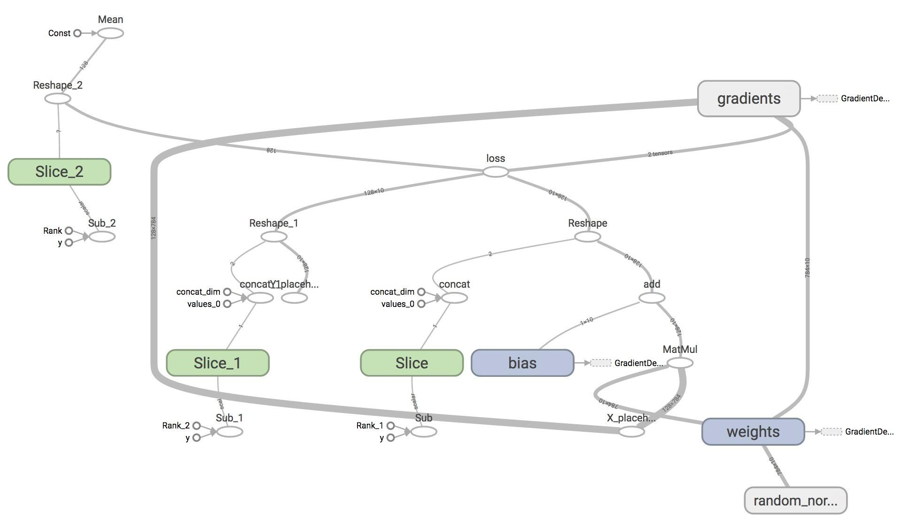
TensorBoard it

Slide 55
Download this course from Git
https://github.com/vertcli/pervasive_academy_introduction_tensorflow

Slide 56
THANKS!!!

