Slide 1

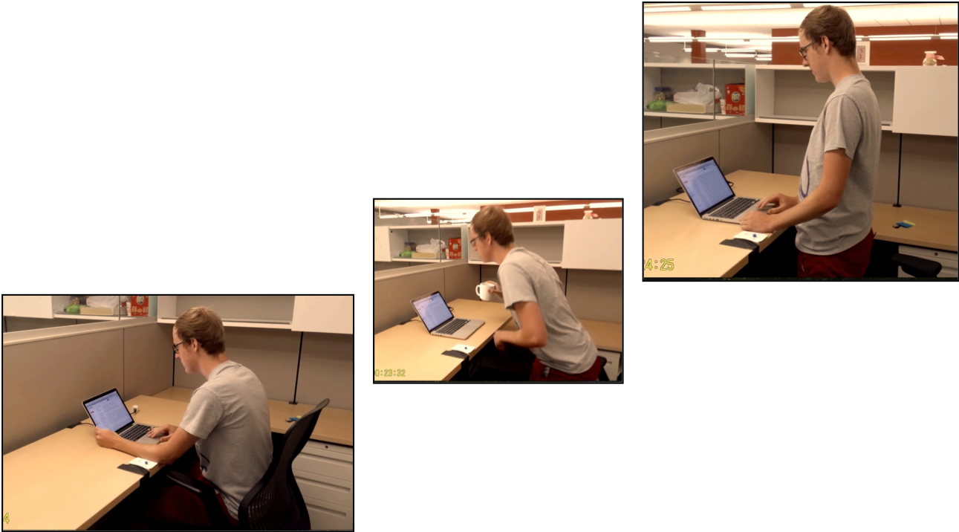
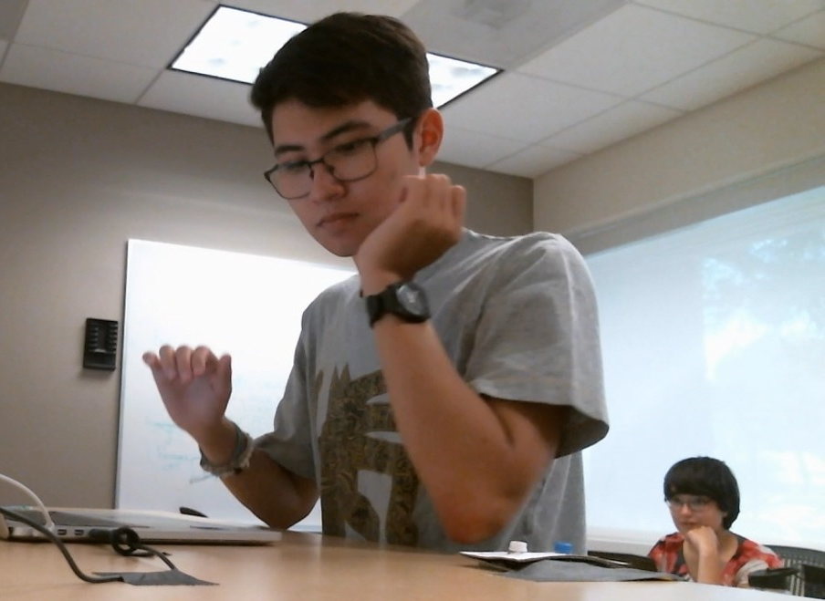

Smart Sit-Stand Desk
Encouraging movement without interrupting workflow
Motivation
What? Switching from sitting to standing and vice versa every 15-30 min is good for your health.
But… 63% of sit-stand desks end up as sitting desks after a few months.
Why? Most people with sit-stand desks simply don’t bother to change the desk height!
Our Innovation
Desk that automatically raises and lowers throughout the work day
rises after 15-30 min
lowers after 15-30 min
Early Feedback
Transitions can be surprising
Spent more time standing
Switched positions more often
Easy to use and override
Easy to understand
Didn’t affect productivity
Affordable Solution
Microcontroller $1.2
Ultrasonic Sensor $2.3
Motor Driver $11.9
Motion Sensor $6.0
Potentiometer $1.4
Total (~2% of desk price) ~$20.0
User Requirements
Snooze when focused on a task
Manual override controls
Warning cue - vibrotactile or sound
Night/power saving mode
Override controls
Next Steps
Controlled study to evaluate attitudes Longitudinal study on adoption rates
Participant reacting to sudden desk movement
Amanda Spyropoulos, Michael Uttmark, Lawrence Domingo, Prof. James Landay, and Dr. Pablo Paredes
School of Medicine - Precision Health and Integrated Diagnostics, Computer Science - HCI
Pervasive Wellbeing Technology Lab - http://med.stanford.edu/pervasivewellbeingtech.html

