Slide 1

17 th August 2022
Topic:
AMAZON ACCESS SAMPLES DATA SET
Gael Tekam Fongouo (280168)
Ahmed Senior Ismail (279701)
Oscar Bediako (280274)
outline

Slide 2
1. Introduction and Visualisation
. Presentation of the dataset
. Explanatory Data Analysis
. Data Cleaning
2. PCA and Clustering using K-mean
3. PCA and Classification using:
3.1 Logistic regression
3.2 Decision Tree
4. Conclusion

Slide 3

Presentation of the dataset:
The data set that we worked on is extracted from the original entire amazon data set which was of size of 4.8 Gb but due to the low performance of our computer we extracted 1000 individuals, but we have preserved the 33264 features associated to everyone. We distinguish the Person attributes category, which describes the ‘user’ which was given access, there are: the user id, the user grouping id(divided in 3 subgroups Rollup_1, Rollup_2, Rollup_3) , the person manager id, the person department name, the person location, the person business title, the person business title detail the person job code, the person company, the person job family id , the region id. The others three attributes are the Resource id, the system support id and the group id, these categories are the resources, the systems and the groups that a user can possibly have access to. A user will have a 1 in those columns if he has access otherwise it will have a 0. All the other attributes excepted the region id(PERSON_LOCATION) are given under the form Attribute_id where the id is an integer. It’s the case as example of the SYSTEM_SUPPORT_id with ranged in the interval [11355, 33262], thus there is 8903 different supports systems that users can have access to.
11355
11355

Slide 4
Explanatory Data Analysis
.The dataset contains 33264 features, we started by dropping all the columns with all values equal to zero, then we remained with 10610 features.
. We noticed that there was another Binaries variables called HOST_id which were not mentioned in the description list of the attributes. There are in total 104 attributes. So the conclusion was that, at least one user has access to each different types of HOST.
. The users have access to only 8903 different types of support system. Also considering the different grouping id attributes of the users PERSON_ROLLUP_1, PERSON_ROLLUP_2, PERSON_ROLLUP_3; we noticed that the ids 2(609 users), 33265(338 users) and 4(609 users) were assigned to the majority of the users respectively. Also the different users Id with respect to 'PERSON_ROLLUP_1', 'PERSON_ROLLUP_2', and 'PERSON_ROLLUP_3' are completely different.
. There are 175 different departments and the majority of the users(204 users) have the id department 33307, Moreover, the majority of the users(387 users) have access to the Job Family Id 33270, moreover this same number of users(the majority) have the Job id 33268, also The ids of certain Job of the users is the same as the id of certain Family Job of others users; this is the case of the id 33270. Furthermore the majority of users(224) have access to the group company whose Id is 33290.

Slide 5
. The 1000 users have the same location, they are all living in the same region( region’s id 6)
. The maximum number of users managed by one manager is 16 and The minimum number of users managed by one manager is 1, also id of managers are completely different from the id of the users.
. Most of the users have (204 users) has the same id Business title 33280 follows by the id 33336 with (201 users) and we have 324 different id business title.
. Since we dropped all the columns having all the values equal to 0, we realized that given the different ids associated to each user with respect to the attributes, none of the users has access to any of the available resources.

Slide 6
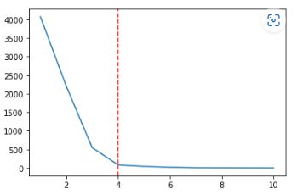
PCA and Clustering using K-mean
We dropped all the features which values are the ids of the users('PERSON_ROLLUP_1', 'PERSON_ROLLUP_2', 'PERSON_ROLLUP_3','PERSON_ID','PERSON_MGR_ID','PERSON_DEPTNAME','PERSON_BUSINESS_TITLE_DETAIL','PERSON_BUSINESS_TITLE','PERSON_JOB_CODE','PERSON_COMPANY','PERSON_JOB_FAMILY’) and we just remain with the binaries attributes which tell us about the possible access or not of a user to a precise category. Thus we remained with 10599 hence we applied the PCA with a number of component equals to 2 then K-Means. But we used the elbow method to find the optimal number of clusters. We have plotted the within cluster sum of square(WCSS) with respect to the number of clusters.

Slide 7
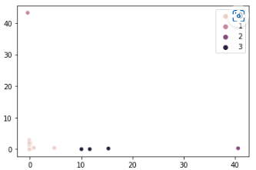
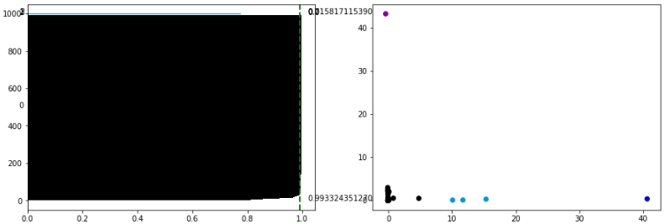
From the elbow method, we realized that the optimal number of cluster is equal to 4, since it corresponds to a lower value of WCSS. Hence using the number equals to 4, we got the result of the figures of clustering below. From the results we remarked that three users we assigned to the cluster 3, one user to both cluster 1 and 2, and the remaining 995 users to the cluster 0. The overall silhouette score obtained is 0.99 which is very close to 1, so we have a very good clustering. Moreover the shape of each cluster is rectangular and the silhouette score with respect to each cluster is of order of 0.9.

Slide 8
3.1 PCA and Classification using Logistic regression.
In this part we just consider the attributes for which elements are the id corresponding to each user. The reason is that we thought that given the different ids assigned to each user with respect to any of the features, this could possibly determine if the users has access to a particular resource or not. Hence we end up having 12 features. Since we don’t want the algorithm to consider the id as quantitative values, we encode each of these features by using the one hot encoder techniques. Once applying the one hot encoder technic, we got 2332 attributes, then we applied the PCA to reduce the dimension of the data, using a number of component equal to 2, from that, we applied the logistic regression to predict if yes or no a user has access to the Binary variable SYSTEM_SUPPORT_11361.
The parameters Beta_0, Beta_1, Beta_1 obtained are -6.549, -0.225 and 1.038. From these parameters we understand the function giving the Logistic Regression will depend on two variables let called them X_1 an X_2, so f=f(X_1, X_2) since we currently have two attributes for each individuals, the results that we obtain considering both features and one features are represented in 3D and 2D as well as the confusion matrix on the following figures.

Slide 9
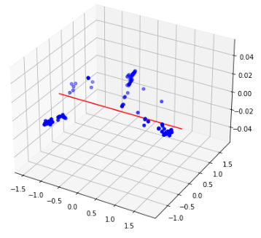
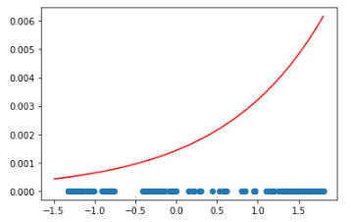
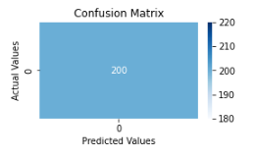

Slide 10

From the figures above, we can conclude that Logistic regression fit very well, since from the confusion matrix the number of true positive is equal to 200, and the precision of the model is equal 1(meaning 100 percent).

Slide 11
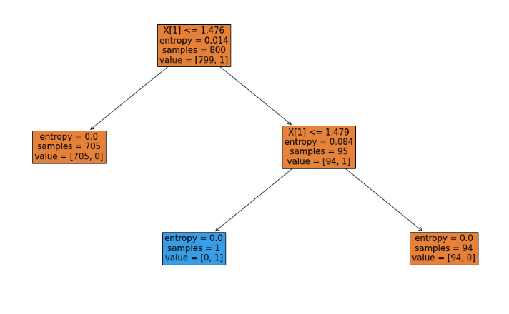
3.2 PCA and Decision Tree
Taking the same data obtained from the previous PCA, we applied now Tree Decision and we obtain the training and the testing accuracy respectively equal to 1 and 0.995. From these results we conclude that Decision Tree Method perform very well. The result obtained is shown on the following figure.

Slide 12
Also the entropy at each root node is very low, of order of 0.01, meaning that for sure we have good splits.

Slide 13
Conclusion
In this work in the first part we have clustered the users based on their accessibility or not to certain resources or support systems, and we have found that the combination of the PCA and the K-mean algorithm give very good clustering results of the users with an average silhouette score of 0.9. In the other side we have found that the different Ids associated to each user allow to know if a user has access or not to a certain resource and support system. And to achieve this task we did a combination of the PCA with a logistic regression algorithm and a Decision Tree. We found that the combination of the PCA with logistic regression gives a very good result compare to when it is combined with Decision Tree. Hence since we used those schemes to predict the access to the support system 11361 (SYSTEM_SUPPORT_11361) we can also use these schemes to predict users access to other support systems and resources.

Slide 14


Slide 15




