Slide 1
Enumeration

Slide 2
Outline
Enums
Working with Enums
Conclusion

Slide 3
Enums ?
Java 5 introduced the data type enum.
Enums are type-safe constructs, meaning that represents a FIXED list of values and can't be reassigned.

Slide 4
KEY POINT
Enums are singletons.
You cannot create an instance of an enum by using the new operator.
A constructor in an enum class can only be specified as private. Enums are not allowed to have a public constructor, or the compiler will complain with following message: "Illegal modifier for the enum constructor; only private is permitted”.
An instance of an enum is created when the enum is first referenced.
Enums are thread-safe by default (meaning that you don't need to do double checks when creating them).

Slide 5

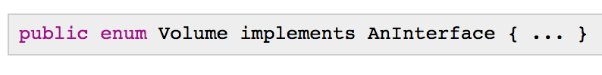
RULE
Enums are implicitly declared public, static, and final, which means you cannot extend because all enums extend from java.lang.Enum
CAN do is implement interfaces:

Slide 6
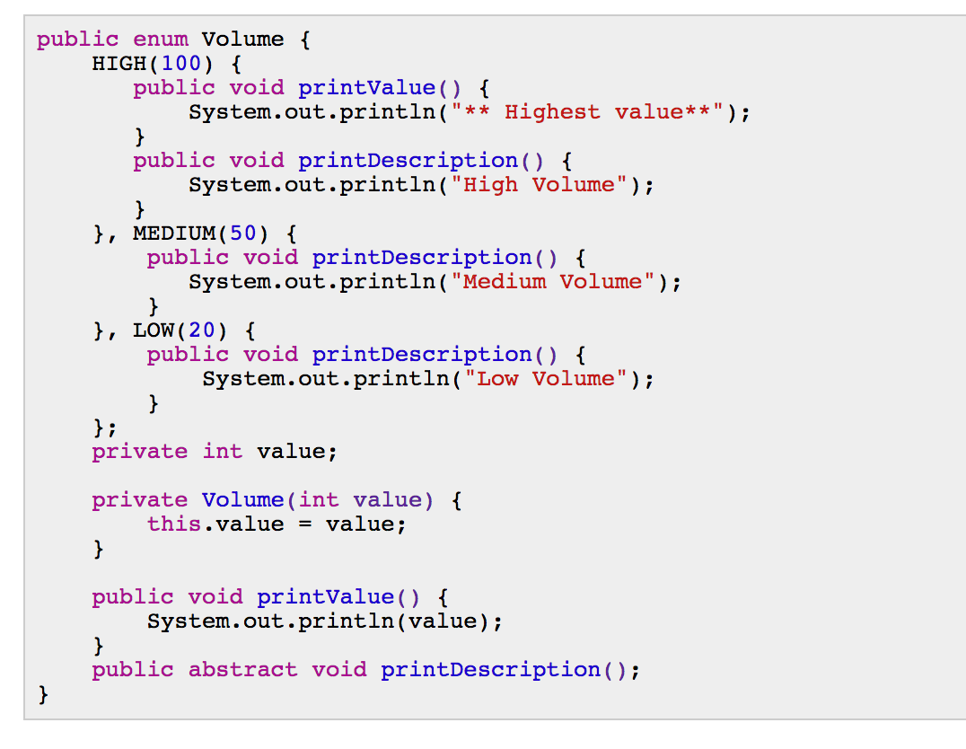
RULE
When working with enums is overriding methods and implementing abstract methods.

Slide 7
RULE
If you declare an enum within a class, then it is by default static.
You can compare two enumerations for equality using == operator.
If enumeration constants are from two different enumerations, the equals() method does not return true.
Enumeration constants cannot be cloned. An attempt to do so will result in a CloneNotSupportedException.

Slide 8
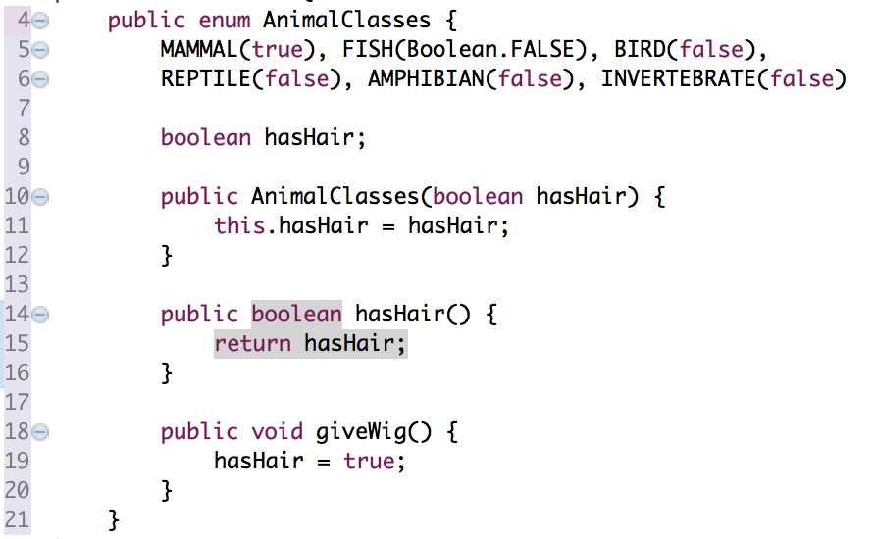
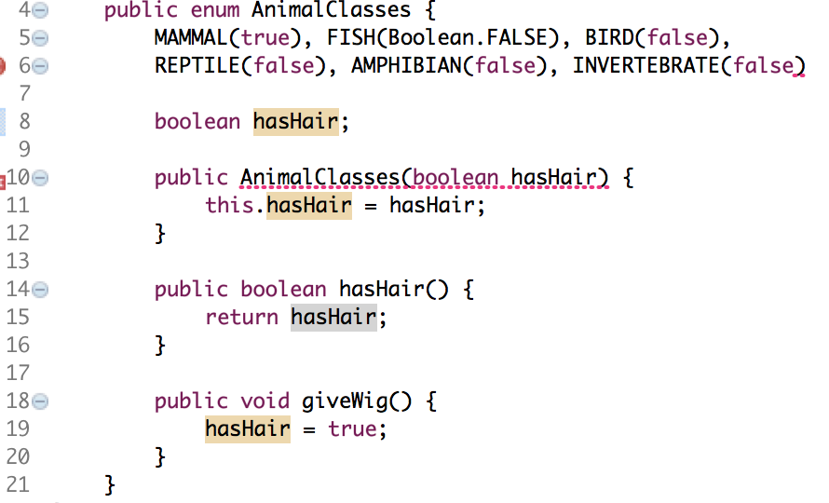
Rule
Enums are required to have a semicolon after the list of value.

Slide 9
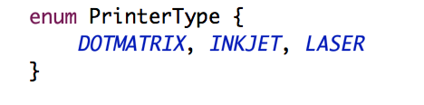
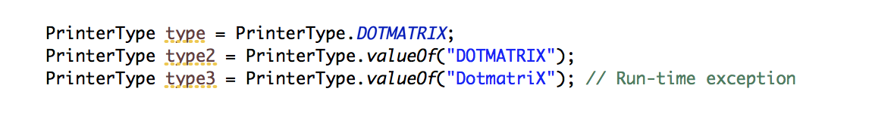
How to get a reference of an enum.
Reference directly
You can apply the valueOf() and name() methods to the enum element to return the name of the enum element.
Get an enum from a string (be careful* case sensitive)

Slide 10
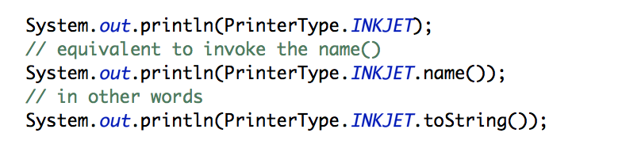
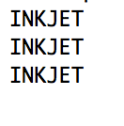
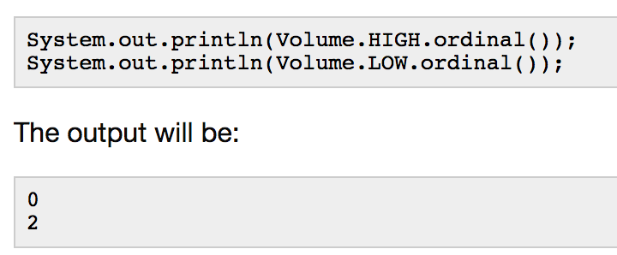
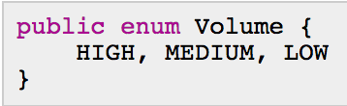
Working WITH ENUMS
name() method its equivalent to invoke the name() method that all enums have
ordinal() method of an enum returns its corresponding int value. Like arrays, enums are zero based. Remember that the index of an enum may change when you recompile the code and should not be used for comparison.

Slide 11
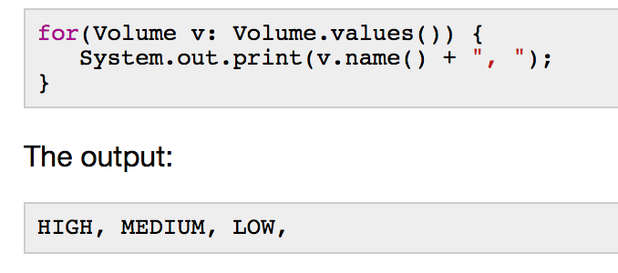
The static values() method in the Enum class returns an array of the enumeration constants when called on an enumeration type.

Slide 12
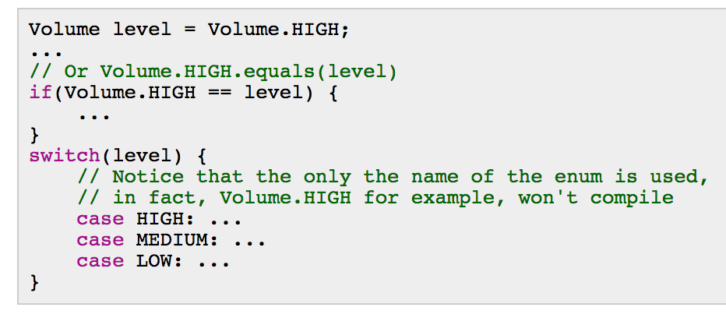
Switch-case
A case statement on an enum data type must be the unqualified name of an enumeration constant. For example, case VANILLA would be valid. You cannot use the ordinal equivalents. Therefore, the code does not compile.

Slide 13
Conclusion
Enum is a type that represents a FIXED list of values, providing type-safe.
Enums can define constructors, but they must be private.
You cannot create an instance of an enum by using the new operator.
Enums are implicitly public, static and final.
Enums can be compared against other enums using the == operator and the equals() method.
Enums can be used in switch statements.
Enums can implement interfaces, but they cannot extend from a class since they implicitly extend from java.lang.Enum.
Enums are the easiest way to implement singletons.

