Slide 1

LOAN ORIGINATION SYSTEM
Presented By
1.Mohammad Labeeb
2.Farhan Ansari
3.Nandan Gowda
4.Malave Navanishwara Rao
5.Pesala Gouthami
6.Kattiboina Satya Narayana
APRIL 2025

Slide 2

AGENDA
Introduction & Problem Statement
Solution Approach & Implementation
ER Diagram with Cardinality Ratios
Key Features of System
Tools and Skills Used
Login Module
Multilingual Module
Customer Details Module
Customer Search Module
Apply Loan Module
Loan History and Transactions Module
Future Enhancements & Learnings
Conclusion

Slide 3
Introduction & Problem Statement
The objective of this Proof of Concept (POC) is to develop a basic workflow for loan origination, allowing employees to efficiently manage customer loans within a secure and multilingual application.
Overview:
Streamlined Loan Processing:
Empowers employees with tools for secure and accurate loan origination.
Simplifies customer management with integrated workflows.
Multilingual Support:
Provides a user-friendly experience for employees by offering language choices (English, Spanish, French).
Scalable and API-Driven Architecture:
Ensures robust data handling with optimized database communication.
Supports future enhancements with an adaptable design.

Slide 4
Solution Approach & Implementation
Agile Methodology:
We adopted the agile methodology to ensure a flexible and iterative approach to developing our Loan Origination System (LOS).
This allowed us to continuously refine our solution based on feedback and evolving requirements.
Collaboration with GitHub:
For seamless collaboration, we utilized GitHub.
API Design:
Following the initial analysis, we focused on designing the contracts and endpoints of our API.
. Project Initiation:
Our journey began with the project architects, who meticulously analyzed the problem statement to define the scope and objectives
Web Application Design with Figma:
To design the user interface of our web application, we leveraged Figma.
This powerful design tool enabled us to create intuitive and visually appealing interfaces, ensuring a seamless user experience.

Slide 5
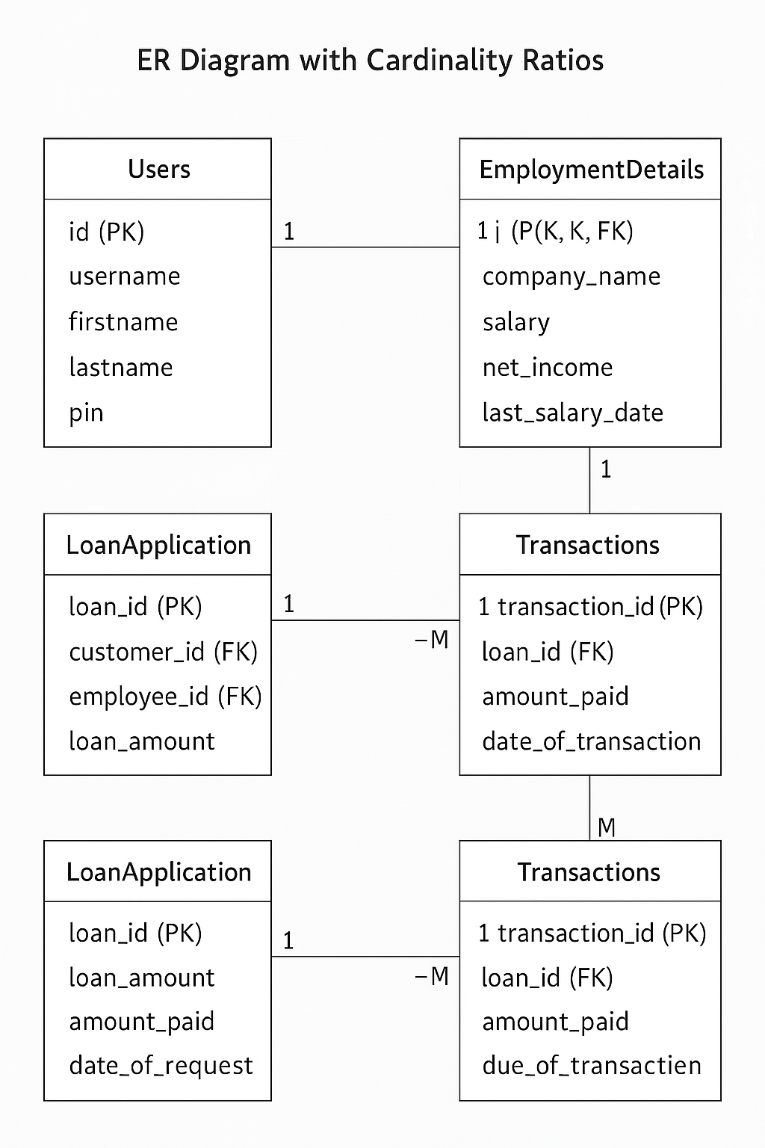
Entity Relationship Diagram with Cardinality Ratios

Slide 6
Key Features of our system
Secure employee login and authentication.
Extend multilingual capabilities to include region-specific terminologies and financial regulations.
Effective customer search and management.
Employment detail validation and loan assessment.
Employees can review and modify the loan amount within the suggested range and maximum range before finalizing the application.
Loan history tracking and transaction monitoring.

Slide 7
Tools and Skills Used
Development Tools:
Visual Studio 2022: Integrated Development Environment (IDE) for building the backend in C#.
VS Code: Lightweight and versatile code editor for designing and managing front-end components.
PostgreSQL: Robust relational database management system used for data storage and handling.
Technical Skills Applied:
C#: For building the backend and implementing application logic.
AngularJS: Framework for developing a dynamic and interactive front-end user interface.
HTML, CSS, and Bootstrap: For designing responsive and visually appealing UI/UX.
PostgreSQL: For creating and managing a secure, scalable, and efficient database structure.

Slide 8
Login Module
Employee Authentication:
Employees log in using their username and password.
Access to the application is granted only if the provided credentials match those stored in the database.
Pre-stored Employee Credentials:
Employee usernames and passwords are securely stored in the database.
Password Encryption:
Passwords are encrypted before storage to ensure data confidentiality and prevent unauthorized access.
The module decrypts data securely during authentication.

Slide 9
Multilingual Module
Enhance the user experience by supporting multiple languages (French, Spanish, and English).
-French, Spanish, and English available as language options. -Users can easily switch between languages.
Technologies Used:
Angular i18n: Built-in Angular internationalization library.
-ngx-translate: Dynamic translation library for Angular, enabling easy management of translations.
-ngx-translate-loader: Helps in reducing page load times by loading translation files only when necessary.
Implementation:
-Separate JSON files for each language (e.g., en.json, fr.json, es.json). -Each file contains key-value pairs for text translations.
Dynamic Language Switching:
-Language change through UI (header) and language switching without reloading the page. .

Slide 10
Customer Details Module
The project facilitates efficient data entry and storage by employees, enabling them to capture comprehensive customer information, including personal and employment details, for loan origination purposes.
Customer Data Entry:
Employees can input customer personal details, such as name, address, phone number, and email.
Employment details like company name, net income, and last salary date are also recorded.
Data Validation:
All entered customer details are validated before submission to ensure accuracy and completeness.
Database Integration:
Both personal and employment details are stored securely in the database for future reference and loan assessment.

Slide 11
Customer Search Module
This feature streamlines the process of locating customer records and initiating loan applications, allowing employees to efficiently manage customer data and actions.
Customer Search:
Employees can search for existing customers using firstname, lastname, and date of birth as input criteria.
The system fetches and displays records that match the provided details.
Record Validation and Display:
Ensures only valid and accurate customer records are retrieved.
Displays relevant customer details for easy reference.
Loan Application Initiation:
Employees can select a matched customer and click the "Apply Loan" button to initiate the loan process.
This feature integrates seamlessly with the loan origination workflow.

Slide 12
Loan Application Process Module
Customer Validation:
Checks whether the customer exists in the database
If found, retrieves the customer detail and displays the loan application form.
Loan Calculation:
Automatically Calculates :
Suggested Amount: Net Income /3 (rounded).
Maximum Amount: Net Income/2
Interactive Selection:
Employees use a slider to select the loan amount and tenure
EMI Calculation:
Calculates Equated Monthly Income (EMI) based on loan amount and tenure
Data Storage:
Saves loan details, tenure and customer information securely in the Loan Application Table.

Slide 13
Loan History and Transactions Module
The loan history and transactions feature provides employees with a comprehensive view of a customer's financial activity, ensuring efficient loan management and tracking.
Loan History Overview:
Displays all past loan applications submitted by the customer.
Includes details such as loan status, loan amount, amount paid, remaining balance, and due date.
Transaction Details:
Lists all payment transactions made by the customer related to their loans.
Includes transaction-specific information such as the amount paid and date of payment.
Data Collection:
Fetches loan history and transaction data directly from the database.
Ensures that all displayed information is accurate and up-to-date.

Slide 14

Future Enhancements
Enhanced Security Measures
Multilingual Expansion
Customer Engagement Features
Mobile Application Development
Reporting and Insights
Automated Notifications
Payment Gateway Integration
Employee Role-Based Access

Slide 15
Learnings from the Project
Technical Proficiency:
Gained hands-on experience with C#, AngularJS, HTML, CSS, and PostgreSQL.
Workflow Optimization:
Learned to design intuitive user interfaces for efficient employee interactions.
Developed skills in database management to ensure smooth integration and retrieval of data.
Problem-Solving and Validation:
Tackled challenges in implementing robust validation for customer and loan details.
Enhanced problem-solving abilities to create seamless workflows.
Team Collaboration:
Gained valuable insights into modular development and working on interconnected features.
Fostered coordination skills while integrating multiple functionalities into a cohesive system.
Project Management:
Learned to manage requirements analysis, feature prioritization, and testing phases effectively.
Emphasized scalability and security throughout the development process.

Slide 16
Conclusion
The Loan Origination Workflow project has successfully created a secure and efficient system to manage customer loans. It integrates key features such as user authentication, multilingual support, dynamic loan calculations, and customer management, ensuring a smooth and user-friendly experience for employees.
With its scalable and modular design, the application provides a strong foundation for future improvements, including advanced security, mobile support, and customer engagement tools. This project lays the groundwork for a comprehensive and reliable loan management system, meeting the needs of modern financial workflows.

Slide 17
THANK YOU

