Slide 1
What I have done so far…
03/11/2022

Slide 2
Cleaned, mapped, angsd genotype likelihoods, hard-called vcfs

Slide 3
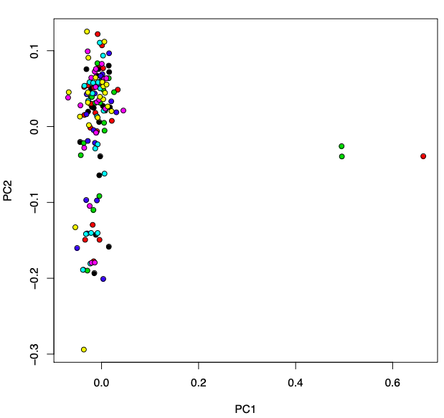
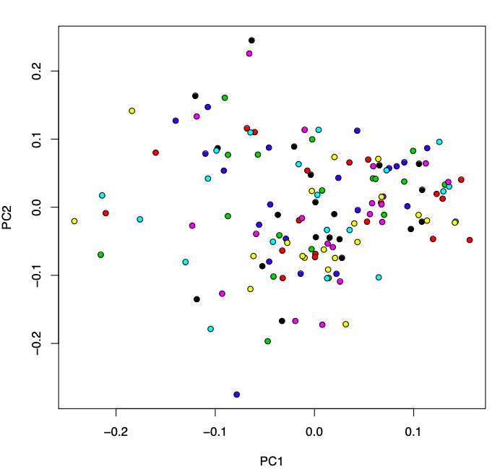
No population structure

Slide 4
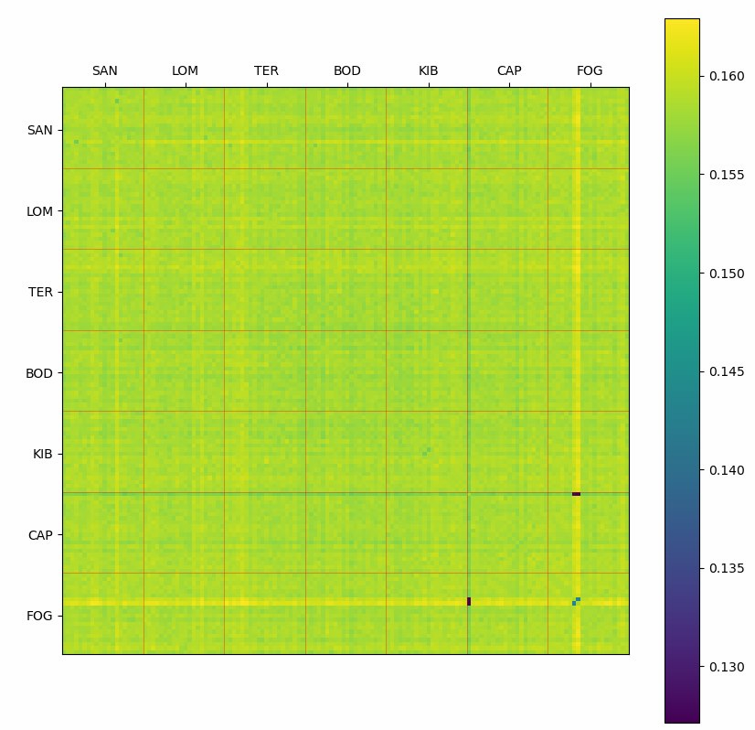
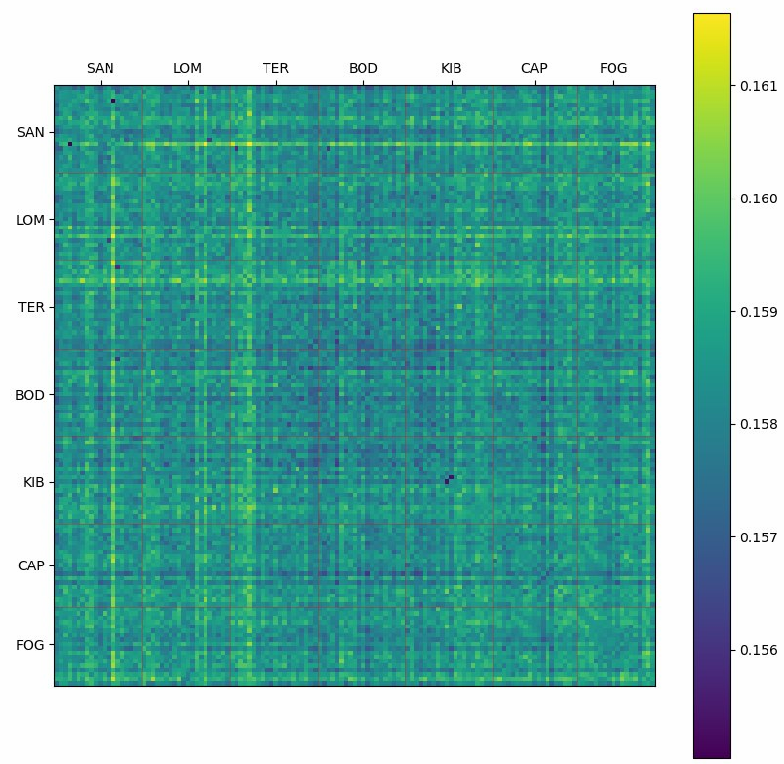

Slide 5
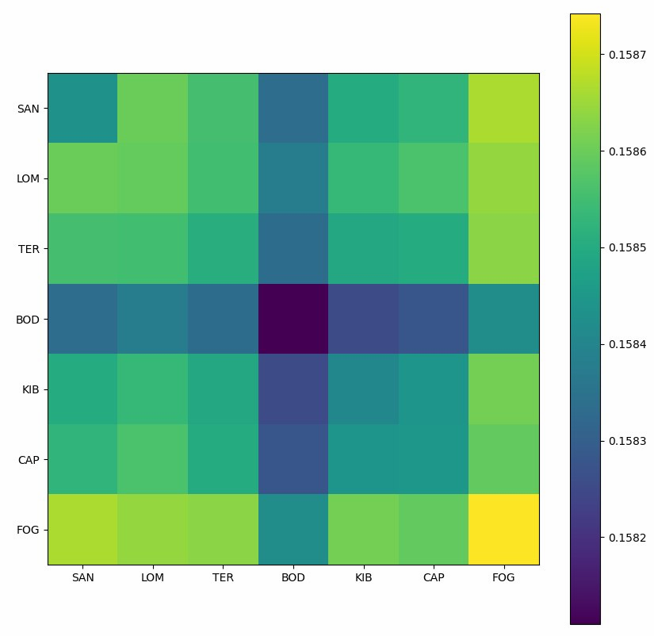

Slide 6
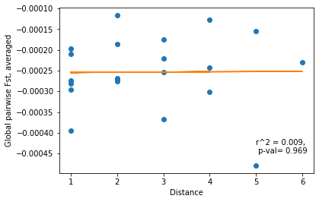
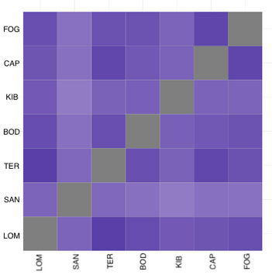
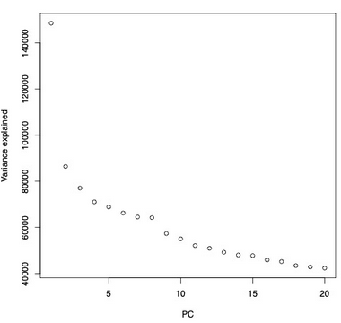

Slide 7
Filtering -> ~900,000 positions
No outliers
biallelic (across all pops, not just per pop)
minMAF 0.025 (7/280)
every pop has to have site information (angsd result)

Slide 8
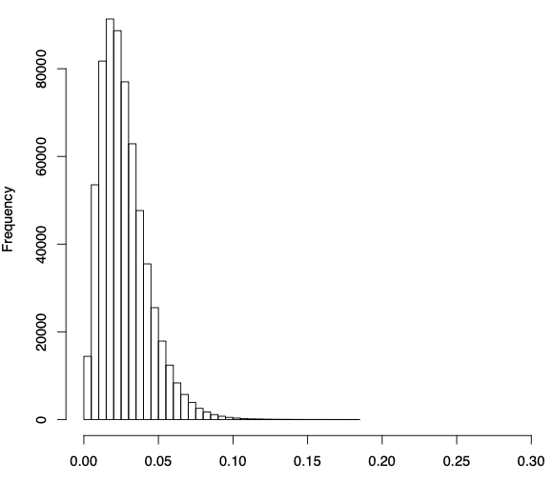
Under selection in general
Fst
PCAngsd
Nucleotide diversity

Slide 9
What loci are under selection? pH, stabilizing
Pairwise Fst
FCT
LFMM
Nucleotide diversity

Slide 10
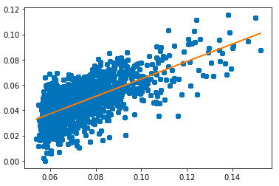
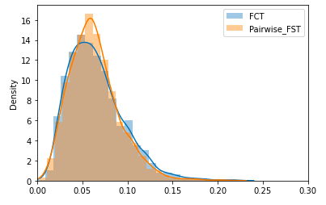
What loci are under selection? pH, stabilizing
Pairwise Fst -> I have results
FCT -> very similar to pairwise fst
LFMM
Nucleotide diversity
P=0.0
R2=0.7
P=0.04

Slide 11
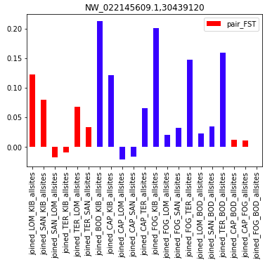
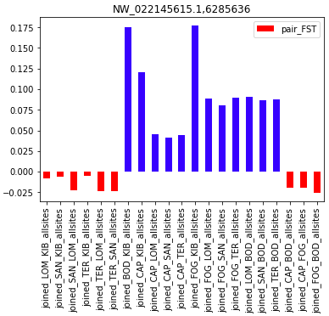
What loci are under selection? pH, stabilizing
Pairwise Fst -> I have results
FCT -> very similar to pairwise fst
LFMM
Nucleotide diversity
FCT top 50, not pairwise FST top 50
FCT top 50, also in pairwise FST top 50

Slide 12
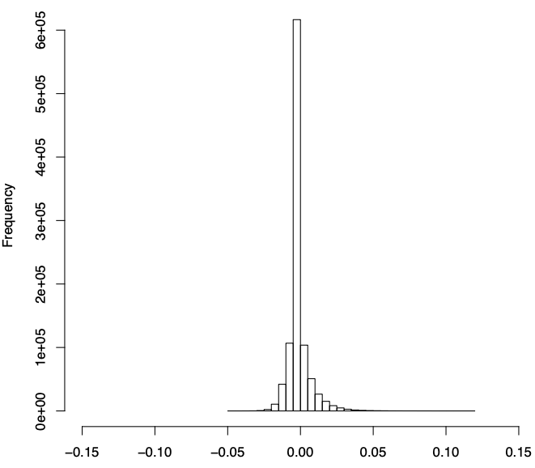
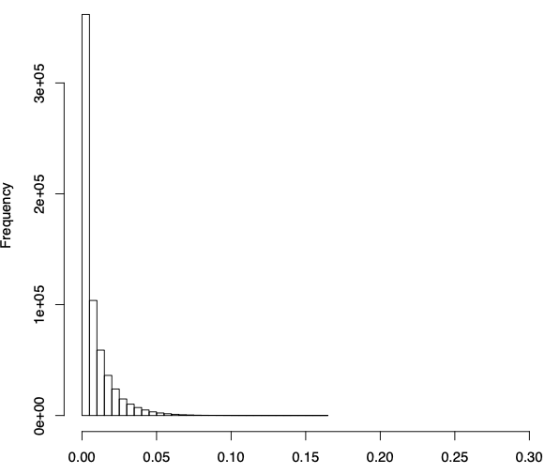
Pairwise Fst results

Slide 13
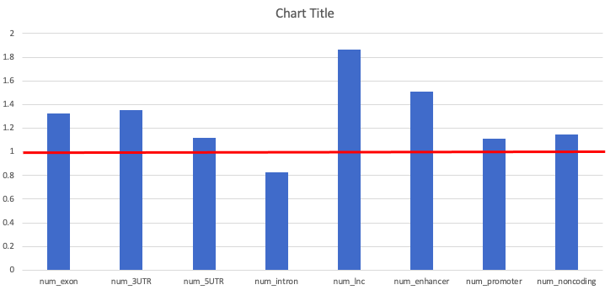
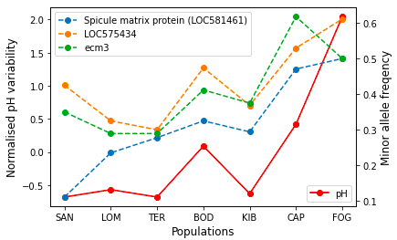
Pairwise Fst results
Chi-squared:
TopGO:
  BP: 42
    Ion transmembrane transport
  MF: 55
    Ion channel activity
    TF activity (2x more than expected)
    Carbonate dehydratase activity
112 differentially expressed (Evans 2017, pop spec pH response)
8 differentially expressed N vs S (Pespeni 2012, after common garden)
77 biomineralization
40 related to pH response (Pespeni 2013, correlated SNPs)
In PP interaction network -> outlier genes have less connections on average (p<0.001)
Outlier genes have a lower expression levels (not significant)
Notes:
genes down-regulated in populations most frequently exposed to ph <7.8 & up-regulated in populations less frequently exposed to ph <7.8

Slide 14
What loci are under selection? pH, stabilizing
Pairwise Fst -> I have results
FCT -> very similar to pairwise fst
LFMM -> with multiple correction, no outliers…
Nucleotide diversity -> haven’t gotten to it yet…

Slide 15
Other things to do
Temperature? Other env variables?
Balancing selection? More in the North?

