Slide 1
WGS results
2.0

Slide 2
Methods
Angsd -> saf
Monomorphic sites, min 85% indv, min 3 coverage / indv, remove low qual mapping
21 pairs
For each pair realSFS fold 1 -> .sfs
-> per site pairwise Fst values
High var
Low var
4
1
5
2
6
3
7
12
3
6

Slide 3
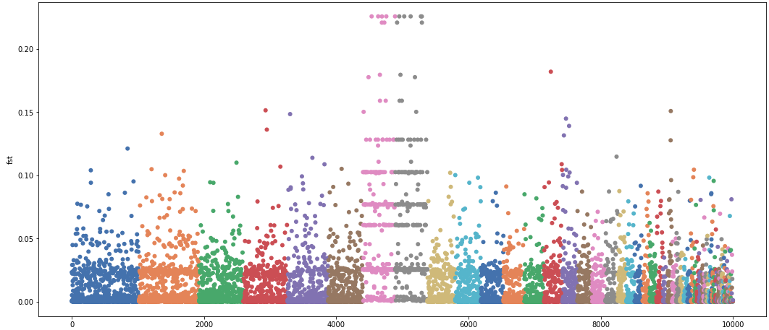
First results looked weird

Slide 4
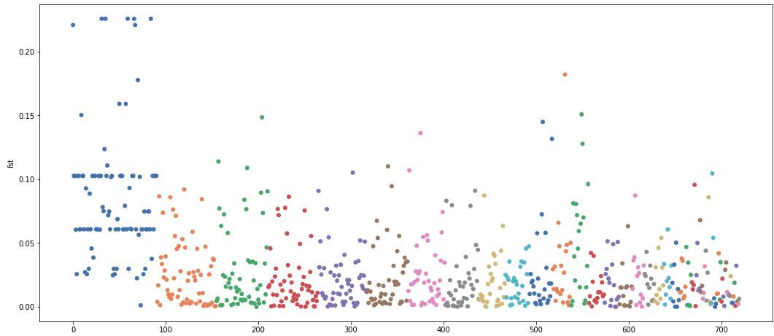
Only polymorphic
Took out mito for now…

Slide 5
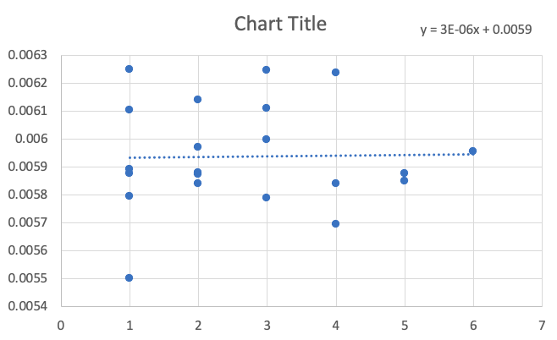
Results
Removed sites not polymorphic
Average per site Fst doesn’t correlate with distance

Slide 6
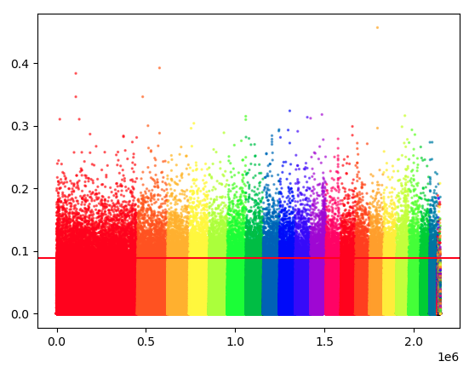
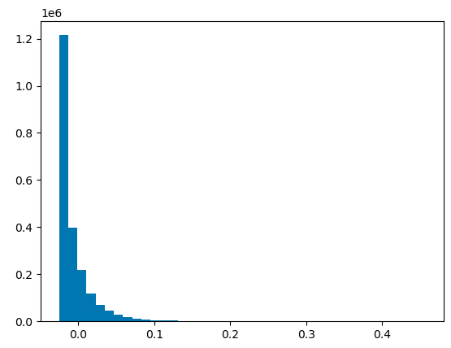
Results
LOM vs KIB
99th percentile -> SUM 219,864 outliers

Slide 7
Results
High var
Low var
79 outliers in 6 or more “red” pairs
Decided to go for a window approach:
If 2 outliers within 1000 bp (regardless of pair)
Save it as 1 outlier region
Find regions that are outlier regions in multiple “red” pairs
745 outlier regions in 6 or more “red” pairs
next step, taking out regions that overlap with regions also high fst within group pop pairs -> 99
4
1
5
2
6
3
7
12
3
6

Slide 8
99 outlier regions…
Fall in 50 genes (4 in promoters)
Gene names are not interesting
GO > negative regulation of actin nucleation, nothing else

Slide 9
Results
High var
Low var
4
1
Averaged red pairs -> list A of Fsts
Averaged green pairs -> list B of Fsts
ndf=df.groupby(["chr","pos"]).mean()
If average < 0 -> 0
List C: A – B
cdf=betw.merge(withi, on=["chr","pos"], how="outer") #keep all sites
cdf = cdf.fillna(0)
#happens if site is missing either from list A or B, if between value is missing negative, if within value missing keep original between
cdf["final_fst"]=cdf["fst_x"]-cdf["fst_y"]
5
2
6
3
7
12
3
6

Slide 10
Now I have list C
0 fst could mean:
Both between and within fst averages were 0
Between and within fsts were the same
Negative fst means:
Within fst was bigger
Or between value didn’t exit (in all pop pairs in one of the pop it was mono)
Positive fst means:
Between fst was bigger
Or within value didn’t exit (in all pop pairs in one of the pop it was mono)

Slide 11
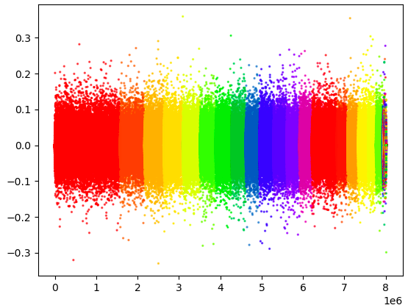
For really high fst snp
Zoom in to 1000bp
Mulitple Manhattan plots for pairwise (LOM-BOD)
Checking my method
Also if I am using it for chapter 2
Windows
1000bp
Before or after taking threshold

Slide 12
Highest fst outlier values?
Permutation test? Only so many combinations… 7!
Bootstrapping?
Seems to me both makes sense but latter is much easier to implement
Simulate pops with gene flow SLIM
Nucleotide diversity… both pops under positive is less likely, balancing selection in the south?
MAF and LD increased
dxy
Stern and Lee nature ecology and evolution 2020 method for balancing selection
Cod paper from the pinsky lab
Guide to low coverage wgs molecular ecology
Baypass – nice also to verify my method

Slide 13
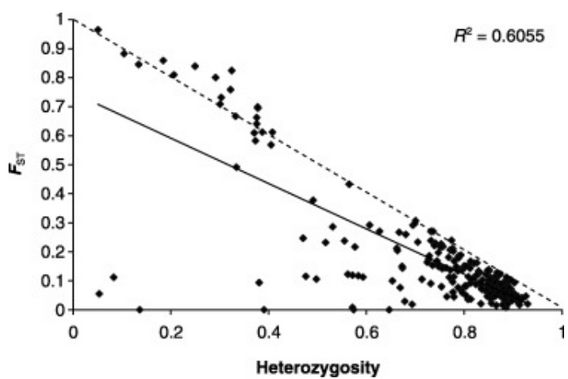
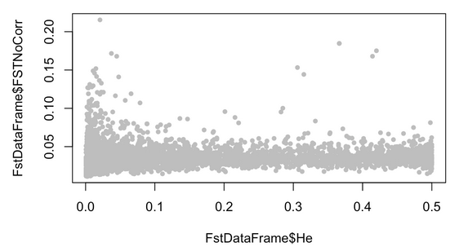
He?
Fst = (Ht-Hs)/Ht
So increasing Hs decreases max Fst
Outflank recommends removing sites where He is less than 0.1
Why? What is this He? Hs or Ht?
Expected (2pq) vs actual He? Former based on AF and no pop structure?
Which one should be > 0.1?
Missing data?

Slide 14

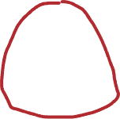

If 1 pop MAF 0.01, other MAF 0.05 -> 5 times bigger

