Slide 1
WGS results
3.0

Slide 2
Methods
Angsd -> saf
21 pairs
For each pair realSFS fold 1 -> .sfs
-> per site pairwise Fst values
High var
Low var
4
1
5
2
6
3
7
12
3
6

Slide 3
Methods
High var
Low var
4
1
Averaged red pairs -> list A of Fsts
Averaged green pairs -> list B of Fsts
If average < 0 -> 0
List C: A – B
5
2
6
3
7
12
3
6

Slide 4
Now I have list C
0 fst could mean:
Both between and within fst averages were 0
Between and within fsts were the same
Negative fst means:
Within fst was bigger
Or between value didn’t exit (in all pop pairs in one of the pop it was mono)
Positive fst means:
Between fst was bigger
Or within value didn’t exit (in all pop pairs in one of the pop it was mono)

Slide 5
He
Filtered for He > 0.1

Slide 6
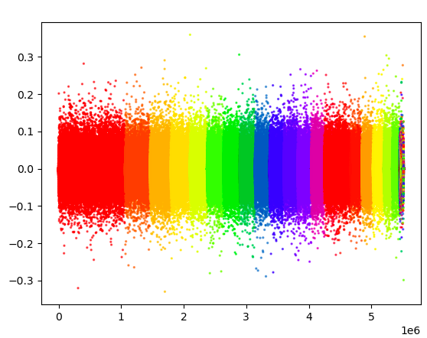
Results

Slide 7
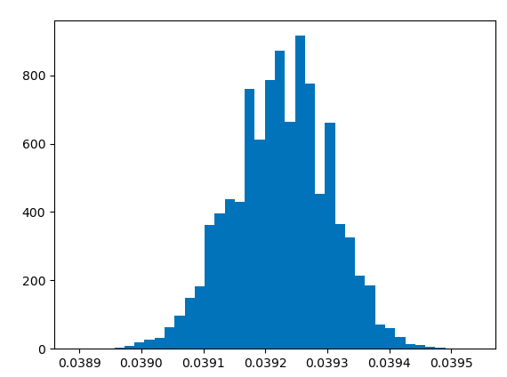
Bootstrapping
Calculating confidence interval for 99th percentile
Similar to permutation test but easier and more intuitive
Randomly sample 5 million pos with replacement
Calculate 99th percentile
Repeat 10,000 times to get a distribution ->
95th percentile:
0.03934912832000001
-> Fst threshold

Slide 8
Results
51,953 SNPs
60% of these falls in genes (31,541)
10,296 unique genes
1326 falls in promoter regions (1119 unique)
Overall 10,665 gene body or promoter region had outlier SNP

Slide 9
Results
Go enrichment -> bunch of enrichment, among which
ion transport
DNA-binding transcription factor activity
transcription cis-regulatory region binding

Slide 10
Results
50% of the genes I found before I found again
Tgif – found the exact same SNP as before which is encouraging (different method and code, realSFS from saf (pairwise persite fst) vs making vcf and using it as input to OutFlank (global persite fst), even different angsd run (same parameters tho) so the only shared starting point was the alignment file)

Slide 11
Further steps
MAF and polymorphism across all not per pop
Make windows, focus on non-lonely SNPs
Validate

Slide 12
Sites beneficial in space, no time
No temp:
Always good in N not in S (or vica versa)
-> high Fst between, low within
-> high corr between allele freq and pH variability (binary, ranked, real valued?) – Bayenv
FORMAT??? With missing values… just drop
-> reduced nucleotide diversity in N, S, or both (calc per pop, per group, or all?)
-> Baypass? (corr + pop structure)
-> Dxy? Any reason for my data?

Slide 13
Space AND time
Sometimes good in N, never in S
-> MAF in N is high, eg 50% A 50% C, MAF in S is low eg 100% A
-> lower Fst when final fst=between fst – within fst (?? Tricky, maybe not needed)
-> correlation between allele freq and pH var
Sometimes good in S, never in N (unlikely)
-> Same as above but MAF high in the S
Sometimes good in N, sometimes good in S
-> high MAF in both
-> very low Fst (eg 50% A 50% C in both)
-> no correlation between allele freq and pH var

