Slide 1
Update 3.0

Slide 2
Bayenv matrix with all sites at least 1 alt all among 20x7 indv
So around 8 million SNPs

Slide 3
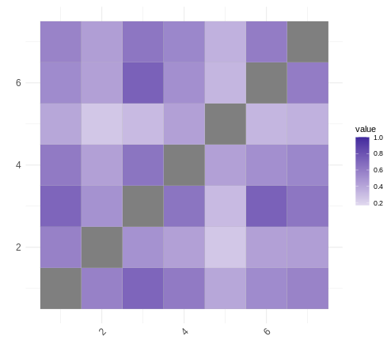
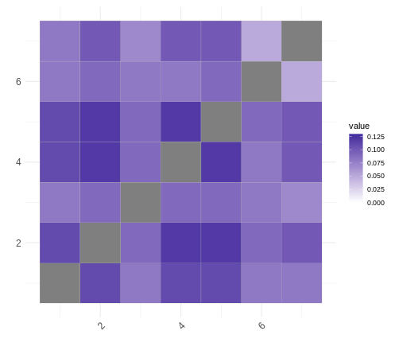
bayenv
fst

Slide 4
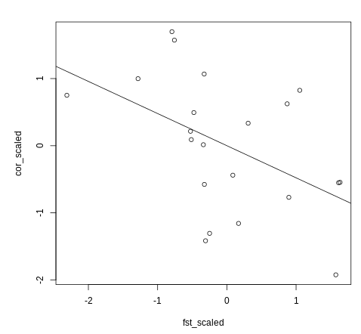
p-value: 0.02816
R-squared: 0.2291
3 out of 5 lowest Fst pops was also in top 5 most correlated by Bayenv

Slide 5
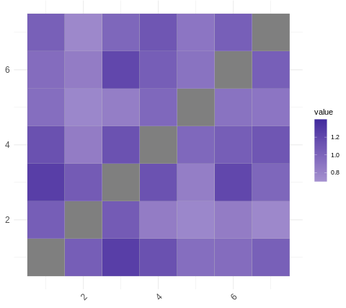
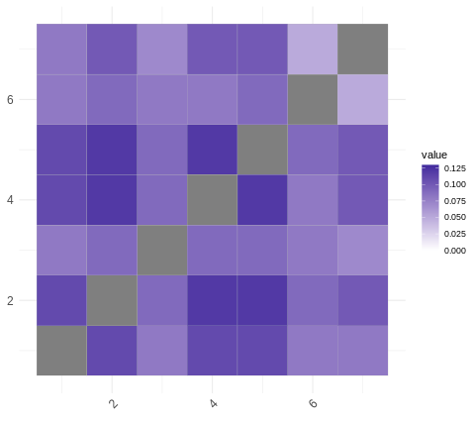
Filtered for MAF
Bayenv cor
Fst

Slide 6
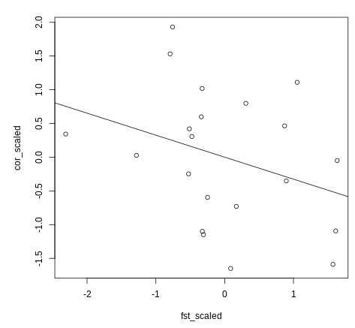

Slide 7
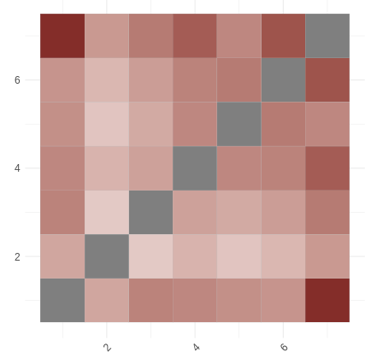
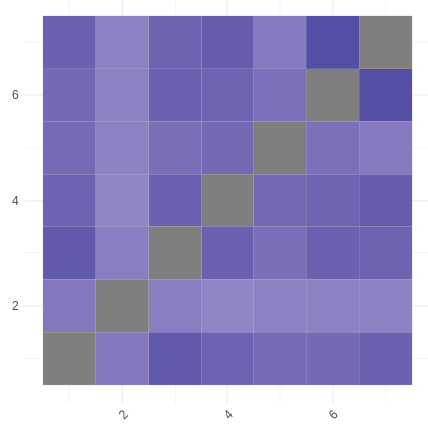
New pairwise fst AND filtering for bayenv (24/09/2021
Bay matrix 5 (the bluer the higher the corr)
Fst (the redder the smaller the Fst)

Slide 8
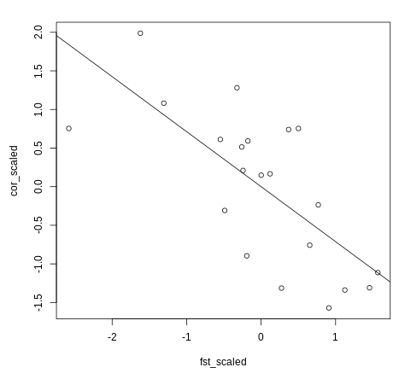
(matrix number 5)
p-value: 0.00029
R-squared: 0.4817

Slide 9
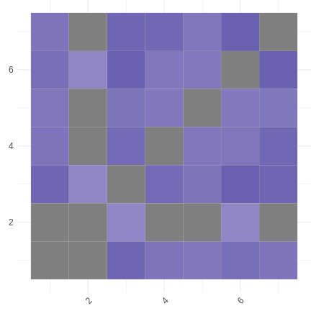
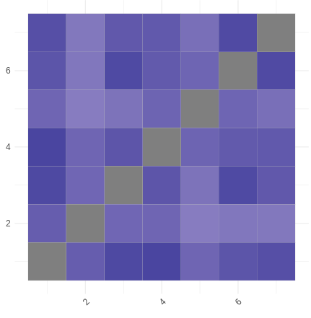
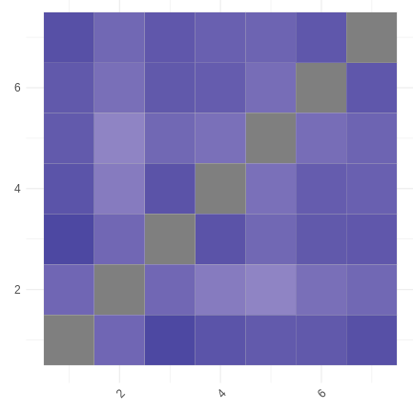
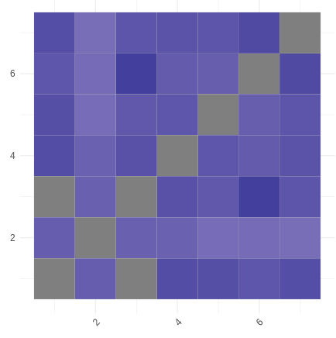
Comparing 5 cov matrix
3
1
2
4
5
(number 5 best corr, but all very similar and significant)

