Slide 1
CLASSIFYING THE SPAM URLS USING THE XGBOOST CLASSIFIER
KUSHAL KUMAR B [PES1UG24AM805]
MITHUN G[PES1UG24AM810]

Slide 2
PROJECT OBJECTIVE
Goal: To develop a high-accuracy machine learning model capable of classifying website URLs as either benign (legitimate) or malicious (phishing).
Core Technology: The project leverages an XGBoost Classifier, trained on features engineered directly from URL strings.
Outcome: A predictive model and a functional real-time testing system.

Slide 3
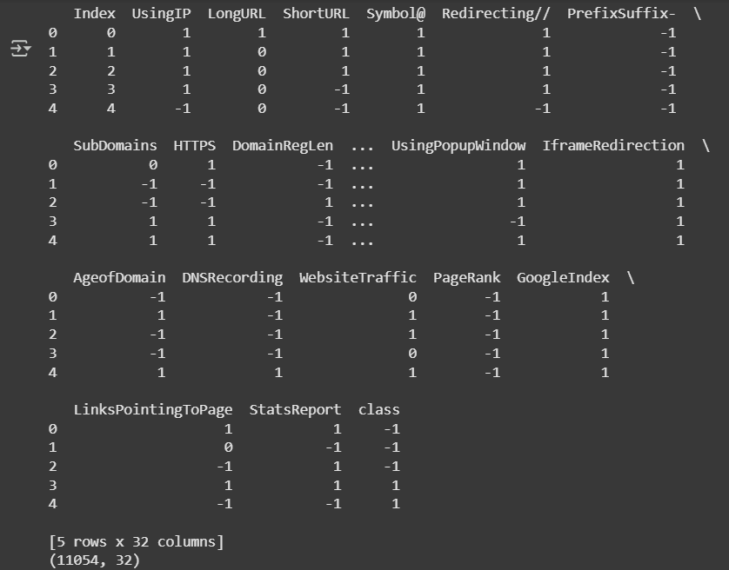
DATASET OVERVIEW
Dataset: phishing.csv
Instances: 11,054 URLs
Features: 30 pre-calculated features + 1 class label
Class Balance: The dataset is well-balanced,
crucial for preventing model bias.
Malicious URLs: ~55%
Benign URLs: ~45%

Slide 4
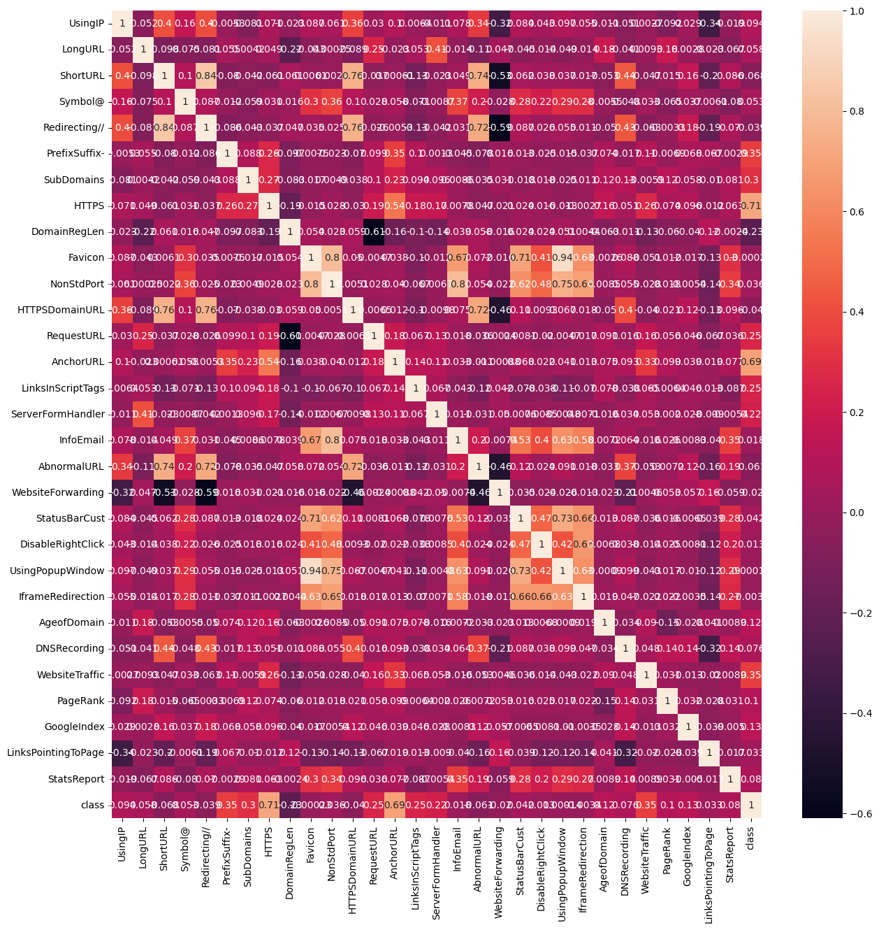
DATA VISUALIZATION

Slide 5
METHODOLOGY WORKFLOW
A structured approach was followed to ensure robust and reproducible results:
Data Exploration (EDA): Analyzed the dataset's structure, balance, and feature characteristics.
Feature Engineering: Developed a function to extract 30 features from any raw URL for real-time prediction.
Data Splitting: Partitioned the data into 80% for training and 20% for testing.
Model Training: Trained the XGBoost Classifier on the training data.
Performance Evaluation: Assessed the model's accuracy on the unseen test data.

Slide 6
MODEL SELECTION
Algorithm: XGBoost (Extreme Gradient Boosting) was chosen for its state-of-the-art performance.
How it Works:
It's an ensemble method that combines hundreds of simple decision trees.
It learns sequentially:
It builds a tree.
It identifies the errors made by that tree.
It builds the next tree to specifically correct those errors.
This process incrementally improves the model's accuracy with each new tree.

Slide 7
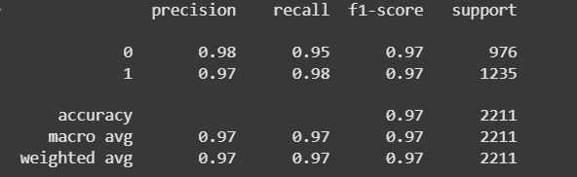
KEY MATRICS

Slide 8
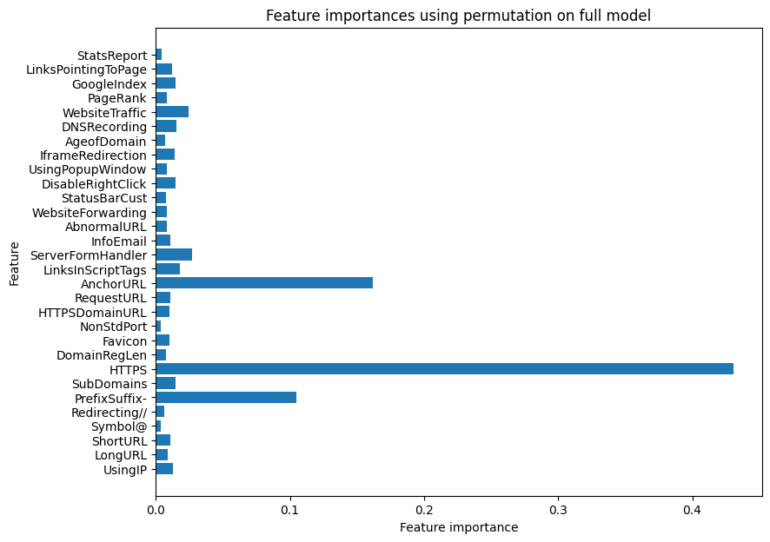
FEATURE IMPORTANCE BASED ON THE MODEL

Slide 9
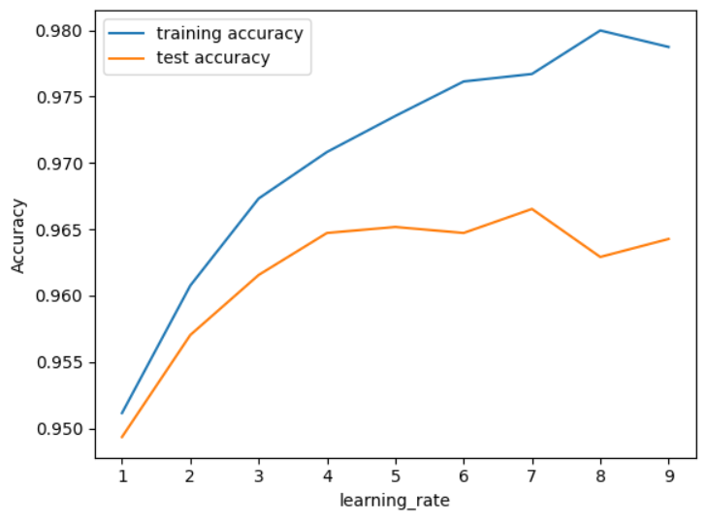
TRAINING AND TESTING ACCURACY

Slide 10
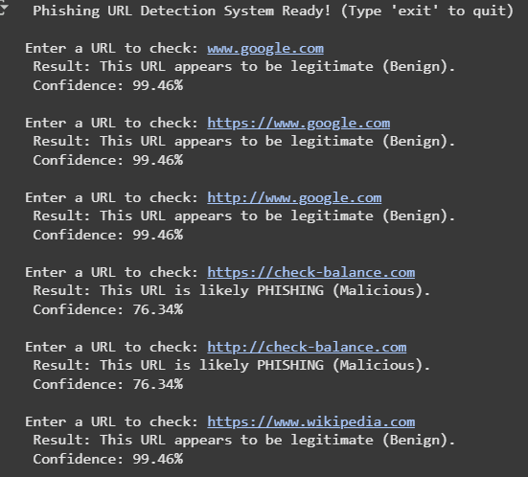
OUTCOMES

Slide 11
CONCLUSION
The project successfully developed a high-accuracy phishing URLs detection model using XGBoost.
The model's strong performance metrics (97% accuracy) validate the effectiveness of the engineered features and the chosen algorithm.
The real-time system serves as a powerful proof-of-concept for a practical, automated web security tool.

Slide 12
FUTURE ENHANCEMENT
Advanced Feature Engineering:
Integrate APIs (like WHOIS and DNS) to replace placeholder values with real-time external data (e.g., Domain Age, DNS Records).
Hyperparameter Tuning:
Use techniques like GridSearchCV to find the optimal settings for the XGBoost model, potentially pushing accuracy even higher.
Deployment:
1. Package the model into a user-friendly web application (using Flask/FastAPI).
2. Develop a browser extension to automatically scan URLs and provide real-time alerts to users.

Slide 13
THANK YOU

