Slide 1

Pet Loves Project
Making the perfect match between human and pet

Slide 2
Intro
We started off with an idea of matching pets with their ideal human.
The first thing we needed to do was to decide how we were going to go about this taking into account the limited time scale and bearing in mind Minimum Viable Product and Proof of Concept.

Slide 3
Concept
We wanted to structure the app in the form of a quiz asking some basic questions of potential pet owners, such as:-
Do you have a garden?
How much time do you spend at home?
Do you have children?

Slide 4
Structure
We decided the best way to structure the app would:-
Landing page with quiz
Weighting system to score potential pet owners

Slide 5
Process
Display results of hard coded pets
Display results of pets pulled from database
Add CSS
Add quiz questions
Filter pets by one answer ("Do you have a garden?" - matches to all pets with that specific requirement)
Function to weigh answers (secret matching algorithm)
Match quiz answers to pets

Slide 6
Technology Used
We used a range of technology including:-
Scraper tool
React/Javascript
Trello
In Vision
Amazon Web Services
Web Scraper
Mysql database/ Amazon web services (LAMBDA)

Slide 7
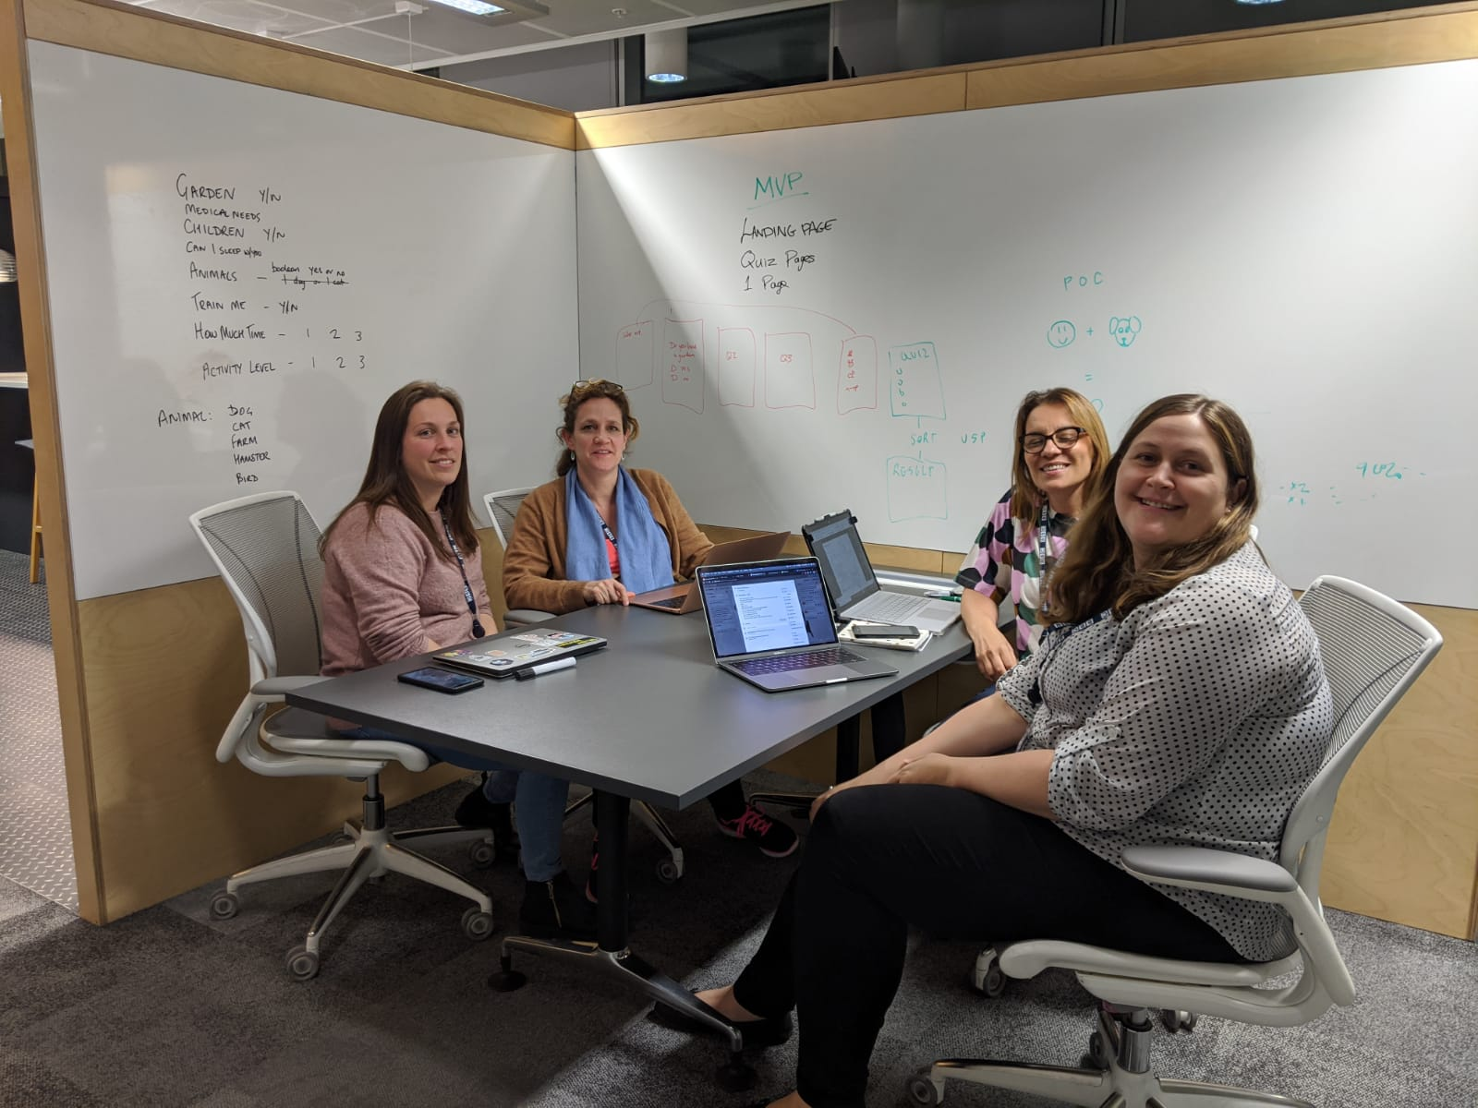
The Team!
Amelia
Laura
Jyoti
Lorna

Slide 8
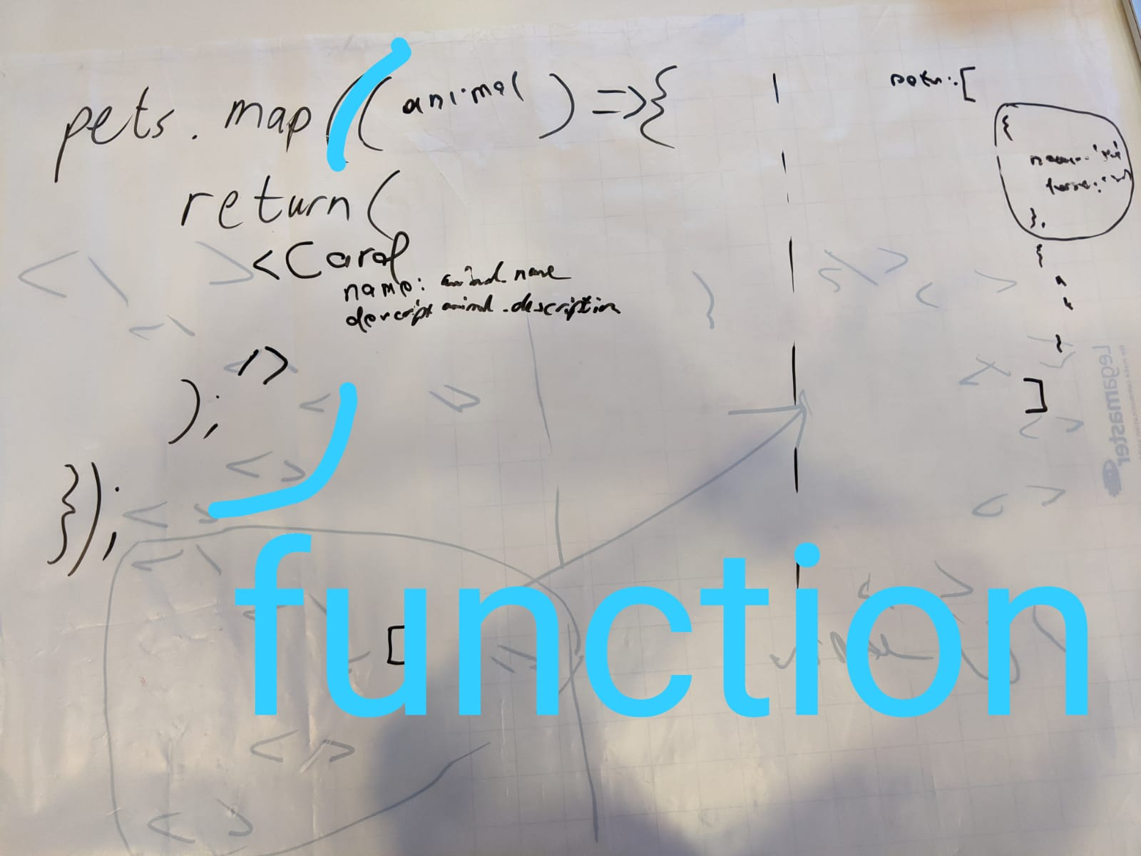
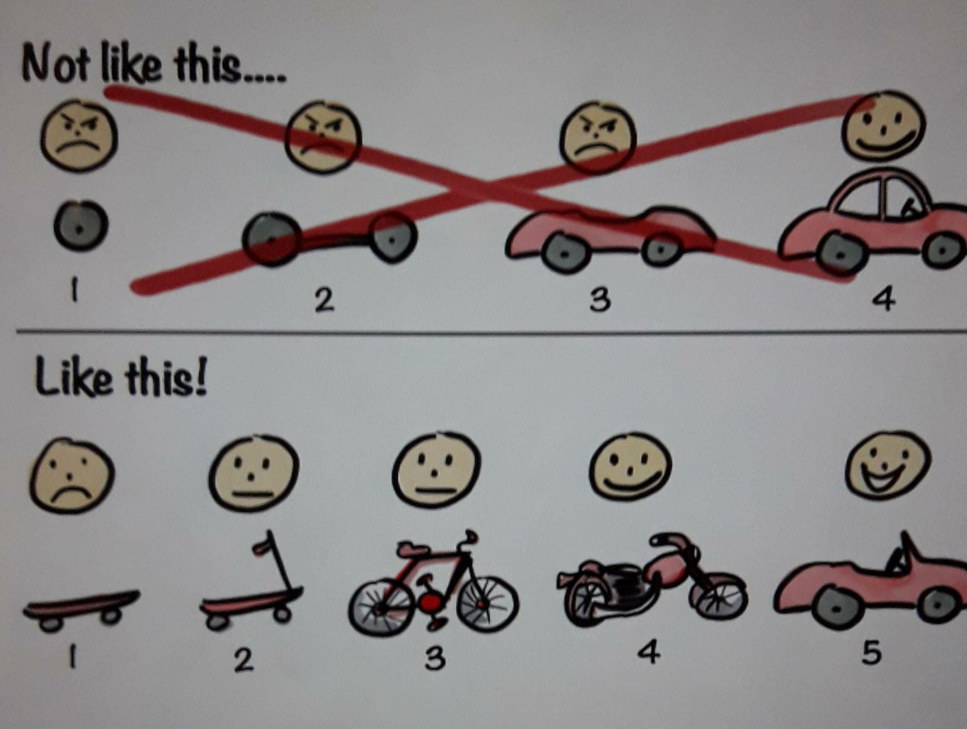
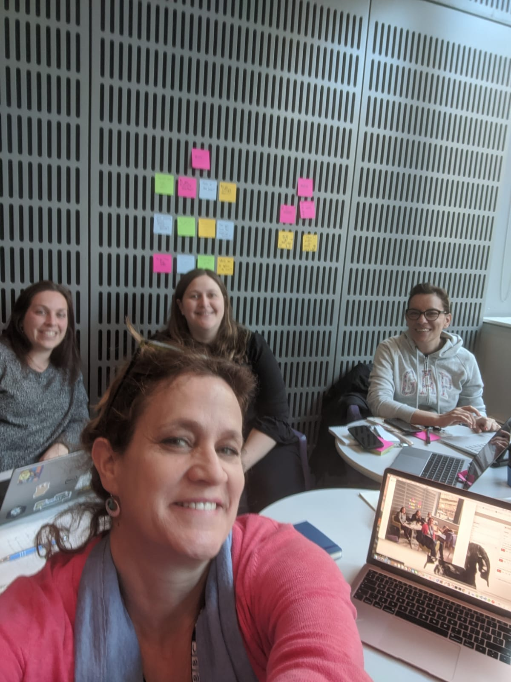
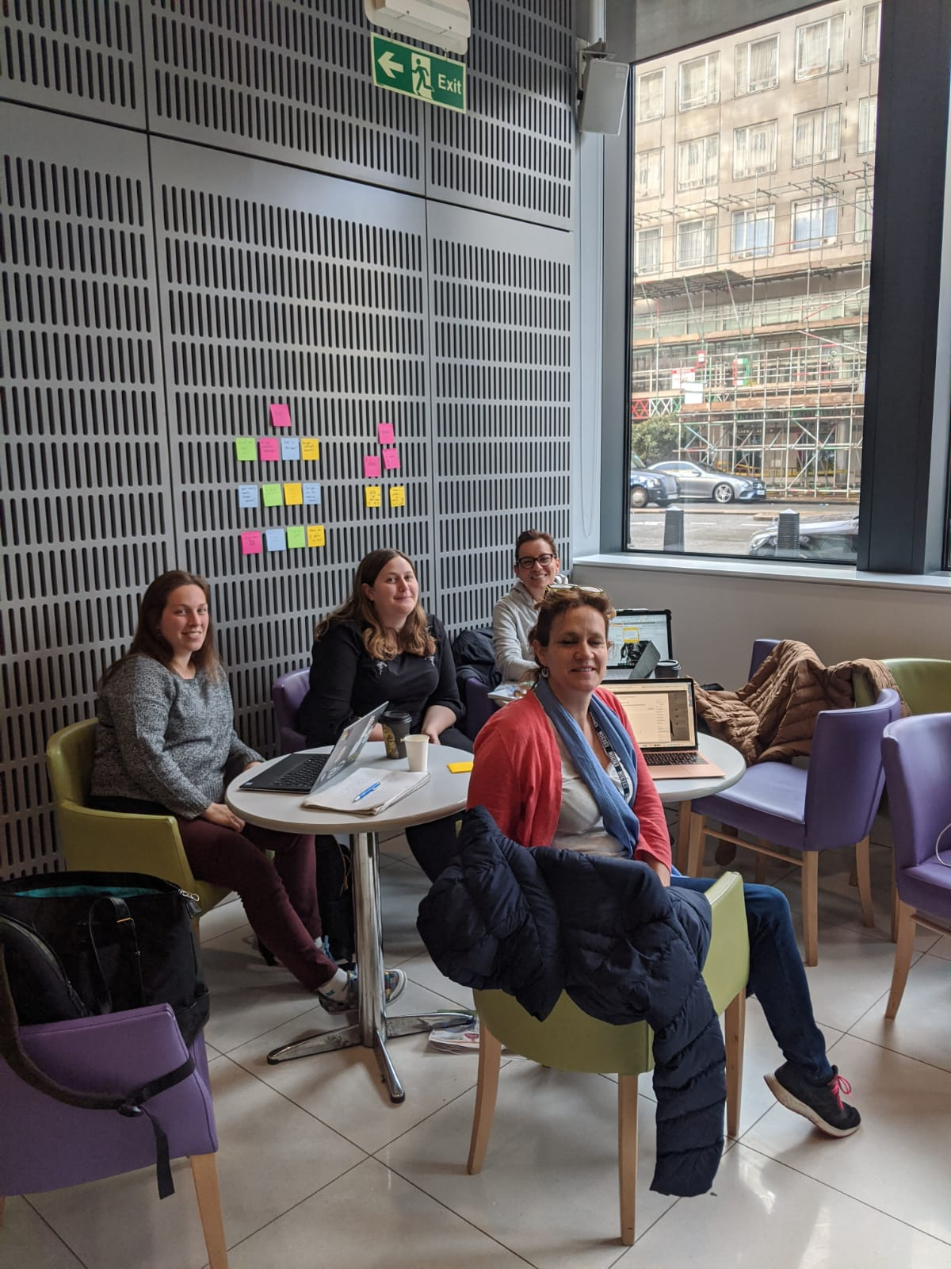
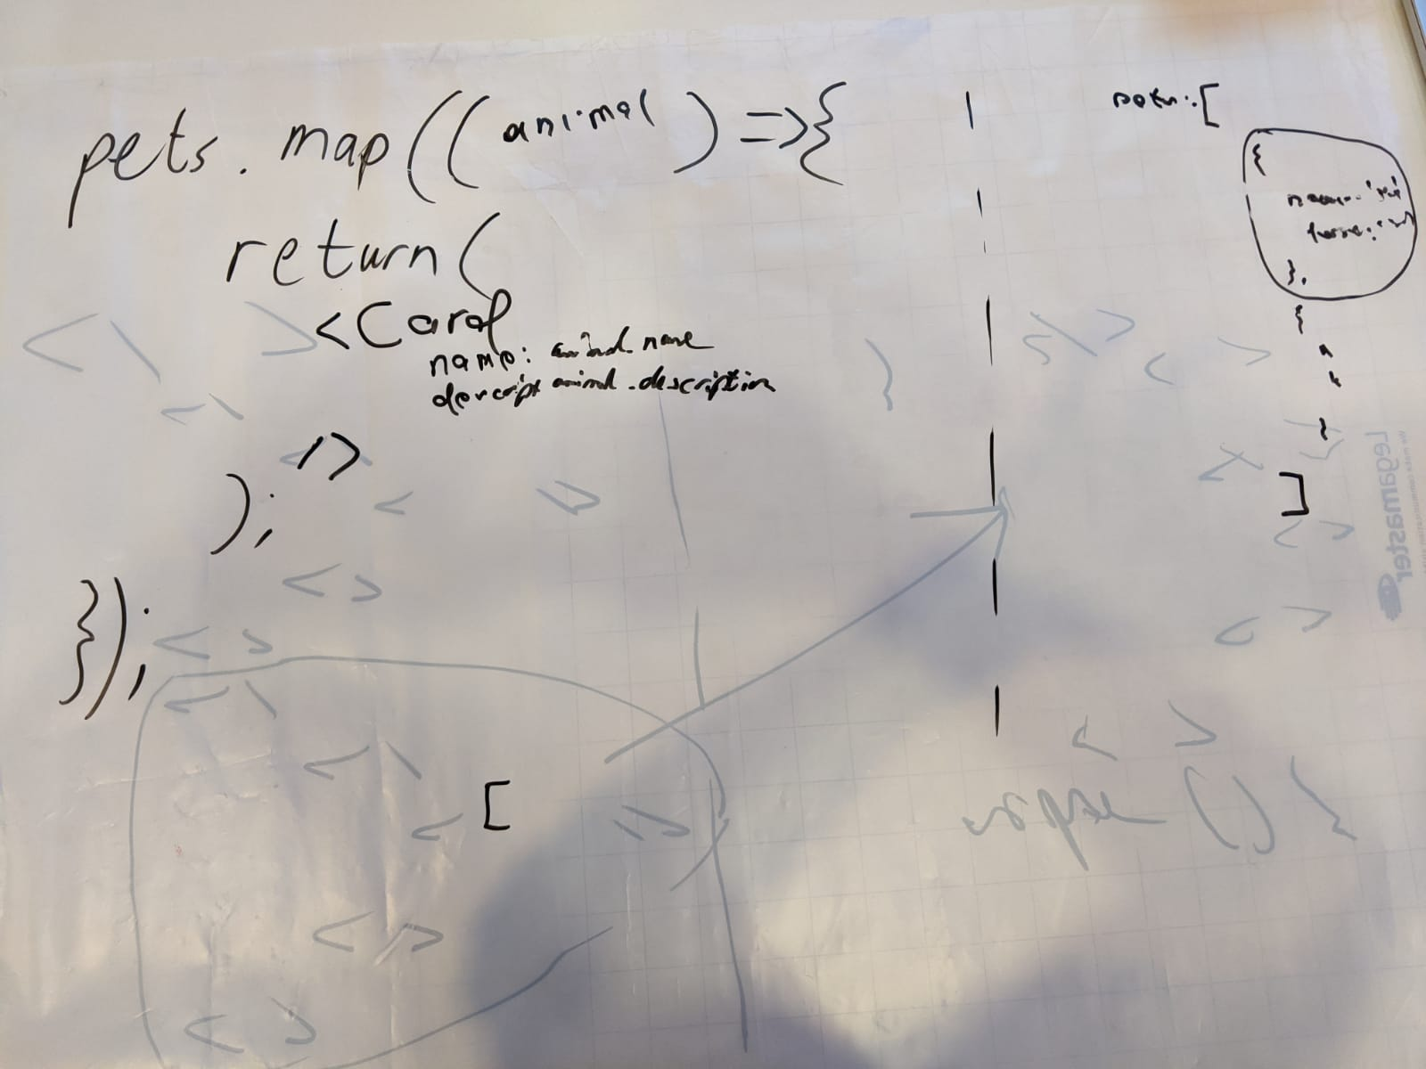
Whiteboard Discussions

Slide 9
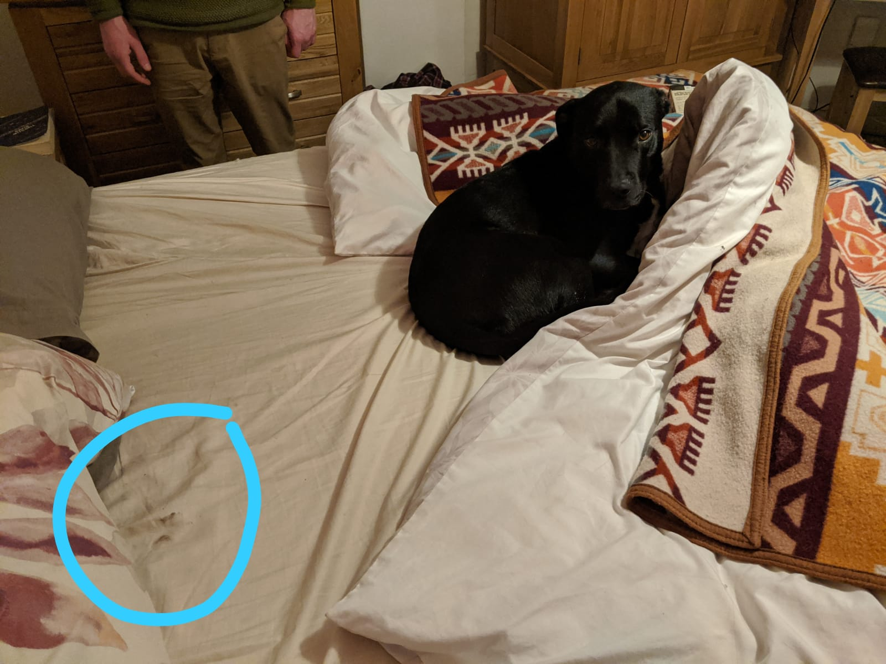
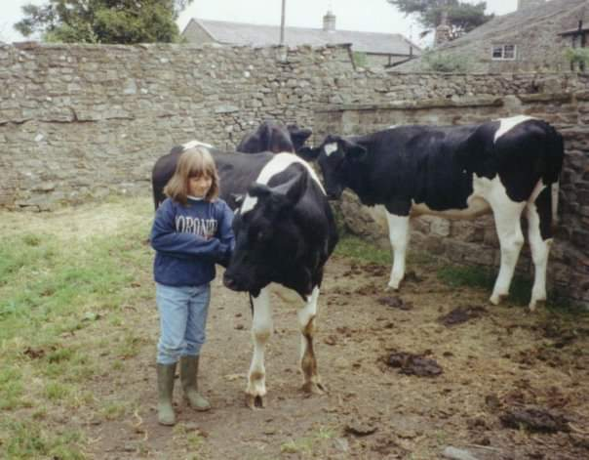
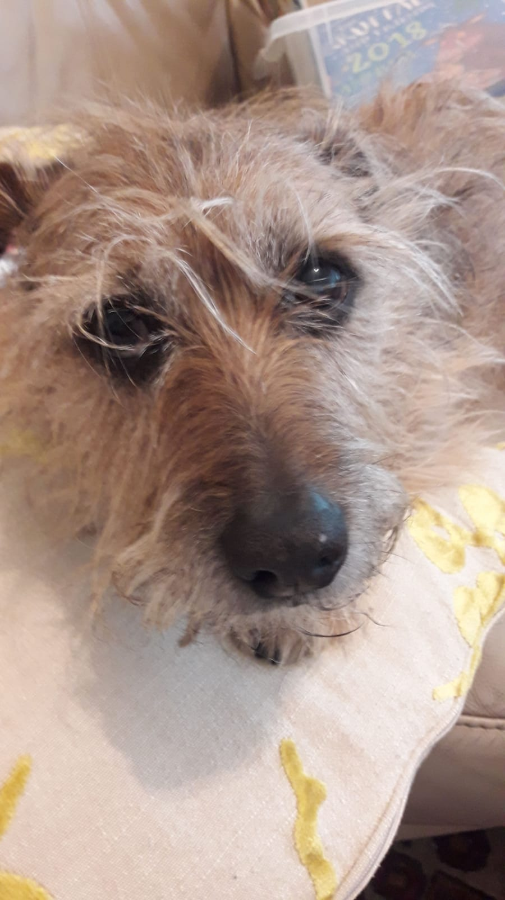
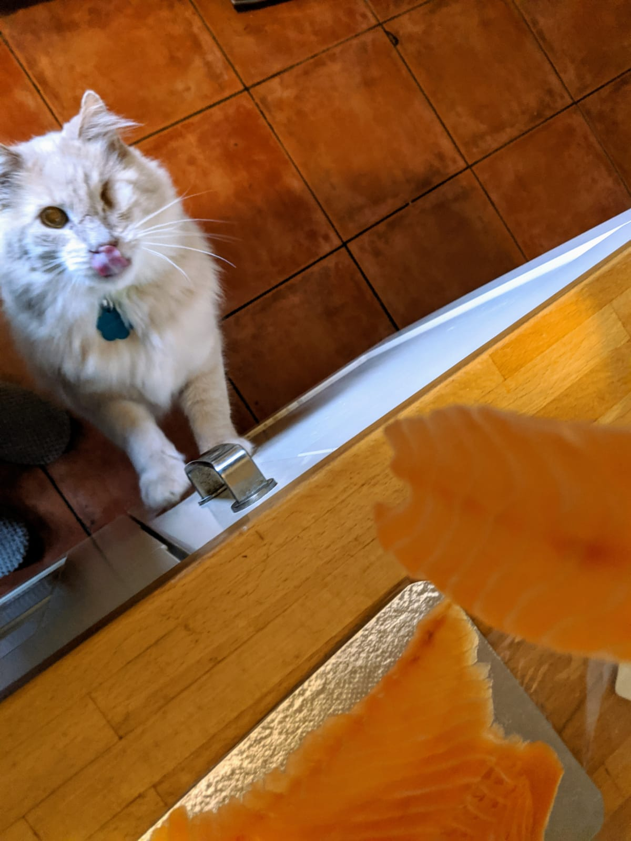
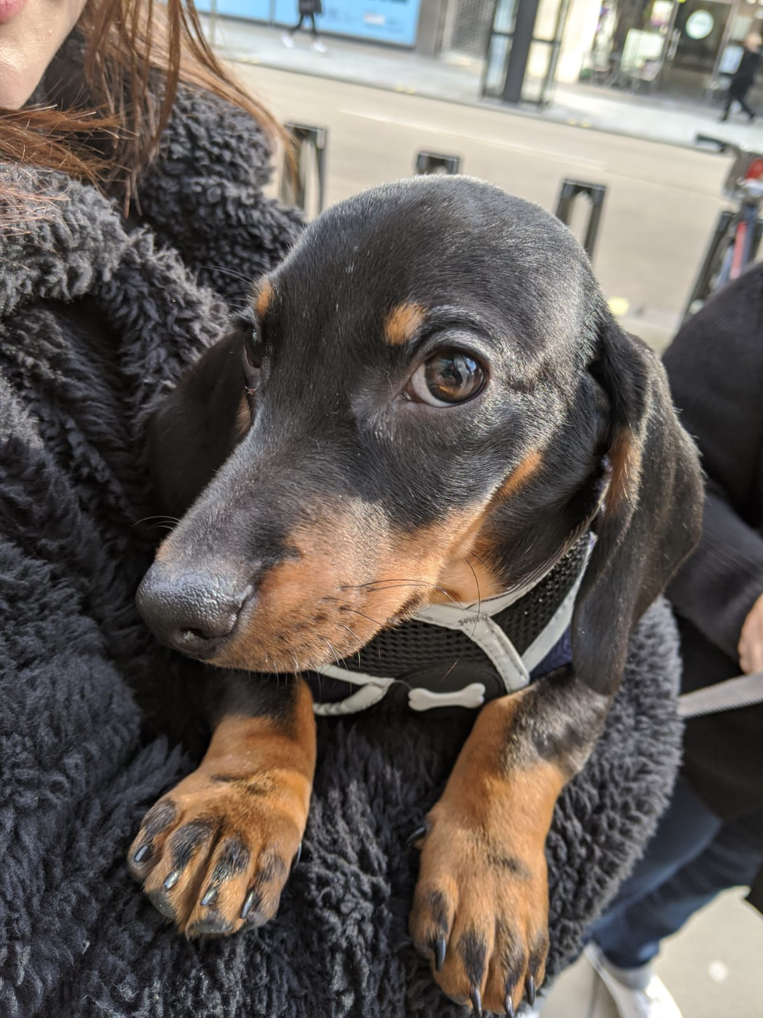
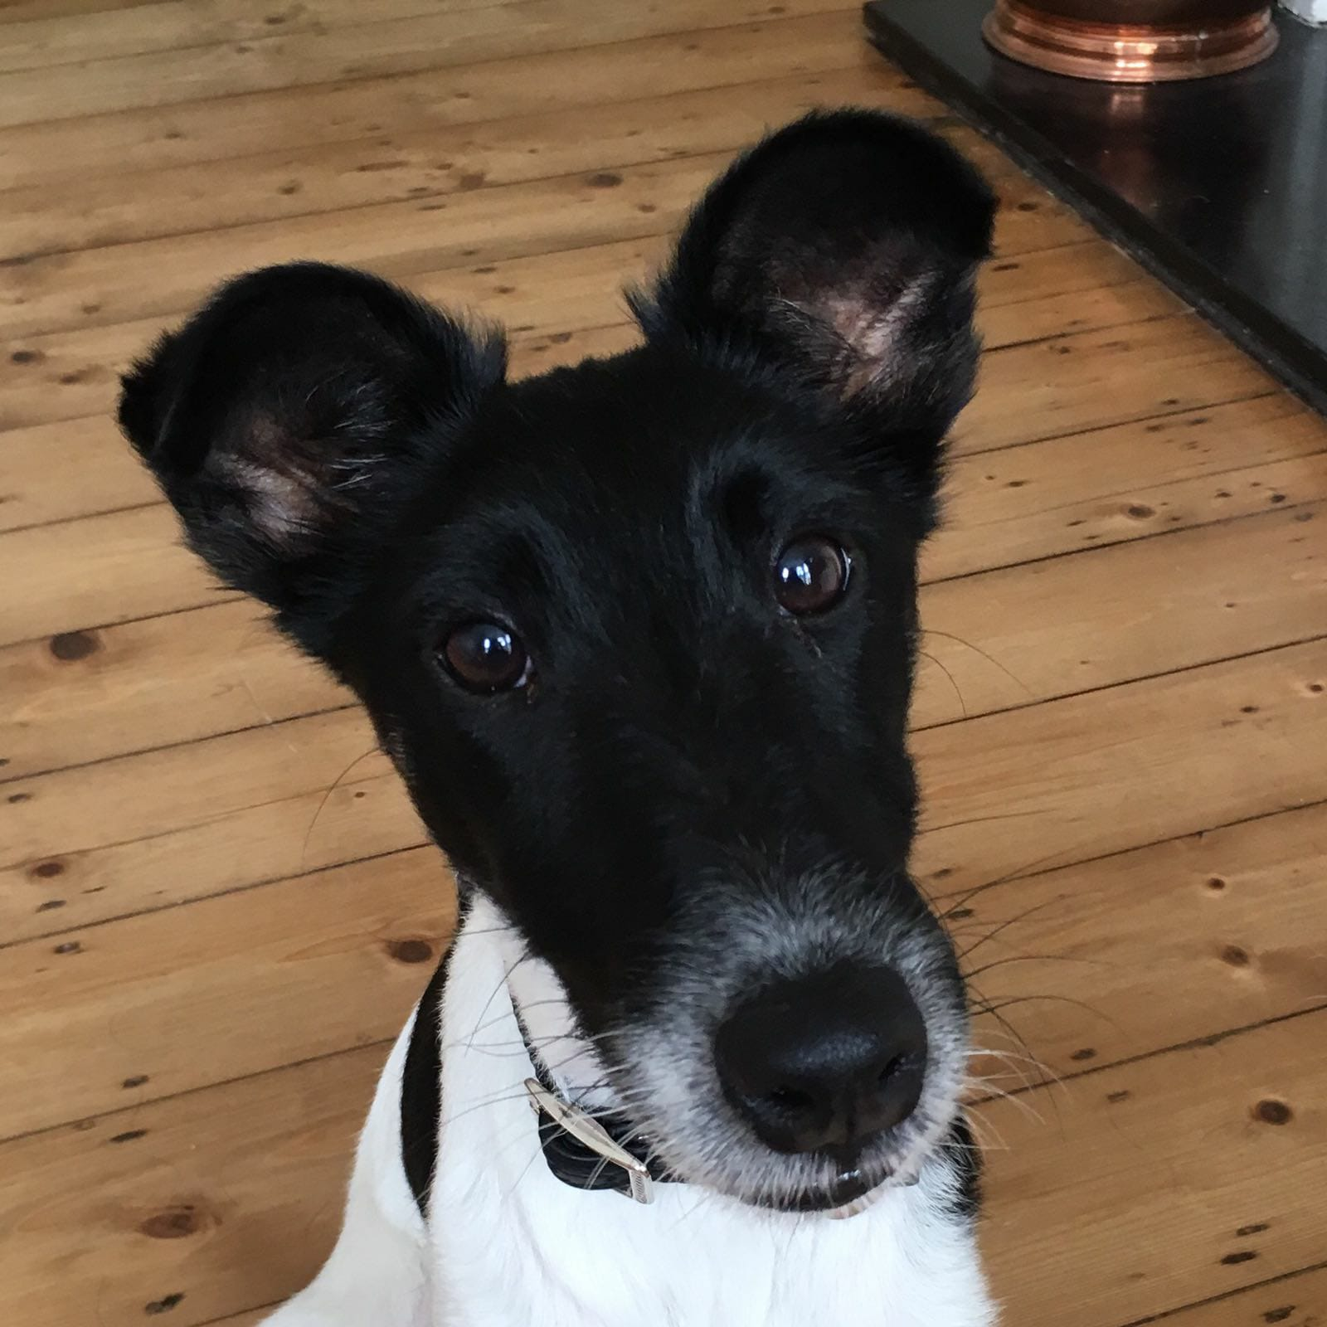
Inspiration

Slide 10
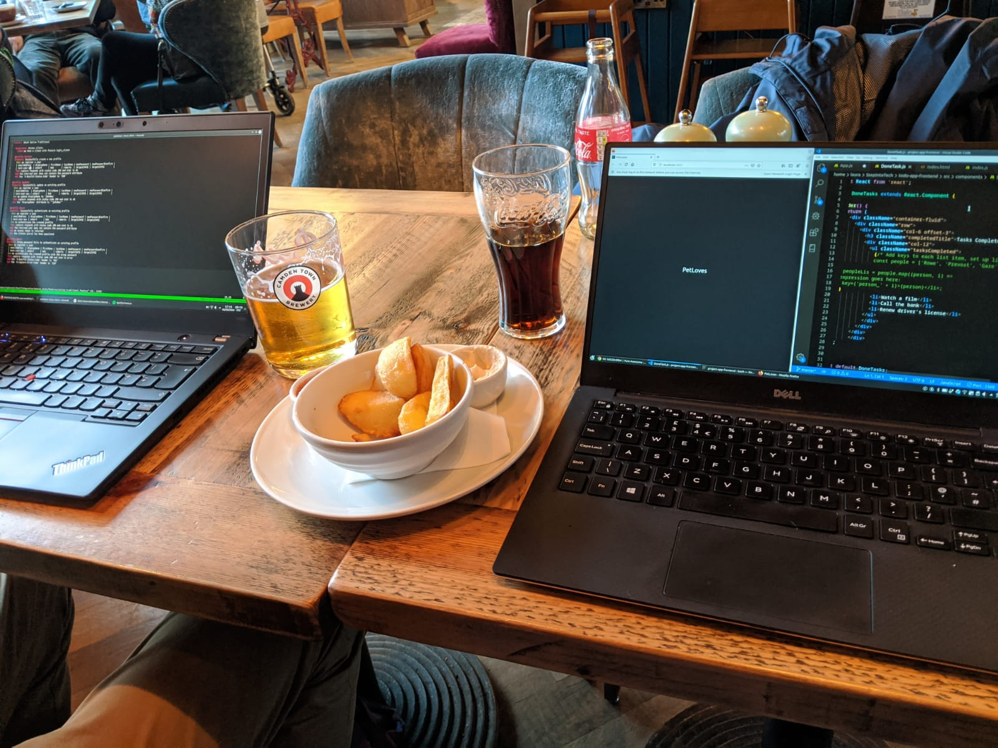
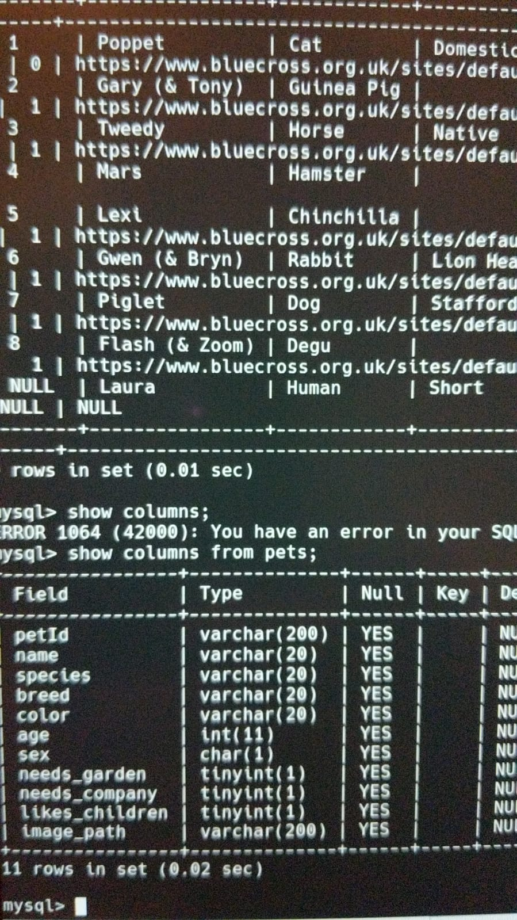
Research

