Slide 1

Pet Loves Project
Making the perfect match between human and pet

Slide 2
Intro
We started off with an idea of matching pets with their ideal human.
The first thing we needed to do was to decide how we were going to go about this taking into account the limited time scale and bearing in mind Minimum Viable Product and Proof of Concept.

Slide 3
Concept
We wanted to structure the app in the form of a quiz asking some basic questions of potential pet owners, such as:-
Do you have a garden?
How much time do you spend at home?
Do you have children?

Slide 4
Structure
We decided the best way to structure the app would be:-
Landing page with images of pets and a ‘Learn more’ button which you could press and then find out more about a particular pet you are interested in.
You would then be directed to a quiz page that was designed to narrow down your suitability to owning any particular pet.
Weighting system to score potential pet owners.

Slide 5
Work Process
With a mixture of stand up meetings, quad programming, pair programming we have worked on the shape and structure of the app.
Display results of hard coded pets
Display results of pets pulled from database
Add CSS
Add quiz questions
Filter pets by one answer ("Do you have a garden?" - matches to all pets with that specific requirement)
Function to weigh answers (secret matching algorithm)
Match quiz answers to pets

Slide 7
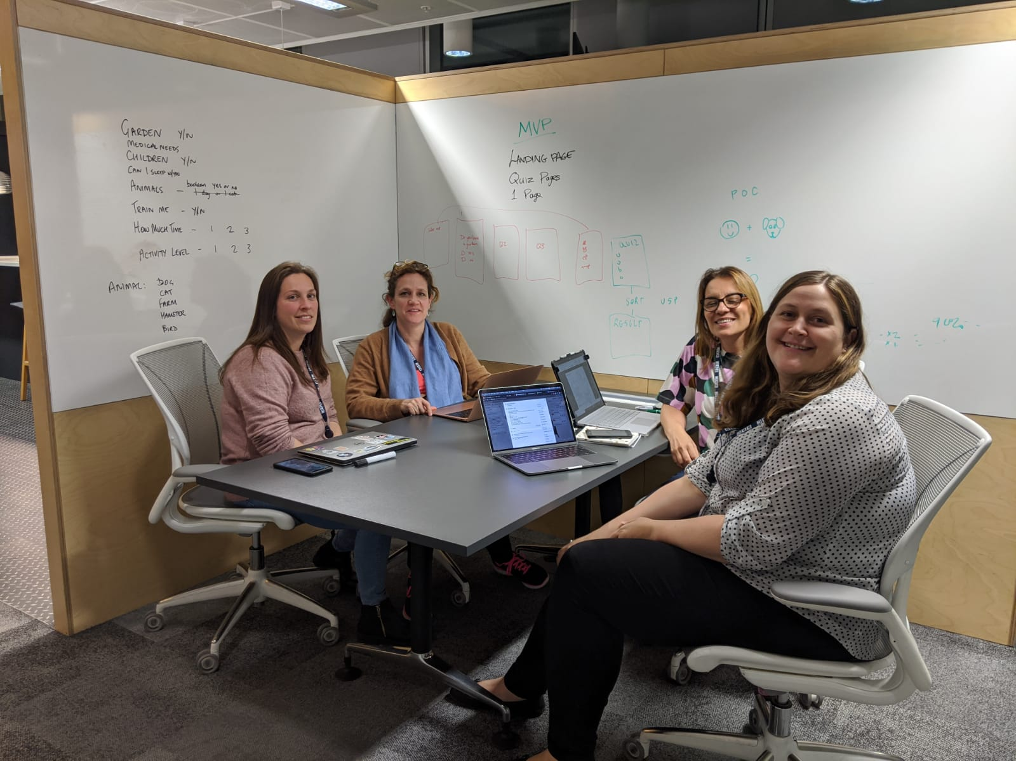
The Team!
Amelia
Laura
Jyoti
Lorna

Slide 8
Technology Used
We used a range of technology including:-
Scraper tool
React/Javascript
Trello
In Vision
Amazon Web Services
Web Scraper
Mysql database/ Amazon web services (LAMBDA)

Slide 9
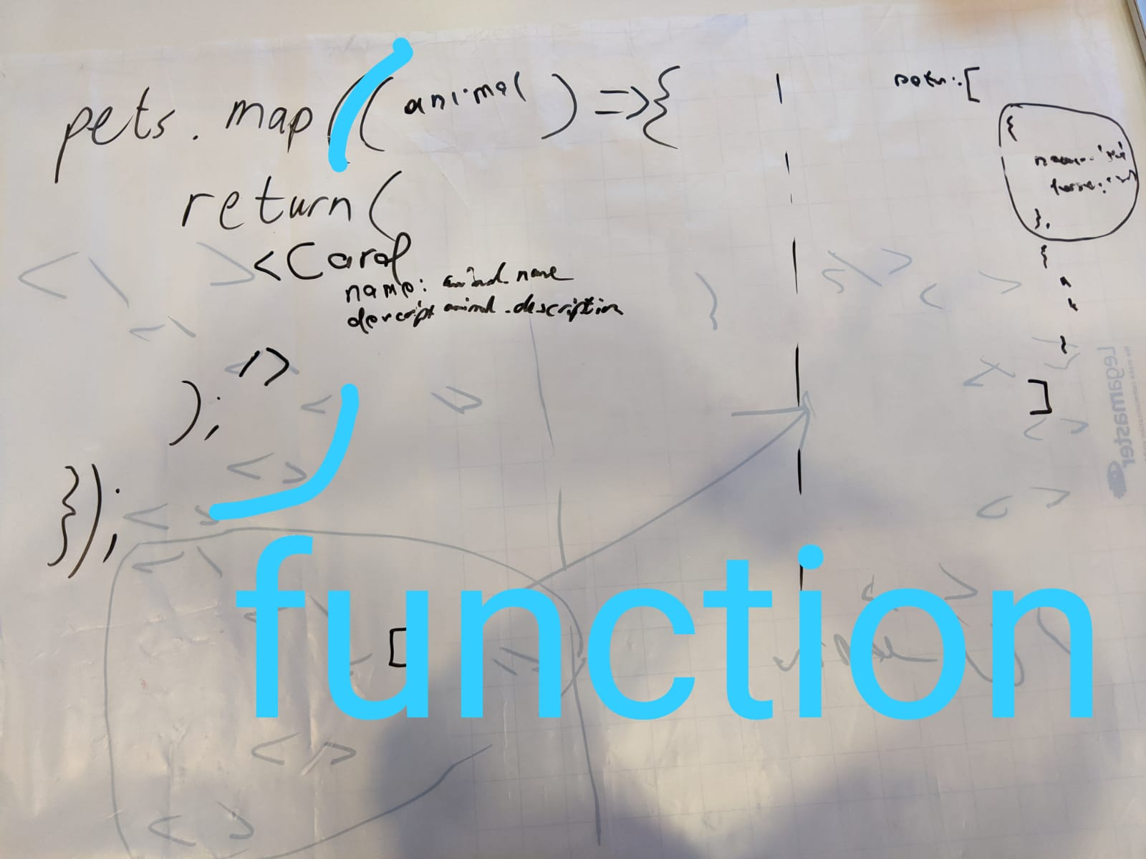
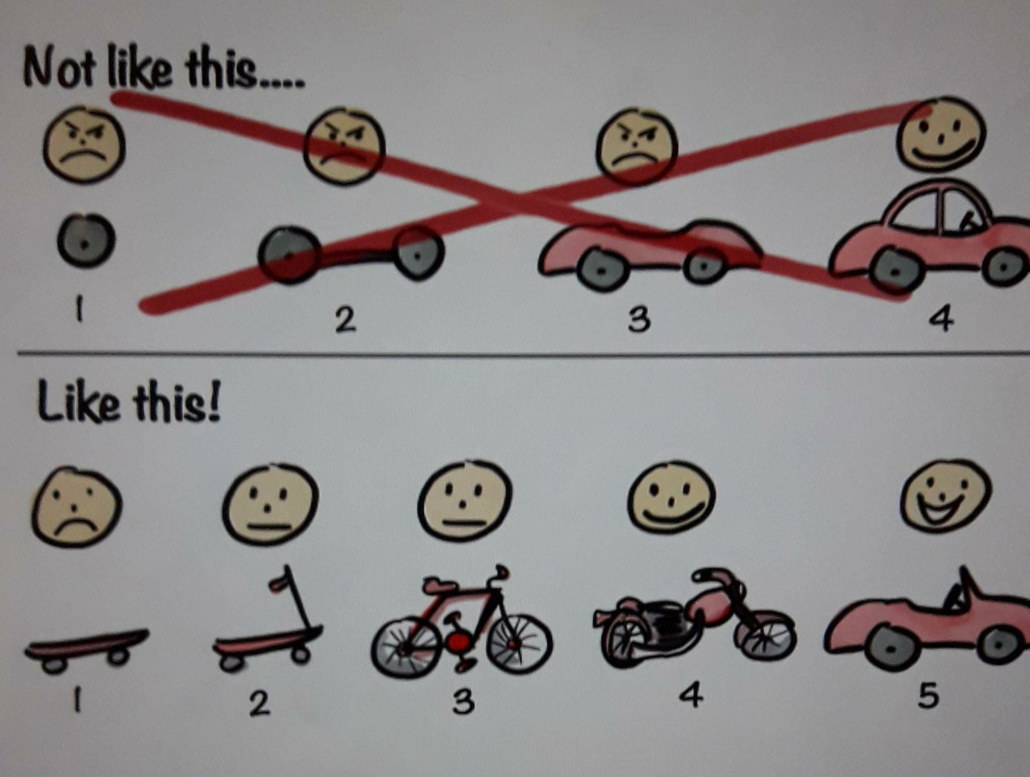
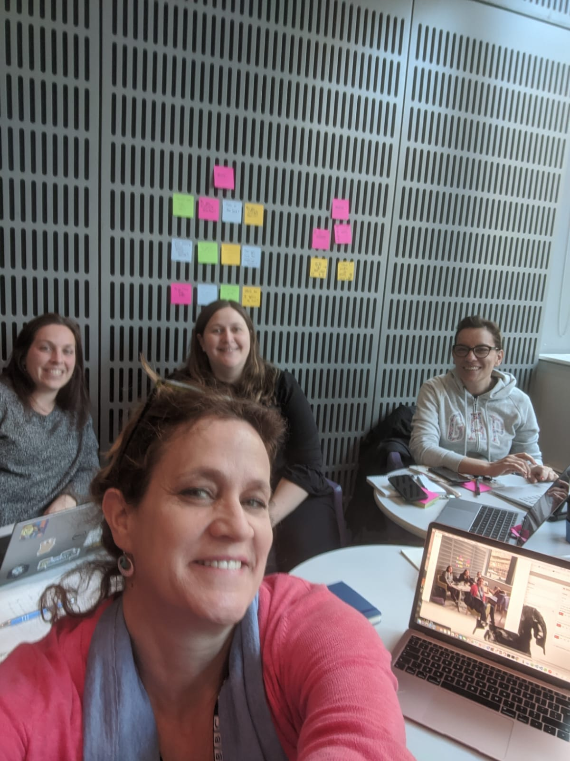
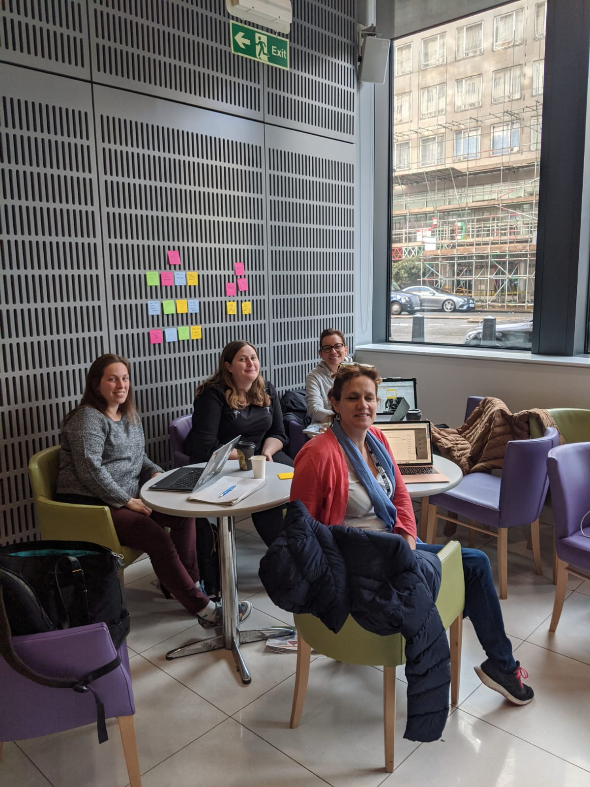
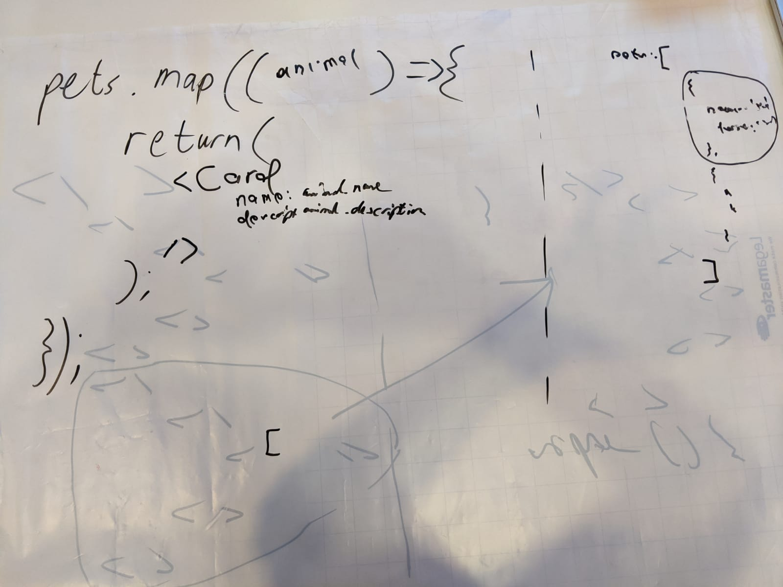
Whiteboard Discussions

Slide 10
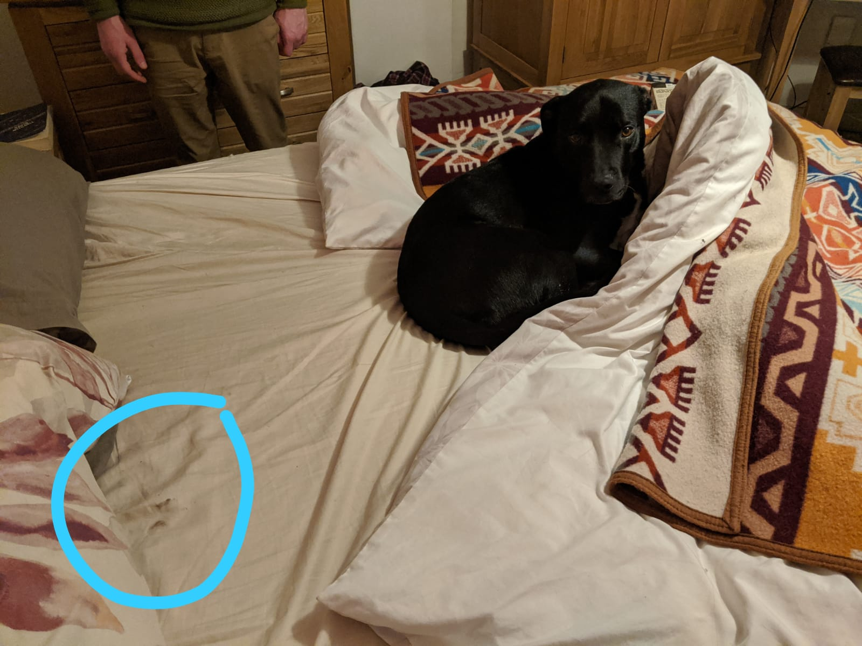
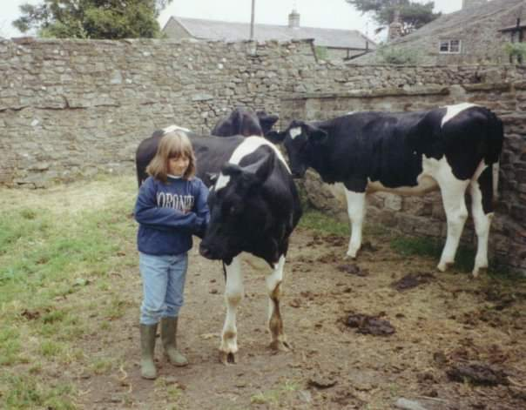
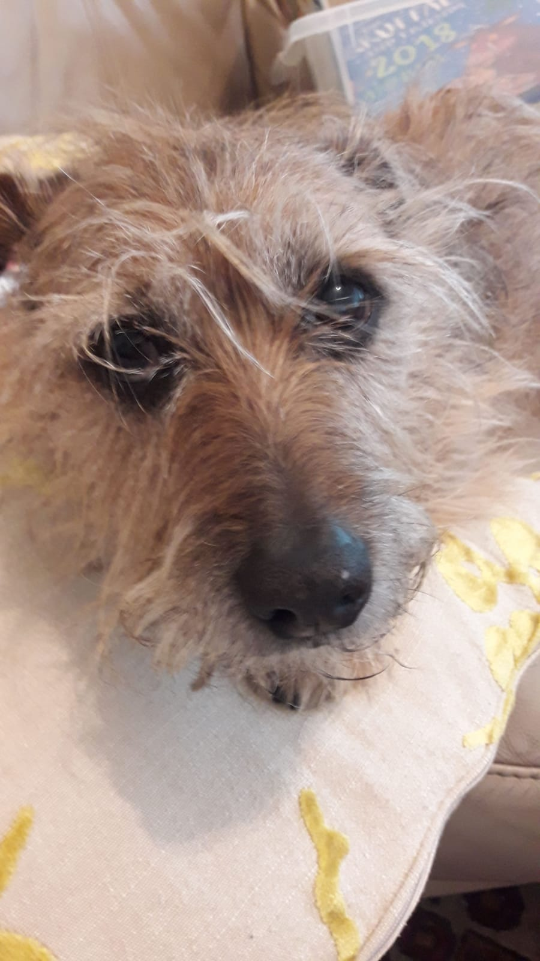
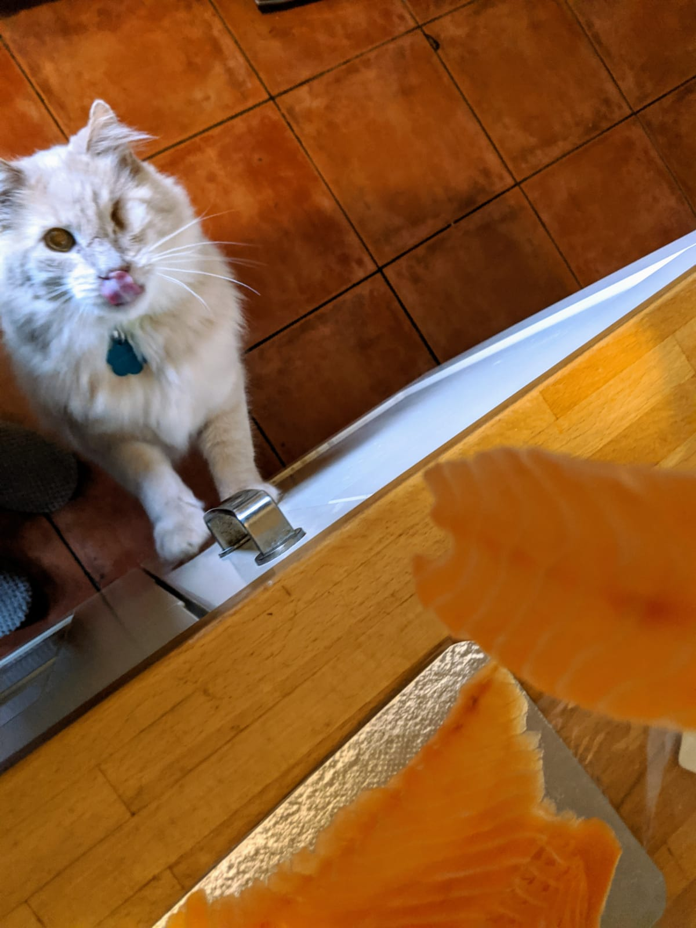
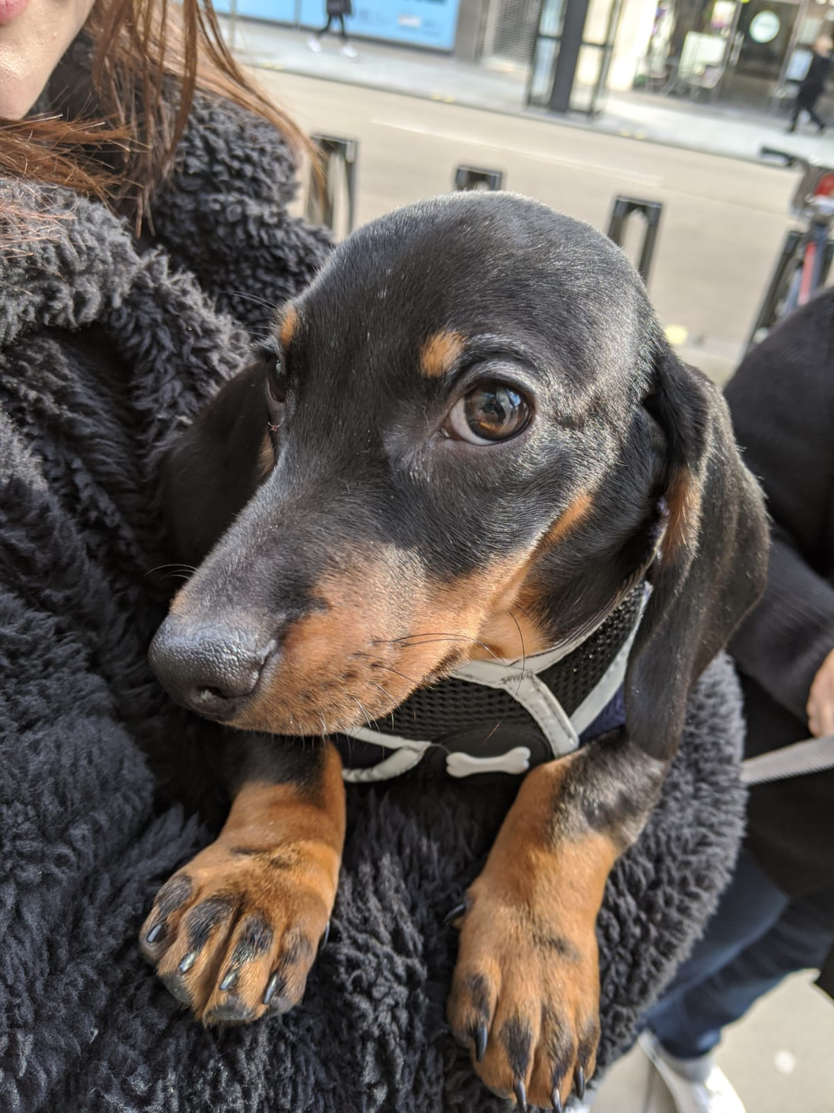
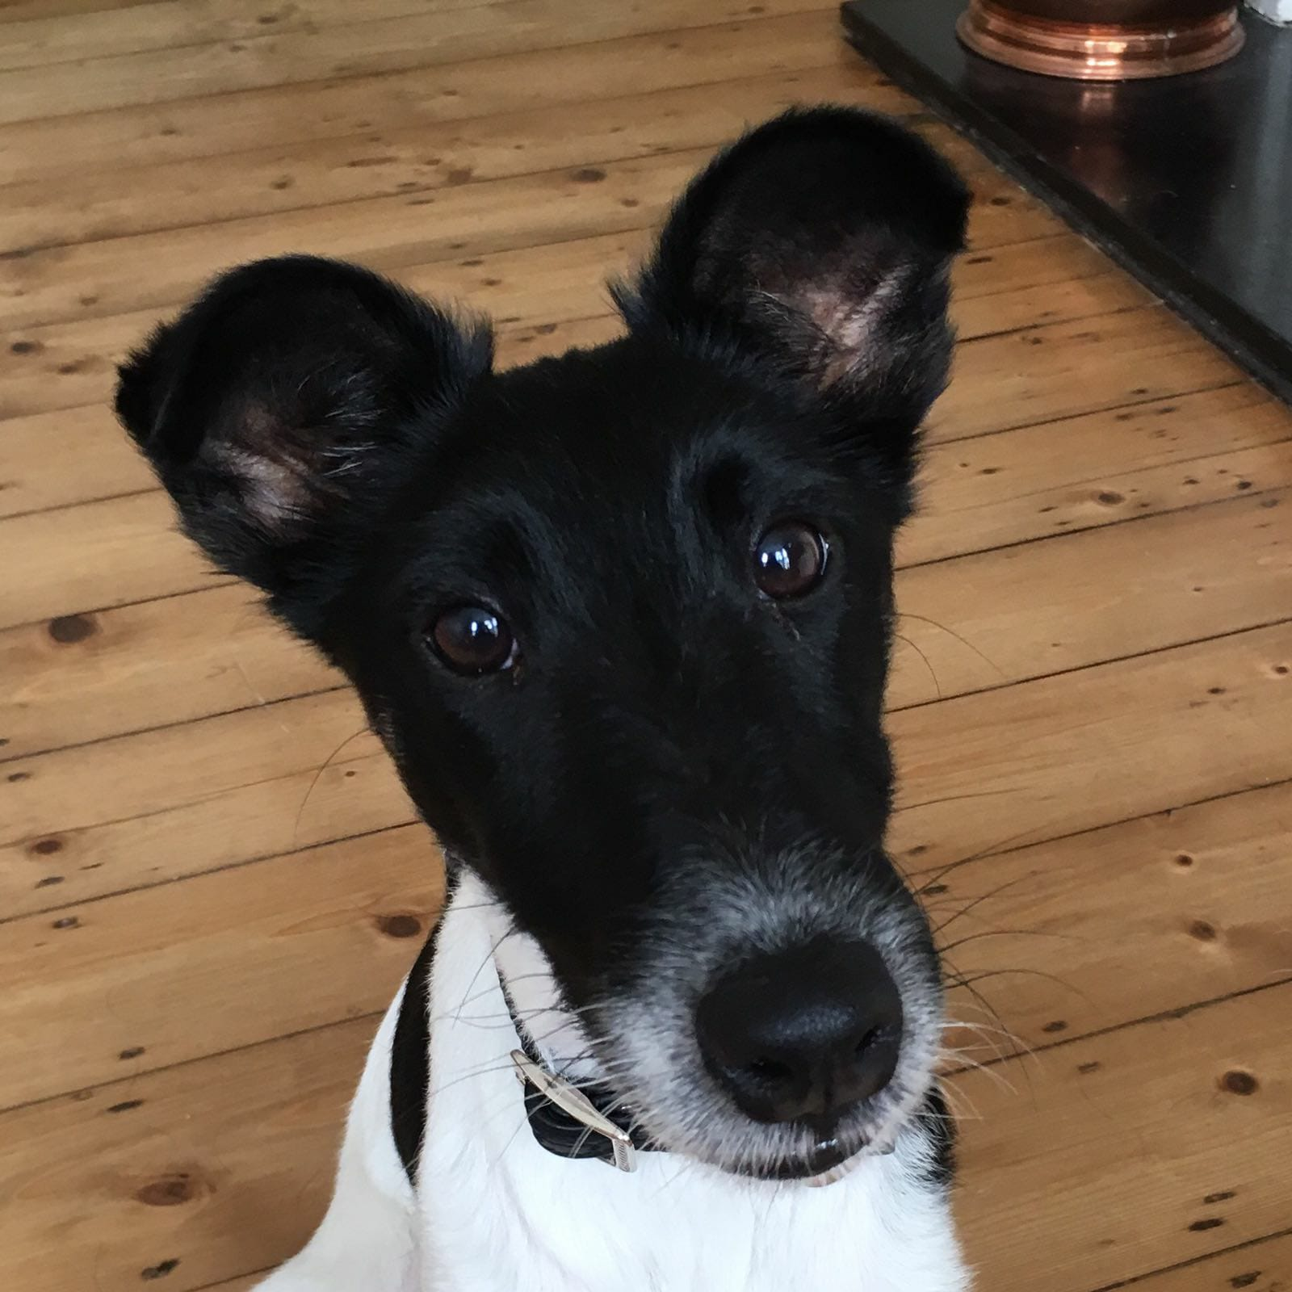
Inspiration

Slide 11
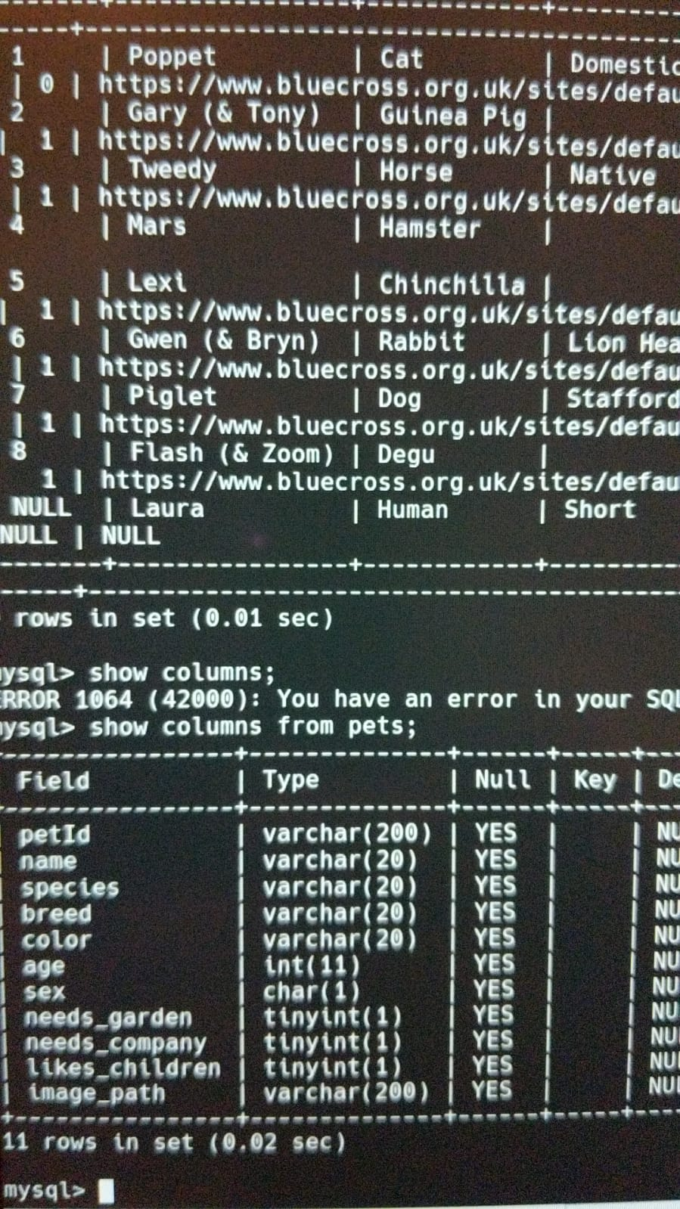
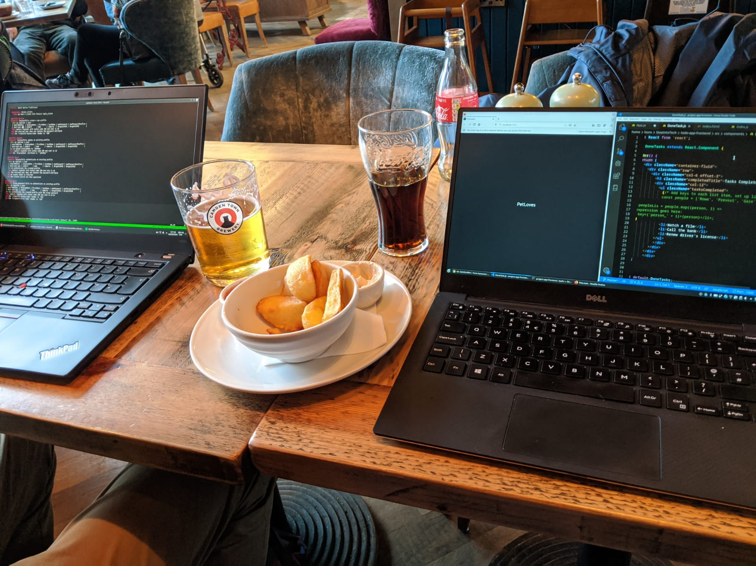
Research

Slide 12
Research
Battersea Dogs Home
https://www.battersea.org.uk/?gclid=CjwKCAjwgbLzBRBsEiwAXVIygI4J4ZSZX6-P5c40rajtzDheXah2J5Nq13wbY18RsTcZK6US3nydkxoC2jUQAvD_BwE
PDSA
https://www.pdsa.org.uk/?_$ja=tsid:67827|cid:258761070|agid:20225634390|tid:kwd-90377080|crid:294826746416|nw:g|rnd:689055166402275185|dvc:c|adp:|mt:e|loc:9045889&gclid=CjwKCAjwgbLzBRBsEiwAXVIygNLvyOhANwyFTG-IXqlDjm6TFekid1w9fp0cdTi0DWnR1GvDnytUXhoCgbYQAvD_BwE
Dogs Trust
https://www.dogstrust.org.uk/rehoming/?gclid=CjwKCAjwgbLzBRBsEiwAXVIygL1cK3OWJR2YcviJWbah0PIaAB0_8phRiOxDatclzuRAERLfx_JQphoCn3UQAvD_BwE&gclsrc=aw.ds

Slide 14
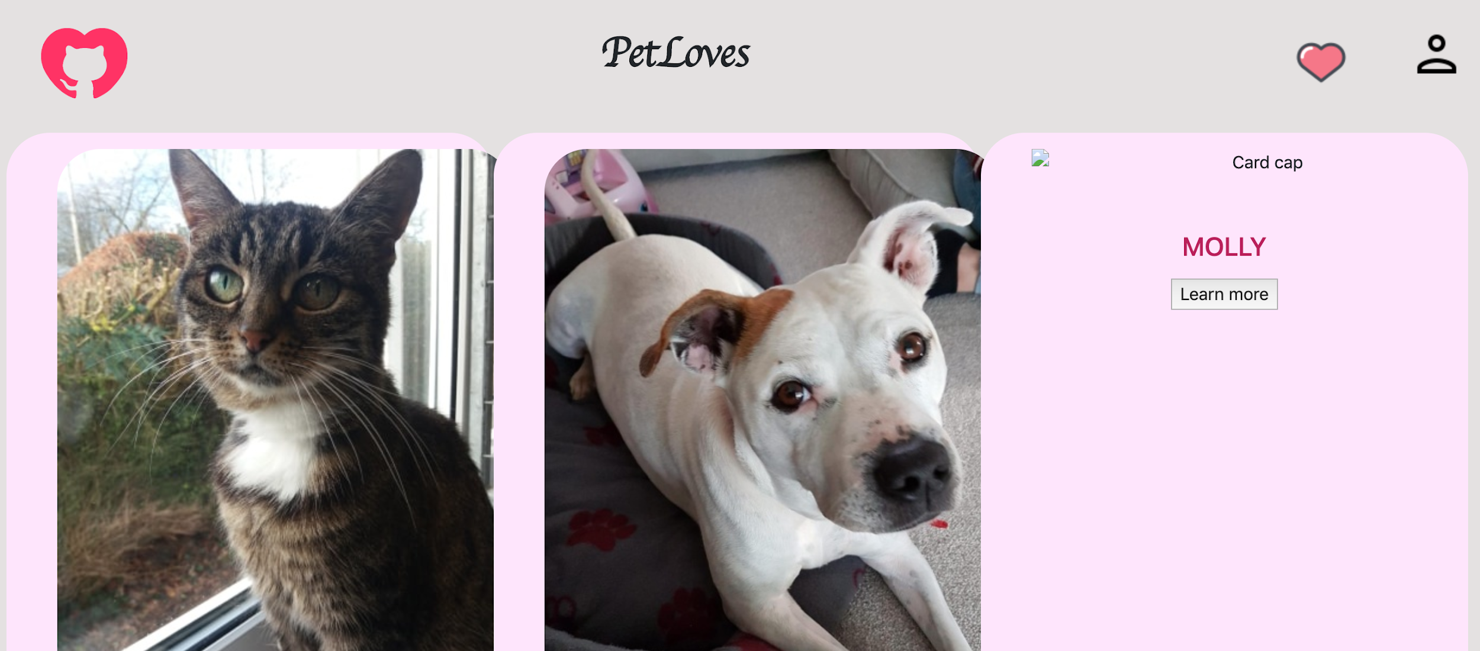
Filming explanation of the app

Slide 15
Project review

