Slide 1
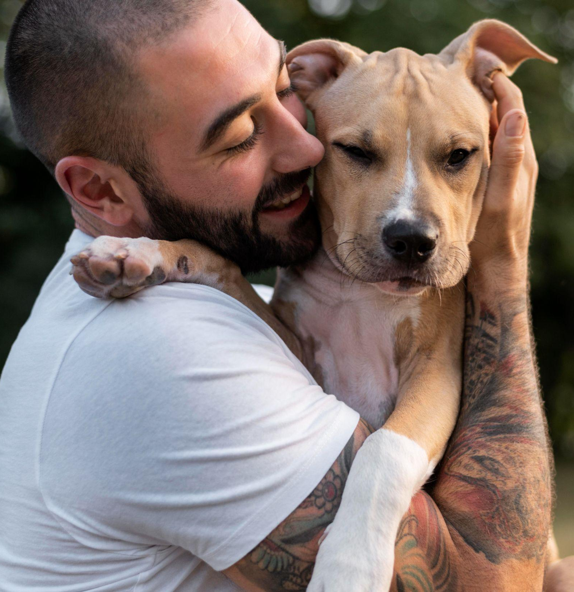
PetPal
Adopt
Nathaniel Brown, Noah Acosta, Lucas Noack, Tera Parish, Rachel Bang, Aidan Duong & Ritvik Chilakamarthy

Slide 2
“Bumble for pet adoption”
Our mobile app shows users pets that need adopting in their area, and the user can swipe (left or right) to match with their potential future pet and the shelters or owners housing them.

Slide 3
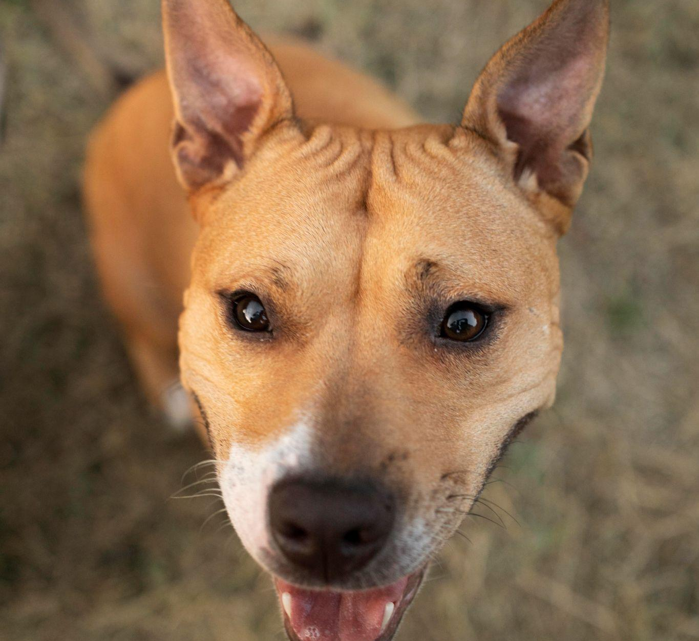
Our motivation
For too long, pet adoption has been a convoluted and abstract process. By offering a location-based matching service, users are able to both give away or adopt a beloved pet near them. We hope that our app will prevent any further animals from being euthanized in shelters (as a result of never being adopted), abandoned by owners who no longer want them, and so much more.

Slide 4
What sets us apart?
Inclusivity
Personal
Our adoption platform is open to pets in any and all forms, not just cats & dogs.
Private pet owners, not just shelters, are welcome to give away their pets after undergoing a background check. We understand that giving away a loved one to a shelter can be heartbreaking, so we seek to be the bridge between two loving homes.

Slide 5
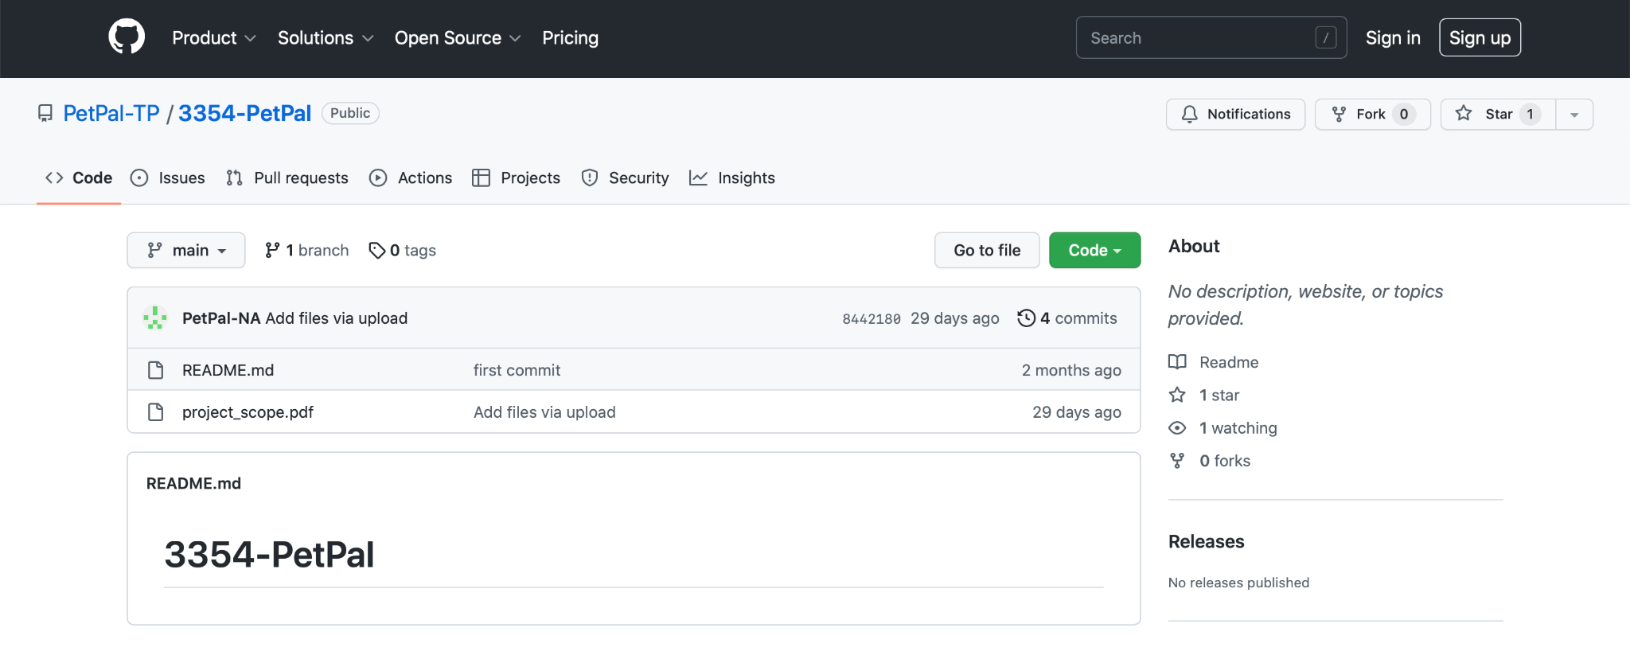
Our Github Repository
https://github.com/PetPal-TP/3354-PetPal

Slide 6
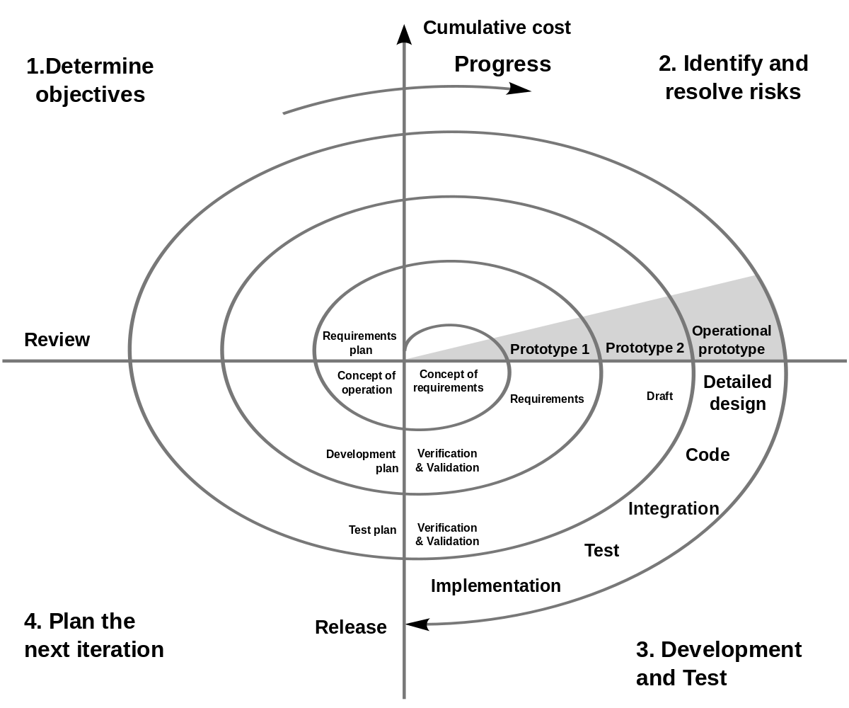
Software Process Model
Spiral Model
At the beginning stages of our project, the specific requirements are not yet known; allows us to understand, react, and adapt to changing requirements and risks.
Most closely reflects how development progresses in the real world; as the group keeps iterating through multiple cycles, our project will progressively become more and more complete, building upon previous iterations.

Slide 7
Functional Software Requirements
A user shall be able to:
Create a profile for themselves or their pets, containing relevant information about them
Message any other user they ‘match’ with
Select requirements in order to specify what qualities they wish to look for in their ideal match
Browse other users which match their requirement, and view these other users’ profiles
‘Swipe left’ to reject a candidate, or ‘swipe right’ to accept a candidate
View other users who ‘swiped right’ on them, view their profile, and swipe back in return

Slide 8
Non-functional Software Requirements
Usability | The ‘swiping’ system shall be explained after the user creates their profile such that users are not confused on how the app’s primary system, the matching system, works
Space | The application shall not take up more than 1GB of space
Dependability | The software development team shall continuously monitor the application to fix all bugs or errors as soon as possible.
Security | The application will store passwords in a secure location to avoid access by hostile entities
Environmental | The app must take weather into account when determining adoption dates and types. It should keep an eye out for where a pet will be rehomed (eg. it should warn that a Husky should not live in a hot area)
Operational | The application must be able to perform all actions requested by the user
Development | The software must be programmed in a high-level programming language and implement a database management system such as SQL
Accounting | The application must include a security fail-safe to protect user’s account
Safety Security | If we allow users under 13 to be on the app (if a family wants to allow their child to choose a pet to adopt), the app must abide by COPPA

Slide 9
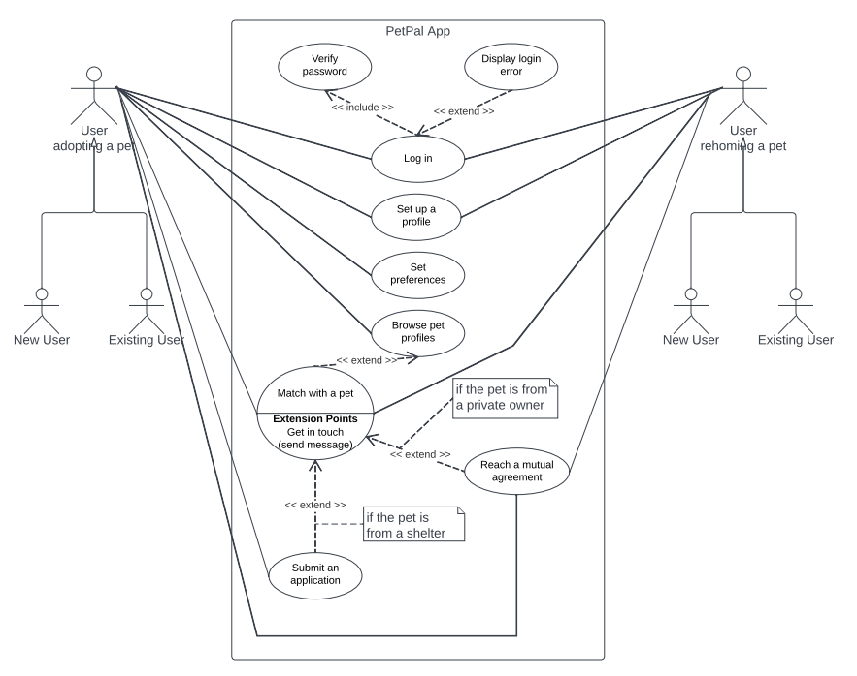
Use Case Diagram

Slide 10
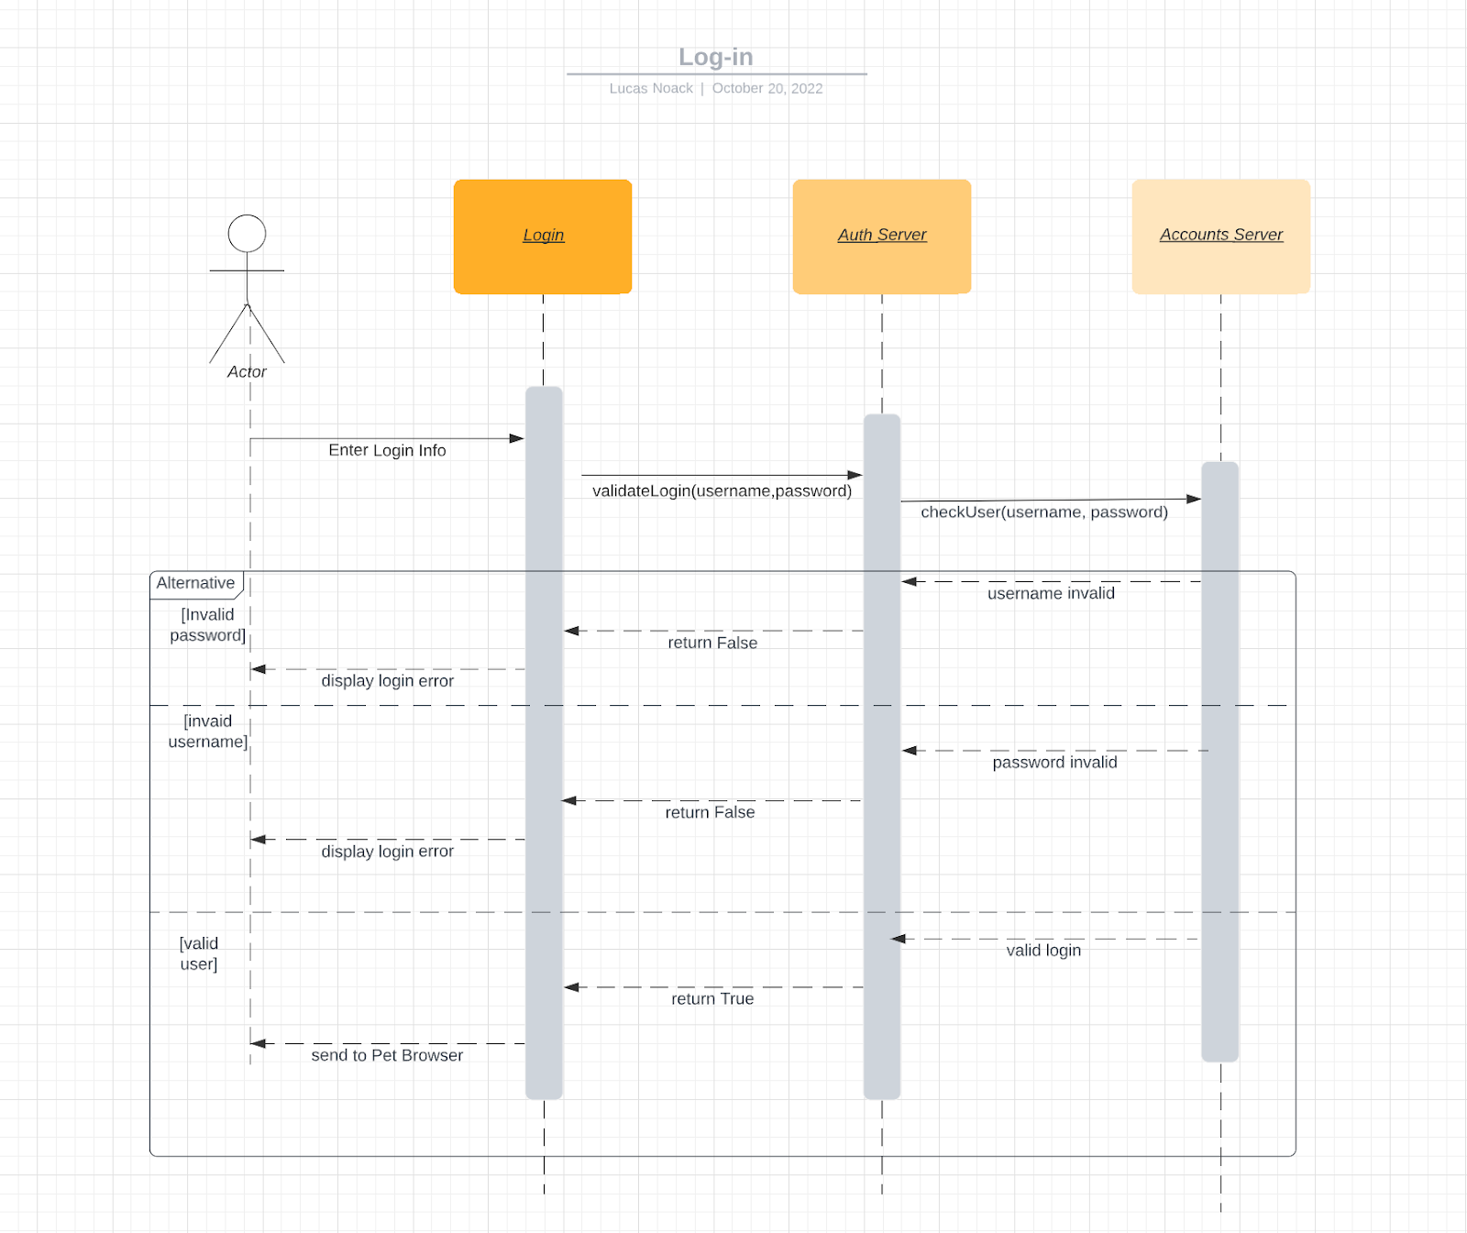
Sequence Diagram 1

Slide 11
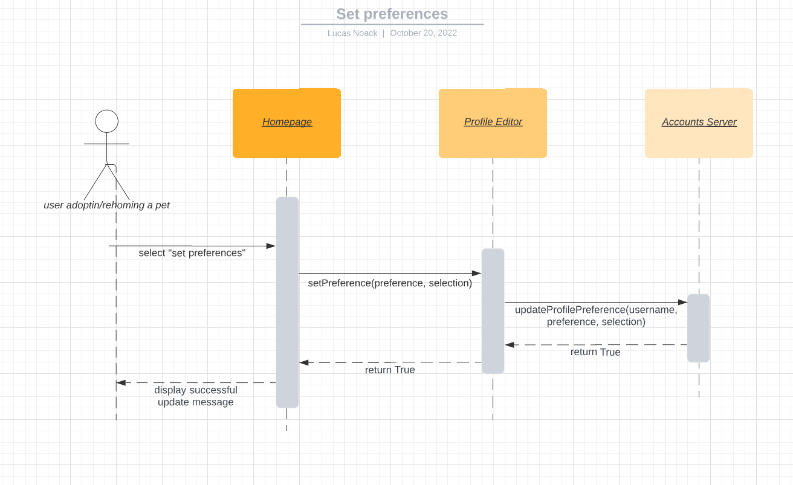
Sequence Diagram 2

Slide 12
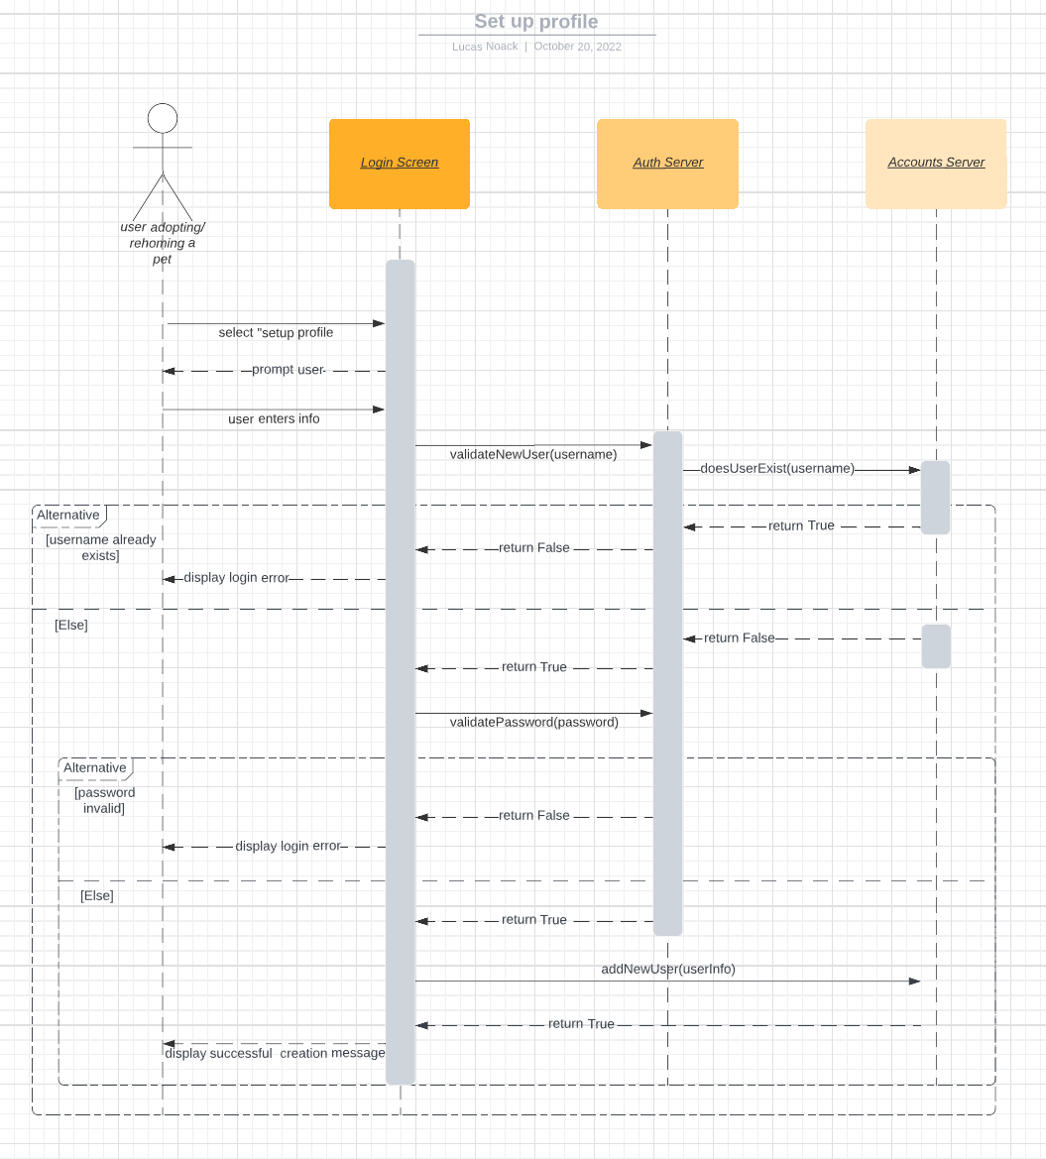
Sequence Diagram 3

Slide 13
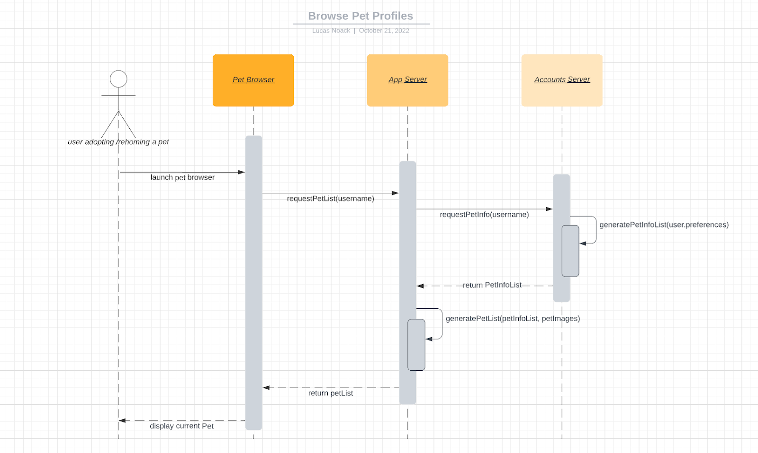
Sequence Diagram 4

Slide 14
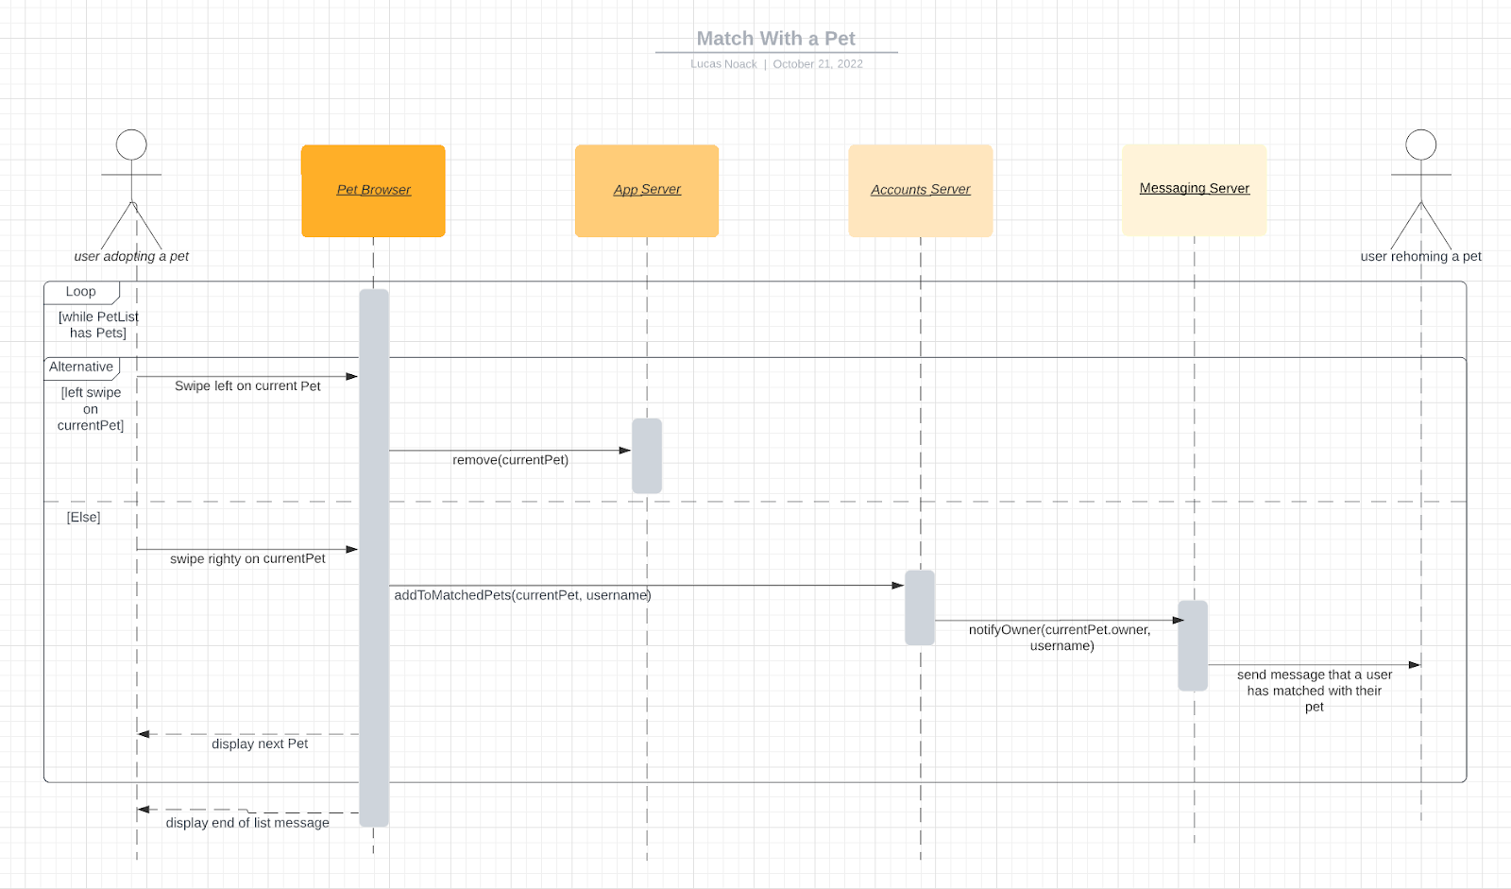
Sequence Diagram 5

Slide 15
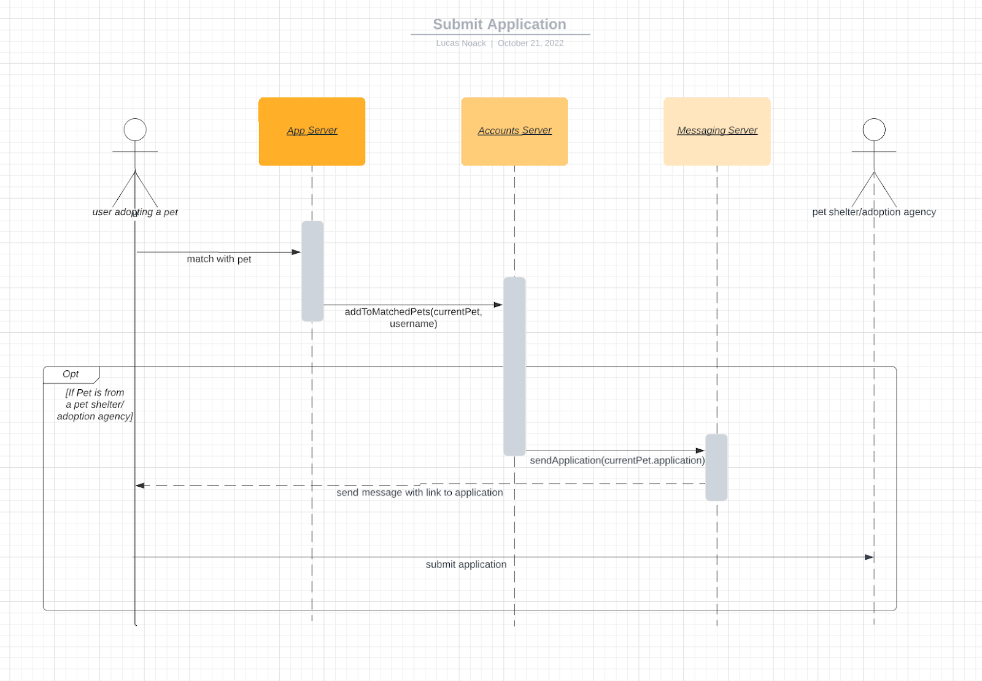
Sequence Diagram 6

Slide 16
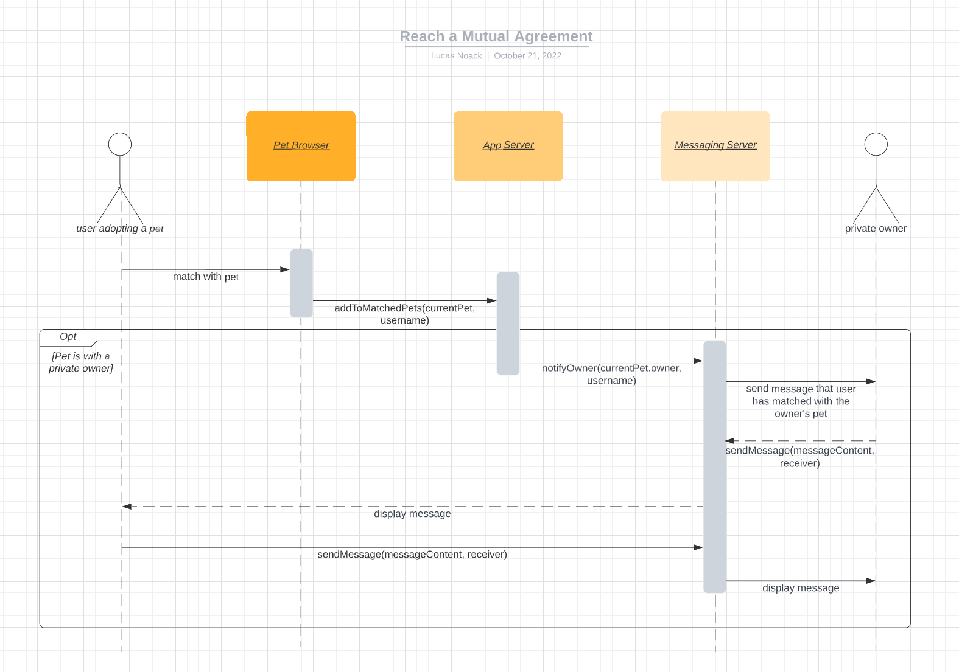
Sequence Diagram 7

Slide 17
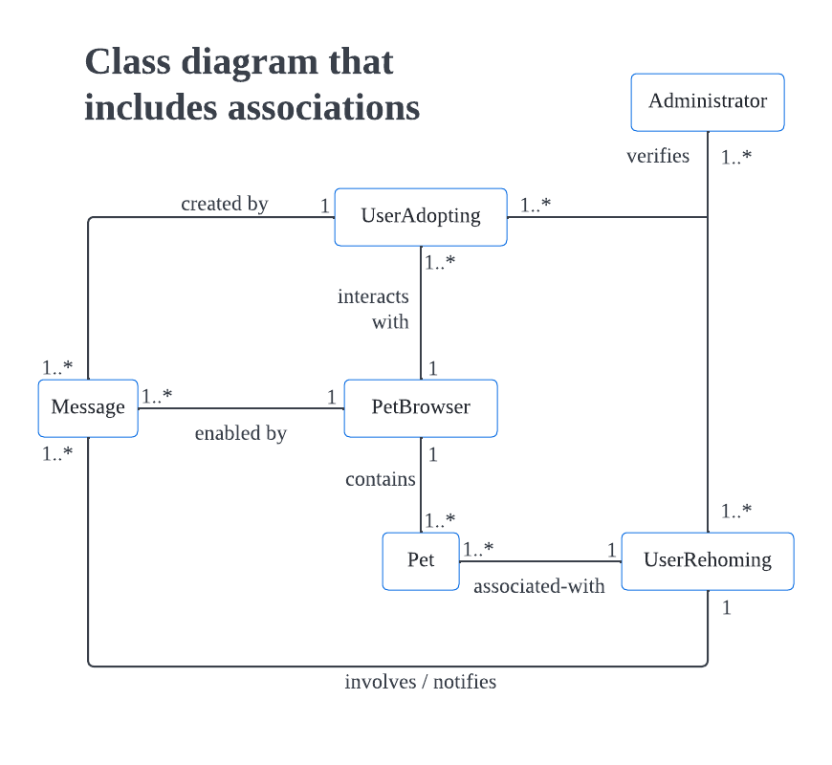
Class Diagram 1

Slide 18
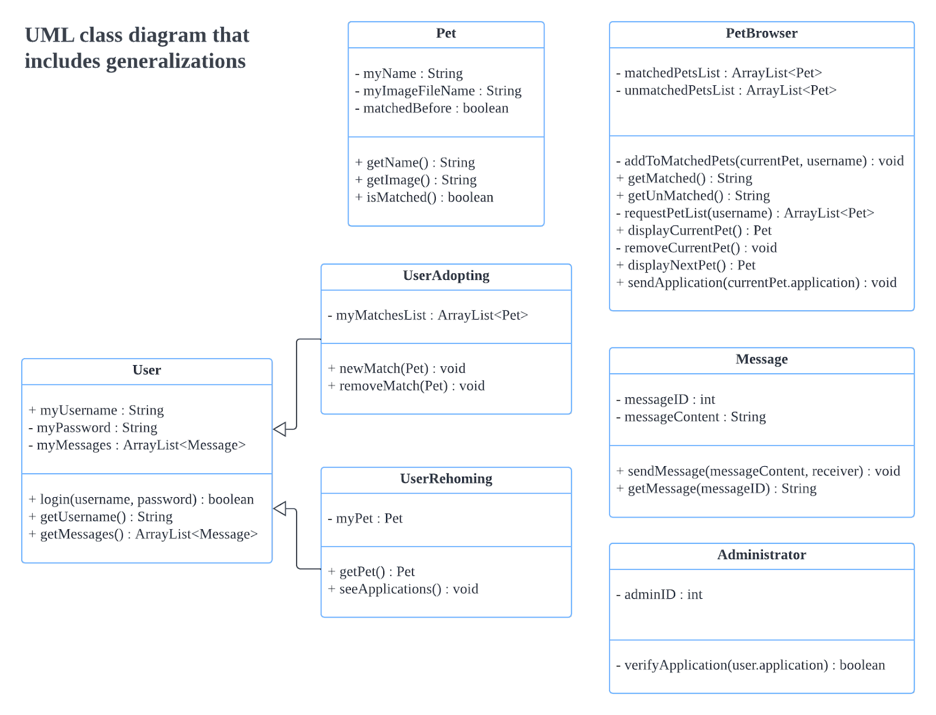
Class Diagram 2

Slide 19
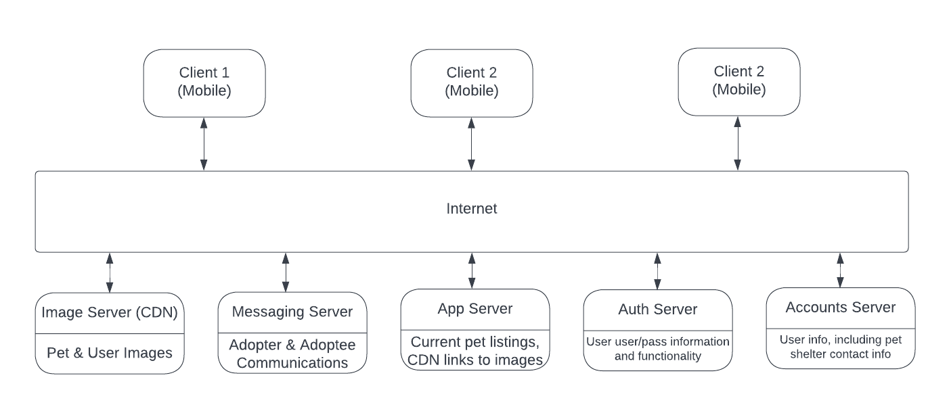
Client-server Architecture

Slide 20
Client-server Architecture
Image Server (CDN): Server configured as a Content-Delivery Network (CDN) specifically for serving lots of images to users. That way users are able to see pet images quickly, as they’re delivered by a specialized server capable of transferring high amounts of binary image data quickly.
Messaging Server: This server will operate at low latency to allow users to contact pet listers on a quick and secure server to facilitate pet adoption.
App Server: This will server as the main server the user’s device initially points to, generating/retrieving the pets that are adopted in the user’s area, links to pet images, and more relevant information.
Auth Server: Handles user authentication and account creation in a secure manner.
Accounts Server: Stores user info, including pets up for adoption and pets users are interested in.

Slide 21
Project Scheduling
Start
End
The uncertainty would range from 2x the estimated time to 0.5x the estimated time, which would mean 3-12 months, so any time from February 2023 to December 2023.
Weekends are not counted in this schedule, and we will be working 8 hours per workday
01
06
Setting a hypothetical start date of December 1st, 2022
Estimating the development timeline to be about 6 months, based off similar app Tinder

Slide 22
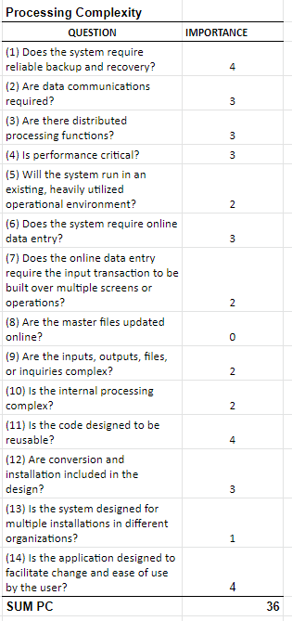
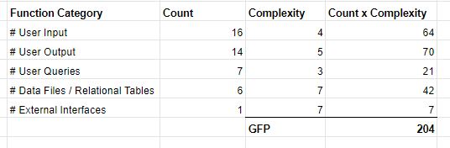
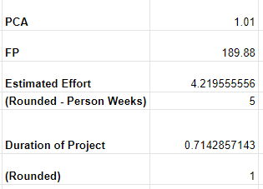
Cost, Effort, & Pricing
Using Function Point (FP) Method:
We will have no hardware since we will be using Amazon Web Services to host the information of the app.
Amazon Web Service as a software will cost $13.51 per month.
For the cost of personnel, the current development team has 7 people.

Slide 23
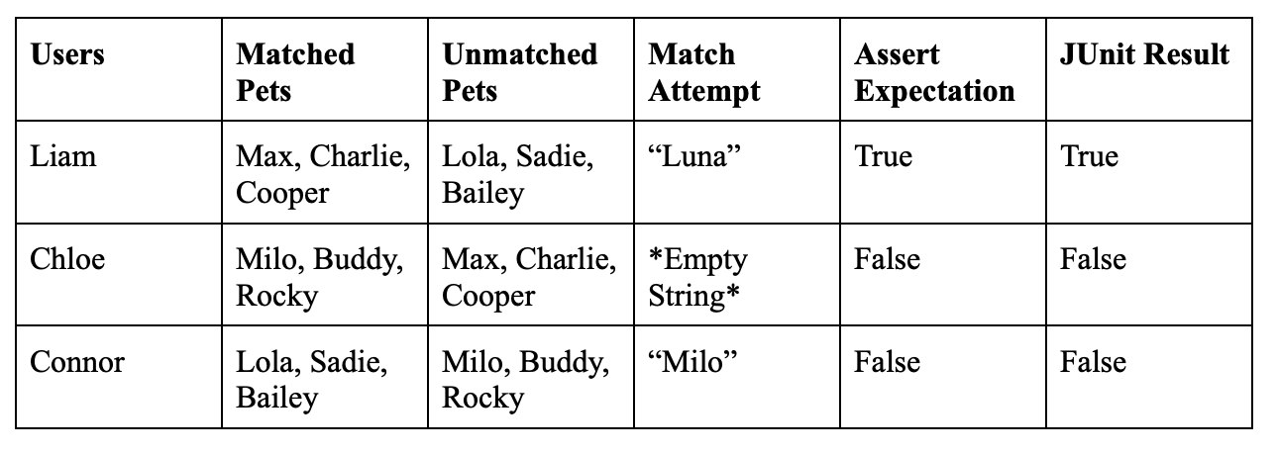
Test Plan
Link to Github containing code:
https://github.com/PetPal-TP/3354-PetPal/tree/main/addToMatchedPets
Testing: addToMatchedPets method
This method is called when a user adopting a pet swipes right on the pet browser and adds the selected pet to their list of matched pets in our user database.
For the test, we created dummy users with lists of matched and unmatched pets. We then attempted to add three different pets to the dummy users. One user matched with a pet that was not present in their unmatched pets, the second user matched with a pet that had an invalid, empty name, and the final user was matched with a pet that was in their unmatched pets list.
The only user that is expected to have the pet added is Liam since they are given the only valid pet name that is not present on their unmatched pets list

Slide 24
Similar Designs
We found three other applications that are similar to ours.
PetFinder:
Has a Tinder-like feature
Communication is facilitated through email
Users can put their own pet up for adoption
WeRescue:
Includes a social media section for success stories
Have a “Learn” section to learn about pet adoption, pet caretaking, etc
Prompt users to contact the shelter to facilitate adoption
Petdar:
Prompts users to call or email the pet store
Though our app was similar to PetFinder, our design provides the user
with in-app messaging, hopefully leading to a higher retention rate
among adoptions

Slide 25
Conclusion
Though our initial idea for the project did not change, some of the implementation decisions were.
Software process model:
Used spiral as it was agreed to be the most effective for this project
Architecture:
Used Client-server though pipe/filter and MVC were discussed
Though we were aware of similar applications, we believe our application has the potential to be more effective at retaining adoptions of pets. The main improvement over the closest application, Petfinder, is the in-app messaging feature allowing potential adopters to more easily connect with potential pets.

Slide 26
Sources
[1] J. Allman, “Petdar,” App Store, 25-Mar-2015. [Online]. Available: https://apps.apple.com/us/app/petdar/id975535349. [Accessed: 18-Nov-2022].
[2] L. Levy, “5 Ways To Optimise Your App For High User Retention,” Usability Geek, 04-Sep-2019. [Online]. Available: https://usabilitygeek.com/optimise-app-user-retention/. [Accessed: 18-Nov-2022].
[3] Nestle, “Petfinder - Adopt a Pet,” App Store, 07-Nov-2012. [Online]. Available: https://apps.apple.com/us/app/petfinder-adopt-a-pet/id557228073. [Accessed: 18-Nov-2022].
[4] Pet Ventures LLC, “WeRescue – Adopt a Pet,” App Store, 14-Nov-2014. [Online]. Available: https://apps.apple.com/us/app/werescue-adopt-a-pet/id918610594. [Accessed: 18-Nov-2022].
[5] Schweb Design LLC, “Lancaster Puppies,” App Store, 03-Apr-2020. [Online]. Available: https://apps.apple.com/us/app/lancaster-puppies/id1478908590. [Accessed: 18-Nov-2022].

Slide 27
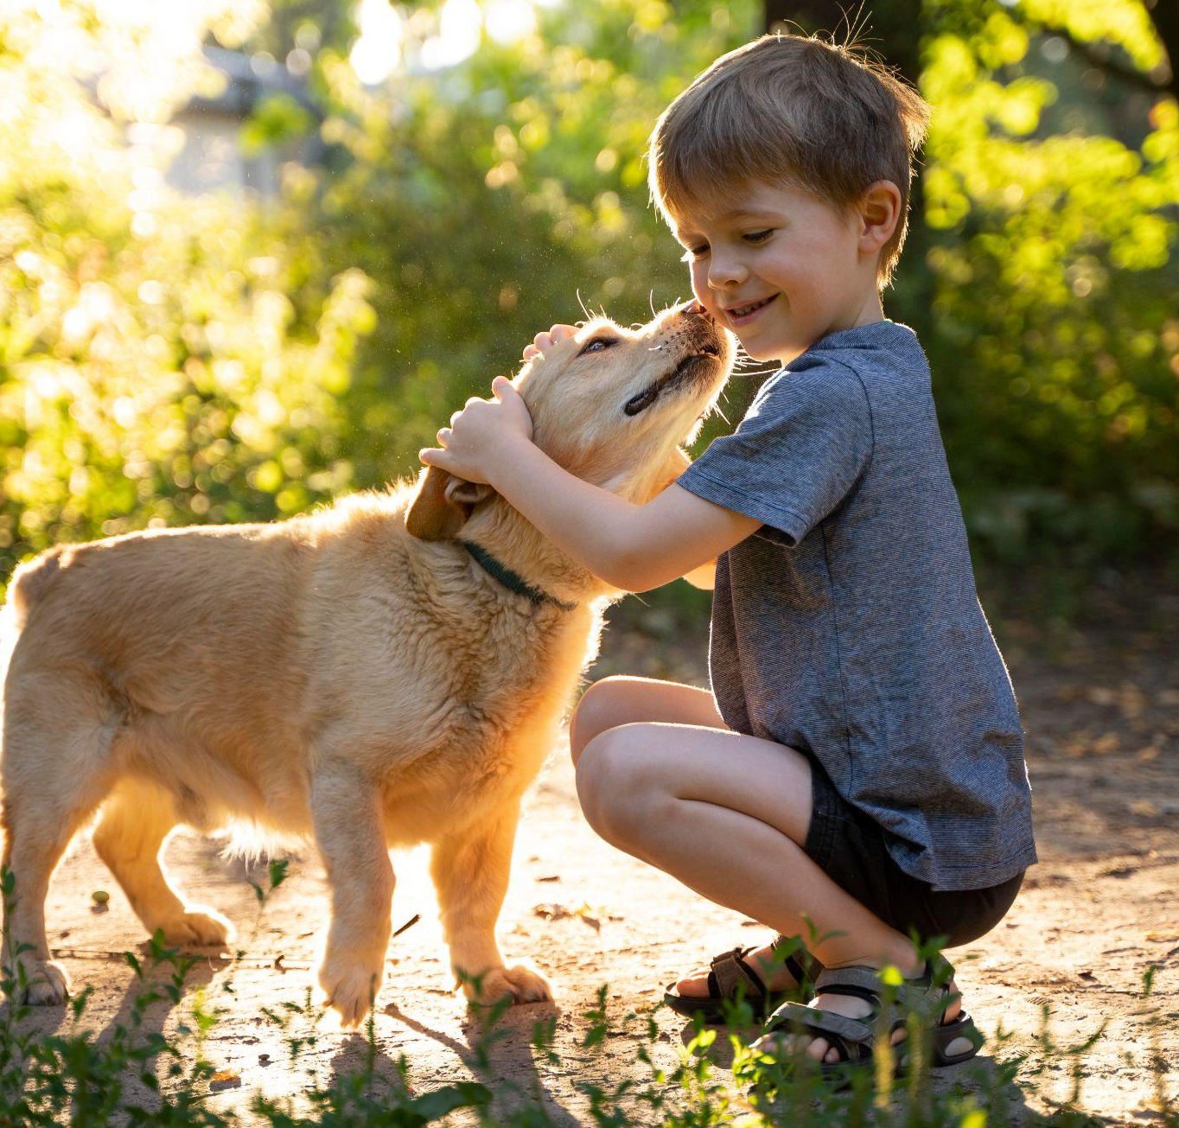
Thanks!
Adopt
Questions?

