Slide 1
Velkommen til Pet projects

Slide 2
Om os

Slide 3
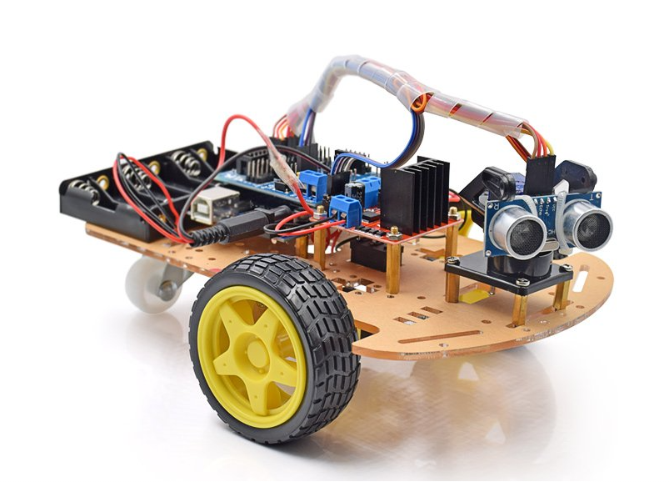
what will you learn?
Basic electrical circuit
Sensor technology
Basic C programming
Basic knowledge about Arduino
How to build your own projects

Slide 4
how to follow this course

Slide 5
Day 1
Intro
Install software (Code Blocks, Thikercad, Arduino EDI)
What is coding?
What is Arduino?
GPIO pins
Analog vs digital signal
Analog vs digital pins
Basic electrical circuit
Multimeter
Led, resistance
Breadbord
Exercise for Breadbord circuit

Slide 6
Day 2
Discussion about homework videos
Start with Arduino
Build in functions
Serial.println()
Exercise
Build in functions
Led, resistance, buzzer, DC - motor
What is H-bridge
basic circuit
H-bridge exercise

Slide 7
Day 3
Discussion about homework videos
Data sheet for sensor
Analog Sensor Theory
Type of sensor
Temp, potential resistor, photoresistor
How they work
How to use them with Arduino
Exercise (Analog sensor)
Digital Sensor Theory
Type of sensor
Temp, potential resistor, photoresistor
How they work
How to use them with Arduino
Exercise (Digital sensor)
Exercise (PWM)

Slide 8
Day 4
Discussion about homework videos
Sensor modules
Sensor library
Type of sensor
DH-11, Servo
Sensor shield
Exercise (Sensor modules)
Build project car, and connect the wires

Slide 9
Day 5
Discussion about homework videos
Debug techniques
Coding for car project

Slide 10
Day 6 (Optional)
Maze competition
Creative build project competition

Slide 11
Important links
https://www.youtube.com/channel/UCq8cULjyKLFifAogkfsXdOg
https://github.com/PetProjects1/Kursus-i-Arduino/tree/main

