Slide 1

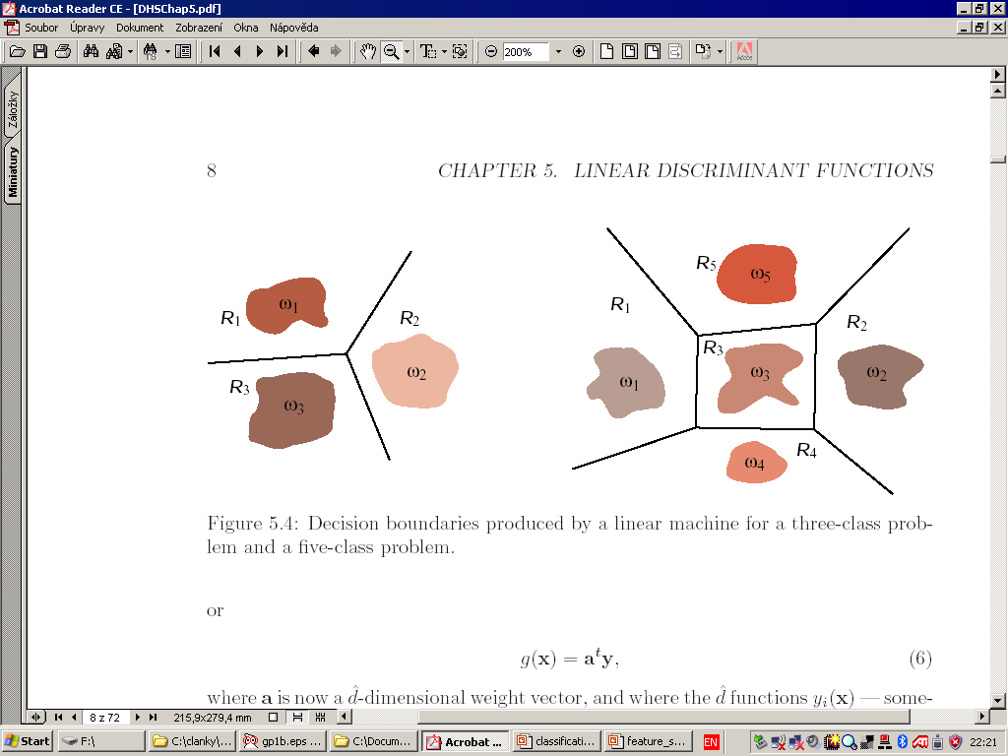
Visual Object Recognition
Image acquisition
Preprocessing
Object detection
Computing of
the features
Classification
Class label

Slide 2
Classification rule setup
Equivalent to a partitioning of the feature space
Independent of the particular application

Slide 3
Pattern Recognition
Supervised PR
– training set available for each class
Unsupervised PR (clustering)
– training set not available, No. of classes may not
be known

Slide 4
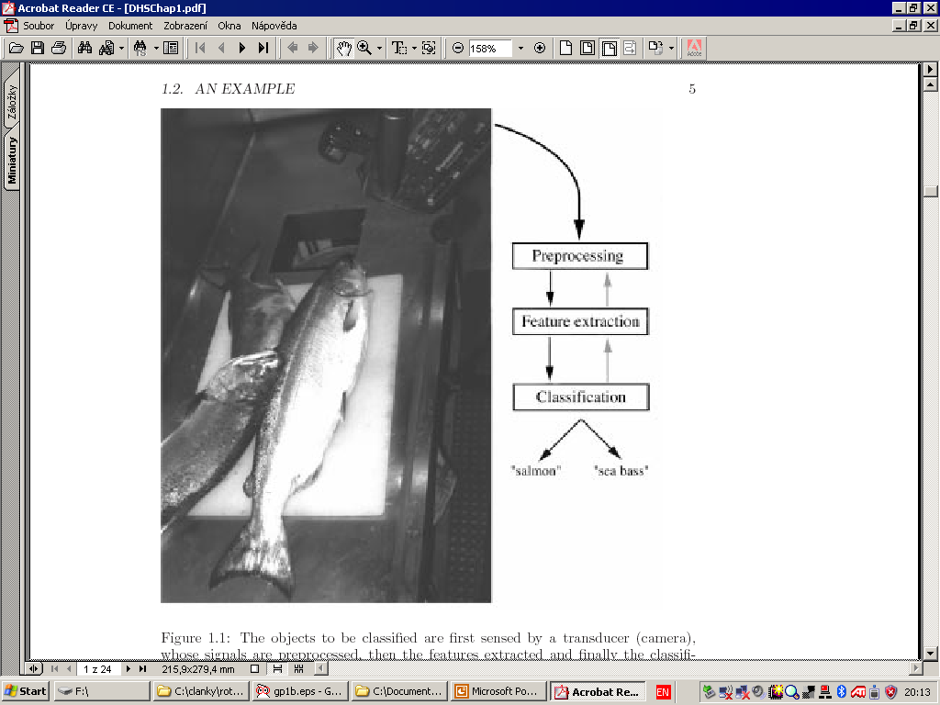
An example – Fish classification

Slide 5
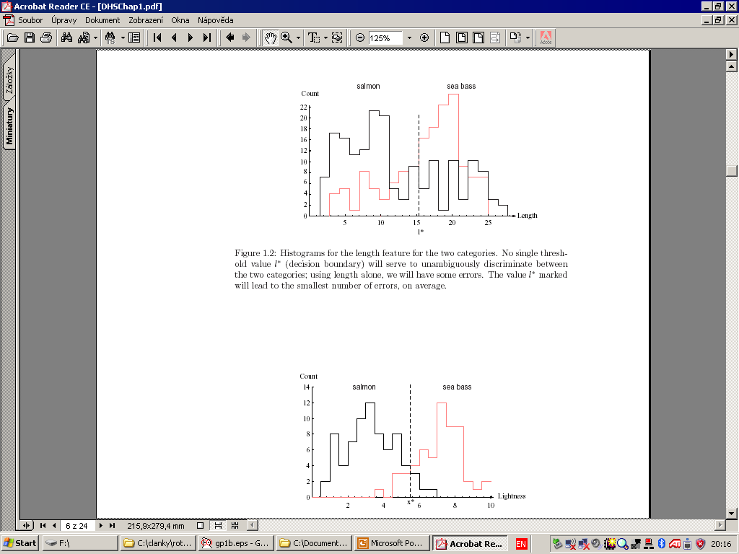
The features: Length, width, brightness

Slide 6
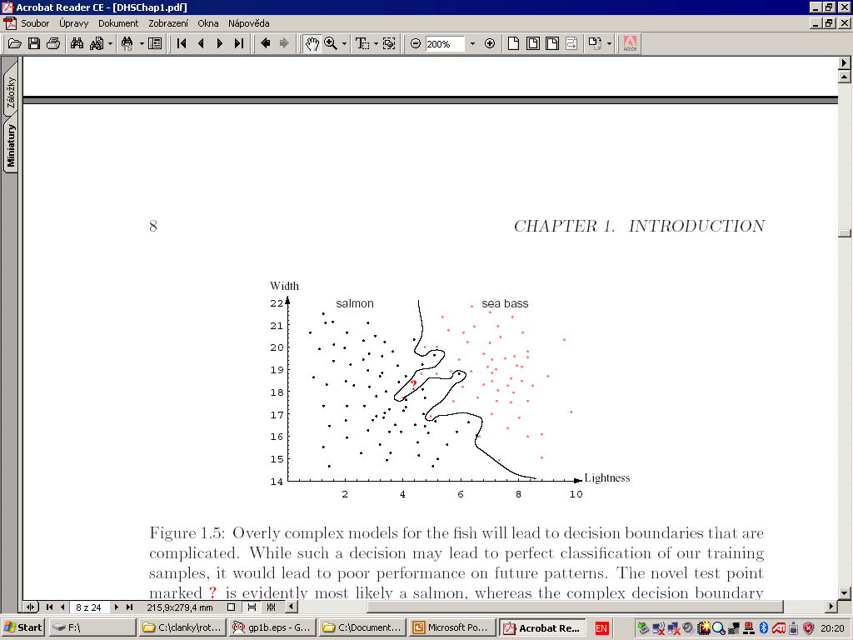
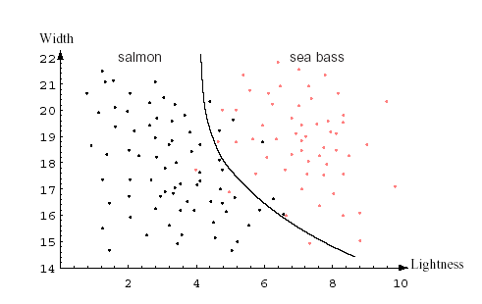
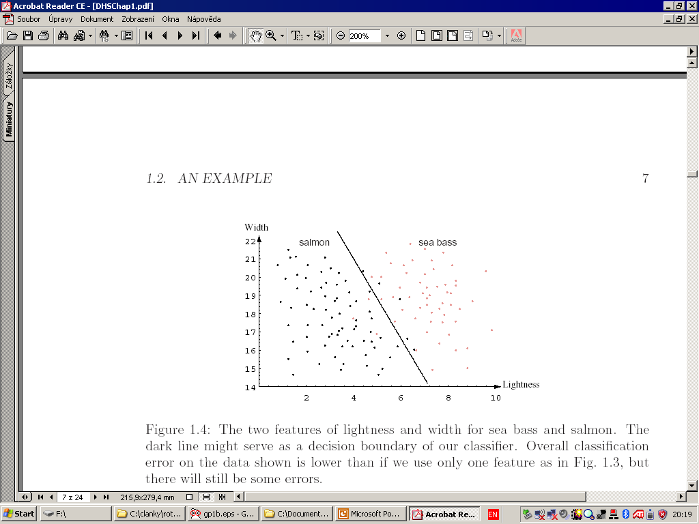
2-D feature space

Slide 7
Empirical observation
For a given training set, we can have several classifiers (several partitioning of the feature space)

Slide 8
Empirical observation
For a given training set, we can have several classifiers (several partitioning of the feature space)
The training samples are not always classified correctly

Slide 9
Empirical observation
For a given training set, we can have several classifiers (several partitioning of the feature space)
The training samples are not always classified correctly
We should avoid overtraining of the classifier

Slide 10
Minimum distance (NN) classifier
Depending on , NN classifier may not be linear
NN classifier is sensitive to outliers → k-NN classifier

Slide 11
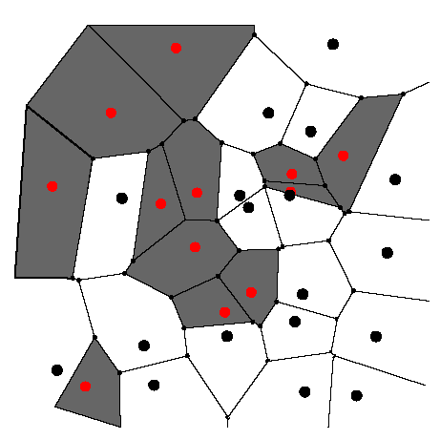
Voronoi polygons

Slide 12
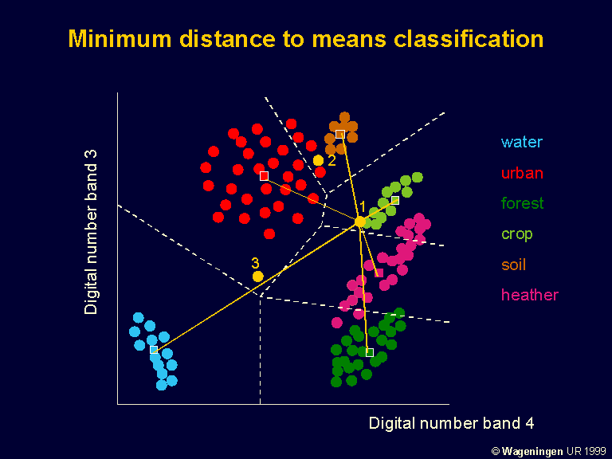

Slide 13
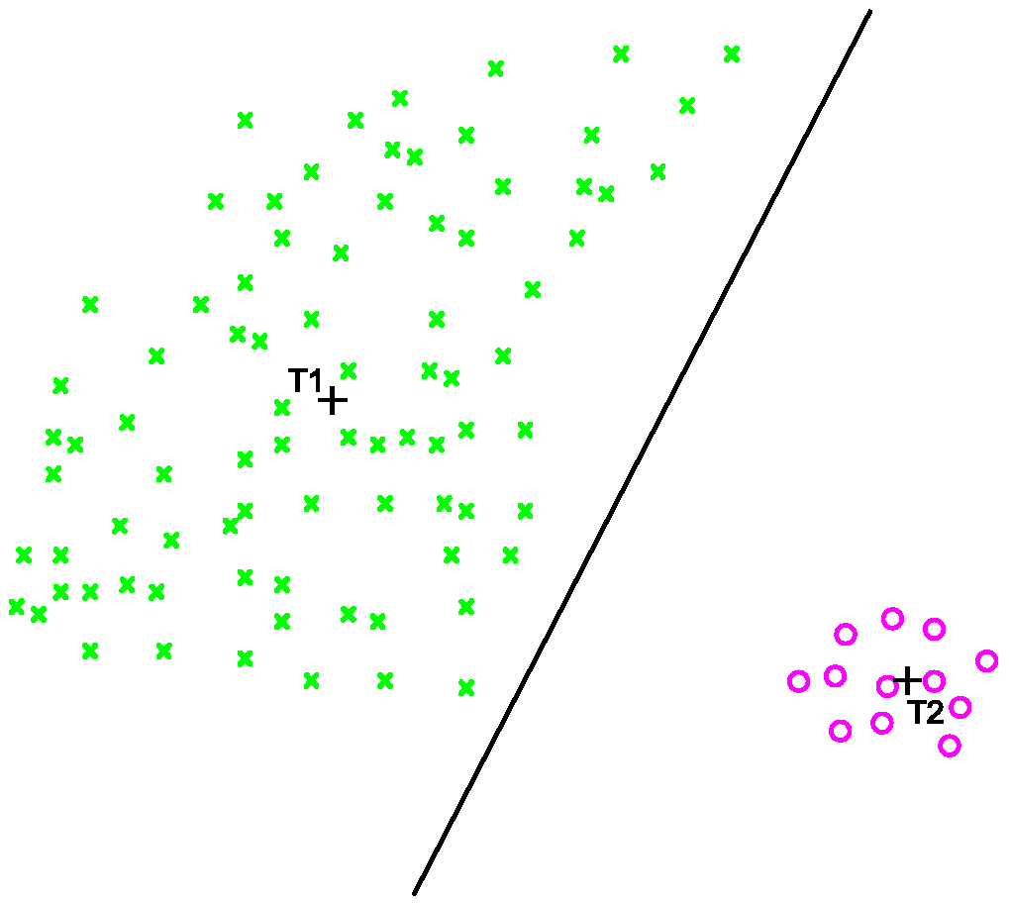

Slide 14
k-NN classifier
NN classifier is sensitive to outliers → k-NN classifier
It finds the nearest training points unless k
samples belonging to one class has been reached

Slide 15
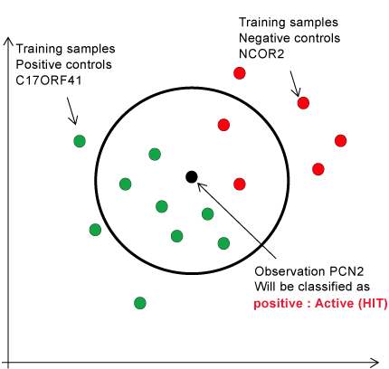
k-NN classifier

Slide 16
Linear classifier
Discriminant functions g(x) are hyperplanes

Slide 17
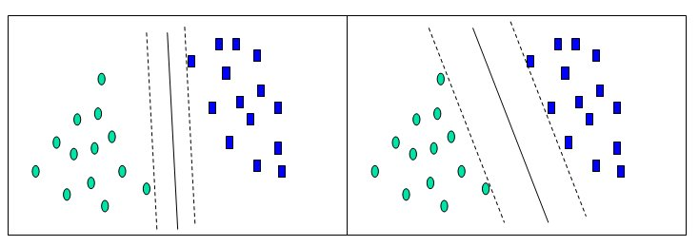
„Optimal“ linear classifier
Maximizing the margin

Slide 18
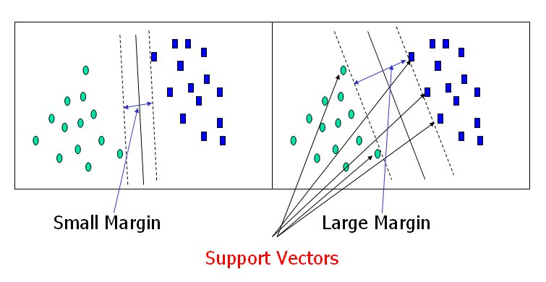
Support vector machine (SVM)
“Optimal” linear classifier

Slide 19
Support vector machine (SVM)
Training algorithm: Discrete optimization
many versions
Drawbacks:
very sensitive to outliers and noise
does not consider the shape and the size of the training set

Slide 20
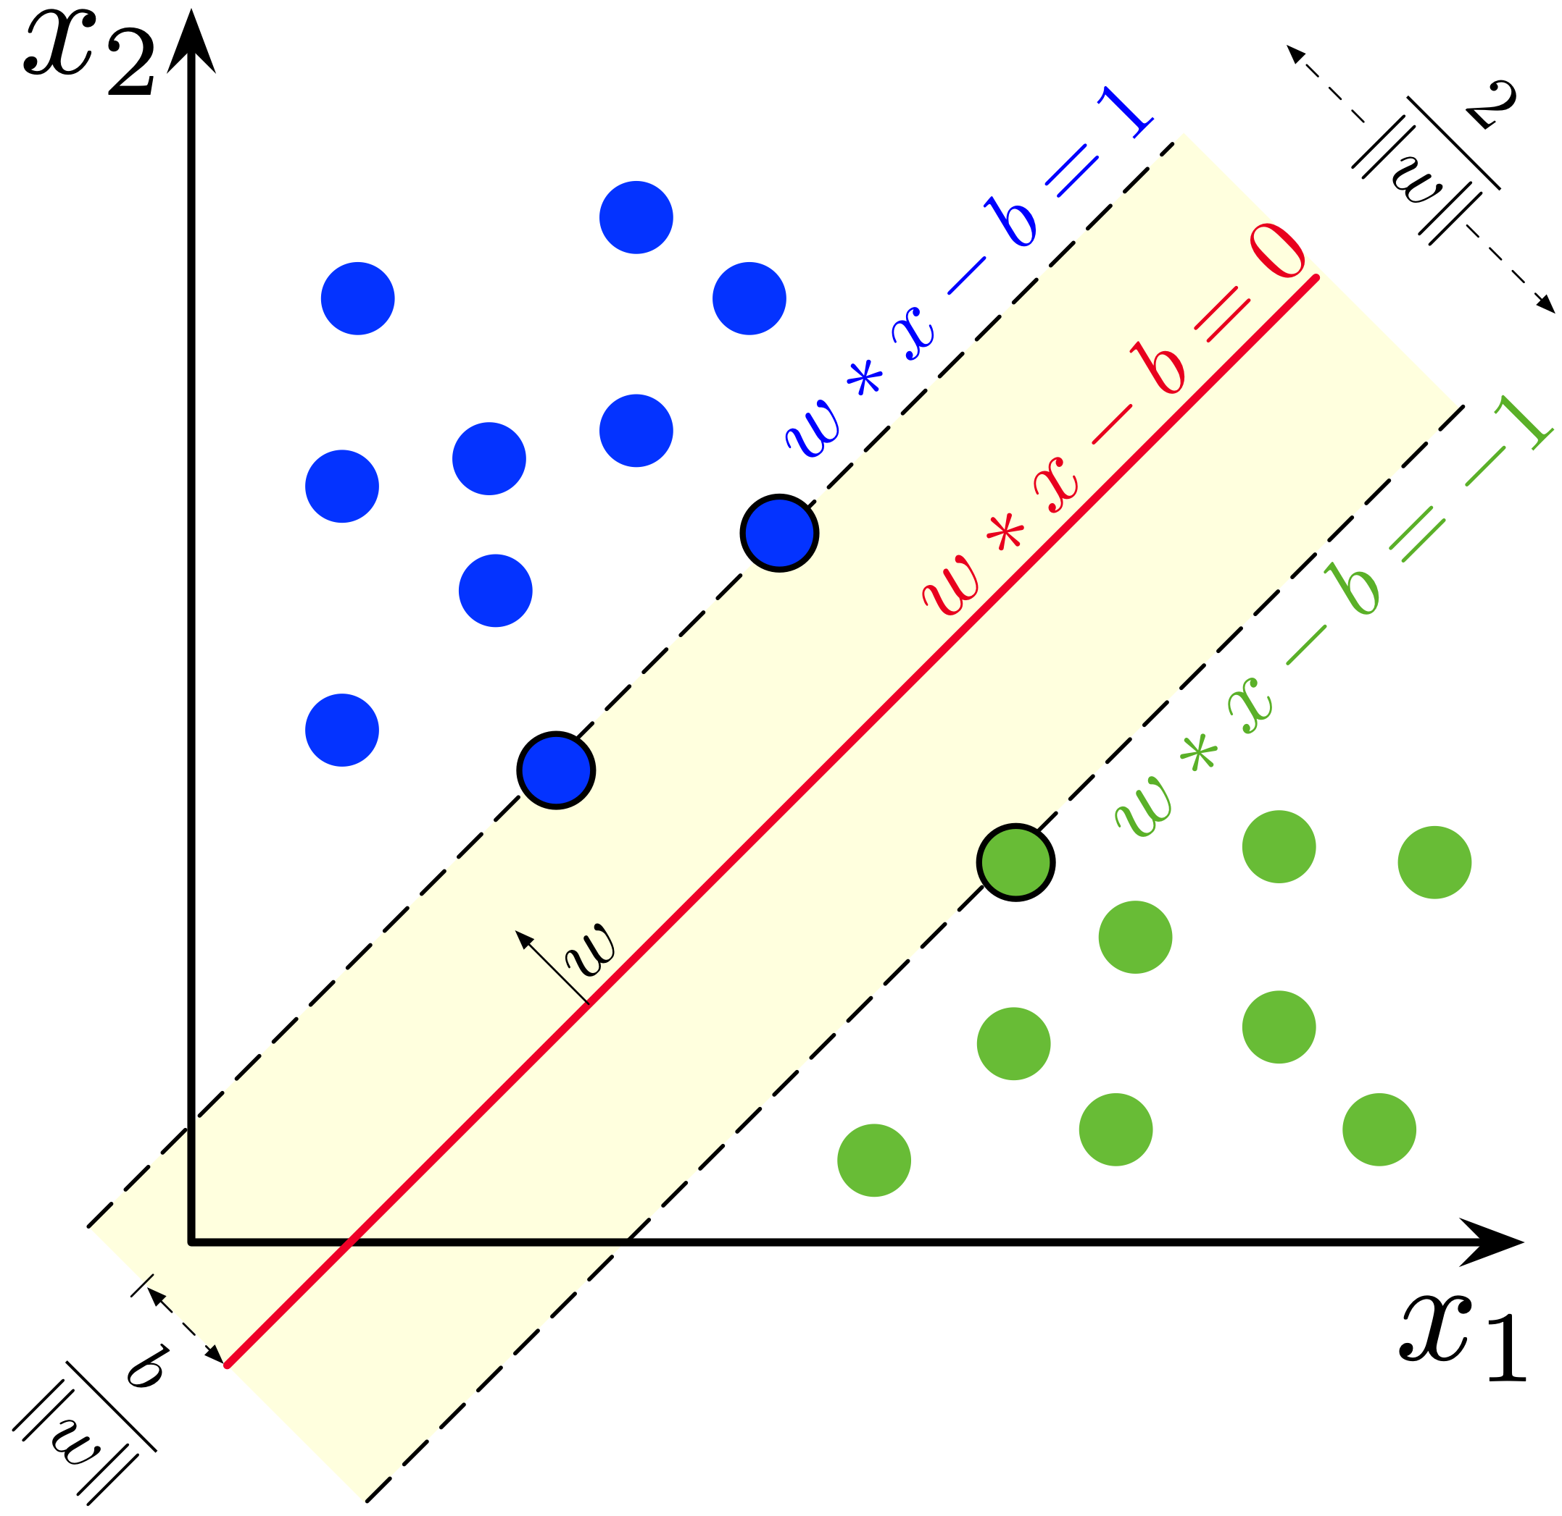

Slide 21
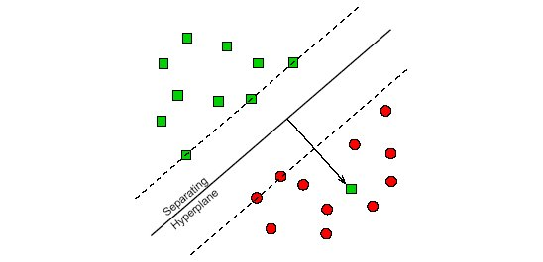
Soft margin SVM
Cost function penalizes the errors
Regularization

Slide 22
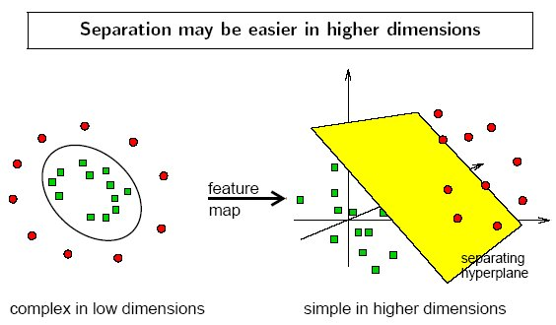
SVM for linearly non-separable classes
How to make them linearly separable?

Slide 23
Increasing the number of features
“Curse of dimensionality”

Slide 24
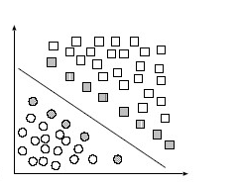
Mapping the features into another space
“The kernel trick”
“Overtraining/undertraining”

Slide 25
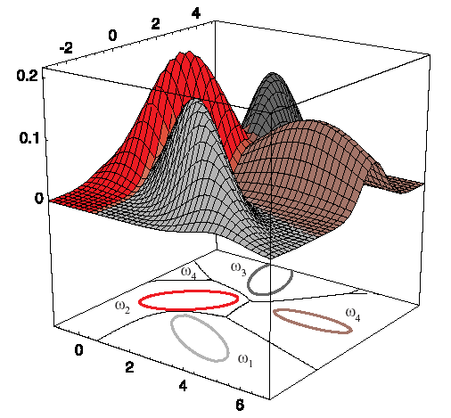
Bayesian classifier

Slide 26
Bayesian classifier
Assumption: feature values are random variables
Statistic classifier, the decision is probabilistic
It is based on the Bayes rule

Slide 27
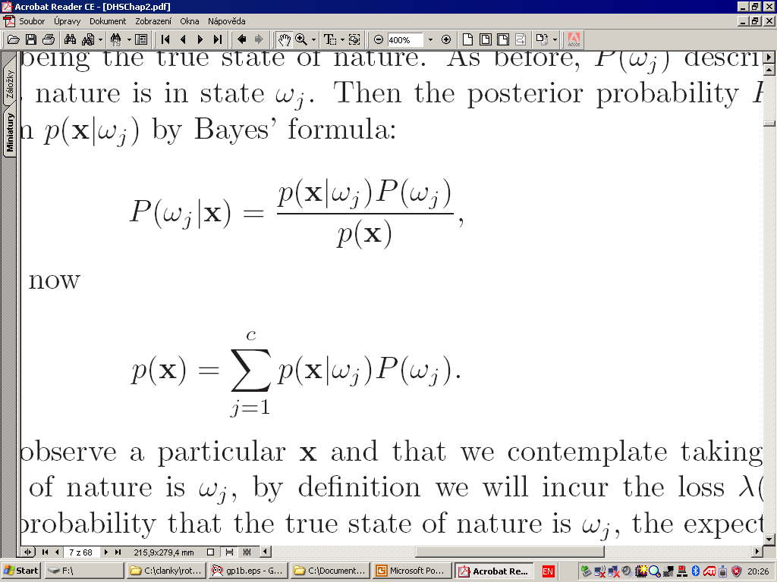
The Bayes rule
Class-conditional probability
A posteriori
probability
A priori
probability
Total
probability

Slide 28
Bayesian classifier
Main idea: maximize posterior probability
Since it is hard to do directly, we rather maximize
In case of equal priors, we maximize only

Slide 29
How to estimate ?
From the case studies performed before (OCR, speech recognition)
From the occurence in the training set
Assumption of equal priors
Parametric estimate (assuming pdf is of a known form, e.g. Gaussian)
Non-parametric estimate (pdf is unknown or too complex)

Slide 30
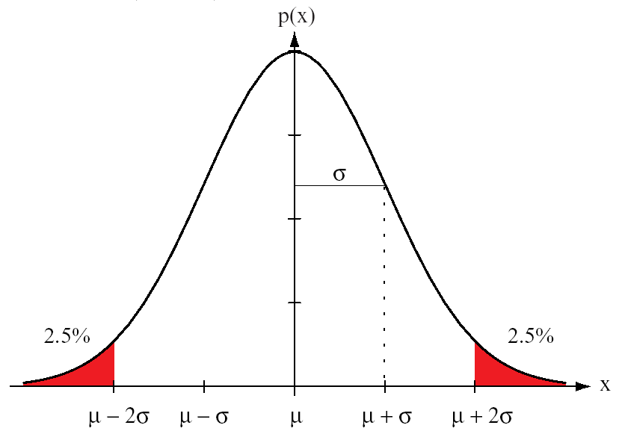
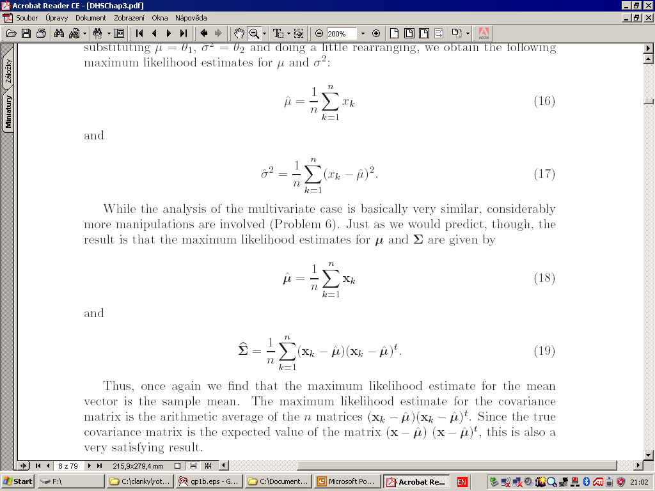
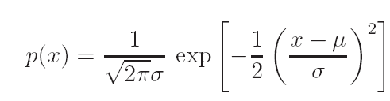
Parametric estimate of Gaussian

Slide 31
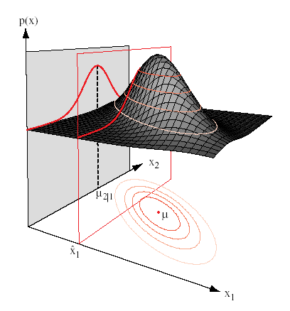
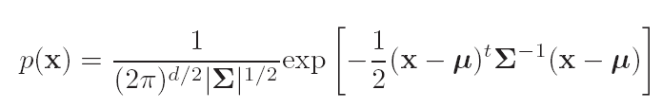
d-dimensional Gaussian pdf

Slide 32
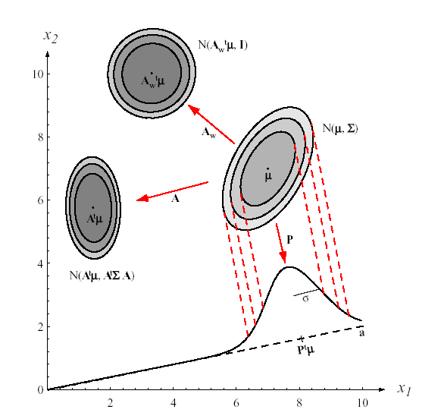
The role of covariance matrix

Slide 33
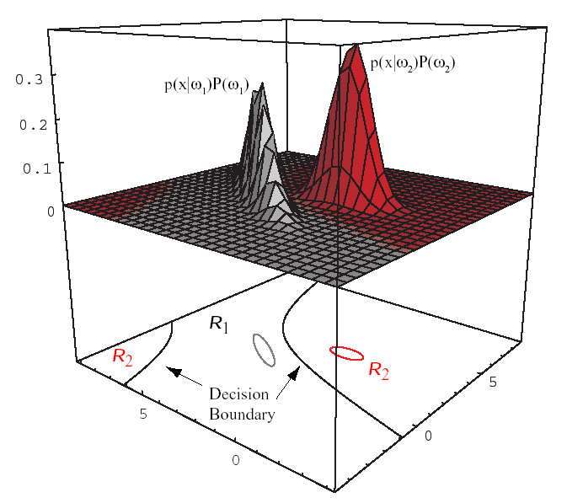
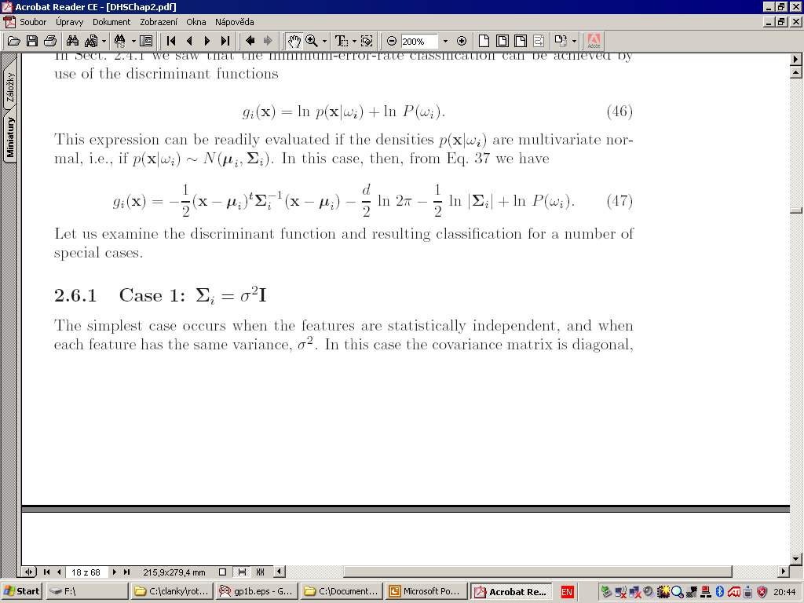
Two-class Gaussian case in 2D
Classification = comparison of two Gaussians

Slide 34
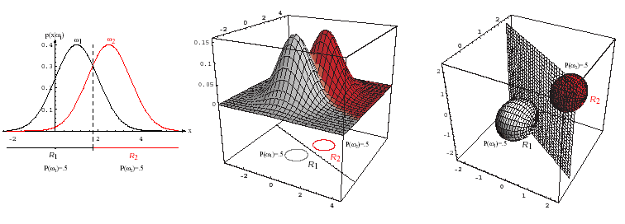
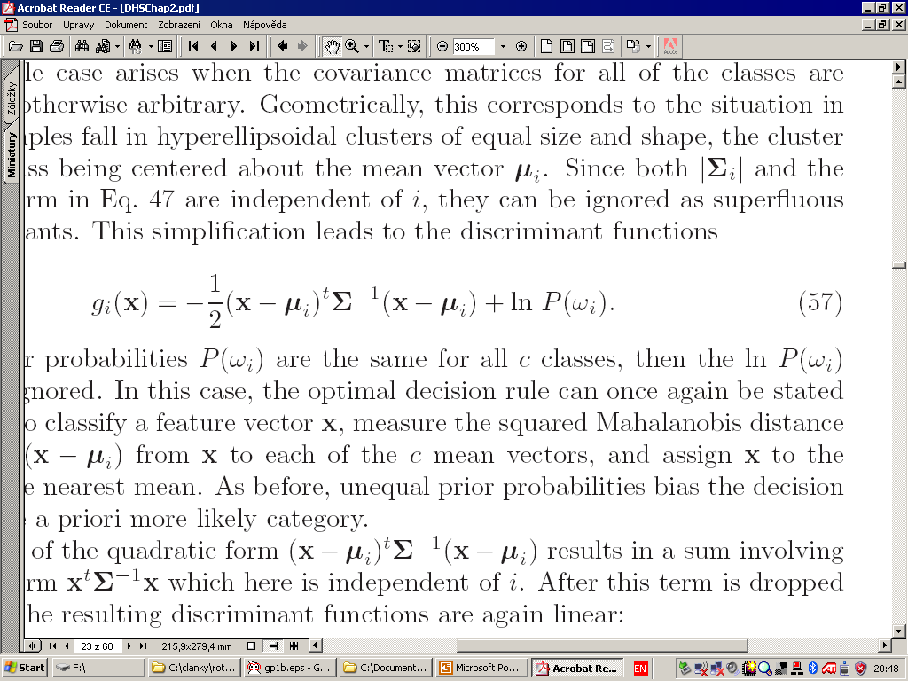
Two-class Gaussian case – Equal cov. mat.
Linear decision boundary

Slide 35
Equal priors
max
min
Classification by minimum Mahalanobis distance
If the cov. mat. is diagonal with equal variances
then we get “standard” minimum distance rule

Slide 36
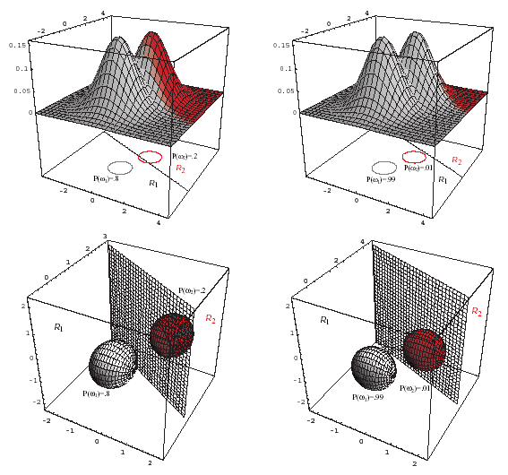
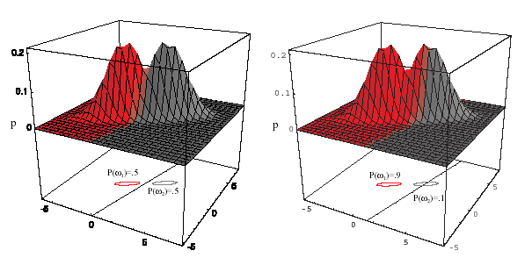
Non-equal priors
Linear decision boundary still preserved

Slide 37
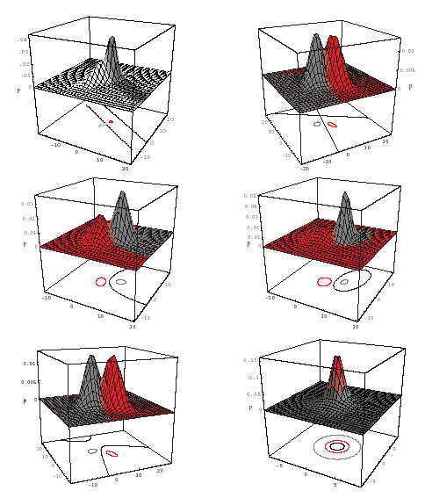
General G case in 2D
Decision boundary is a hyperquadric

Slide 38
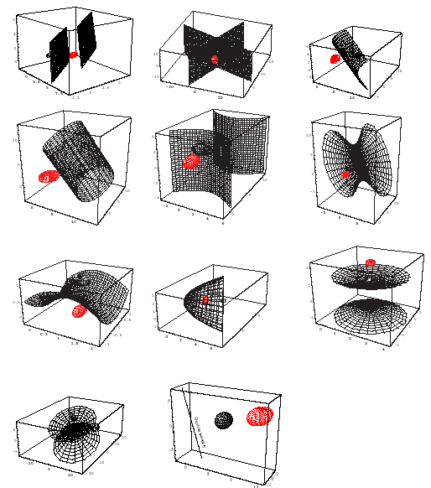
General G case in 3D
Decision boundary is a hyperquadric

Slide 39
More classes, Gaussian case in 2D

Slide 40
Applications of Bayesian classifier
…in multispectral remote sensing
Objects = pixels
Features = pixel values in the spectral bands (from 4 to several hundreds)
Training set – selected manually by means of thematic maps (GIS), and on-site observation
Number of classes – typically from 2 to 16

Slide 41
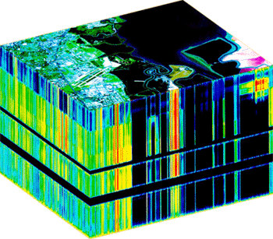
Applications of Bayesian classifier
…in multispectral remote sensing

Slide 42
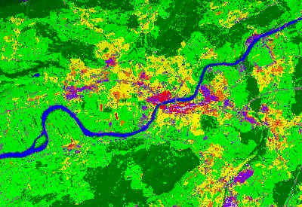
Applications of Bayesian classifier
…in multispectral remote sensing

Slide 43
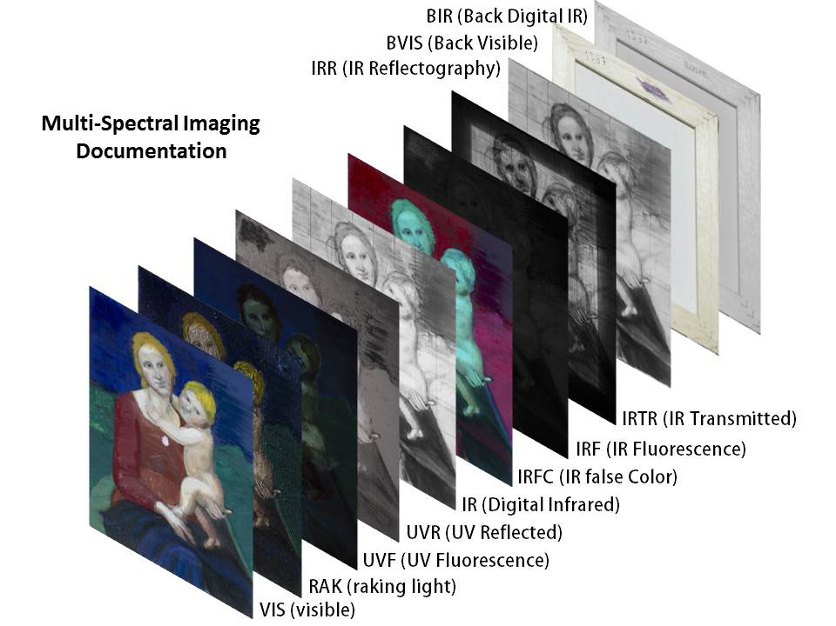
Applications of Bayesian classifier
…in art

Slide 44
Classification performance
How to evaluate the performance of the classifiers?
Evaluation on the training set (optimistic error estimate).
Evaluation on the test set (pessimistic error estimate). Intuitive evaluation is misleading, different errors may have different significance

Slide 45
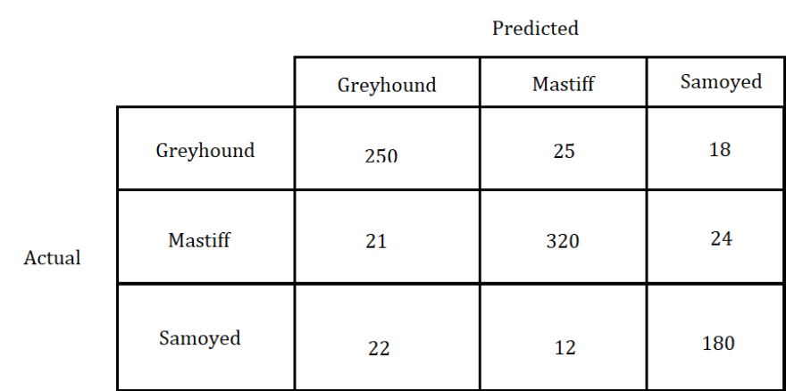
Confusion matrix

Slide 46
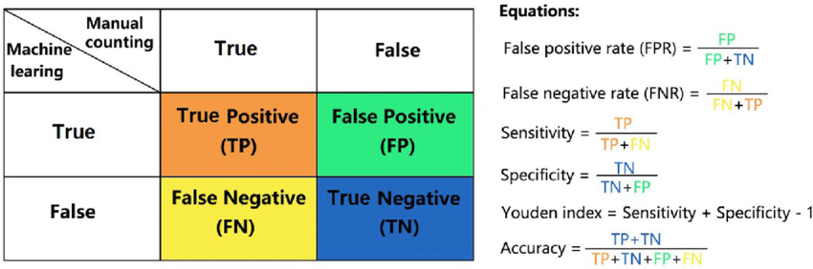
Confusion matrix 2 x 2

Slide 47
Classification performance
How to increase the performance?
- other features
- more features (dangerous – curse of dimensionality!)
- other (larger, better) training sets
- other parametric models
- other classifiers
- combining different classifiers

Slide 48


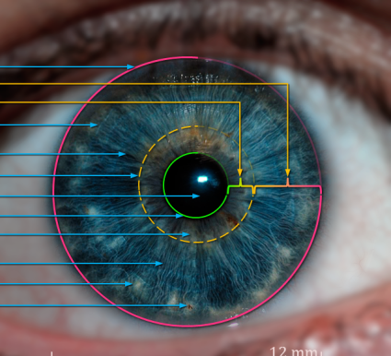
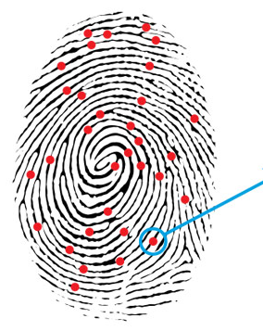
Combining classifiers in biometrics

Slide 49
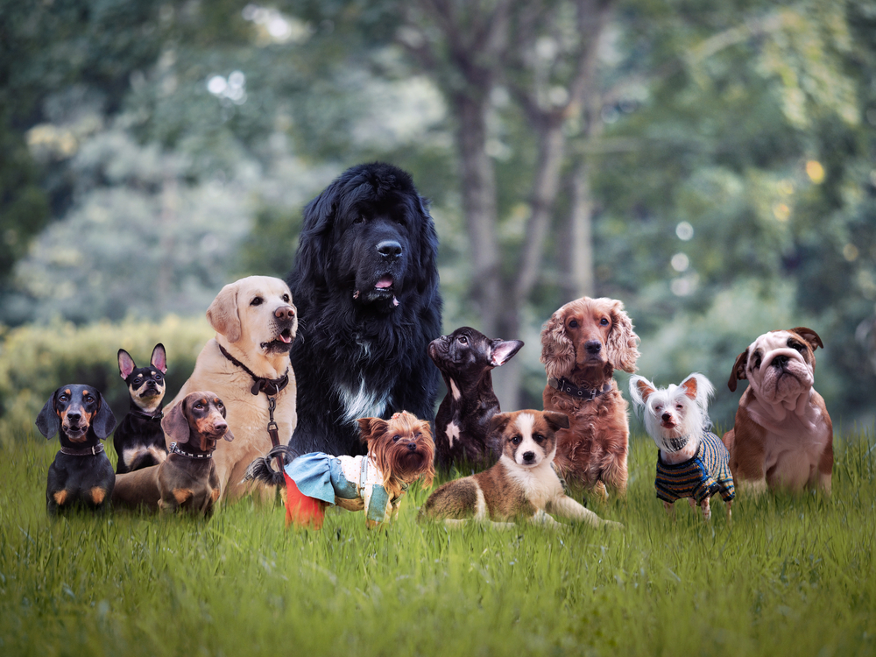
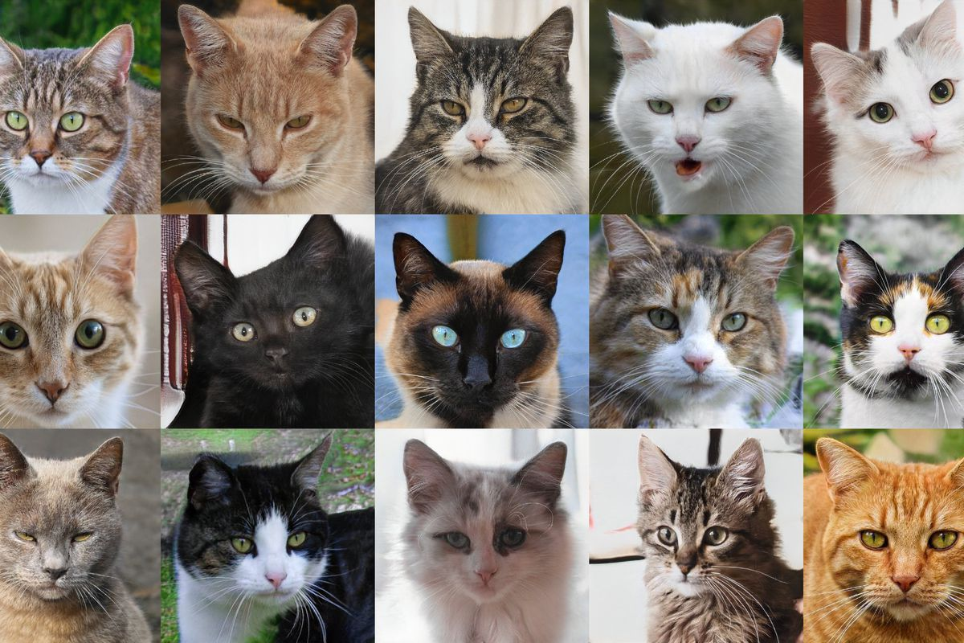
Limitations of invariant theory
Generic classes, no model of intra-class variability

Slide 50
Convolution networks
Teaching by showing many examples without saying what the features are

Slide 51
Handcrafted vs. Learned features
Insight
Explainability
Training set size
Debugging
Concurrent or collaborative approaches?

Slide 52
Unsupervised Classification
Cluster analysis
Training set is not available, No. of classes may not be a priori known

Slide 53
What are clusters?
Intuitive meaning
compact, well-separated subsets
Formal definition
many attempts, mostly unsatisfactory
(t-connectivity, diameter constraint, ...)
any partition of the data into disjoint subsets

Slide 54
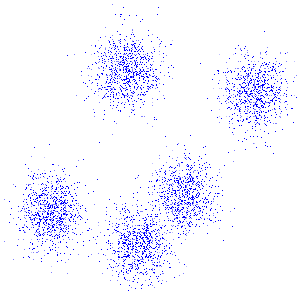
What are clusters?

Slide 55
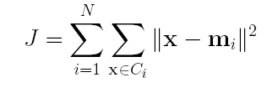
How to compare different clusterings?
Ward criterion
Variance measure J should be minimized
Drawback – only clusterings with the same N can be compared. Global minimum
J = 0 is reached in the degenerated case.

Slide 56
Minimization of J
Drawbacks
The results are sometimes “intuitively wrong”
because J prefers clusters with approx the same size

Slide 57
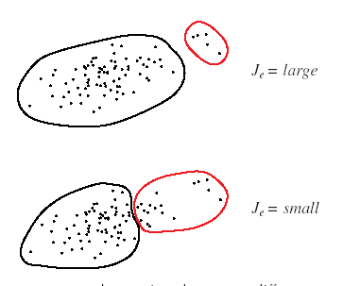
An example of a „wrong“ result

Slide 58
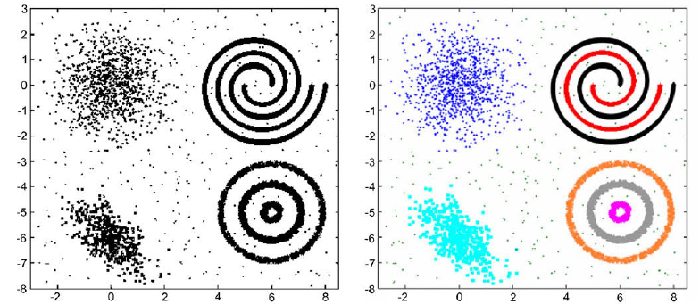
Drawback – assumes uncorrelated features and “convex” clusters

Slide 59
Clustering techniques
Iterative methods
- typically if N is given
Hierarchical methods
- typically if N is unknown
Other methods
- sequential, graph-based, branch & bound, fuzzy, genetic,
model-based, etc.

Slide 60

N-means clustering
Select N initial cluster centroids.

Slide 61
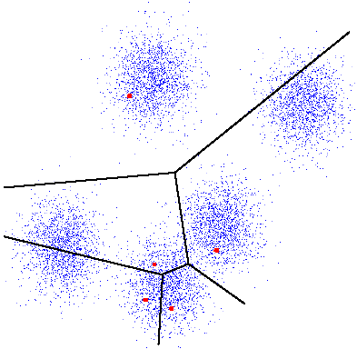
N-means clustering
2. Classify every point x according to minimum distance.

Slide 62
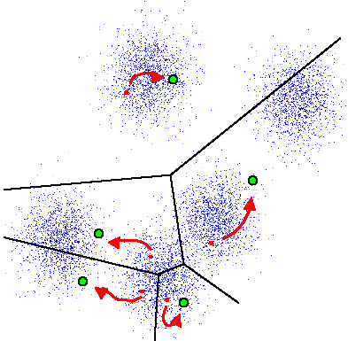
N-means clustering
3. Recalculate the cluster centroids.

Slide 63
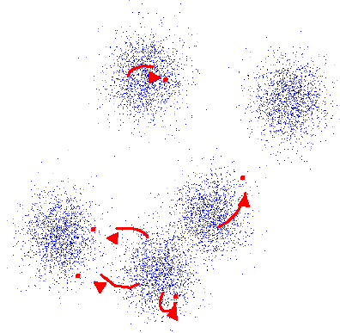
N-means clustering
4. If the centroids did not change then STOP else GOTO 2.

Slide 64
N-means clustering
Drawbacks
The result depends on the initialization
J is not minimized
The results are sometimes “intuitively wrong”

Slide 65
N-means clustering – an example
Two features, four points, two clusters (N = 2)
Different initializations → different clusterings

Slide 66
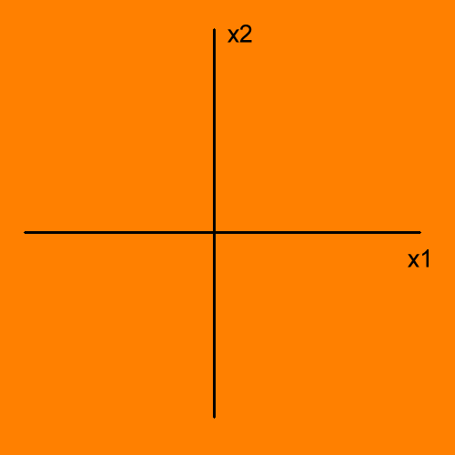
N-means clustering – an example
Initial centroids

Slide 67
N-means clustering – an example
Initial centroids

Slide 68
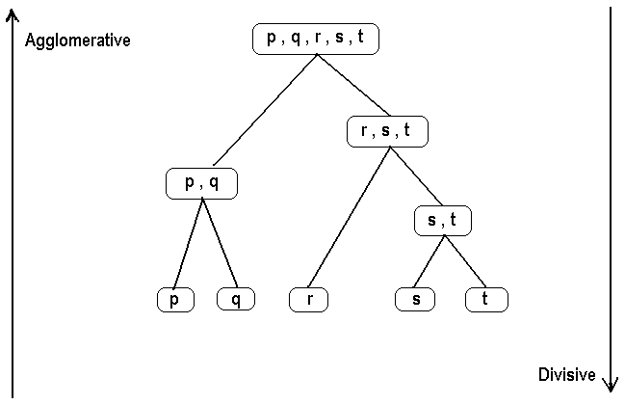
Hierarchical clustering
Agglomerative clustering
Divisive clustering

Slide 69

Basic agglomerative clustering
Each point = one cluster

Slide 70


Basic agglomerative clustering
Each point = one cluster
Find two “nearest” or “most similar” clusters and merge them together

Slide 71


Basic agglomerative clustering
Each point = one cluster
Find two “nearest” or “most similar” clusters and merge them together
Repeat 2 until the stop constraint is reached

Slide 72
Basic agglomerative clustering
Particular implementations of this method differ from each other by:
The STOP constraints
The distance/similarity measures used

Slide 73


Simple between-cluster distance measures
d(A,B) = d(m₁,m₂)
d(A,B) = min d(a,b) d(A,B) = max d(a,b)

Slide 74

Agglomerative clustering
Representation by a clustering tree (dendrogram)

Slide 75
How many clusters are there?
Difficult to answer even for humans
“Clustering tendency”, “cluster validity”
Hierarchical methods:
N can be estimated from the complete dendrogram
The methods minimizing a cost function
N can be estimated from the “knees” in J-N graph

Slide 76
Applications of clustering in image proc.
Segmentation – clustering in color space
Preliminary classification of multispectral images
Clustering in parametric space – RANSAC, image registration and matching
Numerous applications are outside image processing area

Slide 77


Slide 78


Slide 79
Dimensionality reduction
Having D features, we want to reduce their number to n, where n<<D

Slide 80

Karhunen-Loeve Transform
Principal Component Transform
PCT is a method for “one-class” problem, i.e. for non-structured data (no class representatives, no training sets, just a cloud of data points in the feature space)

Slide 81


Principal Component Transform

Slide 82
Principal Component Transform
PCT is a rotation of the feature space
y = T’x,
such that the new features y are uncorrelated, i.e. covariance matrix C_{y} is diagonal.
This is always possible since the original covariance matrix C_{x} is symmetric and can be diagonalized in the orthonormal basis of its eigenvectors
C_{y} = T’C_{x} T
Features with the highest variances are called principal components. First n PC’s are kept.

Slide 83
Applications of the PCT
“Optimal” data representation
Visualization and compression of multimodal images

Slide 84


PCT of multispectral images

Slide 85

PCT for visualization

Slide 86




PCT Reconstruction from two PC’s
PCT Original

Slide 87
Why is PCT not suitable for classification?
PCT evaluates the contribution of individual features solely by their variances, which may be different from their discrimination power.

Slide 88


Why is PCT not suitable for classification?

Slide 90

PCT: How many components?
80% of total variation
The “elbow” rule

Slide 91


Face recognition by eigenfaces

Slide 93

PCT vs. SVD
M – arbitrary matrix
U, V – orthogonal
S - diagonal

Slide 94
PCT vs. SVD
M – data matrix
C = M’M – covariance
matrix
SVD of M is the same
as diagonalization of C

Slide 95


Linear discriminant analysis (LDA)
Selection of the “best” feature/direction
Optimal direction is given by the principal eigenvector of

Slide 96
Thank you!
Any questions?

