Slide 1
C/C++ language
NSWI170 Computer Systems
Jakub Yaghob, Martin Kruliš

Slide 2
Features
Procedural, structured, imperative programming language
Code organized in functions (that can return a value)
Explicit control flow (structure)
Static type system
All variables, parameters, and return values must have a type
Compiler checks type compatibility (e.g., in assignments)
C/C++ constructs are mapped efficiently to machine instructions
Good for operating systems, HPC, embedded systems, …
Explicit memory management (heap)
Case sensitive, ignore all whitespaces (unlike Python)
Unlike Python, which has dynamic typing

Slide 3


Type systems
Dynamic typing (e.g., Python)
num = 42
num = "forty two"
Variables are just mnemonic holders (like dictionary keys)
Values are dynamically managed (collective heap)
Static typing (e.g., C++ or C#)
int num = 42;
num = "forty two";
Variables allocate space in memory (e.g., local variable on the stack)
Values are placed directly to that memory on assignment
At compile time!

Slide 4
History
BCPL
(Cambridge 1966)
B
(Bell Labs. 1969)
C
(Bell Labs. 1971)
C with classes
(Stroustrup 1979)
superset
almost superset
K&R C
(Kernigan & Ritchie 1978)
significant change
The C++ programming language
(Stroustrup 1985)
Objective-C
(Cox & Love 1981)
inspired
ANSI C
(ANSI X3J11 1989)
C++98
(ISO/IEC 14882 1998)
Java
(Sun 1995)
Object-Oriented Programing
(Cox 1986)
C#
(Microsoft 2002)
C99
(ISO/IEC 9899 1999)
C++03
(ISO/IEC 14882 2003)
C++20
(2020)
Objective-C 2.0
(Apple 2006)
C18
(2018)
C++/CLI
(Microsoft 2005)
C++TR1
(ISO/IEC 19768 2007)
C++17
(2017)
Objective-C++
(Apple 2010)
C11
(ISO/IEC 9899 2011)
C++11
(ISO/IEC 14882 2011)
C++14
(2014)

Slide 5
Hello World Example
#include <stdio.h>
int main(int argc, char **argv)
{
printf("Hello World!\n");
return 0;
}

Slide 6
Constant Literals
Integer numbers
Decimal number 123, -18
Hexadecimal 0xc001bea3
Binary 0b11001001
Octal (0-prefixed) 0123, 017
Floating point numbers
0.42, -1.234e-5
Boolean
true, false
String
"foo bar"
Char
'a'
Escape sequence
\n – LF (line feed)
\r – CR (carriage return)
\t – TAB
\\ – (one) backslash
\' – single quote
\" – double quote
\xab – char with value 0xab
Do not use!

Slide 7
Basic types
Integer types
Base
char, int
Modifiers
short, long, long long
signed, unsigned
Auxiliary
size_t
Floating point types
float, double
Other types
void, bool
Implicit conversions
Quite complex rules
No data loss – no problem int -> long
Possible data loss – warning double -> float
Operands are converted to a common type
Conversion rank
The actual range (size) depends on architecture
Writing unsigned alone is shorthand for unsigned int
Bad! ☹

Slide 8
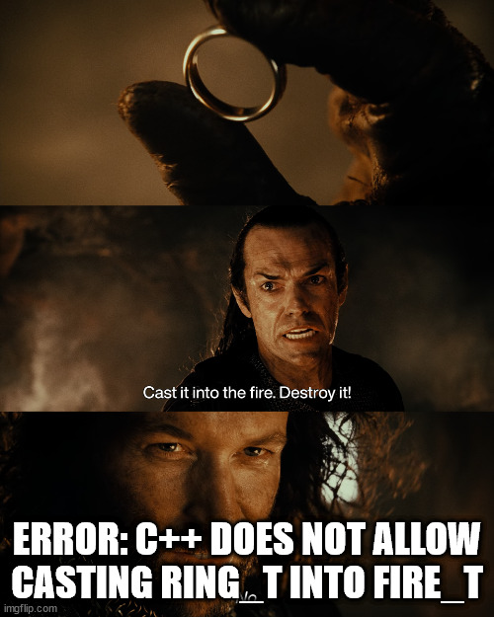
Casts
Explicit conversions (casts)
Simply prefix an expression with type in ()
double d = 4.2;
float f = (float)d;
Tells the compiler that it is OK to change the type (does not generate a warning)
Use wisely!
Do not use it just to fix your errors (warnings)
In C++, the situation gets more complicated
static_cast, dynamic_cast, reinterpret_cast

Slide 9
Variables
Named values stored in memory
Must be declared before first use (it is a good idea to initialize them as well)
int i; double x = 0.0;
auto keyword can be used instead of type (the type is inferred)
Variable scope
Determines where the value is stored and how (in code) it can be accessed
Local variables – exist within one block { } (e.g., in one function)
Function arguments are also local variables (pre-initialized in the function call)
Global variables
Static local variables
void foo() { static int counter = 0; … }
Handle with care!
Unlike in Python, there is no global keyword, accessing local and global variables has the same syntax
Like global variables, but better encapsulation

Slide 10
Statements
Indentation bears no meaning…. However, it makes code more readable (do it)!
Compound statement (block)
{ }
Expression statement
expr ;
If statement
if (expr) stmt
if (expr) stmt else stmt
Return from a function
return expr;
; separator makes it easier to write multiple statements on one row… But do not do it (makes the code less readable)!
stmt could be a block and it is generally a good idea to always make a block here (it is less error-prone when refactoring and more readable)

Slide 11
Statements
switch (expr) { case 0:
// something
break; case 1:
// something else
break; case 2: case 3:
// common code for 2 and 3
break; default:
// do something else otherwise
break; }
Switch may be better than many if-elses, but heavy branching is bad!
When you are trying to use switch-case, re-think your code again, maybe there is better way how to structure it…

Slide 12
Statements
Conditional loop
while (expr) stmt
Conditional loop with at least one iteration
do stmt while (expr);
Regular loop
for (einit; etest; einc) stmt
Additional loop control statements
break;
continue;
for (int i = 0; i < N; ++i) { … }

Slide 13
Statements
Unconditional control flow redirection (goto)
for (int i = 0; i < N; ++i) {
for (int j = 0; j < M; ++j) {
if (is_last(i, j)) goto end_loops;
}
}
end_loops: // ...
Better to be avoided
Most situations can be handled by other constructs (if, while, break, return, …)
Makes the code less readable, hinders some compiler optimizations, …
The goto is often mocked or frowned upon by experienced programmers. E.g., INTERCAL programming language introduces “COME FROM” parody…

Slide 14
Expression Operators
Arithmetic
+, -, *, /, %
Beware //
++, --
Comparison
<, <=, >, >=, ==, !=
Bitwise
~, &, |, ^, <<, >>
Logical
&&, ||, !
Pointers
&, *
Assignment
=, +=, -=, *=, /=, %=, &=, |=, ^=
Variable/type size in bytes
sizeof
Ternary expr (like if-else)
test ? e1 : e2
A one-line comment

Slide 15
Arrays
We can create dynamically allocated arrays (but it will not be covered in this course)
A sequence of elements of the same type
Occupying continuous block of memory
Zero-based index, the (fixed) size is given at compilation
Correct alignment, row-major order
int u[4];
int p[] = { 1, 2, 3 };
int a[2][3] = { { 1, 2, 3 }, { 4, 5, 6 } };
If this is a local variable, the array may have random values!
sizeof(int)
u[0] | u[1] | u[2] | u[3]
0 | 0 | 0 | 0
a[0][0] | a[0][1] | a[0][2] | a[1][0] | a[1][1] | a[1][2]
1 | 2 | 3 | 4 | 5 | 6

Slide 16
Strings
Sequence (array) of characters ended with zero (NUL) character
NUL character (zero-byte) is added automatically for "string" literals
Represented as a pointer to the first character (pointers coming up soon…)
An array of characters is not necessarily a string! (beware the ending NUL)
char str[] = "Hippo";
char chars[] = { 'H', 'i', 'p', 'p', 'o' };
str[0] | str[1] | str[2] | str[3] | str[4] | str[5]
'H' | 'i' | 'p' | 'p' | 'o' | '\0'
str[0] | str[1] | str[2] | str[3] | str[4]
'H' | 'i' | 'p' | 'p' | 'o'

Slide 17

Memory alignment
Used in many situations
A type of size $X$ needs to be placed at address $A$, so that $A \% X = 0$
E.g., 32-bit integer must be placed only on addresses divisible by 4
Hardware reasons (the CPU can load the value from memory more easily)
0x13b
0x13c
0x13d
0x13e
0x13f
0x140
0x141
0x142
0x143
0x144
0x145
0x146
0x147
char
int (32b)
double (64b)
…
…
Char is aligned everywhere
An integer can be here, 0x13c is divisible by 4
A double can be here, 0x140 is divisible by 8

Slide 18
Structures
To the size of the largest type used inside
Collection of fields (members)
Logically bound together
Inner alignment (padding), outer alignment (padding)
struct point2d {
int x, y;
};
struct data {
char c;
double d;
int i;
};
point2d pt;
pt.x = 1;
pt.y = 2;
0 B
c
8 B
d
16 B
i

Slide 19
Constants and Enums
Regular constants
Basically immutable variables
const int the_answer = 42;
Compile-time constants (C++)
Do not exist in memory
constexpr int the_answer = 42;
Enumerations
Special type with a predefined set of allowed values
Compiles (natively) to int (quite efficient)
class enum state_t { WAITING, RUNNING, STOPPED };
state_t s = state_t::WAITING;
Inlined at compile-time (i.e., usually a better choice)

Slide 20
Preprocessor
Preprocessor directives
Text-based replacements handled as the first step of compilation
#include <algorithm>
#include "my_module.h"
#define N 1000
#define ALLOW_DEBUG
#ifdef ALLOW_DEBUG
printf("This code was executed\n");
#endif
Includes are used all the time, remember!
Avoid if you can (e.g., use constexpr)!
Good to know, but quite advanced (for special situations only)

Slide 21
Application Entry-point
Function named main
The return value is the exit code of the process
Without explicit return, a 0 exit code is assumed
Note that all statements must be in some function or method
Unlike in Python where main-level code is executed
Simplistic version
int main() { ... }
Advanced version
int main(int argc, char *argv[]) { ... }
Command line arguments as array of strings

Slide 22
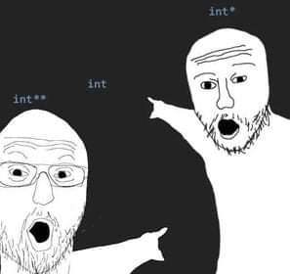
Pointers
Memory address abstraction
Pointer = number that holds an address (index of starting byte in memory)
Pointers are typed
What data type we can expect in memory where it points to
Pointers of different types are incompatible
int v = 8;
int *pv = &v;
*pv = 4;
8 (int)
1234
4 (int)
v
6666
1234 (ptr)
pv
memory

Slide 23
Pointers
Array variable = pointer to the first element
This applies to strings as well
(String = array of chars with extra NUL at the end)
int vals[] = { 42, 54, 18 };
int *vals = { 42, 54, 18 };
char str[] = "xkcd";
char *str = "xkcd";
1234
'x' (char)
1235
'k' (char)
...
'c' (char)
'd' (char)
'\0' (char)
6666
1234 (ptr)
str
memory

Slide 24
Pointers
Pointer address can be also computed by arithmetic operations
char *str = "Hippo";
for (int i = 0; i < 5; ++i) {
doSomethingWithChar(str[i]);
}
for (int i = 0; *(str + i) != '\0'; ++i) { /* ... */ }
while (*str) {
// ...
++str;
}
These two expressions are equivalent
This is just an example to illustrate pointer arithmetic. Use str[i] in this case which is much more readable!!

Slide 25
References
Reference (C++)
Fixed pointer (address not re-assignable)
int v = 8;
int &rv = v;
rv = 4;
memory
8 (int)
1234
4 (int)
v
Note, that when we used pointers, we wrote: int *pv = &v;
6666
1234 (ptr)
rv

Slide 26
Functions
Parameters in C are always passed by value
Output (mutable) parameters must use pointers
struct point2d {
float x, y;
};
void rotate(point2d in, point2d *out)
{
out->x = in.y;
out->y = - in.x;
}
ptr->field is a shorthand for (*ptr).field

Slide 27
Functions
Parameters in C++ are passed by value or by reference
Use references for output (mutable) parameters
struct point2d {
float x, y;
};
void rotate(point2d in, point2d &out)
{
out.x = in.y;
out.y = - in.x;
}

Slide 28
Know The Size of Things
The sizeof operator
sizeof(int)
struct data_t { … };
sizeof(data_t)
Also works for fixed-size arrays
int u[4];
sizeof(u) == 4 * sizeof(int)
char s[] = "Hello";
sizeof(s) == (5+1) * sizeof(char)
Beware the size of pointers
The compiler only knows the size of the pointer itself (not the contents)
const char *s_ptr = "World";
sizeof(s_ptr) == sizeof(char*)
sizeof(*s_ptr) == sizeof(char)
If you need the length of the string, you need to count characters until you find NUL (as function strlen() does)

Slide 29
C++ Classes
C++ classes (very briefly)
Similar to structures
But combining data members with methods (embedded functions)
Encapsulation
Data holding a state and functions that can manipulate the state
Important concept
Will be covered in programming lectures in 2nd year…
class C {
public:
C() : sum(0) {}
void add(int a) { sum += a; }
int get_sum() const {
return sum;
}
private:
int sum;
};

Slide 30
Coding Practices and Guidelines
Writing good, readable code is important
Maintenance, less error-prone, easier to review/check/grade…
Some rules are summarized on our web page https://www.ksi.mff.cuni.cz/teaching/nswi170-web/pages/labs/coding
Unforgivable curses – the most important rules
Code decomposition
Using named constants instead of literals
Do not Repeat Yourselves (keep it DRY)
Restricted use of global variables
Encapsulations (designing proper interfaces)
More details will be provided in the labs…

Slide 31
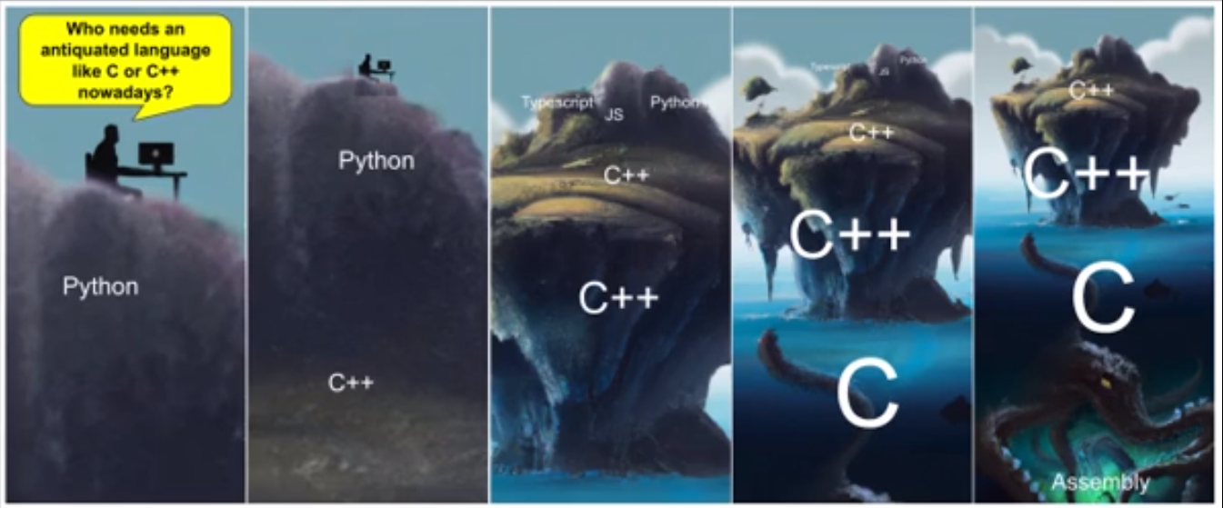
If you still crave for Python...

Slide 32

Discussion

