Slide 1
CPU
NSWI170 Computer Systems
Jakub Yaghob, Martin Kruliš

Slide 2




Semantic gap
Gap between user intent and instructions executed by CPU
I want to upload this meme to Discord…
LDW $r1, $r30
ADDI $r2, $r1, 1
SHL $r2, 2
STW $r30, $r2
JNE $r3, 0, $ip + 6
...
0110110110101010100101001001101010011010111010110101101101101010101001010010011010100110101110101101011...
c = http.connect();
req = c.postRequest();
req.setMultipart();
req.add(img, "image/png");
req.send();
compiler

Slide 3
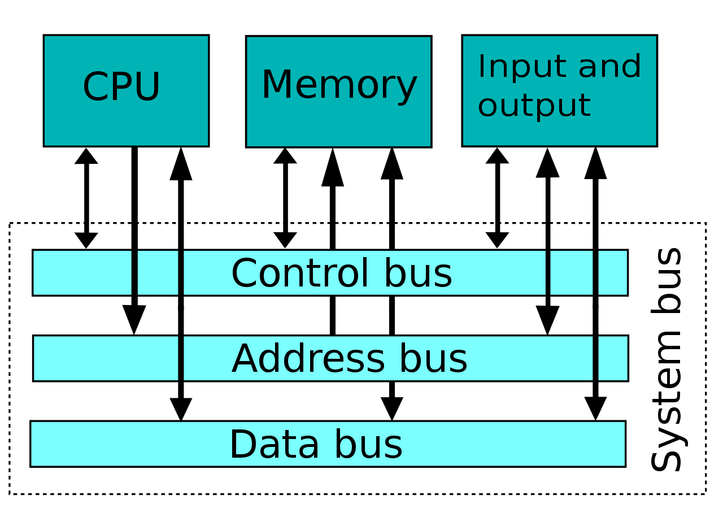
Von Neumann architecture
System architecture
Program and data in the same memory
One shared bus
Evolution of the architecture
Notes:
Picture taken from https://en.wikipedia.org/wiki/Von_Neumann_architecture
Program and data in the same memory – simplification of the hardware, complication for programmers (program can overwrite itself – used as a hack in the past, now avoided, some protection mechanisms exist)
How the data transfers on the shared bus works
Collisions
Input and output devices could look like memory from CPU (memory mapped devices)
IO devices can initiate direct memory transfers (DMA)

Slide 4
Harvard architecture
Instruction Memory
Separate memory spaces
With separate buses
And separate addressing mechanism (instructions)
Still used in some SoC microcontrollers
Notes:
Picture taken from https://en.wikipedia.org/wiki/Von_Neumann_architecture

Slide 5
Real PC architecture
External Graphics
Card
PCI express ×16
2133-1066 MHz
Sandy Bridge
DDRIII
Channel 1
Memory controller
Cache
GFX
System Agent
Mem BUS
Core
DDRIII
Channel 2
Core
Display link
4×DMI
Line out
Audio Codec
Line in
South Bridge (PCH)
D-sub, HDMI, DVI, Display port
S/PDIF out
S/PDIF in
exp
slots
BIOS
PCI express ×1
Super I/O
LPC
Lan
Adap
USB
SATA
SATA
Parallel Port
Floppy
Drive
PS/2 keybrd/ mouse
mouse
DVD
Drive
Hard
Disk
Serial Port
LAN
Notes:
Explain the blocks
Memory has the fastest buses and multiple channels, since it is the greatest bottleneck.
Many separate buses, each is peer-to-peer, avoids collisions (an analogy can be found in networking)
Hierarchical division, fast buses (controllers) integrated to the CPU die (mem bus, PCIe), others are deferred via south bridge.
Memory buses and internal CPU buses are massively parallel, external buses are mostly serial (PCIe has links, SATA, USB, LAN, …) – problems with sync. on multiple wires
GPU is the second important component, requires a lot of throughput (that is why it also has its own memory for caching the data)
Southbridge term is no longer used (explain Northbridge), now it is just generically called “chipset”.

Slide 6
CPU
CPU Architecture
Instruction Set Architecture (ISA)
Abstract specification (contract between programmers and HW designers)
Hardware architecture
Actual implementation
What is CPU?
"Simple" machine that executes instructions
Instruction – simple command, arithmetic operation, …
Registers, memory controllers, I/O
Notes:
Examples for ISA (x86, IA64, MIPS, Risc-V) and and HW architectures (Intel Raptor Lake/Raptor Cove, AMD Zen 5)

Slide 7
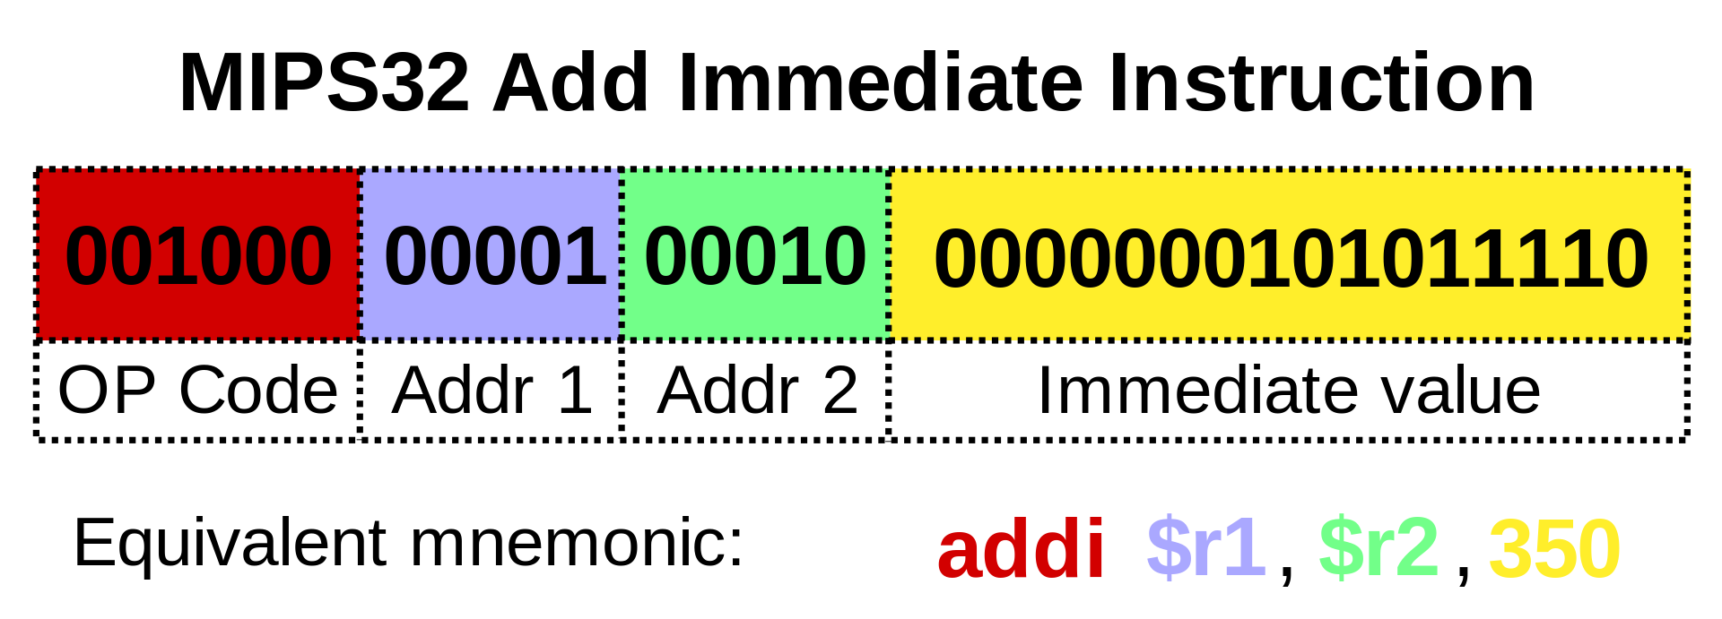
Instruction
Simple command to the CPU
Binary encoding (CPU), assembler (programmers)
Operands
Depending on ISA – max 1, 2, or 3 (some may be implicit)
Register, immediate value
Fixed vs. variable lengths
Notes:
The example is taken from https://en.wikipedia.org/wiki/Instruction_set_architecture

Slide 8
Instruction cycle
Sub-steps performed in every instruction
Load an instruction from the address stored in IP register
Decode the instruction
Load operands
Execute the operation
Store the result
Increment IP
Some steps may be skipped for some instructions
Notes:
IP = Instruction Pointer (also called Program Counter or PC)

Slide 9
add execution example
Simplified CPU using one internal bus
Instruction decoder and scheduler
Adder unit O = A + B
register R₁
register R₂
register R₃
…
reg. A
reg. B
reg. O
GR1_i
GR1_o
GR2_i
GR2_o
GR3_i
GR3_o
GAA
GAB
GAO
data bus
add r3 r1 r2 = GR1_out + GAA; GR2_out + GAB; ADD; GAO + GR3_in

Slide 10
Instructions - motivation
How can we execute the following code?
if (a < 3) b = 4; else c = a << 2;
for (int i = 0; i < 5; ++i) a[i] = i;
int f(int p) { return p + 1; }
void g() { auto r = f(42); }
Notes:
C++ is quite close to instructions.
Try to guess, how such instructions could look like (for the code snippets above).
Also mention relation to higher languages (like Python or even Haskell), scripting languages (bash, Python, PHP)

Slide 11
Instruction classes
Load instructions
Memory -> register
Take a long time to execute, important to detect soon (fetch data ahead)
Store instructions
Register/immediate -> memory
Move instruction
Between registers
x86-64 also between registers and memory
Difficult to implement efficiently in HW

Slide 12
Instruction classes
Arithmetic and logic instructions
+, -, <<, >>, &, |, ^, ~
*, /, %
Jumps
Unconditional × conditional
Direct × indirect × relative
Call, return
…
No funny stuff like "str" * 4
Tests required (==, <, …)

Slide 13
Higher-level code structures
if (a < 3) b = 4; else c = a << 2;
...
jge [a], 3
store [b], 4
jmp
load r1, [a]
shl r1, 2
store [c], r1
...
This is just a symbolic abstract assembler (not an actual one)

Slide 14
Higher-level code structures
for (int i = 0; i < 5; ++i) a[i] = i;
mov r1, 0
jge r1, 5
load r2, [a]
add r2, r2, r1
store [r2], r1
add r1, r1, 1
jmp
...
Actually, the offset needs to be multiplied by sizeof(a[0]), but you got the point...

Slide 15
Registers
Types
General, integer, floating point,
address, branch, flags, predicate,
application, system,
vector, …
Naming
Direct (EAX, r01, …) × stack (relative addressing to top of the stack)
Aliasing
Notes:
Address register – holds an address for a data operation
Branch register – holds an address for a jump instruction
Predicate registers – IA64 example with if-else (better than cond jump), instruction masking for vector instructions and SIMT execution (GPUs)
Stack naming – e,g,, 8087 ST(0), ST(1)…
Aliasing EAX, AX, AH AL

Slide 16
Registers – example 32-bit x86
EAX | AX | AH | AL |  | CS
EBX | BX | BH | BL |  | DS
ECX | CX | CH | CL |  | ES
EDX | DX | DH | DL |  | SS
ESI |  | SI |  |  | FS
EDI |  | DI |  |  | GS
EBP |  | BP |  |  | EFLAGS |  | FLAGS
ESP |  | SP |  |  | EIP |  | IP
x86-64 extends registers to 64bits (RAX, RBX, …)
+ adds general regs. R8 - R15
Notes:
Explain diff between 16bit, 32bit, and 64bit versions. Explain aliasing. Explain (non)orthogonal register sets.
A – Accumulator
B – Base
C – Counter
D – Data
SI – Source Index
DI – Destination Index
BP – Base Pointer
SP – Stack Pointer

Slide 17
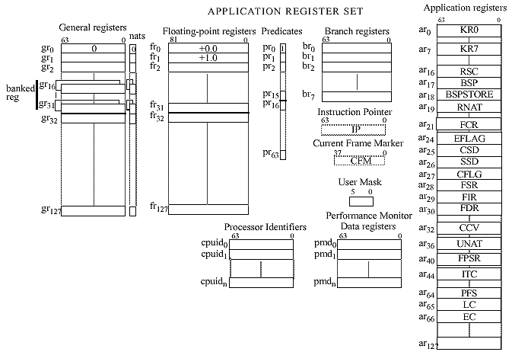
Registers – example IA-64
Notes:
Note that some of the int and float registers have fixed value (0, 1).
FYI: IA-64 has currently no mainstream hardware implementations and was recently removed from Linux kernel…

Slide 18
MIPS – simple assembler
Execution environment
32-bit (almost general) registers r0-r31
r0 is always 0, writes are ignored
r31 is a link register for the jal instruction
No stack (register)
Realized by SW
No flags
Slightly different instruction set (especially tests and conditional jumps)
Program Counter (PC) register
Notes:
jal instructon is indirect jump (used for return from functions)

Slide 19
Application Binary Interface
Application Binary Interface (ABI)
Additional specification that accompanies ISA
Prescribes how the CPU should be used
Important for compiler designers
If application and a library are compiled separately, they need to be compatible
Binary interfaces between applications
Typical utilization (meaning) of registers
Stack implementation and layout
Function call conventions
…

Slide 20
MIPS – register aliases
Register | Name | Purpose | Preserve
$r0 | $zero | 0 | N/A
$r1 | $at | Assembler temporary | No
$r2-$r3 | $v0-$v1 | Return value | No
$r4-$r7 | $a0-$a3 | Function arguments | No
$r8-$r15 | $t0-$t7 | Temporaries | No
$r16-$r23 | $s0-$s7 | Saved temporaries | Yes
$r24-$r25 | $t8-$t9 | Temporaries | No
$r26-$r27 | $k0-$k1 | Kernel registers – DO NOT USE | N/A
$r28 | $gp | Global pointer | Yes
$r29 | $sp | Stack pointer | Yes
$r30 | $fp | Frame pointer | Yes
$r31 | $ra | Return address | Yes
Notes:
Preserve - a function must save/restore their values if these registers are used
Temporaries = ad-hoc intermediate values of expressions
Saved temporaries = temporaries with preserve flag
Kernel – syscall interface
Global pointer – reference to a frame were global variables are
Stack pointer – unlike x86, this is only ABI specification, there are no instructions that would rely on the fact that $r29 is the stack pointer
Frame pointer – additional pointer to stack that is used by functions (e.g., splits arguments and local variables), will be detailed later
Return address – saved by jal instruction (used for function calls)

Slide 21
MIPS – instructions
Arithmetic
add $rd,$rs,$rt
R[rd] = R[rs] + R[rt]
addi $rd,$rs,imm16
R[rd] = R[rs] + signext(imm16)
sub $rd,$rs,$rt
subi $rd,$rs,imm16
These are only symbolic placeholders, real example could look like add $r2,$r4,$r5
Immediate value, 16 bit number encoded directly in the instruction itself
Signed extension to 32bits
(to match size of the registers)
Notes:
Instruction add, addi, sub, and subi work on signed integers. For unsigned operations, there are counterparts with –u suffix (like addu).

Slide 22
ISA comparison
MIPS
x86
add $t1,$t1,$t0
addi $t1,$t1,1
add $t2,$t0,$t1
add eax,ebx
add eax,1
or inc eax
mov eax,ebx
add eax,ecx

Slide 23
MIPS – instructions
Logic operations
and $rd,$rs,$rt andi $rd,$rs,imm16
or $rd,$rs,$rt ori $rd,$rs,imm16
xor $rd,$rs,$rt xori $rd,$rs,imm16
nor $rd,$rs,$rt • R[rd] = R[rs] and/or/xor zeroext(imm16)
No not instruction, use nor $rd,$rs,$rs
Shifts
sll / slr $rd,$rs,shamt
R[rd] = R[rs] << / >> shamt
sra $rd,$rs,shamt
Arithmetic shift (keeps the sign)
Notes:
Arithmetic shift can be used for signed integers (correctly fills in 0s or 1s from the left to preserve the sign of the int).
Note: There is no instruction for arithmetic left shift as shifting to left is the same for arithmetic and binary case.

Slide 24
ISA comparison
MIPS
x86
nor $t1,$t2,$t2
sll $t1,$t1,3
mov eax,ebx
not eax
shl eax,3

Slide 25
MIPS – instructions
Memory access
lw $rd,imm16($rs)
R[rd] = M[R[rs] + signext32(imm16)]
sw $rt,imm16($rs)
M[R[rs] + signext32(imm16)] = R[rt]
lb $rd,imm16($rs)
R[rd] = signext32(M[R[rs] + signext32(imm16)])
lbu $rd,imm16($rs)
R[rd] = zeroext32(M[R[rs] + signext32(imm16)])
sb $rt,imm16($rs)
M[R[rs] + signext32(imm16)] = R[rt]
Moves
li $rd,imm32
R[rd] = imm32
Pseudo-instruction, translates to lui and ori
Load upper immediate
move $rd,$rs
R[rd] = R[rs]
Notes:
lw/sw – load/store 32bit word
lb/sb – load/store byte
lbu – unsigned load (simple zero extension instead of signed extension)

Slide 26
ISA comparison
MIPS
x86
lw $t1,1234($t0)
sw $t1,1234($t0)
lb $t1,1234($t0)
li $t1,5678
move $t1,$t0
mov eax,[ebx+1234]
mov [ebx+1234],eax
mov al,[ebx+1234]
mov eax,5678
mov eax,ebx

Slide 27
MIPS – instructions
Jumps
j addr
PC = addr
jr $rs
PC = R[rs]
jal addr
“Jump and link”
R[31] = PC+4
PC = addr
Slightly different instruction format – the address is a 26bit immediate value
jal instruction (like all other instructions) takes 4 bytes in memory

Slide 28

ISA comparison
MIPS
x86
j label
jr $ra
label:
jal fnc
jmp label
jmp [ebx]
label:
call fnc
This is double indirection!!! Register ebx holds address where is the pointer that is loaded and used as target address for the jump!
Placeholder that marks a place in the code, the actual address is computed by a compiler
Return address stored to stack!
Notes:
Note: jr $ra is single indirection (jumps to address stored in $ra).

Slide 29
MIPS – instructions
Conditional jumps
beq $rs,$rt,addr
If R[rs] == R[rt] then PC = addr else PC = PC+4
bne $rs,$rt,addr
Analogical (not equal)
Testing
slt / sltu $rd,$rs,$rt
If R[rs]<R[rt] then R[rd] = 1 else R[rd] = 0
slti / sltiu $rd,$rs,imm16
If R[rs] < signext/zeroext(imm16) then R[rd] = 1 else R[rd] = 0
sltu is unsigned version of slt
Only lesser-than test, greater-than is created by swapping operands

Slide 30
ISA comparison
MIPS
x86
Universal compare (result stored in flags)
beq $t0,$t1,label
slt $t2,$t1,$t0
bne $t2,$zero,label
slti $t2,$t1,5
bne $t2,$zero,label
cmp eax,ebx
jz label
cmp eax,ebx
jl label
cmp eax,5
jl label
Jump decision based on flags
Notes:
cmp has similar semantics like subtraction
jz = jump if zero (flag is set)
jl = jump if lesser

Slide 31
Code examples
Simple for-loop
for (int i = 0; i < N; i++) {
A[i] = 42;
}
addi $t0, $gp, 28 # $t0 <- address of A
lw $t1, 4($gp) # fetch N
move $t2, $zero # i = 0
ori $t3, $zero, 42 # $t3 = 42
j cond # go to condition
body:
sll $t4, $t2, 2 # i*4 -> offset
add $t4, $t4, $t0 # A+i*4
sw $t3, 0($t4) # A[i] = 42
addi $t2, $t2, 1 # i = i+1
cond:
slt $t4, $t2, $t1 # are we there yet?
bne $t4, $zero, body # no, we're NOT done
Notes:
Based on https://courses.cs.washington.edu/courses/cse378/03wi/lectures/mips-asm-examples.html

Slide 32
Code examples
i = N*5+3;
lw $t0, 4($gp) # fetch N
ori $t1, $zero, 5 # 5
mult $t0, $t0, $t1 # N*5 (fake)
addi $t0, $t0, 3 # N*5 + 3
sw $t0, 0($gp) # i = ...
lw $t0, 4($gp) # fetch N
sll $t1, t0, 2 # N*4
add $t1, $t1, t0 # N*4+N
addi $t1, $t1, 3 # N+3
sw $t1, 0($gp) # i = ...
Multiplication is more complex as the result needs to be stored in 2 registers (but we have simplified it here)
Code can be optimized…
Notes:
Based on https://courses.cs.washington.edu/courses/cse378/03wi/lectures/mips-asm-examples.html

Slide 33
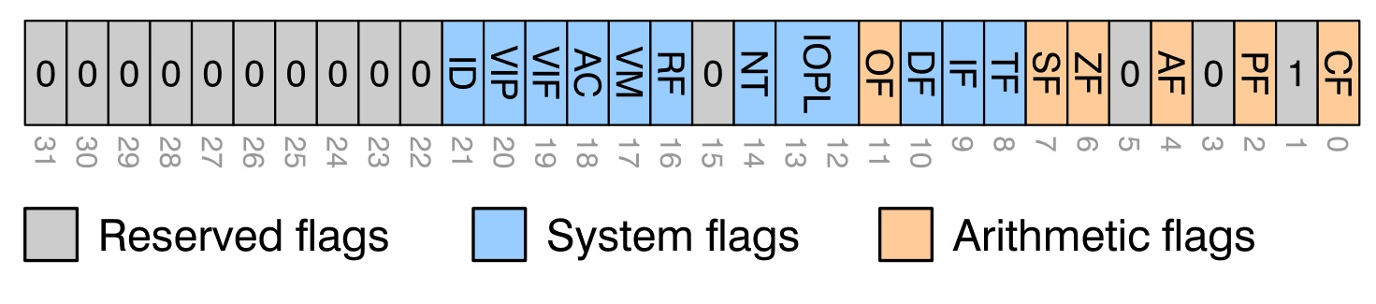
Flags
Only used by some ISA
Control execution
Check status of the last instruction
Usual flags
Z – zero flag
S – sign flag
C – carry flag
O – overflow flag
x86 example
Notes:
Very complex semantics which instructions affect which flags. For example,
add – sets all arithmetic flags
inc – sets almost all (ignores CF)
and – sets CF = 0 (always)
mov – does not affect anything

Slide 34
ISA consolidation
Instruction set architecture
Abstract model of CPU
Classification
CISC – Complex Instruction Set Computer
RISC – Reduced Instruction Set Computer
VLIW – Very Long Instruction Word
EPIC – Explicitly Parallel Instruction Computer
Orthogonality
Accumulator
Load-Execute-Store
Notes:
CISC – example x86
RISC – example ARM
Was true in the past, no longer true (x86 uses RISC-like core for microinstructions, ARM or MIPS have been extending their instructions sets steadily, so it is hard calling it “reduced” nowadays)
VLIW – multiple instructions encoded together to easily exploit instruction-level parallelism (they are executed concurrently) – e.g., Intel i860, IA64 (itanium), AMD GPUs (TeraScale, up to 2010, abandoned with GCN arch.)
EPIC – moving beyond VLIV
Explicitly declare dependencies between bundles of instructions (allowing grouping the bundles – e.g., in future hw generations)
More opportunities for speculative loads and instruction execution
Multiway branch instructions, emphasis on predicated execution (predicate registers instead of branching)
Example: Itanium

Slide 35
Hardware architecture
CPU comprise…
Memory controller
Cache hierarchy
Core
Registers
Types
Logical processor
Hyper threading
Note that HW registers and ISA registers do not need to match exactly (e.g., x86 register remapping)

Slide 36
CPU – simplified scheme
Package
CORE 0
CORE 1
CORE 2
CORE 3
T0
T4
T1
T5
T2
T6
T3
T7
EU
EU
EU
EU
L1I
L1I
L1I
L1I
L1D
L1D
L1D
L1D
L2
L2
L2
L2
L3/LLC
Notes:
Cache latencies
https://www.7-cpu.com/cpu/Skylake.html
https://gist.github.com/jboner/2841832

Slide 37
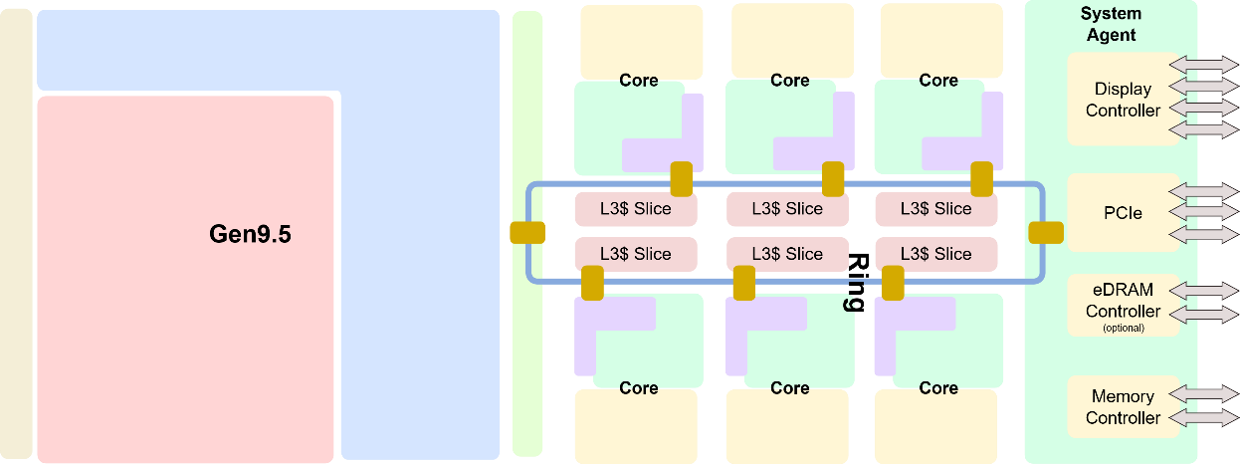
Scheme of Real CPU (Package)
Intel Coffee Lake

Slide 38
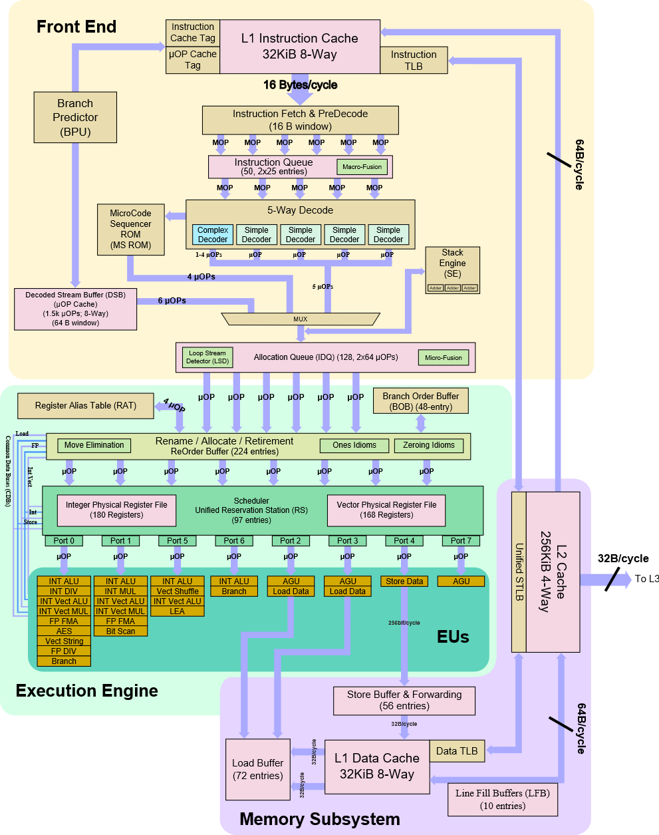
Real CPU
Scheme of one core

Slide 39
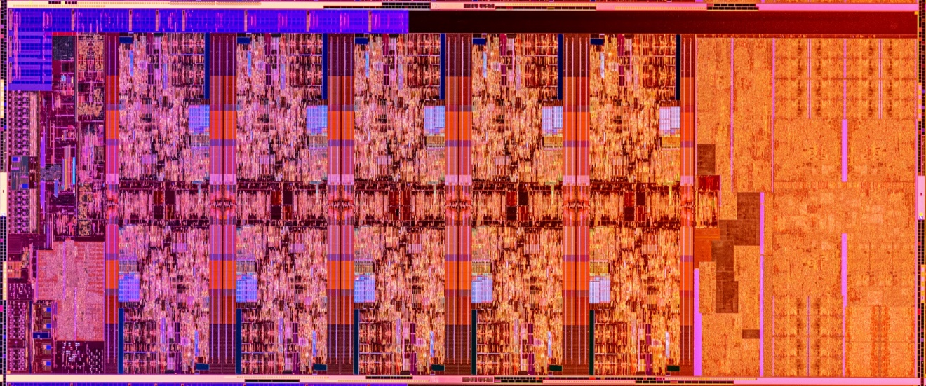
Real CPU Die

Slide 40
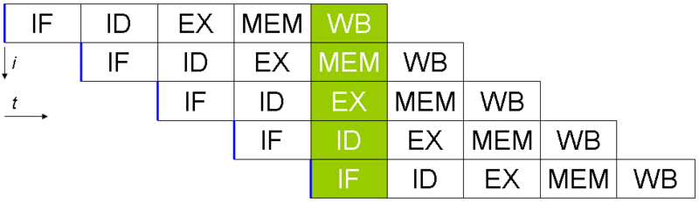
CPU architecture – pipeline
Current CPU
14-19 stages

Slide 41
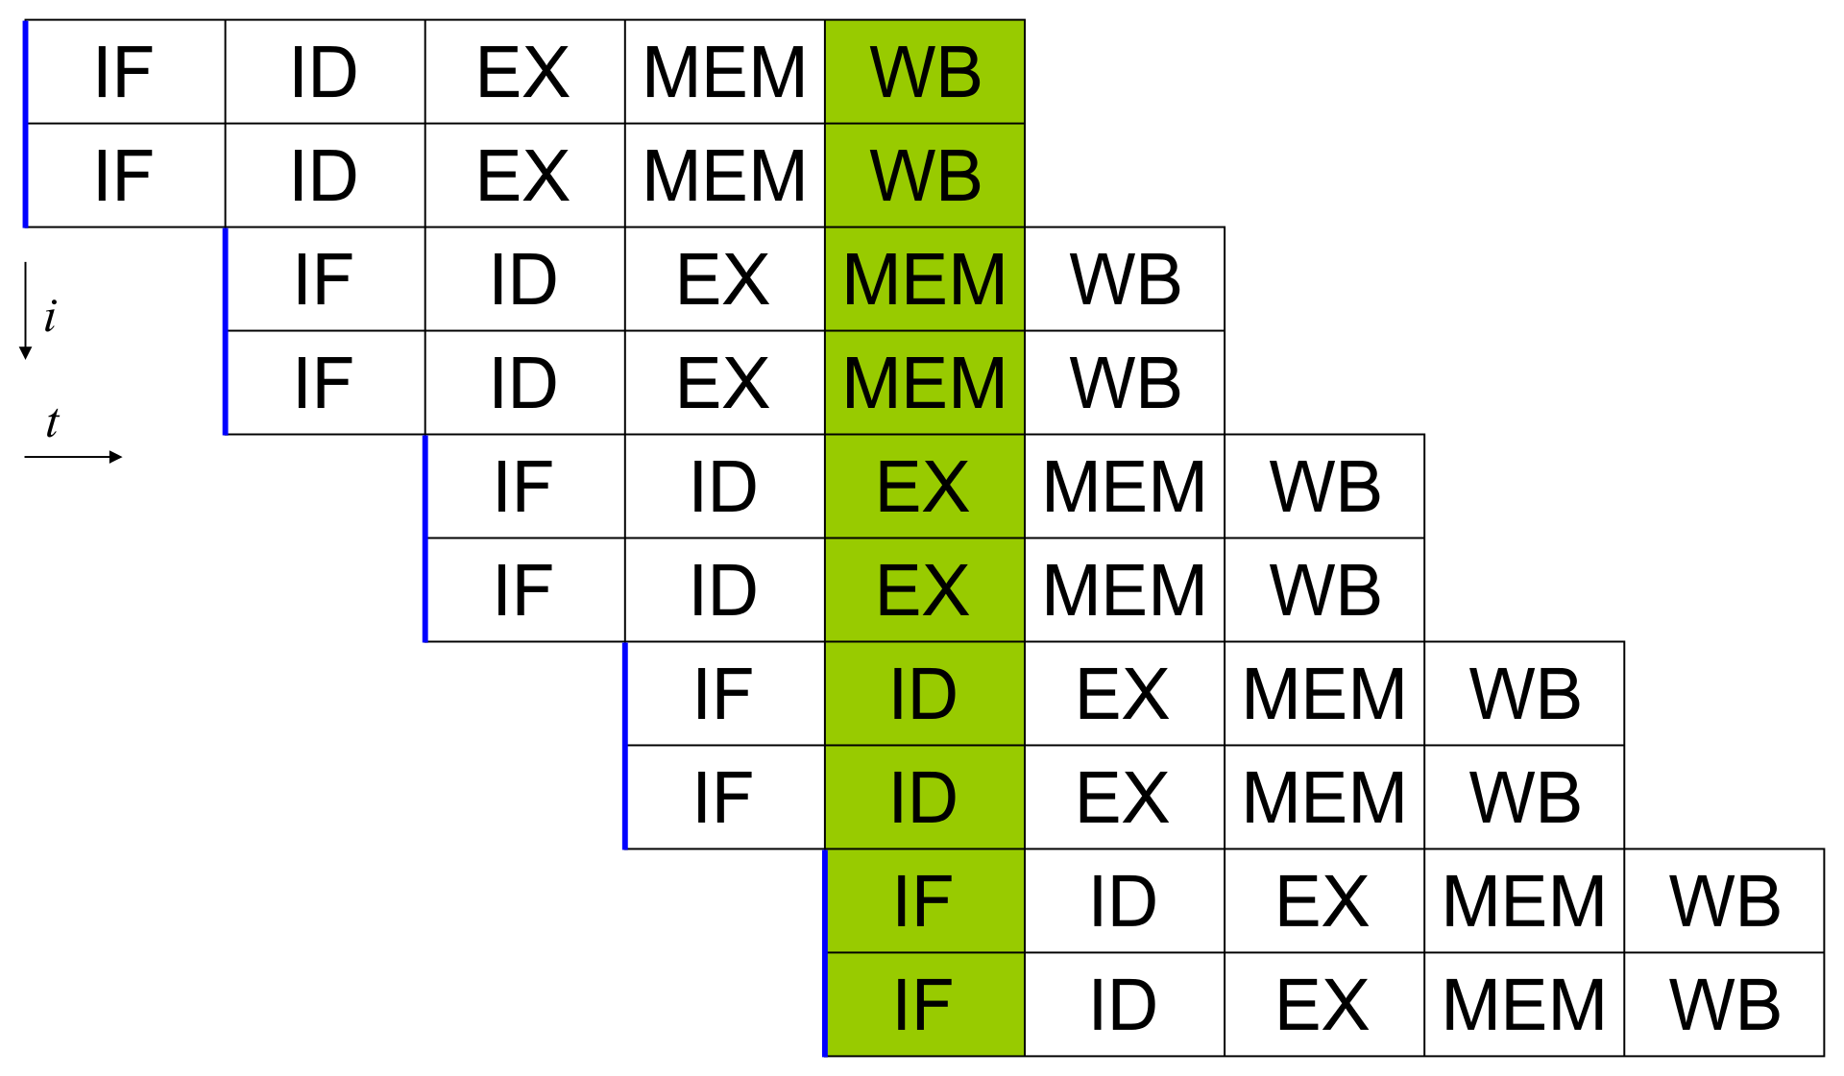
CPU architecture – superscalar processor
Current CPU
5-way, asymmetric
Notes:
Contemporary CPUs are superscalar, but also asymmetric (e.g., Intel example – there were 4 simple decoders and one full decoder).

Slide 42
CPU architecture – out-of-order execution
Decoder
µOPs
Reservation station (pool)
Port 0
Port 1
Port 5
Port 6
Port 2
Port 3
Port 4
Port 7
I/V ALU
I/V ALU
I/V ALU
I ALU
AGU
AGU
AGU
AGU
I/V MUL
I/V MUL
Vec Shuff
I Logic
Load
Load
Store
I/V Logic
I/V Logic
F ADD
Branch
String
Bit scan
Comp Int
F FMA
F FMA
AES
SQRT
I/F DIV
Reorder buffer
Branch
Notes:
ALU = Arithmetic Logic Unit
AGU = Address Generation Unit
FMA = Fused Multiple-Add (a = b*c + d)
…

Slide 43

Discussion
Notes:
If you wish to learn more about low-level CPU principles, a good place to start could be https://simulator.io/samples#sample10

