Slide 1

Memory
NSWI170 Computer Systems
Jakub Yaghob, Martin Kruliš

Slide 2
Computer memory hierarchy
Size
Speed/Price
reg
Our focus
cache
RAM
Power on
Power off
persistent RAM
Directly accessible by CPU
SSD, flash disks
External I/O
HDD
tapes
Notes:
Persistent RAM refers to non-volatile memory (NVM) compatible with DRAM interface (e.g., Intel Optane).

Slide 3
Memory
Definition
Each memory is organized into memory cells – bits
Bits are grouped into words of fixed length
1, 2, 4, 8, 16, 32, 64, and 128 bits
Each word can be accessed by a binary address
N bits (usually 32 or 64 on contemporary architectures)
We can store 2^{N} words in the memory
Today, the 8-bit word is used exclusively
Byte
This is the basis for addressing, but many architectures have “native” support only for larger words (e.g., 32 bit)

Slide 4
Memory – address space
0
Logical view (abstraction for programmers)
1
2
the address
1234
0b01001011
One byte per address
Typical 32-bits, or 64-bits (also a value stored in pointers)
2^{N}-2
2^{N}-1

Slide 5
Memory – physical view
2D array
Row x column
Select, access, deselect row
Timing
CAS (tCL) – Column Access Strobe
tRCD – Row Address to Column Address Delay
tRP – Row Precharge
RAS (tRAS) – Row Active Time
Row decoder
Column decoder
C
Row (14 bits)
Bank (3 bits)
Column(11 bits)
Byte in bus (3 bits)

Slide 6
Data representation – integers
Unsigned numbers
Simple binary representation of a number
Usual sizes
1, 2, 4, 8 bytes
Represented range
[0; 2^{N}-1]
Signed numbers
Two’s complement
Bitwise negation + 1
One 0
Compatible with unsigned arithmetic
Asymmetric range
[-2^{N-1};2^{N-1}-1]

Slide 7
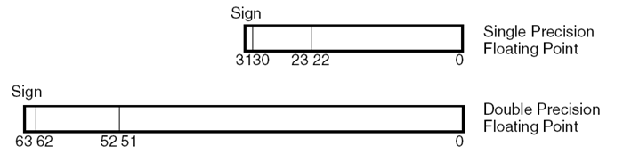
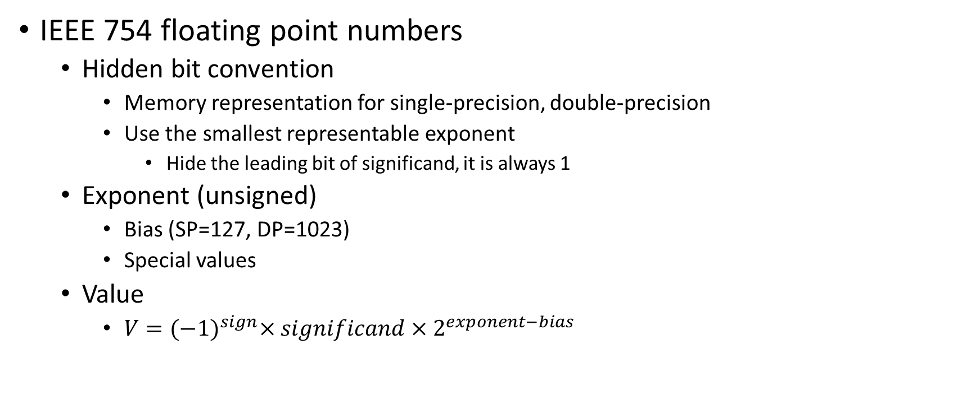
Data representation – floats
IEEE 754 floating point numbers
Hidden bit convention
Memory representation for single-precision, double-precision
Use the smallest representable exponent
Hide the leading bit of significand, it is always 1
Exponent (unsigned)
Bias (SP=127, DP=1023)
Special values
Value
$V={(−1)}^{sign}×significand×2^{exponent−bias}$
CPUs may internally use different representation (more suitable for circuits, but more redundant)
Notes:
Bias – a number explicitly subtracted from the exponent (which is stored as unsinged number).
E.g., Intel uses 80bit internal representation
Other precisions emerged with machine-learning (e.g., 16bit half-float, but it has to narrow range for exponent, so TF came up with 19bit floats). These new formats directly affect HW development (especially GPUs).

Slide 8
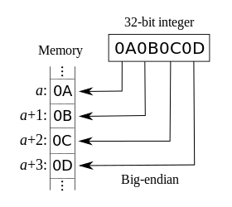
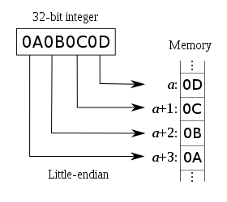
Data representation - Endianness
How to store multi-byte numbers?
Big endian
MSB first, LSB last
PowerPC, …
Little endian
LSB first, MSB last
Intel (x86)
Example
Store 32-bit number 0x0A0B0C0D
Btw. big endian is used in TCP/IP protocols
Notes:
Some CPUs may choose the endianness.

Slide 9
Data representation example
Hexdump
32bit system, little endian
Variable int *p stored at 0x1234
What is the value of *p ?
 | 0x0 | 0x1 | 0x2 | 0x3 | 0x4 | 0x5 | 0x6 | 0x7 | 0x8 | 0x9 | 0xa | 0xb | 0xc | 0xd | 0xe | 0xf
0x1230 | be | ba | ad | de | 68 | 12 | 00 | 00 | 49 | 66 | 20 | 79 | 6f | 75 | 20 | 63
0x1240 | 61 | 6e | 20 | 72 | 65 | 61 | 64 | 20 | 74 | 68 | 69 | 73 | 20 | 79 | 6f | 75
0x1250 | 20 | 75 | 6e | 64 | 65 | 72 | 73 | 74 | 61 | 6e | 64 | 20 | 48 | 65 | 78 | 64
0x1260 | 75 | 6d | 70 | 73 | 00 | 00 | 00 | 00 | 3a | 01 | 00 | 00 | 01 | b0 | 01 | c0
Notes:
The answer is 314 … to commemorate the pi-day!

Slide 10
Data alignment – inner padding
Modern CPUs require data in memory aligned to their size
E.g., integer (4B) must have address aligned to 4
Structure is aligned to largest data type available on CPU (e.g., 16B)
struct dem {
char c;
double d;
int i;
};
A
c
1B
A
c
1B
A+1
d
7B
8B
A+8
d
A+9
i
8B
4B
A+13
A+16
i
4B
A+20

Slide 11
Data alignment – outer padding
dem arr[2];
A
c
1B
A
c
1B
7B
7B
A+8
d
arr[0]
A+8
d
arr[0]
8B
8B
A+16
i
4B
A+16
i
4B
A+20
c
1B
4B
7B
A+24
c
1B
arr[1]
7B
%8?
A+28
d
8B
A+32
d
8B
arr[1]
A+36
i
4B
A+40
A+40
i
4B
4B
A+48
Notes:
A structure must be aligned to the largest basic type used inside (e.g., double in this example).

Slide 12
Memory management
Global variables
Allocated at the beginning, fixed place, released when application terminates
Local variables, function arguments
Allocated on the stack by shifting stack pointer
Stack growth, reallocation
Dynamically allocated variables
Allocated explicitly by the programmer (malloc(), new, unique_ptr, …)
Specially dedicated memory block for these allocations
Requires special management provided by the runtime in cooperation with OS (OS allocates huge chunks, runtime manages fine-grained allocation)

Slide 13
Memory allocation
Task
Locate a block of unused memory of sufficient size
Allocate portions from a large pool of memory
Heap, memory arena/pool
Lifecycle
Allocate a block
Different strategies, allocators
Use the block
Free the block
Explicitly, by a garbage collector
Not a d-regular heap, binomial heap, nor Fibonacci heap (the data structures)

Slide 14
Fragmentation
Internal
Allocated more memory than needed in a block (e.g., by 64B blocks)
External
Free memory is separated into small blocks and interspersed by allocated memory
requested
The heap
Gap after freed block
allocated

Slide 15
Dynamic memory allocation
Contiguous allocation of variable size
Free blocks evidence
Linked list
Bitmap
Each bit represents a block of a fixed size
0
0
0
0
0
1
1
0
0
0
1
1
1
1
1
1
1
1
1
1
1
1
0
0
1
1
1
0
0
0
0
Notes:
Some algorithms may need also to monitor allocated blocks (so in linked-list representation, we need a second list for allocated blocks).

Slide 16
Allocation algorithms
First fit
Start from the beginning, find the first free space big enough to accommodate the required block
Pros: fast, simple Cons: can divide larger blocks
Next fit
Like the first fit, but starts from the last position
Pros: fast, doesn’t make fragmen-tation on the start of the heap
Best fit
Start from the beginning, find the smallest space big enough
Pros: keeps large blocks Cons: slower, creates many tiny blocks
Worst fit
Start from the beginning, find the largest space
Cons: divides large blocks

Slide 17
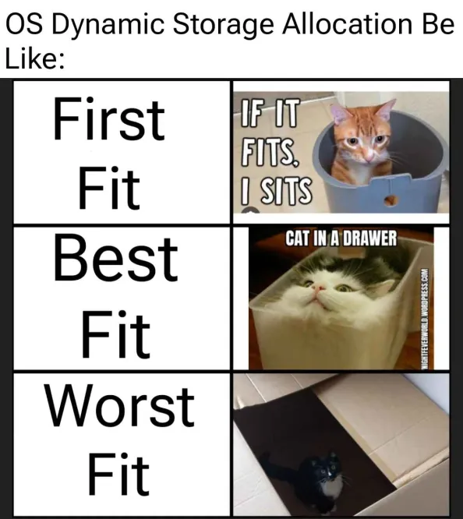

Allocation algorithms

Slide 18
Allocation algorithms example
Allocate (per 64B blocks)
A ~ 42 B B ~ 2 KiB C ~ 100 B D ~ 400 B E ~ 4 B
Deallocate B and D
Allocate F ~ 314 B
What will happen in
First fit
Best fit
Next fit
+64 B
+2240 B
+2752 B
A
B
F
C
D
F
E
F
Notes:
Block F will take 320 B (5x 64B) and will be located at offset - 64 B (first fit)
- 2240 B (best fit)
- 2752 B (next fit)

Slide 19
Buddy memory allocation
Blocks of 2^{N} size
Address aligned to 2^{N}
Find the smallest 2^{N} block fitting the required size
“List” of free blocks lists with fixed sizes 2^{N}
If there are no small blocks, create them by dividing larger blocks
Buddies
Find the buddy address by XORing my address with the block size
Merge blocks back when both buddies are free
Significant internal fragmentation

Slide 20
Buddy memory allocation
64
Request 200B
128
256
A:1280,S:256
512
A:1024,S:512
A:1024,S:256
1k
2k
4k
8k
16k
A:16384,S:16k

Slide 21
Cache
HW or even SW
A structure holding data
Data loads/computations (for the first time) is slow/expensive
Future requests for that data can be served faster
Limited (fixed) size
Generic cache operation
Make a request for data
Are data placed in the cache?
If they are, return them, otherwise do a slow calculation/access
Cache in CPU
Hides memory latency
Based on the locality of reference
CPU cache operation
Make a request for data in the memory
Are data placed in the cache? Look in all levels of cache in the CPU from the fastest L1 to the slowest LLC
If they are, return them to the execution unit in a CPU core, otherwise do a full memory access
Notes:
Important is that a cache has limited (restricted) size. When the cache gets full and new items needs to be stored in cache, some old items needs to be removed. We will get to that in page-replacement algorithms.

Slide 22



Real World Cache Example
Cache of clothes (accessible in O(1) due to ingenious organization)
A bachelor (Matfyzák)
Wardrobe (too distant from the bed)

Slide 23
Cache terminology
Cache line/entry
Caches are organized in lines
The usual size is about 64B
Aligned
Cache hit
Request served from the cache
Success rate is around 97%
Common problems/algorithms
Cache miss
Data not found in a cache hierarchy, do a full memory access
Load data from the memory to a cache line
Select either a free cache line or select a victim cache line
Store modified cache lines back to the memory
Cache line state
MESI protocol

Slide 24
CPU caches (reminder)
Package
CORE 0
CORE 1
CORE 2
CORE 3
T0
T4
T1
T5
T2
T6
T3
T7
EU
EU
EU
EU
L1I
L1I
L1I
L1I
L1D
L1D
L1D
L1D
L2
L2
L2
L2
L3/LLC
Notes:
Cache latencies
https://www.7-cpu.com/cpu/Skylake.html
https://gist.github.com/jboner/2841832

Slide 25
Associative memory
RAM
Associative memory
Very fast
Content based addressing
Used in CPU caches
Fully associative vs. n-way associative
1334
4096
key
value
Address
8832
7296
7296
1334
4096
8832

Slide 26
NUMA
Multiprocessors
SMP – Symmetric multiprocessing
NUMA – Non-uniform memory access
Address space
RAM1
RAM1
RAM3
RAM2
CPU1
CPU2
CPU1
CPU3
System bus
RAM3
RAM
CPU2
CPU4
RAM4
RAM2
RAM4

Slide 27

Discussion

