Slide 1
Operating Systems
NSWI170 Computer Systems
Jakub Yaghob, Martin Kruliš

Slide 2

Yaghob to Kruliš: No more kitten memes or you’re dead…
Okay…

Slide 3
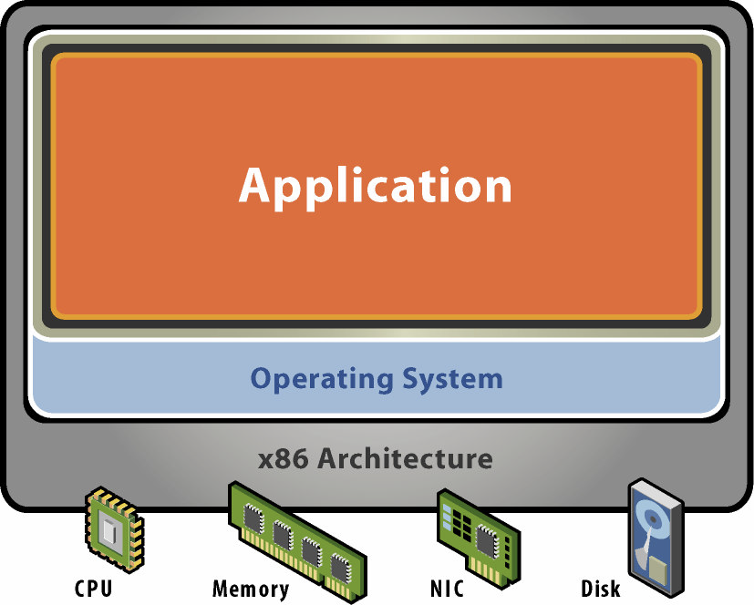
Operating system – role
Abstract machine
Presented by kernel API
System calls
Wrapped in C libraries
Hide HW complexity/diversity
Resource manager
All HW managed by OS
Sharing HW among applications
Allocation (memory)
Time-sharing (CPU)
Abstraction (disk, network)
Shared libraries
Language Runtime

Slide 4
CPU modes
User mode
Available to all applications
Limited (e.g., read-only) or no access to some resources
The system registers, instructions
Kernel (system) mode
More privileged (all registers and instructions are available)
Used by OS or by only part of OS
Full access to all resources
The transition between the modes (especially user -> kernel)
Syscall (user instruction), jumps to the explicit kernel entry point

Slide 5
Kernel mode example
Print string to std. output
Note that requires kernel call
int main() {
printf("Hello");
...
}
x86 64bit
movq rdx, @len
movq rcx, @@msg
movq rbx, 1
movq rax, 4
syscall
...
sysret
Jumps to address stored in IA32_LSTAR register whilst switching to ring 0 (kernel mode)
Return and switch to ring 3

Slide 6
Strace example
#include...
int main() {
std::ifstream f("a.txt");
std::string str;
if (f) {
std::ostringstream ss;
ss << f.rdbuf();
str = ss.str();
}
std::cout << str;
}
Reads a text file, prints it to stdout
How many syscalls would this trigger?
We can analyze this by calling $> strace ./app
… let’s see the results

Slide 7
Architecture – monolithic
Monolithic systems
Big mess – no structure
“Early days”
Linux
Collection of procedures
Each one can call another one
No information hiding
Potentially error prone
Efficient use of resources, efficient code
Originally no extensibility
Now able to load modules dynamically (flexible, but even more error-prone)
Entry point
Service proc.
Utility (internal) proc.
Notes:
Modularity example – USB drivers. USB is a generic bus, anything can be plugged in. The OS must recognize newly plugged USB device and load the right driver dynamically.

Slide 8
Architecture – layered
Evolution of monolithic system
Organized into hierarchy of layers
Layer n+1 uses exclusively services supported by layer n
Easier to extend and evolve
User interface
File system
Input/output
Memory management
Kernel
Notes:
Original Intel CPU design was modeled by this – the CPU had 4 rings of security (0 = kernels, 3 = user space). Intermediate rings (1 and 2) were meant for things like memory management or device drivers.

Slide 9
Architecture – microkernel
Microkernel architecture
Move as much as possible from the kernel space to the user space
Communication between user modules
Message passing (client/server)
Extendable, secure, reliable
May be quite slow
Idea partially adopted in modern systems
Windows kernel design
Linux FUSE (Filesystem in Userspace) interface for custom FS implementations
Svc 1
Svc 2
App
μKernel

Slide 10
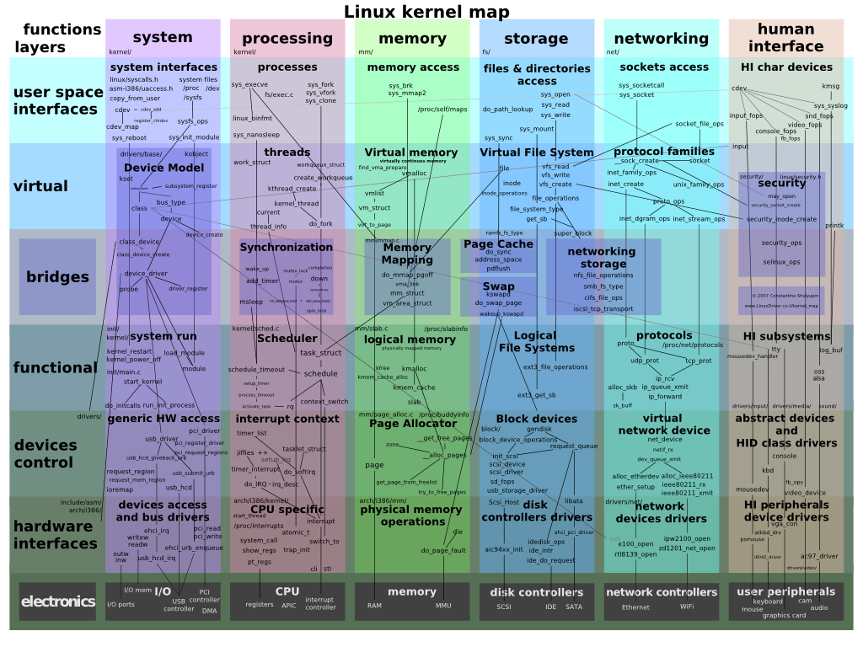
Linux kernel architecture
Notes:
Note the matrix structure of current Linux kernel design. The vertical communication is good, horizontal communication is not so good.
Some “modules” cannot be easily located in one slot – e.g., Page cache and swap (spans between memory and storage), or networking storage (spans between storage and networking).

Slide 11
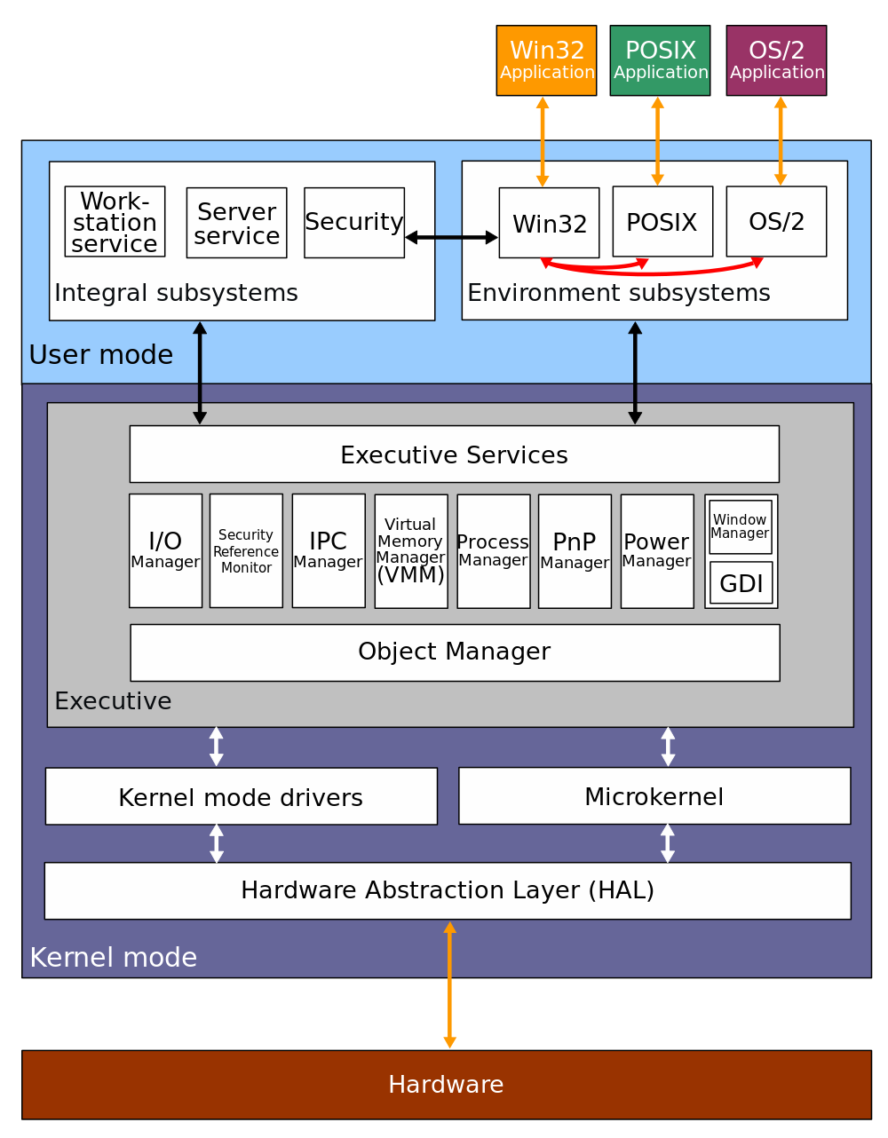
Windows kernel architecture

Slide 12
Devices
Terminology
Device - “a thing made for a particular purpose”
Device controller
Handles connected devices electrically (signals “on wires”, A/D converters)
Devices connected in a topology
Device driver
SW component (piece of code), part of OS (module, dynamically loaded)
Abstract interface to the upper layer in OS
Specific for a controller or a class/group of controllers
BIOS/UEFI
Basic HW interfaces that allow to enumerate and initialize devices on boot

Slide 13
Devices topology
DC
Ring
DC
Bus
Dev1
Dev2
Dev3
Dev1
Dev3
Dev2
Dev1
Dev2
Tree
DC
Star
DC
Dev3
Dev4
Dev1
Dev2
Hub1
Dev3
Dev4
Notes:
Bus example – old HDD (PATA,SCSI)
Star example – modern HDDs (SATA, M.2)
Tree example - USB

Slide 14
Device communication
How CPU performs I/O operations
Specialized instructions
in al, dx
out al, dx
Memory-mapped devices
Device operating structures are mapped at fixed addresses (at boot)
Basic memory operations are translated by HW into I/O operations
Reads and writes may trigger some device functions
E.g., writing at a specific offset may in fact send a command to the device
Old x86 input-output instructions (dx holds the IO port number associated with the device)

Slide 15
Device handling
Application issues an I/O request
Language library makes a system call
The kernel decides, which device is involved
The kernel starts an I/O operation using a device driver
The device driver initiates an I/O operation on a device controller
Device does something
The device driver checks for the status of the device controller
When data are ready, transfer data from the device to the memory
Return to any kernel layer and make other I/O operations fulfilling the user request
Return to the application
User I/O libraries
User
Device independent I/O
Kernel
Device driver
Device driver
Device controller
Device controller
HW
Device
Device
Notes:
Example opening + reading a file.

Slide 16
Example – PIO disk handling
Port offset | Function
0 | Data register
1 | Error register
2 | Sector count register
3 | Sector number register
4 | Cylinder low register
5 | Cylinder high register
6 | Drive/head register
7 | Status/Command register
Reading sectors (simplified)
Check status/error
Set count register
Set address (sector and cylinder)
Send reading command 0x20
Read the status register until the operation completes (or fails)
Read the data register 256 times (based on the size of the data)
Possibly repeat steps 5 & 6
Ports relative to the device base address operated by in/out instructions
Notes:
If you wish to see the complete thing: https://wiki.osdev.org/ATA_PIO_Mode
PIO is very old and has not been used in decades.. Contemporary storage devices rely mainly on DMA.

Slide 17
Device intercommunication
Polling
CPU actively checks device status change (like in previous example)
Interrupt
The device notifies the CPU that it needs attention
CPU interrupts the current execution flow
IRQ (interrupt request) handling
CPU has at least one pin for requesting an interrupt
DMA (Direct Memory Access)
Transfer data to/from a device without CPU attention
DMA controller
Scatter/gather
Notes:
DMA example – disk transfers
Scatter/Gather example – network card

Slide 18
Interrupt types
External
HW source using an IRQ pin
Masking (temporary disabling interrupts)
(Hardware) Exception
Unexpectedly triggered by an instruction (when an instruction is executed)
Trap (trigger exception after) or fault (instruction rollbacks, trigger before)
Predefined set by CPU architecture
Software
Special instruction (e.g., x86 has int)
Can be used for the system call mechanism
Notes:
Masking may be necessary for critical operations (e.g., handling interrupts ;) ).

Slide 19
x86 Exceptions
Interrupt | Exception description
0x00 | Division by zero
0x01 | Single-step interrupt (see trap flag)
0x02 | NMI
0x03 | Breakpoint (which benefits from the shorter 0xCC encoding of INT 3)
0x04 | Overflow
0x05 | Bound Range Exceeded
0x06 | Invalid Opcode
0x07 | Coprocessor not available
0x08 | Double Fault
0x09 | Coprocessor Segment Overrun (386 or earlier only)
0x0A | Invalid Task State Segment
0x0B | Segment not present
0x0C | Stack Segment Fault
0x0D | General Protection Fault
0x0E | Page Fault
0x0F | reserved
0x10 | x87 Floating Point Exception
0x11 | Alignment Check
0x12 | Machine Check
0x13 | SIMD Floating-Point Exception
0x14 | Virtualization Exception
0x15 | Control Protection Exception (only available with CET)
x86 Architecture
256 interrupts
First 32 reserved for exceptions
Remaining are IRQ or SW interrupts
Notes:
https://wiki.osdev.org/Exceptions
Besides traps and faults there are also “aborts” (severe unrecoverable errors).
A few examples:
Breakpoint – useful since it takes only 1B (debugger can replace the 1st byte of any instruction) and it is a trap
Overflow – another example of trap, triggered by INTO instruction (if overflow flag is set)
Double fault = exception failed (unhandled or the handler causes an error) – cannot be recovered, faulting process must terminate (btw. there is also triple fault that is triggered when double fault fails and it restarts the CPU)
Page fault = memory protection (will be later)

Slide 20
Interrupt request handling
What happens when an interrupt occurs?
CPU decides the source of the interrupt
Predefined or IRQ controller
CPU gets the address of the interrupt handler
Fixed (defined by ISA)
Interrupt table (array of pointers to handlers for individual interrupts)
The current stream of instructions is interrupted, the CPU begins execution of the interrupt handler’s instructions
Usually between instructions (current instruction must be complete or rollback)
A privilege switch usually happens since the interrupt handler is part of the kernel
Critical part of the CPU state (at least IP) must be saved (e.g., to a special register)
The interrupt handler saves (the rest of) the CPU state
The Interrupt handler does its job (whatever is needed for that particular exception)
The interrupt handler restores the CPU state (that was stored by the handler)
CPU restores the critical part of the state (like IP) and continues with the original instruction stream
IRQ controller
#INT
INT
CPU

Slide 21
Processing
Program
A passive set of instructions and data
Created by a compiler/linker
Process
An instance of a program created by the OS
Program code and data
Process address space
The program is “enlivened” by an activity
The CPU executes instructions
Owns other resources
Thread
One activity in a process
Stream of instructions executed by the CPU
Unit of kernel scheduling
I.e., Holds CPU context
Fiber
Lighter unit of scheduling
Cooperative scheduling
Running fiber explicitly yields
Code
T1
T2
Static data
Stack for thread 1
Stack for thread 2
Heap

Slide 22
Process vs. Thread
Process
Code (loaded in memory)
Memory space
Other system resources
File handles
Network sockets
Synchronization primitives
…
Thread
Position in code (program counter)
Own stack (rest is shared)
Access to some system resources may require synchronization
CPU state
Must be saved when thread is removed from CPU core and reloaded when the thread resumes

Slide 23
Creating a process
Windows
STARTUPINFO si;
PROCESS_INFORMATION pi;
ZeroMemory(&si, sizeof(si));
si.cb = sizeof(si);
ZeroMemory(&pi, sizeof(pi));
// ...
bool ok = CreateProcess(NULL,
cmdline,
NULL, NULL, FALSE, 0, NULL, NULL,
&si, &pi);
// ...
WaitForSingleObject( pi.hProcess, INFINITE);
Linux
pid_t p = fork();
if (p == -1) {
// handle error
} else if (p == 0) {
// new process
execv(pathToExecutable, args);
} else {
// original process
int status;
waitpid(p, &status, 0);
}

Slide 24
Parent-child process relation
Linux
A child holds its parent’s IDs (ppid)
A child notifies the parent by SIGCHILD signal when terminated
A terminated process becomes a zombie until asked for an exit code
Killing a process does not kill its children
Children are orphaned and re-adopted by the init process (pid 1)
Killing an entire process tree needs special effort
Windows
Slightly more complicated (the win32 process entry does not record ppid, but it is available in NTQuerySystemInformation)
No special relationship between child and parent
Process manager can kill the whole sub-tree (but it is not a feature of the OS)

Slide 25
Creating a thread
C++ example (but C#/Java are similar)
void thread_code(/* params */) {
// ...
}
int main() {
// ...
std::thread t(thread_code, /* params */);
// here main thread and t run concurrently
t.join();
// ...
}
This will translate in some low-level system calls

Slide 26
Processing
Scheduler
Part of OS
Uses scheduling algorithms to assign computing resources to scheduling units (CPU cores)
Multitasking
Concurrent executions of multiple processes
Multiprocessing
Multiple CPUs (cores) in one system
More challenging for the scheduler
Affinity

Slide 27
Processing
Context
CPU (and possibly other) state of a scheduling unit
Registers (including PC, specialized vector registers)
Additional units (x87 coprocessor)
Virtual memory and address-space-related context
Page tables, TLB (will be covered later)
Memory caches are transparent (not part of the context, but may affect performance)
Context switch
Process of storing the context of a scheduling unit (when suspended) and restoring the context of another scheduling unit (when resumed)
Quite costly (hundreds-thousands of instructions)

Slide 28



Real-time scheduling
Real-time scheduling
RT process has a start time (release time) and a stop time (deadline)
Release time – the time at which the process must start after some event occurred
Deadline – the time by which the task must complete
Hard – no value to continuing computation after the deadline
Soft – the value of late result diminishes with time after the deadline
Notes:
Release time example – airbag deployment (which must be delayed so that the human body have time to get in position by momentum).
Specialized OSes (e.g., MACH).

Slide 29
Unit of scheduling state
Created
Awaits admission
Terminated
Until the parent process reads the result
Ready
Wait for scheduling
Running
CPU assigned
Blocked
Wait for resources
Created
Terminated (zombie)
Running
Ready
Blocked

Slide 30
Multitasking
Cooperative
Unit of scheduling must explicitly and voluntarily yield control
All processes must cooperate
Special systems
Scheduling in OS reduced on starting the process and making context switch after the yield
OS does not initiate a context switch
Preemptive
Each running unit of scheduling has an assigned time slice
OS needs some external source of interrupt (HW timer)
If the unit of scheduling blocks or is terminated before the time slice ends, nothing of interest happens
If the unit of scheduling consumes the whole time slice
interrupted by the external source
changed to READY state
OS will make a context switch

Slide 31
Scheduling
Objectives
Maximize/optimize CPU utilization (based on the workload)
Fair allocation of CPU
Maximize throughput
Number of processes that complete their execution per time unit
Minimize turnaround time
The amount of time taken by a process to finish
Minimize waiting time
Time a process waits in the READY state
Minimize response time
Time to respond in interactive applications
Notes:
Also note, that different applications (scheduling units) may have different objectives of their own (e.g., computing threads vs GUI interactive threads).

Slide 32
Scheduling – priority
Priority
A number expressing the importance of the process
Units of scheduling with greater priority should be scheduled before (or more often than) units of scheduling with lower priority
The priority of the process is the sum of a static priority and a dynamic priority
Static priority
Assigned at the start of the process
Users’ hierarchy or importance
Dynamic priority
Adding fairness to the scheduling
Once in a while, the dynamic priority is increased for all READY units of scheduling
The dynamic priority is initialized to 0 and is reset to 0 after the unit of scheduling is scheduled for execution

Slide 33

Scheduling

Slide 34
Scheduling algorithms – non-preemptive
First Come, First Serve (FCFS)
Single FIFO queue
New processes enter the queue at the tail
The head process is running on the CPU
Afterward, it is removed from the queue
Shortest Job First
Maximizes throughput
Expected job execution time must be known in advance
Longest Job First
Notes:
Each process is removed from scheduling at the end (assuming each process terminates since the scheduling is non-preemptive). If the process yields (cooperatively), it simply re-enters the scheduling as a new process.

Slide 35
Scheduling algorithms – preemptive
Round Robin
Like FCFS (but preemptive)
Single queue
Each unit of scheduling has an assigned time slice
If the unit of scheduling consumes the whole time slice or is blocked, it will be assigned to the tail of the queue
CPU
US
US
US
US
Notes:
Round robin was originally used as a method for signing documents (e.g., petitions) where the order of signatures should not be maintained (so that no one is first on the list…).

Slide 36
Scheduling algorithms – preemptive
Multilevel feedback-queue
Multiple queues
Time-slice defined by queue (increasing)
If the unit of scheduling consumes the whole time slice, it will be assigned to the lower queue
If the unit of scheduling blocks before consuming the whole time slice, it will be assigned to the higher queue
Schedule head unit of scheduling from the highest non-empty queue
US
US
US
US
CPU
US
US
US
US
US
US
US
US

Slide 37
Scheduling algorithms - preemptive
Completely fair scheduler (CFS)
Implemented in Linux kernel
Currently the default scheduler
SUs are stored in a red-black tree
Indexed by their total execution time (called virtual runtime)
One tree per CPU core
Maximum execution time
A time slice calculated for each unit
Total waiting time divided by the current number of processes
The longer it waits, the greater
Scheduling algorithm
The leftmost node in the RB tree is selected (lowest virtual runtime)
If the process completes its execution, it is removed from the schedule
If the process reaches its maximum execution time or is somehow stopped or interrupted, it is reinserted into the tree with a new time key
Actual time spent on the CPU is added to the virtual runtime
Virtual runtime decays over time
Notes:
https://developer.ibm.com/tutorials/l-completely-fair-scheduler/
The virtual runtime decays over time. The rate of the decay is determined by the static priority assigned to the process.

Slide 38
Inter-Process Communication
Cooperating processes
OS isolates resources of each process (memory, device handlers, …)
IPC presents a secure way for data exchange
OS-specific APIs
Typical IPC methods supported by most systems
Pipes
Or other types of sockets (e.g., TCP over loopback)
Shared memory
Or shared external memory (files)
Signals
Also used for kernel -> process communication (e.g., when CPU exception occurs)
Notes:
https://en.wikipedia.org/wiki/Inter-process_communication
https://en.wikipedia.org/wiki/Signal_(IPC)
Signal
Process sets signal handlers (functions that are triggered).
Kernel executes these functions (outside main thread) when signal occurs.
If signal is not handled, process is terminated. Some signals cannot be handled (e.g., SIGKILL)
Some signals may be sent as a reaction to CPU exception
Examples:
SIGTERM – a request to terminate
SIGKILL – unstoppable way to terminate a process
SIGSEGV – segmentation violation (invalid memory access)
SIGILL – sent when process attempts to execute illegal instruction
SIGCHLD – is sent to a parent process when child process terminates (or is interrupted/resumed)
SIGINT – Ctrl+C (interrupt) was sent to the process
SIGUSR1, SIGUSR2 – signals that can be used for user-defined purposes

Slide 39
File
File
Data organization unit
Collection of related information
Abstract stream of data (bytes)
Kernel does not understand file formats
Typically stored on secondary storage, but there are other possibilities
File identification
System uses numeric identifiers
File name and path – a named reference to the file identifier in organized tree structure
So that humans can find the files
Some parts of the file name may have special meaning (leading dot, extension)

Slide 40
File operations
Std. lib in C
#include <stdio.h>
FILE *fp = fopen("file.txt", "r");
if (!fp) { /* error */ }
fseek(fp, 42, SEEK_SET);
fgets(buf, 16, fp);
fclose(fp);
POSIX
#include <unistd.h>
int fd = open("file.txt", O_RDONLY);
if (fd == -1) { /* error */ }
lseek(fd, 42, SEEK_SET);
read(fd, buf, 16);
close(fd);
Notes:
The open operation performs translation path -> system file identifier. Also performs necessary checks (e.g., that the process/user can access the file).

Slide 41
File operations
Additional operations
Create, truncate, delete, flush, change attributes
File handle
Process-specific sequentially assigned, kernel holds translation table
Buffering
To increase performance, multiple levels (system, language runtime)
Sequential vs random access
Alternatives
Memory mapping (will become more clear after memory management)
Async file I/O
It is no coincidence that stdin, stdout, and stderr file descriptors have handles 0, 1, and 2.
Notes:
The file handle must be local (private) and assigned by OS, so the process cannot guess/steal file handlers and bypass open() verifications.

Slide 42
File attributes
$> stat ./smart.py
File: ./smart.py
Size: 11534 Blocks: 24 IO Block: 4096 regular file
Device: fd05h/64773d Inode: 120575467360 Links: 1
Access: (0664/-rw-rw-r--) Uid: (29345/krulm3am) Gid: (29345/krulm3am)
Access: 2021-05-17 18:25:06.734717566 +0200
Modify: 2021-05-16 15:58:16.000000000 +0200
Change: 2021-08-04 16:11:32.853190394 +0200
Birth: -
When the file content was modified
When the file attributes (inode) were last changed
Notes:
Note that updating access time every time a file is read is quite a performance hog. There is some discussion whether it is worth it and you can mount a fs without performing this operation (check about `noatime` attribute in /etc/fstab).

Slide 43
File directory
Directory
Collection (list) of file entries
Efficiency – a file can be located more quickly
Naming – better navigation for users
Grouping – a logical grouping of files
Usually represented as a file of a special type
May store (some of) the file attributes (depends on fs design – e.g., FAT vs. EXT)
Hierarchy or structure
Root
Operations
Create/delete/rename file/subdirectory
Search for a name
List members
Moving file on the same file system = moving only file entry between directories

Slide 44
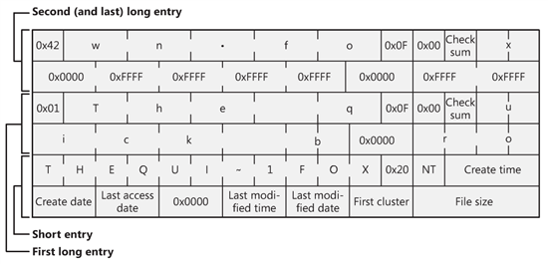
File directory example
FAT directory entry
File name “The quick brown fox”
FAT dir. entry also holds file attributes (however, other FS may store them elsewhere – e.g., EXT inode)
https://social.technet.microsoft.com/wiki/contents/articles/6771.the-fat-file-system.aspx
Notes:
Note the awkward (dual) naming.
Most attributes are in the dir entry.
File size is 32bit long -> max file size is 4G.
First cluster is a pointer to the first block.

Slide 45
File storage
Traditional storage
File system in secondary or external storage (persisted)
File system in RAM (e.g., for temporary files)
Network storage
Protocols for performing FS operations remotely over network
Virtual (system) files
Using file abstraction to provide additional (system) features
/dev/null
/dev/urandom
/proc/cpuinfo
You can try it yourselves (e.g., read cpuinfo)

Slide 46
File links
Links (hard links)
Multiple directory entries refer to the same physical file (same file ID)
Most operations are transparent (no special handling required)
Saves space (in some situations), creates additional problems
E.g., file deletion should not always remove the file data (reference counting)
Symlinks (soft links)
Special files where text content holds a path to another file
Does not refer to file IDs
Requires special handling in path processing (“follow symlinks”)
Often hidden in basic system tools or programming runtime libraries

Slide 47
File system
File system
How and where data are stored
Formats, protocols
Implementation of an abstraction for files and directories
Responsibility
Name translation (directory format)
Data blocks management
Allocated vs. free blocks
Bitmap, linked list, B-tree, …
File data management
Sequence of data blocks
Local file system
Stored on HDD, SSD, removable media
FAT, NTFS, ext234, XFS, …
Network file system
Protocol for accessing files and directories over the network
NFS, CIFS/SMB, …

Slide 48
FAT
File Allocation Table (FAT)
Simple, old, MS-DOS, many variants used today
One structure (FAT) for managing free blocks and file data location
Directory
Sequence of entries with fixed size and attributes
Starting cluster, name+ext, size, timestamps, attributes
Root in fixed position
Directory
FAT
Boot record
FAT1
a.txt
2
0
3
10
4
0
5
-1
13
6
0
7
0
8
5
9
0
FAT2
b.txt
3
10
15
11
0
12
0
13
8
Root directory
14
-1
15
14
16
0
17
0
Data

Slide 49
Ext2
Second extended file system (ext2)
Simple, old, Linux
Ext3 – added journal to improve persistence
Ext4 – improvement of ext3, larger individual files (16T) and FS (1 EB)
Inode (index node)
Represents one file/directory
Tree-like hierarchy with block references (faster than linked list)
Smaller files are represented more efficiently
Holds most of the attributes
Directory
Sequence of entries with fixed structure
Inode number, file name

Slide 50
Ext2
Contains most important information about the FS (a copy is in each block group)
Data blocks of one file are kept in one Block group if possible
Block group descriptor table (a copy is in each block group)
Data block
Data block
Superblock
Info
Boot record
Descriptor
Data block
Data block
Block group 0
Data bitmap
Block 0
Inode bitmap
Block 1
Block group 1
Block 0
Inode table
Data block
Block 11
Data blocks
Block 12 (I)
Block 127
Block group N
Block 0
Data block
Block 13 (DI)
Block 14 (TI)
Block 0
Block 127
A single Inode structure
Block 127
Notes:
Superblock – 1KiB (84B common prefix, rest is extension)
Block Group Descriptor – 32 B
https://wiki.osdev.org/Ext2

Slide 51
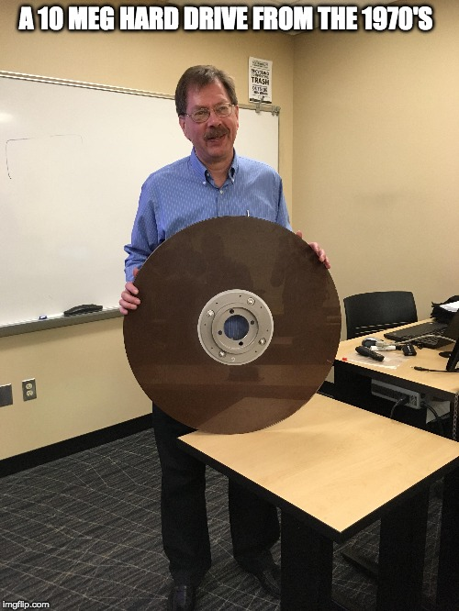
Hard disc mechanics
arm
track
spindle
sector
platter
RW head
Additional terminology
Block – the same sector on all platters
Cluster – the same track on all platters
Flying height – distance between head and platter (~5 nm)
Rotational speed – 5400, 7200, 10k, 15k rpm

Slide 52
Disk scheduling algorithms
What?
Scheduling of I/O requests for the disk
Originally done by OS, now by disk itself
Why?
Disk access time = Seek Time + Rotational Latency + Transfer time
Seek Time – time to locate the arm to a track (~ms)
Rotational latency – time to rotate a sector to the fixed position of heads
Transfer time – time to transfer data
Minimize disk access time for multiple I/O requests
Examples
All algorithms demonstrated with the same pattern of I/O requests and initial position
I/O requests - 82, 170, 43, 61, 24, 16, 190
Initial position - 50

Slide 53
Disk scheduling algorithms
FCFS (First Come First Served)
Pros
Fair chance for all requests
Simple, good for light load
Cons
No optimization – usually not the best
0
16
24
43
50
61
82
170
190
199

Slide 54
Disk scheduling algorithms
SSTF (Shortest Seek Time First)
Pros
Average access time decreases
Increased throughput
Cons
Possible starvation for distant requests, when new short seek requests arrive
0
16
24
43
50
61
82
170
190
199

Slide 55
Disk scheduling algorithms
SCAN (a.k.a. Elevator algorithm)
Keeps direction (as long as request exists)
Pros
High throughput – good for heavy loads
Low variance in access time
Cons
Long waiting times for new requests just visited by the arm
0
16
24
43
50
61
82
170
190
199

Slide 56
Disk scheduling algorithms
CSCAN
Circular SCAN
Pros
More uniform time compared to SCAN
0
16
24
43
50
61
82
170
190
199

Slide 57
Disk scheduling algorithms
LOOK/CLOOK
Like SCAN/CSCAN but does not visit ends of the disk
FSCAN
Two queues
Compute algorithm only for 1st queue, new requests are inserted to the 2nd one
0
16
24
43
50
61
82
170
190
199

Slide 58
Solid state disk
Solid-state disk (SSD)
Disk without moving parts (only electric circuits)
NAND flash, made of floating gate transistors
Similar to RAM, but slower and the transistors retain the charge without refreshing
Reads/writes damage the transistors over time (writes and erases far more than reads)
1k-100k program-erase (P/E) cycles (MTBF)
Grid structure organized as block of pages
Page is ~ 2-16 KiB long, block has ~ 128-256 pages
1-4 bits per cell (SLC, MLC, TLC QLC), more bits = cheaper, but less efficient
Read/write per page, erase per block (!)
Complex controller that handles the I/O operations
And data caching in internal RAM
Notes:
https://www.extremetech.com/extreme/210492-extremetech-explains-how-do-ssds-work

Slide 59
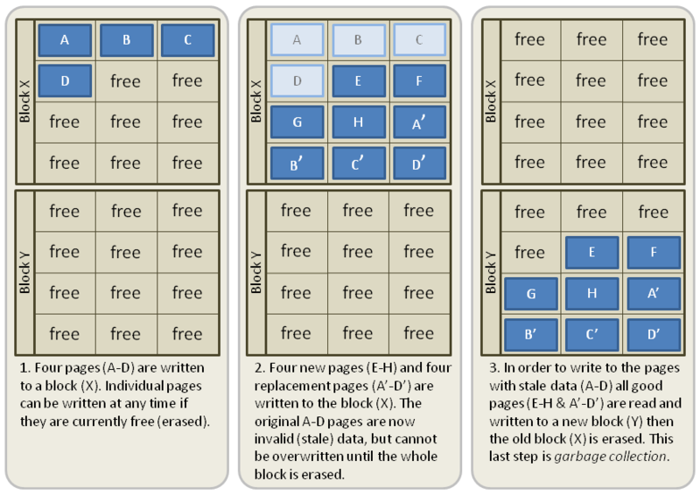
Solid state disk
SSD data updates
Writing new data is OK
Page update cannot erase only one page
Erase is performed on blocks
Update invalidates old page and writes a new one
Garbage collection preforms data consolidation
Copy only valid pages of a block
Erase entire block
https://en.wikipedia.org/wiki/File:Garbage_Collection.png

Slide 60
Solid state disk
SSD issues
Write amplification problem
A page is re-written many times due to garbage collection
Each write/erase create cumulative damage to NAND flash
HW solutions
Wear leveling – elaborate algorithm that remaps the blocks
Over-provisioning – the SSD is larger than it declares
Operating systems solutions
Special file systems designed for SSDs
Flash-friendly FS (F2FS), BtrFS, log-structure file systems (e.g., LFS)
TRIM operation – special command how OS can render blocks invalid (file is deleted)

Slide 61
File system(s) on HDD(s)
HDD Partitioning
Division of physical drive into multiple logical drives (MBR, GPT)
Each may have its own file system
Mounted to paths in the root tree (Linux), or presented separately (Windows)
Redundant Array of Inexpensive Disks (RAID)
A way to interconnect multiple HDDs into one
Typically at the hardware level, but OS can implement it as well
The main objective is to increase reliability (and possibly R/W speed)
RAID 0 – two disks, per-sector interleaving (better speed, worst reliability)
RAID 1 – two disks completely mirrored
RAID 5 – each data block is divided among N disks + 1 checksum is created

Slide 62

Virtual memory
Basic concepts
All memory accesses from instructions work with a virtual address
Virtual address space
Even instruction fetch
Operating memory provides physical memory
Physical address space
Always 1-dimensional
The memory controller uses physical addresses
Translation mechanism
Implemented in HW (MMU embedded in CPU)
Translates a virtual address to a physical address
The translation (mapping) may not exist -> exception (fault)
Two basic mechanisms – segmentation, paging

Slide 63
Virtual memory
VAS = process address space
PAS = available memory
Code
Constants
VA
Initialized static data
Uninitialized static data
MMU
Stack for thread 1
PA
Stack for thread n
Heap

Slide 64
Virtual memory
Why?
More address space
VAS can be larger than PAS (an illusion of having large memory)
Today, IA-32 can have larger PAS than VAS
Add secondary storage as a memory backup/swap
This is no longer the primary reason today
Security
Process address space separation
“Separation” of logical segments in a process address space (read-only, executable, …)
Specialized (advanced) operations
Memory-mapped I/O (e.g., memory-mapped file)
Controlled memory sharing

Slide 65
Segmentation
Concepts
Virtual (process) address space divided into logical segments
Segments are numbered
may have different sizes
Virtual address has two parts
[segment number; segment offset]
Offsets 0-based for each segment
Segment table (translation data structure)
In memory, for each process
Stores base physical address, length, and attributes for each segment
Indexed by the segment number
Segment fault (if translation or validation of access fails)

Slide 66
Segmentation
Schema
Code
Constants
VA
offs
Heap
seg
offs
Constants
Initialized static data
offs
Uninitialized static data
+
Stack for thread
BPA
Stack for thread
len
Code
Heap
Seg table
Notes:
There are several drawbacks of segmentation:
Addition seems trivial, but in address translation, it could be quite costly.
Different segment sizes may cause fragmentation and may not be grow-able (relocation is possible, but costly).

Slide 67
Paging
Concepts
VAS divided into equal parts
Page, 2^{n} size
PAS divided into equal parts
Frame, equal size with page (i.e., one page fits exactly one frame)
VA 1-dimensional
Page table (translation data structure)
In memory, for each process
Indexed by a page number
Each entry contains a frame number and attributes (P)
Page fault
This is very important!

Slide 68
Paging
Concepts
0
0
1
Physical address
1
2
Virtual address
P-1
n-1
0
N-1
n-1
0
f
offs
f
offs
p
offs
p
offs
f
2^{N-n}-1
2^{P-n}-1

Slide 69
Page table – 1-level
VAS pages
Page table
PAS frames
0
1
0
2
1
2
14
456
17
123
17
222
1111
NA
Page fault
456
3333
222
2^{P-n}-1
2^{N-n}-1
2^{N-n}-1
Notes:
Reasons for a page fault examples:
The memory was allocated (in VAS), but the actual memory frames are not associated yet (lazy allocation). The OS allocates new (zeroed) frame and creates the association (program continues).
The memory was swapped (e.g., to disk or other external memory). The OS needs to find an empty frame, load the page from the swap and create the mapping (program continues).
Program is accessing wrong memory (stack overflowed, bug in pointer/array usage, …).

Slide 70
Page table – problems
Size
1-level page table, 32-bit VA/PA, 4k pages/frames (12 bits)
Size of the page table entry?
Size of the page table?
Do we really need the whole VA?
Multilevel page tables
1st level always in memory
Individual tables on other levels may be missing (i.e., we are saving space)
Speed
Each memory access from an instruction means at least one other memory access to the page table
TLB (Translation Lookaside Buffer)
Associative memory
Cache for translating page number to a frame number
0-level page tables (MIPS)

Slide 71
Page table – 2-level
Virtual address
31
21
11
0
PT index 1
PT index 2
offset
10
PT1
10
PT2
PTAR
offs
4k
4k 1024 entries
4k 1024 entries
Notes:
1 page table is usually designed to fit exactly one page

Slide 72
Example/Exercise
Having the following code executed on IA-32
32bit addresses
2-level paging, 4 KiB pages
sizeof(int) == 4
const int* data = …
long long sum = 0;
for (int i = 0; i < 2000; ++i) {
sum += data[i];
}
Questions
How many (data) pages are read?
What is the minimal amount of page faults (optimistic scenario)
What is the maximal amount of page faults (pessimistic scenario)
How many distinct pages may cause a page fault in the worst case?
What if we copy the data?
What about the code?
Notes:
The data block is 4 * 2000 = 8000B long, i.e., it can span 2 or 3 (4KiB) pages depending on the actual address of data pointer.
Optimistic and pessimistic scenarios are trick questions. The answers are 0 and infinity.
The block spans over 3 pages (worst case), so it is covered by two 2nd level page tables (worst case) and the first level is always in the memory (i.e., 5 distinct faults in total).
If we copy the data, the number will double (we need to count source and destination pages, unless there are some assumptions about from where to where the data are being copied).
The code may also cause some page faults. This will definitely be at least a few instructions, but clearly the loop does not require more than 4 KiB of code (it is simple enough), so it can span 2 pages at the worst + 2 (2nd level) page tables = 4 additional page faults.

Slide 73
Page table – real AMD64 example

Slide 74
Paging – address translation
Steps for address translation
Take the page number from VA and keep offset (separately)
Check TLB for mapping
If exists, retrieve the frame number, otherwise continue
Go through the page table
Update A(ccessed) and D(irty) bits in page table/TLB
Assemble PA by concatenating the retrieved frame number and the original offset from VA
Go through the page table
Divide page number into multiple PT indices
Index 1st level PT
If there is no mapping for 2nd level PT, raise page fault exception
Retrieve PA for 2nd level PT and continue
Go through all levels of PTs
If there is no mapping in any PT level, raise page fault exception
If all PT levels are mapped, retrieve frame number
Save retrieved mapping to TLB
f
offs

Slide 75
Paging – page fault exception handling
An instruction raises the page fault exception
OS interrupt handler
Determine the cause of the fault
Unauthorized access
Out of allocated virtual space, store to R/O page, access to kernel memory, …
Valid address but not mapped
Create mapping
Find a free frame
Load content to the free frame
Construct/fill corresponding page tables
Return back from handler and retry the instruction
Find a free frame
Either there is one unoccupied
Or find a victim (for swapping)
Page replacement algorithms
Save dirty victim frame
Remove mapping from TLB
For example:
Newly allocated memory, which is lazily assigned
A page that was swapped, but a copy exists in the persistent storage

Slide 76
Page replacement algorithms
Cache-replacement algorithms
In any situation, when you need to find a victim from a limited space
Frames, TLB, cache, …
Optimal page algorithm
Replace the page that will not be used for the longest period of time
Lowest page-fault rate
Theoretical, we do not have an oracle for foretelling the future

Slide 77
Page replacement algorithms
Clock
Frames organized in a circular manner
A clock hand points to the next frame to replace
Each page has A(cessed) bit
A is the accessed flag which is set to 1 whenever the page is touched (by HW)
If the frame has A != 0, set A = 0 and advance the hand
If the frame has A == 0, select this frame
0
A=0
A=1
5
1
A=1
A=0
A=1
4
2
A=0
A=0
3
A=1

Slide 78
Page replacement algorithms
NRU (Not Recently Used)
Each page has A(ccessed) and D(irty) bits
Clears A bits periodically (e.g., once a minute)
Bit D is not touched
Uses A and D bits to classify frames into four classes
Selects a random frame from the lowest non-empty class
Class | A | D
0 | 0 | 0
1 | 0 | 1
2 | 1 | 0
3 | 1 | 1

Slide 79
Page replacement algorithms
LRU (Least Recently Used)
Uses the recent past as a prediction of the near future
Replaces the page that has not been referenced for the longest time
Existing HW implementations
Cache
Bit matrix
SW implementation
Move-to-front algorithm
Can be implemented by linked list or heap data structure
Too complicated and space consuming
Approximation algorithms exist

Slide 80
Page replacement algorithms
NFU (Not Frequently Use)
Rough approximation of LRU
Each frame has a counter (typically small, several bits)
Periodically scan page table and increase the counter for a frames with A==1
Always clear A
Select the frame with lowest counter
Problems
Newly occupied frames may be swapped before they get used
Frames that were previously heavy used will never be selected
Aging
Periodically divide counters by 2 (i.e., shift by 1)

Slide 81
Advanced paging
Shared memory
Part of a virtual memory space shared amongst processes
The block is probably placed on different starting virtual address
Memory-mapped files
File as a backing store for paging
Direct access to the file content using CPU instructions
Problems with file size and with appending data
File
VAS
VAS1
VAS2
PAS
PT1
PT2

Slide 82
Virtual machine and containers
VM = Emulation of a computer system
Full virtualization
Substitute for a real machine, allows execution of entire OS
Hypervisor shares real HW, native execution, virtual HW
Isolation, encapsulation, compatibility
Process VM
Runs as an application inside OS
Provides platform-independent programming environment
Abstract machine (instructions, memory, registers, …)
Java VM, .NET CLR
Slow execution
JIT, AOT
Container = OS-level virtualization
OS kernel allows existence of multiple isolated user space instances
Notes:
Isolation – if one VM crashes or is hacked, other VMs are still fine (one VM cannot affect or even see other VMs)
Encapsulation – VM is stored in regular files on host system (moving, snapshotting, cloning)
Compatibility – abstract hardware allows migration among host servers (load balancing)

Slide 83
Physical machine
Physical HW
CPU, RAM, disks, I/O
Underutilized HW
SW
Single active OS
OS controls HW

Slide 84
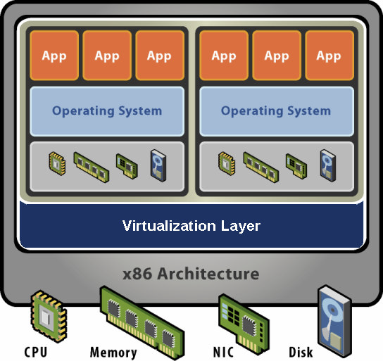
Virtual machine
HW-level abstraction
Virtual HW: CPU, RAM, disks, I/O
Virtualization SW
Decouples HW and OS
Multiplexes physical HW across multiple guest VMs
Strong isolation between VMs
Manages physical resources, improves utilization
Encapsulation – VM represented as a set of files, can be easily distributed

Slide 85

Discussion

