Slide 1
Parallel programming and synchronization
NSWI170 Computer Systems
Jakub Yaghob, Martin Kruliš

Slide 2
Parallel and concurrent computing
Parallel computing
Calculations or executions of processes are carried out simultaneously
Bit-level, instruction-level, data, and task parallelism
Parallelism without concurrency – bit-level parallelism
The problem is broken into several similar subtasks, results combined
Concurrent computing
Multiple computations (processes) are executed simultaneously
Concurrent without parallelism – multitasking on a single CPU
Processes do not work on related tasks
Forces
One (shared) address space
Threads
Multiprocessing
Scheduling
Notes:
Bit-level – some operations are natively parallel, e.g., bit-wise logic instructions
Instruction-level – pipelining, superscalarity, vector instructions

Slide 3
Race condition
Race condition
Multiple threads accessing (updating) the same data in shared memory space
Cache coherency helps a little, but does not actually solve anything
Load-store architecture makes it more pronounced
The result of a computation depends on the sequence or timing of units of scheduling
class List {
private:
Node *root;
public:
void PushFront(Node *n) {
n->next = root;
root = n;
}
};

Slide 4
Race condition
Shared variable
List lst;
Thread 1
lst.PushFront(A);
Thread 2
lst.PushFront(B);
lst
X
Y
A
lst
X
Y
B
B
lst
X
Y
A
B
lst
X
Y
A

Slide 5
Critical section
Problem definition
Concurrent access to a shared resource can lead to the race condition or even to an undefined behavior
Solution
Parts of the program, where the shared resource is accessed, need to be protected to avoid concurrent access
Critical section
Protected section of the program
Mutual exclusion
A critical section can be executed simultaneously by at most one unit of scheduling

Slide 6
Synchronization
Process synchronization
Multiple units of scheduling do some form of a handshake at a certain point to make an agreement to a certain sequence of action
Data synchronization
Keeping multiple copies of data in coherence with each other
Maintain data integrity
Usually implemented by process synchronization
Problems with synchronization
Deadlock, starvation, overhead…

Slide 7
Synchronization primitives
Synchronization primitives
Implement process synchronization (in OS)
Active
Instructions are executed during waiting for an access
Busy waiting (testing a condition in a loop)
Passive/blocking
The unit of scheduling is blocked until access is allowed
Hardware support
Atomic instructions
Test-and-set (TSL), compare-and-swap (CAS)
Instruction semantics:
bool cas(T* var, T old, T newVal)
{
if (*var != old) return false;
*var = newVal;
return true;
}
This is realized as one instruction!

Slide 8
Synchronization primitives
Spin-lock
Busy waiting using TSL/CAS
Short latency, right for short waiting times
Semaphore
Protected counter and a queue of waiting units-of-scheduling (US)
Atomic operations UP and DOWN
threads
void down() {
if (counter > 0) --counter;
else {
queue.push(myUS);
myUS.block();
}
}
void up() {
if (counter == 0 && !queue.empty()) {
US = queue.popany();
US.unblock();
}
else ++counter;
}

Slide 9
Synchronization primitives
Mutex
Implements mutual exclusion (semaphore with counter = 1)
Atomic operations LOCK and UNLOCK (corresponding to UP and DOWN)
Barrier
Multiple units of scheduling meet at the same time on the same barrier
Specific programming language constructs
Monitor
Methods in an object executed with mutual exclusion
Possibility to wait on a certain condition
Java/C#
Keyword synchronized/lock
Creates a critical section

Slide 10
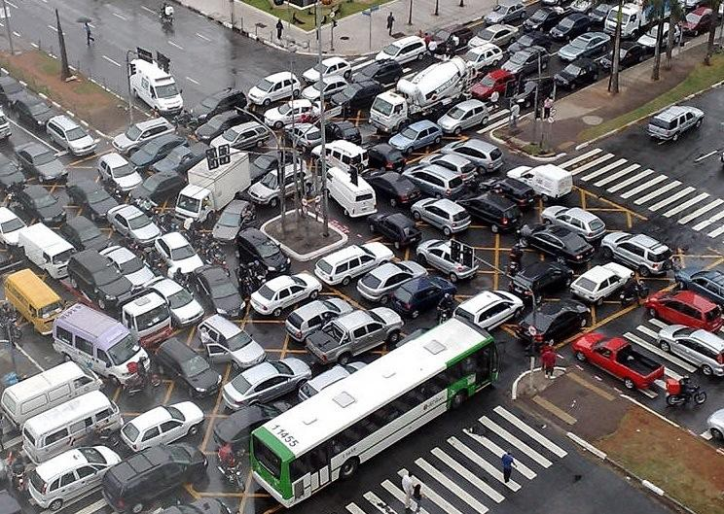

Deadlock

Slide 11
Deadlock
Deadlock
A state of a group of units of scheduling and resources, where every member of the group waits for an action, which can be performed by other member in the group
Necessary conditions for deadlock (Coffman)
Mutual exclusion
At least one resource in exclusive mode
Hold and wait
US holding a resource requests for another one
No preemption
Resources cannot be reclaimed without harm
Circular wait
There is a circle in a deadlock modelling graph
T1
R1
R2
T2

Slide 12
Deadlock – example
Shared mutexes
Mutex m1, m2;
Thread 1
m1.lock();
m2.lock();
m2.unlock();
m1.unlock();
Thread 2
m2.lock();
m1.lock();
m1.unlock();
m2.unlock();
Notes:
Mutexes are exclusive (condition 1)
Both threads acquire 1 lock and then request another (condition 2)
Mutex locks are not preemptive by design (condition 3)
Alernate lock orderings in both threads create the dependency cycle (condition 4)
Solutions – remove one of the Coffman’s conditions
Cannot be removed
We could merge m1 and m2 to m12 (not always possible)
Cannote be removed
We can make total ordering on the mutexes and the threads must always lock in this order (may be difficult to implement).

Slide 13
Classic synchronization problems
Classic synchronization problems
Set of well-known synchronization problems
Demonstrate a problem using an allegory
Avoid deadlock, starvation, and other problems
Bounded-buffer (producer-consumer)
Dining philosophers
Readers and writers
Sleeping barber

Slide 14
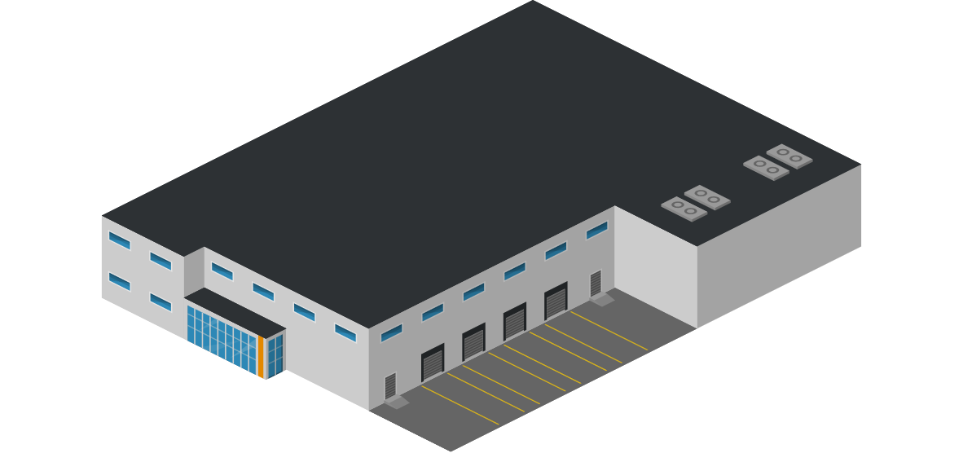

Producer-consumer
Problem
Producer produces a product and he places it to the warehouse with a limited capacity. If the warehouse is full, producer will stop production of products.
Consumer takes a product from the warehouse. If there is no item available, consumer will wait for an item.
If the warehouse is empty and producer produces the first product and there is a waiting consumer, producer will wake up consumer
If the warehouse is full and consumer takes the first product and there is stopped producer, consumer will wake up producer

Slide 15
Dining philosophers
Problem
N philosophers sitting around a circular table
Each philosopher has a plate of Chinese food in front of him
There is one chopstick between each dish, two chopsticks are needed to eat
The life of a philosopher consists of thinking and eating
P1
P5
P2
P4
P3

Slide 16


Readers and writers
Problem
Common data structure
Readers are only able to read data
Writers change data or a data structure
Many readers may read simultaneously
Only one writer can change the data at a time
A reader must wait if there is a working writer
A writer must wait if there are working readers
RW Lock
More difficult to make it fair/efficient

Slide 17


Sleeping barber
Problem
Barbershop with one barber, one barber chair, and N waiting chairs
When there is no customer, the barber goes to sleep in the barber chair
Barber must be woken when a customer comes in
When the barber is cutting hair, new incoming customers are waiting in chairs or leaving the shop, if there is no empty chair

Slide 18

Discussion

