Slide 1
Computational Statistics (MA51109)
Term Paper

Slide 2
Abstract
Poisson Process: A type of random mathematical object that consists of points randomly located on a mathematical space.
Compound Poisson Process: Process in which each arrival in an ordinary Poisson process comes with an associated real-valued random variable that represents the value of the arrival in a sense.
There exists the extremal index θ, 0 ≤ θ ≤ 1, which is directly related to the clustering of exceedances of high values for such stationary sequences.
θ = 1, for independent, identically distributed sequences and θ > 0, for most of the cases.
Estimation of extremal index through the use of the Generalized Jackknife methodology, possibly together with the use of subsampling techniques.

Slide 3
Flow of the paper
Stationary Dependant Sequences
Extremal index
Nandagopalan Method
Generalized Jackknife Method
Subsampling Method
Case studies

Slide 4
Scope of the Paper
Assumption of the bias term of the extremal index estimator same as the bias term of the Nandagopalan’s estimator (𝛳_{N} ) for the stationary ARMAX sequences and i.i.d. sequences. There is an important tradeoff between bias and variance, linked to the choice of the threshold.
Bias reduction and stability over a considerable set of thresholds is the major objective of this paper.
Other objectives:
To Perform Generalized Jackknife methodology for the estimation of the extremal index for ARMAX process as well as for i.i.d random samples.
To use subsampling techniques in the estimation process of the extremal index and look for the effects and changes.

Slide 5
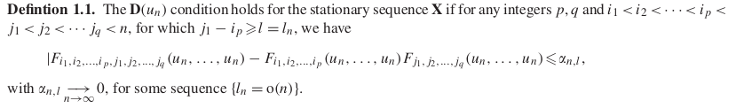
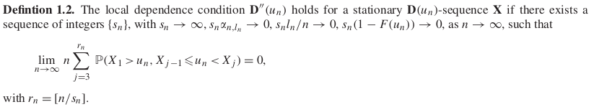
Definitions

Slide 6
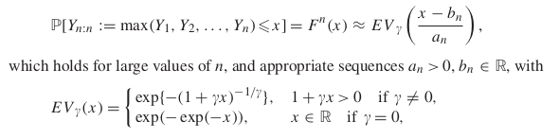
Tail index
For Y = {Y_{n}}_{n≥1}, sequence of i.i.d. r.v.’s from an underlying parent d.f. F. Let Y _{i:n} , 1 i n, be the set of associated ascending order statistics (o.s.). Tail index is defined as:
The tail index 𝛄 is thus directly related to the weight of the right tail of the underlying model F and as 𝛄 increases the right tail becomes heavier and heavier.
If the sequence of maximum values Y_{n:n} , linearly normalized, converges towards a r.v. has an EV_{𝛄} d.f. defined above.

Slide 7
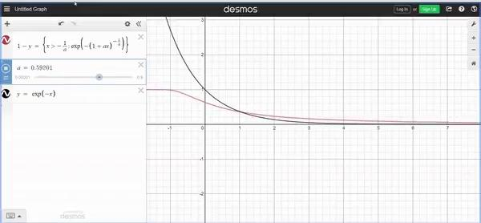
Background Search
Heavy Tailed Distributions: The distribution which have their CCDF (Complementary Cumulative Density Function) tail above that exponential distribution, or in other terms they are the distributions whose tails are not exponentially bounded.
CCDF of exponential distribution = 1 - CDF = e^{-λx}
Figurative verification to heavy tailedness of Extreme Value function
Notes:
From heavy tail distribution comes into the picture of tail index.

Slide 8
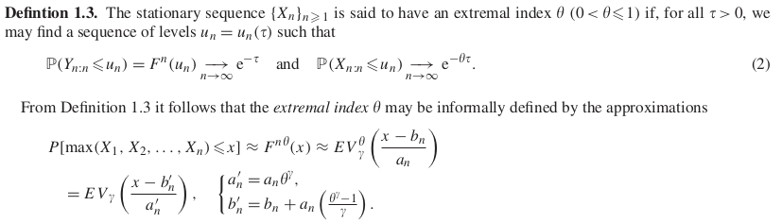
Extremal Index
Let X = {X_{n}}_{n≥1} stationary sequence comes from an underlying d.f. F and the limiting d.f. of the maximum X_{n:n} := max(X₁ , X₂ , . . . , X_{n} ) may be directly related to the limiting d.f. Of the maximum, Y_{n:n} , of the associated i.i.d. sequence, through a new parameter, the so-called extremal index.

Slide 9
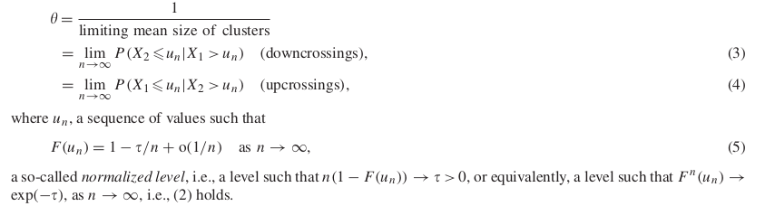
Extremal Index
Under independence, this point process converges to a homogeneous Poisson process, as n → ∞, but when there is a slightly stronger local dependence, clusters of exceedances may occur and the limiting process may be a compound Poisson process.
The extremal index can then also be defined as the reciprocal of the “mean time of duration of extreme events”.

Slide 10

Nandagopalan’s Extremal Index
Nandagopalan’s estimator: For given (X₁ , X₂ , . . . , X_{n} ) samples, non-parametric estimator of θ, given by the ratio between the number of down-crossings/up-crossings and the number of exceedances over a high threshold is
u = u_{n} must be such that n(1 − F (u_{n} )) = c_{n}𝜏 = 𝜏_{n} , 𝜏_{n} → ∞ and 𝜏_{n}/n → 0.
If 𝜏 is fixed, the Nandagopalan’s estimator may not be consistent. So we need to assume 𝜏 = 𝜏_{n} → ∞, as n → ∞. We shall here consider a deterministic level u ∈ [X_{n−k:n} , X _{n−k+1:n} ), the interval between the (k + 1) and the k^{th} top order statistics.

Slide 11


Nandagopalan’s Extremal Index
The extremal index estimator is then a function of k, the number of top o.s. higher than the chosen threshold. The estimator can be modified as
Or
Consistency is attained only if k is intermediate, i.e., k = k_{n} → ∞, k = o(n) as n → ∞.

Slide 12

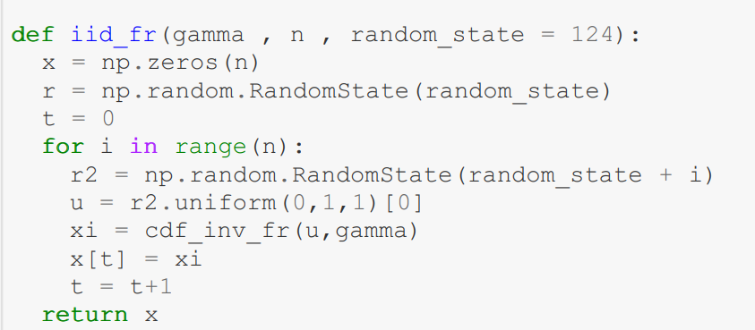
Fréchet Process
The cdf of the Frechet Parent distribution we have utilised to simulate from.
We have utilised the inverse transform method to simulate from this distribution.
The data simulated from this distribution are iid stationary.

Slide 13

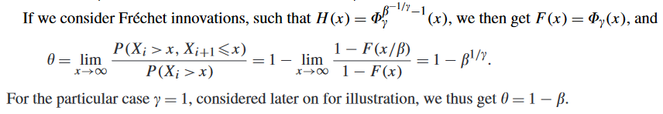
ARMAX Process
An ARMAX process is based on an i.i.d. sequence of innovations {Zi }_{i>=1} , with degree of freedom H, and is defined through the following relation:
ARMAX sequence has a stationary distribution F, it depends on the d.f. H of the i.i.d. sequence {Zi }_{i>=1} through the relation:
F(x)/F(x/β) = H(x/β)

Slide 14

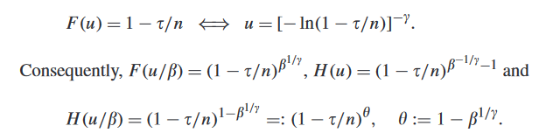
ARMAX Process
Let us consider the ARMAX model. As said before, the use of the stationarity equation in which enables us to write:
Then,

Slide 15
Generalized Jackknife Method
The main objectives of the Jackknife methodology are the following:
Bias and variance estimation, together with the derivation of the sampling distribution of a certain statistic, only through manipulation of the observed data x.
The building of estimators with bias and mean squared error smaller than those of an initial set of estimators.
Jackknife Methodology is thus a resampling methodology, which usually gives a positive answer to the question whether the combination of information can improve the quality of estimators of a certain parameter or functional.

Slide 16
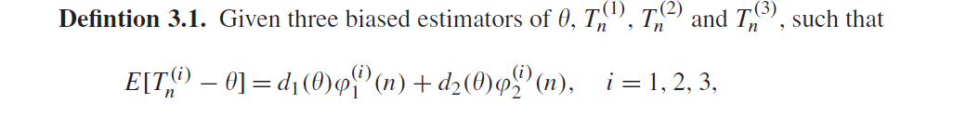
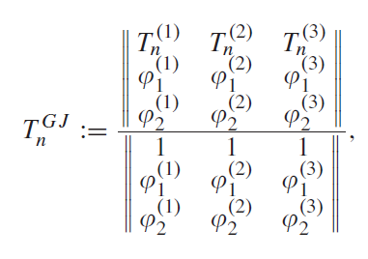
Generalized Jackknife Method
According to the Generalized Jackknife methodology, we need to have access to three estimators of , T_{n}⁽¹⁾ , T_{n}⁽²⁾, T_{n}⁽³⁾ , with the same type of bias.
Generalized Jackknife statistic (of order 2) is given by the equation on the right with ||A|| denoting, as usual, the determinant of the matrix A.

Slide 17
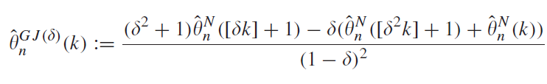
Generalized Jackknife Method
The class of estimators are found by the equation below:
The choice of 𝜹 equal to 0.25
𝜹 is regarded as a tuning parameter

Slide 18
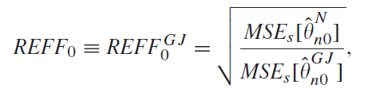
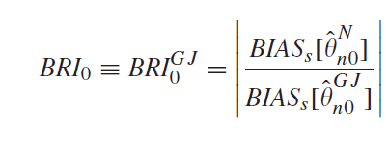
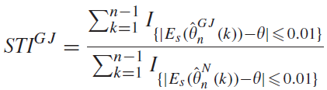
Simulated Distributional Behavior of the Generalized Jackknife Extremal Index Estimator
Relative Efficiency (REFF₀^{GJ}) is defined defined as
Bias reduction Indicator (BRI₀^{GJ})
Indicator to illustrate the loss of sensitivity of the
new estimators to the choice of the level k
Note: Higher the indicators, the better the GJ estimator.

Slide 19
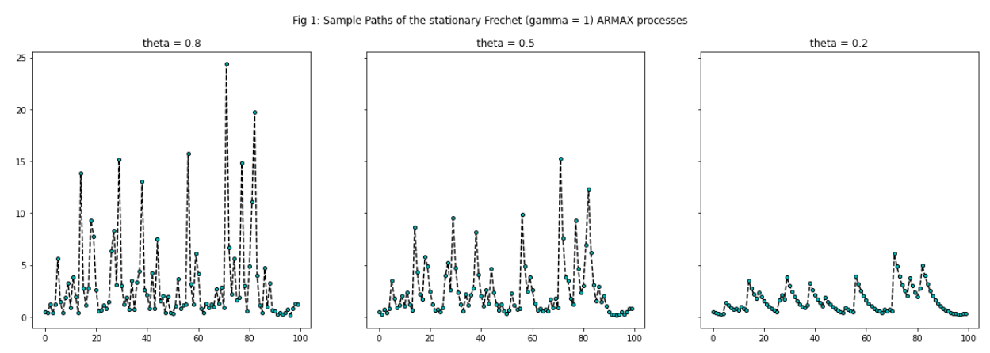
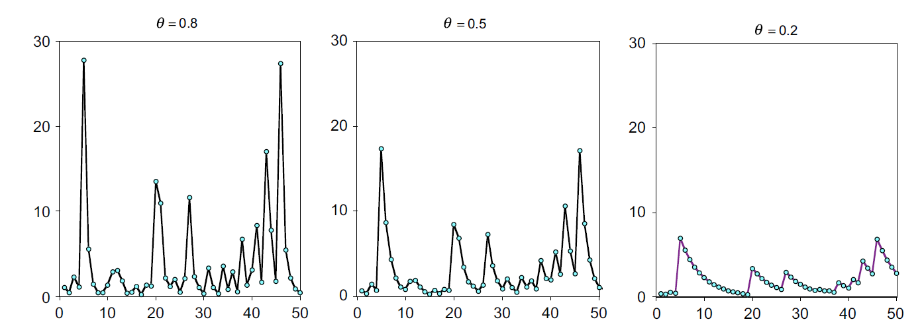
Fig 1: The Armax Simulation
Our results
The results in the paper

Slide 20
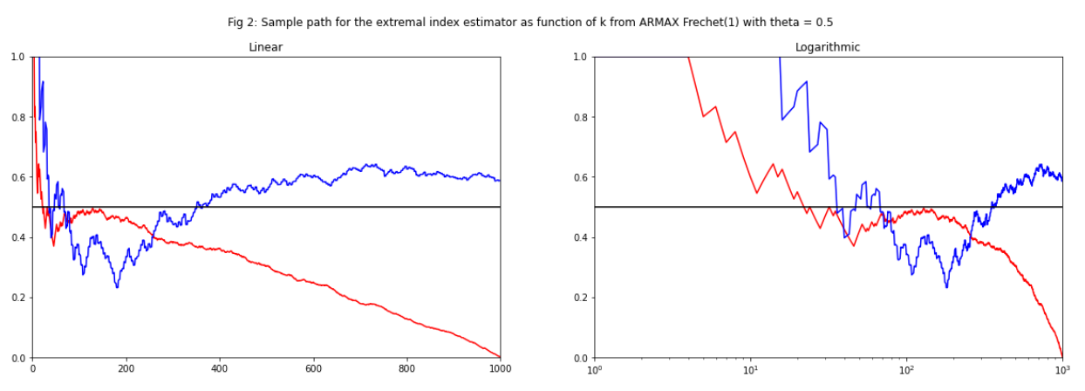
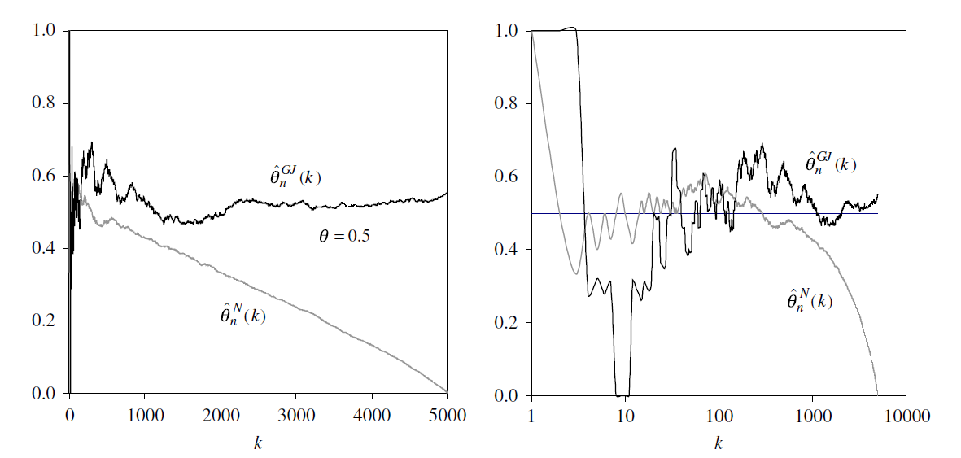
Fig 2: Sample path of extremal index estimator
---- θ_{GJ}
---- θ_{N}
Our results
The results in the paper

Slide 21
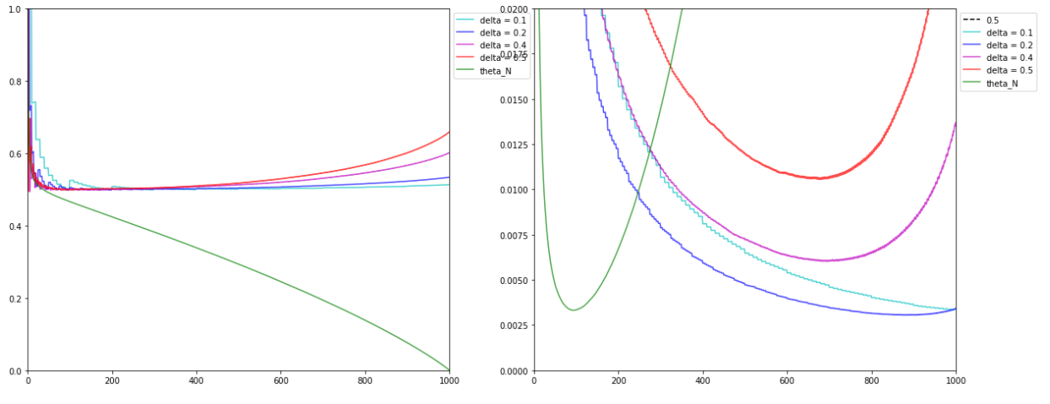
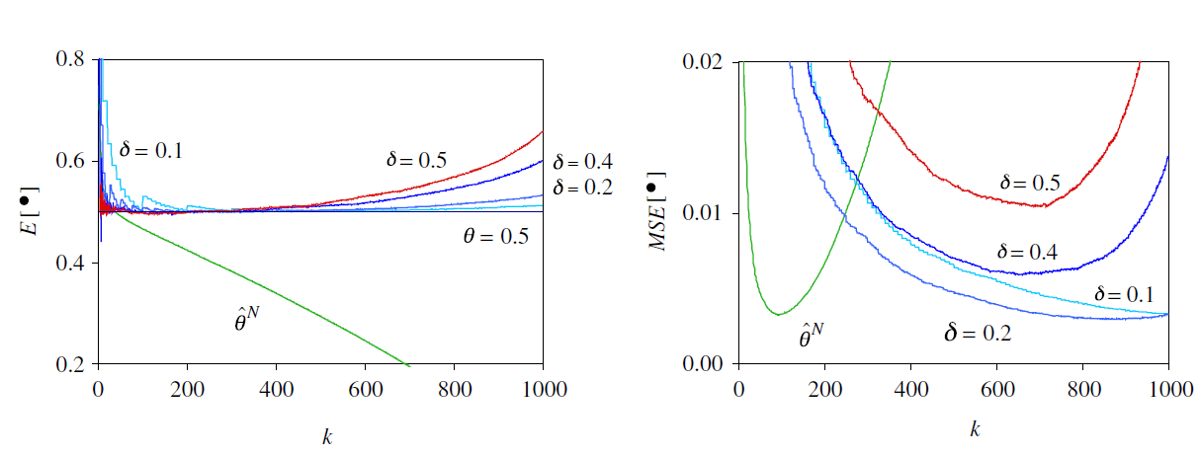
Fig 3: Variation with delta, Fréchet(1) theta = 0.5
Our results
The results in the paper

Slide 22
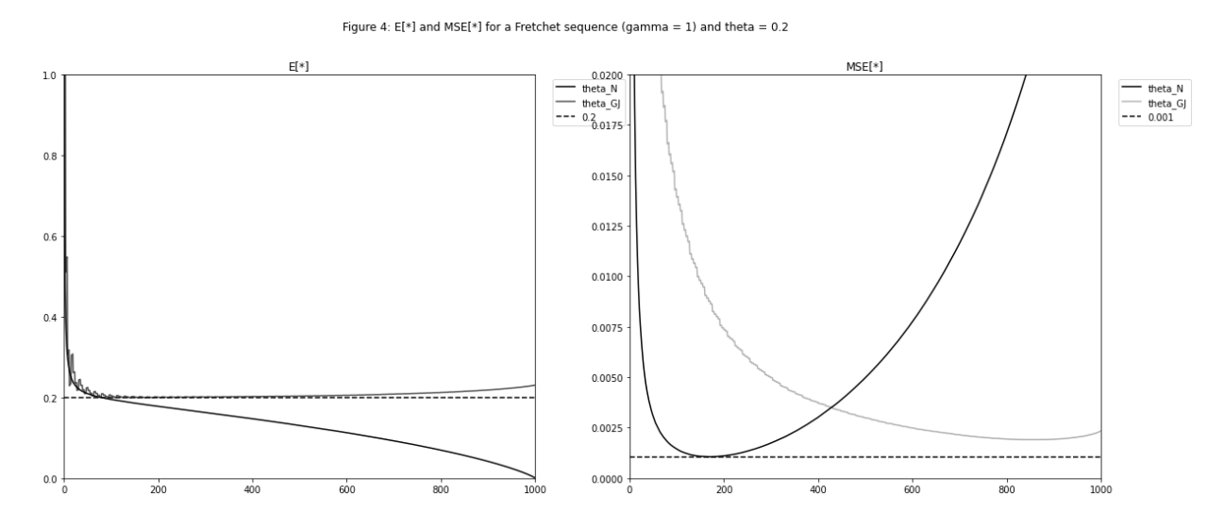
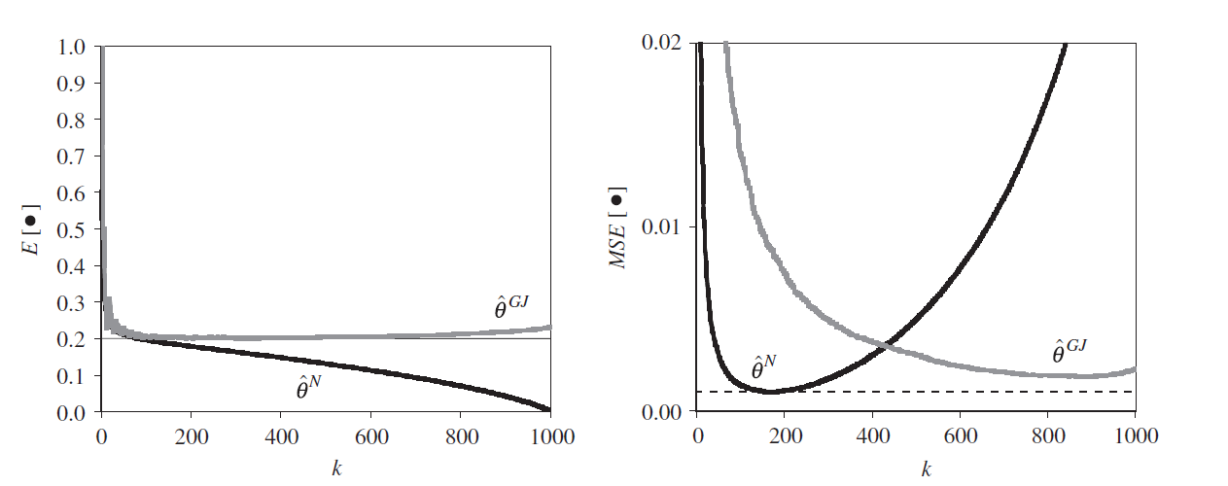
Fig 4: Mean and MSE, Fréchet(1) theta = 0.2
Our results
The results in the paper

Slide 23
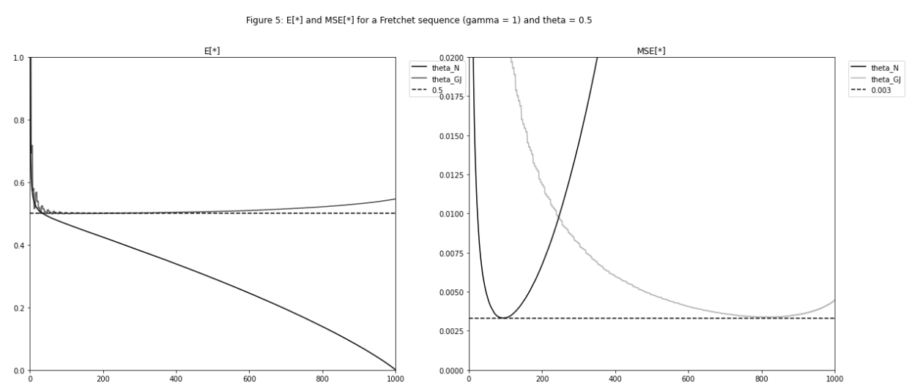
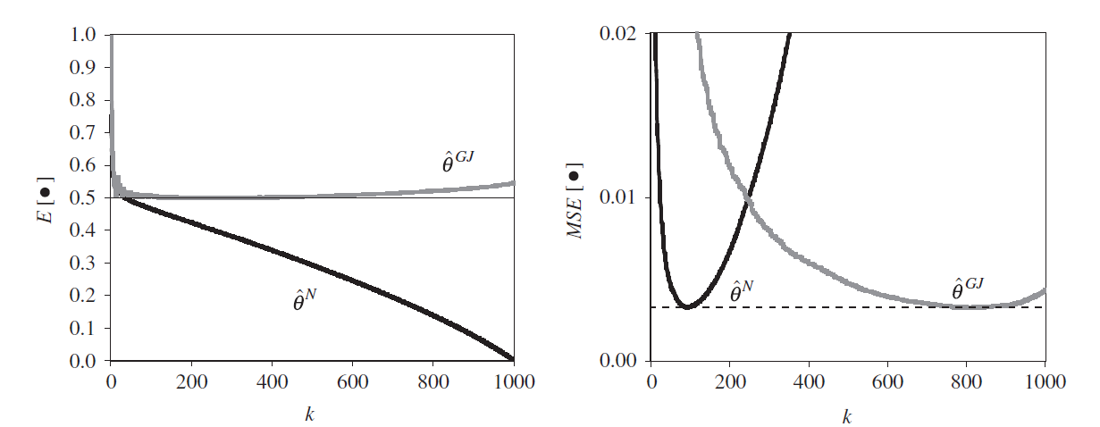
Fig 5: Mean and MSE, Fréchet(1) theta = 0.5
Our results
The results in the paper

Slide 24
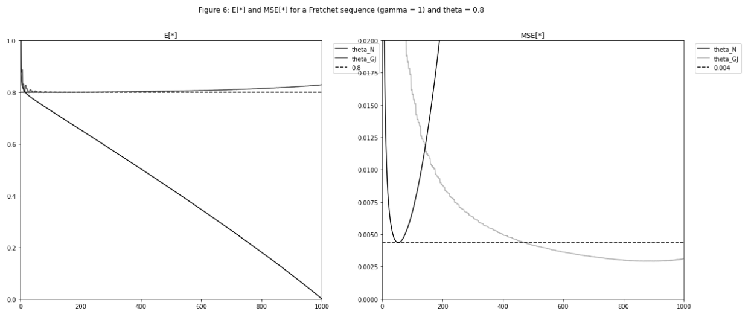
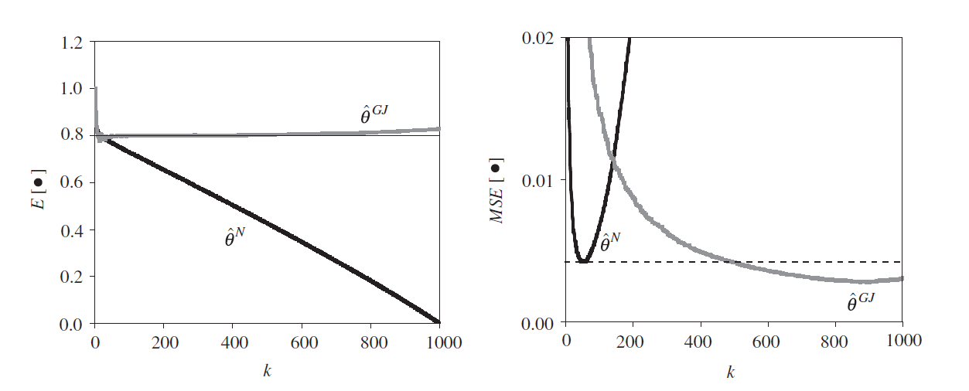
Fig 6: Mean and MSE, Fréchet(1) theta = 0.8
Our results
The results in the paper

Slide 25
Table 1: Simulated values (theta = 0.2)
 | N = 100 | N = 200 | N = 500 | N = 1000 | N = 2000
k/n | 0.3600 | 0.2800 | 0.2180 | 0.1720 | 0.1365
k_gj/n | 0.9700 | 0.9850 | 0.9300 | 0.8690 | 0.8085
E_n | 0.1698 | 0.1761 | 0.1787 | 0.1825 | 0.1858
E_GJ | 0.2227 | 0.2247 | 0.2205 | 0.2164 | 0.2127
MSE_n | 0.0038 | 0.0026 | 0.0016 | 0.0011 | 0.0007
MSE_GJ | 0.0136 | 0.0074 | 0.0034 | 0.0019 | 0.001
REFF | 0.5255 | 0.5919 | 0.6786 | 0.7425 | 0.822
BRI | 1.3324 | 0.9698 | 1.0419 | 1.0686 | 1.1132
STI | 3.1429 | 7.4286 | 8.4474 | 8.6418 | 9.0440

Slide 26
Table 1: Simulated values (theta = 0.5)
 | N = 100 | N = 200 | N = 500 | N = 1000 | N = 2000
k/n | 0.2100 | 0.1600 | 0.1220 | 0.0950 | 0.0780
k_gj/n | 0.9700 | 0.9650 | 0.8980 | 0.8170 | 0.7445
E_n | 0.4419 | 0.4530 | 0.4609 | 0.4683 | 0.4737
E_GJ | 0.5310 | 0.5348 | 0.5296 | 0.5224 | 0.5176
MSE_n | 0.0130 | 0.0087 | 0.0051 | 0.0034 | 0.0021
MSE_GJ | 0.0232 | 0.0129 | 0.0060 | 0.0034 | 0.0019
REFF | 0.7476 | 0.8217 | 0.9207 | 0.9956 | 1.0599
BRI | 1.8731 | 1.3531 | 1.3203 | 1.4162 | 1.4959
STI | 20.00 | 20.00 | 20.9231 | 22.76 | 21.6481

Slide 27
Table 1: Simulated values (theta = 0.8)
 | N = 100 | N = 200 | N = 500 | N = 1000 | N = 2000
k/n | 0.1200 | 0.0950 | 0.0660 | 0.0530 | 0.0430
k_gj/n | 0.9700 | 0.9850 | 0.9700 | 0.9050 | 0.8105
E_n | 0.7344 | 0.7443 | 0.7592 | 0.7654 | 0.7718
E_GJ | 0.8129 | 0.8203 | 0.8228 | 0.8199 | 0.8148
MSE_n | 0.0195 | 0.0123 | 0.0068 | 0.0043 | 0.0027
MSE_GJ | 0.0227 | 0.0119 | 0.0053 | 0.0029 | 0.0016
REFF | 0.9256 | 1.0175 | 1.1379 | 1.2155 | 1.3037
BRI | 5.0710 | 2.7433 | 1.7870 | 1.7364 | 1.9117
STI | 66.0000 | 46.6667 | 50.0000 | 52.6923 | 49.1429

Slide 28
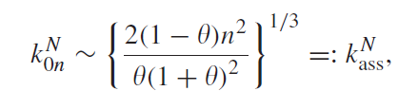
Table 2: Asymptotic and simulated optimal sample fractions for Nandagopalan’s estimator
n | Theta = 0.2 | Theta = 0.2 | Theta = 0.5 | Theta = 0.5 | Theta = 0.8 | Theta = 0.8
 | k_ass/n | k/n | k_ass/n | k/n | k_ass/n | k/n
100 | 0.3816 | 0.3600 | 0.2071 | 0.2100 | 0.1156 | 0.1200
200 | 0.3029 | 0.2800 | 0.1644 | 0.1600 | 0.0917 | 0.0950
500 | 0.2231 | 0.2180 | 0.1211 | 0.1220 | 0.0676 | 0.0660
1000 | 0.1771 | 0.1730 | 0.0961 | 0.0950 | 0.0536 | 0.0530
2000 | 0.1406 | 0.1365 | 0.0763 | 0.0780 | 0.0426 | 0.0430

Slide 29
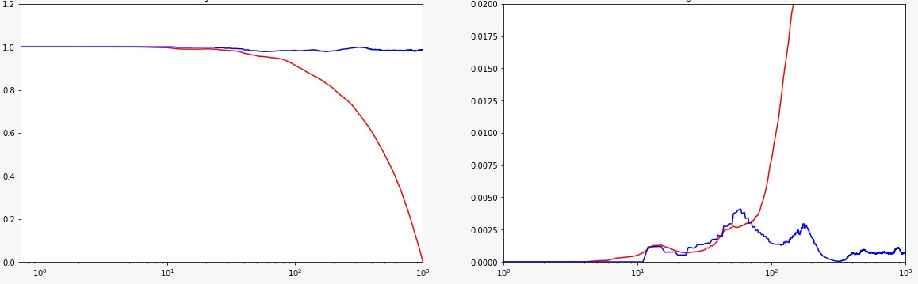
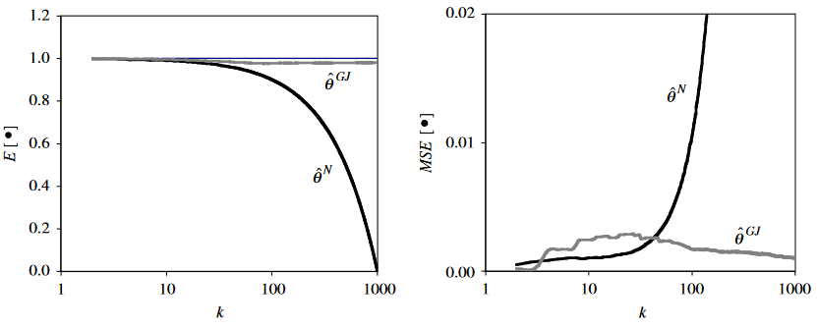
Fig 7: Simulation from Fréchet(1) i.i.d. framework
---- θ_{N}
---- θ_{GJ}
Our results
E[*]
MSE[*]
k
k
The results in the paper

Slide 30

Autoregressive Process of Order 1 (AR~1)
We have simulated for sample size n = 1000 , the class of exponential autoregressive processes of order 1 with with {ε_{j}} _{j>=1} standard exponential random variables. For this type of sequences we have 𝛳 = 1 and D’’ satisfied.
In next slide, we present the simulated mean values of the extremal index estimators on a logarithmic scale, for the autoregressive processes in the equation above, with 𝛳 = 0.1 and 0.5.

Slide 31
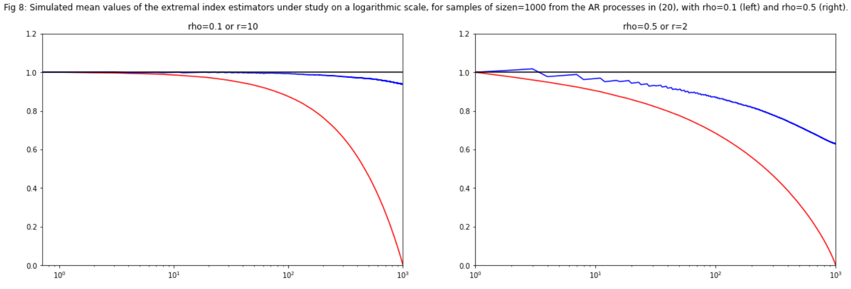
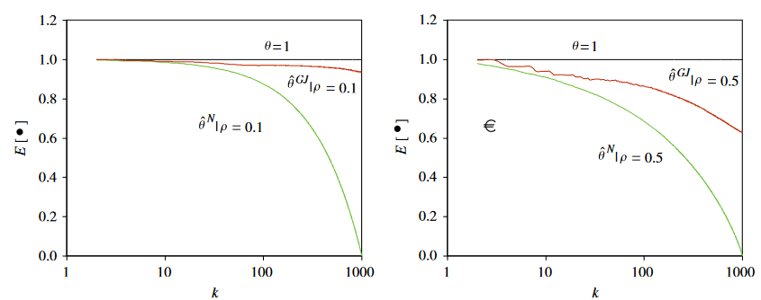
Fig 8: AR(1) Process
---- θ_{GJ}
---- θ_{N}
Our results
E[*]
E[*]
The results in the paper

Slide 32

Autoregressive Process (AR_{r})
For a fixed r>=1, and a sequence of i.i.d. Random variables {ε_{n}} _{n>=1} such that P( ε₁= k/r ) = 1/r, k = 0, 1, . . . , r − 1. We consider the process below:
In next slide, we present the simulated mean values of the extremal index estimators on a logarithmic scale, for samples of size n = 1000 from the AR_{r}(1) processes in the equation above with r = 2, 5 and 10.

Slide 33
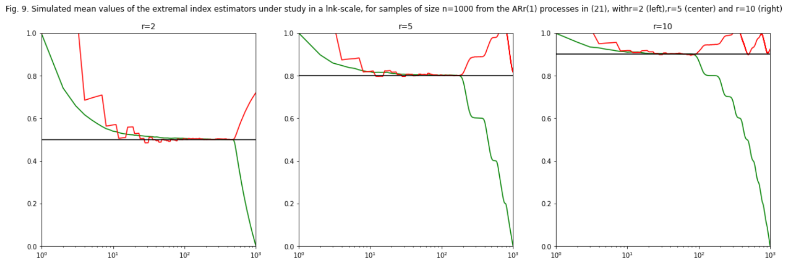
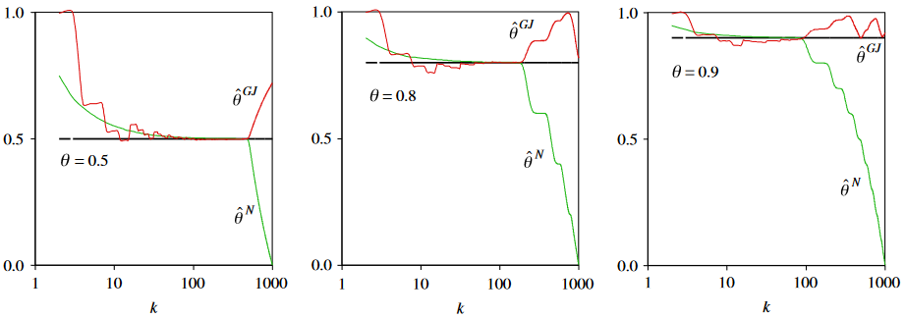
Fig 9 AR_{r}(1)
---- θ_{GJ}
---- θ_{N}
Our results
E[*]
The results in the paper

Slide 34
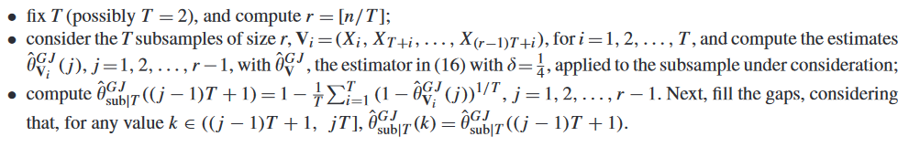
Subsampling
Subsampling may thus improve the performance of an estimator, through the consideration of averages, which often enable a decrease in variance, and consequently in mean squared error.
The following sub-sampling algorithm has been used in the paper:
If 𝛳 <= 0.2, we are able to overpass the original estimator at optimal levels, when we consider the Generalized Jackknife statistic in with 𝛅=1/4, together with the use of subsampling techniques with T= 2, 3 and 4. A graph with representation along with the table has been computed for the same.

Slide 35
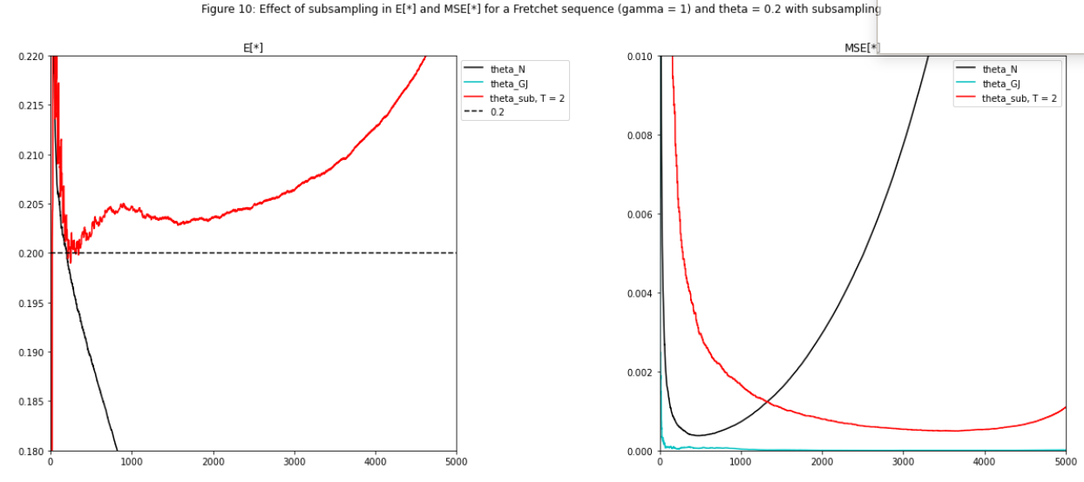
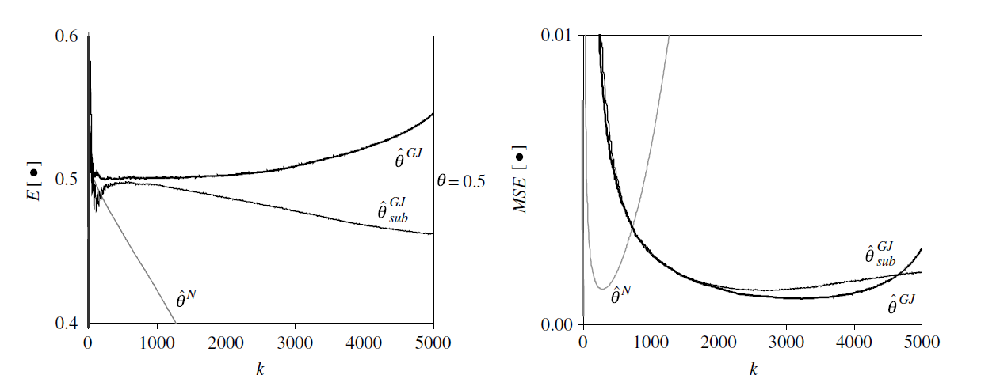
Fig 10: Effect of subsampling, Fréchet(1) theta 0.5
Our results
The results in the paper

Slide 36
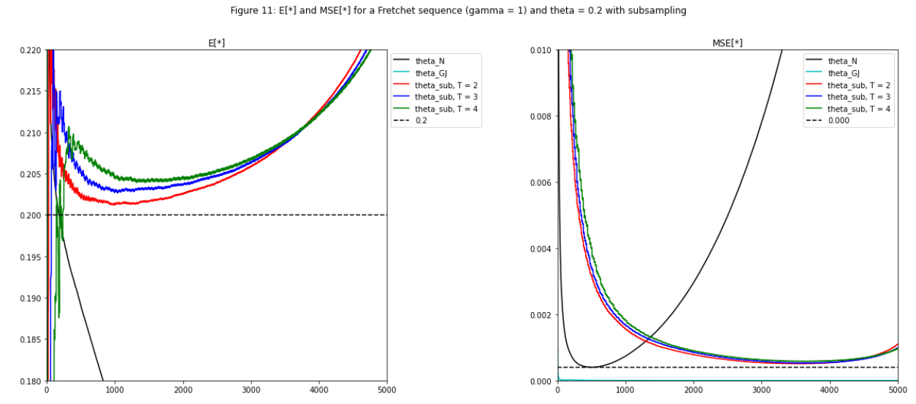
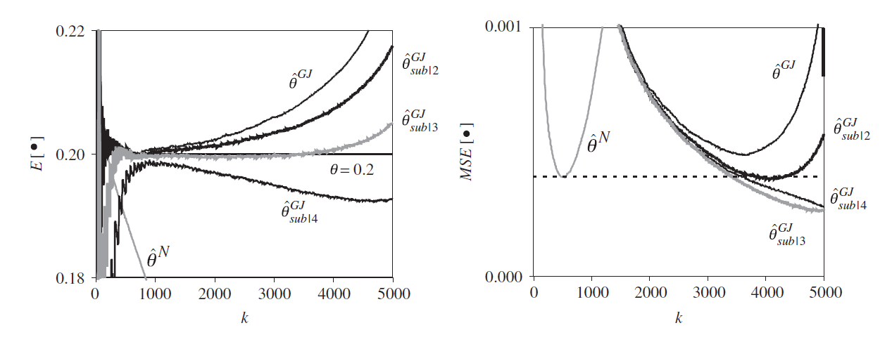
Fig 11: Effect of subsampling, Fréchet(1) theta 0.2
Our results
The results in the paper

Slide 37
 | N = 1000 | N = 2000
REFF, no subsample | 0.7428 | 0.8220
REFF, T = 2 | 0.7348 | 0.8089
REFF, T = 3 | 0.7031 | 0.7729
REFF, T = 4 | 0.6437 | 0.7263
BRI, no subsample | 1.1668 | 1.1132
BRI, T = 2 | 1.0539 | 1.1589
BRI, T = 3 | 1.0313 | 1.1105
BRI, T = 4 | 0.9122 | 1.0140
STI, no subsample | 8.6418 | 9.0440
STI, T = 2 | 7.6667 | 8.6026
STI, T = 3 | 6.8462 | 7.9108
STI, T = 4 | 3.8462 | 7.8500
Table 3: REFF, BRI and STI for estimators, theta = 0.2

Slide 38
Conclusion
Two most attractive features of the proposed Generalized Jackknife estimator of the extremal index are:
Stable sample path (for a wide region of k-values), close to the target value
Wide “bathtub” patterns of their MSE(k) functions, which make less relevant the choice of the optimal sample fraction k₀/n
Regarding MSE, the initial GJ estimator does not overpass the original estimator, when both estimators are considered at their optimal levels (θ is small)
For the estimator with δ = 1/4 or its subsampling variants with a moderate value of T, both the BRI and the STI indicators are greater than 1 for all simulated models and sample sizes
The above insensitivity of the mean value (and sample path) to changes in k is indeed a new feature of extremal index estimators

Slide 39
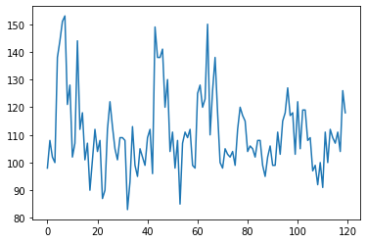
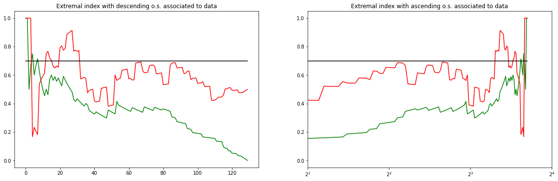
Ozone Case Study
Performance of the estimators has been examined for n = 120 weekly maxima of hourly averages of ozone concentrations measured in parts per million
Data used
Result: θ converges to 0.7 for GJ estimator
---- θ_{n}
---- θ_{GJ}

Slide 40
Ozone Case Study: Conclusions
Higher stability of the GJ estimates, around a value close to 0.7, is clear
Stability appears only for reasonably large values of k, whereas for the classical estimates, the sample path exhibits a very small region of stability around the value = 0.7 (for small values of k)
The estimates seem to work in a way similar to the one achieved for data under conditions D and D’’
Provide heuristic support for the validity of the above-mentioned conditions

Slide 41
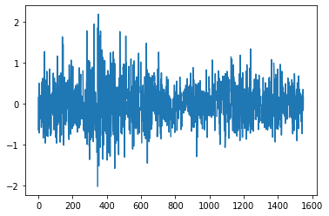
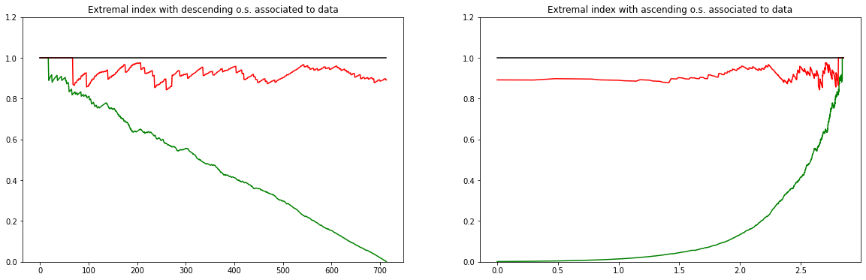
Financial Log returns Case study
Performance of the above mentioned estimators in the analysis of the Euro–UK pound daily exchange rates from January 4, 1999, until December 14, 2004.
Data used
Result: θ converges to 1 for GJ estimator
---- θ_{n}
---- θ_{GJ}

Slide 42
Financial Log Returns: Conclusions
Higher stability of the Generalized Jackknife estimates, around a value close to 1, is clear
The stability appears both for small and large values of k
The value of extremal index (=1) could be interpreted as efficiency of the financial market under study and would enable us to deal with the sample of log-returns as approximately i.i.d.
However, essentially because of their varying volatility, financial time series are very unlikely to satisfy condition D
Thus, a derived estimate =1 can be a consequence of assuming D instead of a genuine feature of the process, as we expect an overestimation of θ in case condition D’’ does not hold

Slide 43
References
https://www.sciencedirect.com/science/article/pii/S0167947305000733
https://rss.onlinelibrary.wiley.com/doi/epdf/10.1111/1467-9868.00223
https://link.springer.com/article/10.1023/A:1016592028871
https://link.springer.com/article/10.1023/A:1011470010228
https://www.sciencedirect.com/science/article/pii/S0378375803001940
http://emis.dsd.sztaki.hu/journals/PM/59f4/pm59f402.pdf
https://onlinelibrary.wiley.com/doi/full/10.1111/1467-9892.00320

