Slide 1
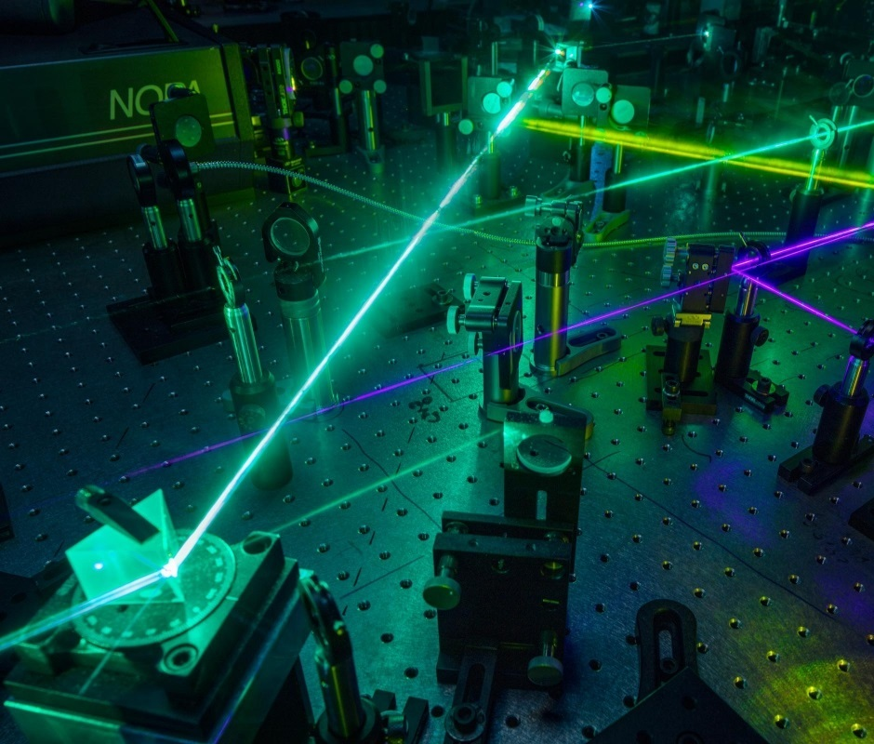
Time-Domain Lab
Petar V Peshev
EE4730 High Frequency Wireless
Architectures

Slide 2
Table of Contents
Time-Domain Setup & Equipment
Methodology
Beam-Path Alignment
Dielectric Characterization
Permittivity
Loss Tangent & Attenuation Constant
Appendices
30-07-2023

Slide 3
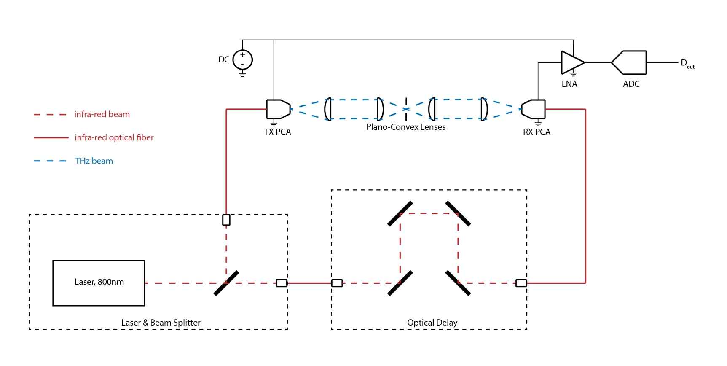
Time-Domain Spectroscopy Setup
Pump pulse generation
Pulsed laser, 800nm
Beam splitter
Optical fibers
Optical delay
THz beam-path
TX & RX PCA
Plano-convex lenses
Electronics
DC source
LNA
ADC
30-07-2023

Slide 4
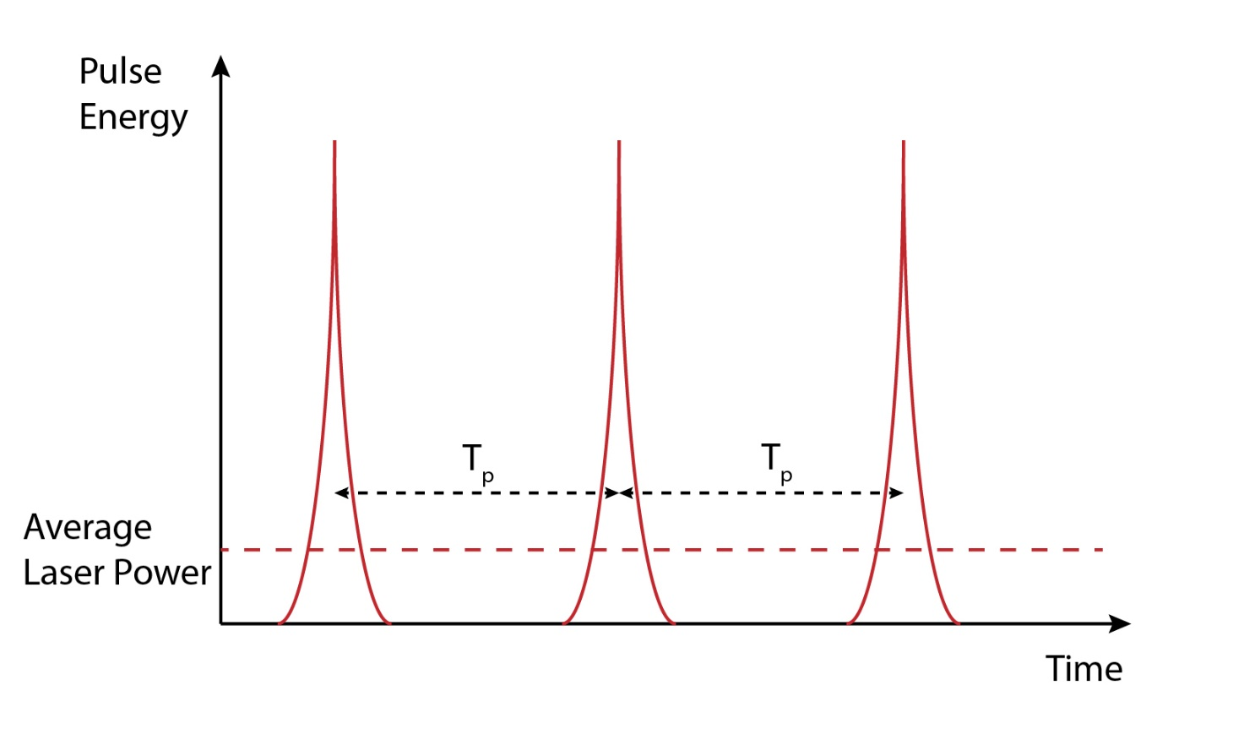

Pulsed Laser
Generates laser pulses (instead of continuous
laser signal)
Pulse repetition rate
$T_{p}=\frac{1}{f_{p}}$
Emitted energy has Gaussian spatial distribution
Pulses are equal and repetitive; hence, average
emitted laser power
$P_{avg}=\frac{E_{p}}{T_{p}}$
30-07-2023

Slide 5
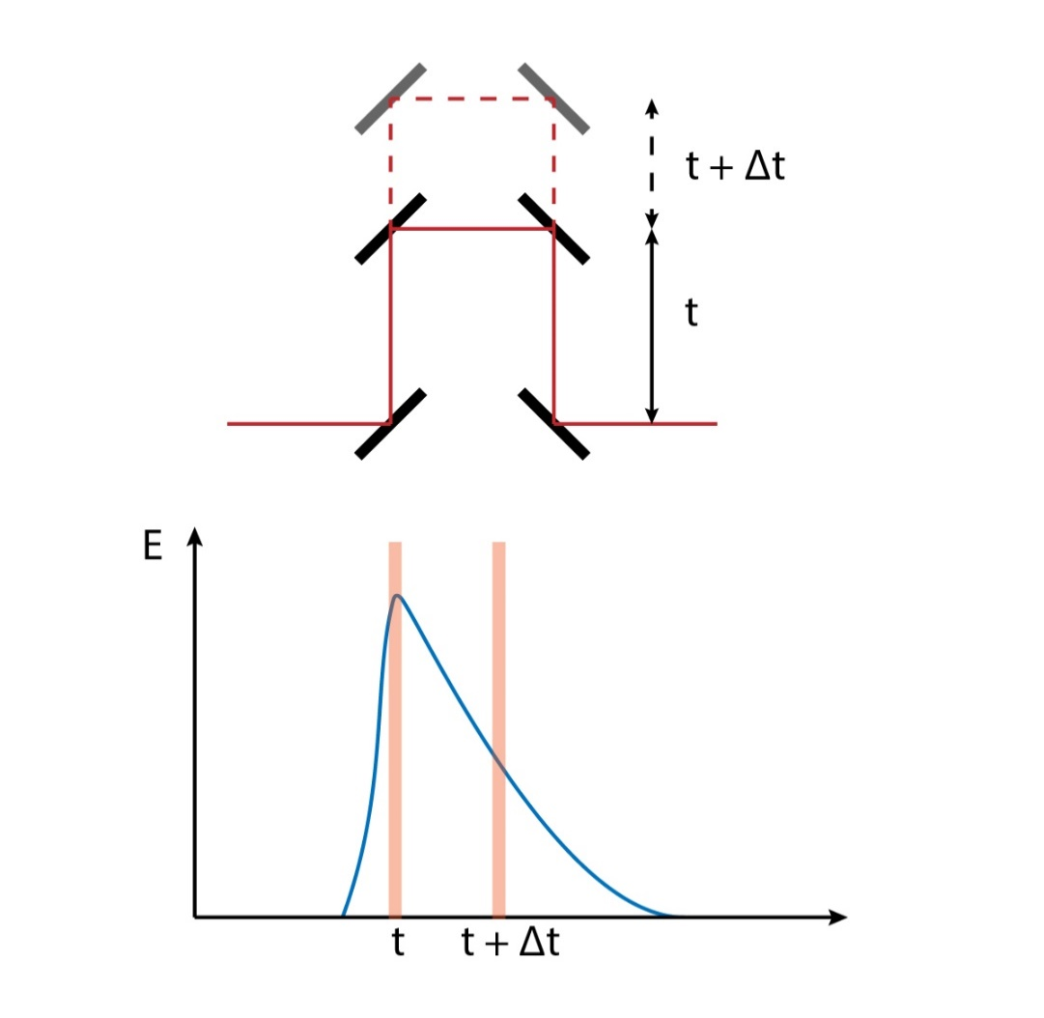

Optical Delay
Consists of moving mirrors
Introduces delay into gating pulse of RX PCA
Laser / gating pulse increases conductivity of
the RX PCA for a certain time (defined by $τ_{rec}$)
To sample the THz electric field, the peak
conductivity must be moved in time over the time
range
Achieved using multiple excitations over different $Δt$
30-07-2023

Slide 6
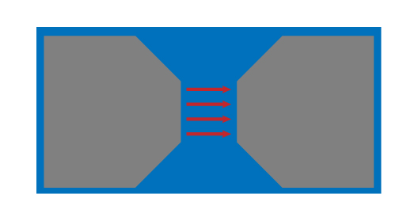
Photoconductive Antenna
Laser pulses moves electrons from valence
to conduction band (increase conductivity)
TX PCA
PCA is biased
Freed electrons start to move across the gap
and create THz field
RX PCA
THz field is incident on the PCA
Freed electrons move across the gap due to
THz field and cause current flow
30-07-2023

Slide 7

Electronics
Excitation and induced current at RX PCA terminals
happens faster than sampling rate of ADC
The ADC samples the average induced voltage
over many samples
Signal-to-Noise ratio is related to the integration time
$SNR|_{τ_{int}}=SNR|_{1s}\sqrt{τ_{int}}$
Larger integration time, smaller noise (larger $SNR$),
but slower sampling
30-07-2023

Slide 8
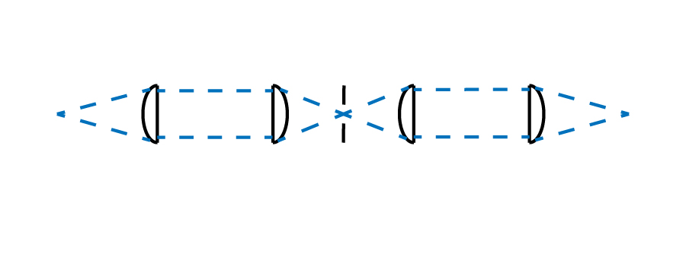

Plano-Convex Lenses
Four similar plano-convex lenses with focal
length $f=50$ mm
THz beam is collimated between first-second
and third-fourth lenses, and focused between
second-third
30-07-2023

Slide 9
Methodology
1. Choose number of averaged samples to
increase SNR
2. Align THz beam-path (PCAs and lenses) to
increase the power of the received reference
signal (no sample)
3. Record reference and sample signal
(reference, samples A / B / C)
4. Use time-delay between recorded reference
and sample pulses to derive sample permittivity
5. Use frequency domain ratio between reference
and sample to derive attenuation constant and
loss tangent with TL model
30-07-2023

Slide 10

Number of Averaged Samples
Averaging more samples
Reduces noise (increases $SNR$)
Increases measurement acquisition time
Number of averaged samples,
$N=300$ samples
$SNR=40$ dB
30-07-2023

Slide 11
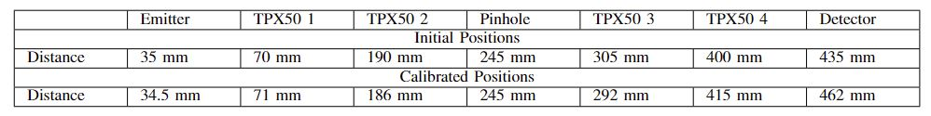
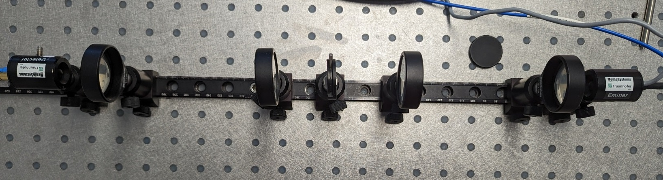

Terahertz Beam-Path Alignment
Goal: maximize the reference signal amplitude (achieved $\sim 5.3$ V)
Plano-convex lens:
TPX50
$f=50$ mm
30-07-2023

Slide 12
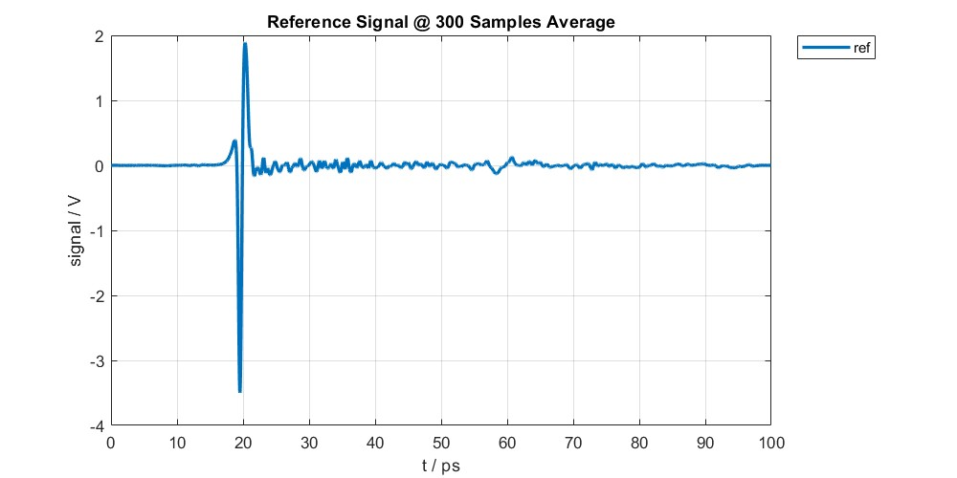
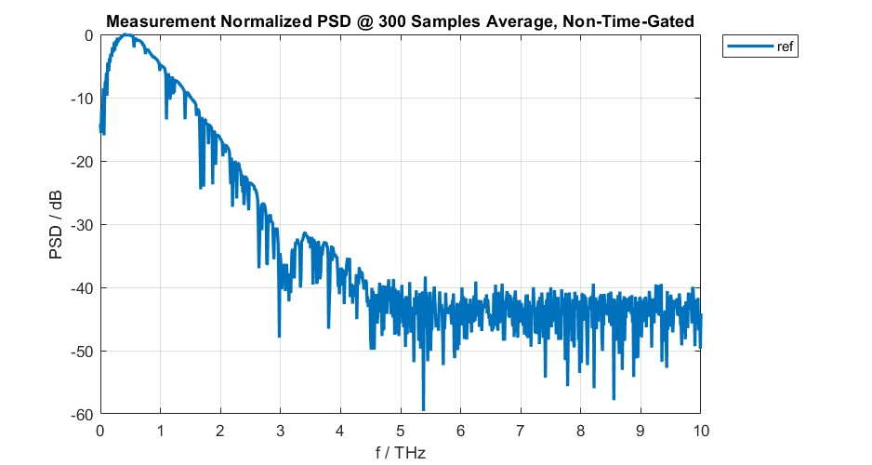
Calibrated Reference Signal
Useful band up to 2.0 – 2.5 THz
30-07-2023

Slide 13
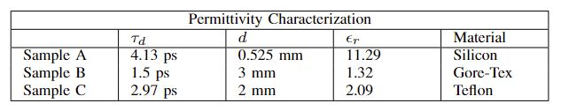

Characterization: Permittivity
Wave propagation through sample is slower
Use pulse delay between reference and sample
signals to estimate the speed of light inside the
dielectric and permittivity
$ε_{r}={(\frac{c_{0}(τ_{d}+τ_{0})}{d})}^{2}$
30-07-2023

Slide 14
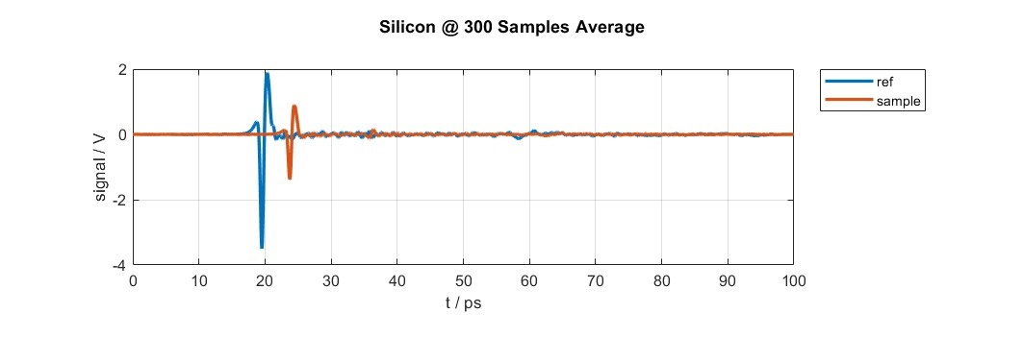
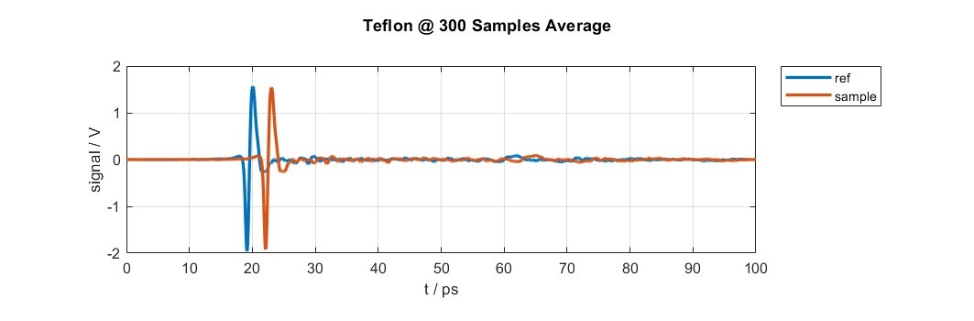
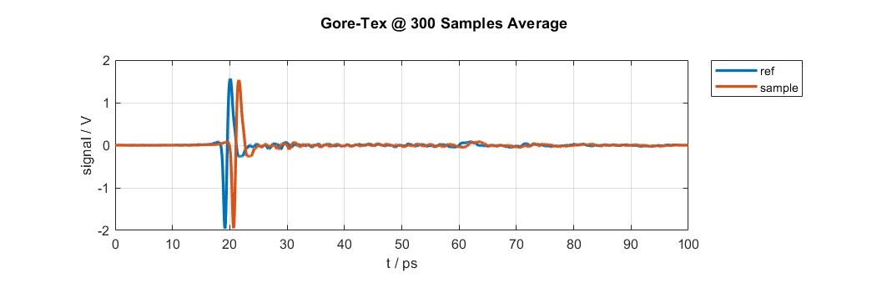
Sample Signals
30-07-2023

Slide 15
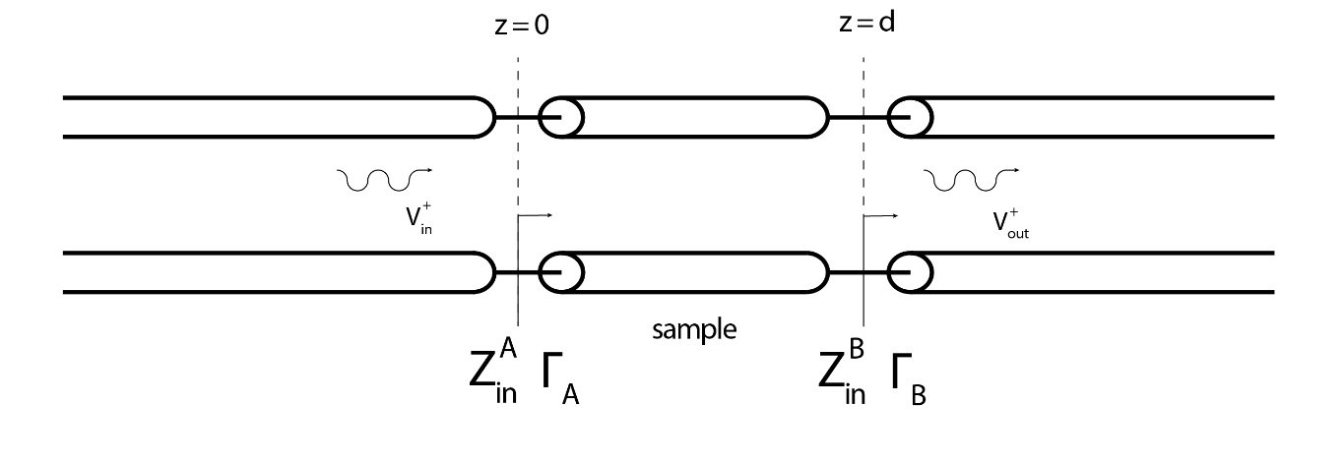
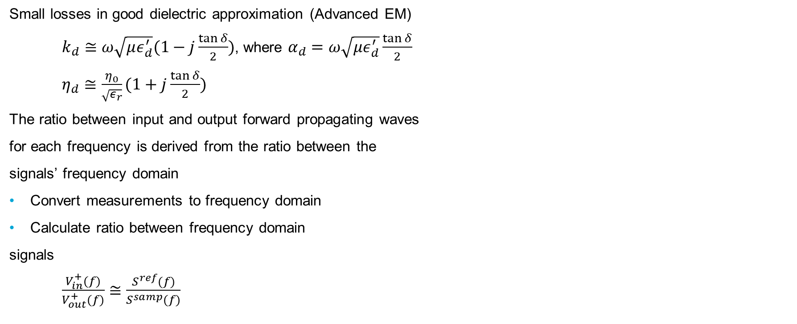
Characterization: Loss Tangent and Attenuation Constant (1)
Small losses in good dielectric approximation (Advanced EM)
$k_{d}≅ω\sqrt{με_{d}^{′}}(1−j\frac{\tan{δ}}{2})$, where $α_{d}=ω\sqrt{με_{d}^{′}}\frac{\tan{δ}}{2}$
$η_{d}≅\frac{η_{0}}{\sqrt{ε_{r}}}(1+j\frac{\tan{δ}}{2})$
The ratio between input and output forward propagating waves
for each frequency is derived from the ratio between the
signals’ frequency domain
Convert measurements to frequency domain
Calculate ratio between frequency domain
signals
$\frac{V_{in}^{+}(f)}{V_{out}^{+}(f)}≅\frac{S^{ref}(f)}{S^{samp}(f)}$
30-07-2023

Slide 16
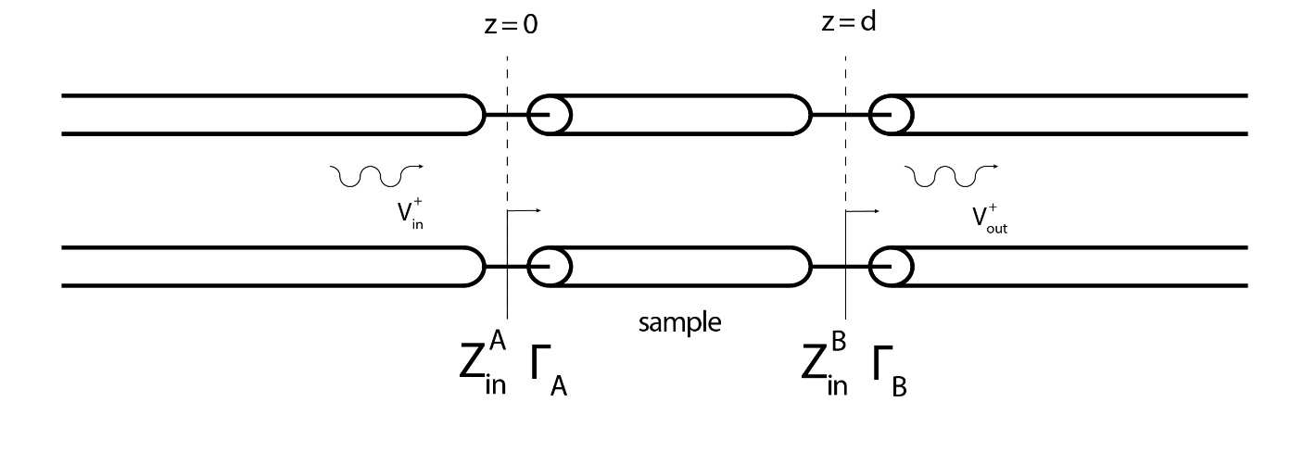

Characterization: Loss Tangent and Attenuation Constant (2)
Use TL model ratio between input and output
forward propagating waves
Calculate ratio for an array of different $\tan{δ}$
values
Choose loss tangent with smallest absolute
value difference between measurements and
TL model calculation
$$\frac{V_{in}^{+}}{V_{out}^{+}} = \frac{e^{jk_{d}d}e^{−jk_{0}d}}{1+Γ_{B}} \frac{1+Γ_{B}e^{−jk_{d}2d}}{1+Γ_{A}}$$
30-07-2023

Slide 17
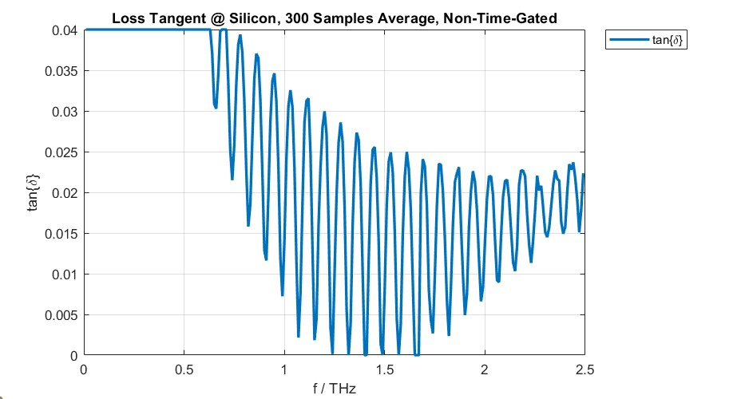
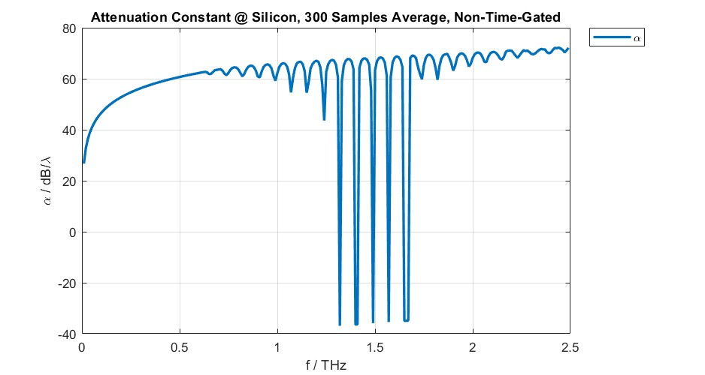
Loss Tangent and Attenuation Constant: Silicon (Sample A)
Highest losses
30-07-2023

Slide 18
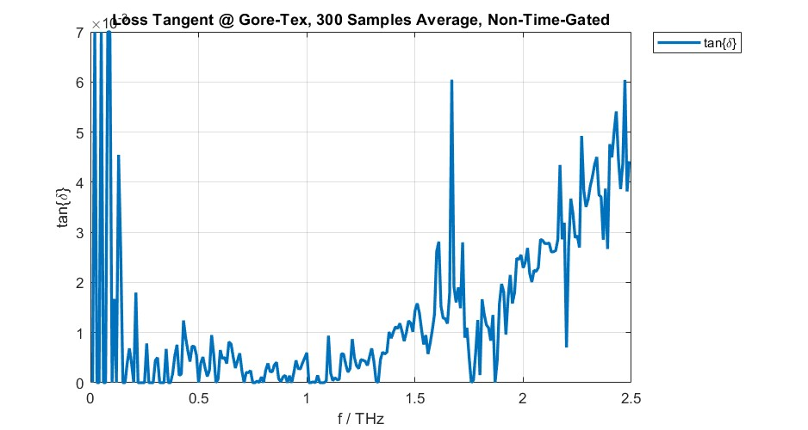
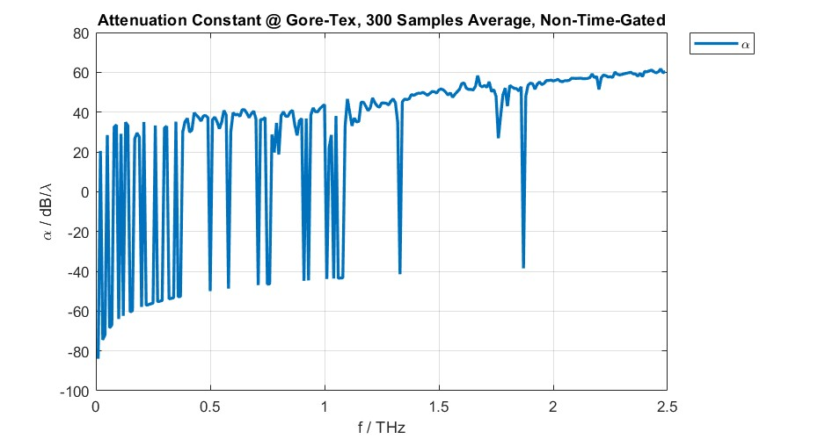
Loss Tangent and Attenuation Constant: Gore-Tex (Sample B)
Second highest losses
30-07-2023

Slide 19
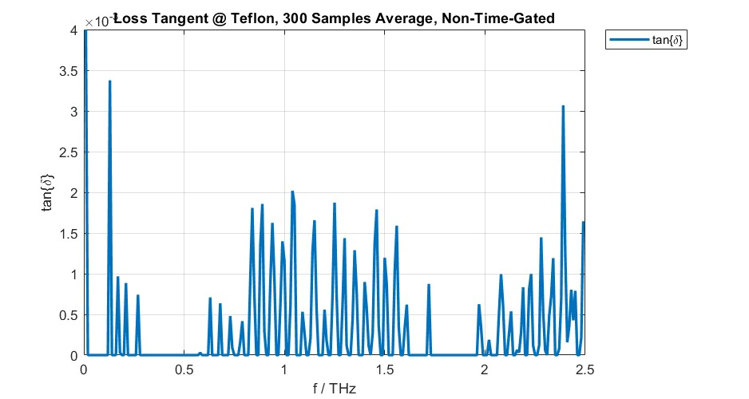
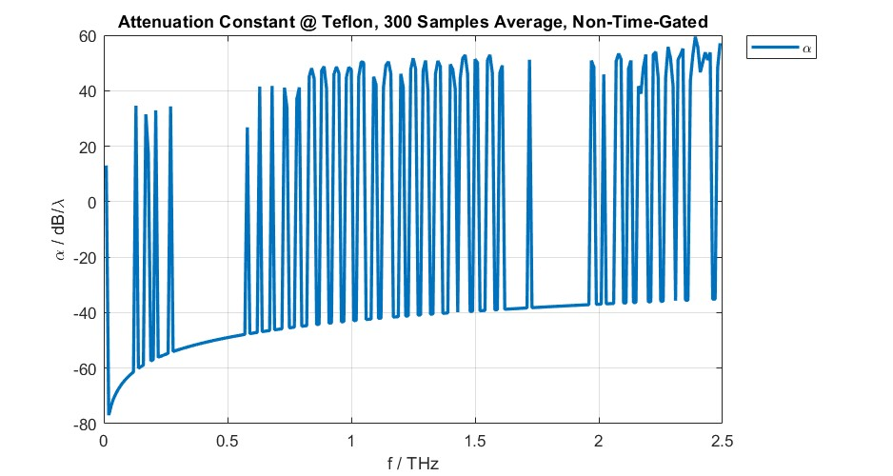
Loss Tangent and Attenuation Constant: Teflon (Sample C)
Least losses
30-07-2023

Slide 20
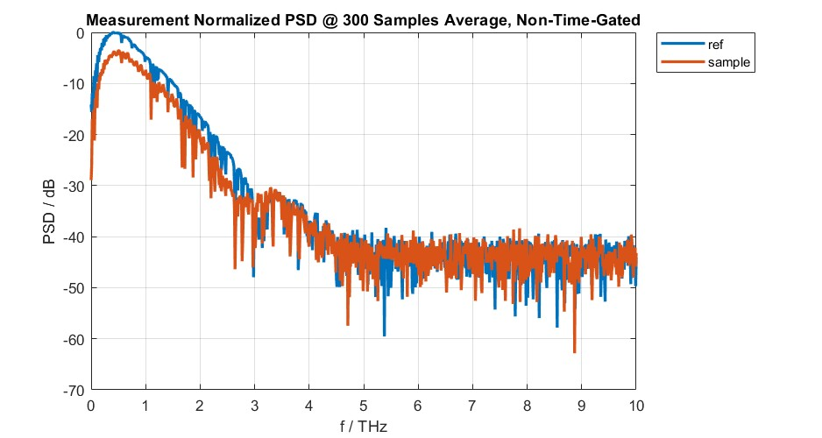
Power Spectral Density: Silicon (Sample A)
30-07-2023

Slide 21
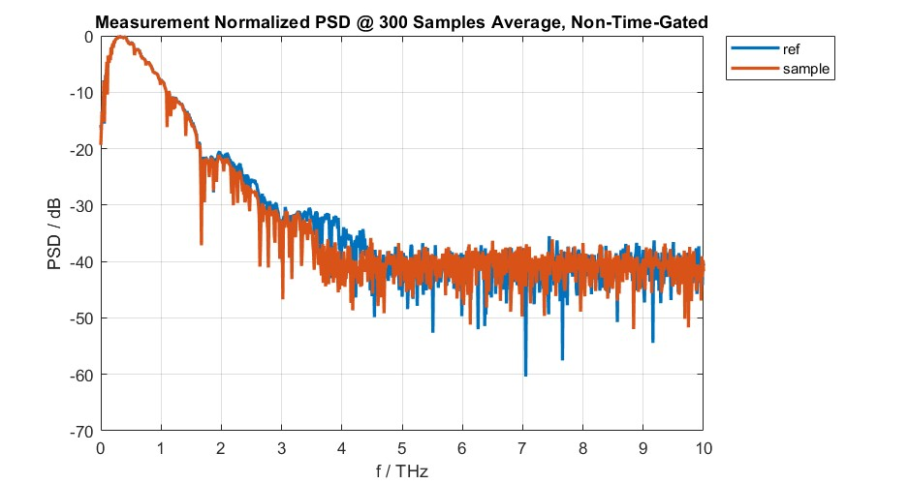
Power Spectral Density: Gore-Tex (Sample B)
30-07-2023

Slide 22
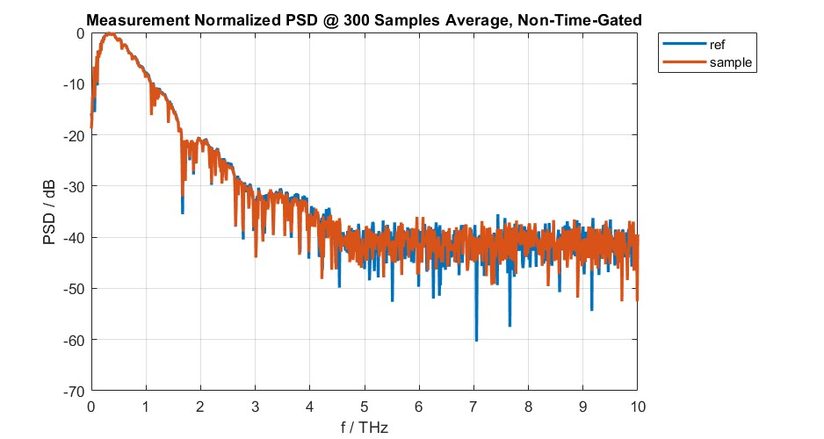
Power Spectral Density: Teflon (Sample C)
30-07-2023

Slide 23
Q & A

Slide 24
Thank you for your attention
Petar V Peshev

Slide 25
Appendices

Slide 26

Appendix A: Transmission Line Model
$Γ_{A}=\frac{Z_{in}^{A}−η_{0}}{Z_{in}^{A}+η_{0}}$ and $Γ_{B}=\frac{η_{0}−η_{d}}{η_{0}+η_{d}}$
$$Z_{in}^{A}=η_{d}\frac{η_{0}+jη_{d}\tan{(k_{d}d)}}{η_{d}+jη_{0}\tan{(k_{d}d)}}$$
$V_{out}\left(z=d\right)=V_{d}(z=d)$
(wave is continuous across interface)
$$V_{in}\left(z=0\right)=V_{d}(z=0)$$
(wave is continuous across interface)
$$V_{d}\left(z\right)=V_{d}^{+}(e^{−jk_{d}z}+Γ_{B}e^{jk_{d}(z−2d)})$$
30-07-2023

Slide 27
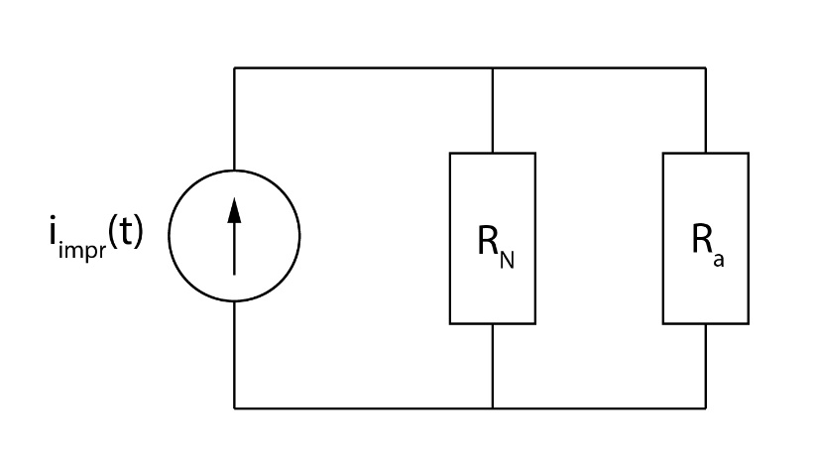

Appendix B: Photoconductive Antenna Model
$$i_{impr}\left(t\right)=V_{b}\int_{t_{0}}^{t}{F^{iv}\left\{t^{′}\right\}dt′}$$
$$R_{a}→∞$$
$$R_{N}\left(∞\right)=\frac{m_{e}W_{x}^{2}}{τ_{s}q_{e}P_{opt}{(q_{e}\frac{T_{L}}{hf_{c}})}^{2}}2\frac{τ_{C}+τ_{S}}{τ_{C}−τ_{S}}$$
Increasing optical power, increases impressed current
and decreases Norton impedance
30-07-2023

Slide 28
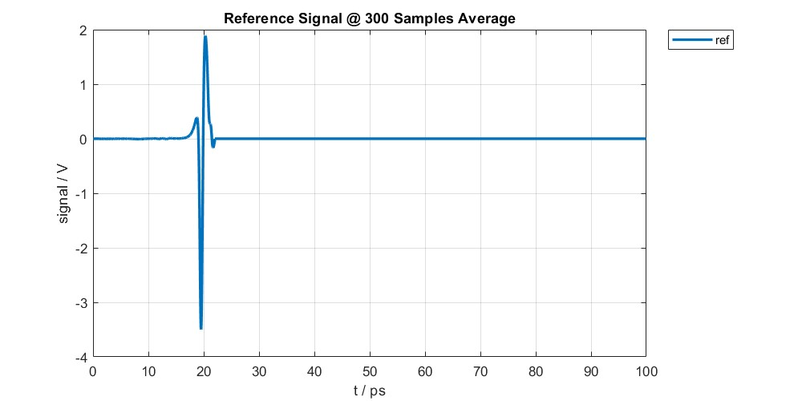
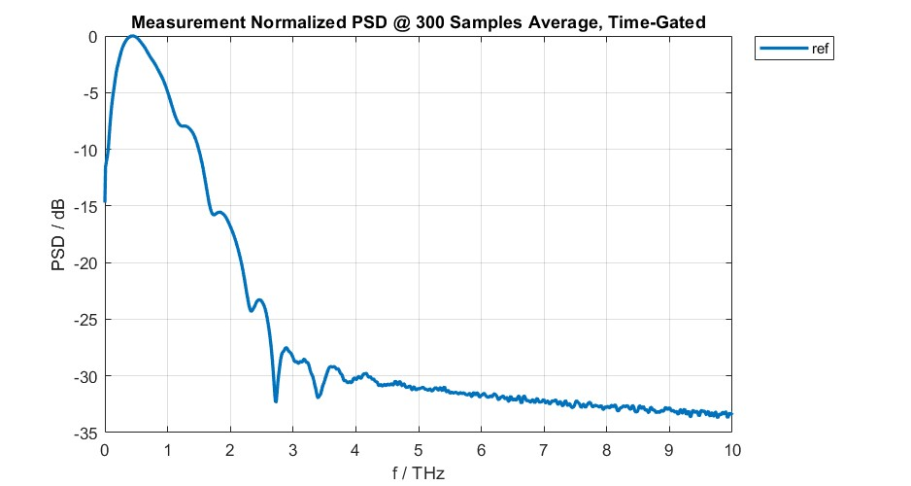
Appendix C: Time-Gated Signals (1)
Time-gating can be used to remove noise and reflections
30-07-2023

Slide 29
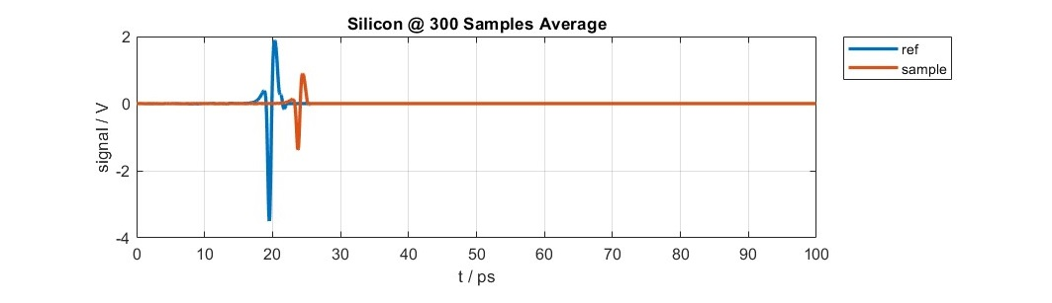
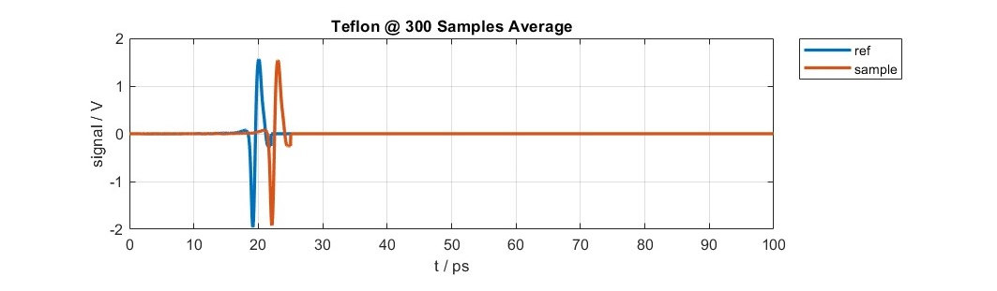
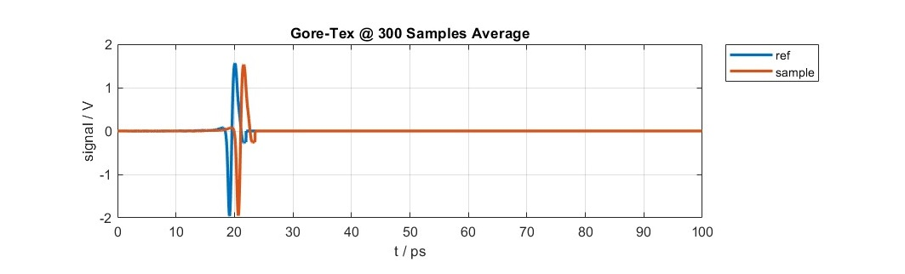
Appendix C: Time-Gated Signals (2)
30-07-2023

Slide 30
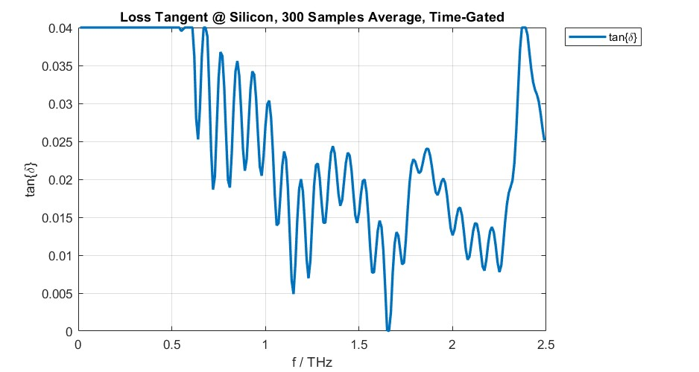
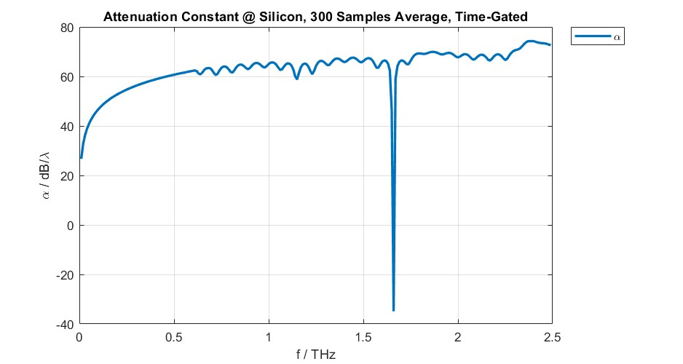
Appendix C: Time-Gated Signals (3)
30-07-2023

Slide 31
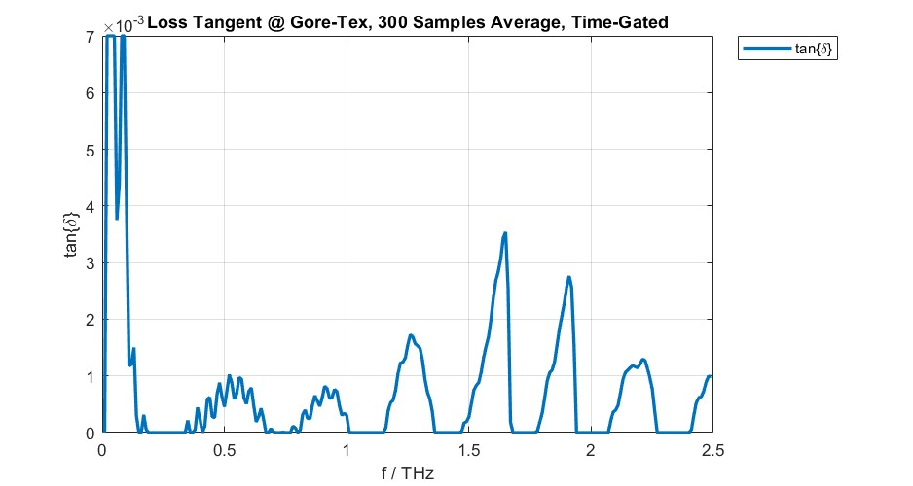
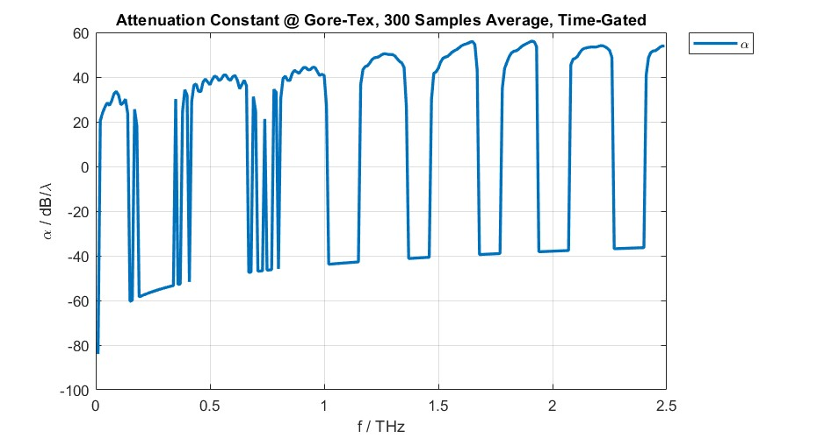
Appendix C: Time-Gated Signals (4)
30-07-2023

Slide 32
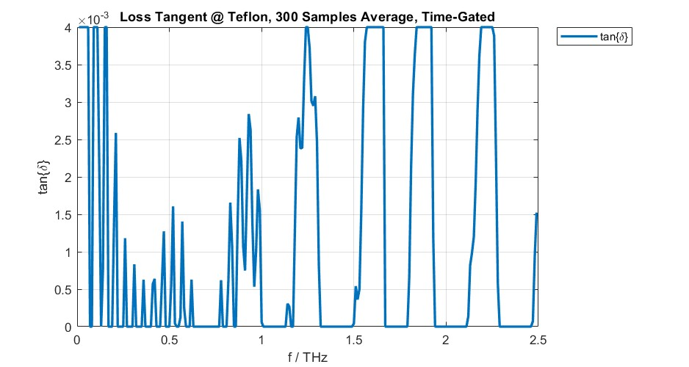
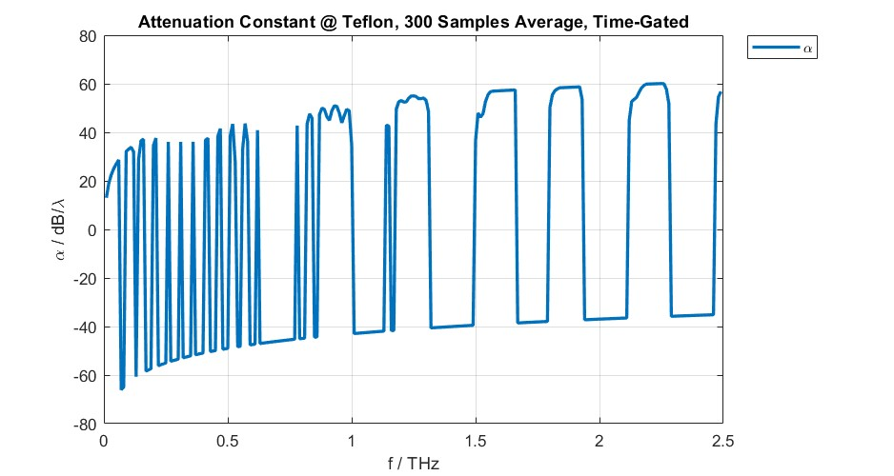
Appendix C: Time-Gated Signals (5)
30-07-2023

Slide 33
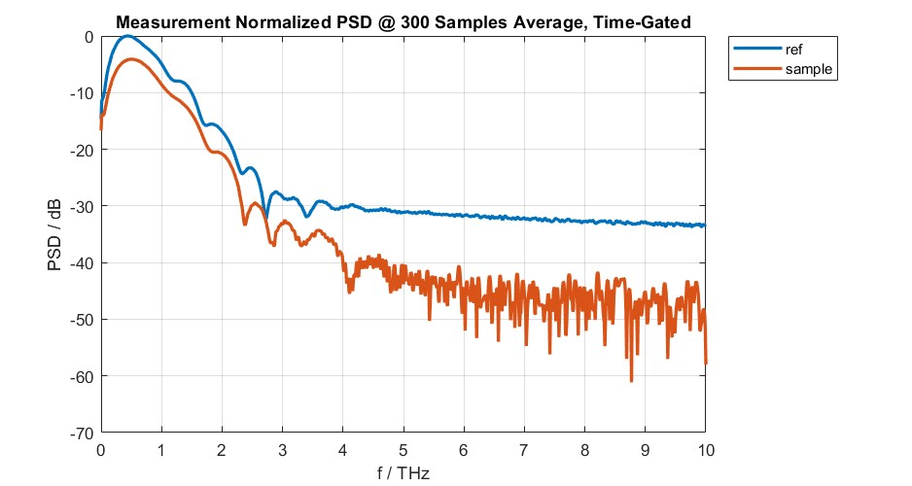
Appendix C: Time-Gated Signals (6)
30-07-2023

Slide 34
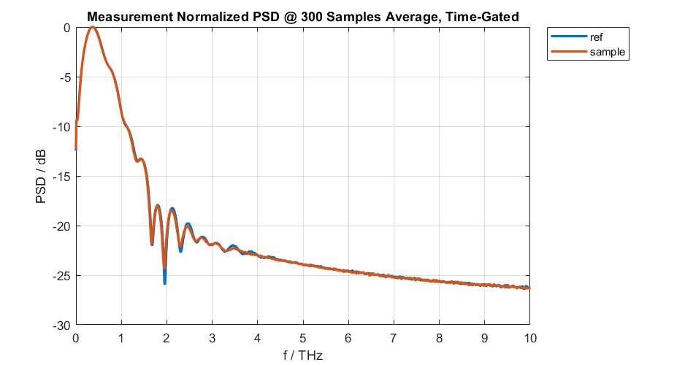
Appendix C: Time-Gated Signals (7)
30-07-2023

Slide 35

Appendix C: Time-Gated Signals (8)
30-07-2023

