Slide 1
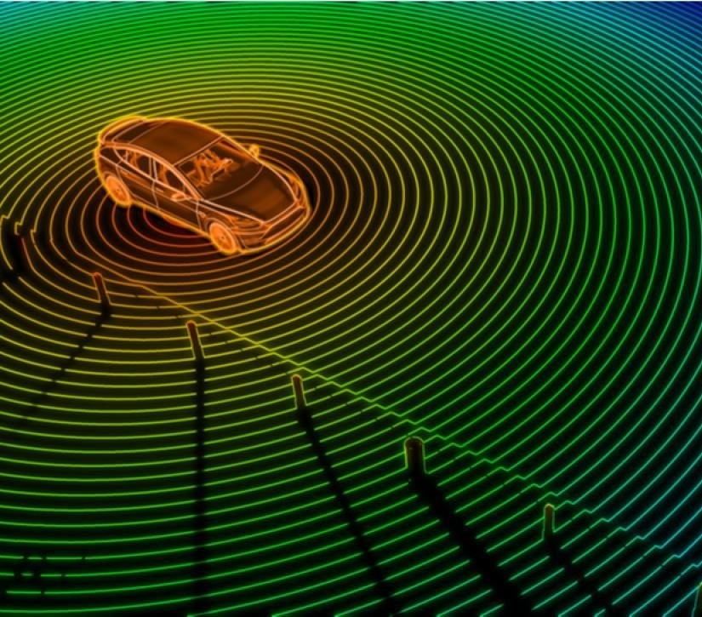
A 70 GHz Automotive Radar Lens Antenna
Petar V Peshev
EE4725 Quasi Optical Systems
Design Project

Slide 2

Constraints & Requirements
Feed: rectangular waveguide (fundamental TE10 mode)
Frequency: $f=70$ GHz
Directivity: $D=30$ dB
Bandwidth: $BW=1$ GHz (REC ITU-R M.2057-1, 01/2018)
Materials:
silicon, $ε_{r}=11.9$
quartz, $ε_{r}=4$
plastic, $ε_{r}=2$
30-07-2023

Slide 3
Procedure
Far-field of the open-ended waveguide feed (analytical derivations)
Equivalent currents
Electric far-field
Optimization of the waveguide dimensions
Transmission coefficients at lens interface
Equivalent aperture currents of the lens (analytical)
Far-field of the lens (numerical)
Optimization of the lens
30-07-2023

Slide 4
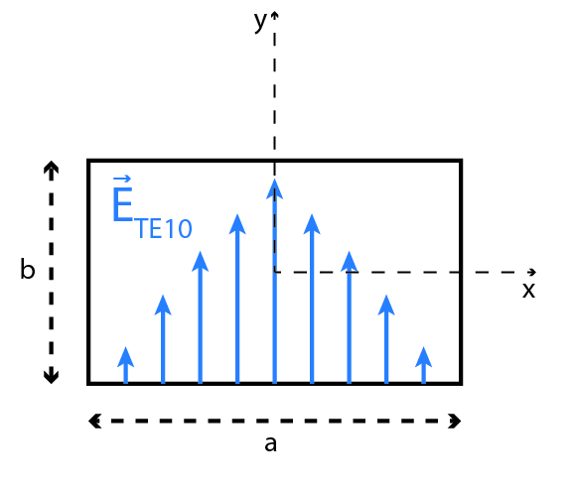
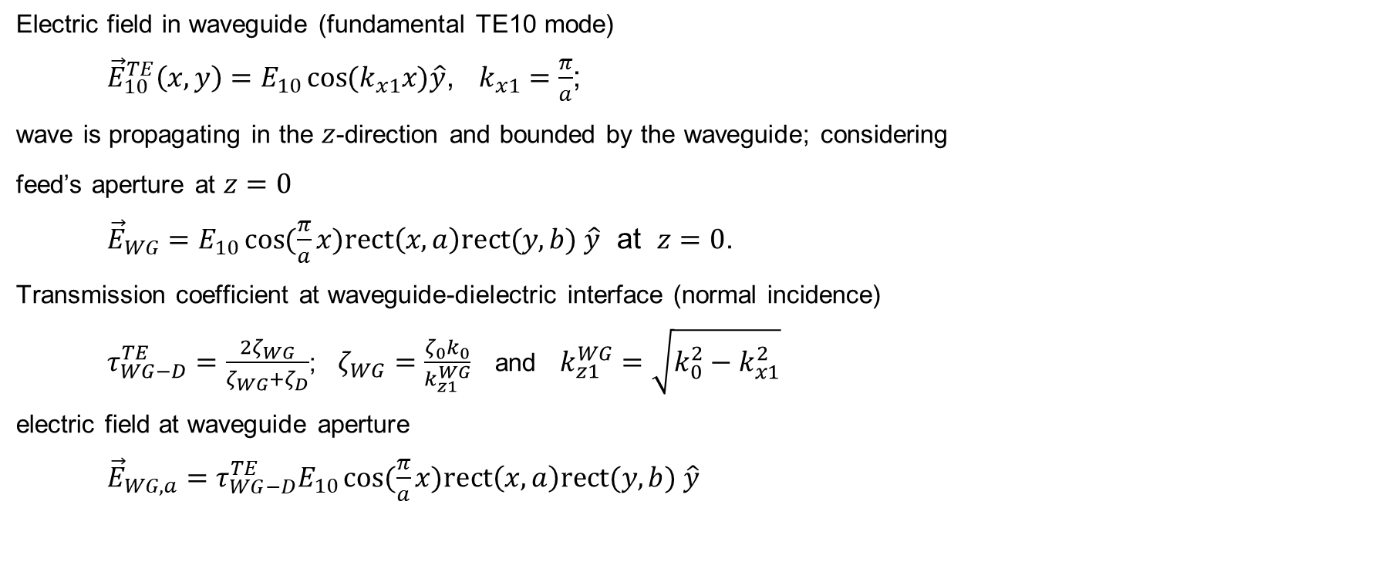
Feed Equivalent Currents (1)
Electric field in waveguide (fundamental TE10 mode)
${\vec{E}}_{10}^{TE}\left(x,y\right)=E_{10}\cos{{(k}_{x1}x)\hat{y}}$, $k_{x1}=\frac{π}{a}$;
wave is propagating in the $z$-direction and bounded by the waveguide; considering
feed’s aperture at $z=0$
${\vec{E}}_{WG}=E_{10}\cos{(\frac{π}{a}x)rect\left(x,a\right)rect(y,b) \hat{y}}$ at $z=0$.
Transmission coefficient at waveguide-dielectric interface (normal incidence)
$τ_{WG−D}^{TE}=\frac{2ζ_{WG}}{ζ_{WG}+ζ_{D}}$; $ζ_{WG}=\frac{ζ_{0}k_{0}}{k_{z1}^{WG}}$ and $k_{z1}^{WG}=\sqrt{k_{0}^{2}−k_{x1}^{2}}$
electric field at waveguide aperture
${\vec{E}}_{WG,a}=τ_{WG−D}^{TE}E_{10}\cos{(\frac{π}{a}x)rect\left(x,a\right)rect(y,b) \hat{y}}$
30-07-2023

Slide 5
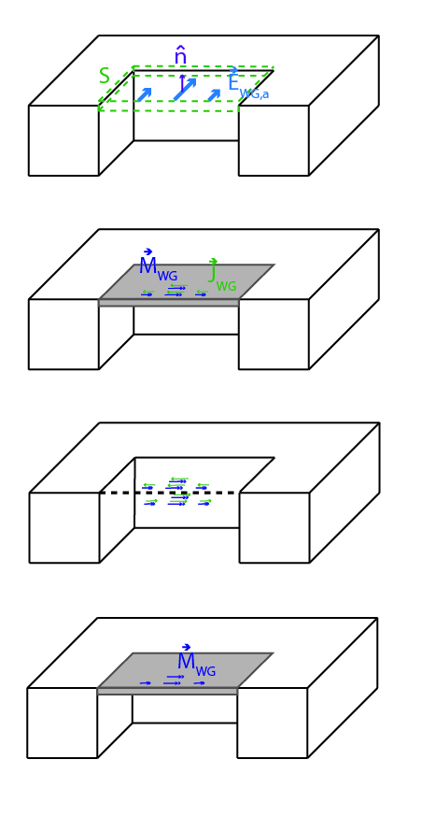

Feed Equivalent Currents (2)
Equivalent magnetic current (equivalence with PEC + image theorem)
${\vec{M}}_{WG}=−2\hat{z}×{\vec{E}}_{WG,a}$ and ${\vec{J}}_{WG}=0$, $\hat{n}=\hat{z}$
the equivalent magnetic current distribution
${\vec{M}}_{WG}={2τ}_{WG−D}^{TE}E_{10}\cos{(\frac{π}{a}x)rect\left(x,a\right)rect(y,b) \hat{x}}$
30-07-2023

Slide 6
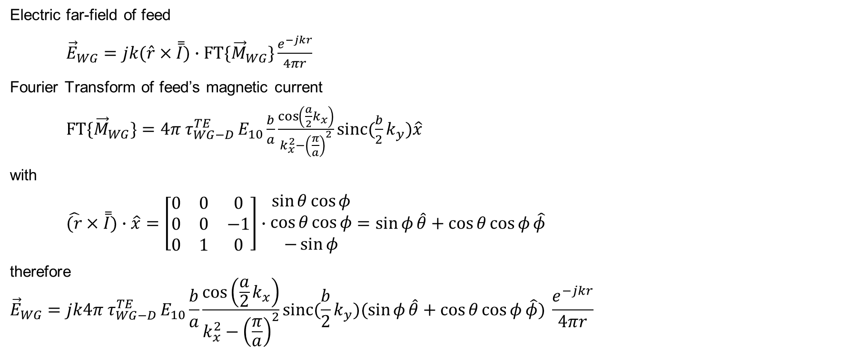
Feed Far-Field
Electric far-field of feed
${\vec{E}}_{WG}=jk(\hat{r}×\overset{̿}{I})∙FT\{{\vec{M}}_{WG}\}\frac{e^{−jkr}}{4πr}$
Fourier Transform of feed’s magnetic current
${FT\{\vec{M}}_{WG}\}={4π τ}_{WG−D}^{TE}E_{10}{\frac{b}{a}\frac{\cos\left(\frac{a}{2}k_{x}\right)}{k_{x}^{2}−{\left(\frac{π}{a}\right)}^{2}}sinc(\frac{b}{2}k_{y})\hat{x}}$
with
$\hat{(r}×\overset{̿}{I})∙\hat{x}=\left[\begin{matrix}0 & 0 & 0 \\ 0 & 0 & −1 \\ 0 & 1 & 0\end{matrix}\right]∙\begin{matrix}\sin{θ\cos{φ}} \\ \cos{θ\cos{φ}} \\ −\sin{φ}\end{matrix}=\sin{φ}\hat{θ}+\cos{θ\cos{φ}\hat{φ}}$
therefore
$${\vec{E}}_{WG}=jk{4π τ}_{WG−D}^{TE}E_{10}{\frac{b}{a}\frac{\cos\left(\frac{a}{2}k_{x}\right)}{k_{x}^{2}−{\left(\frac{π}{a}\right)}^{2}}sinc(\frac{b}{2}k_{y})(\sin{φ}\hat{θ}+\cos{θ\cos{φ}\hat{φ}}) }\frac{e^{−jkr}}{4πr}$$
30-07-2023

Slide 7
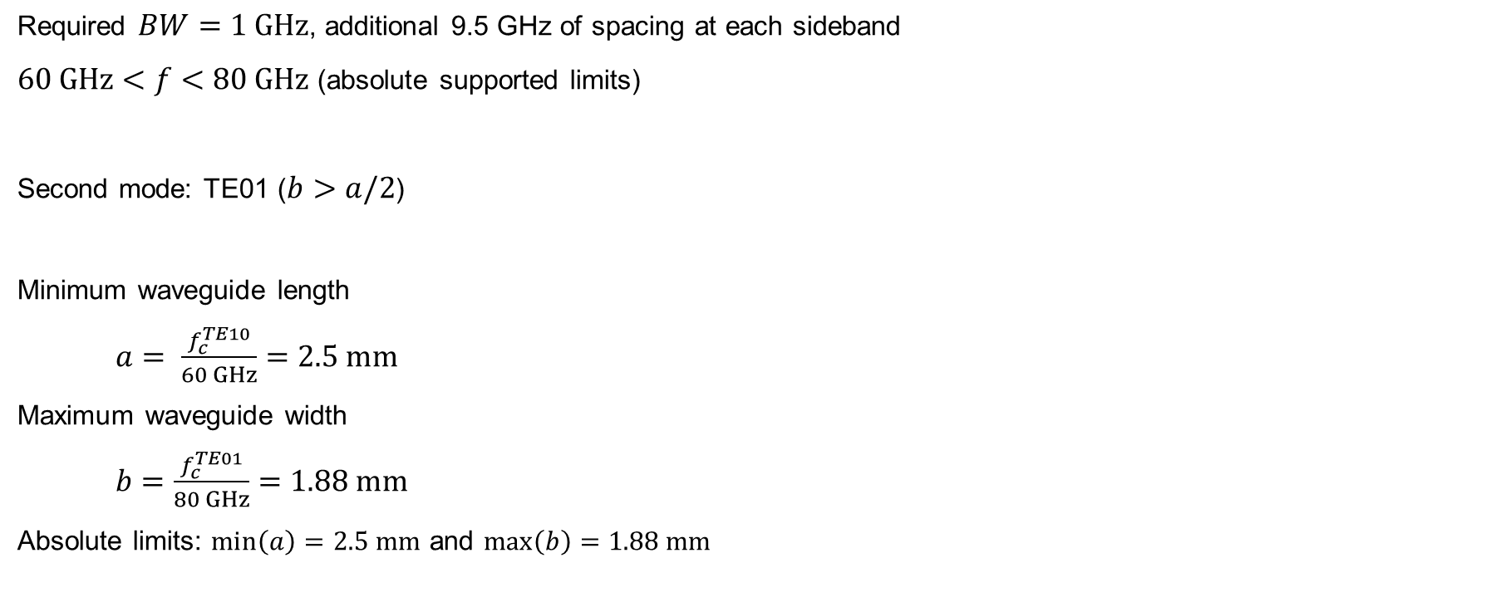
Waveguide Considerations
Required $BW=1 GHz$, additional 9.5 GHz of spacing at each sideband
$60 GHz<f<80 GHz$ (absolute supported limits)
Second mode: TE01 ($b>a/2$)
Minimum waveguide length
$a= \frac{f_{c}^{TE10}}{60 GHz}=2.5 mm$
Maximum waveguide width
$b=\frac{f_{c}^{TE01}}{80 GHz}=1.88 mm$
Absolute limits: $\min\left(a\right)=2.5 mm$ and $\max\left(b\right)=1.88 mm$
30-07-2023

Slide 8
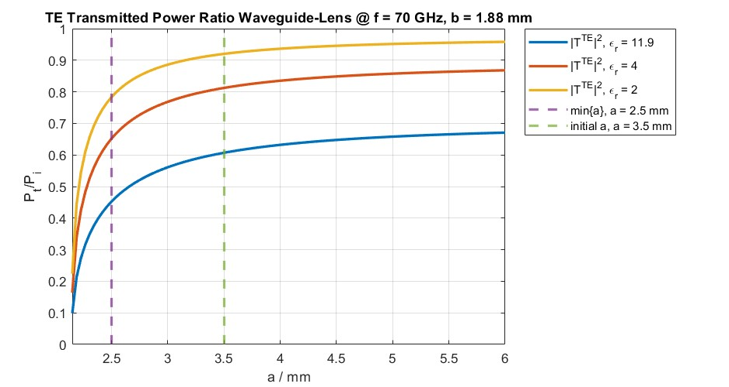
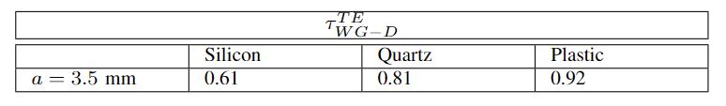

Waveguide-Lens Transmission
Reflection coefficient decreases and transmission
coefficient increases, as $a$ increases
$ζ_{WG}→ζ_{0}$
Goal: high initial transmission coefficient
Chosen initial $a$ at a point providing sufficiently
close to the transmission coefficient’s final value
initial: $a=3.5 mm$
30-07-2023

Slide 9
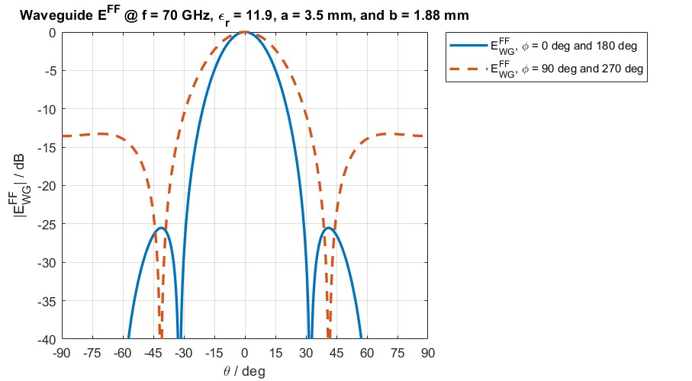
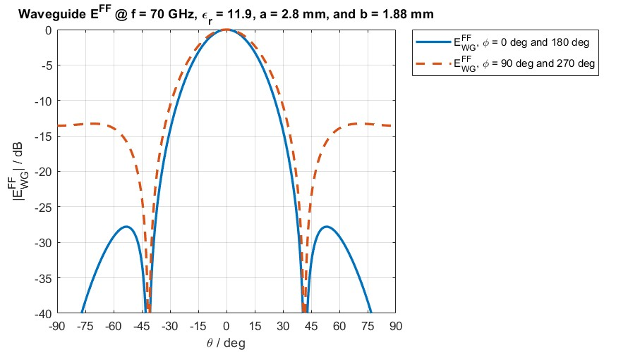

Waveguide Optimization: Silicon
Goal: uniform lens equivalent aperture current distribution
(airy pattern)
Strategy: equal main lobe’s beamwidth in $φ=0^{°}$ and $φ={90}^{°}$
below $θ_{0}$
Increasing $b$ decreases main lobe’s beamwidth in $φ={90}^{°}$;
however, $b$ is at maximum
Hence, decrease $a$ to increase main lobe’s beamwidth in $φ=0^{°}$
Final waveguide dimensions for silicon lens:
$a=2.8 mm$, and $b=1.88 mm$
30-07-2023

Slide 10
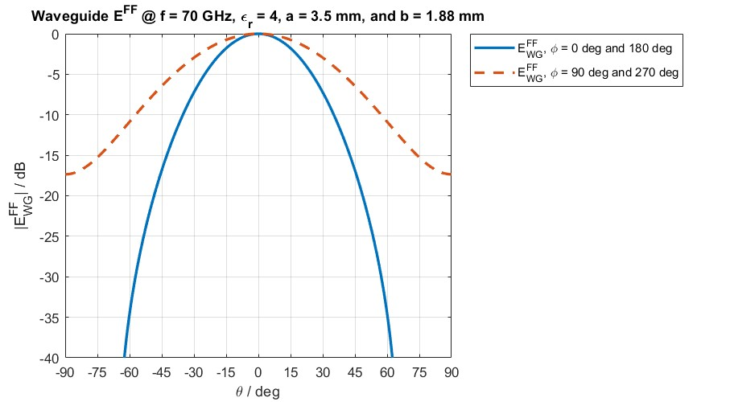
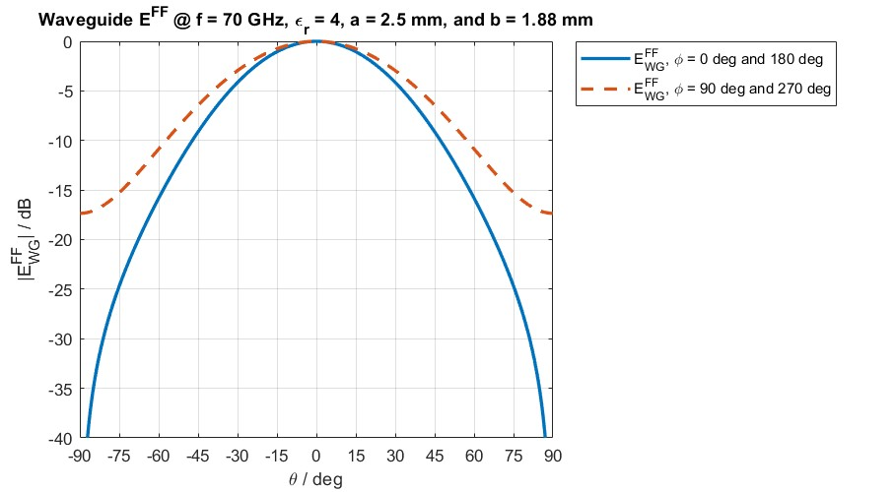

Waveguide Optimization: Quartz
Strategy: equal main lobe’s beamwidth in $φ=0^{°}$ and $φ={90}^{°}$
below $θ_{0}$
Waveguide’s width $b$ is at maximum
Hence, decrease $a$ to increase main lobe’s beamwidth in $φ=0^{°}$
Final waveguide dimensions for silicon lens:
$a=2.5 mm$, and $b=1.88 mm$
30-07-2023

Slide 11
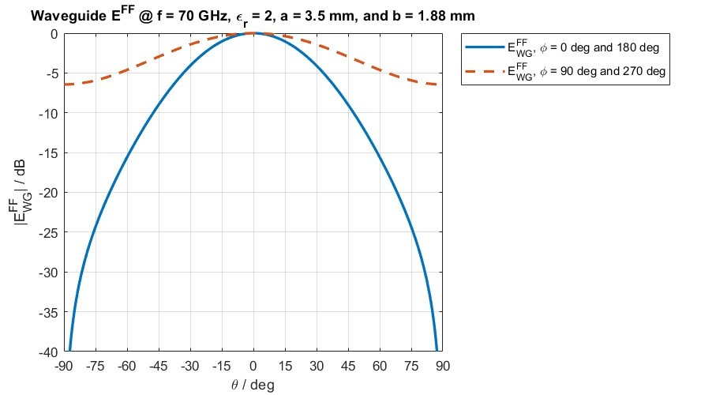
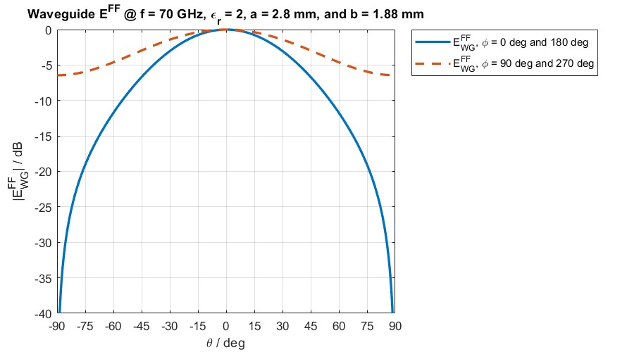

Waveguide Optimization: Plastic
Strategy: equal main lobe’s beamwidth in $φ=0^{°}$ and $φ={90}^{°}$
below $θ_{0}$
Waveguide’s width $b$ is at maximum
Hence, decrease $a$ to increase main lobe’s beamwidth in $φ=0^{°}$
Final waveguide dimensions for silicon lens:
$a=2.8 mm$, and $b=1.88 mm$
30-07-2023

Slide 12
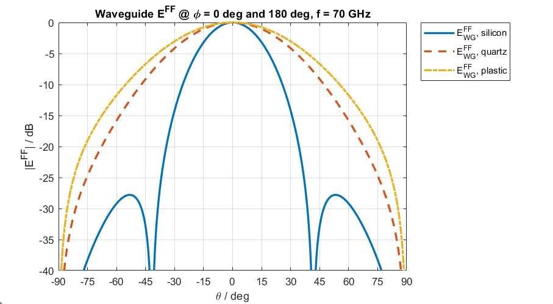
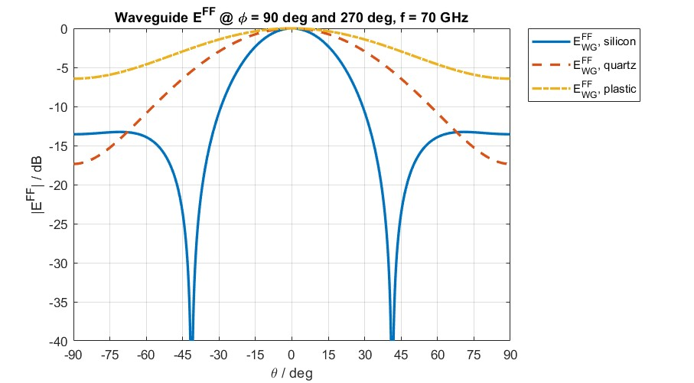
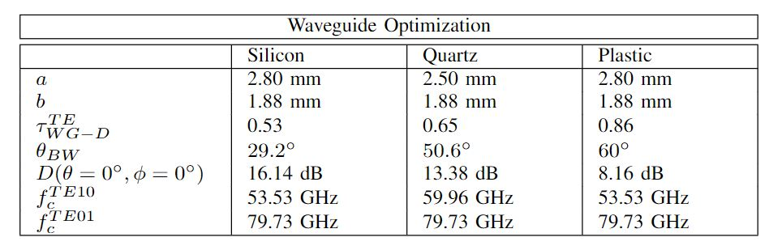

Waveguide Optimization
Directivity inside dielectric:
As the permittivity increases, the directivity inside the
dielectric increases ($λ_{D}$ decreases, $D_{max}∝1/λ_{D}^{2}$)
Reflection efficiency of the waveguide feed:
As permittivity increases, the reflection efficiency of the
feed decreases ($ζ_{D}=ζ_{0}/\sqrt{ε_{r}}$)
30-07-2023

Slide 13
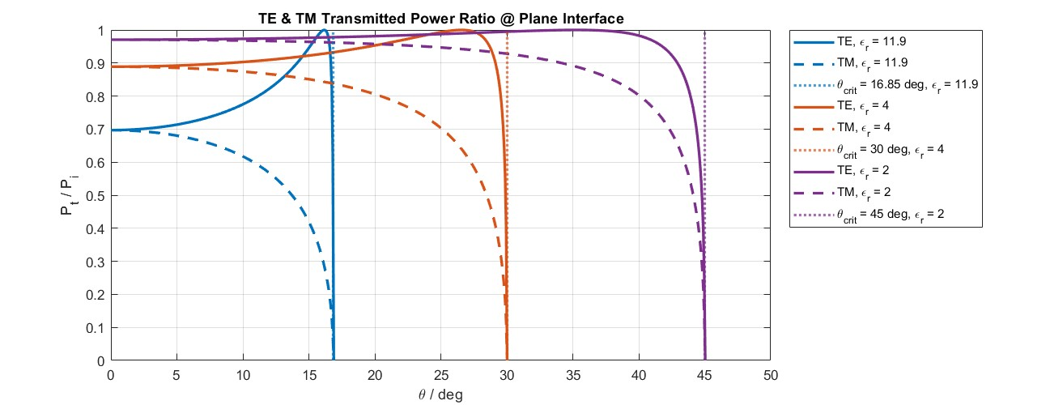

Transmission Coefficient: Flat Interface
Critical angle (increasing $ε_{r}$ decreases $θ_{c}$):
$θ_{c}=\sin^{−1}{\frac{1}{\sqrt{ε_{r}}}}$
TE Fresnel’s reflection coefficient:
$τ^{TE}=\frac{2ζ_{0}\cos{θ_{t}}}{ζ_{0}\cos{θ_{i}+ζ_{D}\cos{θ_{t}}}}$
TM Fresnel’s reflection coefficient:
$τ^{TM}=\frac{2ζ_{0}\cos{θ_{t}}}{ζ_{0}\cos{θ_{t}+ζ_{D}\cos{θ_{i}}}}$
TE Fresnel’s transmission coefficient:
${|T|}^{2}={|τ^{TE}|}^{2}\frac{ζ_{D}\cos{θ_{t}}}{ζ_{0}\cos{θ_{i}}}$
TM Fresnel’s transmission coefficient:
${|T|}^{2}={|τ^{TM}|}^{2}\frac{ζ_{D}\cos{θ_{t}}}{ζ_{0}\cos{θ_{i}}}$
30-07-2023

Slide 14
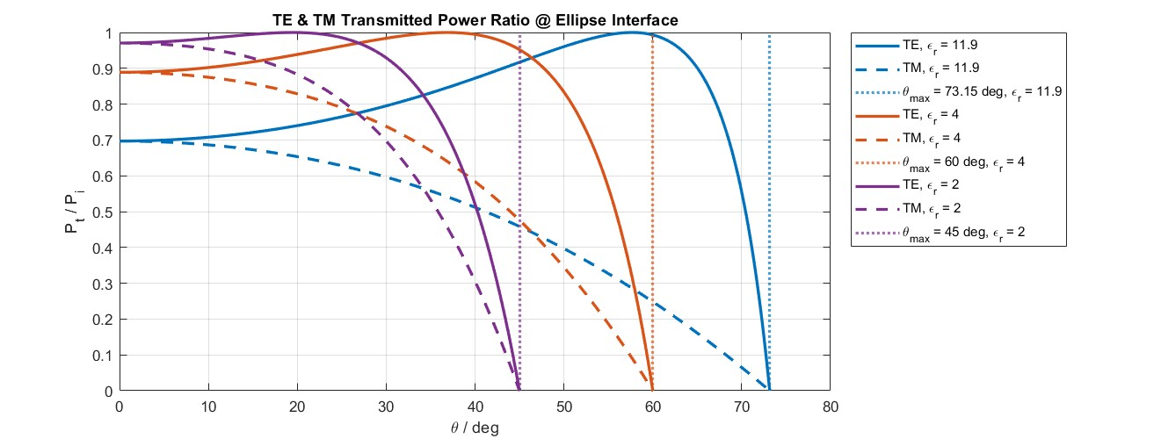

Transmission Coefficient: Elliptical Interface
Maximum elevation angle:
$θ_{0}={90}^{°}−\sin^{−1}{\frac{1}{\sqrt{ε_{r}}}}$
Ellipse eccentricity (quantifies the deviation of
the two focal points from the center):
$e=\frac{1}{\sqrt{ε_{r}}}$
Transmission coefficient pattern is stretched over
larger angular domain
30-07-2023

Slide 15
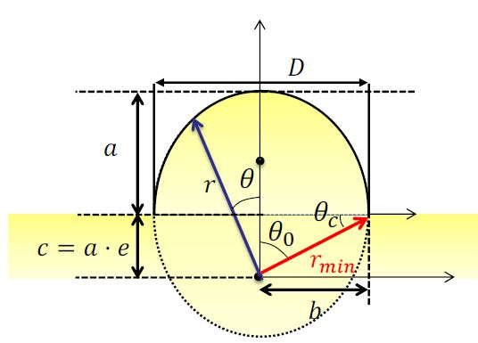
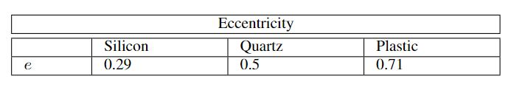

Elliptical Lens Geometry
Ellipse eccentricity:
$e=\frac{1}{\sqrt{ε_{r}}}$
Lens physical dimensions:
The elliptical shape moves towards circular
(higher permittivity, lower eccentricity; lens
foci distance $c$, and lens semi-major axis $a$
decrease)
Angular domain of lens:
The angular domain increases with decreasing
eccentricity (smaller critical angle in flat interface)
Instruction Lecture 3: Lens Antennas, Prof. Shahab Dabironezare, 6th March 2023
30-07-2023

Slide 16
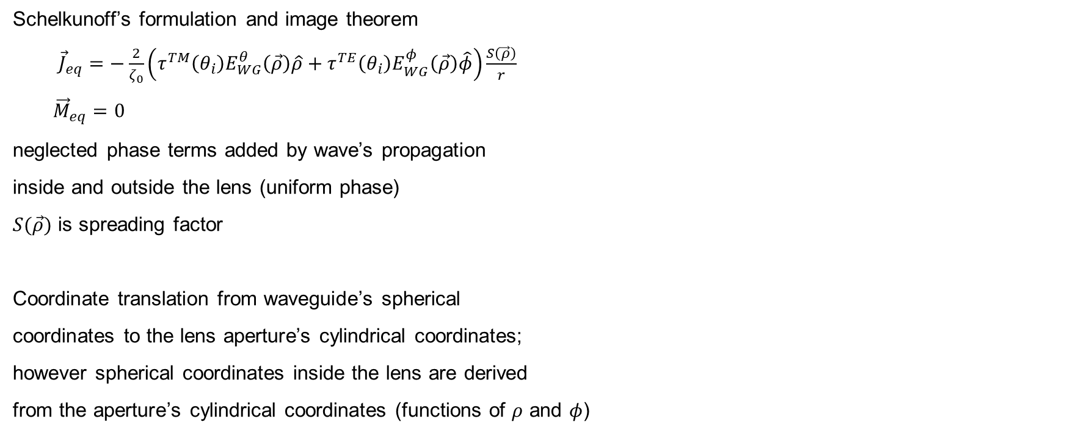
Equivalent Aperture Current
Schelkunoff’s formulation and image theorem
${\vec{J}}_{eq}=−\frac{2}{ζ_{0}}\left(τ^{TM}{\left(θ_{i}\right)E}_{WG}^{θ}\left(\vec{ρ}\right)\hat{ρ}+τ^{TE}{\left(θ_{i}\right)E}_{WG}^{φ}\left(\vec{ρ}\right)\hat{φ}\right)\frac{S\left(\vec{ρ}\right)}{r}$
${\vec{M}}_{eq}=0$
neglected phase terms added by wave’s propagation
inside and outside the lens (uniform phase)
$S(\vec{ρ})$ is spreading factor
Coordinate translation from waveguide’s spherical
coordinates to the lens aperture’s cylindrical coordinates;
however spherical coordinates inside the lens are derived
from the aperture’s cylindrical coordinates (functions of $ρ$ and $φ$)
30-07-2023

Slide 17

Lens Far-Field
Electric far-field of lens
$\vec{E}=jk_{z}{\overline{G}}^{EJ}\left(k_{x},k_{y}\right)FT\{J_{eq}(k_{x},k_{y})\}\frac{e^{−jk_{0}r}}{2πr}$
Fourier Transform of equivalent aperture
electric current (numerically computed)
$FT\left\{J_{eq}\left(k_{x},k_{y}\right)\right\}=\int_{0}^{D/2}{\int_{0}^{2π}{J_{eq}(ρ,φ)e^{jk_{x}ρ\cos{φ}}e^{jk_{y}ρ\sin{φ}}ρdρdφ}}$
30-07-2023

Slide 18
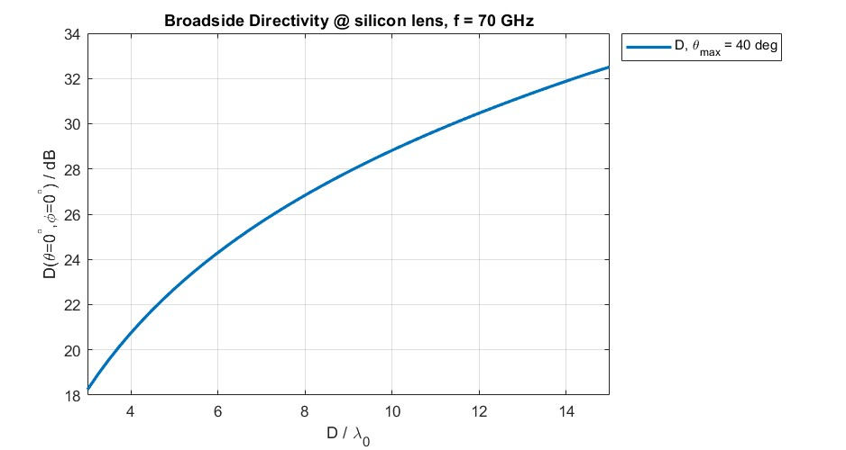

Lens Far-Field Optimization: Silicon Lens
Goal: increase broadside directivity
Strategy: increase aperture
Final lens dimensions:
$D_{r}=12λ_{0}$ and $θ_{max}={40}^{°}$
30-07-2023

Slide 19
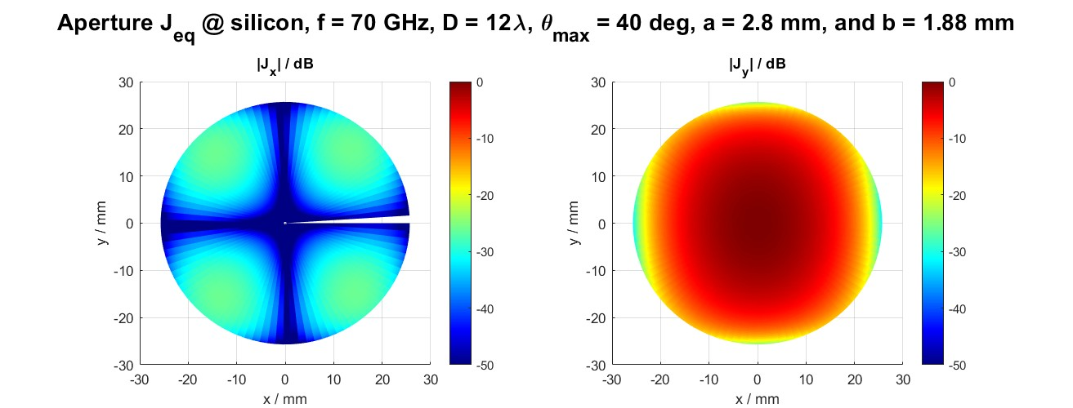
Equivalent Aperture Current: Silicon Lens
30-07-2023

Slide 20
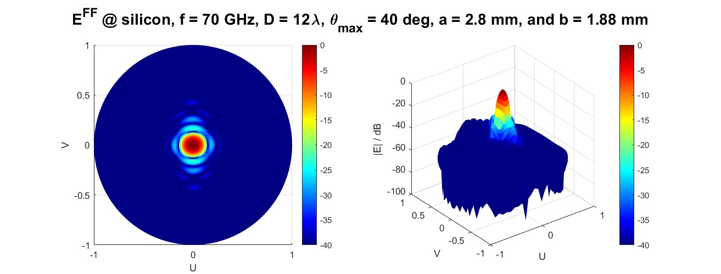
Radiation Pattern: Silicon Lens
Result: approximately airy pattern
30-07-2023

Slide 21
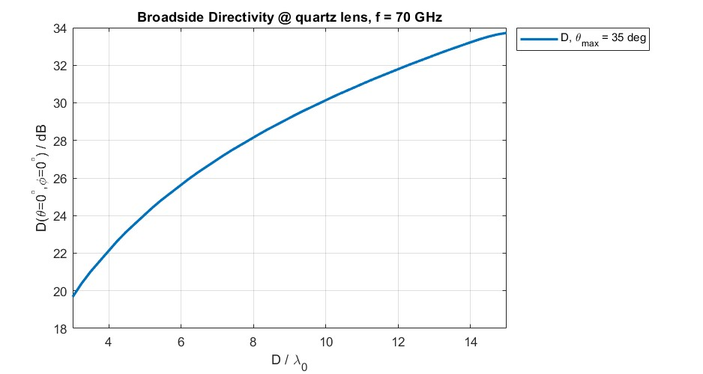

Lens Far-Field Optimization: Quartz Lens
Strategy: increase aperture
Final lens dimensions:
$D_{r}=10λ_{0}$ and $θ_{max}={35}^{°}$
30-07-2023

Slide 22
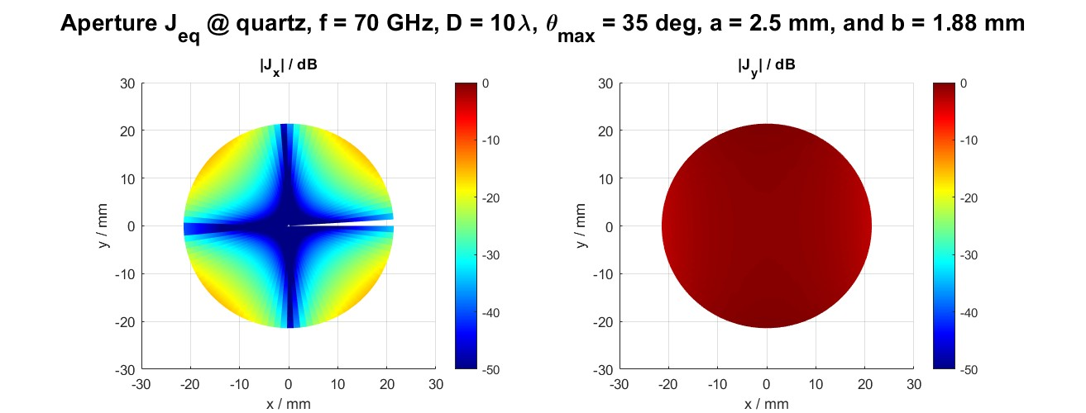
Equivalent Aperture Current: Quartz Lens
30-07-2023

Slide 23
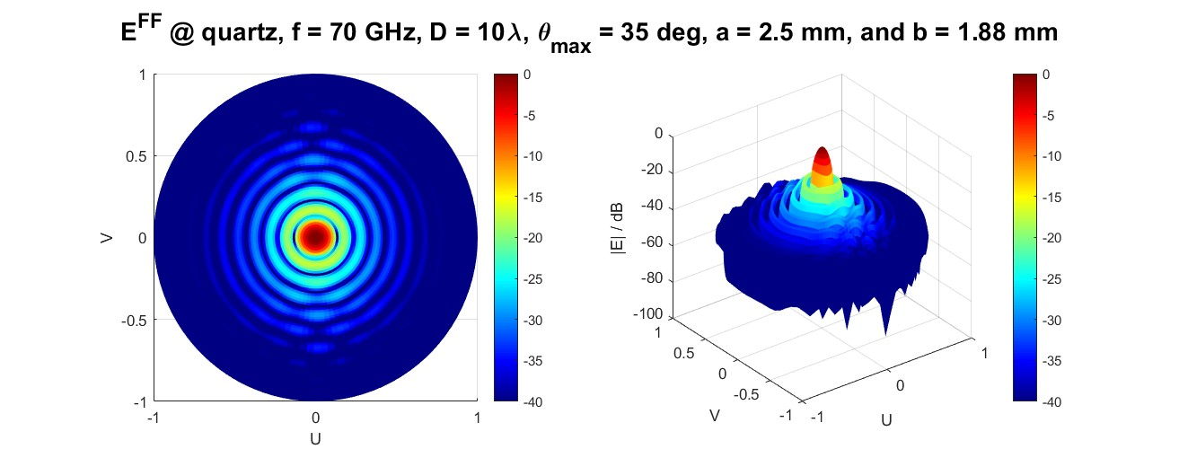
Radiation Pattern: Quartz Lens
Result: approximately airy pattern
30-07-2023

Slide 24
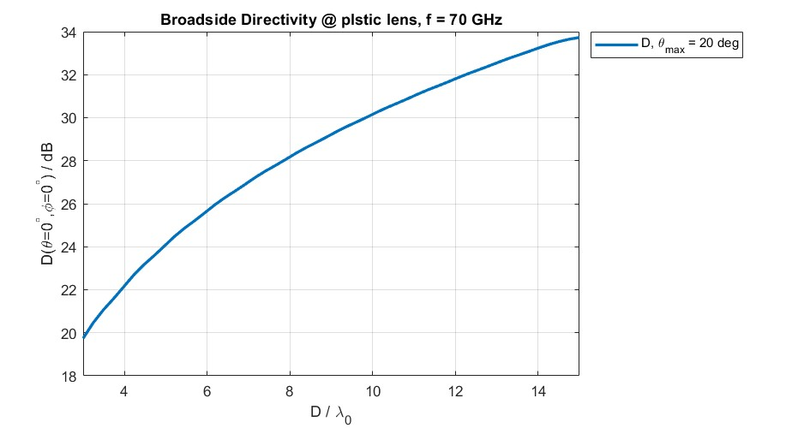

Lens Far-Field Optimization: Plastic Lens
Strategy: increase aperture
Final lens dimensions:
$D_{r}=10λ_{0}$ and $θ_{max}={20}^{°}$
30-07-2023

Slide 25
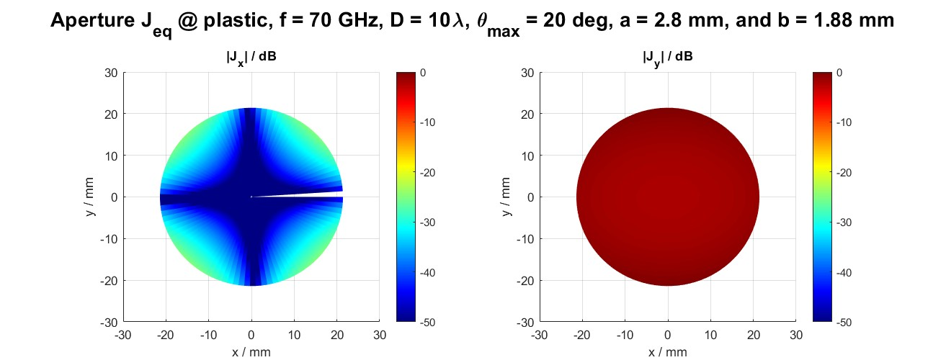
Equivalent Aperture Current: Plastic Lens
30-07-2023

Slide 26
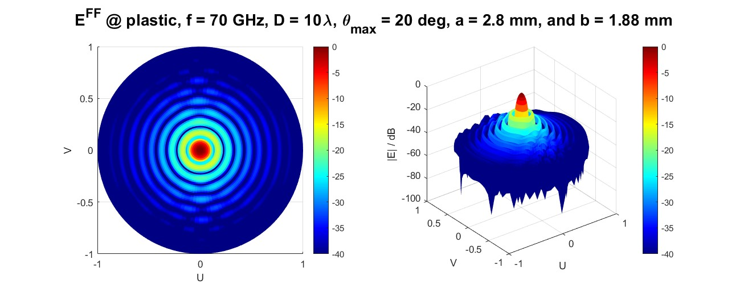
Radiation Pattern: Plastic Lens
Result: approximately airy pattern
30-07-2023

Slide 27
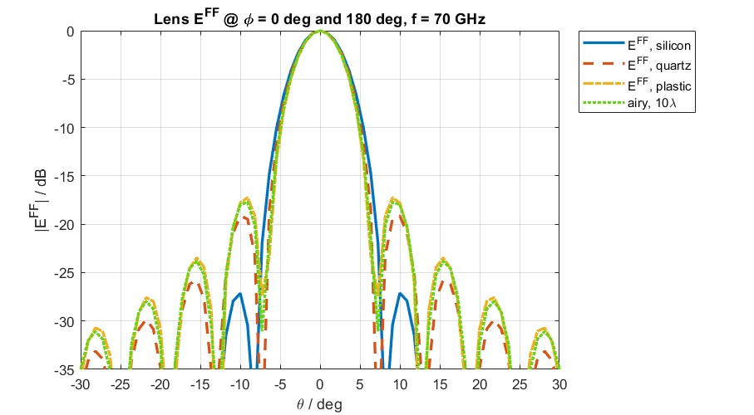
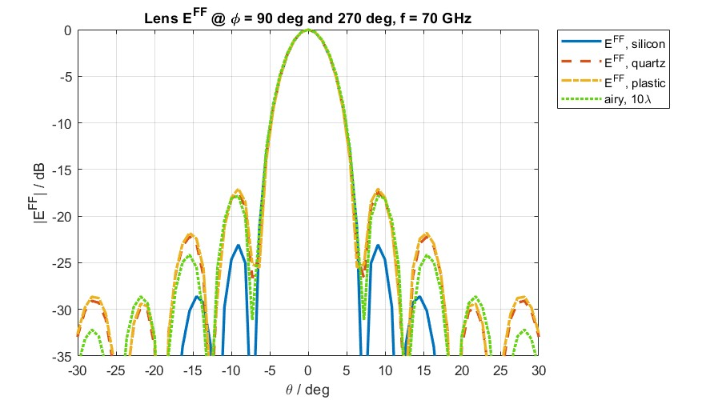
Radiation Patterns Comparison
Result: patterns approximate airy pattern
30-07-2023

Slide 28
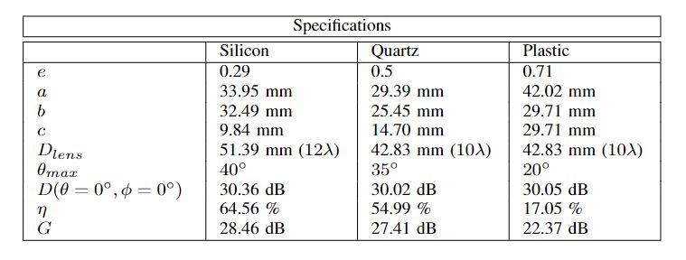

Lens Antenna Specifications
Radiation efficiency:
$η=\frac{P_{rad}^{lens}}{P_{rad}^{WG}}$
Gain:
$G=Dη$
30-07-2023

Slide 29
Q & A

Slide 30
Thank you for your attention
Petar V Peshev

Slide 31
Appendices

Slide 32
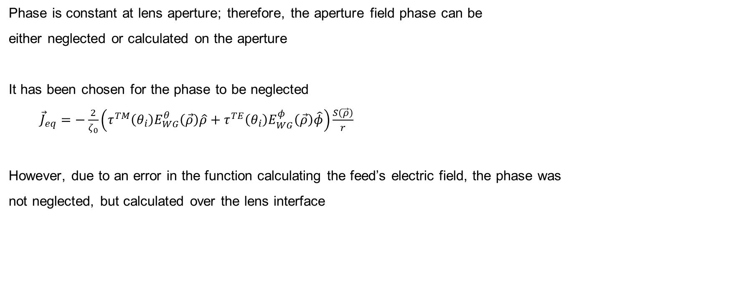
Appendix A: Phase Error
Phase is constant at lens aperture; therefore, the aperture field phase can be
either neglected or calculated on the aperture
It has been chosen for the phase to be neglected
${\vec{J}}_{eq}=−\frac{2}{ζ_{0}}\left(τ^{TM}{\left(θ_{i}\right)E}_{WG}^{θ}\left(\vec{ρ}\right)\hat{ρ}+τ^{TE}{\left(θ_{i}\right)E}_{WG}^{φ}\left(\vec{ρ}\right)\hat{φ}\right)\frac{S\left(\vec{ρ}\right)}{r}$
However, due to an error in the function calculating the feed’s electric field, the phase was
not neglected, but calculated over the lens interface
30-07-2023

Slide 33
Appendix B: Improvements
In order to improve the lens antenna design, matching layer should be considered.
By implementing a matching layer at the lens interface, the transmission coefficient is increased.
However, the angular domain remains the same.
30-07-2023

