Slide 1

Planar PCB Antenna of Two Dipoles
Petar V Peshev
EE4620 Spectral Domain Methods
in Electromagnetics

Slide 2
Table of Contents
Solutions of grounded substrate
Substrate permittivity & height
Surface wave modes
Surface wave power
Reference with higher permittivity dielectric
Minimization of surface waves
Slots below substrate
Cancellation of surface waves in slots
20-09-2023

Slide 3
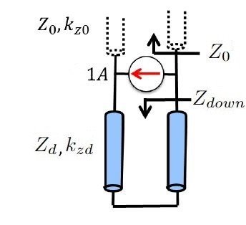
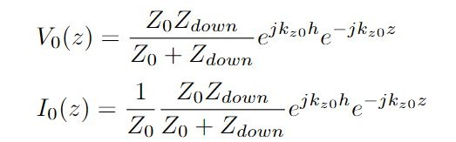
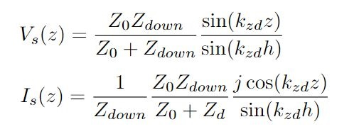
Grounded Substrate
Free space solution
Substrate solution
Dispersion equation
EE4620 Spectral Methods in Electromagnetics: Spectral Green’s Function for Stratified Media MATLAB Instruction 1, Prof. Shahab Dabironezare, 3rd May 2023
20-09-2023

Slide 4
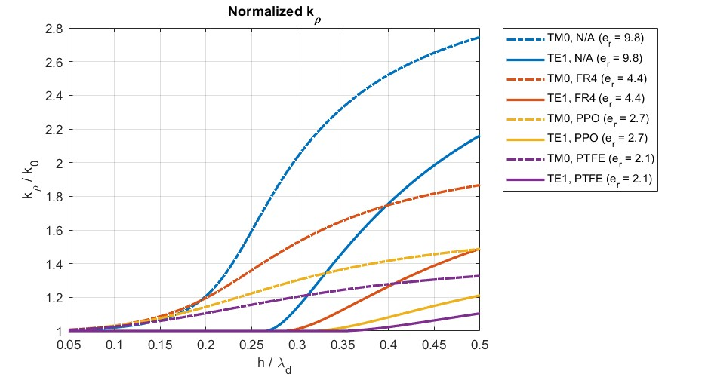


Surface Wave Modes
For TM0 and TE1 modes
TE1 starts propagating at around
20-09-2023

Slide 5

Surface Wave Power (1)
For TM0 surface wave power
For TE1 surface wave power
Expectation: Higher substrate
permittivity decreases the front-to-back ratio
and results in more power added to the
surface wave (higher substrate permittivity higher losses)
20-09-2023

Slide 6
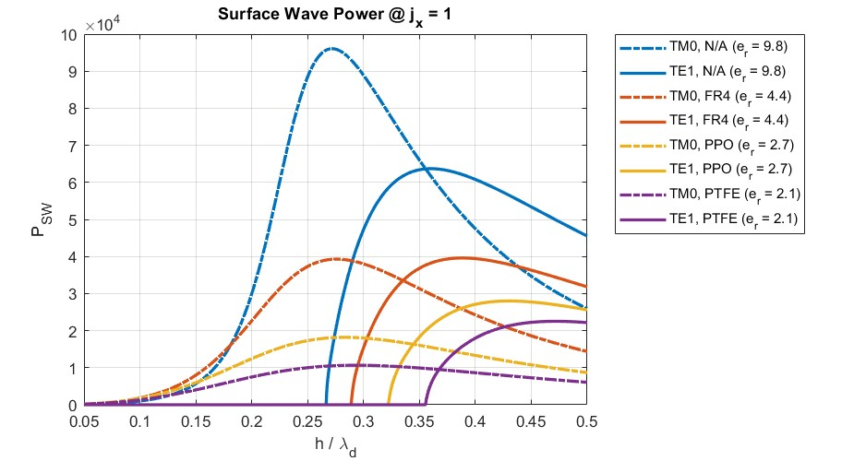


Surface Wave Power (2)
Elementary current source
Higher permittivity results in more power
in surface waves
At low substrate height $h/λ_{d}≤0.15$,
surface wave power is minimum; however,
there is limitation in the bandwidth (dipole
is close to the ground plane)
At low substrate height $h/λ_{d}=0.25$,
larger bandwidth, no TE1 mode, and highest
radiated power; however, largest TM0
surface wave power
20-09-2023

Slide 7
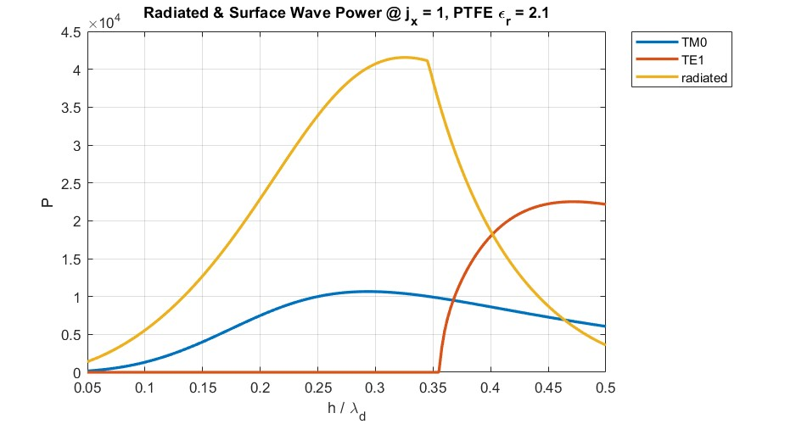
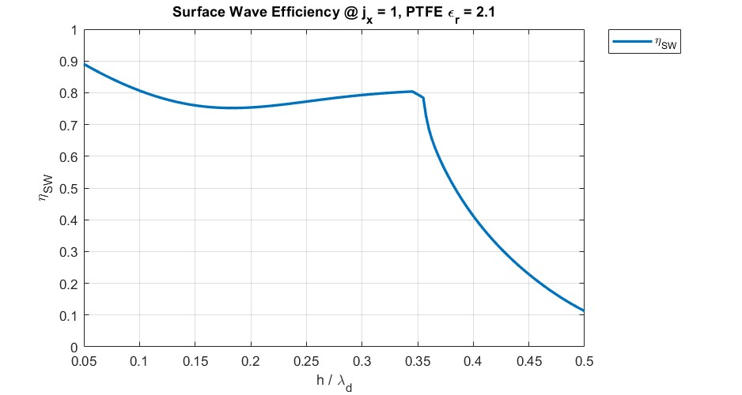

Substrate Permittivity & Height
Dielectric with lowest permittivity is
chosen to decrease the power in the surface
waves (PTFE with $ε_{r}=2.1$)
To maximize the bandwidth and radiated
power, while cutting-off the TE1 mode, the
height is chosen at quarter-wavelength of
dielectric ($h/λ_{d}=0.25$)
At quarter-wavelength, the radiated and
reflected wave from the ground plane add
constructively, increasing the radiated power
20-09-2023

Slide 8
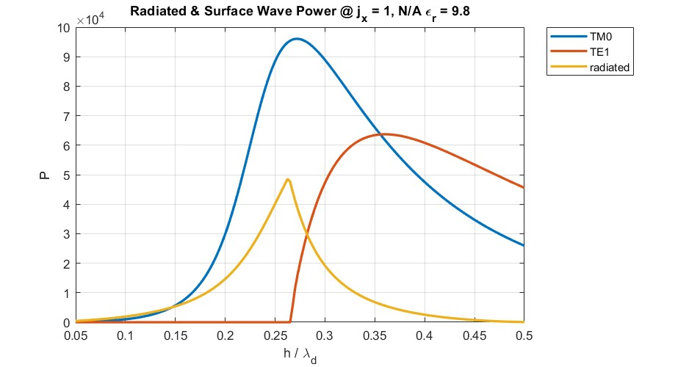
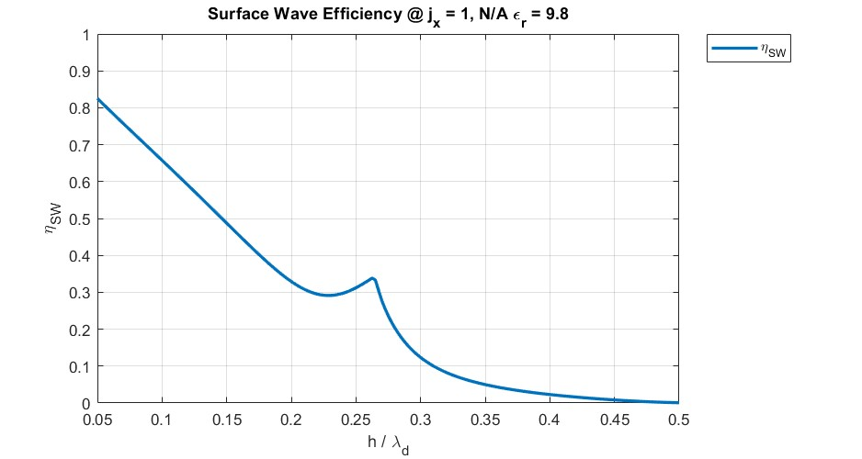
Reference With Higher Permittivity
20-09-2023

Slide 9
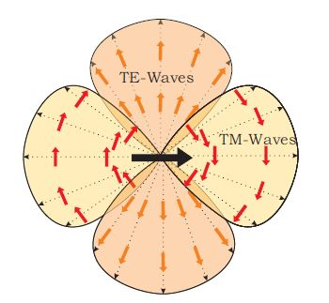
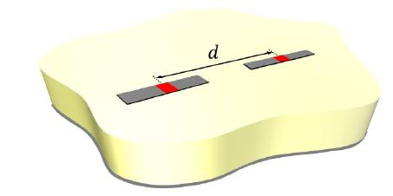
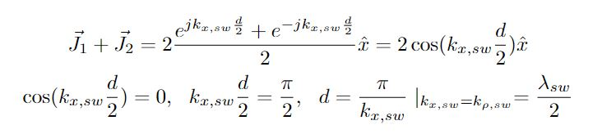

Surface Wave Minimization (1)
For the chosen parameters, only TM0
surface wave propagates
TM0 surface wave propagates in
$φ=0^{°}$ plane
To minimize the power lost in the TM0
surface wave, the dipoles need to be on the
same longitudinal axis
Characterization of Printed Transmission Lines at High Frequencies Using quasi-analytical expressions, M.Sc. Thesis, Sven van Berkel, 23rd April 2015
20-09-2023

Slide 10
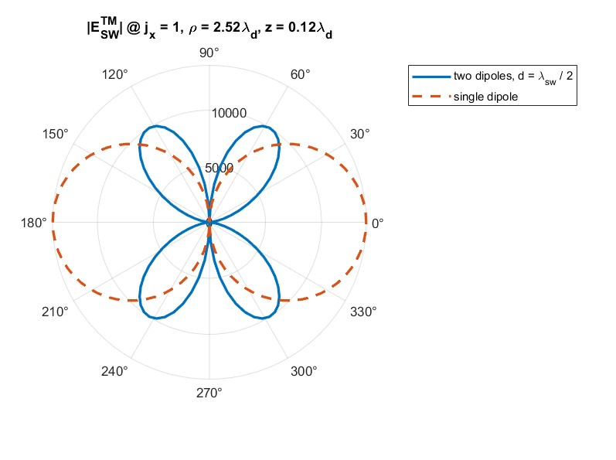
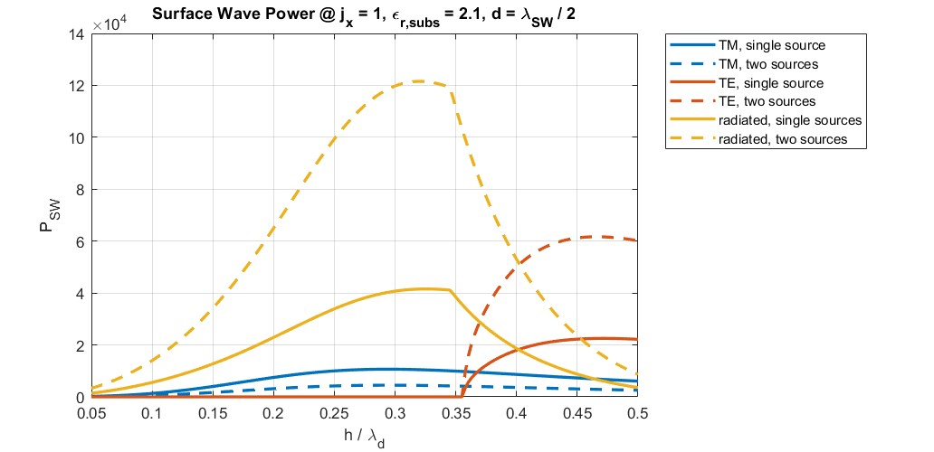
Surface Wave Minimization (2)
20-09-2023

Slide 11
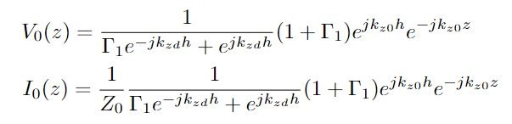
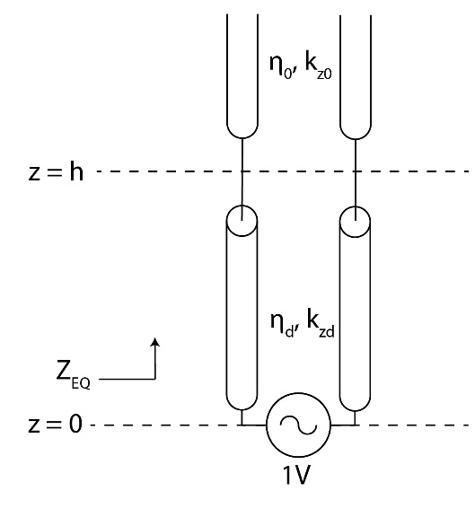
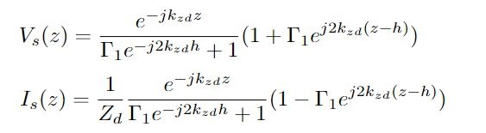


Slot Below Substrate (1)
Free space solution
Substrate solution
Dispersion equation (same as for ground substrate)
20-09-2023

Slide 12
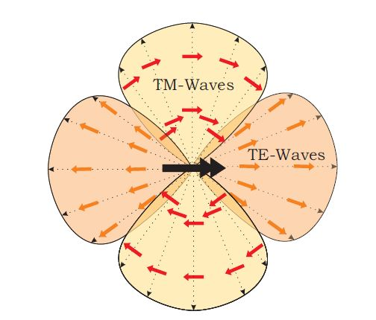


Slot Below Substrate (2)
Expectation: Higher dielectric permittivity
increases the front-to-back ratio, resulting in
higher radiated power
TM0 surface wave propagates in
$φ={90}^{°}$ plane
To minimize the power lost in the TM0
surface wave, the slots need to be in on the
same tangential axis
Characterization of Printed Transmission Lines at High Frequencies Using quasi-analytical expressions, M.Sc. Thesis, Sven van Berkel, 23rd April 2015
20-09-2023

Slide 13
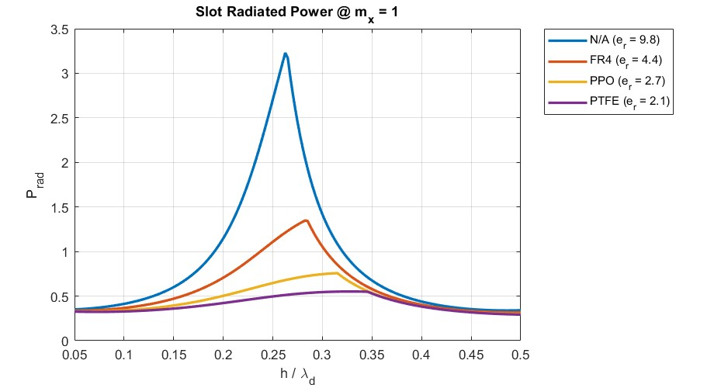
Slot Below Substrate (3)
Higher permittivity results in higher
front-to-back ratio and higher radiated power
However, higher permittivity increases
the losses in surface wave (reduces surface
wave efficiency); these, surface wave must
be minimized
Conclusion: It is more convenient to use
slots to increase the front-to-back ratio, when
the surface waves are minimized / cancelled
20-09-2023

Slide 14
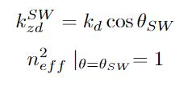
Slot Surface Wave Cancellation
Double arc slot achieves full cancellation
of surface waves, but limits the bandwidth
ADL has angle-dependent refractive
Index, it can be used to increase the
front-to-back ratio, while not allowing surface
waves to propagate; results in high bandwidth
and no surface waves
20-09-2023

Slide 15
Q & A

Slide 16
Thank you for your attention
Petar V Peshev

