Slide 1

ML Bank Loan Approval Assessment
AI Boot Camp Project 2
Team Members:
Ronak Dsouza, VP of Records
Mark Johnson, VP of Personnel
Pete Link, VP of Data
Tanya Soriano, VP of Customer Service
Ethan Wyman, VP of Marketing

Slide 2
Project Overview
Project Purpose / Description
Analyze data and create a Machine Learning model for loan approval predictions
Risk Assessment: Historical loan approvals
Discriminatory Analysis: Analyze historical loan demographics for possible discriminatory practices

Slide 3
Project Overview
Goals/Problem to be solved
Goal #1:
ML Bank wants to develop a process for approving / disapproving loan applications based on historical loan approval data.
Goal #2:
ML Bank wants to determine whether it is being discriminatory by analyzing the historical data further.
Goal #3:
ML-Bank wants to implement a GUI that bank personnel can use for the loan approval process. In the future use of this tool may be extended to ML-Bank customers.

Slide 4
Project Overview
Overview of data collection, cleanup and exploration process
This dataset was sourced from: https://www.kaggle.com/datasets/taweilo/loan-approval-classification-data
Exploratory Data Analysis was performed to ensure issues like nulls, duplicates and outliers were addressed.
Data was standardized using OneHotEncoder and Label Encoder.
Data visualizations were generated to assist with understanding feature importance and outliers were identified and controlled for.
Encoding - control for data leakage
Performed train-test split

Slide 5
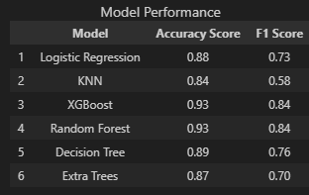
Project Overview
Approach taken to achieve goals
Encoders used were OneHotEncoder and Label Encoder. Features were categorized as either nominal or ordinal and encoded appropriately.
Imbalanced data was addressed using the SMOTE and SMOTEEN methods.
Various machine learning models were used and results were compared. More than one scoring method was used.

Slide 6
Result/Conclusion 1
Provide a summary of the results with the supporting visualization(s)
Goal #1:
ML Bank wants to develop an automated process for approving / disapproving loan applications based on historical loan approval data.
Result:
XGBoost was determined to be the best model for producing accurate results.
ML Bank wants to develop an automated process for approving / disapproving loan applications based on historical loan approval data.

Slide 7
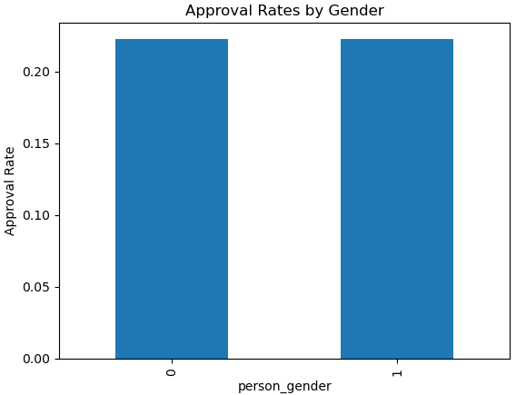
Result/Conclusion 2
Provide a summary of the results with the supporting visualization(s)
Goal #2:
ML Bank wants to determine whether it is being discriminatory by analyzing the historical data further.

Slide 8
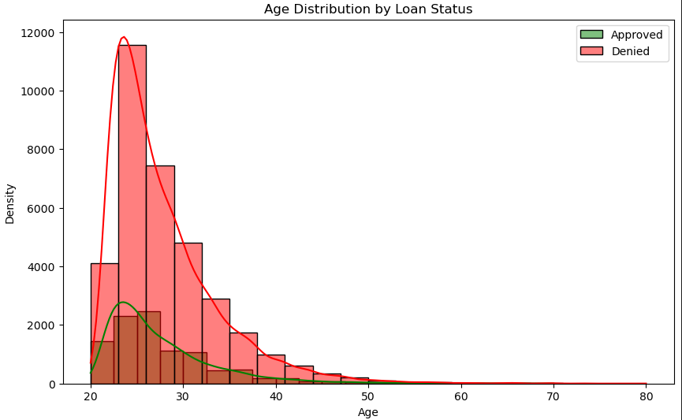
Result/Conclusion 2
Provide a summary of the results with the supporting visualization(s)
Goal #2:
ML Bank wants to determine whether it is being discriminatory by analyzing the historical data further.

Slide 9
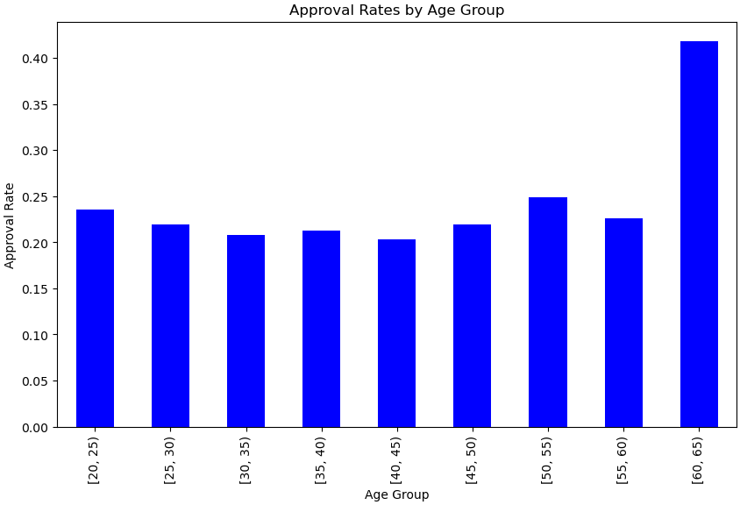
Result/Conclusion 2
Provide a summary of the results with the supporting visualization(s)
Goal #2:
ML Bank wants to determine whether it is being discriminatory by analyzing the historical data further.

Slide 10
Result/Conclusion 2
Provide a summary of the results with the supporting visualization(s)
Goal #2:
ML Bank wants to determine whether it is being discriminatory by analyzing the historical data further.
Results:
P-values for gender-based discrimination were examined and no gender-based discrimination was found.
P-values for age-based discrimination were examined and data shows evidence of age-based discrimination.
The age distributions between approved and denied applicants differ significantly.

Slide 11
Result/Conclusion 3
Provide a summary of the results with the supporting visualization(s)
Text

Slide 12
First
Summary
Second

Slide 13
Text
Problems Encountered

Slide 14
Summarize any additional questions that surfaced, what your group might research next if more time was available, or share a plan for future development.
In the future ML Bank wants to analyze its own historical data and determine its own risk against loan default.
Future Considerations

