Slide 1

ML Bank Loan Approval Assessment
AI Boot Camp Project 2
Team Members:
Ronak Dsouza, VP of Records
Mark Johnson, VP of Personnel
Pete Link, VP of Data
Tanya Soriano, VP of Customer Service
Ethan Wyman, VP of Marketing
Notes:
Pete

Slide 2
Project Overview
Project Purpose / Description
Analyze data and create a Machine Learning model for loan approval predictions
Risk Assessment: Historical loan approvals
Discriminatory Analysis: Analyze historical loan demographics for possible discriminatory practices
Notes:
Pete

Slide 3
Project Overview
Goals/Problem to be solved
Goal #1:
ML Bank wants to develop a process for approving / disapproving loan applications based on historical loan approval data.
Goal #2:
ML Bank wants to determine whether it is being discriminatory by analyzing the historical data further.
Goal #3:
ML-Bank wants to implement a GUI that bank personnel can use for the loan approval process. In the future use of this tool may be extended to ML-Bank customers.
Notes:
Ethan

Slide 4
Project Overview
Overview of data collection, cleanup and exploration process
This dataset was sourced from: https://www.kaggle.com/datasets/taweilo/loan-approval-classification-data
Exploratory Data Analysis was performed to ensure issues like nulls, duplicates and outliers were addressed.
Data was standardized using OneHotEncoder and Label Encoder.
Data visualizations were generated to assist with understanding feature importance and outliers were identified and controlled for.
Encoding - control for data leakage
Performed train-test split
Notes:
Ethan

Slide 5
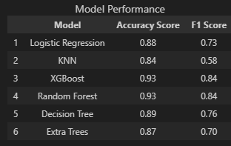
Project Overview
Approach taken to achieve goals
Encoders used were OneHotEncoder and Label Encoder. Features were categorized as either nominal or ordinal and encoded appropriately.
Imbalanced data was addressed using the SMOTE and SMOTEEN methods.
Various machine learning models were used and results were compared. More than one scoring method was used.
Notes:
Tanya

Slide 6
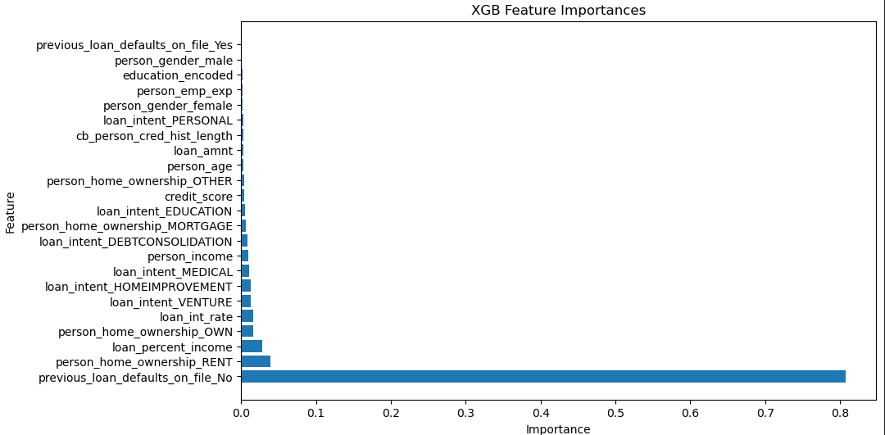
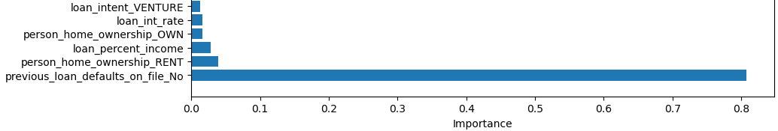
Result/Conclusion 1
Goal #1:
ML Bank wants to develop an automated process for approving / disapproving loan applications based on historical loan approval data.
Result:
Extreme Gradient Boosting, XGBoost, was determined to be the best model for producing accurate results.
Notes:
Tanya

Slide 7
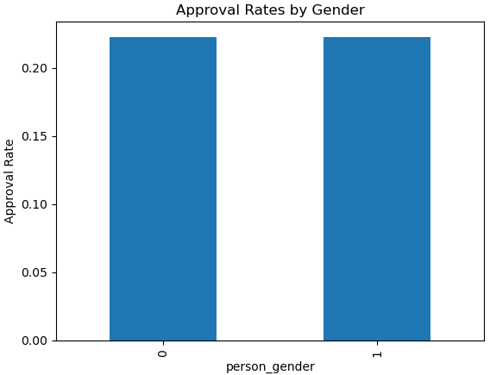
Result/Conclusion 2
Goal #2:
ML Bank wants to determine whether it is being discriminatory by analyzing the historical data further.
Notes:
Mark

Slide 8
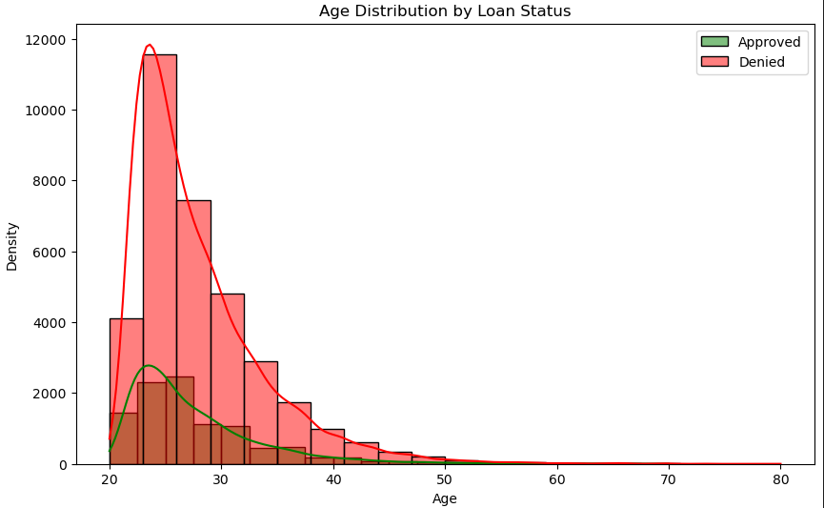
Result/Conclusion 2
Goal #2:
ML Bank wants to determine whether it is being discriminatory by analyzing the historical data further.
Notes:
Mark

Slide 9
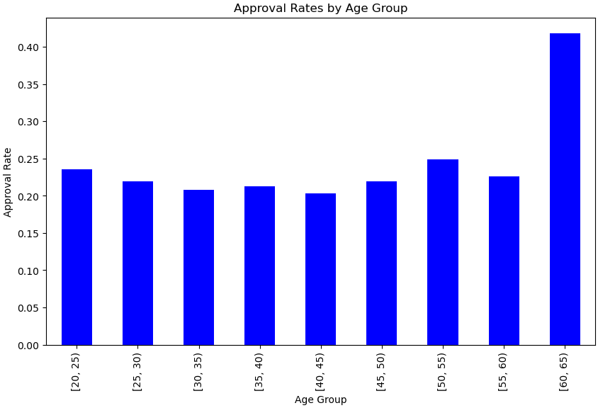
Result/Conclusion 2
Goal #2:
ML Bank wants to determine whether it is being discriminatory by analyzing the historical data further.
Notes:
Mark

Slide 10
Result/Conclusion 2
Provide a summary of the results with the supporting visualization(s)
Goal #2:
ML Bank wants to determine whether it is being discriminatory by analyzing the historical data further.
Results:
P-values for gender-based discrimination were examined and no gender-based discrimination was found.
P-values for age-based discrimination were examined and data shows evidence of age-based discrimination.
The age distributions between approved and denied applicants differ significantly.
Notes:
Mark

Slide 11
Result/Conclusion 3
Provide a summary of the results with the supporting visualization(s)
Goal #3:
ML-Bank wants to implement a GUI that bank personnel can use for the loan approval process. In the future use of this tool may be extended to ML-Bank customers.
Notes:
Ronak

Slide 12
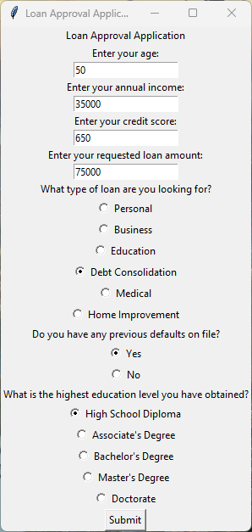

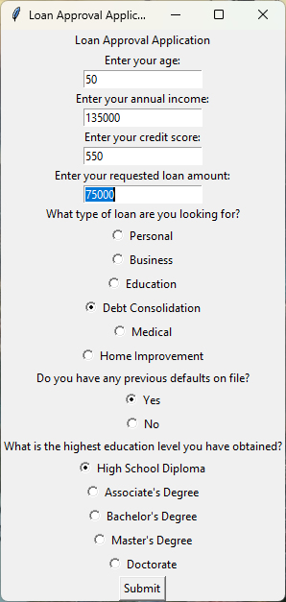
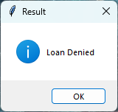
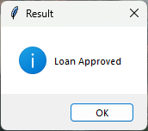
Result/Conclusion 3
Goal #3:
ML-Bank wants to implement a GUI that bank personnel can use for the loan approval process. In the future use of this tool may be extended to ML-Bank customers.
Notes:
Ronak

Slide 13
Summary
→ ML Bank is a Bank of the people and strives to be inclusive and fair. Over the years, the business has established a high-level of trust with its customers. The bank is now leveraging AI models for accessible and affordable banking services.
→ ML Bank strives to build a future where financial opportunities are accessible to all, by using cutting-edge technology to make lending decisions based on objective data and statistical models."
Notes:
Pete

Slide 14
Problems Encountered
During this exercise, the team at ML Bank experienced the following challenges:
Data cleansing by eliminating outliers, some of these found late during coding
e.g.: 140 years being included in the data
Writing and researching new code for statistical analysis
Writing and researching new code for the GUI interface
GitHub not cooperating with Jupyter notebook
Additional research was performed on banking and lending practices; these were analyzed and are included in the Resources folder
Notes:
Tanya

Slide 15
Future considerations:
ML Bank wants to adapt the GUI to a self-service model for lending and other services offered by the bank.
Additional research was performed on banking and lending practices; these were analyzed and are included in the Resources folder
ML Bank wants to analyze its own historical data and determine its own risk against possible loan default. This includes risk such as:
-Credit risk, Operational risk, Market risk, Liquidity risk
This analysis will determine whether our ML Bank is adequately protected against possible risk.
Future Considerations
Notes:
Ronak

