Slide 1

Technology Stock Analysis
AI Boot Camp – Project 1
Module 9 & 10

Slide 2

The Quants Team
Mark Johnson
Pete Link
Marianne Mittelstadt
Steve Vierling
Ethan Wyman
Notes:
Pete

Slide 3
Project Objectives
Equity Trading:
While working for The Quants, a large equity-trading company, your team is tasked with researching a client’s portfolio. Your client wants to invest in a short list of popular tech stocks and needs expert analysis to make the right decision. Client understands that stocks will go up in the long term but the client does not want to see themselves under water in next 90 days.
Notes:
Pete

Slide 4
Project Objectives
Using NASDAQ historical data*, we need to pull five year’s worth of trading data for the major US technology companies: Apple, Microsoft, and Google and compare their historical performance to each other and to the S&P 500 and NASDAQ indexes.
Our goal?
Analyze which stocks are trending upward
Which are trending downward
Based on the data, what would you recommend to your client?
How does the tech stock performance compare to the S&P and NASDAQ indexes?
Source of NASDAQ historical stock data:
https://www.nasdaq.com/market-activity/quotes/historical
Notes:
Pete

Slide 5

Data Collection, Clean-Up, and Exploration
5 years of daily trading data was downloaded from https://www.nasdaq.com/ for each of the stocks (Apple, Google, Microsoft) and both of the indexes (NASDAQ and S&P 500) resulting in 5 .csv files
Data Collection:
Data Exploration:
The 5 .csv files were read in as DataFrames and each file was explored through the info() method. This method revealed that there were no null values and the files for the indexes had 1 less row. Additionally, the closing price was read in as an object in the three stock files since there was a dollar sign ($) included in the price
Data Clean-Up:
Rename – closing price columns were renamed to reference the stock or index
Created a merged DataFrame by concatenating the 5 csv files using the required closing price columns
Remove $ - replace() method was used to replace $ with single quotes
Change data type from object to float by using the astype() method
Notes:
Marianne

Slide 6

Approach in Achieving Project Goals
Stocks
Our analytic approach was to first look at historical trends for the 3 stocks and determine if we were seeing an upward or downward trend
Second, we wanted to understand if there was a correlation between any of the 3 stocks
Third, we wanted to get a closer look at the trends for 2024 only
Next, the team reviewed cumulative returns
Finally, Prophet was used to forecast expected stock prices over the next 90 days, plotted, and a growth rate calculated
Indexes
To understand how the stock performance compared to index performance, we used Prophet to forecast index prices out 90 days and calculate an expected growth rate for the two indexes
Notes:
Steve

Slide 7

Results and Conclusions

Slide 8
Disclosure
As Financial Analysts at The Quants we are fiduciary advisors. Based on our understanding of your needs, requirements, and financial risk tolerance our recommendations are not guaranteed to deliver historical performance.
Notes:
Marianne

Slide 9
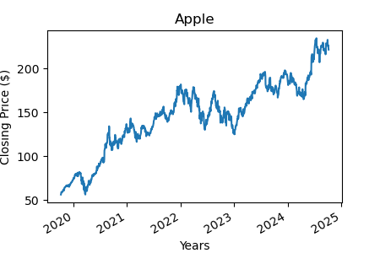
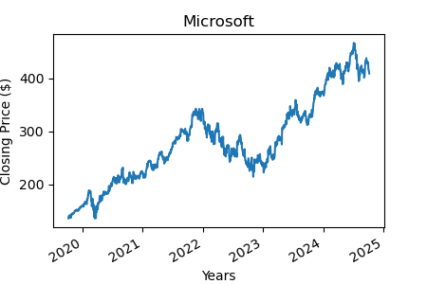
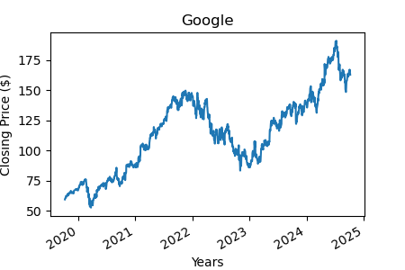
Historical Trends
APPLE
MICROSOFT
GOOGLE (class A)
Industry – Computer Manufacturing
5 year performance - 250% increase
Share volume – 19,342,616
Current yield – 0.44%
Summary Statistics
Mean - $146.07
Standard Deviation - $41.33
Industry – Computer Software
5 year performance - 245% increase
Share volume – 9,090,960
Current yield – 0.72%
Summary Statistics
Mean - $281.25
Standard Deviation - $80.22
Industry – Computer Software
5 year performance - 174% increase
Share volume – 21,606,095
Current yield – 0.49%
Summary Statistics
Mean - $113.88
Standard Deviation - $31.75
Notes:
Marianne

Slide 10
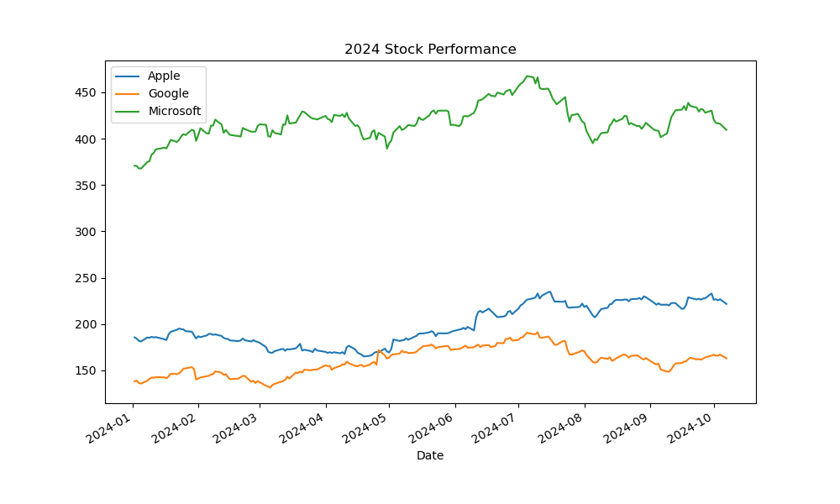
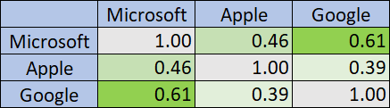
Correlation and 2024 Trends
Since the trending graphs look visually similar we explored correlation
The correlation matrix shows how the daily returns of Microsoft, Apple, and Google relate to each other in 2024
Microsoft and Apple (0.46) - There’s a moderate positive relationship, meaning they sometimes move in the same direction but not strongly aligned.
Microsoft and Google (0.61) - A stronger positive relationship, indicating that their returns tend to move together more often.
Apple and Google (0.39) - A weak positive relationship, showing that their returns are relatively independent.
Drilling into 2024 performance shows more variation in trends
Although historically all three stocks have an upward trend, more recently (October) the trends are downward
Notes:
Pete

Slide 11
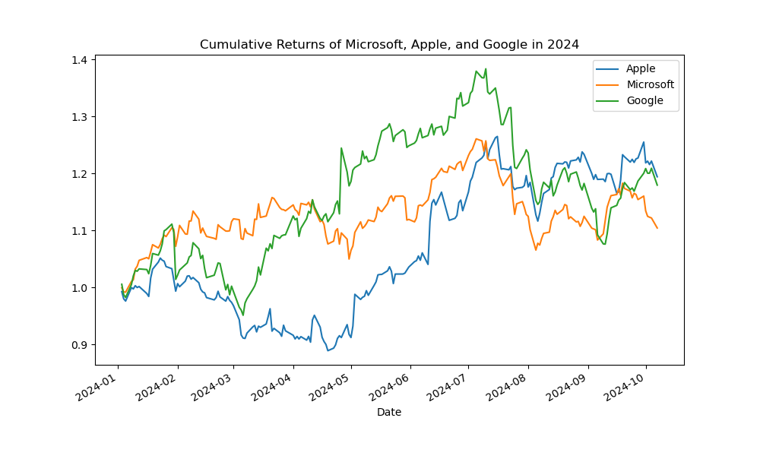
Cumulative Returns - 2024
A special function of Pandas called .cumprod() calculates a cumulative returns of the stock
From the analysis of the graph we would expect Apple to have the best growth rate
Additionally, Google and Apple stocks show more price volatility
Notes:
Pete

Slide 12
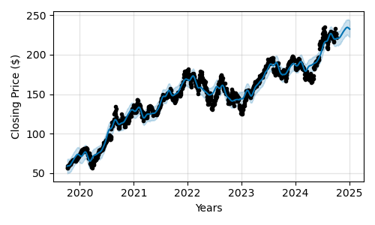
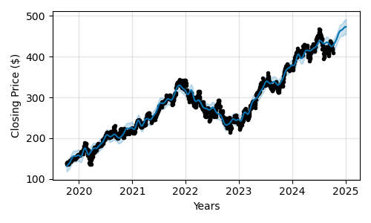
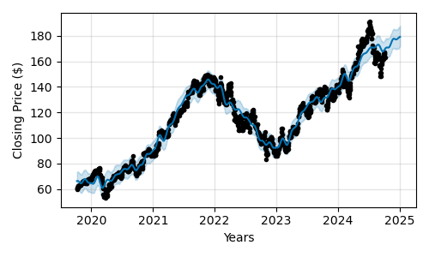
Forecast and Expected Growth
Apple
Microsoft
GOOGLE (class A)
The time series forecast for Apple shares shows an upward trend for the next 90 days
The forecast predicts that the Apple share price will increase 5.4% over the next 90 days
The time series forecast for Microsoft shares shows an upward trend for the next 90 days
The forecast predicts that the Microsoft share price will increase 10.4% over the next 90 days
The time series forecast for Google (class A) shares shows an upward trend for the next 90 days
The forecast predicts that the Google share price will increase 5.4% over the next 90 days
Notes:
Mark

Slide 13
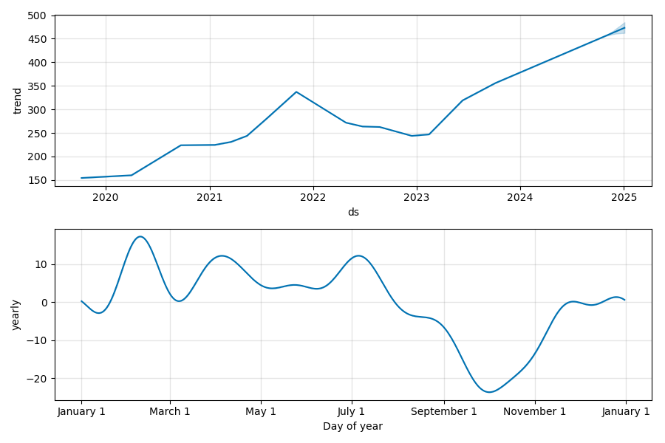
Microsoft Component Graphs
The highest projected growth stock is Microsoft
The preference is to buy stocks at a low price, which historically is in October for Microsoft
Notes:
Ethan

Slide 14
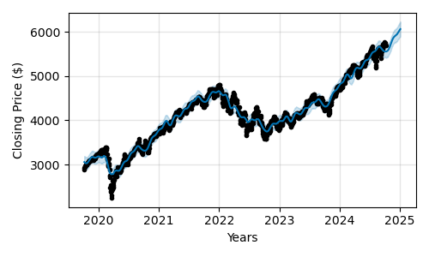
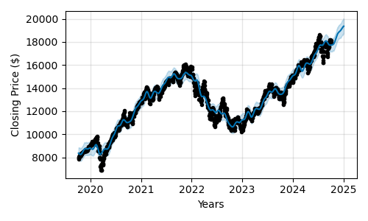
Comparisons to Indexes
S&P Index
NASDAQ Index
The time series forecast for S&P index shows an upward trend for the next 90 days
The forecast predicts that the S&P index price will increase 9.1% over the next 90 days
The time series forecast for NASDAQ index shows an upward trend for the next 90 days
The forecast predicts that the NASDAQ index price will increase 9.5% over the next 90 days
Notes:
Steve

Slide 15
Recommendations
The Quants Team recommends to buy Microsoft as a growth stock with fantastic short term forecasted gain
By using Prophet we’re able to forecast forward 90 days and measure the expected growth rate of each stock and index
Microsoft had the highest expected growth rate at 10.4%
Apple and Google had lower expected growth at 5.4%
NASDAQ and S&P indexes had expected growth of 9.2% and 9.1%, respectively
Historically, October had the lowest expected stock price for Microsoft as shown through .plot_components() method
This indicates a potentially good time to purchase Microsoft stock
Notes:
Mark

Slide 16
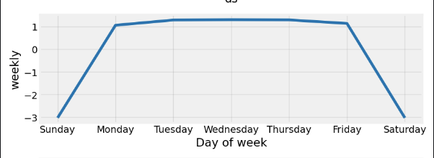
Problems Encountered
Collaborating with Jupyter notebook and GitHub was clunky and troublesome and lead to a number of conflicts identified when trying to merge to main branch, which is a known issue.
To resolve the team divided coding into sections assigned to specific team members
The team also coordinated changes to the code and upload to GitHub during meetings
During review of the output of .plot_components() the team recognized that the weekly graph looked the same for all stocks
The team identified that a forecasting with Monday through Friday data lead to the same graphs
The resolution was to turn off weekly seasonality in the Prophet model and adjust the prediction DataFrame to remove weekend days using the following code:
model = Prophet(weekly_seasonality=False)
future_trends = future_trends[future_trends[‘ds’].dt.weekday <5]
Notes:
Ethan

Slide 17
Future Considerations
Compare to non-technology stock performance
Consider the risk of a single stock versus index stocks or a more diverse portfolio
Sentiment analysis
Other factors impacting stock price growth (Ex. R&D spending)
Notes:
Ethan

Slide 18


Questions?

Slide 19

The End

