Slide 1
Technology Stock Analysis - DRAFT
AI Boot Camp – Project 1
Module 9 & 10
© 2023 edX Boot Camps LLC. Confidential and Proprietary. All Rights Reserved.
Notes:
Brief overview of what students will learn in this class.

Slide 2

Project Objectives
Equity Trading: While working for a large equity-trading company, you’re tasked with researching a client’s portfolio. Your client wants to invest in tech stocks and needs expert analysis to make the right decision. Using NASDAQ historical data (https://www.nasdaq.com/market-activity/quotes/historical), pull five year’s worth of trading data for the major US technology companies: Apple, Microsoft, and Google and compare to each other and the S&P 500 and NASDAQ indexes. Which stocks are trending upward? Which are trending downward? Based on the data, what would you recommend to your client? How does the tech stock performance compare to the S&P and NASDAQ indexes?

Slide 3

Data Collection, Clean-Up, and Exploration
Add collection, clean-up, and exploration

Slide 4

Approach in Achieving Project Goals
Also additional questions – like compare to non-tech stocks

Slide 5

Results and Conclusions
Notes:
Learning Outcomes:
Understand the concept of pseudocoding
Source Material:
Coding prework: adapt content from Practice Computational Thinking section - some of this should be presented in a slideshow, and some of it could be presented by the instructor in VS Code.
Additional details:
The pseudocode provided in the source material uses JavaScript commenting style (double slashes //); we’re using Python for this course so the commenting style should use # instead.

Slide 6
Disclosure
No guarantee can be offered that projections or estimates will actually occur. Actual results may be materially different from projections or estimates. Additionally, past performance should not be relied upon as a forecast of future performance.
Notes:
Learning Outcomes:
Understand the concept of pseudocoding
Source Material:
Coding prework: adapt content from Practice Computational Thinking section - some of this should be presented in a slideshow, and some of it could be presented by the instructor in VS Code.
Additional details:
The pseudocode provided in the source material uses JavaScript commenting style (double slashes //); we’re using Python for this course so the commenting style should use # instead.

Slide 7
DRAFT
Historical Trends
APPLE
MICROSOFT
GOOGLE (class A)
Industry – Computer Manufacturing
5 year performance - 250% increase
Share volume – 19,342,616
Current yield – 0.44%
Summary Statistics
Mean
Standard Deviation
Industry – Computer Software
5 year performance - 245% increase
Share volume – 9,090,960
Current yield – 0.72%
Summary Statistics
Mean
Standard Deviation
Industry – Computer Software
5 year performance - 174% increase
Share volume – 21,606,095
Current yield – 0.49%
Summary Statistics
Mean
Standard Deviation

Slide 8
DRAFT
Correlation and Sentiment
With the trending graphs visually looking similar correlation was explored
ADD SENTIMENT
Drilling into 2024 performance shows more variation in trends

Slide 9
DRAFT
Forecast and Expected Growth
Forecasting forward shows highest growth in…

Slide 10
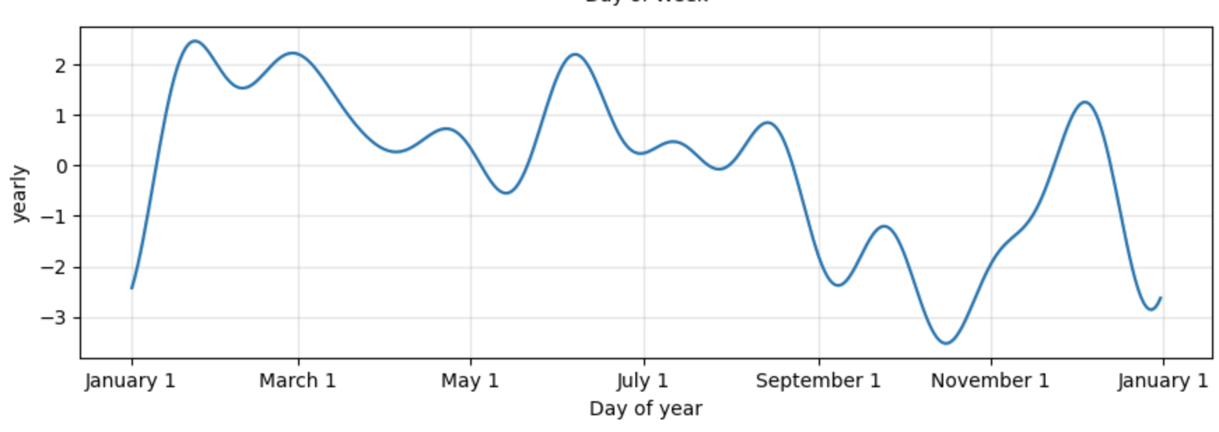
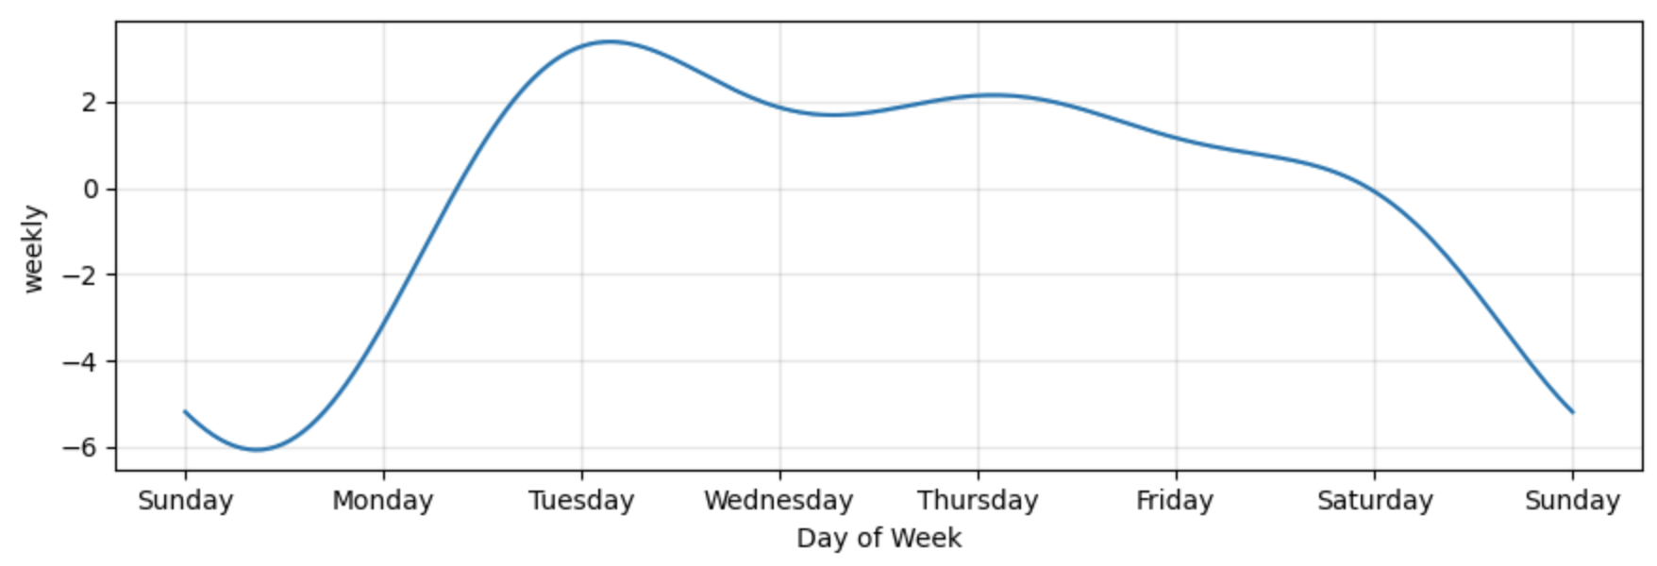
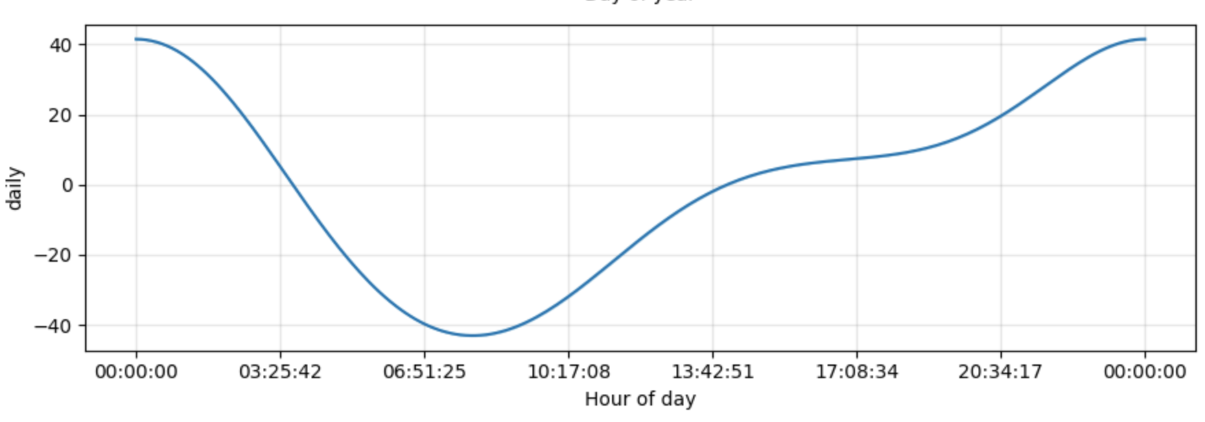
DRAFT
Focused Component Graphs
Optimal time to buy (month of year, day of week, hour of day) for highest growth stock

Slide 11
DRAFT
Comparisons to Indexes

Slide 12
Recommendations
Recommendations

Slide 13
Next
Additional items to research are impacts of research and development investment and compare to non-technology stock performance.

Slide 14
Let’s recap

Slide 15
Recap
1
Comparison on performance over last 5 years is similar
2
No correlation
3
Time series forecast shows highest expected growth in xxxx
4
Performance of indexes is higher/lower than the technology stock performance.

Slide 16


Questions?

Slide 17

The End

